Slide 1

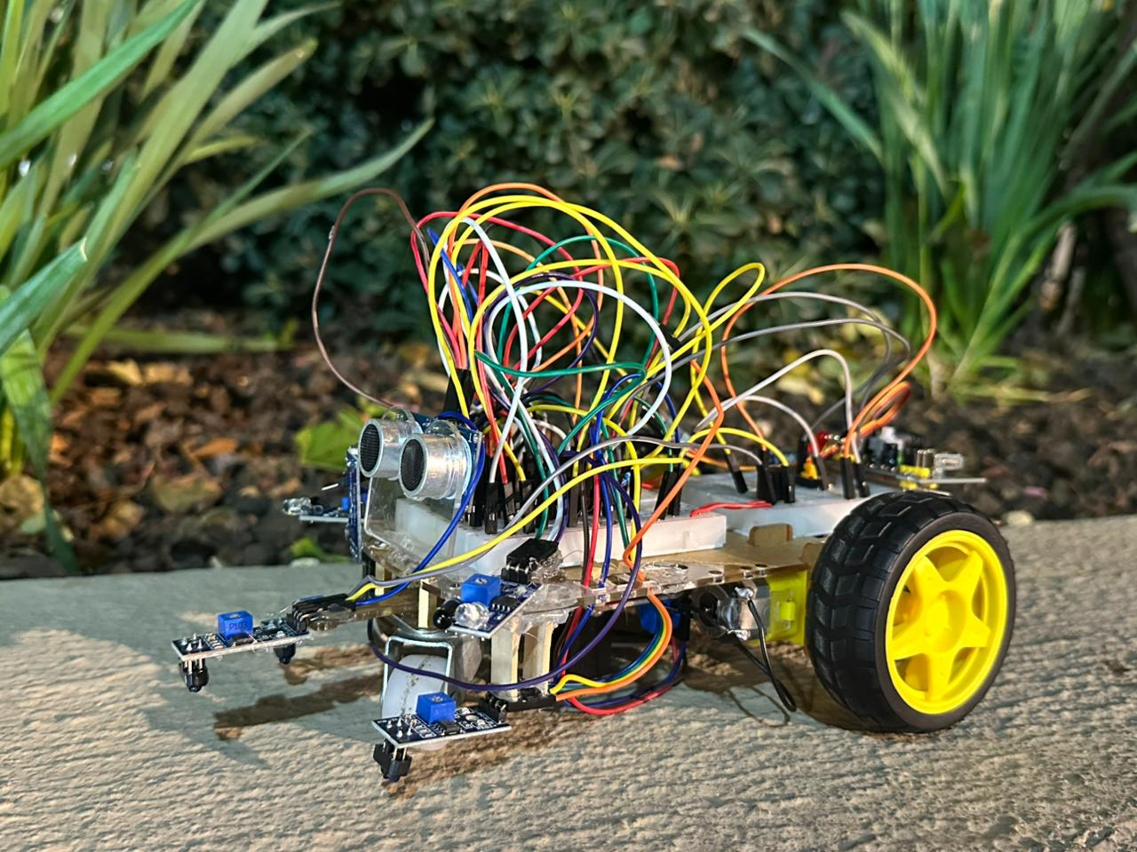
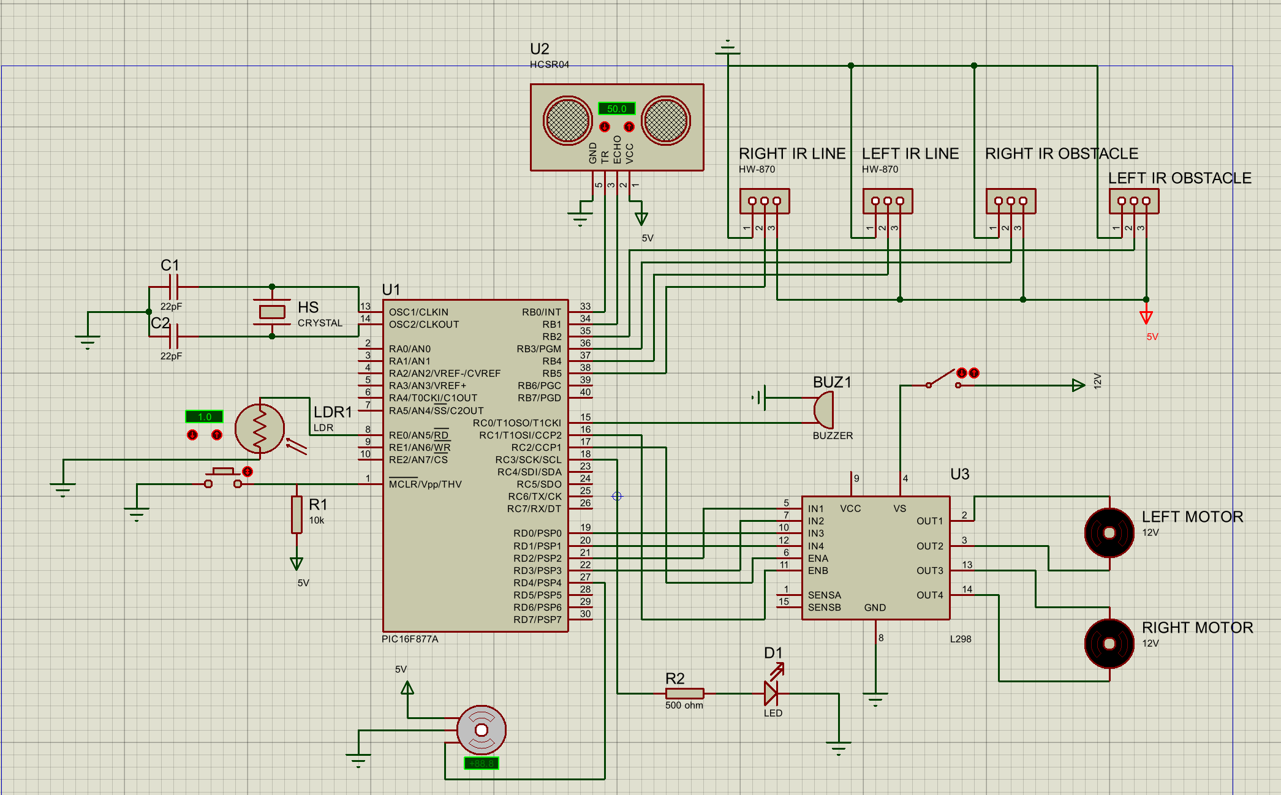
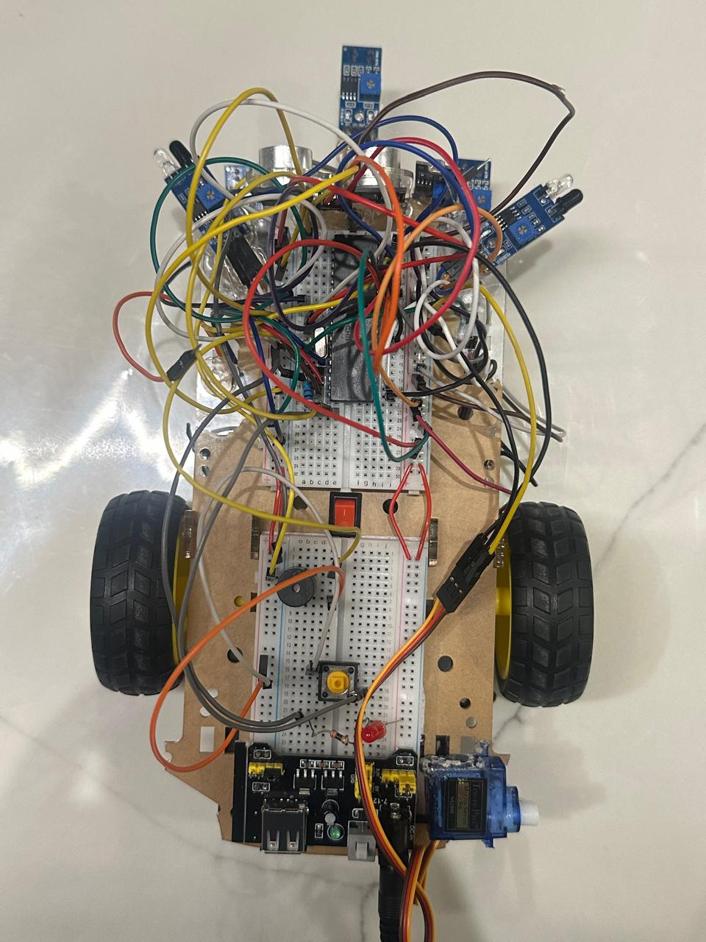
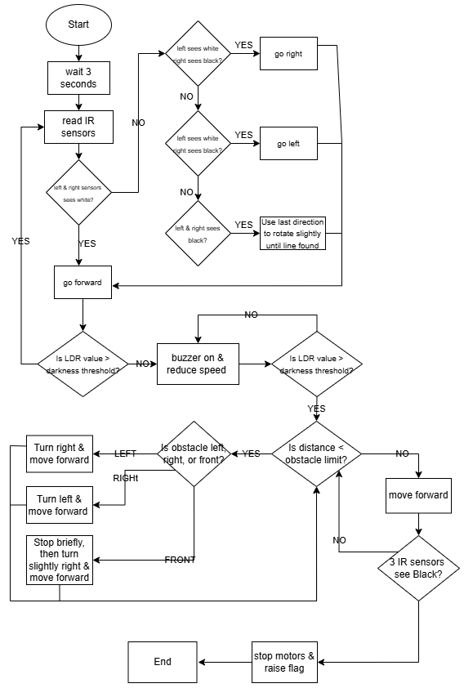
Autonomous Robot for
Multi-Zone Navigation
R. Jamjoum, L. Qasmieh and M. Al-Nsour
Supervisor: Prof. Esam Al-Qaralleh
Embedded Systems Final Design Project, Fall 2025
King Abdullah II School of Engineering
Princess Sumaya University for Technology
Introduction
This project presents the design and implementation of an autonomous robot capable of navigating multiple zones of a structured track. The robot uses IR line sensors, light-dependent sensors, ultrasonic and obstacle-detection IR sensors, and a servo motor signaling flag. The system follows a black line, detects tunnel darkness, avoids obstacles, climbs a physical bump, and finishes by performing a controlled parking action. The design integrates mechanical, electrical, and software subsystems to achieve reliable navigation and smooth transitions between all zones.
Results
The robot was tested across all zones of the track and demonstrated stable and reliable performance. It was able to detect and follow the black line smoothly on straight paths and curves, respond correctly when entering the tunnel, avoid obstacles using both the ultrasonic and IR obstacle sensors, climb the bump without losing balance, and finally stop accurately in the parking zone while raising the servo flag. Throughout the tests, the robot consistently maintained proper sensor readings, adjusted motor speeds correctly, and recovered smoothly from temporary sensor loss, ensuring complete autonomous operation from start to finish.
Design
The robot uses IR line sensors, an LDR for tunnel detection, ultrasonic and IR sensors for obstacle detection, a motor driver, buzzer, LED, and a servo flag. All components share one regulated power supply and ground. The software reads the sensors and adjusts motor movement for each zone. A flowchart shows the main steps: line following, tunnel response, obstacle avoidance, bump crossing, and final parking with the flag raised.
Figure 1: Electrical Design
Figure 2: Software Design
Conclusion
The autonomous robot successfully met all design requirements and demonstrated smooth operation across all track zones. By combining multiple sensors with coordinated motor control, the robot was able to follow the line accurately, detect lighting changes, avoid obstacles, climb uneven surfaces, and complete a final parking action. This project highlights the effectiveness of embedded system integration and showcases how different sensing and control methods can work together to achieve fully autonomous navigation.

