Slide 1
Architecture Gates Dossier
Presentation & Approval
<<Name of the project>>

Slide 2
Revisions index of the template
Release | Date | Update details | Author(s)
1.0 | 01/2025 | Merge of ICT template with SIBS M2C templates and review with architects | V. Cassotti / E. Lootens
2.0 | 04/2025 | SaaS updates | Nathalie C
3.0 | 06/2025 | Architecture Gates Merge of ICT with SIBS | Enterprise Design Authority
4.0 | 08/2026 | Exit Plan slides + Link correction for SIBS Criteria + New slide for Enterprise/Business Data Model | Gunjan/Aymeric/Prab
5.0 | 09/2026 | Slide 63 : Gate 2 instead of Gate 4 Slide 64 : Update SSDLC link | Yann B / Viviane C.

Slide 3
Introduction
Architecture Gates are mandatory to approve an IT solution. It’s part of the Strategic Portfolio Management’s (SPM) Demand & Project Process in DigitalMe.
Architecture approval is an internal SIBS approval mandatory before presentation and decision with the Business.
​This new Template is used by IT Project Manager to present the IT solution for gates approval.
It covers all topics and project deliverables needed by the Architecture Review Board members (formerly TCC) to review the solution for approval or for recommendations, advices.
Notes:
ITPM=IT Project Manager
Note : for a “SaaS project” , a TCC after design phase/build phase and golive are mandatory as usually all topics may not be instructed completely in pre-study (among them exit plan strategy with its governance, mediation layer & integration , ITSM processes etc).
Note : in pre-study all topics should be challenged in order to understand the share model responsibility and to value workload and skills to support the project and to complete the instruction and the deliverables on a deep way. The TCC shall give the exact situation and the rest to evaluate post contractualization for validation

Slide 4
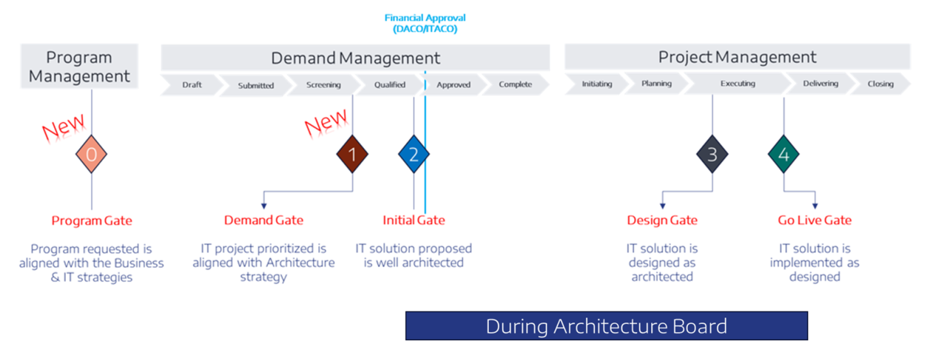


Architecture gates approval process: Study/NO/Discovery
Audit Control 1
Audit Control 2
Audit Control 3

Slide 5
Architecture gates approval process: Realisation/NE/Delivery
Audit Control 1
Audit Control 2

Slide 6

NOTES – User guide
This template is used from Gate 1 to Gate 4 approval (ARB process).
Use the same document all along the project for all gates
  For Gate 1 : complete only the “Gate 1” section
  For Gate 2 : Eventually, update Gate 1. Complete slides on section “Gate 2”.
  For Gate 3 to 4 :
            Modify/Include slides on section “Gate 2 to 4”
            Complete with information needed for specific Gate
Read explanation in Yellow and remove them after filled-in the text
Also, check more explanation on the speaker notes for each page to help you to fill-in the document
Rely on the list of criteria to fill this document : HERE
Notes:
For a SaaS solution : please refer to documentation published on the page SaaS frawework
- « SaaS « presentation to identify and present all topics referenced within it.
- SaaS well architect a guideline to challenge the offer and to assess the pre-study on all topics
For a TCC onboard a solution based on »SaaS », please refer to remarks attached to each slide
Note :
A “SaaS” Service or Product is an external function or service “used by” or “interacting with” the Bank, the Insurance or any JVs of Stellantis Financial Services (excluding service deliveries).
The term “SaaS” to refer to any external solution or service that does not reside on a Stellantis resource.

Slide 7
TABLE OF CONTENT
Objectives
Project Synthesis
Functional Architecture
Solutions description (NFR, Technical architecture, cost, schedule)
Summary of the Solutions
Gate 1 Demand Gate (Mandatory for all Demands)
Gate 2 initial Gate
Gate 3 after Design Gate
Gate 4 before Go-Live Gate
Notes:
Indicate the validation date for the gate to be validated when the document is sent to stakeholders

Slide 8
ObjectiveS
Functional architecture (validation by enterprise architects)​
Technical architecture (designed with help of solution architects, validation by solution architects & Infrastructure Team)​
Cybersecurity impacts (validation by cybersecurity Team)​
Data privacy (validation by data privacy team)​
For “SaaS”, an exit plan strategy and contract defined according to it
(optional) List of application decommissioning (application + date)
(optional) Contract & licenses impacts and ad hoc contracts (validation by Contract Team)​
(optional) Data impacts (validation by Data team)
Costs
Timelines
Important: solutions are defined and problem are solved before the gate.
Remark:
Write here the points to be validated 🡺 do not forget development and operational criteria and the technical means.
Notes:
Project when onboarding a “SaaS” product .
The validation of the project shall validate the delivery of exit plan document and the delivery of the export facilities attached to migration plan with test done on Supplier’s side during the project.
The contract content relative to exit plan and reversibility shall be done
The testing exit plan shall be designed and regularly executed according to the risk level resulted of the risk assessment and based on the Risk testing policy (contact : Ciso Team)
Project when executing an exit plan :
When the project is done for executing an exit plan of a current and existing SaaS service ,then
- List of applications and the “SaaS contract” to be decommissioned are mandatory
- Timelines are mandatory such as
Decommissioning phase of the initial service : the Service/contract decommissioning and Data plan for deletion/migration/archiving
Data migration plan (design/test/deploy) towards the new target
Transition phase to manage the switch between Initial source service and the new target solution
A high level planning of the project is mandatory showing all these phases evolving the supplier (decommisioning) and the new one (Stellantis/SFS and/or other supplier) , without missing the exit plan deliverables for the new target.
A slide on Organization project , Skills management and Risk conduct shall be added .
That information shall be more and more detailed regarding TCC gate event

Slide 9
Architecture One Pager (Demand/Project Overview) – Gate 1 review / Gate 1 PoC
Project Details
DIGITALME Demand ID | Provide DIGITALME Demand ID with Link here ---- | Primary Business domain impacted: ICT domain as CORF… | Other domain(s): other ICT domains as SMKG, EDSC, etc...
Demand Type | Describe the type of this Demand. See slide notes for applicable values (1).
Build type | Describe what is plan to be done during execution phase (=build): See slide notes for applicable values (2)
Business Capabilities Map available HERE
Look at the Business Capability map and List the Business Capabilities impacted with criticality indicator
---
---
Technical Principles Compliance
Regulatory compliance | List of the regulatory the project needs to comply with. See slide note for applicable values (4). if Personal data involved, mention what PII Data for gate 2 - Complete section “#Data Privacy” “DORA compliance requires exit plan for business-critical cloud applications” . What is the substitutability of the service provider?
Technology(ies) involved | List of technologies involved. See slide note for applicable values (5).
Detailed technology(ies) | Cloud implementation type: See slide note for applicable values (6) API re-use or new: See slide note for applicable values (7)
Platform re-used | List the platform(s) expected to be re-used among the existing ones or new platform. See slide note for applicable values (8).
Applications Service decommissioning | List the existing applications to be decommissioned during this project. Application services selected in the CMDB. Complete for Gate 2 section #Impacted Applications Service
Scope coverage | List of RegionS, PlantS, BrandS, Countries that used (extension to other regions/plants foreseen): -----
End Users
Describe which type of User Users are impacted. Include front-end and back-end users.
See slide notes for applicable values (3).
Business Applications / Application Services List the Business Application(s) impacted (in DigitalMe Portfolio) or Application Services impacted (in DigitalMe Portfolio)
Complete for Gate 2 section #Impacted Applications Service
---
---
Related records
List the potential other program(s) or project(s) in planning/roadmap dependence with this Demand
GenAI BrightIdea #id if needed
DigitalMe ID(s)
RPA : Idea number + Opportunity Assessment Template + shadowing
Notes:
Complete this slide for Gate 1 approval and Gate 1 PoC
#Architecture One Pager
(1) Demande type : multi selection from
New Application
Enhancement to existing application; new functionality(ies) without architecture & infrastructure changes and no impact on SOX, CIA, privacy regulation, # of users
Enhancement to existing application with architecture (e.g. new interface) or infrastructure changes, or impact on SOX, CIA, privacy regulation, # of users
New Software Product Approval Request (PAR)
Move to Cloud
Technical migration, Infrastructure refreshment (for obsolescence)
Decommissioning
POC
(2) Build type : multi section from
M2C Rehosting
M2C Replatforming
M2C Refactoring
Based on an existing platform
Based on a SaaS solution
Commercial off-the-shelf product implementation
In-house development (=“custom development”)
Decommissioning
Other
(3) End users : multi selection from
Internal Stellantis employees (with ID)
External Stellantis users like Partners
Dealers
Suppliers
Dealers with contracts
Dealers without contract
Stellantis end customers
Other
(4) Regulatory compliance : multi selection from
SOX / CAC
Personal data
GDPR
CCPA
Accessibility
(5) Technologies involved : multi selection from
Cloud implementation: identify new Cloud implementation or Cloud architecture changes
API used: identify if the project concerns API use (could be re-use existing API or creating new API)
GenAI: identify if the project concerns GenAI use
RPA: identify if the project concerns RPA use
DATA: identify if the project incorporates DATA deliverables (as dashboard, data analysis…)
IOT: identify if the project concerns IOT use
Low-code & Citizen Dev: identify if the project concerns Low-Code&Citizen development
Infrastructure: project has impact on hardware, virtual servers, cloud services, network, database, middleware, interfaces, storage or backup
(6) Detailed technology(ies) Cloud implementation type : If the project concerns Cloud implementation, at least for Gate 2, Identify which type of Cloud implementation (for hosted in cloud provider, not applicable for external SaaS service). multi selection from
SAAS Cloud
CAAS Cloud
PAAS Cloud
IAAS Cloud
(7) Detailed technology(ies) API re-use or new. is related to existing API (=consume an existing API for re-use) or new API (=Producer API for creation), at least for Gate 2.
API Producer
API Consumer
(8) Plateform re-used :
ADOBE platform
AR/VR platform
Blue Prism
DigitalMe
Foundry Data4All
GenAI platform
IBM API Connect
IOT platform (BTNROUTER, IOTTX, COPLA)
Microsoft power platform
Mulesoft
PEGA
Salesforce
SAP
Sharepoint/K2
Snowflake Data4All
Stella.AI
Workday
Explanation
The Architecture One Pager provides an overview on the architecture and is complementary to the OnePager described in DigitalMe.
There is no redundancy with DigitalMe, so, it’s necessary to read the information into DigitalMe before this OnePager.
This Architecture OnePager helps all people who needs to better understand:
the project perimeter with Business Capabilities, End users and Business Applications in order to evaluate the impacts and changes on the Business activities and on the existing IT landscape;
the technical context expected in order to anticipate the future architecture by identifying the technical project’s components linked to the technical principles (Cloud, API, Platform, data privacy…).
With this information, the Enterprise Architect and Technical Enterprise Architecture will be able to better guide the ITPM through the right SMEs and so, to build the architecture in compliance with the ICT standards and policies.
SaaS Specific
The project should clearly mention the « hosting » modele context such as
Solution based on a « SaaS solution
Solution hybrid based on a SaaS solution and a Cloud/Make part (in that case slides shall be filled for all requirements for SaaS and Make/cloud according their hosting )
When the project is due to conduct an executive exit plan between an existing SaaS service to a New target, the TCC should present the new target and should present the organization to support data migration plan, transition phase and desengagement phase .

Slide 10
Architecture OVERVIEW DIAGRAM – Gate 1 review / Gate 1 PoC
As-IS/To-Be Overview Diagram
(For example see References section)
Notes:
#Architecture Overview Diagram – A reflection of information in Slide 9 as a diagram for easier understanding of the solution.

Slide 11
Applicability
Report applicable domains
Domain | Applicable
API | Yes / No : not API involved
Cloud | Yes / No : not hosted on the cloud
Data | Yes / No : no data platform involved
Data privacy | Yes / No : no data privacy involved
DevSecOps | Yes / No : there is no development
Enterprise Architecture | Yes
Gen AI | Yes / No : no usage of AI or GenAI
Infrastructure | Yes / No
Cybersecurity | Yes
Accessibility (criteria not published yet) | Yes / No : no user interface
IOT | Yes / No : no IOT devices or platform involved
RPA Criteria not published yet | Yes / No : no need for RPA
LowCodeNocode (criteria not published yet) | Yes / No : no CitizenDev involved
Services Contracts | Yes / No : no services
Hardware & Software Contracts | Yes / No : no need for software contracts
Note : all non-applicable domains will not be discussed during the Gate review.
Notes:
Remove or hide PPT section that are not applicable.
Applicability must be confirmed by Enterprise Architect, based on the Global Criteria List

Slide 12
Project Synthesis
Project information
Project
Provide DIGITALME Demand ID with Link here
Documents repository
Link
Regional Impacts
JVxx, JVxx, …
Need for software or infrastructure licence, or other contracts such as SaaS
Contracts & licenses
Development approach
Waterfall / Agile
Suppliers Involved
Supplier name | Activity (PM/Design/Dev
Eviden | Dev
Risks Analysis
Link
GO-LIVE Date
dd/mm/yyyy
Main Application of the project
Bus. Appilication name (New/Update/Decom)
Yes / No
Application information
DORA Compliance Required
Confidentiality
Level* (no change/changed from …)
SOX/CAC application
Yes / No
Integrity
Level* (no change/changed from …)
Data Privacy Severity
Level* (no change/changed from …)
Availability
Level* (no change/changed from …)
Cloud Hosting Type
SFS Cloud / SaaS / PaaS / …
Traceability
Level* (no change/changed from …)
RTO
See expected value in slide comments
Indicate referential value and duration
SLA
Level* (no change/changed from …)
RPO
See expected value in slide comments
Indicate referential value and duration
If the project impact more than one application, move slide “Project Synthesis – other applications” here
*Use level definition according to target CMDB application (specify if the level is changed or not)
To present additional information, move slide “Project Synthesis - Additional information” here
To present multiple solutions, move slide “Project Synthesis – Possible Solutions” here
Notes:
Focus on availability of the project, by using DICT(AICT) and SLA.
The SLA is the expected value from the business owner. It must be measured from an end user point of view : each time the apps is down, for any reason (planned maintenance included), we decrease the measured SLA.
The project team must design an application (infra + software + process) targeting the DICT/SLA.
Indicate if the application have maintenance slot.
The table shows dependencies with apps with a lower DICT or SLA. It may rise some incompatibility with the project, so the project must plan some actions to fix this :
Apps must improve their own DICT/SLA
Or the project must find a workaround to work with a dependency with a lower SLA (retry strategy, design for failure).
For SLA computation, use https://uptime.is/
Some references :
For digital apps dedicated to average end-user : no less than 99.95% (4h of downtime per year).
For a cheap B2B app located in a single region : 99 % (3d of downtime per year) may be sufficient
We do not indicate here what happens if the SLA is not respected. It may be negotiated with the partner (penalty?) inside the business contract.
DICT = Disponibilité, Intégrité, Confidentialité, Traçabilité
CIAT = Confidentiality, Integrity, Availability, Traceability
The valorization of the criteria Availability, Integrity, Confidentiality and Traceability (DICT/AICT) of an application is a mandatory element of any computer project and constitutes one of the first deliverables of the preliminary study.
The analysis is conducted by considering the interdependences with the other IT applications constitutive of the information system.
For SaaS solution :
Add the slides to mention the other offers challenged on pre-study and the slide to summarize the orientation gived to the SaaS offer retained and presented on that present TCC. (in doc repository , we should find each SaaS well architect filled and the residual analysis For the “SaaS” offers to be selected , we should find them with an analysis consolidated after workshops. And comparaison .
SLA for a SaaS shall be well detailed and notified in the contract with all commitments regarding the management if Issue, change , obsolescence, Security, Cybersecurity, Alerting and monitoring, facilities for exit plan etc . Add the link to the technical annexe included on the contract. The SLA shall be declined according environment if it differs .
ICT Documentation below for reference
#Architecture One Pager Gate 2
/!\ CIAT is equivalent to (D/A)ICT but letters are in an other order
Complete this slide for Gate 2 approval. It must be focused on the main application. See slide #Impacted Applications Service for dependencies.
Data Privacy usage: What we'll do with personal data (Dashboard, data analysis) : final value of the self-assessment excel file (available in the criteria list https://shiftup.sharepoint.com/sites/Enterprise_Architecture/SitePages/Criteria-per-Gates.aspx#list-of-criteria-available-here)
Data Privacy Legal basis: What authorization is granted for the use of this data: consent, contract, legal obligation, vital interests, public task, or legitimate interests.
SOX Relevance: Any process which can have significant impact on Stellantis Financial Statements. Data used needs to be used as a part of SOX relevance control to be considered SOX relevant. Sox Relevant Use Cases will have to have specific ITGC controls implemented in order to ensure the accuracy of data. Traditionally, the scope for SOX IT General Control (ITGC) testing has been defined through risk assessment procedures that consider whether a system captures data that could impact financial reporting. Recently, external audit risk assessment procedures are being expanded to evaluate tools used to support ITGCs.
SOX INTRO Training: SOX IT Training - INTRO.pptx https://shiftup.sharepoint.com/:p:/r/sites/ictdata/Shared%20Documents/04%20-%20Governance/21%20-%20Audit/SOX/Training%20Materials/SOX%20IT%20Training%20-%20INTRO.pptx
Availability: consists on valuing based on the maximum bearable duration of non-accessibility to the informational Asset
For Snowflake & Foundry = 3, means: Between 4 hours and 12 hours
Maximum tolerable duration of non-accessibility of Informational Assets
1 =+ than 48 Hours
2 = Between 12 hours and 48 hours
3 = Between 4 hours and 12 hours
4 = - than 4 hours
Integrity: view of the importance of resources in the identical replacement or to the resetting of Informational Assets subject to alteration, destruction, disappearance, as well as with respect to consecutive immaterial damages (such as loss of production, of profit, etc…).
For Snowflake & Foundry = 3, means: Strong
Maximum tolerable duration of non-accessibility of Informational Assets
1 =Weak
2 = Moderate
3 = Strong
4 = Critical
Confidentiality: Confidentiality of the project = Maximum confidentiality on the entire pipeline (= maximum confidentiality on source systems)
RTO and RPO values must be aligned with the values indicated in the CMDB.
RTO = Recovery Time Objective.
Duration during which the Application can remain unavailable without impacting the company in the event of a disaster (value to be determined by the business team).
1 : 0 - 48 h
2 : 2 - 4 days
3 : 4 - 7 days
4 : 7 days
5 : Preproduction
6 : Archive
9 : not involved
For Snowflake RTO = 1
RPO = Recovery Point Objective.
Number of hours/days of data lost without putting in danger the company in case of major disaster.
0 : zero data loss
1 : 24 h max
2 : 48 h max
3 : 7 days
4 : data can be rebuilt
9 : no data involved
For Snowflake RPO = 0

Slide 13


Data Privacy
Personal data:
  List personal data managed by the solution
  Link to the self-assessment (file available in the criteria list Gates Criteria & Deliverables) for Gate 1 PoC and Gate 2
Data privacy regulation to apply:
  (EU GDPR, North America CCPA, South America, ASIA, …)
Other recommendation received from Data Privacy assessment :
  1.
  2.
Remark:
Indicate if the application handle personal / private / privacy data, and what are the applicable laws. To be GDPR compliant, an application must have also business process that must be anticipated, like :
The end user can request all know data
He can request data deletion
Can refuse data transfer
It can be some manual processes to handle that, or the application must have embedded feature to handle them (like “click here to download all data we have about you”).
In case of doubt ask to your Data Privacy Officer
TO ADD – AI Act
EU Artificial Intelligence Act | Up-to-date developments and analyses of the EU AI Act
Notes:
## AI Act
"AIU-14: AI system data privacy The right to privacy and to protection of personal data must be guaranteed throughout the entire lifecycle of the AI system used by Stellantis Financial Services. To comply with it, all Personally Identifiable Information (PII) should be removed or obfuscated before its use within an AI system."
#Data Privacy
Indicate if the application handle personal / private / privacy data, and what are the applicable laws. To be GDPR/CCPA compliant, an application must have also business process that must be anticipated, like :
The end user can request all know data
He can request data deletion
Can refuse data transfer
It can be some manual processes to handle that, or the application must have embedded feature to hande them (like “click here to download all data we have about you”).
In case of doubt ask to your Data Privacy Officer : https://shiftup.sharepoint.com/sites/Enterprise_Architecture/SitePages/Organization_Architecture-Name.aspx
In case of doubt ask to your Data Privacy Officer :
https://meteor-it.inetpsa.com/Topics/GDPR_in_IT_projects/GDPR_global_view.html
https://docinfogroupe.stellantis.com/ead/doc/ref.01989_18_00251/v.vc/pj
For a SaaS solution :
The evaluation in pre-study shall evaluate the compliancy.
The Build/run phase should reenforce the verification and GDPR is part of the DATA inventory for exit plan
That GDPR compliancy should also be managed when the executive plan when termination of the contract. So the export facilities and processes attached to it shall be compliant too.

Slide 14
Exit plan for SaaS Applications
DORA compliance
SaaS application specific questions
Contract Management
SaaS Provider Name
Provide SaaS application name …
Contract End Date
Provide the contract end date if known …
Internal responsible person for the Third Party
Name of owner who interacts with SaaS provider…
Termination Notice period
Provide the notice period required by SaaS provider … (part of contract)
Internal responsible person for the Exit Plan
Application Owner name …
Is exit plan in contract
Yes/No … choose one
Related critical or important functions
Name any critical functions that would be attached to this SaaS…
Does contract cover support during Exit
Yes/No … choose one
SaaS Application Exit Readiness questions
Will data be easy to migrate during Exit?
Easy/Medium/Complex … choose one
Exit Readiness Levels
Prepared/Well prepared/Very well prepared/Not Prepared …choose one
SaaS Exit plan framework referred and followed
Yes/No … choose one
Duration of executing the exit without an impact
Exit Likelihood
Not likely (>12 months) Likely (<12 months) Very likely (<6 months) … choose one
6 months/12 months 18 months 24 months >24 month/ Unknown … choose one
What is Substitutability of this SaaS service
Kind of exit test plan
Table-top/Data-export /Load/Simulation/others/not sure now – Data(export,input, access, recovery … choose one
Non substitutable/Highly complex/ Medium complexity /Easily substitutable … choose one
Exit Plan regular testing planned
Yes/No … choose one
Possibility Of Reintegration
Easy/Difficult/Highly complex … choose one
Are there subcontractors? If yes, name them
Name of sub-contractors of SaaS provider…
Estimated cost of Exit
<10k EUR 10-100k EUR 100-500k EUR 500-1M EUR >1M EUR ) … choose one
Exit Strategy Options Planned
Stop providing the services/Do it ourselves again (in-sourcing)/Migrate to another service provider/ Otherwise … choose one
Substitute SaaS Application for future in market
Provide the name of substitute application …

Slide 15
* To minimize risks of lock-in, the mentioned services should be avoided for critical workloads whenever possible.
Exit Plan for make cloud applications (AWS)
Contract Management – Service provider not CSP
Application Specific Information
Is exit plan ready in contract (for Vendor)
Yes/No … choose one
Landing zone and CSP
Enter the chosen CSP with SFS landing zone….
Does contract cover support during Exit
Yes/No … choose one
Related critical or important functions
Mention all critical functions that will be integrated with this service…
Does contract cover data retrieval, transition assistance, termination timelines?
Yes/No … choose one
Can application be redeployed on to another CSP
Yes/No/Unsure … choose one
Application Exit Readiness
Data migration plan
Enter the ex SQL dump …etc
Kind of exit test planned
Table-top/Data-export /Load/Simulation/not sure now – Data(export, input, access, recovery … choose one
Duration of executing the exit without an impact
3 months/6 months/12 months 18 months 24 months >24 months Unknown … choose one
Exit trigger likelihood – that project wants to exit CSP
Not likely (>12 months) Likely (<12 months) Very likely (<6 months) … choose one
Are services architected to avoid vendor lock-in(containers, terraform)
Non substitutable/Highly complex/ Medium complexity /Easily substitutable … choose one – Risk assessment >?
Exit Readiness Level
Prepared/Well prepared/Very well prepared/Not Prepared … choose one
Choose if any of these AWS services are used
Lambda* & API Gateway/*Kubernetes*/certificate*
SFS Exit strategy and AWS exit plan reviewd
Yes/No … choose one
Use of open standards and containerised workload to reduce vendor lock-in
Yes/No … choose one if No please explain
Exit Strategy Options Planned
Stop providing the services/Do it ourselves again (in-sourcing)/Migrate to another service provider/ Otherwise … choose one
Are compliance artifacts(application audit logs, configuration) exportable and usable
Yes/No … choose on ---Risk assessment
Exit Cost
Estimated cost of exit plan testing
Provide the cost for exit plan testing …
Exit Plan regular testing planned
Provide frequency of exit test plan …
Estimated cost of Exit
<10k EUR 10-100k EUR 100-500k EUR 500-1M EUR >1M EUR ) … choose one
Notes:
Contractual Safeguards
Include termination rights, notice periods (minimum 2 months), and transition clauses.
Define retrieval periods (minimum 30 days) and fallback options (up to 7 months if needed).
Ensure clauses for:
Data ownership and portability
Secure deletion
Vendor support during transition
Access to systems, documentation, and personnel

Slide 16

PROJECT Summary
OBJECTIVES OF THE PROJECT
Objectives: 
Stakes: 
Remark:
Mention here the benefits of the project
Example:
Example:

Slide 17
Functional Architecture - DEPENDENCIES MACRO VIEW
Functional Architecture document (add here the link) ​
  Including list of applications decommissioning
  (Application + date)​​
Functional architectural diagram (Focus on the application interactions with other Information systems):
Macro-view:
  Business functional view of the application (internal view) and add:
    Isolation of critical/non-critical functions.
  Functional business view of user's interactions(end user, admin, ….) and add:
    User profiles (public, internal, third parties, partners, etc…),
    User localization,
    Access mode: by using a mobile, browser, …
Remark:
The functional architecture must be validated by the Functional Architect before the technical gate.
Notes:
For a “SaaS” solution and its exit plan
the functional architecture document shall be maintained during all the life of the application until termination of the contract in order to serve as a base to build RFI/RFQ new target research with its content. The content shall be exhaustive. The document is initiated on Pre-study and maintained in a continuous way on run phase . The exit plan document may refer to its content and its link (ie Refer to SaaS_exit plan_framework_helper (chapter inventory) . It is essential for Service under DORA compliancy control.
For a SaaS project concerning the execution of exit plan to a new target , the TCC should mention
The AS-IS functional scope supported by the SaaS current solution (to be disengaged)
The functional scope supporting by the new target (the new solution)
The Gaps.
The functional architecture must be validated by the Functional Architect before the technical gate.

Slide 18
Solution 1 - Non-Functional Requirements (NFR)
Non-Functional Requirements document(s) (add here the link from the project repository)
Compliance with non-functional requirements:​
  All expected Non-Functional Requirements will be implemented
  (if not, list all NFR that will not be implemented and explain why to have the approval during the gate. The project manager is engaged to implement all NFR not listed here)
To present multiple solutions, duplicate the 5 slides referring to the solution 1
Link to NFR model on Meteor-IT
Documentation/Non-Functional Requirements
MANDATORY: add the link to the non-functional requirements (NFR) document(s).
The reasons why any NFR will not be implemented must be justified.
The choices about non implemented NFR must be validated during the TCC
Notes:
MANDATORY: add the link to the non-functional requirements (NFR) document(s).
Non-Functional Requirements (NFR) are all requirements that all systems must implement in order to work correctly.
They are about different topics:
Security
Compliance (privacy, SOX …)
Infrastructure (including Cloud)
Performances
Compatibility
Usability
Reliability
Maintainability
…
The reasons why any NFR will not be implemented must be justified.
The choices about non implemented NFR must be validated during the technical gate (ex: if any security NFR will not be implemented, the security team must validate).

Slide 19
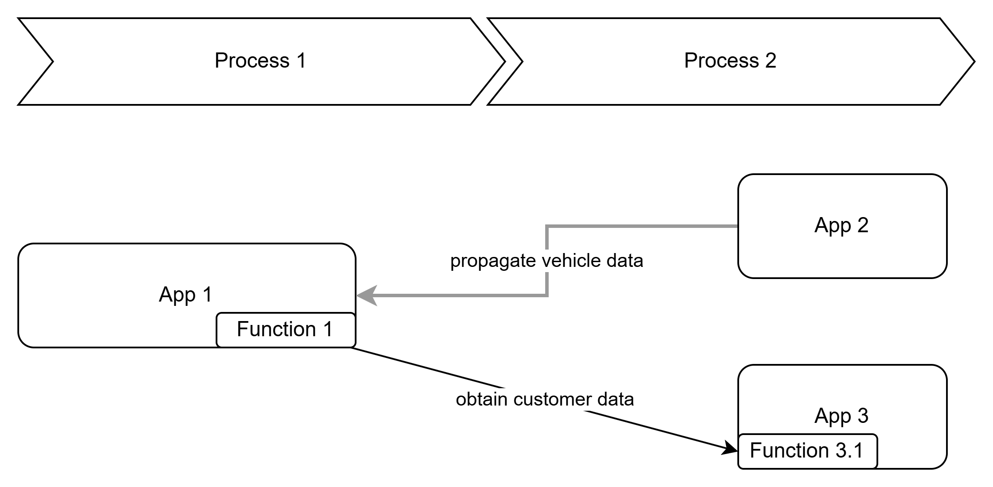
Enterprise Architecture - DEPENDENCIES MACRO VIEW
Business / functional Application Flow (add here the link described in ARIS tool and based on Examples) ​
SIBS_CCT_template-flow-mapping
Notes:
#Enterprise Architecture
The Application flow quickly shows interactions and dependencies with other information system. It gives a global overview of the complexity. An architect may be able to include such schema.
The Application flow must be validated by the Enterprise Architect before the gate.

Slide 20
FOR SOX / CAC APPLICATIONS
To review with Risk team
Stock-flow identification
Stock flow control definition: From a SFSE perspective, when a back-office sends a financial data flow, it is translated by a flow sent to the accounting systems and generates a variation in the balance. The stock-flow control ensures no movement is lost during automatized treatments. If a movement is lost; the variation of stock does not match with the sum of flows therefore triggering an alert at IT and business level. Stock-flow controls can be defined according to the interface (i.e. back-office, accounting systems) and at different levels (number of records, writing status, global balance…) depending on the sensitivity of the process and the business needs. More generally, stock-flow controls can be applied outside finance, like supply-chain or commercial orders processing.
Expected: The stock-flow scope relies mainly on the perimeter of the works of the statutory and SOX auditors. Internal Auditors can also issue recommendations in that respect. In broad terms, the scope is the generation of the financial reporting for the shareholders. A strategy has been defined jointly to secure this perimeter by order of priority:
0- Sustainability of the systems involved
1- Securing inter-SOX application data flows including gateways: list here
2- Securing inter-IFRS9 application data flows including gateways
3- Securing ITD treatments related to the General Ledger: list here
4- Securing financial data flows that have led to major operational incidents (as it comes)
Description of the solution: The set-up of stock-flow controls uses the “Control Tower” architecture. The treatment emitting the flow creates a header and a footer with the calculated parameters to control, it also creates a control file with a good achievement status sent to the Control Tower. The treatment receiving the data flow controls the information and sends a control file with a second achievement status to the Control Tower. In case of discrepancy, the recipient creates an incident in PSASM to raise an alert at IT level. The files sent to the “Control Tower” allow in-depth investigations by the business.
1- “Tour de Contrôle” general introduction: here
2- Header and footer’s specifications by the accounting department: here
*financial flows include accounting, cash and prudential flows

Slide 21
SOLUTION TO BE VALIDATED
Next slides : Solution 1
Eventually, duplicate the section to present an other solution

Slide 22
Enterprise Architecture – Impacted Applications Service
Application Service Name | Availability ​ | Integrity | Confidentiality | SOX | Data Privacy severity | Hosting​ | Technology | RTO/RPO | SLA
​ | ​ | ​ | ​ | ​ | ​ | AWS GLZ​ Dublin | Websphere zOS | ​
 |  |  |  |  |  | Onprem HR | Linux
PingFederate (PASSEXT/IDP2) | 4 | 4 | 3 | No | ? | Onprem BE | Windows | 2 / 9 | PLATINUM
Decommissionned applications
Application Service Name | Forecast end date​ | Comment
​ | ​ | ​
Notes:
#Impacted Applications Service
Refer on CMDB to know AIC/SOX/DP/RTO-RPO/SLA
SLA ?
Application Service Name : as referenced in CMDB
Availability, Integrity, Confidentiality :
Technology: main technologies used to develop the source application

Slide 23
Solution 1 – RISKs (For Gate 1 PoC and Gate 2/4)
Example :
Risk name | Impact (0..3) | Likehood (0..3) | Mitigation plan | Comments
Gen AI
Accessibility ? Lack of accessibility awareness ? (Gate 2 & 3) |  |  |  | Applicable if there is visible interface for user (Gate Architecture One Pager)
Lack of training
Data
Notes:
#Risks
Risk of the current solution, not on the demand (to be managed in DigitalMe)
Examples : lack of training ; high latency ; …
Impact : 0 to 3 (from Negligible to Severe) ; likehood : 0 to 3 (from very unlikely to very likely)

Slide 24
Costs (for Gate 1 Poc and Gate 2/4)
Cost global view:
Cloud Provider cost details link to document with detailed Cost (see next slide)
Cost details link to document with detailed Cost:
Gate 3 : update the planned cost if it is differents than in Gate 2 and highlight differences
Year 1
Year 2
Costs types | Q1 | Q2 | Q3 | Q4 | Next year recurrent costs
IT costs Included outsourcing | Xxx K€ Xxx K€ | Xxx K€ Xxx K€ | Xxx K€ Xxx K€ | Xxx K€ Xxx K€ | Xxx K€ Xxx K€
Cloud consumption | Xxx K€ | Xxx K€ | Xxx K€ | Xxx K€ | Xxx K€
Investments: Hardware costs (servers, …) Software license costs | Xxx K€ Xxx K€ | Xxx K€ Xxx K€ | Xxx K€ Xxx K€ | Xxx K€ Xxx K€ | Xxx K€ Xxx K€
Total cost | Xxx K€ | Xxx K€ | Xxx K€ | Xxx K€ | Xxx K€
Notes:
#Costs

Slide 25
(Solution X) - Costs
Cost estimate per environment (Multi-AZ), present:
  The selected region(s),
  AWS services,
  Monthly costs,
  Annual costs,
  Currency,
  Configuration summary.
By using l'AWS Calculator : Link to the shared AWS calculator estimation.
CLOUD SPECIFIC
Example
Region(s) | Service | Monthly | Annual | Currency | Configuration summary
EU (Paris) | Application Load balancer | 203,59 | 2443,08 | USD | Number of ALB: 8
EU (Paris) | AWS ECS Fargate | 777,88 | 9334,56 | USD | Operating system (Linux), CPU Architecture (x86), Average duration (24 hours), Number of service (6 services each service execute per day 3 min 9 max tasks), Amount of memory allocated (2 GB), Amount of ephemeral storage allocated for Amazon ECS (20 GB) 18x24x(cost vCPU+cost RAM)
EU (Paris) | Amazon Elastic Container Registry | 5,32 | 63,84 | USD | DT Inbound: Internet (28 GB per month), DT Outbound: Amount of data stored (28 GB per month)
EU (Paris) | Amazon CloudFront | 132,96 | 1595,52 | USD | Data transfer out to internet (1,5 TB per month), Data transfer out to origin (30 GB per month), Number of requests (HTTPS) (1,5 million per month)
...
Notes:
For a SaaS solution :
precise the model pricing and track the drivers
Cf slide around finops
Cost governance is part of event governance around exit plan …
Don't forget the recurrent cost around regular testing on exit plant and maintains inventory and export facilities.

Slide 26
(Solution X) - Timeline
Macro Schedule (including key milestones, sprint duration for agile):​​​
Remark:
Paste the schedule of the project.
Mention the link to the schedule and its version. The schedule describes interventions of different actors involved (tasks, dates, efforts, responsible). The critical path must be highlighted.
➔ Do not forget to show the major milestones.
Notes:
For a SaaS solution and for executing exit plan :
It is mandatory to put the milestones of transition phase, migration phase and disengagement of the old SaaS and the milestones for the new target with golive .
The publication of the exit plan document shall be put on the macro schedule.
The millestone for the new exit plan testing with the new supplier (when the new target is a SaaS one) . We may consider that exit plan deliverables are delivered after the disengagement.

Slide 27



Summary of the Solutions
CRITERIA | SOLUTION 1 | SOLUTION 2 | SOLUTION 3
Functional coverage
Non-Functional Requirements implementation
Technical expertise
Implementation complexity
Performance and reliability
Project costs (business and IT)
Investments: Hardware cost (servers, …) Cost of software licenses
Schedule
Cloud (cloud solution is mandatory)
Recommended solution
For each cell of the table, place a smiley of suitable color
Remark:
Selection criteria are proposed; they can be fulfilled or withdrawn.

Slide 28
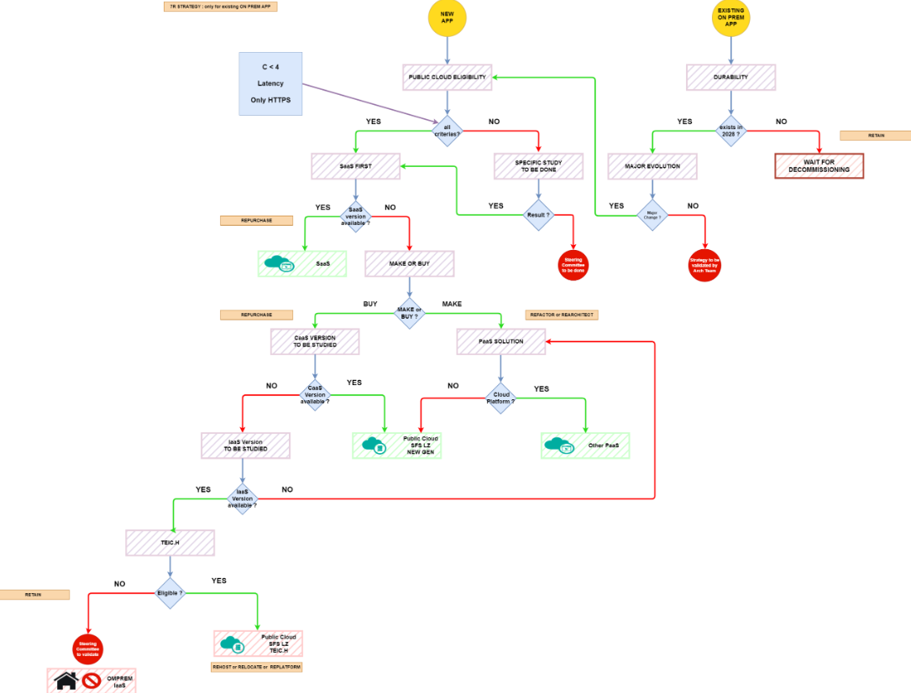
PRESENTATION OF THE CLOUD PROJECT
1.1 - Objective
  Positioning of the project regarding to the SFES cloud strategy:
    CLOUD ELIGIBILITY TREE : Add the diagram + Link + Document Version & Date
    https://docinfogroupe.stellantis.com/ead/doc/ref.20373_21_06727/v.dp/pj
    Implementation typology: New? / Replatforming?
  Cloud Solution Provider: AWS ?
    If not AWS, add:
    - The justification / reason,
Notes:
When the project is conducted for executing an exit plan, the objective shall mention it too.
SaaS project and execution of an exit plan for a SaaS solution towards a new target
The slide shall mention the risk assessment and decision track conduction at that execution (link to the CR)
In that case the choice of the solution presented for the new target shall answer to the remediation plan and decision taken conducting to that executive exit plan project

Slide 29
Cloud (Gate 1 poc and Gate 2)
Cloud architecture
  Selected cloud provider : AWS / AZURE / On prem
  Cloud Landing Zone : AWS Global Landing Zone ; Azure Landing Zone
  Main region : eu-west-1 ; backup region if needed : eu-west-3
  Network model : standalone
  Network connectivity with on-premise datacenter : no ; via private endpoint ; vpn
Availability
  SLA desired by the business for critical end-user features (planned downtime must be counted as unavailability): 99.95%
  SLA provided by the cloud infrastructure for critical end-user features : 99.95%
Environments
  New cloud accounts needed : PROD + Non-Prod
Notes:
#Cloud
SLA Availabilty must be calculated for critical feature for end users. Any downtime (planned or not) is substitued to the uptime.
Visit https://shiftup.sharepoint.com/sites/GDP_CCOE

Slide 30
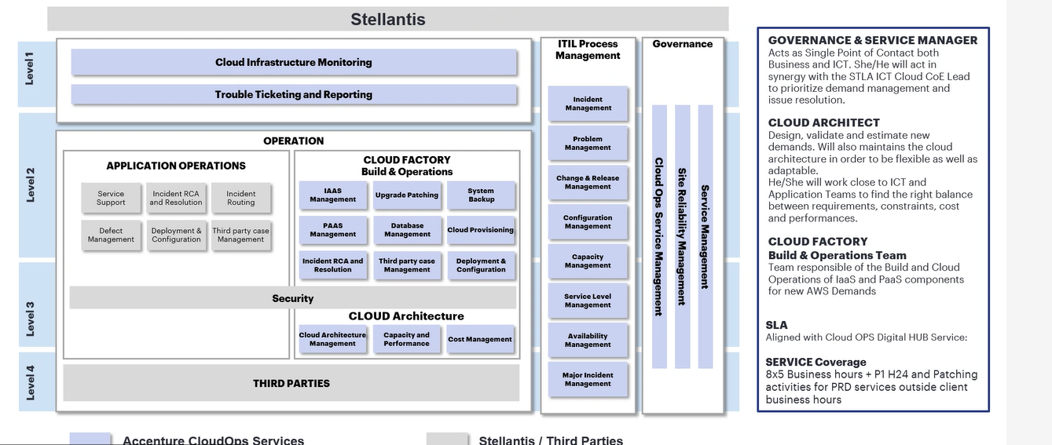
Cloud : Build & Run organization
Build organization
  Which team will do the build phase
  Confirm usage of Terraform or other IaC tool
Run organization
  Which team will do the build phase
  Confirm usage of Terraform or other IaC tool
Cloud Operating Model
  Describe the cloud operating model applicable for your product, for Build phase
    And for Run phase (Gate 3 and Gate 4)
  Based on recommandations from GDP_CCOE or the example →
Notes:
#Cloud : Build & Run
#Cloud : Operating Model
Describe how the product is managed : who do the support, with which tools, how incidents and changes are managed.
https://docs.aws.amazon.com/pdfs/wellarchitected/latest/operational-excellence-pillar/wellarchitected-operational-excellence-pillar.pdf#welcome

Slide 31
technical Architecture – global description of solutions
Explain the main aspect of each solution
Describe the criteria that led to the solution(s) being proposed (IT strategy, project dependency, architecture, etc.)
Describe the elements common to all the solutions
Provide a macro description of each solution.
Notes:
For a solution based on “ SaaS” offer
the description should present all topics mentioned on “ SaaS” presentation .
The overview is general schema but then in TCC each topic requires a focus (schemaa and/or description).
to be declined by physical localization, environment, End users, User projects , Supplier organization and its 3rd parties team evolved

Slide 32
(Solution X) - TECHNICAL DESCRIPTION OF THE SOLUTIONS
Here is an example for a LAMP application with CMS
Check the appropriate software stack with architecture team
XX* appropriate version for the relative software
TO BE COMPLETED AT GATE 3
Technical stack:
  List all the products, framework, OS with the versions:
Element | Value | Comments
CMS | Drupal XX* | Latest Drupal XX* LTS version
Back-End Framework | Symfony XX* | Latest Symfony XX* LTS version
Front-End Framework | Angular XX* | Latest Angular XX* LTS version
Dev language | PHP XX* | …
Database | MySQL XX* | …
OS | Debian XX* | Based on Debian XX* Official Image with minimalist installation
​All the software and libraries will be upgraded at least once a year
Notes:
For a SaaS solution : replace that slide by a focus on the general technical approach
PaaS features and stack/skills kknowledge required by the Customer
Full web (or not !!!!)
CI/CD pipeline and artifacts
Containerization / VM provisionning, public ressources…
Here it is important to show the maturity of the conception .
Modular platform , etc.
Cf SaaS presentation and Supplier’s answer to the SaaS well architect

Slide 33
Applications Flows technical diagram for Gate 2 or Gate 1 PoC
Insert Technical Architecture document link here - Example
Insert here your data flow applicative diagram - Based on Examples
Notes:
Source example : https://docinfogroupe.stellantis.com/ead/doc/ref.20533_24_00013/v.vc/pj
Purpose : Show diversity and complexity of integration flows
Identify target solution (SaaS, cloud make (Landing Zone), M2C, on prem)
Identify all systems incoming or outgoing data to the application
Identify the direction of the flow (who is doing the call, who is receiving it)
Identify the technical system supporting the flow (gateway, file transfer)
Identify hosting services, including hosting region
Add relevant methods and data transiting in the flow
Identify authentication source
Identify gateway type and location
Identify CICD toolchain and flows
Identify other tools depending of the app

Slide 34
AVAILABILITY, SLA
Remark: Depending of business requirements in terms of application’s availability, there will be an impact on the design and choice of product, architecture and managed services.
  Application global SLA: xxxx,
  Required SLA per environment,
  SLA per functions/services from critical and non critical functions: xxxx,
  Ranges of interruptions authorized per environment (maintenance): xxxx,
  Ranges of service shutdowns per environment: xxxx.
Notes:
For application SaaS :
please check and control regarding the Supplier commitments given on its offer. (cf contract commitments too)
Please check and present its compliancy and revelancy regarding the E2E eco system.

Slide 35
DATA summary
Revised by JOA
People & Organization
Business Owner | TBD | Business Data manager | TBD | The solution proposed is the target one: Yes/No (if temporary solution, target solution to be presented too with planning)
ICT Lead | TBD | Data Product Manager Data Product Owner | TBD TBD
SIBS tribe lead
Proposed Solution Highlights
Short description of the technical solution and the data technologies used
Business Domain​ | Initiative | Data PM | GoLive date | Milestones for Architecture​ | Data Products
Engineering​ | Global Lakehouse​ | ​TBD | 1° wave: xxx​ Last go-live: xxx | End of Scope: 01/01/2099 End of Design: 01/01/2099 | Datasets, Dashboards, app, …
Business domain (bank , Insurance), BCM and JV
Bank, Insurance lakehouse or LSI or Risk DWH, Ins DWH, ..
Notes:
#Data
Remove the data section if data is not involved
Proposed Solution Highlights: brief description of the technical solution, listing the platforms / technologies used or any other relevant element of the proposed solution
Business Domain​: declare the business domain stakeholder of the initiative / projects. There is a relationship between business domain and data product manager / data product owner.

Slide 36
[PROJECT NAME] – Functional OBJECTS for [data platform]
Functional objects & sources
Miss « existing flow to be updated »
prefer to change by a link to « Data contract »
Functional Objects |  |  |  |  |  |  | Data Sources (applications)
Object Name (from Enterprise Data Model) | Business owner | History depth | Status | Data model | Confidentiality | Personal data (Y/N) | Region / Brand | Source Name | Source ingestion status | Flows already ingested | New flows to be ingested | Retention Period | Disposal Action | Start of Event
Dealers sites | Sales & Marketing | Jan 2020 | New | LINK or availability date | C2 | N | EP | ARCAD | Ingested in SL only | 1 | 0 | 5 Years | Deletion | End of Contract
 |  |  |  |  |  |  | xF EE | WEBDAC | Data already ingested from the sources, but new data required | 0 | 1 | 10 Years | Anonymization | End of Contract
Dealer employees | Sales & Marketing | Jan 2020 | New | LINK or availability date | C2 | Y | EP | ARCAD | Not ingested yet | 0 | 1 | 3 years | Deletion | Record Date
Dealers | Sales & Marketing | Jan 2020 | In SNF DB_TL_CMN.TL_SAL.ENT_NETWORK_SUBJECT | LINK or availability date | C2 | N | EP | ARCAD | In Global SNF | 1 | 0
 |  |  |  |  |  |  | xF EE | WEBDAC | In Global SNF | 1 | 0
Business Object Model
Business resp.
JV scope (could be « ALL »
Link to BOM
Notes:
#Data
Remove the data section if data is not involved
Characteristics of the functional objects requested for the data product development
Object Name: functional name of the object
Business owner: name of the business department owner of the functional object
History depth: history depth required in data products, which contributes in the analysis of the data volumetry and the costs for storage
Status: status of the functional object, e.g., “New” if is a new one (into SnowFlake databases, Foundry Ontology, Databricks catalog), already existing with the related technical name
Data model: link to the documents of the functional data model, deliverables under the responsibility of the business team as part of the documentation that specify all the requirements, or the availability date if the functional data model is not defined yet. Mandatory
Confidentiality: specify the maximum level of confidentiality, compliant with the official documentation for the confidentiality criterias, and aligned with the official result of the self assessment with the DPO team. If no detailed information are available, take the available information from the source systems, supported by the business data owners, or from the repositories used to register the applications (APM for xF, Reflex for xP). In case of personal data availability, the level of confidentiality become C3, with the exception when VIN code is the only personal information available, for which the level of confidentiality is C2. Possible values are:
C1
C2
C3
C4, for which the initiative is automatically not approved
In case of C3 data, provide more detailed informationfor tables and fields hosting confidential information. The same for C4 data. LINK TO STELLANTIS DOCUMENTS. Mandatory
Personal data (Y/N): specify if personal information are available; possible values are:
Y, if personal information are available
N, if personal information are not available
VIN, if VIN code is the only personal information available
Y + geolocalization, if geolocalization information are available
Mandatory
Region / Brand: regions / brands associated with data sent by the source systems
Source Name: source system name
Source ingestion status: ingestion status, e.g., already ingested, not ingested yet, ingested into the layer …. only, etc.
Flows already ingested: number of flows already ingested into the data platform
New flows to be ingested : number of new flows to be ingested into the data platform
Retention Period: retention period inside the data platform. The retention period must be compliant with the level of confidentiality, the internal regulations an the external international regulations for personal data. Mandatory
Disposal Action: disposal action at the end of the retention period. Specify the disposal action in case of change of the consense for personal information. Mandatory
Start of Event: event which triggers the disposal action

Slide 37
[PROJECT NAME] - POWER BI SIZING - TECHNICAL INFORMATION
Data ingestion
POWER BI
rather than Power BI sizing
Configuration |  |  | Consumers |  | Ingestion |  | Confi-den-tiality | Personal data | Comments
Applications | Data ingestion | Requested SKUs (P1, P2, …) | # Nominal users | # Concurrent users | Frequency Refresh | Full Dataset Data volumetry
Dashboard xxx | Import mode | 1 P1 | 200 | 40 | Daily, 6 AM CET | 2 GB | C3 | PI
Miss : SOURCES, BCM (schema) or Database,
Miss : PM
Same slide to create for Dataiku
Same slide to create for DataXP
Same slide to create for Data products exported
Notes:
#Data
Remove the data section if data is not involved
Technical information for data ingestion and usage requested for the development of Power BI dashboards:
Applications: name of the source application
Data ingestion: data ingestion technique used to populate the data set, e.g. import mode, direct query, hybrid mode
Requested SKUs: declare which are the SKUs (P1 units, P2 untis, etc.) needed to support the consuming of the dashboard by all the expects users
# Nominal users: total number of users enabled to access the dashboard
# Concurrent users: number of users connected into the dashboard that are pushing a computational activity in concurrent mode
Frequency refresh: frequency for the refresh of the Power BI data set
Confidentiality: specify the maximum level of confidentiality, compliant with the official documentation for the confidentiality criterias, and aligned with the official result of the self assessment with the DPO team. If no detailed information are available, take the available information from the source systems, supported by the business data owners, or from the repositories used to register the applications (APM for xF, Reflex for xP). In case of personal data availability, the level of confidentiality become C3, with the exception when VIN code is the only personal information available, for which the level of confidentiality is C2. Possible values are:
C1
C2
C3
C4, for which the initiative is automatically not approved
In case of C3 data, provide more detailed informationfor tables and fields hosting confidential information. The same for C4 data. LINK TO STELLANTIS DOCUMENTS. Mandatory
Personal data (Y/N): specify if personal information are available; possible values are:
Y, if personal information are available
N, if personal information are not available
VIN, if VIN code is the only personal information available
Y + geolocalization, if geolocalization information are available
Mandatory
Comments: additional comments

Slide 38
DevSecOps
DevSecOps platform (for Gate 1 PoC and Gate 2) :
  CICD platform to be used : CIQ / others
Software quality :
  Tools to use to verify software quality : Sonarqube Report (Gate 4) within Stellantis ( Quality Gate validated)
  Quality gate value to use (Gate3) : describe gate threshold
Software security :
  SAST/DAST tool to be used : link to the Scan Checkmarx (Gate 4) & Action Plan with CISO validation
Test
  Unitary test, load test strategy explained : Unit test in CICD ; Storm runner for Load test …
Notes:
#DevSecOps
Related to the DevSecOps criteria domain.
CIQ : https://ciq.mpsa.com
From CIQ you will have access to all other CICD tools (SonarQube, Artifactory, Checkmarx).

Slide 39
DevSecOps (Gate 2 + Gate 3)
DevSecOps environment
  Environment defined : PROD + PREPROD + QA + DEV + STAGING
CD/Delivery
  Tools and language used for Infra-as-code : terraform
  Explain how to deploy infrastructure and application code (Gate 3):
    Dev team is able to deploy in non-prod env via the CICD pipeline
    Product Owner is able to deploy in prod via a dedicated CICD pipeline
    BlueGreen deployment in preprod and prod to ensure no user downtime during upgrade
Notes:
IaaC / IaC : Infra as a code

Slide 40
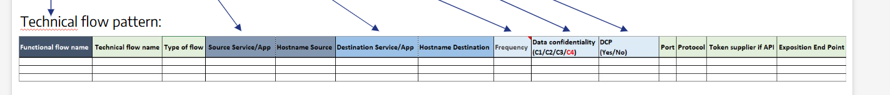
Enterprise Architecture – interactions details
Application Service Consumer | Application Service Producer | Flow type + protocol | Exchange Format​ | Gateway | Authentication | Volume / Frequency | New, update or no-change | Comment
 | PingFederate | API / HTTPS | OIDC | No | oAuth via PingFederate | 10 req/min | No-change | To authenticate users
 |  | File / SFTP | CSV | MTS2 | mTLS | 1MB/day | Update
 |  | API / HTTPS | JSON REST API | APIC (AWS Irlande) | oAuth via PingFederate + mTLS | 10 req/sec | New
OBT | OMS VN | Queue / Kafka:8886
Notes:
Application Service : use the ARIS name
Flow type <> protocol => MQTT…. If TCP port is not standard, indicate the custom TCP port

Slide 41
Enterprise Architecture – Impacted Applications Service
Application Service Name | Availability ​ | Integrity | Confidentiality | SOX | Data Privacy severity | Hosting​ | Technology | RTO/RPO | SLA
​ | ​ | ​ | ​ | ​ | ​ | AWS GLZ​ Dublin | Websphere zOS | ​
 |  |  |  |  |  | Onprem HR | Linux
PingFederate (PASSEXT/IDP2) | 4 | 4 | 3 | No | ? | Onprem BE | Windows | 2 / 9 | PLATINUM
Decommissionned applications
Application Service Name | Forecast end date​ | Comment
​ | ​ | ​
Notes:
#Impacted Applications Service
Refer on CMDB to know AIC/SOX/DP/RTO-RPO/SLA
SLA ?
Application Service Name : as referenced in CMDB
Availability, Integrity, Confidentiality :
Technology: main technologies used to develop the source application

Slide 42
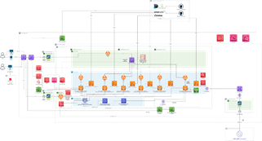
(Solution X) - Technical Architecture global view
Technical Architecture document
  Add here the link for each application ​​​
Technical architectural diagram (production):
  Link to the file support (draw.io, png): Link (Date & Version)
  The diagram(s) must include:
    View of services / tools or means integrated in the solution in term of security,
    Short description of flow security (https, mtls or tls, sftp, data encryption …) for all the external and internal exchanges,…)
    All the source / destination dependences (App on premises / cloud, APIC, Partner(s), …), not only the internal solution.
Remarks:
The diagram must included:
- view of services / tools or means integrated in the solution in term of security and logging,
- Flow Security (https, mtls or tls, sftp …) for all the external and internal exchanges,
- All the source / Destination dependences (App on premises / cloud, APIC, Partner …), not only the internal solution,
- The list of all the managed services necessary and an explanation in the application usage context (Must be present in the DAT and explained during the CCT).
- Diagram for PPROD + DEV
Action: Check the following network design pattern
FRW ( firewall ) subnets : represents firewall subnet and hosts firewall endpoints to ICT PALO ALTO
PUB ( public ) subnets : represents public facing subnet , hosts application Load balancer or api gateway
PRIV ( private ) subnets : represents private subnet , hosts application workload such as ECS cluster , EC2 ....
ISOLATED subnets : represents private subnet isolated from the network which hosts databases
TGW subnets : represents transit gateway subnet , hosts network interfaces of transit

Slide 43
DATA MODEL
Enterprise/Business Data Model (add here the deliverables based on Examples)
Notes:
#API
Gate 2:
Notice if Subscribe existing API and list the API concerned Or/and creation and publication for new API → Table in the page « Enterprise Architecture – interactions details »
Refere to https://shiftup.sharepoint.com/sites/COEAPI/SitePages/Publish-APIs-all-Lifecycle.aspx

Slide 44
API
API Architecture
  Gateway to use as API consumer or API producer :
    IBM APIC deployed in AWS eu-west-1
Notes:
#API
Gate 2:
Notice if Subscribe existing API and list the API concerned Or/and creation and publication for new API → Table in the page « Enterprise Architecture – interactions details »
Refere to https://shiftup.sharepoint.com/sites/COEAPI/SitePages/Publish-APIs-all-Lifecycle.aspx

Slide 45
Gen AI
GenAI Gateway
  Gateway to use to consume AI service :
  Cost estimation (link to the template to ask to GenAI), for Gate 1 PoC and Gate 2
  API keys for environnements (Gate 3):
    Prod : to do ; preprod : yes
Notes:
#GenAI
Initial in Gate 2 and complete in Gate 3

Slide 46
TECHNICAL STACK (gate 3)
Example
Isolated network
:80
Container orchestrator
MySQL
Linux Alpine:3.17.2 Docker
Apache 2
5.7
« CUSTOMER » schema
PHP 8.1
Symfony 6.4
:3306
TLS
To summarise with preceding
Notes:
#Technical Stack
EXAMPLE of a technical stack diagram.
We can use here specific cloud provider service (AWS DynamoDB) or we can stay cloud-agnostic (« MySQL » instead of « Aurora »)

Slide 47

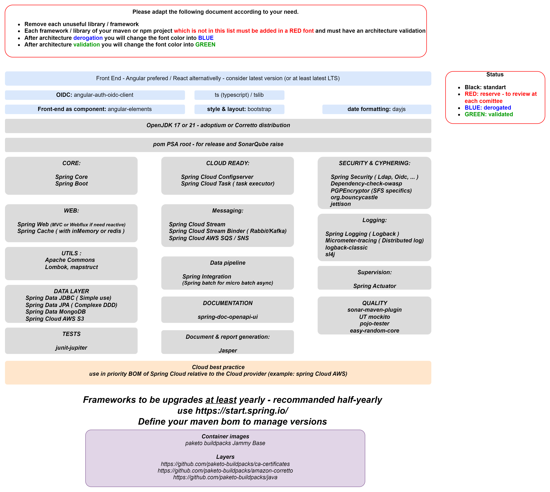
(Solution X) - TECHNICAL DESCRIPTION OF THE SOLUTIONS
Technical stack (2/2):
​All the software and libraries will be upgraded at least once a year
Notes:
For a PaaS/SaaS solution :
mention it when supplier gave information .
It is important to focus on stack when the Customer is evolved on development to add features (PaaS features ) to be sure Customer is aware of the langage and skills required to use it.

Slide 48
(Solution X) - Technical Architecture global view
  Create others diagrams or slides to focus on :
  Monitoring and alert notifications,
  Backup strategy,
  Different environments,
  Obsolescence level
  Exit and reversibility plan
Notes:
Project when onboarding a “SaaS” product
The project shall present the exit strategy attached to the selected SaaS Scope and the contract content defined to support it. https://docinfogroupe.stellantis.com/ead/doc/ref.20373_21_06896/v.vc/pj
The validation of the project shall validate the delivery of exit plan document and the delivery of the export facilities attached to migration plan with test done on Supplier’s side during the project.
A slide shall present the export facilities in front of the data migration plan and the conditions of security to control and access to the data exported, the validation of the test and its deletion process after validation.
For SaaS and a executive exit plan :
three main scopes to present ( the new target itself, the exit plan execution whit the migration and transition phase, and the disengagement of the SaaS replaced) .
1- New target :
Add as slide explaining your organization future/in place (build/run) to prevent and follow the risk on exit triggers events (cf SaaS_ exit plan _framework_helper)
On design/build phase, define the export facilities attached to each catagory data set managed or processed by the Supplier : it is a prerequisite for data migration plan (cf SaaS_exit plan_frawework_helper)
On transfer Build/ Run , the exit plan document shall be fully controled and maintained until the end of the new SaaS service
On transfer Build/Run, the governance on exit events triggers should be taken in account and maintained until the end of the new SaaS service
The execution of the disengagement of the old SaaS should be fully controled after the deployment of the new Service and validated (contract, data deleted , etc ) accordiing to the exit plan document.
2 - Old Solution /New target (switch)
Add the schema and policy of the DATA Migration plan between the skateholders
Add the schema and policy of the transition phase organization
All environment shall be considered
Add a schema of conduct of change regarding the others applications
3 - Old solution - disengagement
Add as schema reqgarding the disengagement and policy
Add the schema of what would be disengaged

Slide 49
(Solution X) - TECHNICAL DESCRIPTIONS OF THE SOLUTIONS
Localization:
  Check and validate that the business context is compliant with the regions available through the LZ SFS
  Remarks:
    The application will be on Paris Region. If need of DRP application, it will be on Dublin Region
    Check Risk analysis document if Region is not compliant with the business (+ action plan associated).
  AWS Regions required for the application: xxxx
  Remark: take into account the end users localization.
  Check that the latencies between the application and all the others systems interaction and the end users are corrects.
  Remark: it could be possible to check the latencies between your workstation and the different regions in AWS: Link .
CLOUD SPECIFIC
Notes:
For a SaaS solution :
Mention the physical sites evolved by the SaaS supplier service
Physical site, provider of the hosting site , localisation and its rôle in the SaaS context (DRP, backup, part of solution)
Show If the offer is distributed on different physical sites and model of conception (CaaS/IaaS VM, etc.)
Show the interaction of the physical sites evolved by the SaaS supplier and the Eco system of integration (Users, team build/run, flow….)
Cf the evaluation done according to the supplier answer to the SaaS well architect excel
Cf Risk security assesment (add link) with a focus also to the security mechanisms for Data Export faciliites and its control. Cf Risk vendor assessment (add link).

Slide 50
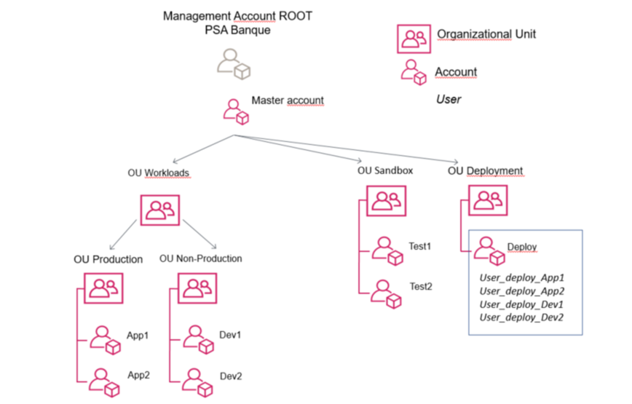
(Solution X) - TECHNICAL DESCRIPTION OF THE SOLUTIONS
Environments needs & Account organization:
Example
Environment | Hosting | Description
Dev | Stellantis BPF AWS Landing Zone | Used by developer for development.
Preprod | Stellantis BPF AWS Landing Zone | Used to validate the next release.
Production | Stellantis BPF AWS Landing Zone | Production.
Remark:
If another environment is required: you must give the reasons / justifications and take into account this environment in the global cost.
Account organization
Notes:
For a project based on SaaS solution ,
Describe all environments focusing on their role, data management and SLA/Control plane services associated
It is important to check that all environments are secured and monitored when they support sensitive data as the same level that a production environment.

Slide 51
(Solution X) - TECHNICAL DESCRIPTION OF THE SOLUTIONS
Existing migration strategy:
For migrations / M2C of existing applications only
Explain the existing features will be migrated.
Examples
Data migration with either SQL scripts and/or Change Data Capture and/or use of AWS DMS
Coexistence with the previous application or “Big Bang” switch
Connection with other applications migration strategy (url change; switch from CFT to other solution, …)
Notes:
For a SaaS solution from scratch or for a make cloud solution :
Precise the exit plan strategy defined according to the risk level (cf SaaS exit plan presentation and helper)
Precise the import facilities for the supplier and the conditions to do the migration ( pre-requisite/tooling, volume, link , way to do the test)
Precise the management of the transition phase.
Precise the export facilities attached to the migration plan and test realized (new in build but maintained and reexecute regularly on run according to the level of risk )
For a project conducted for executing an exit plan , that chapter is mandatory and essential
That data migration plan and transition phase shall be conducted regarding the clause termination of the initial SaaS provider and its exit plan document. That migration shall be based on the principles and data inventory declared and maintained in the exit plan document attached to the current solution with its prerequisite.
Here the project shall describe the principles consolidated with the new target supplier and give the principles adopted by the parties with their requirements and costs.

Slide 52
(Solution X) - TECHNICAL DESCRIPTION OF THE SOLUTIONS
Batch strategy:
Only if Batch processing in the new solution
Explain the complexity of Batch orchestration
Example: sequencing of batches / dependency to calendar
AWS services retained (AWS Batch, Even Bridge, Step functions, Airflow, …) with the use of each
Notes:
For SaaS solution :
be aware of the SaaS well architect principles and on bacth/orchestration. It is mandatory to focus on that topic.

Slide 53
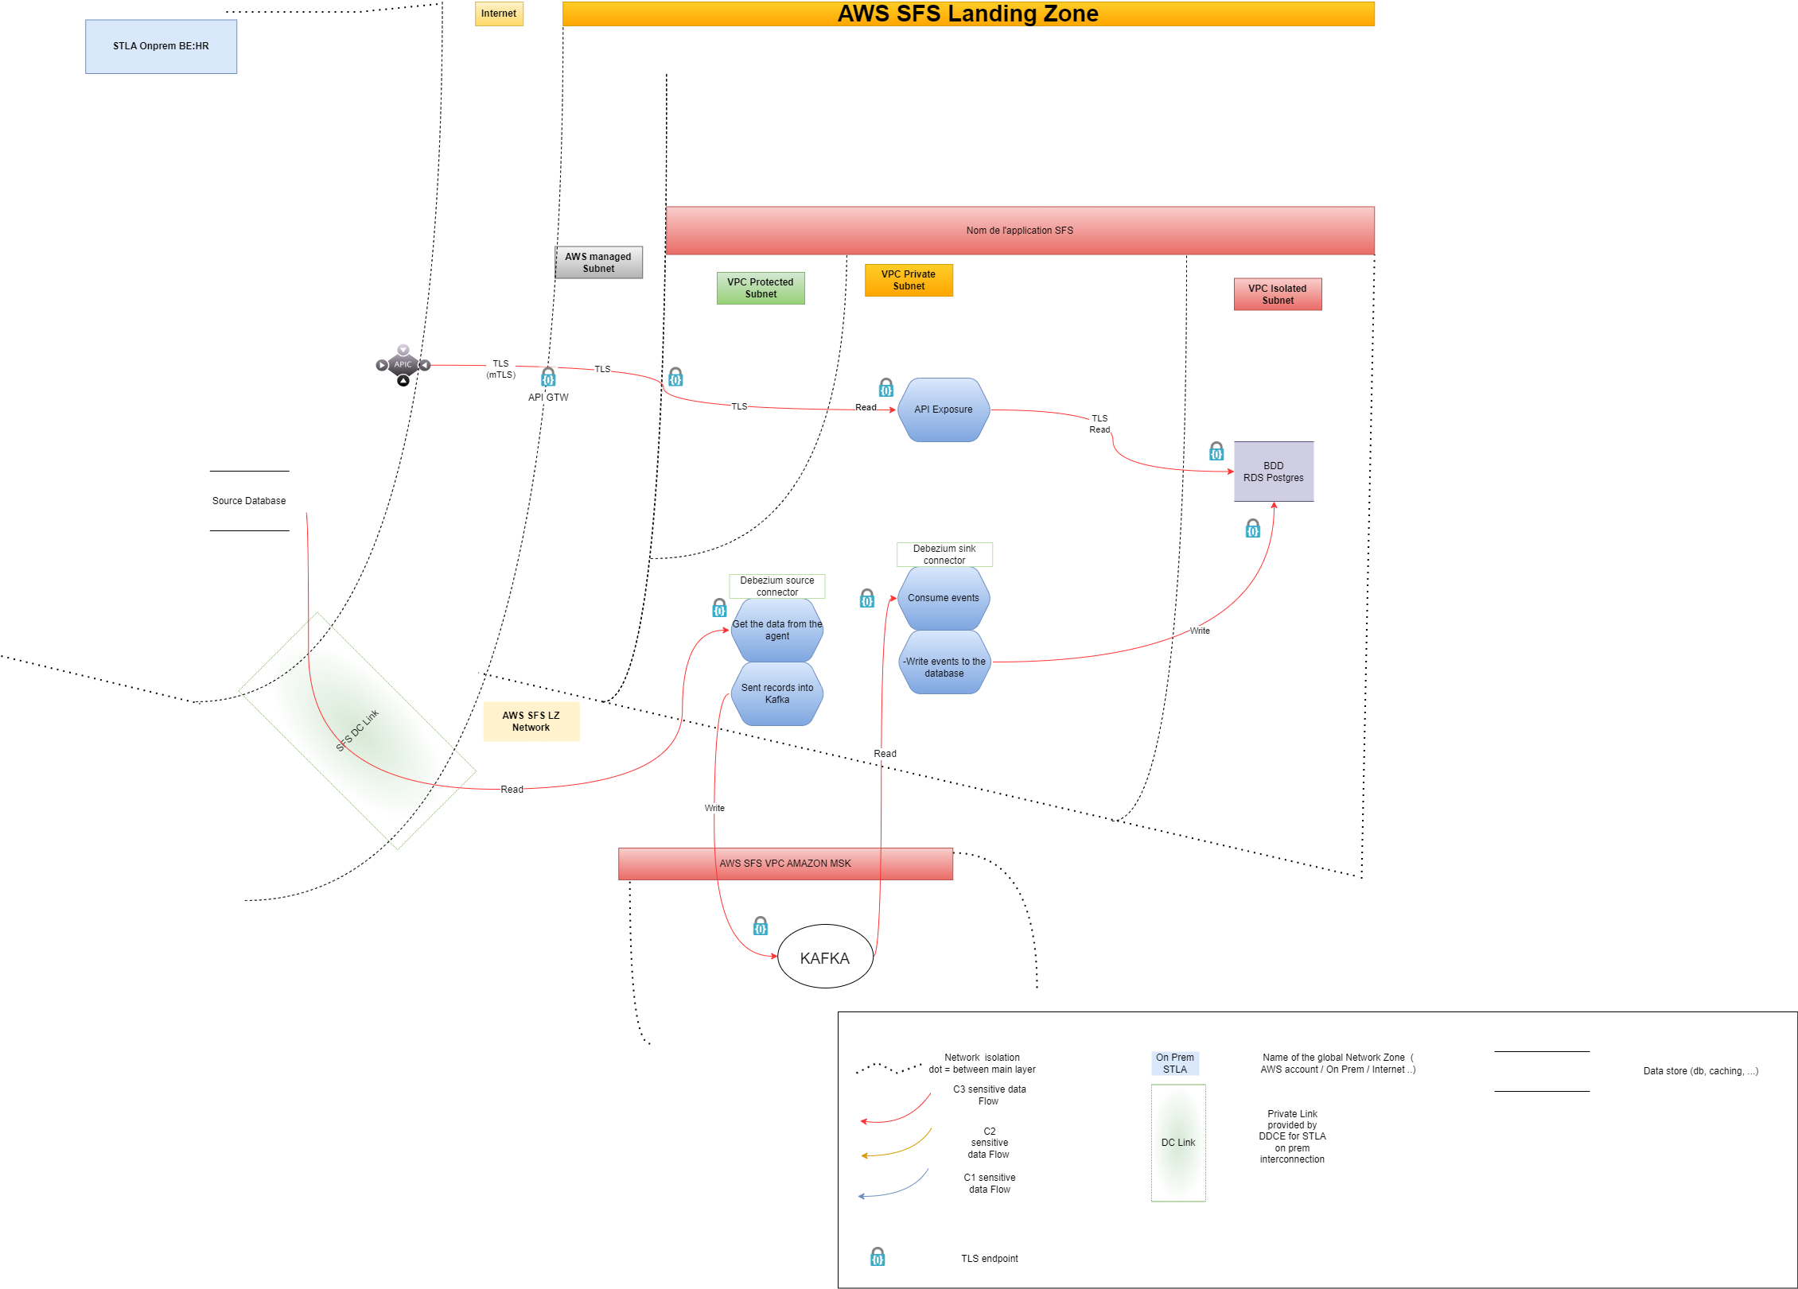
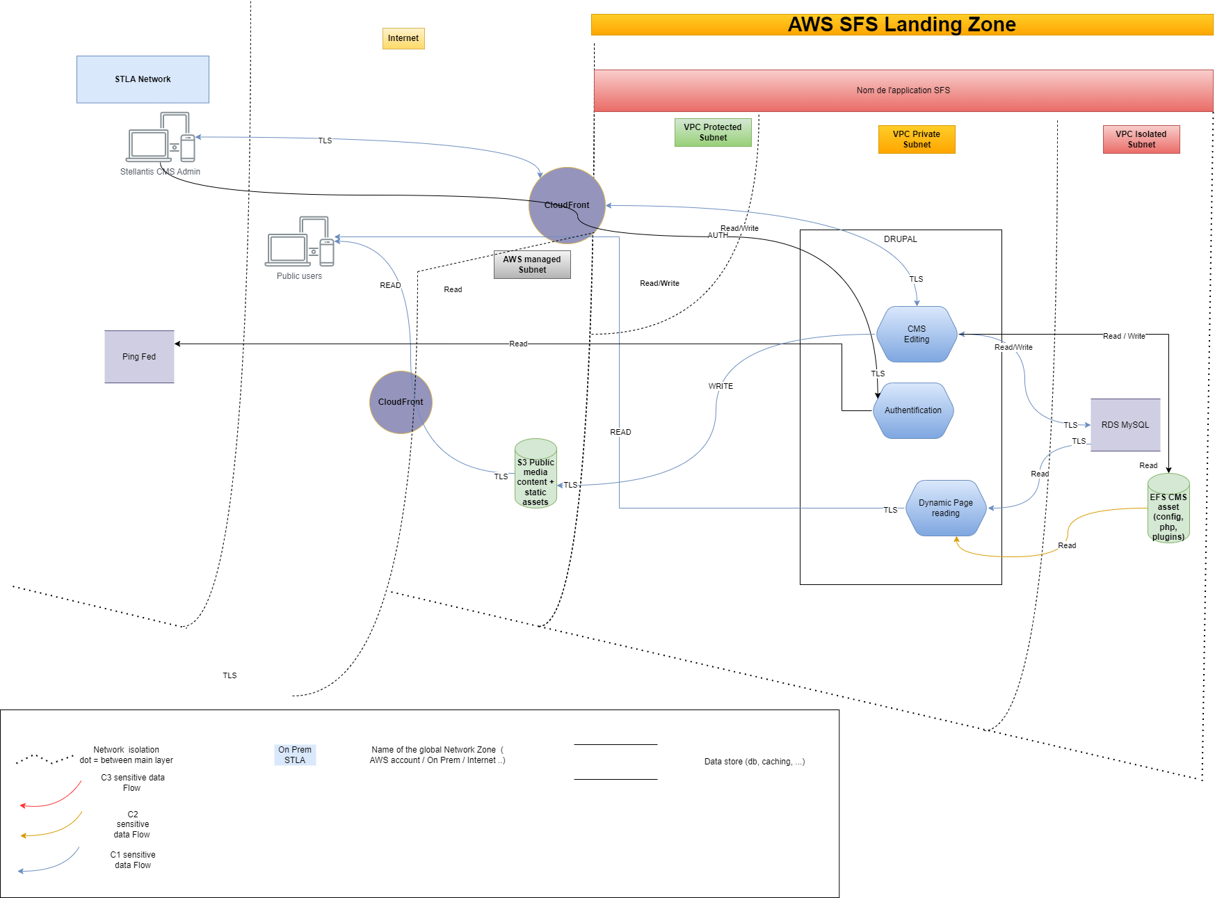
(Solution X) - TECHNICAL DESCRIPTION OF THE SOLUTIONS
Remark:
- Document must be updated continuously (During Build and Run phase).
Data-flow:
  Link to the file support (draw.io, png): Link (+ Date and Version of the document)
Notes:
For a project based on SaaS :
It is essential and mandatory to maintain an UpToDate flow inventory for managing exit plan (cf exit plan frawework helper)

Slide 54
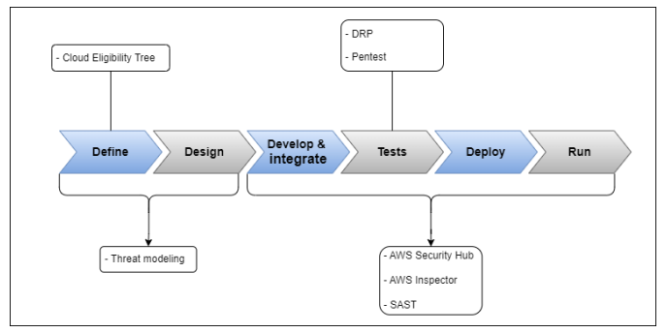
(Solution X) - TECHNICAL DESCRIPTION OF THE SOLUTIONS
Application architecture : SSDLC
Copy last version from SSDLC document
SSDLC documentation:
AWS
On premise
Action:
Show the progress on this slide.
Notes:
For a project based on a SaaS solution,
The project should check that the Vendor applies good pratice and these pratice are applied on the solution itself (cf risk vendor and security analysis on the supplier’s answer to the SaaS well architect )

Slide 55
(Solution X) - ACCESS RIGHTS
Matrix of Application Roles (Application & Database):
  Business,
  Dev&Ops and Release account,
  Technical account? …
Link to the table (+ version & Date)
Link to the template.
Notes:
For a project based on SaaS applicationn :
A detailed RACI matrix is essential (shared model responsabilities between the supplier and the Customer )
It is part of the contract too

Slide 56
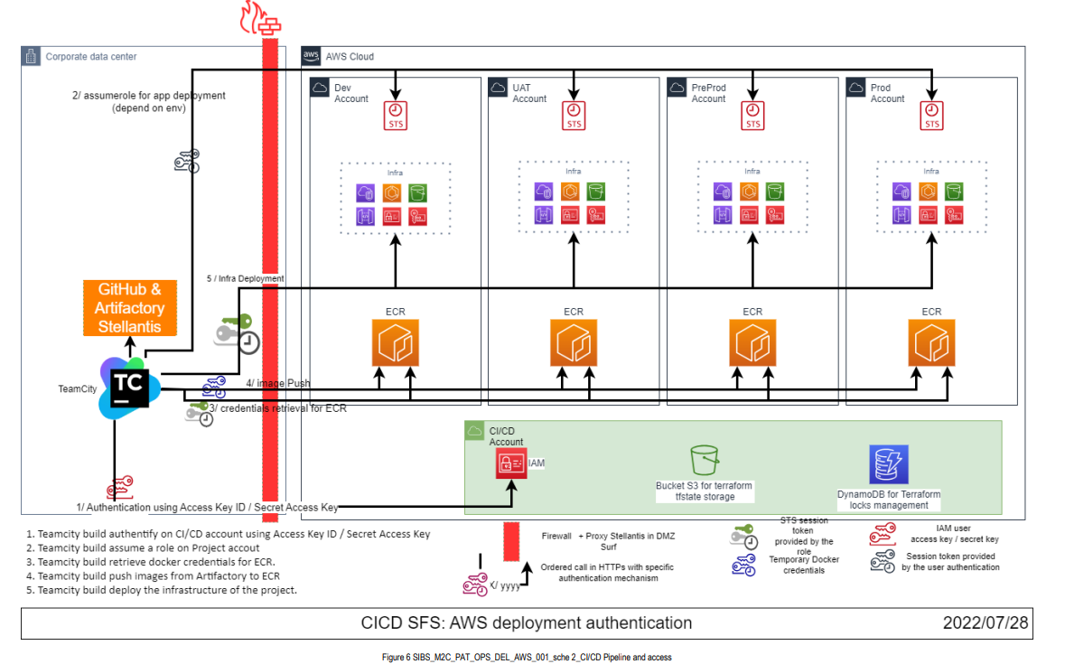
(Solution X) - ENVIRONMENT DEPLOYEMENT
Pipeline CI/CD pattern: Link
- Copying images before deployment
- Deployment of application infrastructure elements
- Automatic purge of unused images in ECR(AWS)​
- Historization of images in artifactory (On-Premise)​
- Rules for managing non-production environments to be defined during the project (Stop / Relaunch)​
Notes:
For a project based on a SaaS application :
the project will show the methodology apply to deliver evolution
Normally, the supplier shall have its CI/CD pipeline and controls ➔ cf SLDC process..

Slide 57
(Solution X) - TAGGING AND FINOPS STRATEGY
Tagging policy: Link
FINOPS Guidelines: Link
FINOPS:
  Resource Automation (start and stop instances in predefined period),
  Performance versus Cost ratio,
  Optimize the different environments: Prod/PProd ≠ Dev,
  Cost follow-up / monitoring:
    To avoid cost drifts,
    See if the application can be optimized :
      Check the design, the AWS services implemented,
      Understand if resources are under or over-provisioned,
      Resize instances and services based on system performance and finances,
      …
    Alerting on consumption threshold.
CLOUD SPECIFIC
Notes:
For a project based on a SaaS application :
The project should describe the principles of model pricing and enlight the drivers for the calculation.
The tracking of the drivers and events that may conduct to a strong increase shall be governed during all the life of the application with the supplier (risk for an exit plan ).

Slide 58
monitoring
Important metrics to monitor :
  Infrastructure cost : mandatory to monitor
  For each environment, it is important to monitor :
    Database size : alert if > 2TB
    Others…
  Alerting : email to the product team (target : SDI / DriveIT or DigitalMe)
  Gate 3 : update monitoring if it is differents than in Gate 2 and highlight differences
Notes:
#Cloud : Monitoring
Product Team must define what are the most critical metrics to monitor, and the alert threshold. Alert can be send to the product team via, at least, email.

Slide 59
RPA (remote process automation)
Idea recorded in RPA Portal : #IdeaNumber
RPA demand form : #demandNumber
Opportunity Assessment Template : Link to the document, approval OK
Process Document Description : Link to the document
Complexity evaluation matrix : link to the document
RPA technical checkpoint : to do / done
Notes:
#RPA
Remove the slide if RPA is not involved

Slide 60
Low code & Citizen development
Roles & Permission are implemented (Gate 3) : Y/N
Solution package for deployment ready (Gate 3) : Y/N
Applications Solutions deployed using GitHub (Gate 3) : Y/N
Notes:
#LowCode
Remove or hide the slide if LowCode & Citizen development is not necessary.

Slide 61
(Solution X) - Costs
Cost estimate per environment (Multi-AZ), present:
  The selected region(s),
  AWS services,
  Monthly costs,
  Annual costs,
  Currency,
  Configuration summary.
By using l'AWS Calculator : Link to the shared AWS calculator estimation.
CLOUD SPECIFIC
Example
Region(s) | Service | Monthly | Annual | Currency | Configuration summary
EU (Paris) | Application Load balancer | 203,59 | 2443,08 | USD | Number of ALB: 8
EU (Paris) | AWS ECS Fargate | 777,88 | 9334,56 | USD | Operating system (Linux), CPU Architecture (x86), Average duration (24 hours), Number of service (6 services each service execute per day 3 min 9 max tasks), Amount of memory allocated (2 GB), Amount of ephemeral storage allocated for Amazon ECS (20 GB) 18x24x(cost vCPU+cost RAM)
EU (Paris) | Amazon Elastic Container Registry | 5,32 | 63,84 | USD | DT Inbound: Internet (28 GB per month), DT Outbound: Amount of data stored (28 GB per month)
EU (Paris) | Amazon CloudFront | 132,96 | 1595,52 | USD | Data transfer out to internet (1,5 TB per month), Data transfer out to origin (30 GB per month), Number of requests (HTTPS) (1,5 million per month)
...

Slide 62
Costs (for Gate 1 Poc and Gate 2/4)
Cost global view:
Cloud Provider cost details link to document with detailed Cost (see next slide)
Cost details link to document with detailed Cost:
Gate 3 : update the planned cost if it is differents than in Gate 2 and highlight differences
Year 1
Year 2
Costs types | Q1 | Q2 | Q3 | Q4 | Next year recurrent costs
IT costs Included outsourcing | Xxx K€ Xxx K€ | Xxx K€ Xxx K€ | Xxx K€ Xxx K€ | Xxx K€ Xxx K€ | Xxx K€ Xxx K€
Cloud consumption | Xxx K€ | Xxx K€ | Xxx K€ | Xxx K€ | Xxx K€
Investments: Hardware costs (servers, …) Software license costs | Xxx K€ Xxx K€ | Xxx K€ Xxx K€ | Xxx K€ Xxx K€ | Xxx K€ Xxx K€ | Xxx K€ Xxx K€
Total cost | Xxx K€ | Xxx K€ | Xxx K€ | Xxx K€ | Xxx K€
Notes:
#Costs

Slide 63
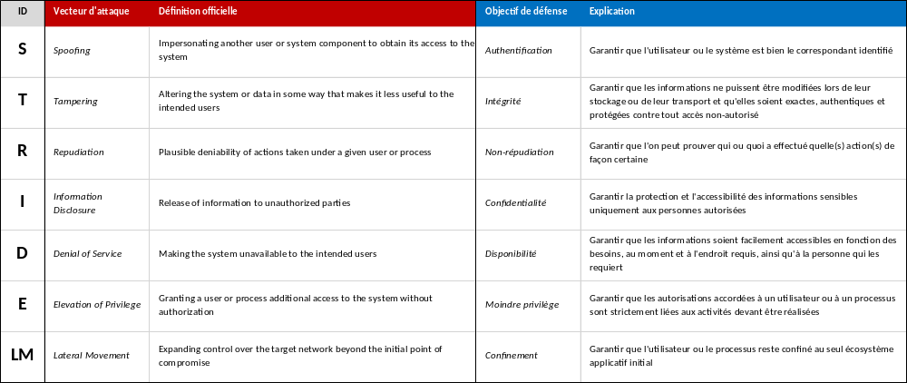
(Solution X) - TECHNICAL DESCRIPTION OF THE SOLUTIONS
Threat modeling - Report
  Threat modeling is a process by which potential threats, such as structural vulnerabilities or the absence of appropriate safeguards, can be identified, enumerated, and mitigations can be prioritized.
Remark: To be planned and validated before the CCT with SFES Cybersecurity team
Action:
Show the numbers of threads in the thread modelling, add the docinfo link to the TM document, and copy specific threads if relevant
Gate 2
Notes:
For a project based on a SaaS application :
add the link to the Cybersecurity and security assessment + Vendor assessment - Cyber vadis
Precise the level of Risk as it drives the policy testing for exit plan during build and run phase on a regular frequency

Slide 64
(Solution X) - TECHNICAL DESCRIPTION OF THE SOLUTIONS
Application architecture : SSDLC
Copy last version from SSDLC document
SSDLC documentation:
SSDLC On-Premise
SSDLC AWS
SSDLC SaaS
SSDLC Microsoft Azure
Action:
Show the progress on this slide.
Notes:
For a project based on a SaaS solution,
The project should check that the Vendor applies good pratice and these pratice are applied on the solution itself (cf risk vendor and security analysis on the supplier’s answer to the SaaS well architect )

Slide 65
Solution – Residual RISKs (For Gate 1 PoC and Gate 2/4)
Example :
Risk name | Impact (0..3) | Likehood (0..3) | Mitigation plan | Comments
Gen AI
Accessibility ? Lack of accessibility awareness ? (Gate 2 & 3) |  |  |  | Applicable if there is visible interface for user (Gate Architecture One Pager)
Lack of training
Data
Notes:
#Risks
Risk of the current solution, not on the demand (to be managed in DigitalMe)
Examples : lack of training ; high latency ; …
Impact : 0 to 3 (from Negligible to Severe) ; likehood : 0 to 3 (from very unlikely to very likely)

Slide 66
Technical Check Committee after Design - Approvers & informed persons
Name | Role in the project | Resp. | Present | Approved
 | IT project manager | Organizer | Yes/No | -
 | IT Manager (Level 4 - Level 3) | Approver | Yes/No | Yes/No
 | Enterprise architect | Approver | Yes/No | Yes/No
 | Solution architect | Approver | Yes/No | Yes/No
 | Security architect | Approver | Yes/No | Yes/No
 | Data Privacy representative | Approver | Yes/No | Yes/No
 | Cybersecurity referent (CISO team) | Approver | Yes/No | Yes/No
 | Platform Architect ( Cloud, API, …..referents) add all relevant architects | Approver | Yes/No | Yes/No
 | Solution delivery referent | Approver | Yes/No | Yes/No
 | Infrastructure referent (Network, Database, Middleware …..) add all relevant referents | Approver | Yes/No | Yes/No
 | Maintain software in production resp. | Approver | Yes/No | Yes/No
 | Contract Manager | Informed | - | -
 | OPS owner | Informed | - | -
 | DRP referent | Informed | - | -
 | API catalog referent | Informed | - | -
 | Data platform referent
sibs-cct@stellantis.com | Infrastructure & Architecture team mailbox (add it in the meeting) | Informed | - | -
To add Saas Manager – informed
Click here to see Architects & Subject Matter Experts managers

Slide 67
Summary of the Solutions
CRITERIA | SOLUTION 1 | SOLUTION 2 | SOLUTION 3
Functional coverage
Non-Functional Requirements implementation
Technical expertise
Implementation complexity
Performance and reliability
Project costs (business and IT)
Investments: Hardware cost (servers, …) Cost of software licenses
Schedule
Cloud (cloud solution is mandatory)
Recommended solution
For each cell of the table, place a smiley of suitable color
Remark:
Selection criteria are proposed; they can be fulfilled or withdrawn.

Slide 68
Technical Check Committee initial - Approval
Organization
Formal meeting / document workflow
global decision
Approved solution
Comments
Number and description of the approved solution.
If the comments are numerous, add a link to an external document (comments / important exchanges, questions / answers collected during the gate).
Remark:
The Technical check Committee Gate is mandatory before presenting the project to the DOPCO
Any dispense (ex: small evolution with no impact on architecture) must be validated by the architect team.
Notes:
The Technical Initial Gate is mandatory before presenting the project to the CIO
Any dispense (ex: small evolution with no impact on architecture) must be validated by the CTO team (francoise.sportiche@stellantis.com)

Slide 69
Technical Check Committee initial - Actions requested by approvers
Code and description of the action | Responsible | Other actors | Due date

Slide 70
Technical Check Committee initial - Approvers & informed persons
Name | Role in the project | Resp. | Present | Approved
 | IT project manager | Organizer | Yes/No | -
 | IT Manager (Level 4 - Level 3) | Approver | Yes/No | Yes/No
 | Enterprise architect | Approver | Yes/No | Yes/No
 | Solution architect | Approver | Yes/No | Yes/No
 | Security architect | Approver | Yes/No | Yes/No
 | Data Privacy representative | Approver | Yes/No | Yes/No
 | Cybersecurity referent (CISO team) | Approver | Yes/No | Yes/No
 | Platform Architect ( Cloud, API, …..referents) add all relevant architects | Approver | Yes/No | Yes/No
 | Solution delivery referent | Approver | Yes/No | Yes/No
 | Infrastructure referent (Network, Database, Middleware …..) add all relevant referents | Approver | Yes/No | Yes/No
 | Maintain software in production resp. | Approver | Yes/No | Yes/No
 | Contract Manager | Informed | - | -
 | OPS owner | Informed | - | -
 | DRP referent | Informed | - | -
 | API catalog referent | Informed | - | -
 | Data platform referent
sibs-cct@stellantis.com | Infrastructure & Architecture team mailbox (add it in the meeting) | Informed | - | -
Click here to see Architects & Subject Matter Experts managers

Slide 71
Reference & examples
(no to fill in your presentation)

Slide 72
Subject Matter Experts
Topic | Global
Cloud Platform | Dany SALMAN
API | Jean-Olivier AZELIE
DevSecops | Aymeric PIERRE
Information Security | Florent CANONNE
Data | Jean-Olivier AZELIE
Infrastructure | Olivier DOIT
RUN | Olivier DOIT
GEN AI | Ilef BEN FARHAT
Data Privacy | Touria BOIXEL Sunday ADENUGA
FinOps | Arnaud MICHELIN / Olivier BERNARD
DATA Platform | Christophe SERWINSKI
SOX Champion | Pascal LAPORTE
Contract manager | Pascal DUPUIS
OPS Leader | For new application : Alexandre BAC | OKRETAFO | Isabelle SALVANEIX
 |  | OKDEMARK | Johan HERNANDEZ
 |  | OKRETABO | Arnaud LIPKA
 |  | OKCECORP | Anouar ALAMAI
 |  | OKCOMRAF | Anouar ALAMI
 |  | OKJVINSU | Karim AKSIL
Cloud Architecture | Nicolas HARTMANN
Security Architecture | Mathieu BRAJEUL & Gunjan SEHGAL
Accessibility | Lucie Laure NGOUNOU KANGOUE
Saas Management | Marc ORTOLO

Slide 73
Functional & Technical flow mapping guidleine
Functional & Technical flow mapping:
  SIBS_CCT_template-flow-mapping
Functional flow pattern:
GATE2
Technical flow pattern:
GATE3&4
Remark:
The Functional & Technical flow mapping are mandatory and must be updated continuously (G2, G3 & G4).
These documents are initialized for the End of study G2, completed for the End of design G3 and validated during the Go-Live transition G4.
These documents will be centralized under DocInfo and not exclusive to applications.
Notes:
For a SaaS solution :
please refer to the inventory (SaaS_exit plan _framework, helper) . The exit plan document shoud fully update for an exit plan with the mediation features attached to the flow for instance.
Please if any privatelink is required, explain the business and technical features implying that private link: Any private link shall be justified and required a validation on TCC. (as it is a « SaaS » anti pattern for flexibbility and mobility.
Present the solution , governance and the shared model responsabilities between the evolved stakeholders (ICT agreement…)

Slide 74



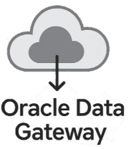



Architecture OVERVIEW DIAGRAM – Gate 1 review / Gate 1 PoC
EXAMPLE
As-Is Overview Diagram
To-Be Overview Diagram
Indicate
location
Local Country
Azure
On-Prem
Local Country
On-Prem
Extract C3** Data
DBs
Automate manual
tasks
Extract C3** Data
DBS
IT User
Indicate logical flows
Report Data
IT User
C3**
1. Contract & Customer Identification Data
2. Financial Exposure & Risk Indicators
3. Operational & Validation Dates
4. Vehicle & Product Details
5. Dealer & Commercial Network Information
6. Compliance information
Report Data
Publish Data
Indicate
technology
Publish Data
Consume Data
Consume Data
Indicate
Data sets involved
Indicate
User
Attention Points
Business User
Business User
Notes:
#Architecture Overview Diagram – A reflection of information in Slide 9 as a diagram to understand the solution easily.

Slide 75

[PROJECT NAME] - Timeline for Data project
Macro Schedule (including key milestones):​​​
 |  | YYYY
Category​​ | Activity​​ | M1 | M2 | M3 | M4 | M5 | M6 | M7 | M8 | M9 | M10
Start​​ | Kick off​​ and detailed analysis phase | ​​ | ​ | ​ | ​ | ​ | ​ | ​ | ​
Develop.​ | Data extraction and transfer​ | ​​ | ​ | ​ | ​ | ​ | ​ | ​ | ​
 | Ingestion & Preparation | ​​ | ​ | ​ | ​ | ​ | ​ | ​ | ​
Test​​ | UAT ​​ | ​​ | ​ | ​ | ​ | ​ | ​ | ​ | ​
Deploy​​ | Deploy and Post Go-Live​​ | ​​ | ​ | ​ | ​ | ​ | ​ | ​ | ​
Activity approval
Sample files with defined strucure
File structure defined
Dependency
Kick-off
Development
Agile activity
UAT
Deploy / Ms
Go-Live
Notes:
Macro Schedule (including key milestones): graphical representation of the high-level planning of the initiative. Add specific data milestone.

