Slide 1

Tools of
Lara Samuelson

Slide 2
Introduction
DataSpace helps customers worldwide turn their raw data into valuable insights to help them make better business decisions. We get involved in all data lifecycle stages, from data acquisition right through to data maintenance!

Slide 3
Primary goals
Managing the supply of electricity.

Slide 4
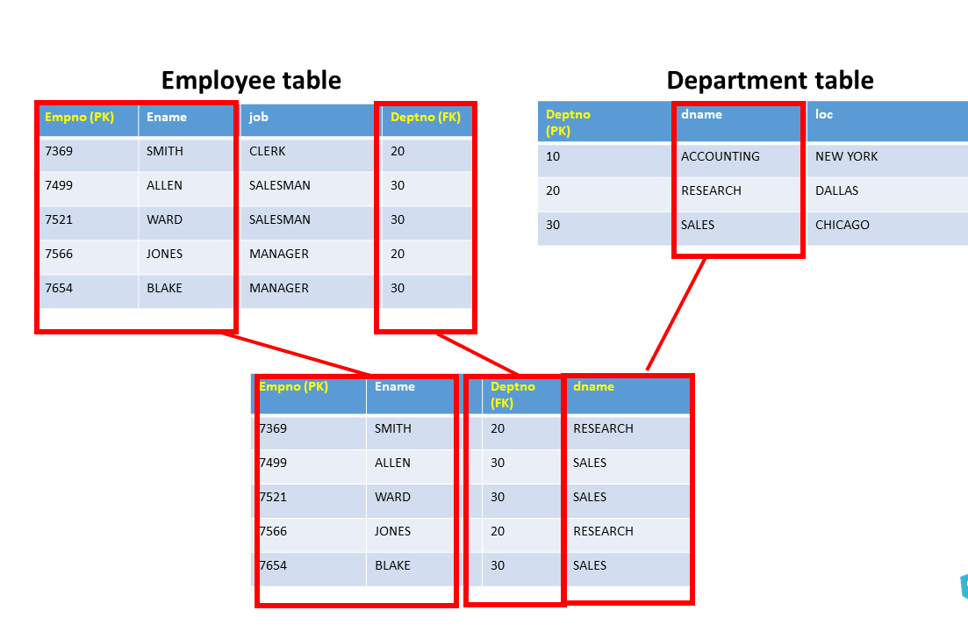
SQL and Databases
What is SQL for?
What are Databases for?
Data Storage and Management
Data Integrity
Concurrent Access
Backup
Integration
Data Retrieval and Filtering
Data Aggregation
Data Joining
Data Modification
SQL is…
Versatile, Efficient and Standardized
Notes:
Databases: are structured and efficient, easy retrieval and manipulation.
Databases often include mechanisms for enforcing data integrity and consistency, such as constraints, validations, and relationships, to ensure the accuracy and reliability of stored data.
Databases are designed to handle multiple concurrent users and applications accessing and modifying data simultaneously without causing data corruption or loss.
Databases often include backup, reducing the risk of data
Databases facilitate integration with other software systems and applications, enabling data exchange
SQL (Structured Query Language) is a language used for managing and manipulating relational databases with operations like querying, updating, and managing data.
: Suitable for both simple and complex data analysis tasks.
: A widely adopted and standardized language for relational databases.

Slide 5
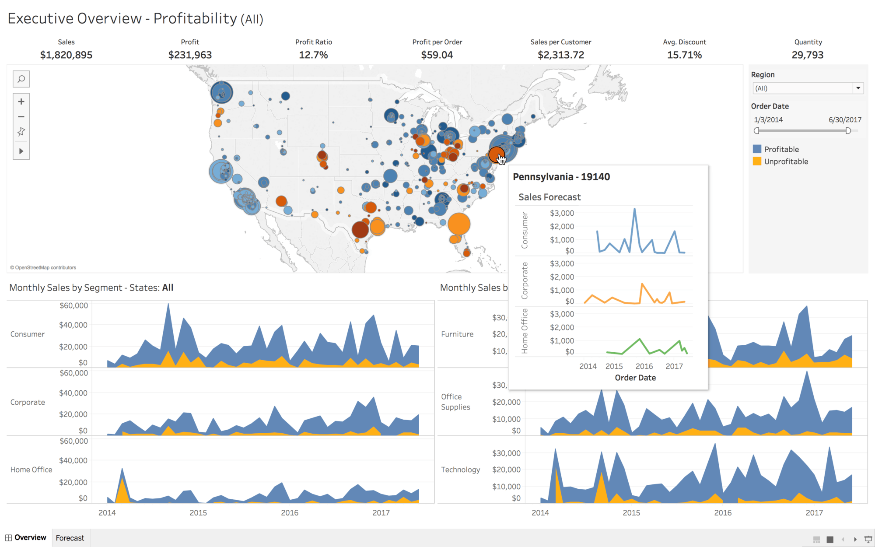
Tableau
What is Tableau For?
Data Visualization
Data Exploration
Real-time Analytics
Storytelling with Data
Collaboration and Sharing
It is no wonder why it’s a favorite with Business Professionals, Data Analysts, and Data Scientists.
Notes:
What is Tableau : Tableau is a powerful data visualization and business intelligence tool that allows users to connect, visualize, and share insights from their data in a seamless and interactive way
*Create interactive, shareable dashboards and reports.
*Analyze and visualize data in real-time.
*Communicate insights effectively through compelling visual narratives.
*Online sharing capabilities allow access to data on the go.

Slide 6
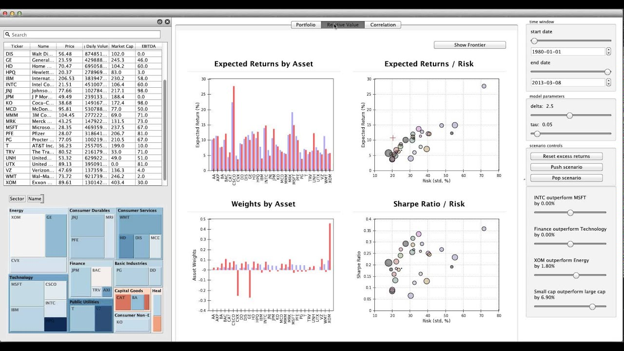
Python
What is Python for?
Data Cleaning and Preprocessing
Data Visualization
Statistical Analysis
Big Data Processing
It is used by Data and Business Analysts as well as Researchers.
Notes:
Python is a quickly becoming the most popular programming language for data analytics but is diverse enough to be used in several fields.
*it can be used to automate data cleaning saving valuable time.
*Python has libraries like Matplotlib, Seaborn, and Plotly that allow you to create a wide range of data visualizations, including charts, graphs, and interactive plots. Which is essential for gaining insights from data and presenting findings effectively.
*Python offers libraries like SciPy and StatsModels for statistical analysis. You can perform hypothesis testing, regression analysis, and other statistical tasks to understand data and make data-driven decisions.
*Python is used in big data processing frameworks This allows data analysts to work with large datasets and perform distributed data processing.

Slide 7
Data Lifecycle
Create
Gathering raw data from various sources. Importing data into a storage or processing environment.
Store
Cleaning, transforming, and storing the data.
Use
Extracting insights and patterns from the data. Presenting findings through charts, graphs, etc.
Data no longer needed on a regular basis can be stored on slower less expensive storage media
Archive
Delete
For example, with data is over 10 years old.
1
2
3
4
5
Notes:
1. Once this process is established via database or other data source it should be updated regularly
2 during the storing process the data is cleaned and transformed either manually or through automation like in python
3 the third phase is where we spend most of our time with the data preforming queries to help up analyze and present the data
4 the 4th and 5th stages are where we maintain the data eventually deleting it when required.

Slide 8
Importance of spreadsheets
Valuable Resources
Limitations
Collection
Processing
Analysis
Visualization
Sharing
It's important to note that while spreadsheets are useful for many aspects of the data lifecycle, they have limitations. They may not be suitable for handling very large datasets, complex analyses, or advanced data visualizations.
Notes:
Initial data may be manually entered into spreadsheets.
Formulas and functions used for cleaning and transformation.
Pivot tables, charts, and other features aid in data analysis
Graphs and tables created for easy interpretation.
Spreadsheets shared for collaboration and insights sharing

Slide 9
How else we can help
Acquire
Scalability-Handling larger datasets and growing data needs.
Communicate
Advanced Analytics-Predictive modeling, machine learning, etc.
Sharing Results-Automated Reporting and Dynamic Dashboards.
Maintain
Data Retention Policies-manage the lifecycle of data and ensures that data is kept only for as long as necessary while complying with legal and regulatory requirements.

Slide 10
Thank you
DataSpace offers a comprehensive solution that goes beyond the initial phases of the data lifecycle. By extending your project into these areas, you can leverage DataSpace to create a more holistic and powerful data analysis environment.

