Slide 1
F# for web development

Slide 2
Introduction to F#
Giraffe
Fable

Slide 3
Introduction to F#
1
What?
2
Origins?
3
Why?
4
Language features?

Slide 4
What is F#
Functional-first programming language
Interoperability with .NET
OCaml inspired
F# Software Foundation
Demo
Notes:
Demo:
Create a new console application:
PS C:\temp> dotnet new console -lang F# -n HelloWorld
Open in rider, explain Program.fs
Do a dotnet publish and open dll in dotpeek. Clue is that the compiled F# needs the Fsharp core dll to run.
Change Program.fs to
[<EntryPoint>] let main argv =
printfn "Hello %s from F#!“ argv.[0] 0 // return an integer exit code
Dotnet run “World”, then publish and check again in dotpeek. The fsharp code get’s compiled to IL that used FSharpCore.

Slide 5
Origins of F#
Initial release 2005
.NET as multilanguage platform
Iron ruby
Peach pie
OCaml port
Haskell for .NET
Notes:
The visional design of the .NET platform was very much expected to be a multilanguage platform from the start.
The Haskell for dotnet ended up with too much dissonance between Haskell and dotnet.

Slide 6
Why use F#
Conciseness
Convenience
Correctness
Completeness

Slide 7
Why use F# - Conciseness
Less coding noise
Semicolons
Brackets
Return keyword
Type inference
Less lines to solve the same problem
Notes:
Compare WhyFSharp\Fsharp\Conciseness with C#

Slide 8
Why use F# - Correctness
Built-in immutability
Built-in `ToString`
Built-in structural equality
Built-in comparable
Notes:
Show WhyFSharp\Fsharp\Correctness and take a look with dotnet peek.

Slide 9
Why use F# - Completeness
.NET eco system
Interopt with other Clr languages
Not a pure functional language
Notes:
Eco system, nuget/editors/ docs by MS
Interopt -> at the end of the day it’s all IL
Not a pure functional language, mutability is possible

Slide 10
Language features
Tuples
Records
Discriminated Unions
Pattern Matching
Active Patterns
Notes:
LanguageFeatures_1.fsx
Active Pattern: divide all possible values for type into ranges

Slide 11
Language features
Partial Application
Piping (|>)
Composition (>>)
Type Aliases
Array/Seq/List

Slide 12
Language features
Option type
Result type
Railway Oriented Programming
Computation Expressions
Async
Notes:
Option and Result are baked into FSharpCore.
They give us ways to represent non existing data or handle errors gracefully.
Things like null and tryCatch are uncommon in functional programming.
We use the type system instead.
Rop.fs

Slide 13
Railway oriented programming
Alternative to “Happy path programming”
Construct a pipeline per use case
Bypass code when something goes wrong
Result type

Slide 14
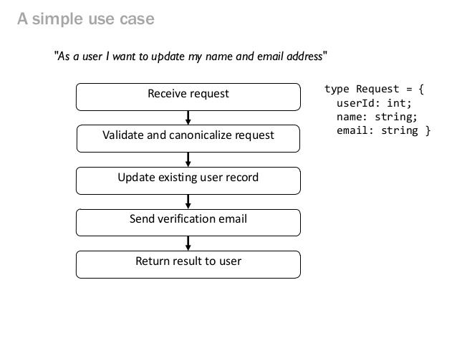
Railway oriented programming

Slide 15
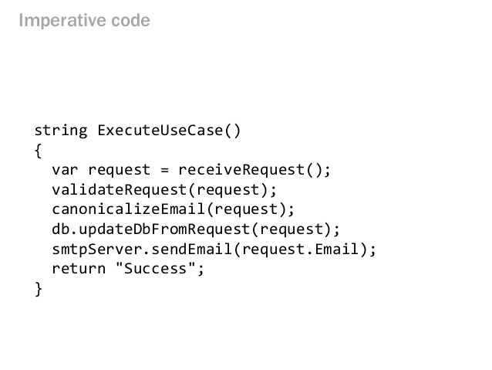
Railway oriented programming

Slide 16
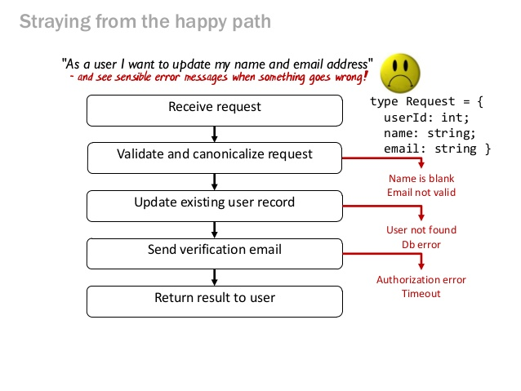
Railway oriented programming

Slide 17
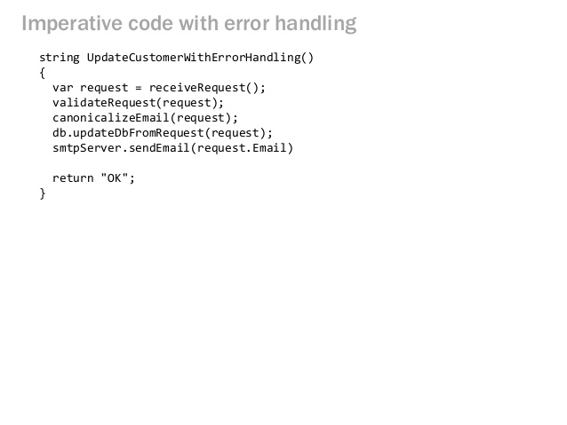
Railway oriented programming

Slide 18
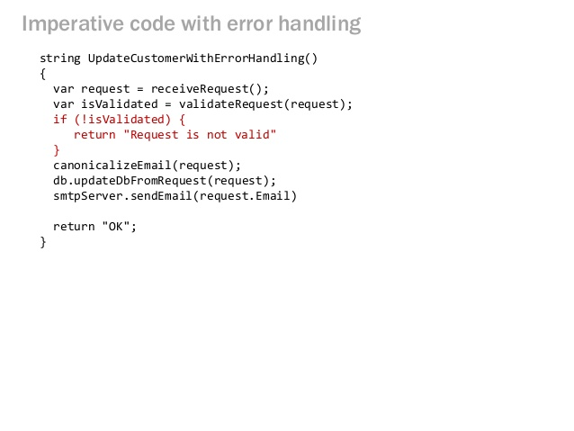
Railway oriented programming

Slide 19
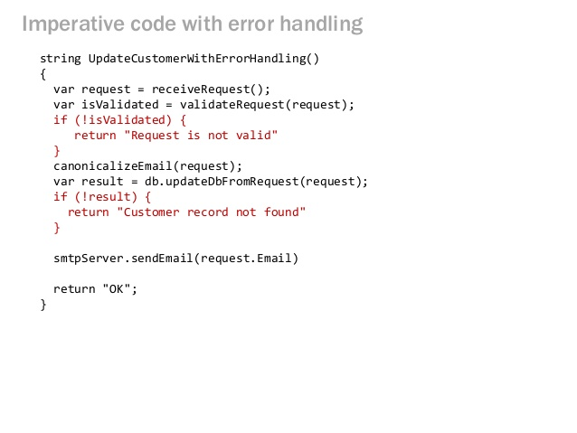
Railway oriented programming

Slide 20
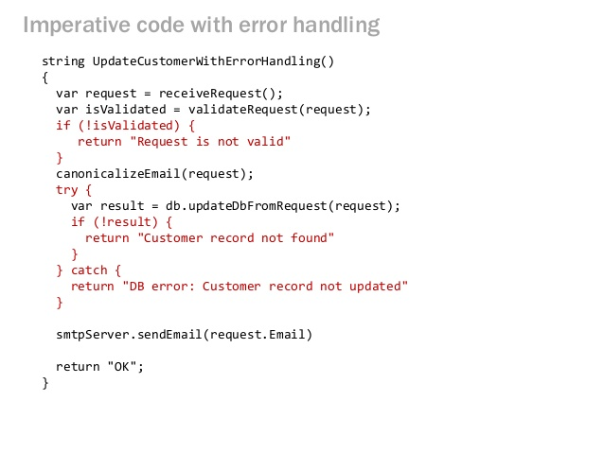
Railway oriented programming

Slide 21
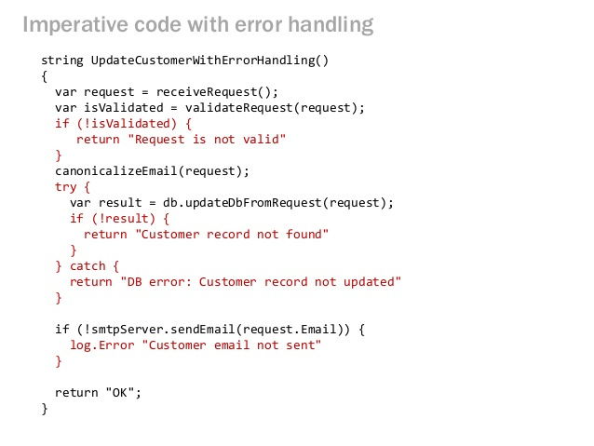
Railway oriented programming

Slide 22

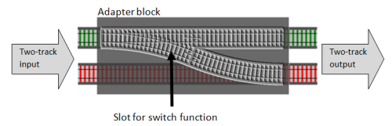
Railway oriented programming
Notes:
Open rop.fs

Slide 23
Computation Expressions
Workflows
Control flow, constructs and bindings
Monads
Use aliases from a Builder Type
Notes:
Extend the F# language with custom constructs. Similar to how Linq and await/async work in C#.

Slide 24
Async
Computation Expression
Asynchronous Workflows
Lazy ⬅➔ C# Task
Notes:
Similar to C# Task, F# Async represents an asynchronous continuation of an expression.

Slide 25
Giraffe
1
AspNetCore
2
Suave
3
Base constructs
4
Http handlers
5
Sample application

Slide 26
Giraffe – AspNetCore
Default template too OO
Giraffe = Functional counterpart
Micro framework on top

Slide 27
Giraffe – Suave
F# web development library
WebParts
Functional pipeline
Linux support before it was cool
Custom http stack

Slide 28
Giraffe - Base constructs
HttpHandler
HttpFuncResult
HttpFunc
Combinators
compose (>=>)
choose
Tasks

Slide 29
Giraffe
ASP.NET Core middleware
Giraffe middleware
HttpHandlers
Demo: just enough Giraffe

Slide 30
Giraffe - Http handlers
GET, POST, PUT, PATCH, DELETE
route(f)
subRoute
text, json, xml, htmlFile
renderHtml, razorView
model binding

Slide 31
Giraffe - Http handlers
compose (>=>)
choose

Slide 32
Giraffe - Sample application
Demo: Invoices app
Exercise: Github app

Slide 33
Fable
1
What?
2
How it works?
3
Elmish
4
Example app

Slide 34
Fable- What?
F# to AST
AST to Babel
Babel to ES5
.NET and F# Compatibility
Notes:
http://fable.io/

Slide 35
Fable- How it works?
Fable daemon in .NET Core
REPL

Slide 36
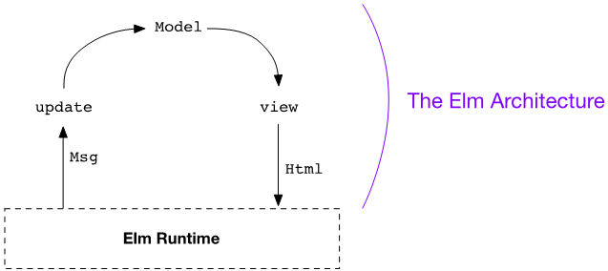
Fable - Elmish
Notes:
http://elm-lang.org/

Slide 37
Fable - Elmish
Demo!

Slide 38
Credits & links
https://fsharpforfunandprofit.com/
http://fsharp.org/
https://suave.io/
http://elm-lang.org/

