Slide 1


Somaya
Lara

Slide 2

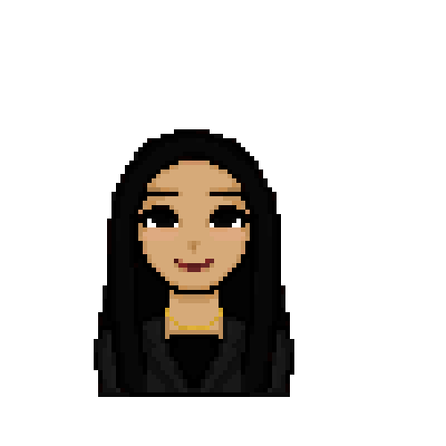
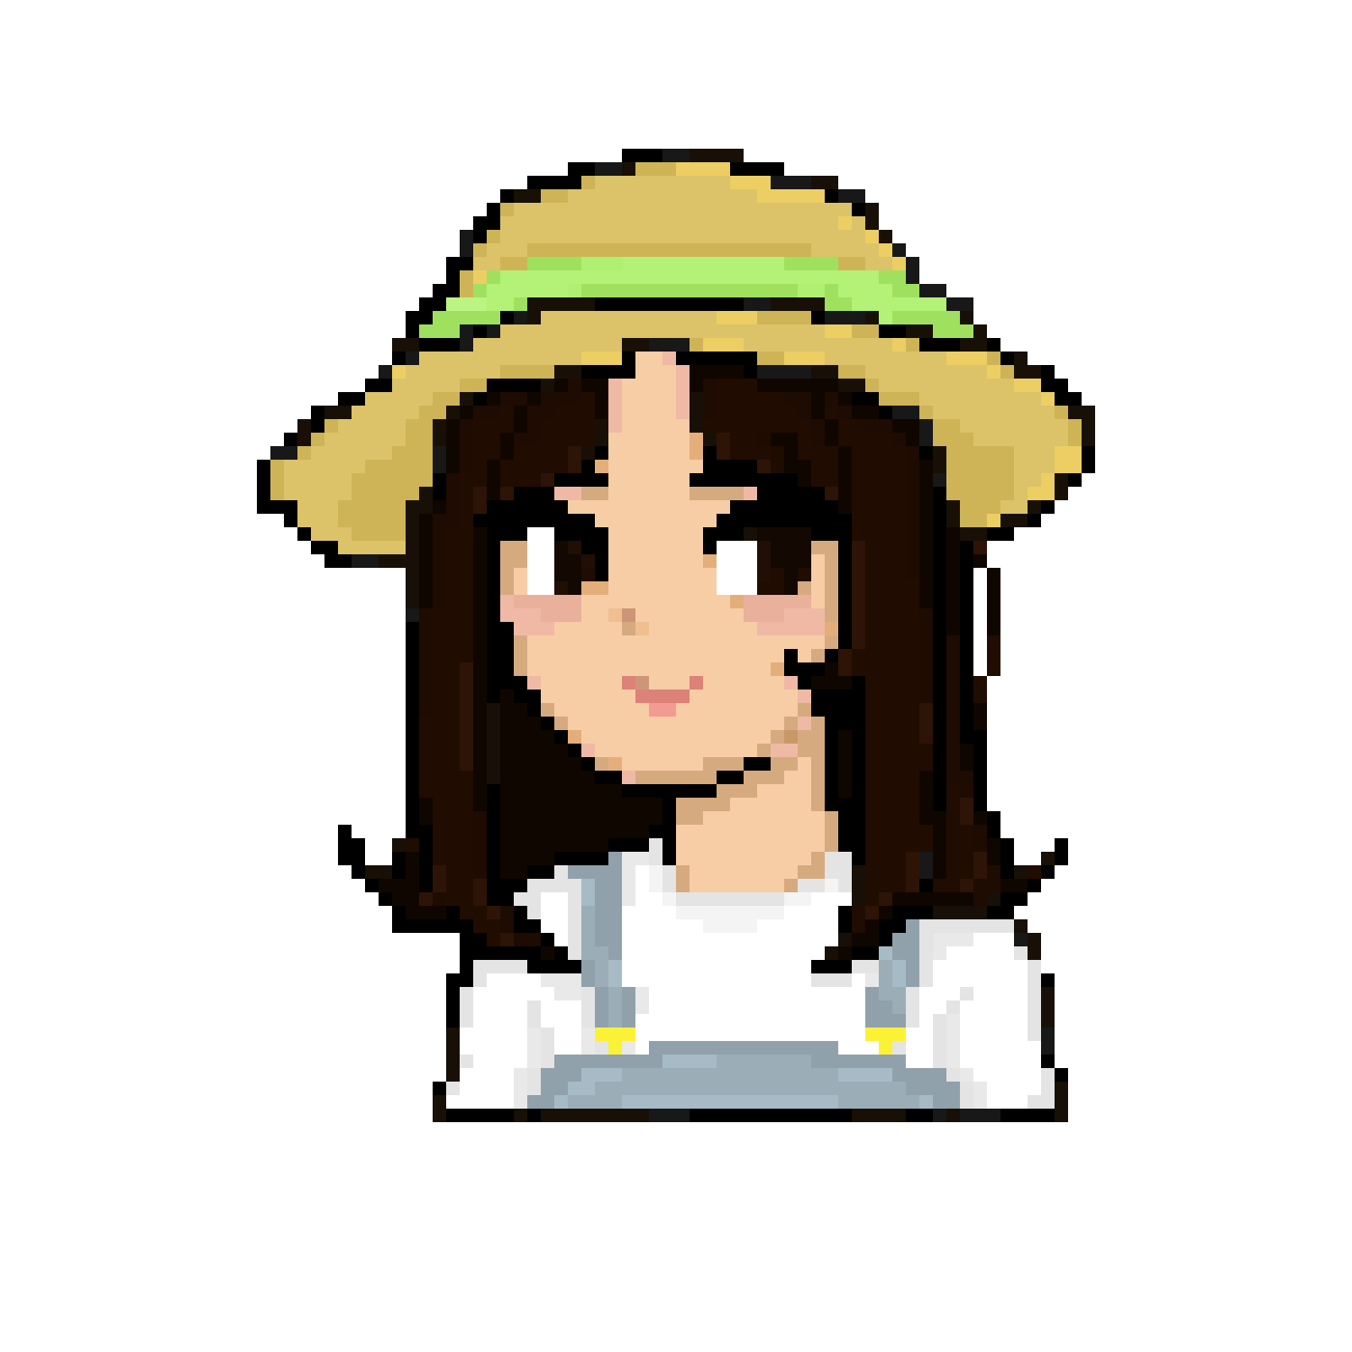
Game🌻
🌸Character Customization
🌸Crops harvesting
🌸Quests
🌸Riddles
🌸Explore
🌸Meet new people!

Slide 3
Information🌻
🌸Game is text based (for now)
🌸Language: Python
🌸Designed by Somaya & Lara
🌸Pixel Game

Slide 4
Characters
🌸Annie: Blacksmith ⚒️
🌸Mark: Fish shop owner 🎣
-----
🌸Others are still in the making

