Slide 1

http://flic.kr/p/6oP7x7
Version Control with Git

Slide 2
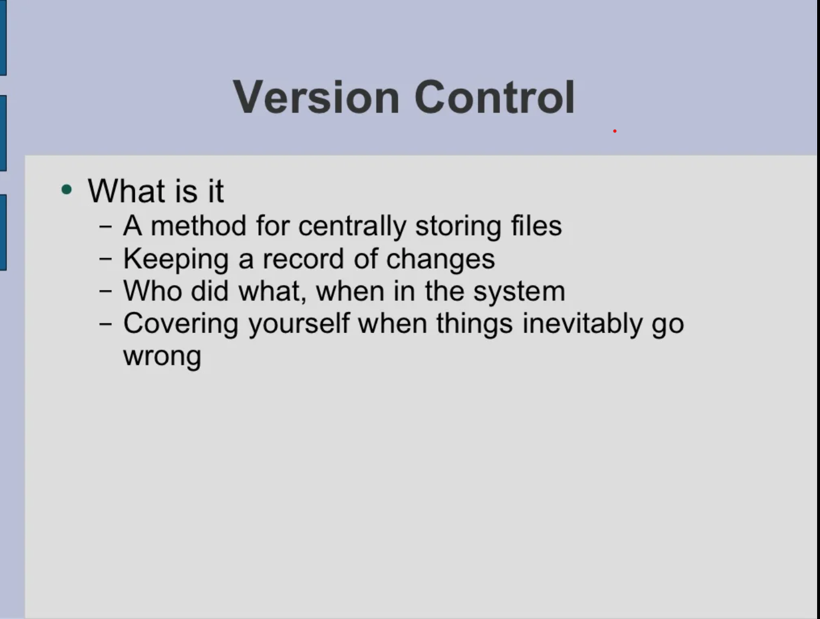

Slide 3
Version Control Why track/manage different versions of code?

Slide 4
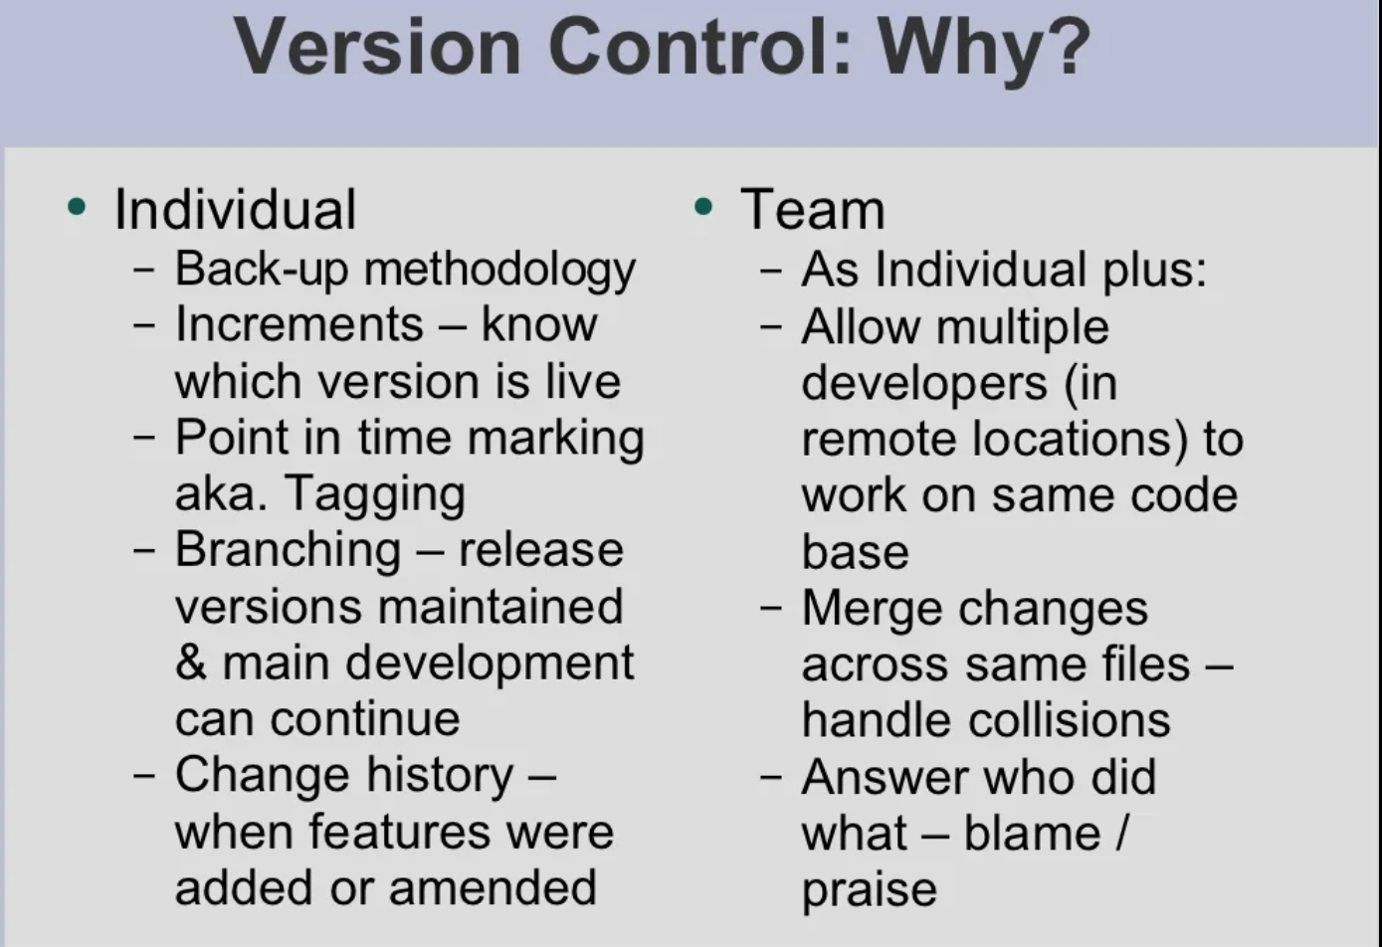

Slide 5
Version Control Why track/manage different versions of code?
Backup: Undo or refer to old stuff
Branch: Maintain old release while working on new
Collaborate: Work in parallel with teammates

Slide 6
Version Control Systems (VCSs)
Help you track/manage/distribute revisions
Standard in modern development
Examples:
Revision Control System (RCS)
Concurrent Versions System (CVS)
Subversion (SVN)
Git
older
newer
Our focus

Slide 7
Version Control Hosting Services
Enable sharing version control repos
Internet/Web based
Examples:
SourceForge
Bitbucket
GitLab
GitHub
Our focus

Slide 8

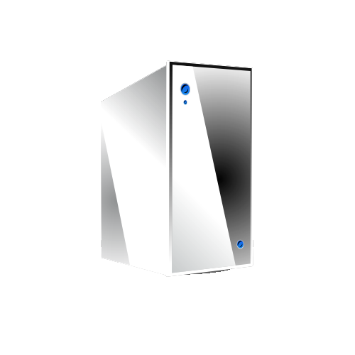
GitHub-User Perspective
You
GitHub

Slide 9
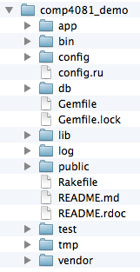
GitHub-User Perspective
You
GitHub
Working Dir

Slide 10
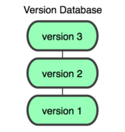
GitHub-User Perspective
You
GitHub
Working Dir
Local Repos

Slide 11
GitHub-User Perspective
You
GitHub
Working Dir
Local Repos
Remote Repos

Slide 12
Using GitHub to Collaborate
GitHub
Remote Repos

Slide 13
Questions to answer
How organized?
You
GitHub
Working Dir
Local Repos
Remote Repos
What operations?

Slide 14
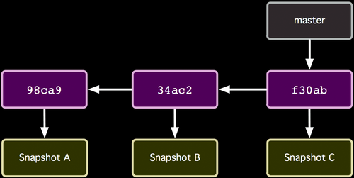
Repo Organization
http://git-scm.com/book/

Slide 15
Repo Organization
Commits (from oldest to newest; hashes as commit IDs)
http://git-scm.com/book/

Slide 16
Repo Organization
Snapshot of all files at each commit
http://git-scm.com/book/

Slide 17
Repo Organization
Branch (last commit)
http://git-scm.com/book/

Slide 18
Local repos also have...
HEAD
Current Version in Working Dir
http://git-scm.com/book/

Slide 19
Local Repo Operations
You
init
add/commit
log
switch/checkout
branch
merge
…
Working Dir
Local Repos

Slide 20
How commit works...
Before
HEAD
http://git-scm.com/book/

Slide 21
How commit works...
After
HEAD
http://git-scm.com/book/

Slide 22
Remote Repo Operations
You
GitHub
Working Dir
clone
push
pull
fetch
remote
...
Local Repos
Remote Repos

Slide 23

Summary
Version Control Systems
Git and GitHub
Repo Structure
Local/Remote Repo Operations
Commit Semantics
http://flic.kr/p/aCLor3

Slide 24
Download and install Git
Install Git on your machine from http://git-scm.com/downloads
Accept context menu items
Git access:
Right click from windows explorer
gitBash to enter commands

Slide 28
