Slide 1
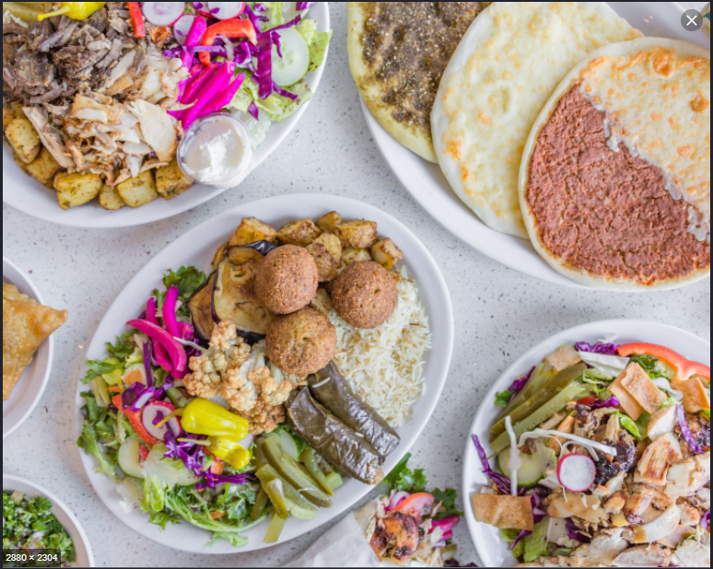
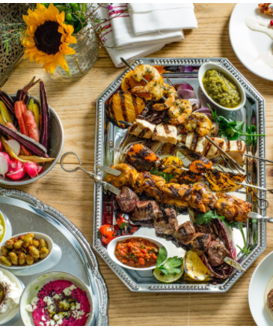
The Battle of Neighbourhoods: Opening a Middle Eastern Restaurant in Toronto, CA.
Lara Yaish – Aug.2020

Slide 2
Introduction - Description and Discussion of Background:
The objective of this project is to determine which neighbourhood in Toronto would be a good option for opening a Middle Eastern restaurant.
Being a multicultural city, Toronto provides countless opportunities for business owners to open such a business. A Middle Eastern restaurant would bring about Palestinians, Jordanians, Lebanese, Syrians as well as many others who enjoy the unique flavors of Middle Eastern food such as hummus, falafel, tabbouleh, manakeesh, shish tawooq, kofta, etc.
Opening a restaurant in the city of Toronto requires finding a neighbourhood that is densely populated and is positioned around numerous venues. These factors would help attract as many people as possible, for grabbing a bite or sitting down for lunch or dinner.

Slide 3
Introduction – Data Overview
The data utilized in this study include:
A list of Toronto’s boroughs, neighbourhoods, and postal codes on Wikipedia under: https://en.wikipedia.org/wiki/List_of_postal_codes_of_Canada:_M.
A list of geographical location data, including postal codes as well as latitude and longitude coordinates, found under: https://cocl.us/Geospatial_data.
A list of venue data, including the most common venues of a given neighbourhood in Toronto, via Foursquare API. These venues include restaurants, gyms, parks, etc.

Slide 4
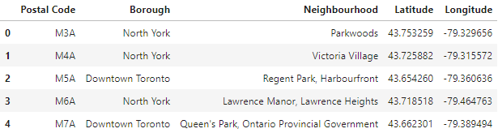
Methodology – Data Pre-processing:
The list of Toronto’s boroughs, neighbourhoods, and postal codes was scrapped from the Wikipedia page using BeautifulSoup library. The html table was converted into a pandas data frame and, then, cleaned:
The list of geographical location data was read into a pandas data frame using the read_csv() method.
The two data frames were merged, based on the postal codes.

Slide 5
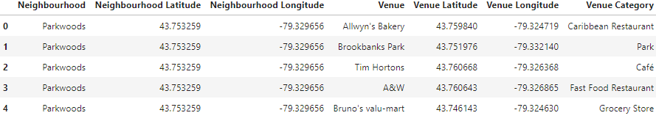
Methodology – Data Pre-processing:
The number of venues within an assigned radius from each neighbourhood center was retrieved using Foursquare API. The maximum number of venues and the radius were set to be 500 venues and 1000 meters, respectively.
A new data frame, containing neighbourhood and venue data, was created.

Slide 6
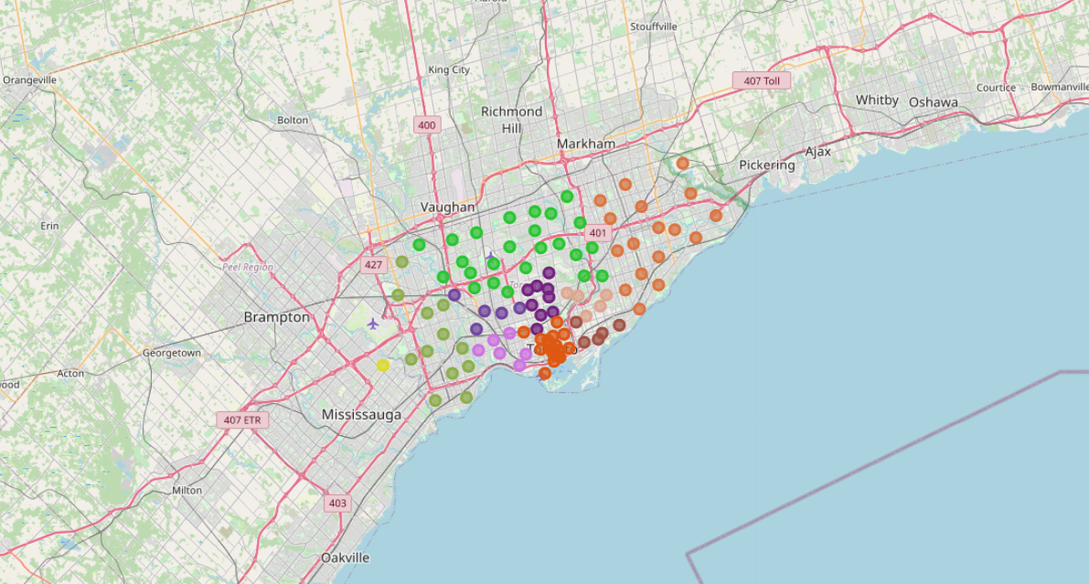
Methodology – Data Exploration and Analysis:
The neighbourhoods in the different boroughs of Toronto were visualized using folium library. Each borough was represented by a different color:

Slide 7
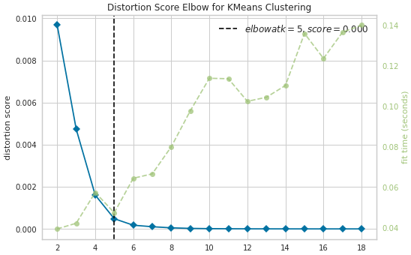
Methodology – Data Exploration and Analysis:
The categorical values, representing the venues, were transformed into numerical values using the one-hot encoding technique. Then, the average of the frequency of each venue category that exist in each neighbourhood was calculated.
A new data frame that stores only the mean frequency of the “Middle Eastern Restaurant” category in each neighbourhood was created.
Before the data was clustered, the optimum value of K was found using the elbow-point technique.

Slide 8
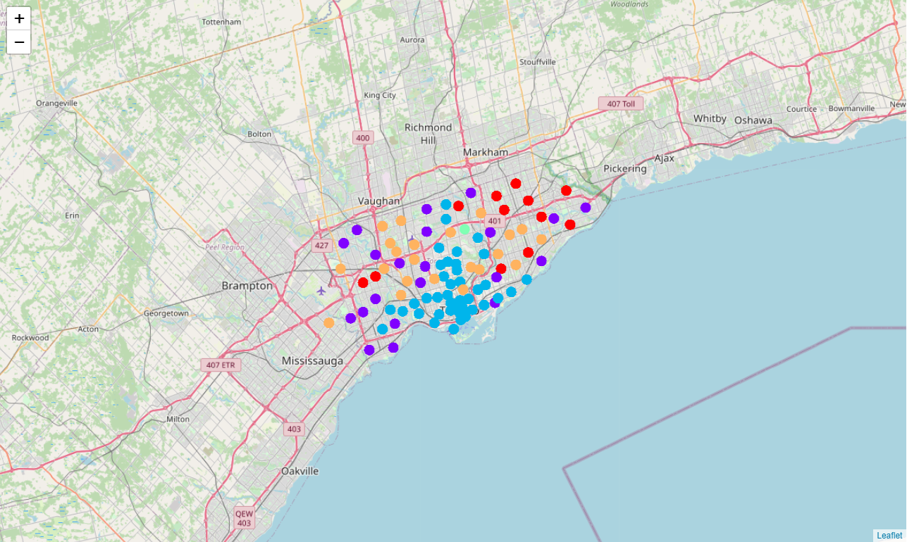
Methodology – Data Exploration and Analysis:
The data was clustered into 5 distinct groups, based on the average of the frequency of venues in each neighbourhood. A new data frame was created to contain the venue data as well as the cluster labels for each neighbourhood.
The 5 different clusters were visualized on a map using folium library.

Slide 9
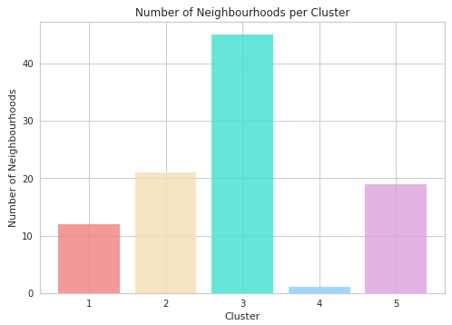
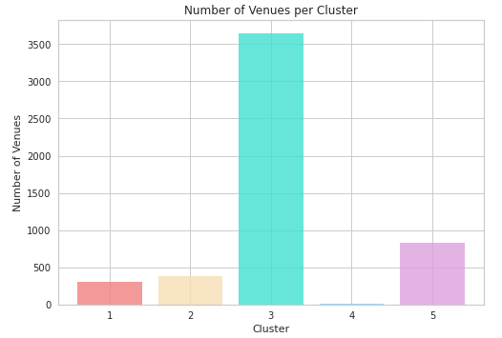
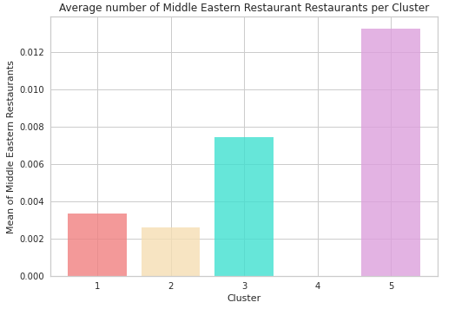
Results:
The number of neighbourhoods in clusters 1, 2, 3, 4, and 5 are 12, 21, 45, 1, and 19, respectively. The number of venues in clusters 1, 2, 3, 4, and 5 are 300, 386, 3644, 4, and 831, respectively. The average number of Middle Eastern restaurants in clusters 1, 2, 3, 4, and 5 are 0.0033, 0.0026, 0.0074, 0.0, and 0.013, respectively.

Slide 10
Discussion:
The number of Middle Eastern restaurants in Toronto is considerably low; thus, decreasing the level of competition. Still, the optimal option would be a place in one of the neighbourhoods that fall under cluster 3. These areas had the highest number of venues and, at the same time, only the second highest number of Middle Eastern restaurants around. This means that opening the desired restaurant in such neighbourhoods would attract large numbers of people and have little to no competition at all – in terms of similar cuisine.
Neighbourhoods under clusters 1, 2, and 4 were not considered as a good option as the number of venues in these areas is extremely low. A new restaurant in one of these neighbourhoods would mostly attract people living nearby only.
Neighbourhoods under cluster 5 had a substantially smaller amount of venues when compared to those under cluster 3. Also, Middle Eastern restaurants made up the highest average of such cuisine compared to the rest of the clusters. Thus, this option was eliminated as well.
In a nutshell, neighborhoods under cluster 3 provide an optimum location for opening a Middle Eastern restaurant in Toronto. Of course, considering other details, such as rental or ownership prices of venues and/or demographic data of people, would improve the accuracy of this study and result in a more precise recommendation.

Slide 11
Conclusion:
All in all, large multicultural cities are attractive places for people to start their own business. In this study, the best neighbourhood in Toronto for opening a Middle Eastern restaurant was determined. This was done by using numerous Python libraries in order to fetch, analyze, and visualize the data. These included pandas, BeautifulSoup, seaborn, matplotlib, scikit-learn, and folium. Also, Foursquare API was utilized to explore the settings in the neighbourhoods of Toronto.
Determining the best place to open this restaurant was based on the average number of surrounding venues for each neighbourhood. The optimal neighbourhoods were ones having very little competition and a very high number of surrounding venues (i.e.: having a dense population).

