Slide 1


BUT Informatique Semester 1 Titouan BRIERRE TD2, TP3 10th September 2021

Slide 2
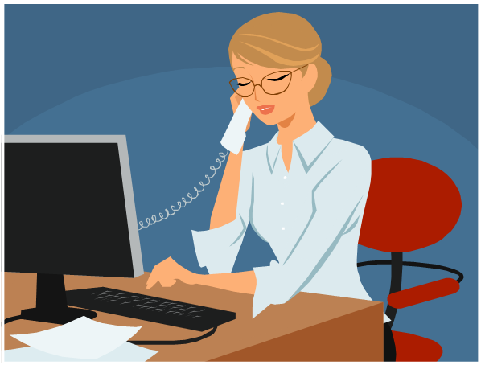
How did people do before this app ?

Slide 3
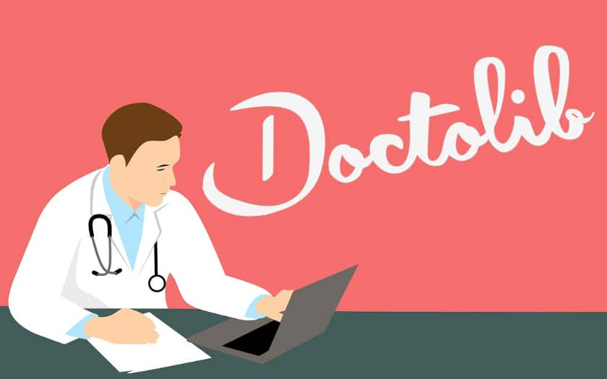
What is the app and what is it used for ?

Slide 4
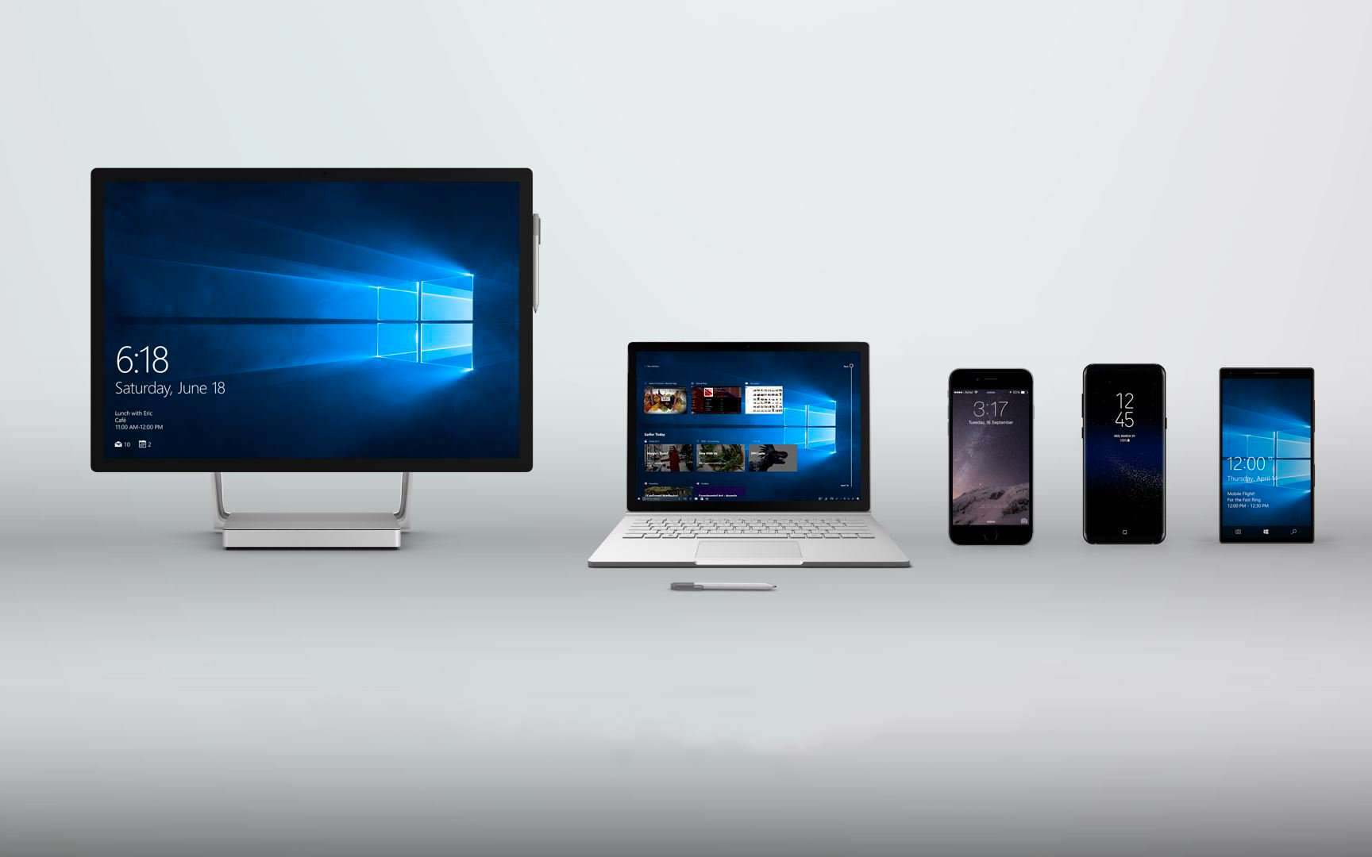
Why is it important ?

