Slide 1
Generate CSV File for Employee Eligibility.
Beautiful Logo Goes Here
Carlos Kassab
This project focuses on automating the generation of a file containing employee eligibility data in CSV format extracted from an XML source file.

Slide 2
Actual needs.
Automating the process.
Implementation Roadmap.
Questions And Answers.
Agenda
A CSV file ready to be imported on external systems.
After the automatic process is created, we need to plan the implementation process.
We are going to create a process to read an XML file and using and XSLT file, the CSV file needed will be created using an xsslt processor.

Slide 3
Actual Needs
Why to convert files from XML to CSV format.
Converting XML files to CSV format is necessary to make data more accessible and easier to work with in spreadsheet applications like Excel or applications that require data in CSV format to import for data analysis, as CSV files are easier to open and be manipulated, making the conversion from XML to CSV a needed solution.

Slide 4
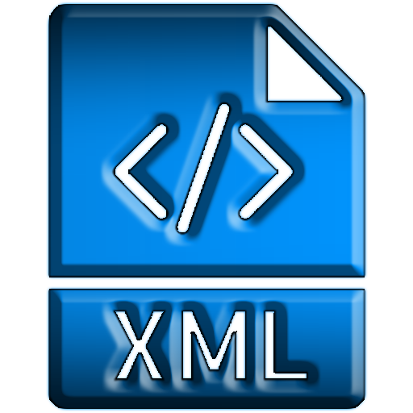

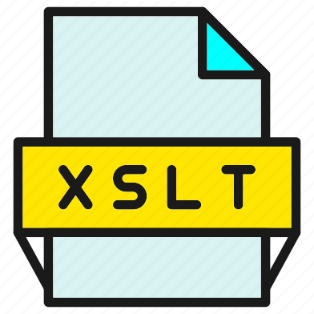
Process Automation
XSLT
Processor
* As part of the automatic process, the output file can be sent by email after conversion to CSV format.

Slide 5
Implementation Roadmap
Create the final functional specification for CSV file generation, including potential XML data format changes and required conditions.
Test the CSV file creation using the XSLTPROCESSOR as many times as possible, here we will need at least 10 different XML files to test the output.
Review the process is working as expected with end users, if there is any additional requirement, like send the CSV file by email, we will need to consider a customization.
Based on the final functional specification provided, create the XSLT file to generate the CSV file.
Once the CSV output is working as defined, the process must be installed on a server and scheduled to be executed as per users need.

Slide 6
THANK YOU!!!
May/2025
Beautiful Logo Goes Here

