Slide 1
Hadamard Codes
Diogo Correia 90327
Lara Rodrigues 93427
Departamento de Eletrónica, Telecomunicações e Telemática
Universidade de Aveiro

Slide 2
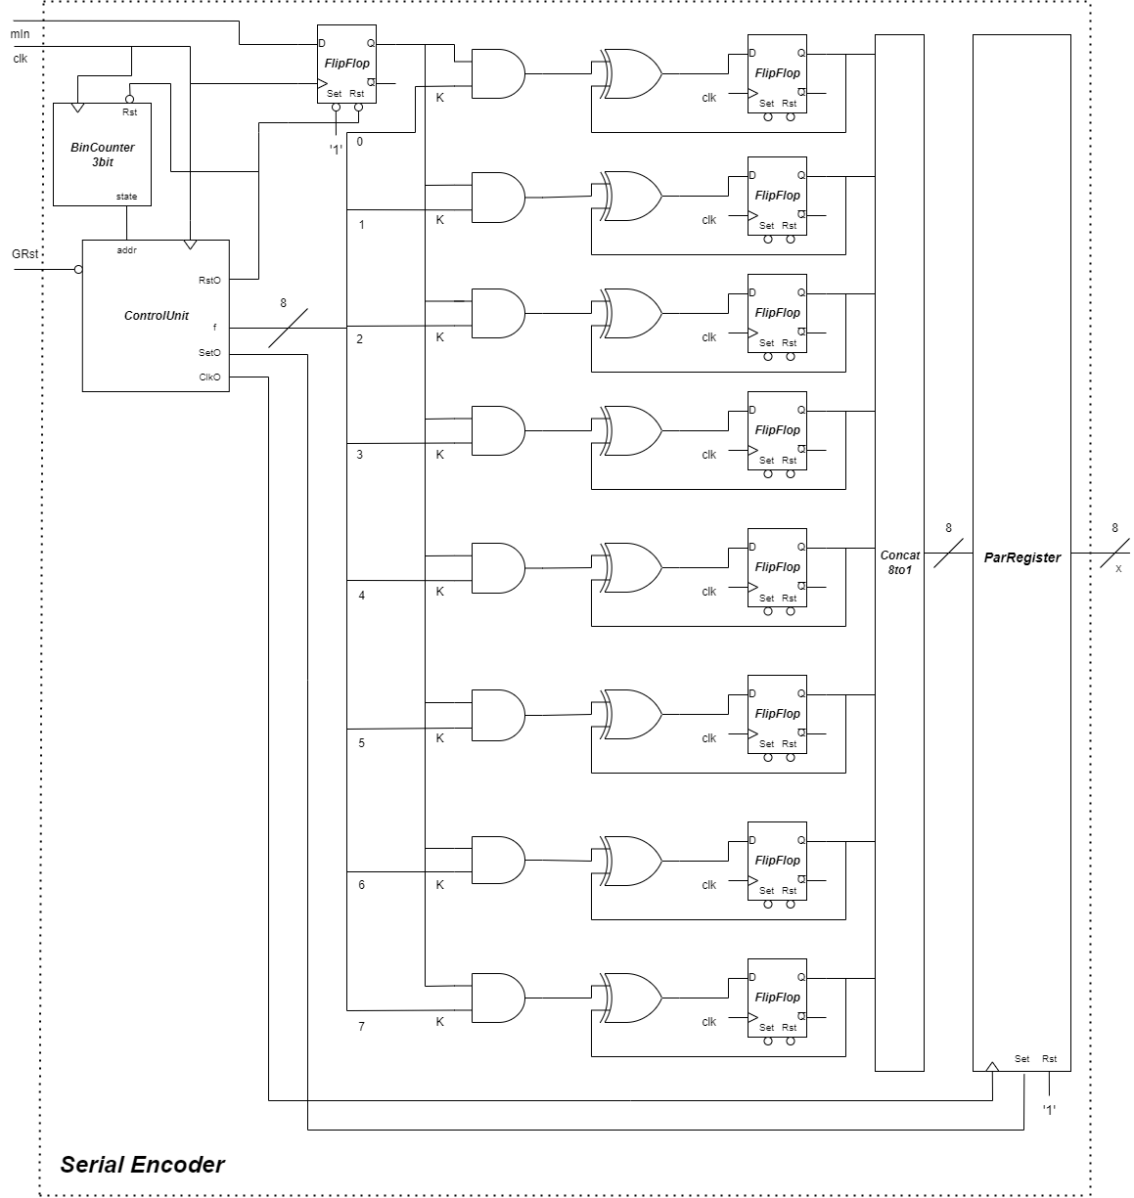
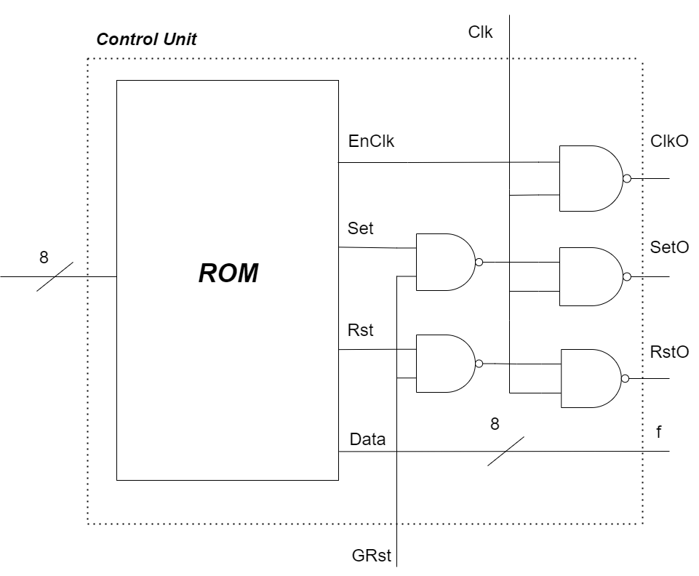
Encoder
Serial

Slide 3
Encoder
Serial
Logic Gates
8 AND Gates
8 XOR Gates
Components
1 Binary Counter
1 Control Unit
9 FlipFlop
1 Concatenator 8 to 1
1 Parity Register

Slide 4
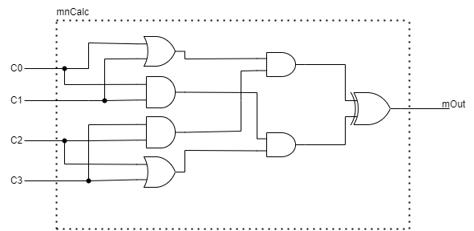
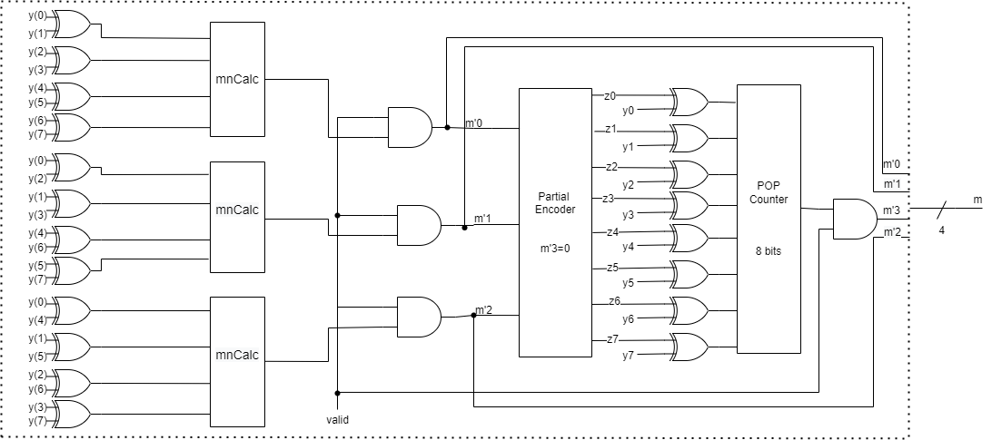
Decoder
Parallel

Slide 5
Decoder
Parallel
Logic Gates
25 XOR Gates
4 AND Gates
16 NOT Gates
1 OR Gate
Worst Case Propagation Delay
Components
6 m_{n} Calculator
1 Partial Encoder
2 Concatenator
1 Pop Counter
12 XOR + 3 AND

Slide 6
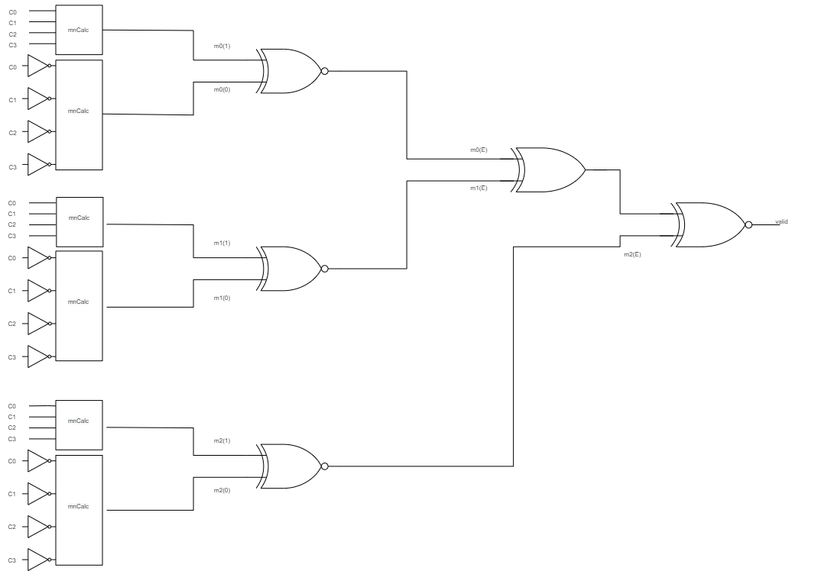
Error
Detection

