Slide 1
STATISTICAL ANALYSIS ON FACTORS INFLUENCING LIFE EXPECTANCY
Ahmad Mustapha Wali (407)
Lara Tomeh (407)
Alexandru-Ștefan Ghiță (407)

Slide 2
ABOUT THE DATASET
The Global Health Observatory (GHO) data repository under World Health Organization (WHO) keeps track of the health status as well as many other related factors for all countries. The datasets are made available to the public for the purpose of health data analysis. The dataset related to life expectancy, health factors for 193 countries has been collected from the same WHO data repository website and its corresponding economic data was collected from United Nation website.

Slide 3
Among all categories of health-related factors only those critical factors were chosen which are more representative. It has been observed that in the past 15 years , there has been a huge development in health sector resulting in improvement of human mortality rates especially in the developing nations in comparison to the past 30 years. Therefore, in this project we have considered data from year 2000-2015 for 193 countries for further analysis.

Slide 4
INSPIRATION
The data-set aims to answer the following key questions:
1. Does various predicting factors which has been chosen initially really affect the Life expectancy?
2. What are the predicting variables actually affecting the life expectancy?
3. Should a country having a lower life expectancy value(<65) increase its healthcare expenditure in order to improve its average lifespan?
4. How does Infant and Adult mortality rates affect life expectancy?

Slide 5
5. Does Life Expectancy has positive or negative correlation with eating habits, lifestyle, exercise, smoking, drinking alcohol etc.
6. What is the impact of schooling on the lifespan of humans?
7. Does Life Expectancy have positive or negative relationship with drinking alcohol?
8. Do densely populated countries tend to have lower life expectancy?
9. What is the impact of Immunization coverage on life Expectancy?
These questions will be answered in the concluding section at the end of the document.

Slide 6
DATASET COLUMNS
Country, Year, Status, Life expectancy, Adult mortality, Infant deaths, Alcohol, Percentage expenditure, Hepatitis B, Measles, BMI, Under five deaths, Polio, Total expenditure, Diphtheria, HIV/AIDS, GDP, Population, Thinness_10-19_years, Thinness_5-9_years, Income composition of resources, Schooling.

Slide 7
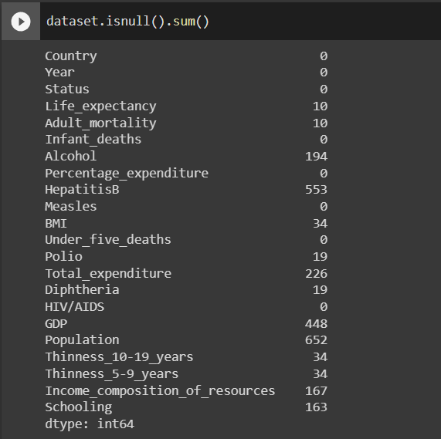
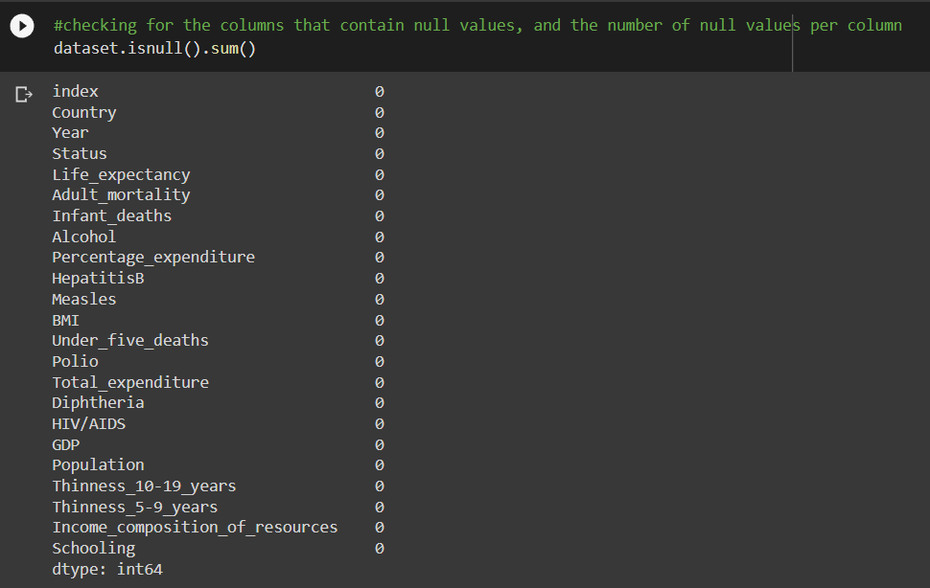
FILLING NULL VALUES
The dataset had some null values, which we tried filling in using linear interpolation, which did not work. An alternative method of filling in with the median values was used afterwards.

Slide 8
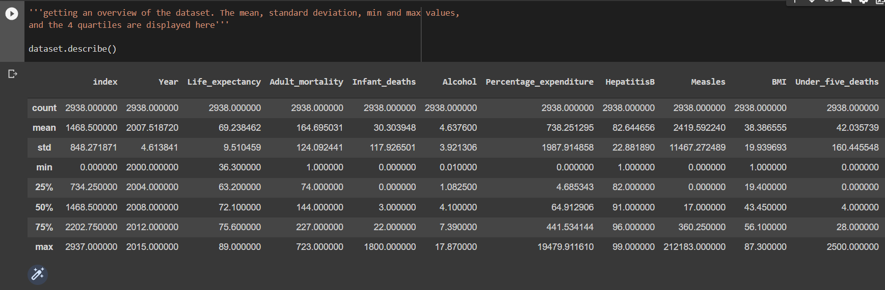
CHECKING FOR AND FIXING OUTLIERS
A brief inspection of the dataset description shows the presence of many outliers. An adult can not die at the age of 1 (min Adult_mortality = 1), and a country can not spend 19479.911610% of its income on health, etc. Various methods of checking and correcting outliers exist. For this project, we used boxplots for easy visual detection of the outliers, and winsorization to correct them. Both methods provide and easy and computationally-light-weight way of dealing with outliers.

Slide 9
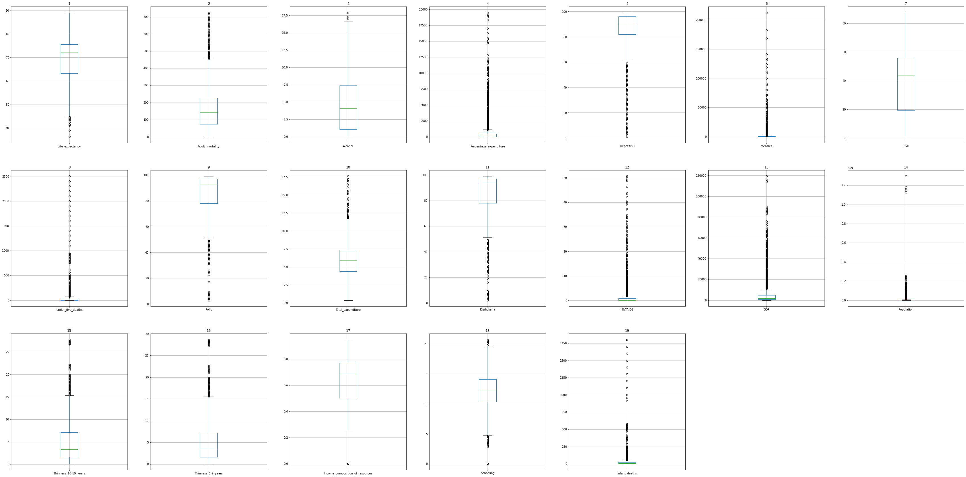
CHECKING FOR AND FIXING OUTLIERS (contd.)

Slide 10
CHECKING FOR AND FIXING OUTLIERS (contd.)
There seems to be many outliers and irregularities with the dataset.
i)'Infant_deaths', 'Measles', and 'Under_five_deaths', which are all per 1000 population (thus shouldn't be above 1000) all have values above 1000. To deal with this, we drop all values not less than 1000 since they are probably a mistake, and there is no way we can know their actual values.
ii) 'Percentage_expenditure' and 'GDP', are unreasonably high. Also 'Population' has been affected by the few countries having a very high population of more than 1 billion (China and India) to create too many outliers. To deal with this category, we take the log of these columns.
iii) For the rest of the columns with outliers, we winsorize them by changing their quartile limits.

Slide 11
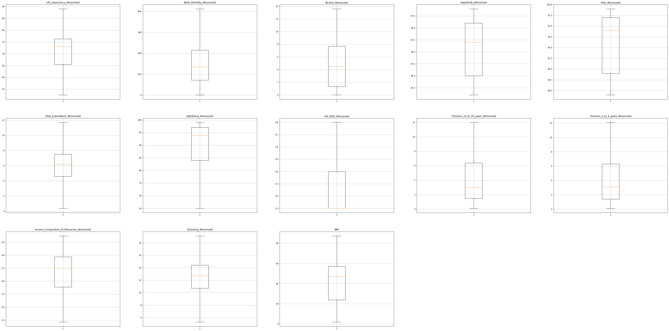
CHECKING FOR AND FIXING OUTLIERS (contd.)

Slide 12
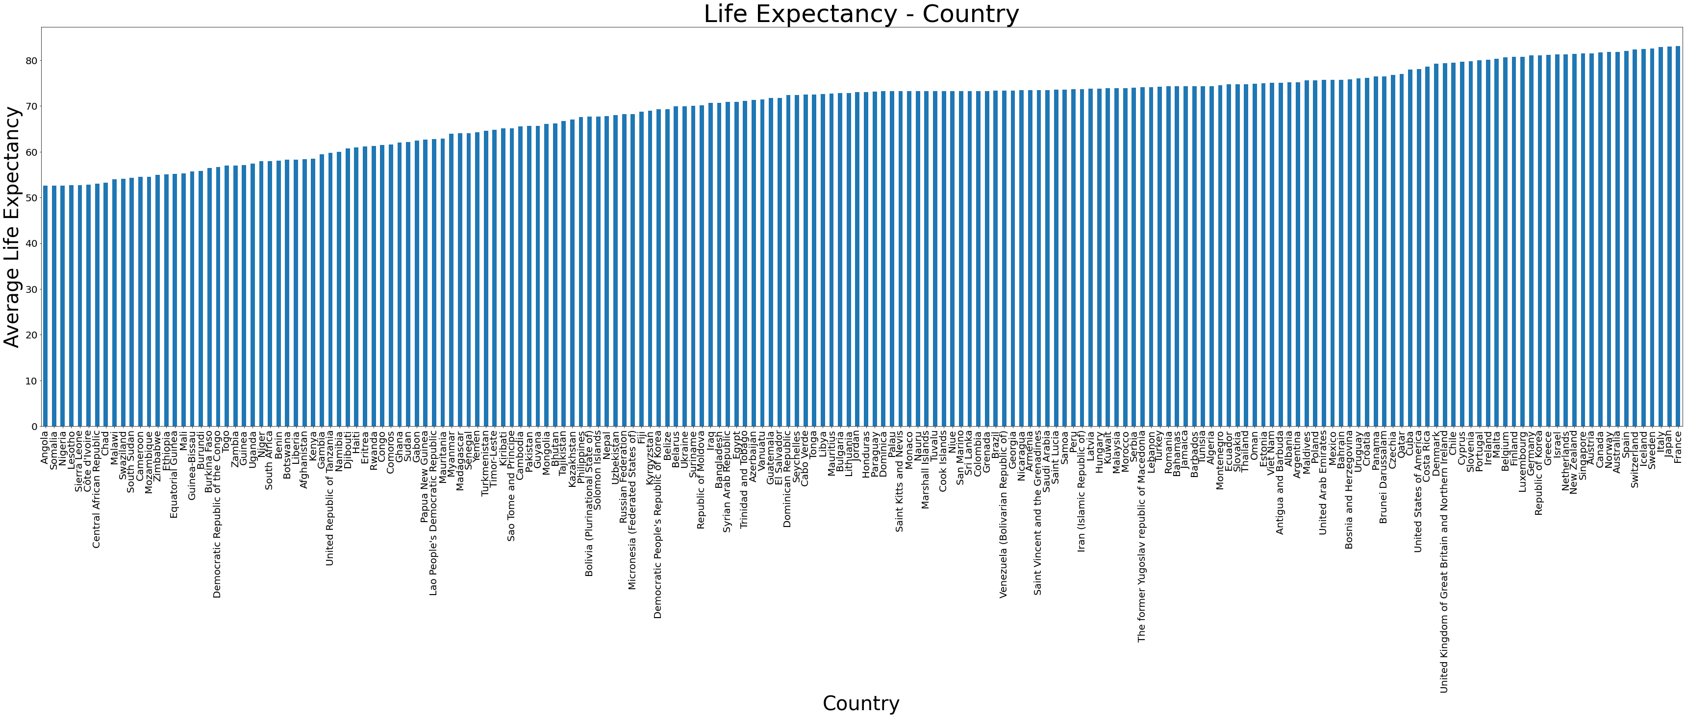
DATA ANALYSIS

Slide 13
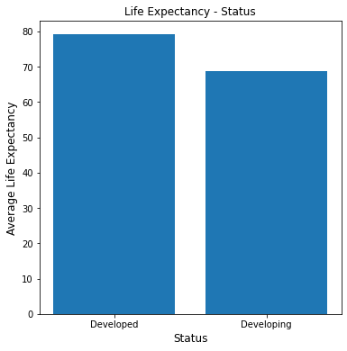
DATA ANALYSIS (contd.)
Residents in developed countries have, on average, 10 years higher life expectancy than those in developing countries on average (70 years). As can also be observed in the figure above, the country with the lowest life expectancy is Angola, a developing country; while the one with the one with the highest is France, a developed country. On closer observation, most of the countries below the 50th percentile are developing countries, and most of those above the 50th percentile are developed nations.

Slide 14
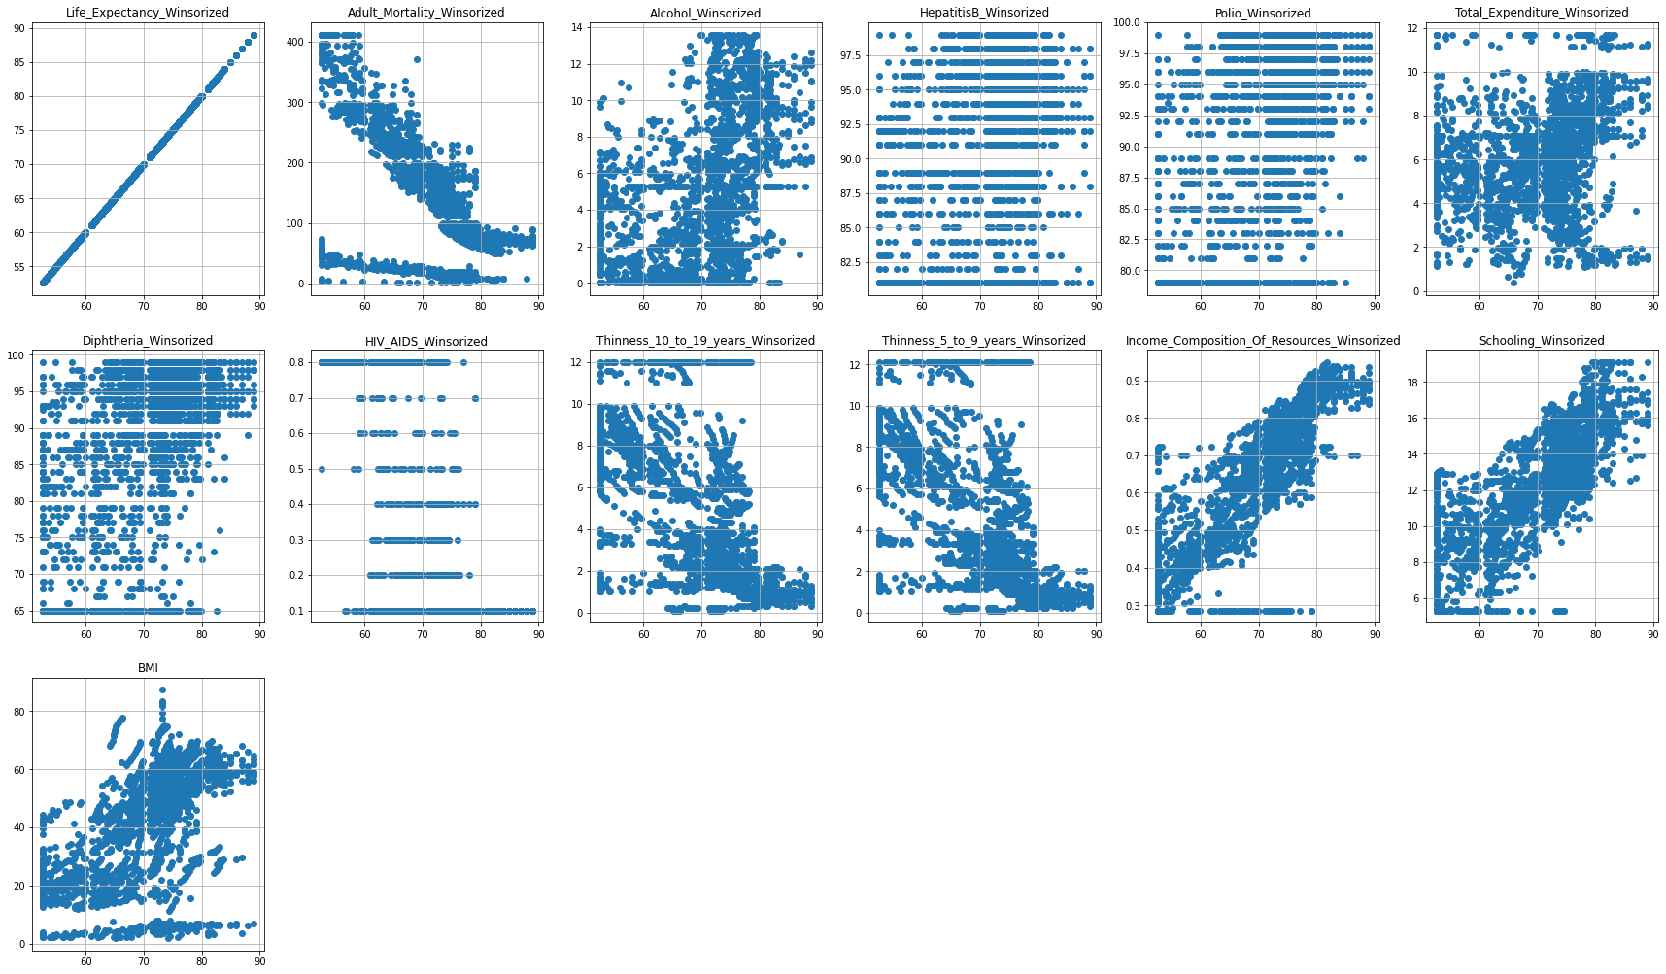
DATA ANALYSIS (contd.)

Slide 15
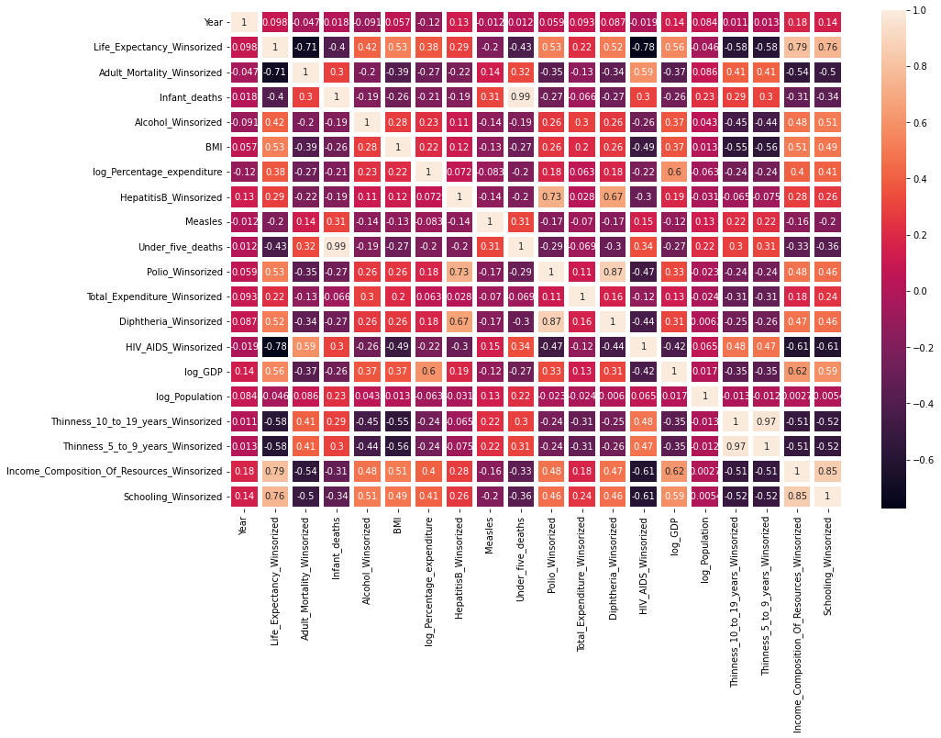
DATA ANALYSIS (contd.)
The 2 cells above indicate the correlations between a predictor and the other predictors. In the case of life expectancy, we can see that it has strong positive correlation with Income_Composition_Of_resources and Schooling. To a lesser extent, it is also affected positively by Polio, and Diphtheria. This is because polio and diphtheria immunization greatly reduces the chances of children dying from those ailments. It turns out that public healthcare expenditure is not the most important predictor determining life expectancy (weakly positively correlated by 0.22).
Life expectancy is also observed to be strongly negatively correlated with Adult_mortality, HIV/AIDS, Thinness_10-19_Years, and Thinness_5-9_Years.

Slide 16
REGRESSION MODEL COMPARISON
MODEL |  | LinearRegression() | SVR() | RandomForestRegressor() | Ridge()
PERFORMANCE METRIC | Mean Absolute Error | 2.5116 | 1.4744 | 1.1088 | 2.5123
 | Mean Squared Error | 11.6888 | 5.8072 | 3.3494 | 11.6894
 | Root Mean Squared Error | 3.4189 | 2.4098 | 1.8301 | 3.4190
 | Explained Variance Score | 0.8347 | 0.9546 | 0.9934 | 0.8347

Slide 17
CONCLUSION
1. As seen from the correlation matrix, some of the predicting factors which were initially do not really affect life expectancy. Factors like government expenditure on healthcare, population and infant measles rates have a little effect on life expectancy in a country.
2. Life expectancy is greatly affected positively by a country's HDI and the average number of years of schooling among its citizens. Life expectancy is also, to a lesser extent, positively affected by a country's GDP, immunization rate against polio and diphtheria, and the average BMI of its residence. Countries' life expectancy is strongly negatively affected by the rates of adults dying in the country (which is quite obvious) and by the number of people who die from HIV under the age of 5. Other strong, but less relevant, negatively-correlated factors include prevalence of thinness among 5-9 year-olds and 10-19-year-olds.

Slide 18
3. As observed, a country's public healthcare spending is weakly correlated to its residents' life expectancy (0.22). The country should spend its funds on more relevant factors instead.
4. Adult mortality greatly affects life expectancy negatively (-0.7), while infant mortality affects it relatively less significantly (-0.4).
5. Lifestyle choices like eating habits and exercise (which ultimately affect the BMI) have a fairly strong positive correlation with life expectancy (0.53). Alcohol consumption, as well, is fairly positively correlated with life expectancy (0.43). A possible explanation for alcohol consumption might be due to the fact that people consuming more alcohol usually have a more income.

Slide 19
6. Schooling, as seen in the matrix, is the second most important predictor in the dataset (0.76). Countries that invest more in their education will most likely increase their life expectations.
7. Population has very little significance with regards to life expectancy (0.046).

