Slide 1

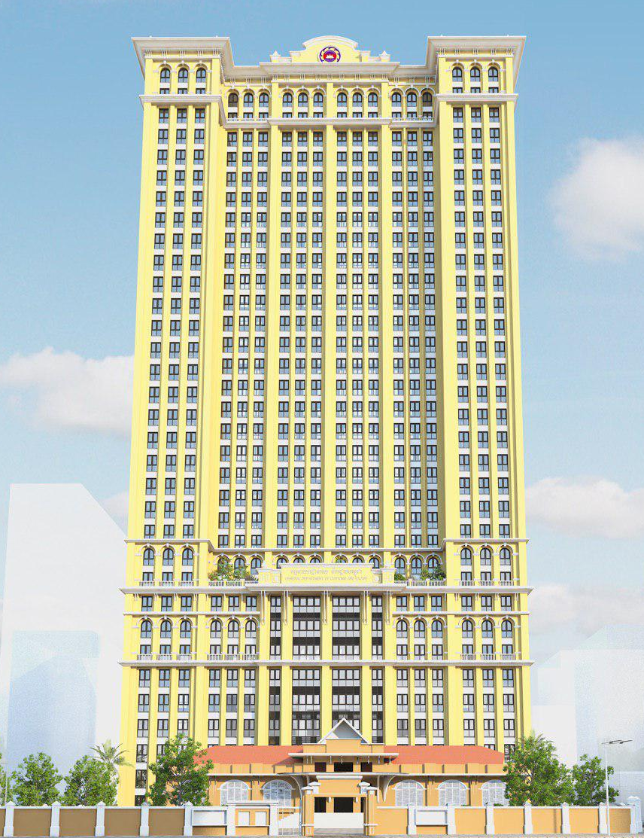
General Department of Customs and Excise
GDCE-CAMBODIA FOOTWEAR
ASSOCIATION
Technical Assistant
on
Post Clearance Audit-PCA
By SEM Meng
Deputy Director of Customs Audit Department
17 January 2020
The Gateway, Phnom Penh, Cambodia

Slide 2
Contents
II. Objectives of PCA
III. Legal Support
I. Introduction
IV. Right of Auditor and Auditee
V. Flow of PCA

Slide 3


1. Introduction
Background
WTO member in 2004 and the commitment to implement Article VII of GATT Valuation in 1st January 2011.
The implementation of Trade Facilitation through Risk Management Policy in 2006.
The balancing between Trade Facilitation Policy and Law Enforcement implementation.
The Best Traders Incentive Mechanism-BTIM and Authorize Economic Operator-AEO Policy.

Slide 4
2. Objectives of PCA
A-Definition:
Post Clearance Audit by Customs and Excise Department is an audit, investigation, inspection or control carried out in a systematic manner by competent Customs officers to verify the accuracy and authenticity of Customs declarations through the examination of the relevant documents, books, records, and other business information systems that are kept in accordance with the provision of the Prakas on the Management of Documents, Books, Records and Other Information on Imports and Exports in the above reference by persons as described in Praka 6 of Prakas 388.
B- Auditee mean:
Importers, Exporters, Customs brokers, Operators of customs temporary storage facilities, Operators of customs bonded warehouses, and Transportation operators and other concerned parties including commercial Bank and similar such institution.

Slide 5
2. Objectives of PCA
C- Objective:
To verify accuracy and authenticity of Customs declarations (SAD) made by an Auditee in past;
To recommend necessary measures for correcting discrepancy in the SAD, including shortage of duties/taxes, to the Auditee and the relevant customs units; and
To encourage the Auditee to improve its degree of compliance with the customs laws and regulations.

Slide 6
2. Objectives of PCA
D- Type:
1- Type of Company:
  QIP Company
  Non-QIP Company
  Regular Importers and Exporters
  Others
2- Type of Audit:
  Desk Review Audit,
  Limit Scope Audit and
  Compliance Audit

Slide 7
3. Legal Support
  Law on Customs promulgated on 20th July 2007
    Article 15, 18, 24, 26, 51, 52, 57, 74, 75
  2. Supporting Regulations:
    MEF Prakas No. 388 on Post Clearance Audit by GDCE
    GDCE guidance No. 583 on Initial PCA Manual
    MEF Prakas No. 928 on Temporary Importation
    MEF Prakas No. 113 on Management of Documents Books Records and Other Information
    MEF Prakas No. 105 on Management of Goods that Exempt Duties and Taxes

Slide 8
3. Legal Support
  3. GMAC Requested for Wastage Used
  4. WTO Recommendation on Wastage
  5. GMAC Requested for Wastage Disposal
  6. GDCE Responded to GMAC

Slide 9
3. Legal Support
-Voluntary Declare
A person, importer/exporter or his agent may make a voluntary declaration to Customs of additional duties, taxes or other fees without penalties or fines if such a declaration is made to Customs within one year of the date of registration of the original customs declaration (See Point C of Article 18 of the Law on Customs).

Slide 10
3. Legal Support
-Appeal Against Re-determination
Appeal Procedures
Notice of Re-Determination by DG
Satisfaction
Dissatisfaction
1. Appeal to DG in Writing
(Within 30 days)
Decision by DG
(Within 60days)
Payment of Duties, Taxes and Penalty
Satisfaction
Dissatisfaction
2. Appeal to the CTC in Writing
Decision by the CTC
Satisfaction
Dissatisfaction
3. Appeal to a court
(Within 30 days)

Slide 11
A) Right of Auditor:
4. Right of Auditor and Auditee
Enter and perform a field audit at any time (normally 06:00 AM to 06:00 PM) at an auditee’s premises or places where documents, record or other information are kept.
Audit on imported and exported goods, business records, business systems and commercial data related to Customs.
Inquiry the auditee about unclear points on such documents, records, and other information and request the auditee to present more detailed documents such as accounting voucher.

Slide 12
A) Right of Auditor:
4. Right of Auditor and Auditee
Temporary keep/Rental auditee’s books and records (PCA Form 7).
Obtain information from Other Government Agency-OGA
Issue a Re-determination Notice.
Apply measures to deal with administrative offense in accordance with the provision of the law on Customs.
Initiate enforcement measures such as the sealing of place of business or space, if
  Auditor remain unable to enter the place or space that is suspected keeping books, records, and other documents and goods.
  There are indicated an act of crime has been committed

Slide 13
B) Right of Auditee:
4. Right of Auditor and Auditee
To request the PCA officers to show their ID cards and the Notification on auditing.
To refuse the auditing if the decision on auditing does not comply with the provisions of the law;
To lodge complaints and denunciations related to the breach of law by PCA officers during the course of an auditing;
To request explanations on the minutes of audit conclusions and on the proposal measures prepared by the PCA officers;
To object to the decision by writing to the Director General of Customs within 30 days from the date auditees receive the Notice of the re-determination, according to article 24 of the Law on Customs;
To request the customs to compensate for damages caused by any unlawful manner as the results of audit.

Slide 14
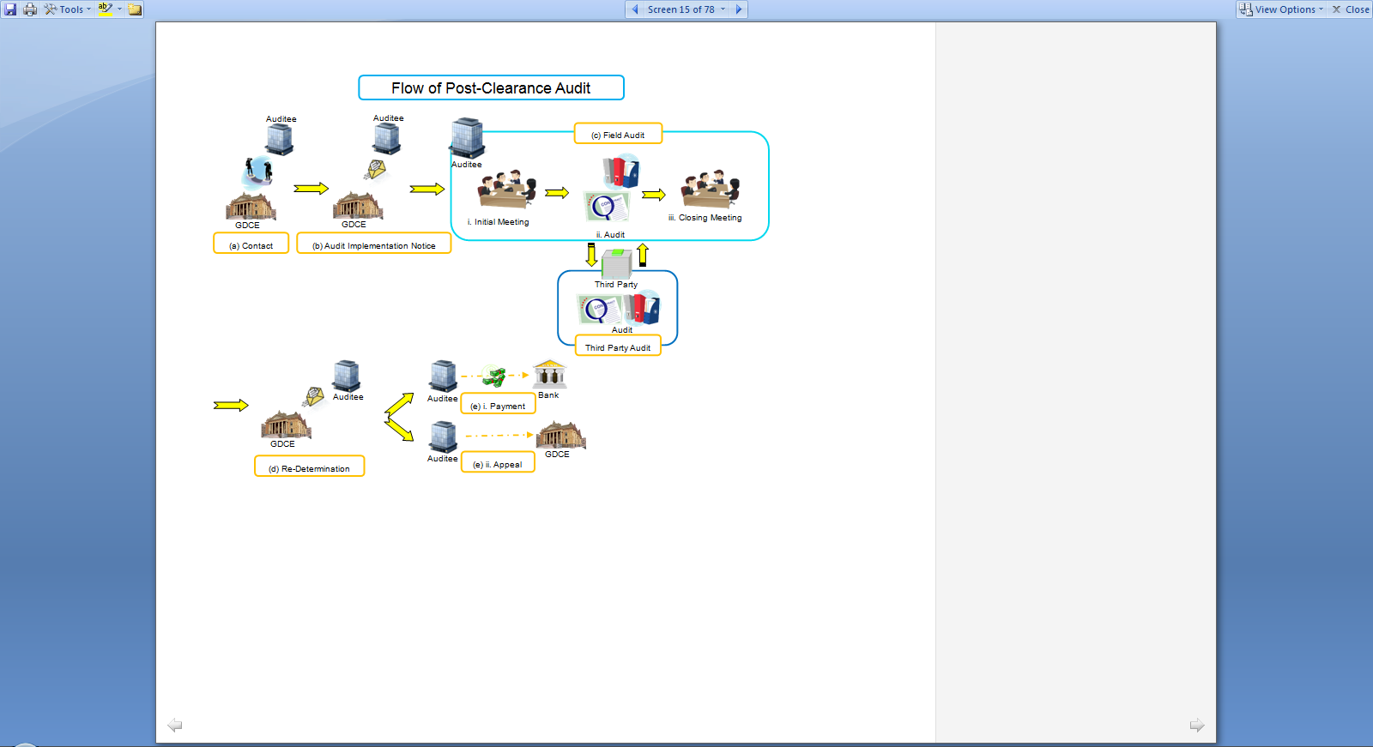
5- Flow of PCA

Slide 15
    5-1 Notification Letter
5- Flow of PCA
  Send notification letter on PCA to Trader within 2 weeks before visiting date.
  During sending:
    explain and request trader to prepare the need of documents,
    Tell to trader who will be Customs Audit Can work with,
    Who is the contacting staff and Telephone number,
    The location of company.

Slide 16
5- Flow of PCA
    5-2 Pre-Audit
    Pre-meeting at local PCA unit
    Preparation of Statistic figure, documents related,
    Find out the suspicious points
    Prepare questionair to ask

Slide 17
    5-3 File Audit
5- Flow of PCA
    Show the PCA mission letter,
    First meeting and provide short presentation on Law and regulation related PCA mechanism,
    Request Auditee to
      Explain the company structure or Flow of document
      Show related documents and Ask suspicius points
      Explain further in case of unclear
      Show further related documents
    Warehouse Inspection
    Request to keep or rental booking record

Slide 18
5- Flow of PCA
5-4 Result of Audit
Issue a temporary result (Form 8),
Issue a comparison Table,
Final meeting to explain a result of PCA,
Minuts of meeting,
Issue Customs offense record.

Slide 19
    5-5 Paper work after Audit
5- Flow of PCA
PCA result’s report,
Process documents for terminated the case,
GDCE issues decision letter,
Follow up the case
TCMS Updated (Rank of Trader)

Slide 20
Thank You for Your Attention!

