Slide 1
Student Perceptions of Teaching (SPT)
March 2024

Slide 2
Purpose
To provide feedback on the teaching and course design
To provide one element of evidence for renewal, tenure/permanence, promotion, and career development
The SPT replaces the previous Student Evaluation of Teaching (SET) form

Slide 3
Process
Surveys are submitted online
Time will be allotted at the start of class
Survey remains open until the last class
You can provide ratings and written comments; comments are only shared with the instructor
Responses are confidential and shared with instructors only after grades are submitted

Slide 4
Survey: Areas of Focus
Instructor Delivery
Grading Expectations & Feedback
Positive Learning Environment
Facilitation of Learning
Workload & Difficulty
Student Motivation
Global Questions
Student Learning Questions
Notes:
There are a total of:
25 course/instructor questions (the first 5 categories)
4 student motivation questions
3 global questions
5 student learning questions

Slide 5
Example of Question Style
Please note that there are different descriptive anchors for each question
1 | For each class, the instructor was… | Poorly prepared | ○ | ○ | ○ | ○ | ○ | ○ | ○ | Well prepared
2 | Material was presented in a well-organized manner. | Almost never | ○ | ○ | ○ | ○ | ○ | ○ | ○ | Almost always
3 | Instructional time was used... | Not efficiently | ○ | ○ | ○ | ○ | ○ | ○ | ○ | Very efficiently
4 | The instructor was able to communicate complex ideas clearly. | Strongly Disagree | ○ | ○ | ○ | ○ | ○ | ○ | ○ | Strongly Agree
5 | The instructor elaborated on concepts in ways that were helpful for understanding. | Not at all true | ○ | ○ | ○ | ○ | ○ | ○ | ○ | Very true
6 | The instructor's knowledge about the content of this course was… | Poor | ○ | ○ | ○ | ○ | ○ | ○ | ○ | Exceptional

Slide 6
Constructive Feedback
Feedback should "feed-forward”
Note, feedback can be influenced by unconscious or unintentional biases - try to focus your answers on the content of the course and your opinions about the quality of instruction
Demographic questions are asked to help the University understand the impact of different factors on the ratings - instructors will not be able to see this information
Notes:
Increasing Response Rates:
- -Talk to students about how the information will be used and why it is important – many do not know why it is collected
-Let students know that you use feedback:
- Near the beginning of your course, share feedback you received from previous classes and what you have done
- Collect mid-way feedback, and share the summary with the class, then share what you are able to change, and what you cannot (and why) – seeing you read and respond to feedback tended to increase response rates on end of course feedback
- Send an email reminder to students about SPTs and invite students to bring devices so they can complete the form online in class
- Provide time at the beginning of class to complete during class time

Slide 7
Please take ~10 minutes to complete the survey
Go to: ask.Uwindsor.ca → “How do I access and complete an online SPT?”
The system may have slight delays loading as we work through the initial implementation phase
Questions? Reach out to spt@uwindsor.ca
Thank you!

Slide 8
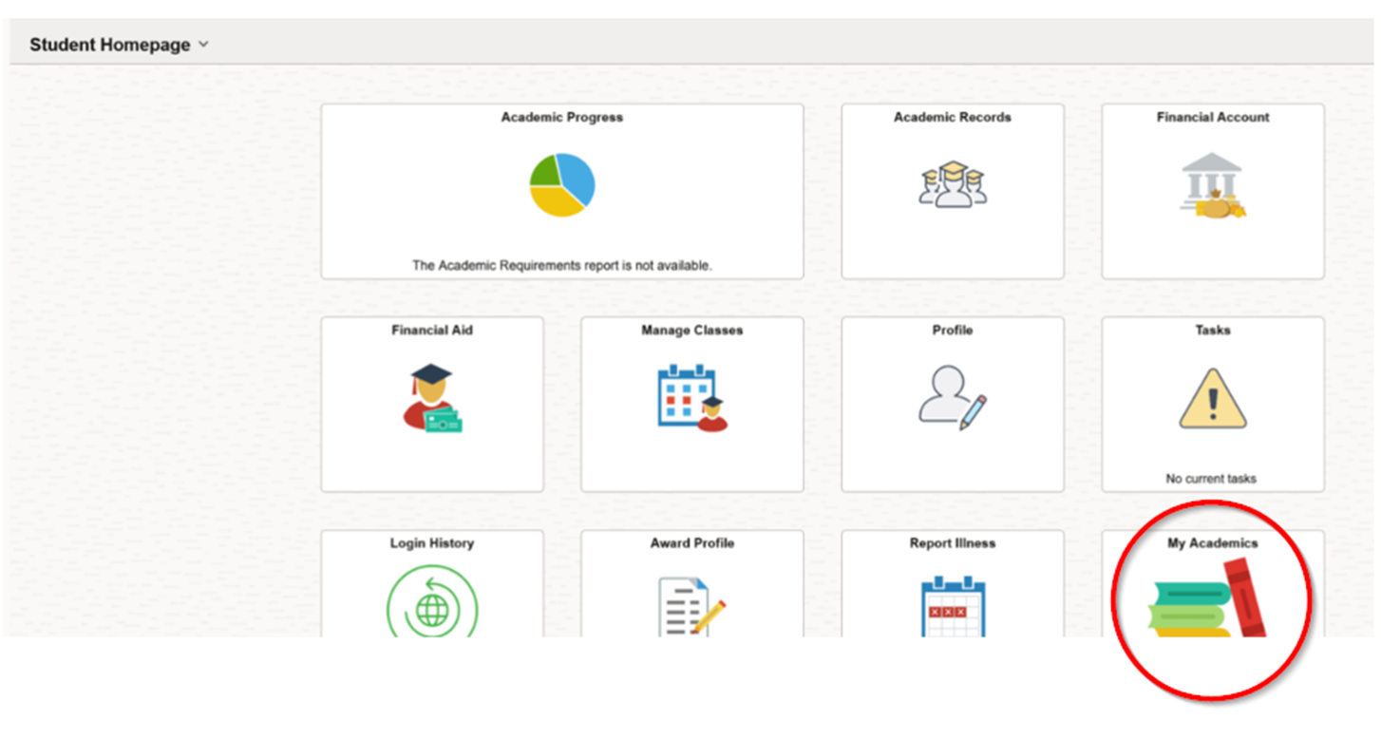
Log into UWinsite and select My Academics

Slide 9
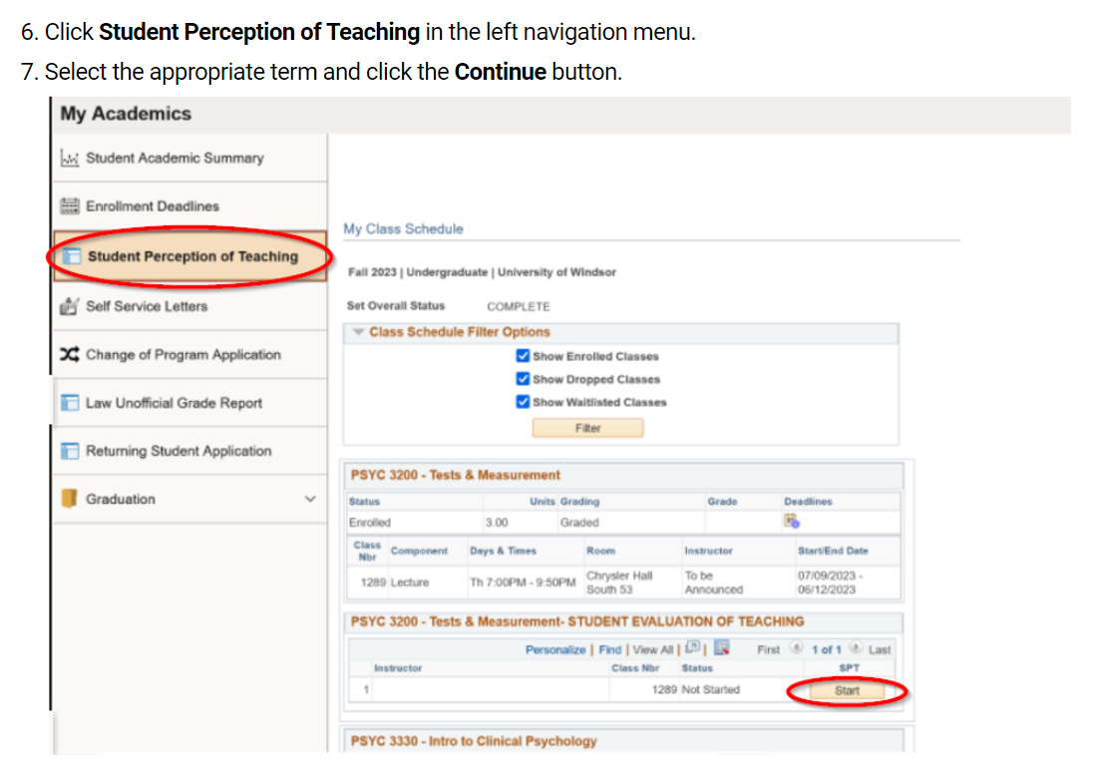
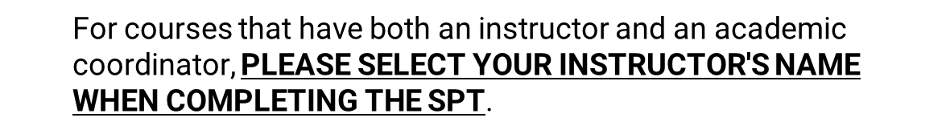
Select Student Perception of Teaching from the menu and press Start
Please note that the Start Button is active during the last two weeks of classes only. You will not be able to complete your course SPT prior to this time or once your term has completed. SPTs will show UNAVAILABLE if they are not active. Follow the instructions within the SPT to complete and submit.
Notes:
n the STUDENT PERCEPTION OF TEACHING box, click the Start button. Please note that the Start button is active during the last two weeks of classes only. You will not be able to complete your course SPT prior to this time or once your term has completed. SPTs will show UNAVAILABLE if they are not active.

Slide 10
Resources
Step by step guide to access SPTs:
https://ask.uwindsor.ca/app/answers/detail/a_id/176/~/how-do-i-access-and-complete-online-student-perceptions-of-teaching-%28spt%29%3F
Technical issues? Submit a ticket: Service - Student Perception of Teach... (teamdynamix.com)
Questions? spt@uwindsor.ca

