Slide 1
Marketing 1310
10.2
Digital and Social Media Marketing
Dr. Preetinder Kaur University of Windsor

Slide 2
Agenda
Digital ecosystem and ecosystem analysis
Paid, owned and earned media
SEO and organic search
SEM and paid search
Network analysis
Social media marketing

Slide 3
Digital ecosystem and ecosystem analysis
Digital ecosystem: is a distributed, adaptive, open socio-technical system
Some characteristics
Customer-centric
Self-organizing
Scalable
Sustainable
Data driven
Dynamic

Slide 4
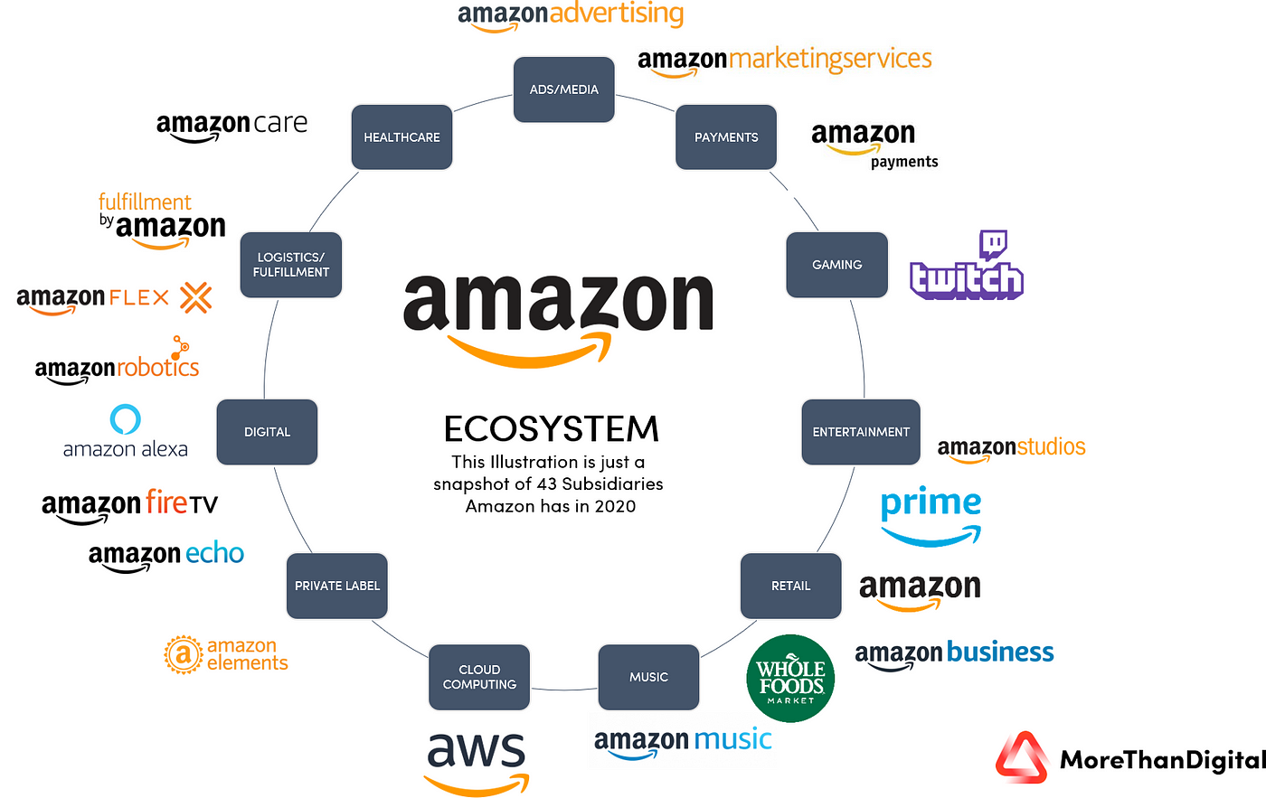
Digital ecosystem and ecosystem analysis

Slide 5
Digital ecosystem and ecosystem analysis
Analysis
Consultants (Example)

Slide 6
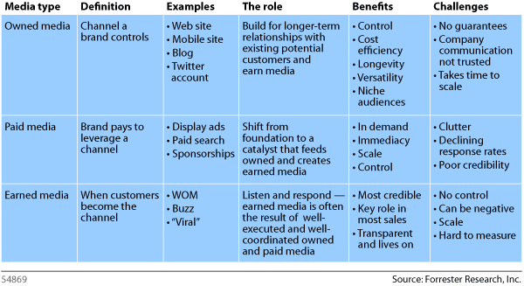
Paid, owned and earned media

Slide 7
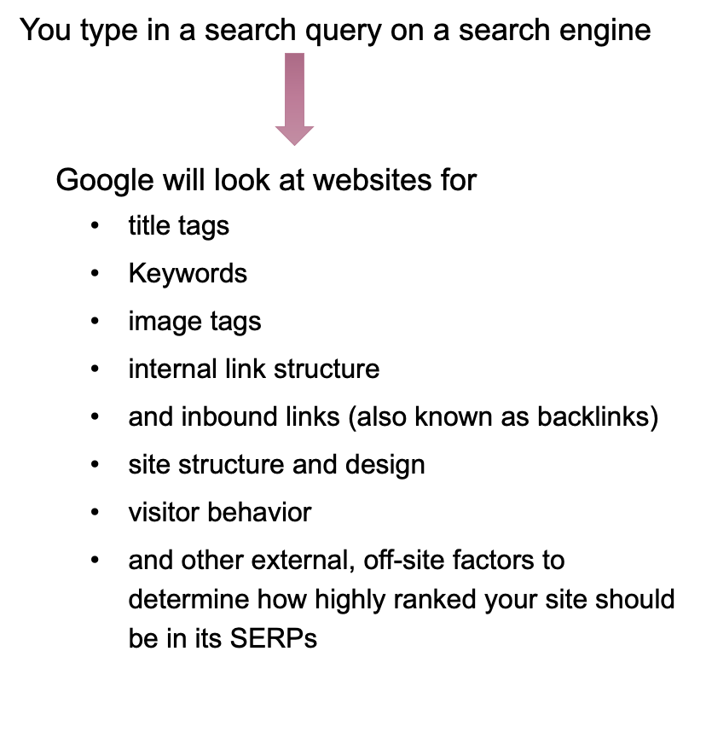
SEO and organic search
What happens when you search online?

Slide 8
SEO and organic search
How does Google rank a page?
Meaning
Relevance
Quality
Usability
Context
https://backlinko.com/google-ranking-factors

Slide 9
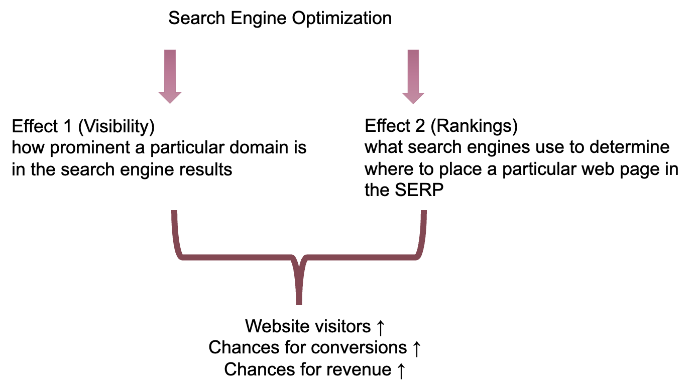
SEO and organic search
What is SEO?

Slide 10
SEO and organic search
How to track SEO performance?
Organic traffic growth
Keyword rankings (split into branded and non-branded terms)
Conversions from organic traffic
Average time on page and the bounce rate
Top landing pages attracting organic traffic
Number of indexed pages
Links growth (including new and lost links)

Slide 11
SEO and organic search
Trends: Go to this link (https://www.wordstream.com/blog/ws/2023/05/15/google-ads-benchmarks) and go to the section titled “Search ads benchmarks: key trends”.

Slide 12
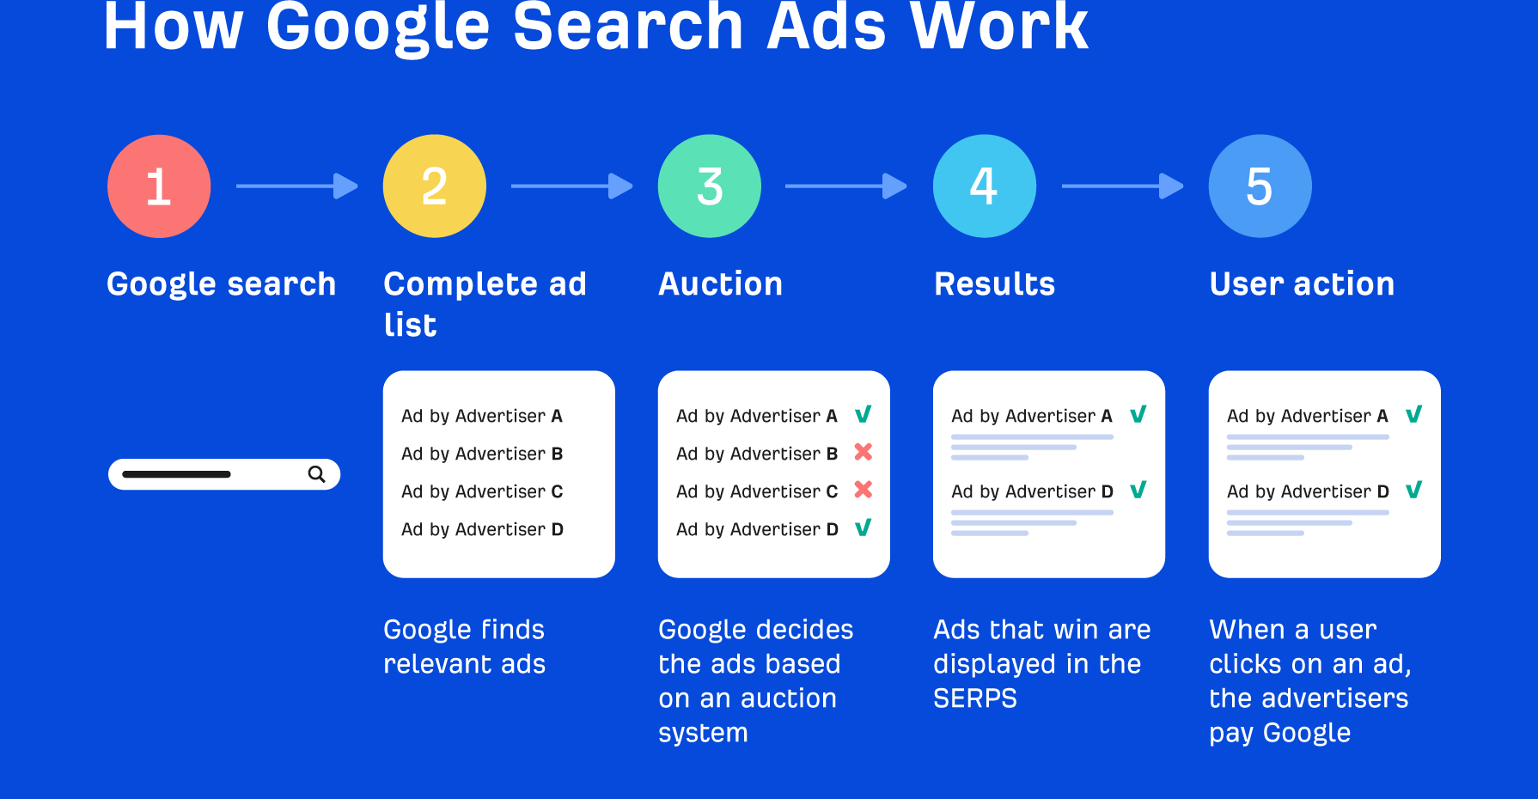
SEM and paid search
Search Engine Marketing

Slide 13
Network analysis
Network: A network is a collection of interconnected entities or nodes that can communicate or exchange information with one another. Networks can be found in many different contexts, including social, technological, and biological systems.
Process of investigating social structures through the use of networks and graph theory

Slide 14
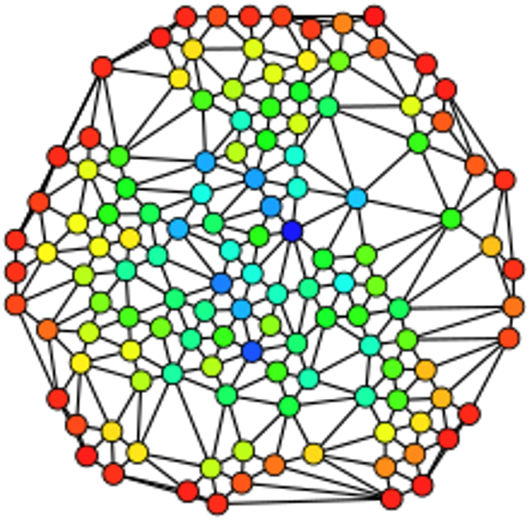
Network analysis
Basic components
Node
Hub
Edge
Province/Module

Slide 15
Network analysis
Some examples of analyses
Topological analysis: the overall structure of a network, including the number and types of nodes and the connections between them.
Centrality analysis: how central or important a particular node is within a network.
Community detection: identify groups or communities within a network
Influence analysis: how the actions or opinions of one or more nodes in a network can influence the actions or opinions of other nodes

Slide 16
Social media marketing
Use of social media platforms and websites to promote a product or service
In-house analytics or use other tools
Complete list: https://blog.hootsuite.com/social-media-analytics/#The_best_social_media_analytics_tools_for_2024

