Slide 1
Marketing 1310
8.2
Promotion: Advanced
Dr. Preetinder Kaur University of Windsor

Slide 2
Agenda
Selecting the right media
Sales promotions
Personal selling
Managing the sales force

Slide 3
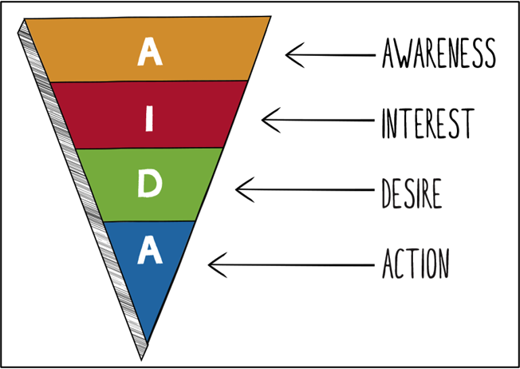
Selecting the right media
AIDA Model
Senders first must gain the attention of the consumer
Some metrics
Aided recall
Top of mind awareness
The customer must want to further investigate the product/service
Interest can also be sparked by a little controversy
It is the ultimate goal
Purchase is just one of the desirable actions
I like it
I want it

Slide 4
Sales promotions
Sales promotions: Can be aimed at both end user consumers or channel members | Used in conjunction with other forms of IMC | Can be used for both short-term and long-term objectives | for pull and push strategies both
Promotion | Advantages | Disadvantages
Coupons | • Stimulates demand. • Allows for direct tracking of sales. | • Low redemption rates. • High cost.
Deals | • Encourages trial. • Reduces consumer risk. | • May reduce perception of value.
Premiums | • Builds goodwill. • Increases perception of value. | • Consumers buy for premium, not product. • Has to be carefully managed.
Contests | • Increases consumer involvement. • Generates excitement. | • Requires creativity. • Must be monitored.

Slide 5
Sales promotions
Sales promotions
Promotion | Advantages | Disadvantages
Samples | • Encourage trial. • Offer direct involvement. | • High cost to the firm.
Loyalty Programs | • Create loyalty. • Encourage repurchase. | • High cost to the firm.
POP Displays | • Provide high visibility. • Encourage brand trial. | • Difficult to get a good location in the store. • Can be costly to the firm.
Rebates | • Stimulate demand. • Increase value perception. | • Easily copied by competitors. • May just advance future sales.
Product Placement | • Displays products nontraditionally. • Demonstrates product uses. | • Firm often has little control over display. • Product can be overshadowed.

Slide 6
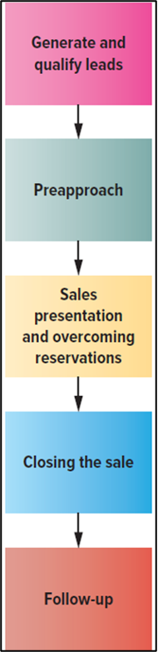
Personal selling
Personal selling: A two-way communication between the buyer and seller to influence buying decisions | Salespeople can add significant value, which can make the expense worth it

Slide 7
Managing the sales force
Determine the structure
Recruit and select the right people
Training salespeople
Motivate and compensate (financial and non-financial)
Evaluate

