Slide 1
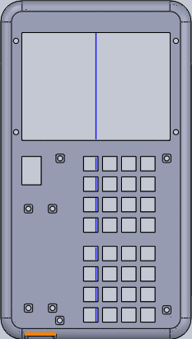



Larzulator
Power
2nd
↑
sym
mode
←
→
(
↓
)
sto
∠
sec
log
ln
del
clr
ins
i/j
°
csc
sin
asin
cos
acos
tan
^
cot
atan
7
x
8
y
9
z
÷
EE
4
→[A]
5
→[B]
6
→[C]
×
•
1
[A]
2
[B]
3
[C]
+
-1
0
.
-
=
ANS

