Slide 1
“what Makes us Smile: world happiness data at a glance”
Project 1, Group 3
*Manuela Munoz
Taylor Clark
Lareena Llamado
Meixi Yu
Scott Provencher

Slide 2


What is the factor that most influences the level of happiness?
Hypothesis: GDP is positively related to happiness level for the year 2020.
Null hypothesis: GDP is not related to the happiness level.
Background: The happiness score ranking use data from theGallup World Poll. The scores are based on answers to different factors including GDP, freedom, family, social support, and others. There are over 150 countries in this dataset, ranging from 2015 to 2020. For our analysis, we use the year 2020.
source: https://www.kaggle.com/mathurinache/world-happiness-report?select=2020.csv

Slide 3
Research questions
Do the countries of the same region have the same level of happiness?
Do all the variables have an equal effect on the happiness level of regions?
How do the countries with the highest GDP compare in terms of happiness level versus the countries with the lowest GDP?
What portion of high-GDP countries have low happiness levels?
What portion of low-GDP countries have high happiness levels?

Slide 4
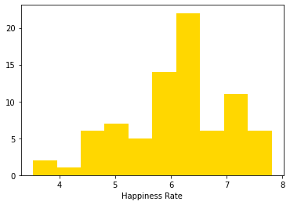
DISTRIBUTION OF THE data

Slide 5
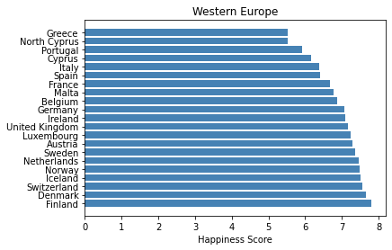
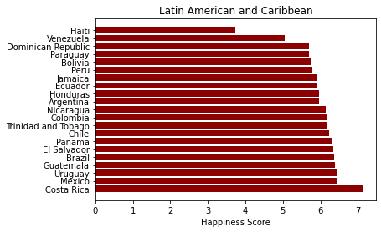
1. Do the countries of the same region have the same level of happiness?
Western Europe
Latin american & Caribbean

Slide 6
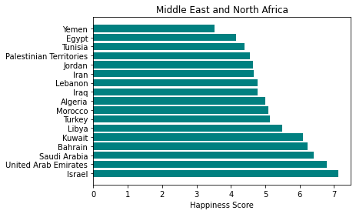
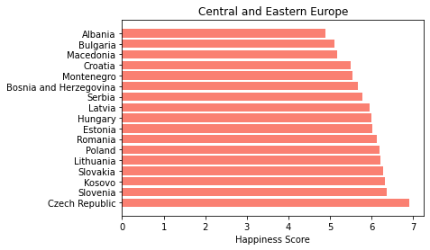
1. Do the countries of the same region have the same level of happiness?
Middle east & North Africa
Central & Eastern Europe

Slide 7
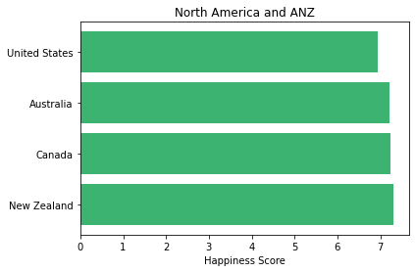
1. Do the countries of the same region have the same level of happiness?
North America and
Australia and New Zealand

Slide 8
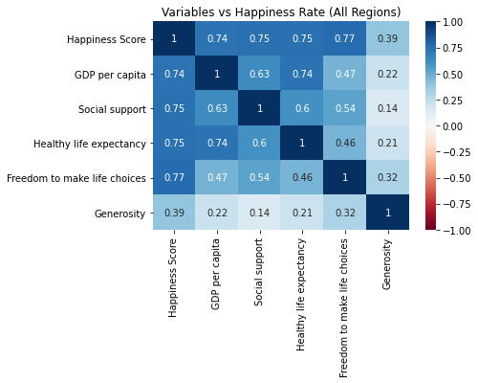
2. Do all the variables have an equal effect on the happiness level of regions?
Correlation for all regions

Slide 9
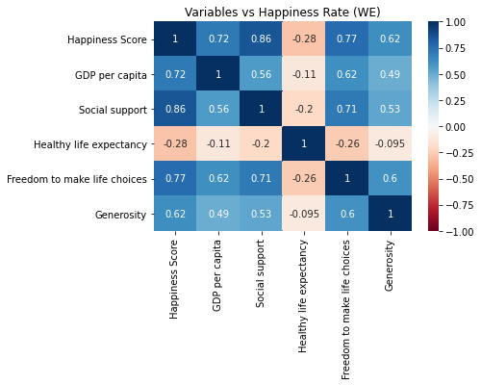
2. Do all the variables have an equal effect on the happiness level of regions?
Correlation for Western Europe

Slide 10
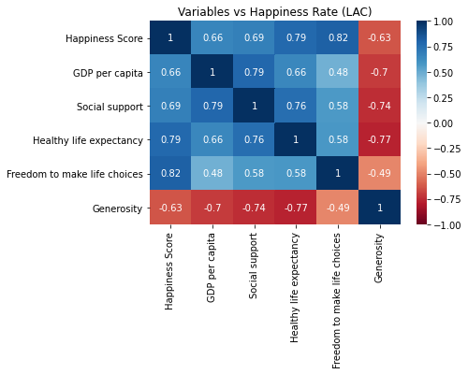
2. Do all the variables have an equal effect on the happiness level of regions?
Correlation for Latin American and Caribbean

Slide 11
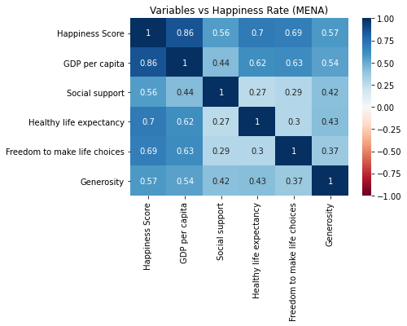
2. Do all the variables have an equal effect on the happiness level of regions?
Correlation of Middle East and North Africa

Slide 12
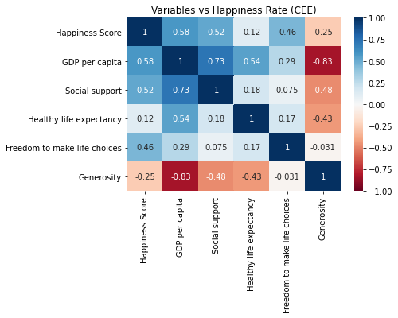
2. Do all the variables have an equal effect on the happiness level of regions?
Correlation of Central and Eastern Europe

Slide 13
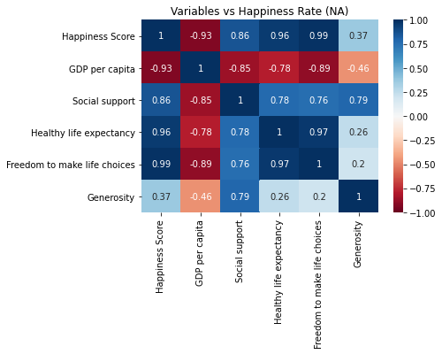
2. Do all the variables have an equal effect on the happiness level of regions?
Correlation of North America and Australia and New Zealand (ANZ)

Slide 14
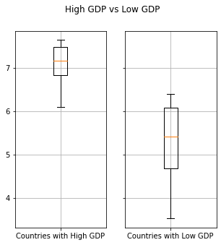
3. How do the countries with the highest GDP compare in terms of happiness level versus the countries with the lowest GDP?

Slide 15
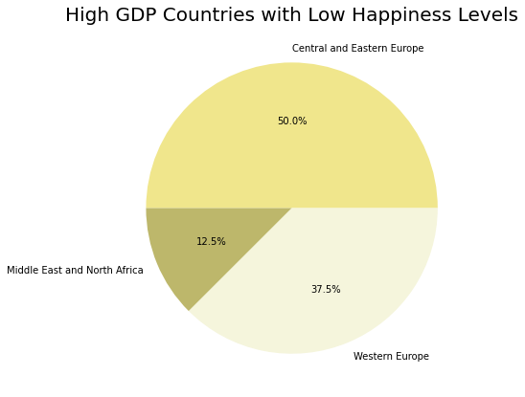
4. What portion of high-GDP countries have low happiness levels?
10.0% of the total countries have high GDP have low happiness levels
18.18% of the countries with high GDP have low happiness levels

Slide 16
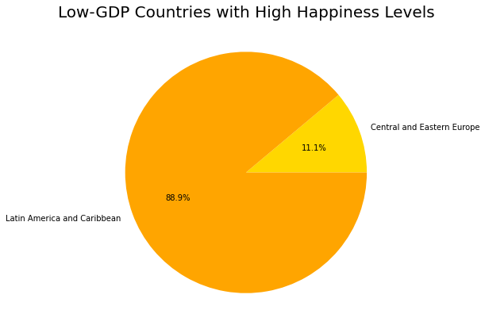
5. What portion of low-GDP countries have high happiness levels?
25.0% of the total countries with low GDP have high happiness levels
11.25% of low-GDP countries have high happiness levels.

Slide 17
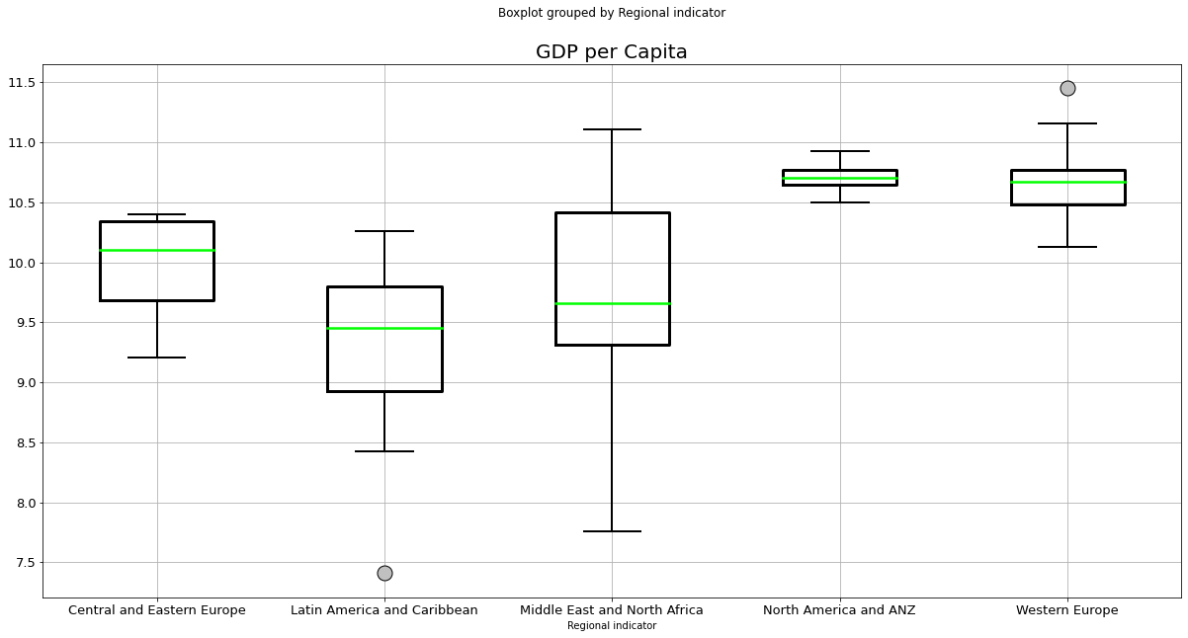
Comparison of means for GDP per region

Slide 18
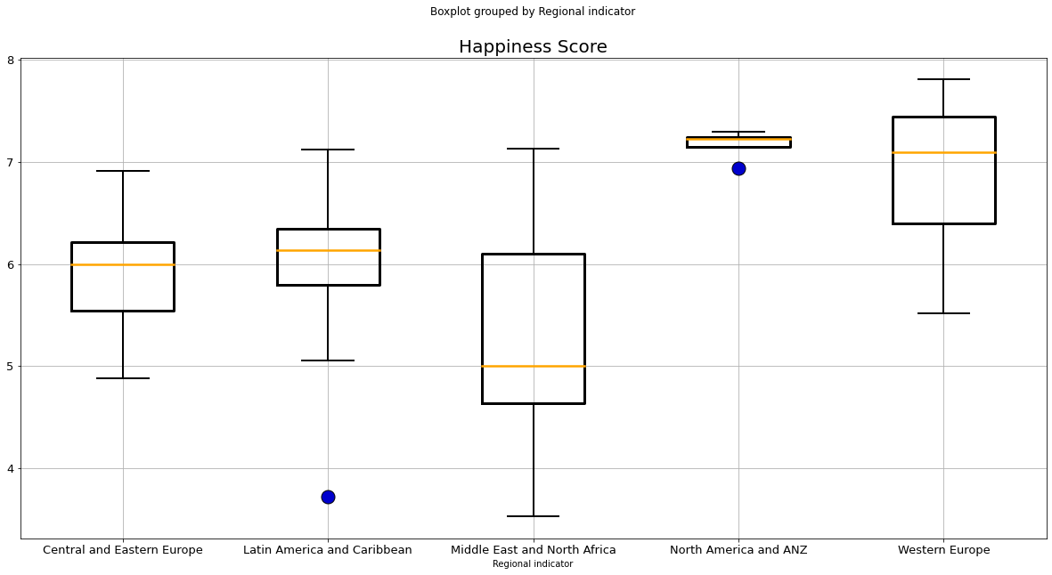
Comparison of means FOR HAPPINESS per region

Slide 19
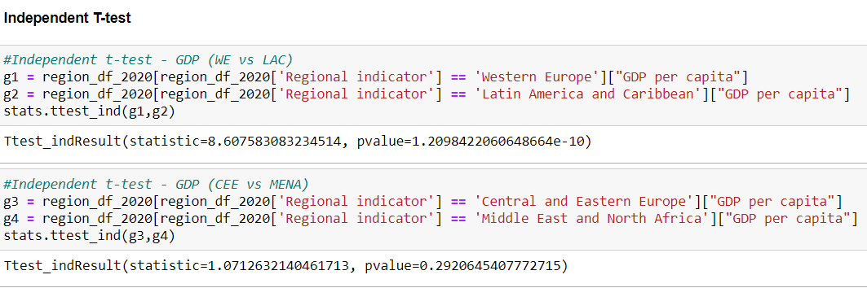
Independent t-test for GDP

Slide 20
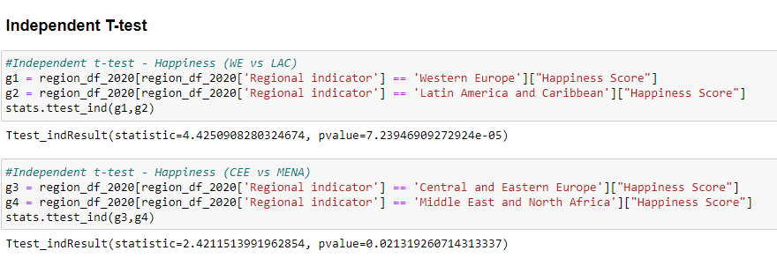
Independent t-test for happiness

Slide 21
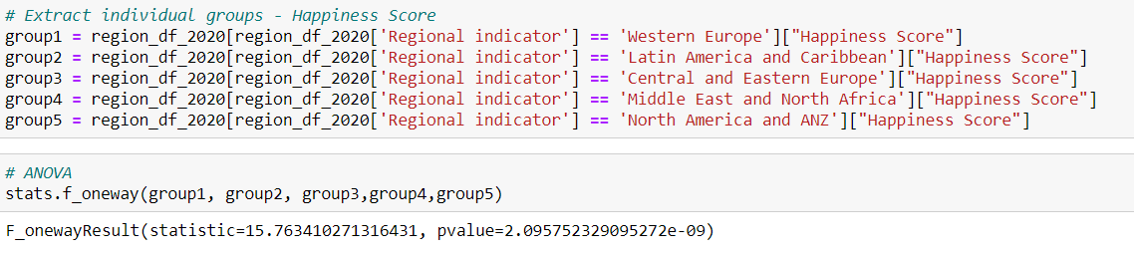
anova

Slide 22
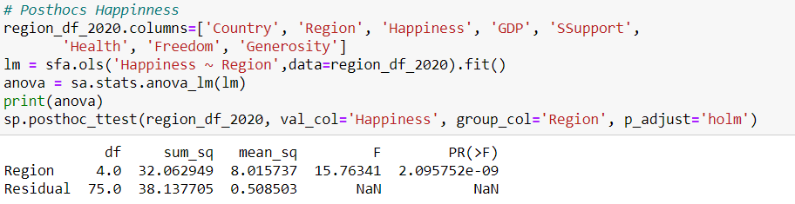
POSTHOCS FOR HAPPINESS

Slide 23
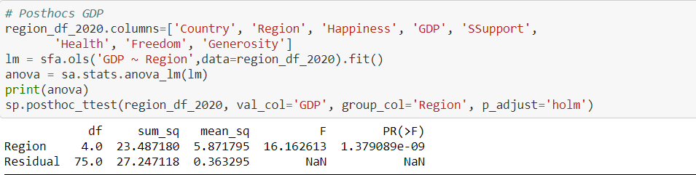
POSTHOCS FOR GDP

Slide 24


conclusions
Reject Null Hypothesis
Evidence shows our hypothesis is correct.

Slide 25
Questions?

