Slide 1
Eniac Discount Case

Slide 2
Do our discounts actually help the business or just eat our profits?

Slide 3
92,81 %
products are discounted

Slide 4
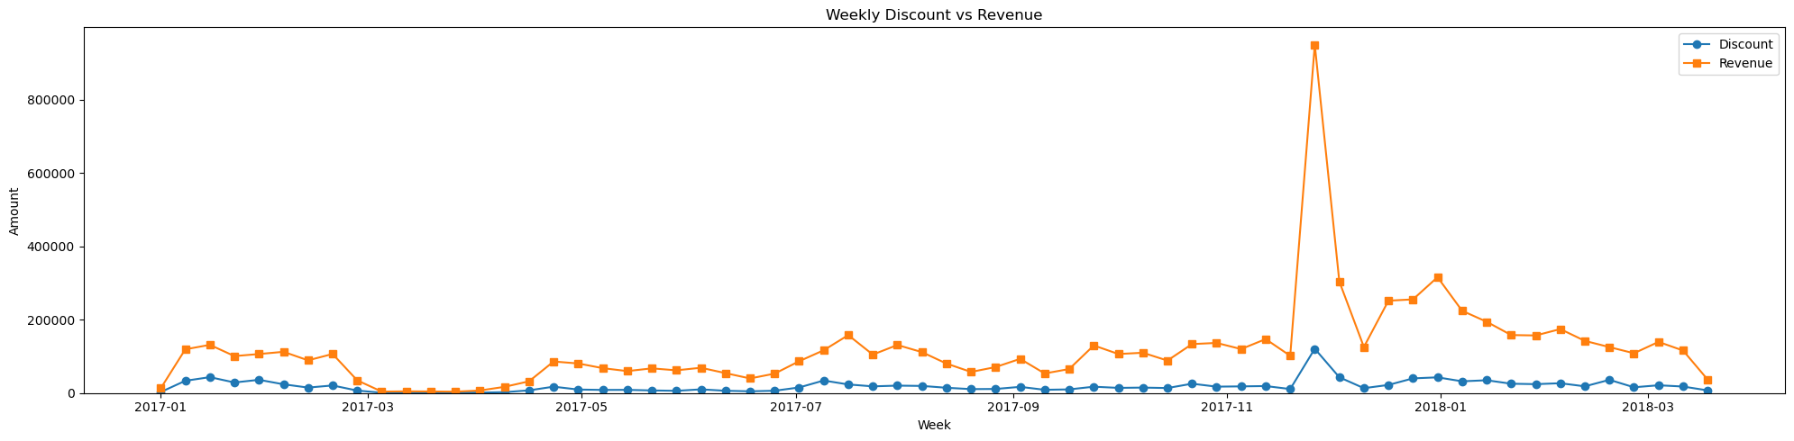
Higher revenue with discounts

Slide 5
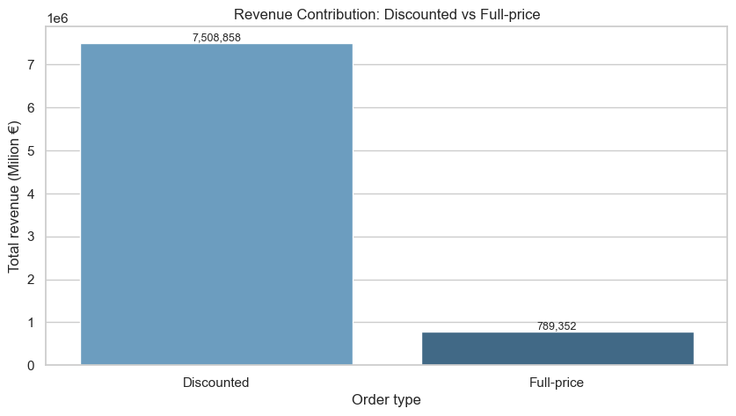
Discounts have huge impact on the revenue

Slide 6
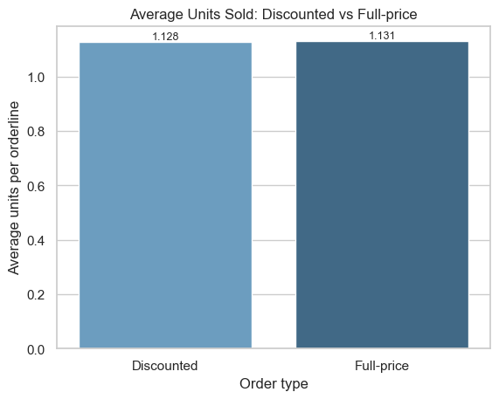
No raise in average units sold

Slide 7
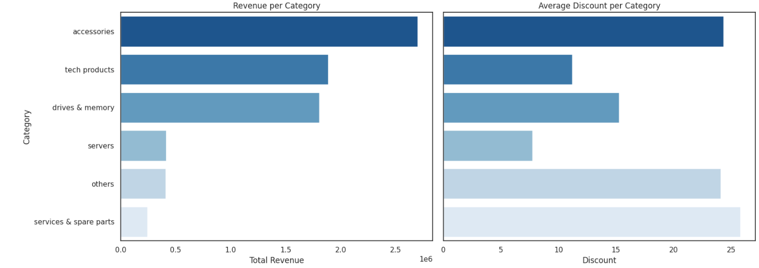
Too much discount on products that bring less revenue

Slide 8
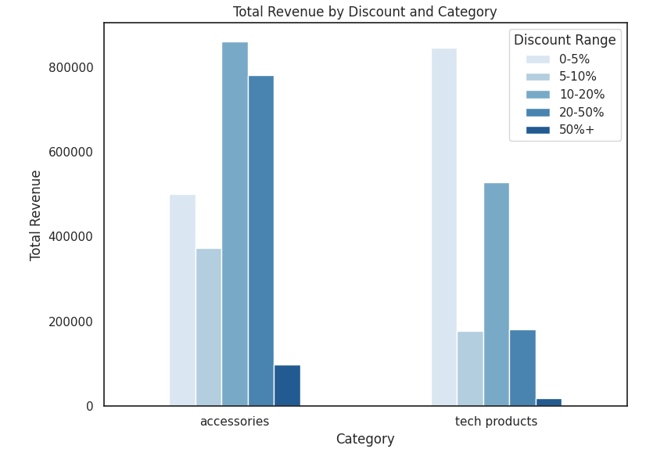
Small discounts bring most revenue

Slide 9
Conclusion
Discounts too high and to many
No targeted discounts
Aggressive discount strategy not efficient
Alternatives
Create loyalty programs and bundles
Seasonal & overstock promotion
Limit discount on high margin product
Notes:
Strategy not efficient on the long run
Discounts should be something special and not taken for granted

Slide 10
Appendix

Slide 11
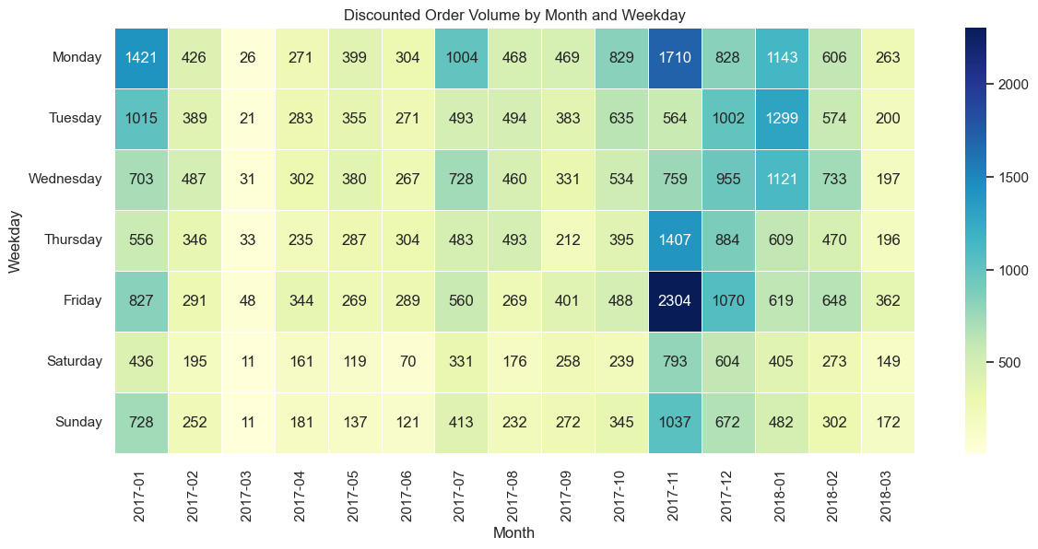
Most discounts on Mondays and Fridays

Slide 12
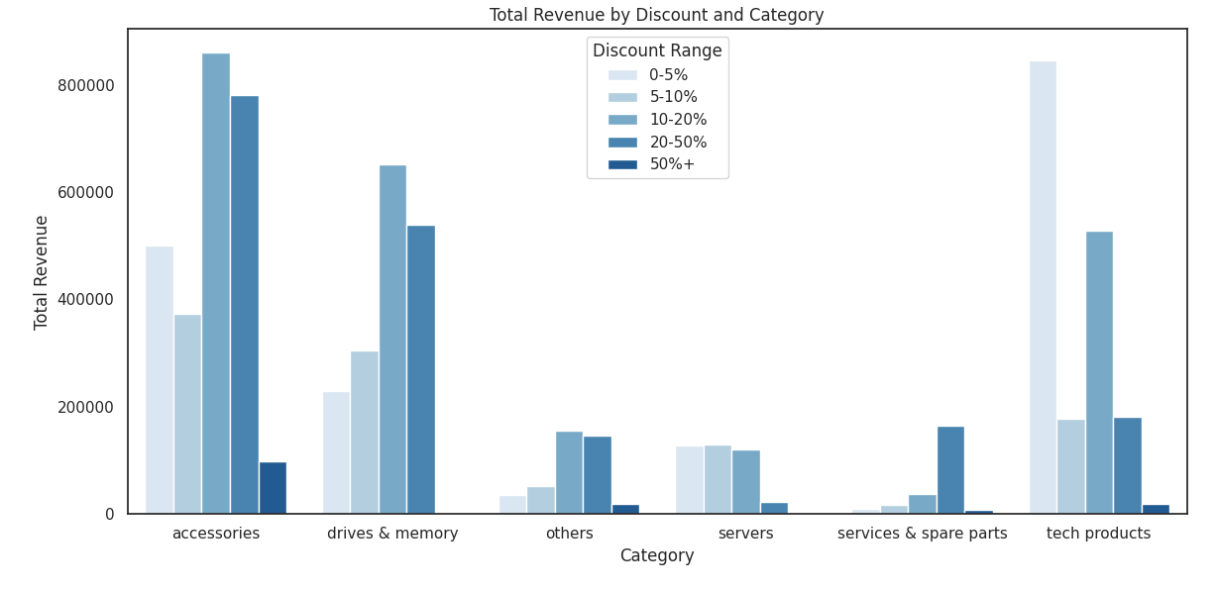
Small discounts bring most revenue

Slide 13
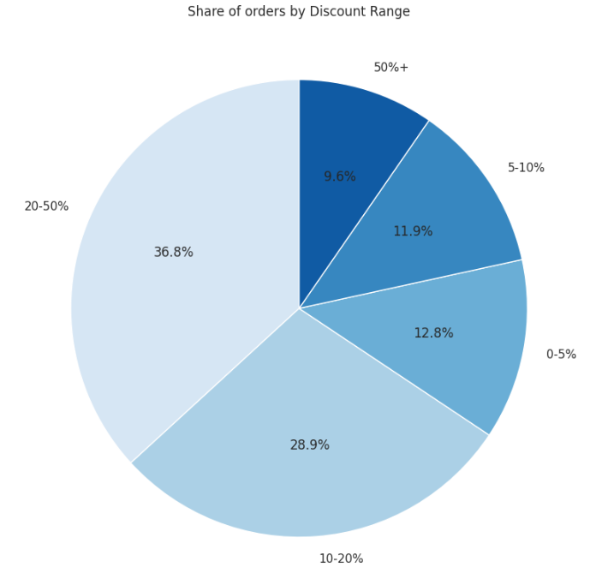
To many high discounts

Slide 14
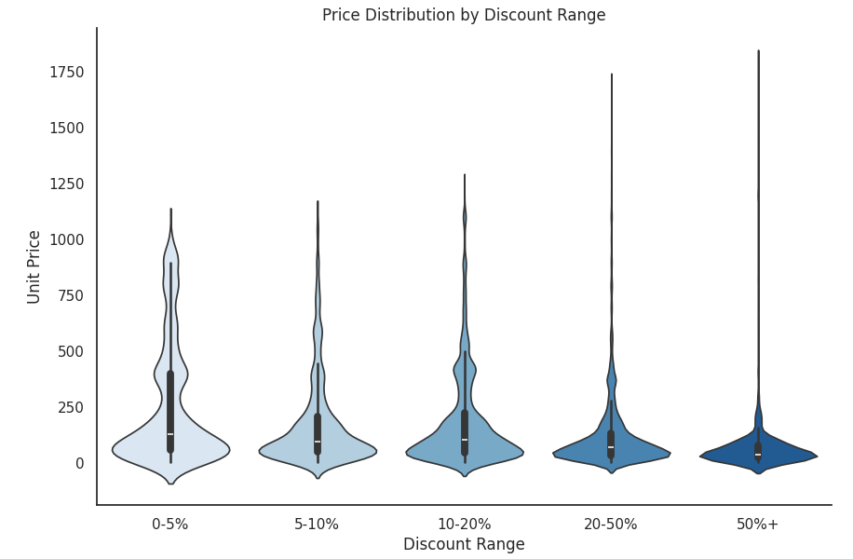
Alarming discount distribution

Slide 15
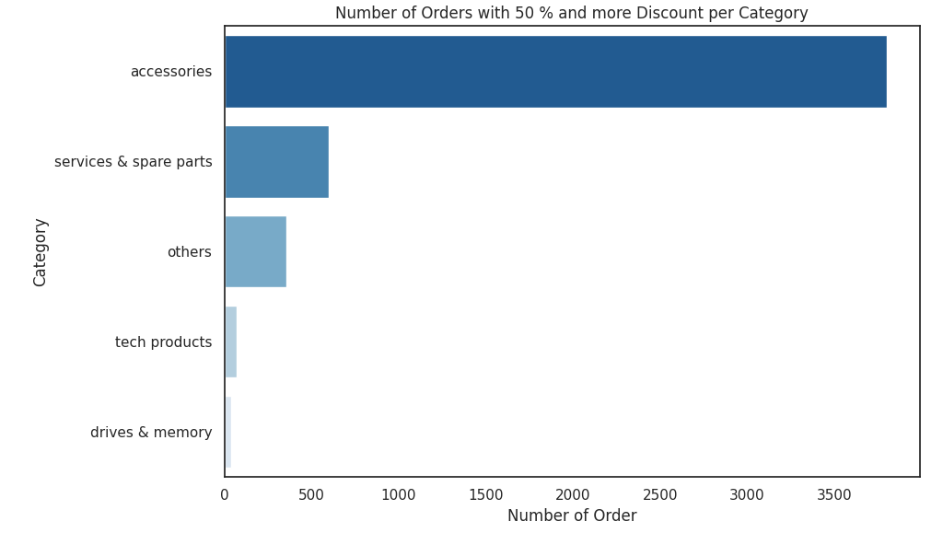
Highest discounts on less expensive products

