Slide 1
EnergyTrace
See where your energy really comes from

Slide 2
The Problem
Consumers and small businesses are told their electricity is “100% renewable”, but in reality, grid electrons are mixed — and even green tariffs often rely on annual certificates (REGOs) that don’t reflect real-time renewable usage.
This transparency gap is becoming critical as:
Companies must report actual carbon intensity of operations (CSRD, GHG Protocol updates).
Smart homes, EVs, and batteries could be scheduled based on real-time renewable availability — if users had access to that data.

Slide 3
Concept
EnergyTrace is a SaaS platform + API that shows the real-time carbon intensity and renewable share of a household’s or SME’s electricity consumption.
It combines:
Real-time grid carbon data (National Grid ESO API)
Smart meter or device consumption data
Machine learning to estimate how much of your power is actually renewable, hour by hour.
Then it visualizes:
📊 Renewable % used today / this week / month
🌱 Carbon intensity trends
⚡ Smart tips: “Run your dryer at 2–4 p.m. to use 80% renewable energy”
🧾 Optional export: auto-generated reports for ESG or carbon accounting.

Slide 4
Target Users
Early adopters / green households — those with solar, EVs, or time-of-use tariffs who care about carbon footprint.
Small businesses — coffee shops, studios, or offices who want credible sustainability claims.
Sustainability professionals — use the API for Scope 2 carbon tracking.

Slide 5
MVP Features
Real-time renewable share + CO₂ intensity (per UK region)
Daily/weekly dashboard with insights (“You used 63% renewable energy this week”)
Smart alerts (“Wait one hour — solar is peaking and grid is 90% renewable”)
Exportable carbon report (CSV or PDF)
(Later) Integration with smart plugs, EV chargers, or heat pumps for automated optimization

Slide 6
Business Model
Freemium app: basic dashboards free; premium (£3–5/mo) adds automation + reports
API license: for sustainability software or energy suppliers to embed transparency data
White-label option for green energy brands or smart device manufacturers

Slide 7
Sustainability Impact
Empowers consumers with data-driven energy choices
Makes real carbon reduction visible and verifiable
Creates market pressure for truly renewable supply transparency
1st step for load management

Slide 8
Example MVP Vision
A simple, elegant web dashboard (built in Streamlit or Dash) that:
Pulls hourly grid carbon data from National Grid ESO API
Lets users input postcode or smart meter data
Calculates and visualizes their personal “renewable energy score” over time
Later versions could integrate:
Real smart meters (via DCC or Octopus API)
EV/heat pump device data
Peer comparisons or gamified carbon reduction (“Top 10% clean energy users in London this week!”)

Slide 9
Growth Strategy – Phase 1
Phase 1 – EnergyTrace (Transparency)
Goal: Build a lean, grant-eligible MVP that provides clear, data-driven value.
What you build:
Simple dashboard with live carbon intensity and renewable share
User region selection (postcode or smart meter ID)
Daily/weekly renewable energy score
Optional email summary (“Tomorrow 2–5pm: greenest hours!”)
What you gain:
Users + brand recognition for energy awareness
Dataset of anonymized consumption + behavioral insights
Partnerships with universities, green utilities, or local councils
Positioning as trusted sustainability analytics platform
Funding opportunities:
Innovate UK “Net Zero Living” or “Energy Data Visibility”
Local innovation accelerators (City, University of London / UK Power Networks / Energy Systems Catapult)

Slide 10
Growth Strategy – Phase 2
Phase 2 – FlexiWatt (Optimization)
Goal: Transition from awareness → automated impact.
How you evolve:
Use EnergyTrace data to predict “best times to use electricity”
Add smart device integrations (EVs, thermostats, smart plugs)
Offer automatic scheduling or control
Create B2B offers (e.g., “optimize all your offices’ energy schedules”)
By that time, you’ll have:
Verified data pipeline
Early adopters who trust your insights
Strong story for investors or grant scaling

Slide 11
“We’re building the digital bridge between awareness and action in the clean energy transition. Phase 1: EnergyTrace empowers households and SMEs with transparent data on their real renewable energy usage. Phase 2: FlexiWatt builds on that foundation to automate decisions — optimizing when and how they use electricity for both savings and carbon reduction.”

Slide 12
How “EnergyTrace” Works (Technically)
1. Grid-Level Transparency Exists
Every electricity system operator (e.g., National Grid ESO in the UK) publishes:
Real-time generation mix (MW by source: gas, nuclear, solar, wind, imports)
Carbon intensity (gCO₂/kWh)
Regional breakdowns (14 UK grid zones)
Forecasts for the next 24–48 hours
Example: At 2:00 p.m. today in London,
Wind: 38%, Solar: 14%, Gas: 31%, Nuclear: 13%, Others: 4% → Estimated carbon intensity: ~120 gCO₂/kWh
This data is publicly available via the Carbon Intensity API (National Grid ESO & Electricity Maps also provide global versions).
2. User’s Energy Consumption Data
From the user, you can get:
Smart meter data (half-hourly or hourly)
Or approximate usage (e.g., “2 kWh between 1–3 p.m.”, estimated from tariffs or manual input)
Or even just time-of-use behaviors for initial MVP (e.g., “I charged my EV at 9 p.m.”)
This doesn’t have to be highly precise at first — it’s enough to timestamp consumption.

Slide 13
How “EnergyTrace” Works (Technically) - cont
3. Data Fusion: Matching Time + Region
“BetYou align the user’s time and location with grid data:
ween 1–2 p.m., your region’s electricity mix was 82% renewable.”
Then EnergyTrace can say:
“Your energy that hour was approximately 82% renewable, with a carbon intensity of 115 gCO₂/kWh.”
4. Smart Metrics Derived
With this logic, EnergyTrace can generate:
📊 Renewable Share (%) of all electricity you used this week
🌱 Carbon Intensity Trend (how clean your electricity was over time)
🔋 Impact Forecast (“Tomorrow 12–4 p.m. will be the cleanest window — plan energy use then!”)
So even though we can’t tag individual electrons, we can trace the quality of the electricity stream with high time and spatial resolution.
5. Optional Advanced Steps
Later, you can integrate:
Supplier-level data: e.g., if a user’s tariff claims 100% renewable, you can overlay REGO (Renewable Energy Guarantee of Origin) certificates or supplier generation assets.
Home generation data (from PV or battery systems).
Peer-region comparison (e.g., “Your area used 10% more renewable energy than average.”)

Slide 14
Analogy
It’s like how weather apps don’t know which exact air molecules you breathe — but they can very accurately tell you the quality of the air around you (PM2.5, ozone, humidity).
Similarly, EnergyTrace doesn’t see your individual electrons — it measures the quality of your electricity supply in space and time.

Slide 15
Why It’s Valuable
For most consumers and SMEs, this level of data transparency simply doesn’t exist yet.
It allows carbon tracking for Scope 2 emissions in near real-time (a regulatory requirement under CSRD).
It empowers users to shift behavior — e.g., doing laundry when the grid is cleanest.
It can later evolve into automated flexibility actions (FlexiWatt).

Slide 16
So, EnergyTrace =
Grid-aware carbon intensity monitor + User behavior insight tool + Decision support layer for when electricity is greenest.

Slide 17
EnergyTrace makes the clean energy transition tangible for everyone. We translate live grid data into personal, hour-by-hour insights—showing when electricity is cleanest and how much carbon you actually avoided. Start with transparency; graduate to automation.

Slide 18
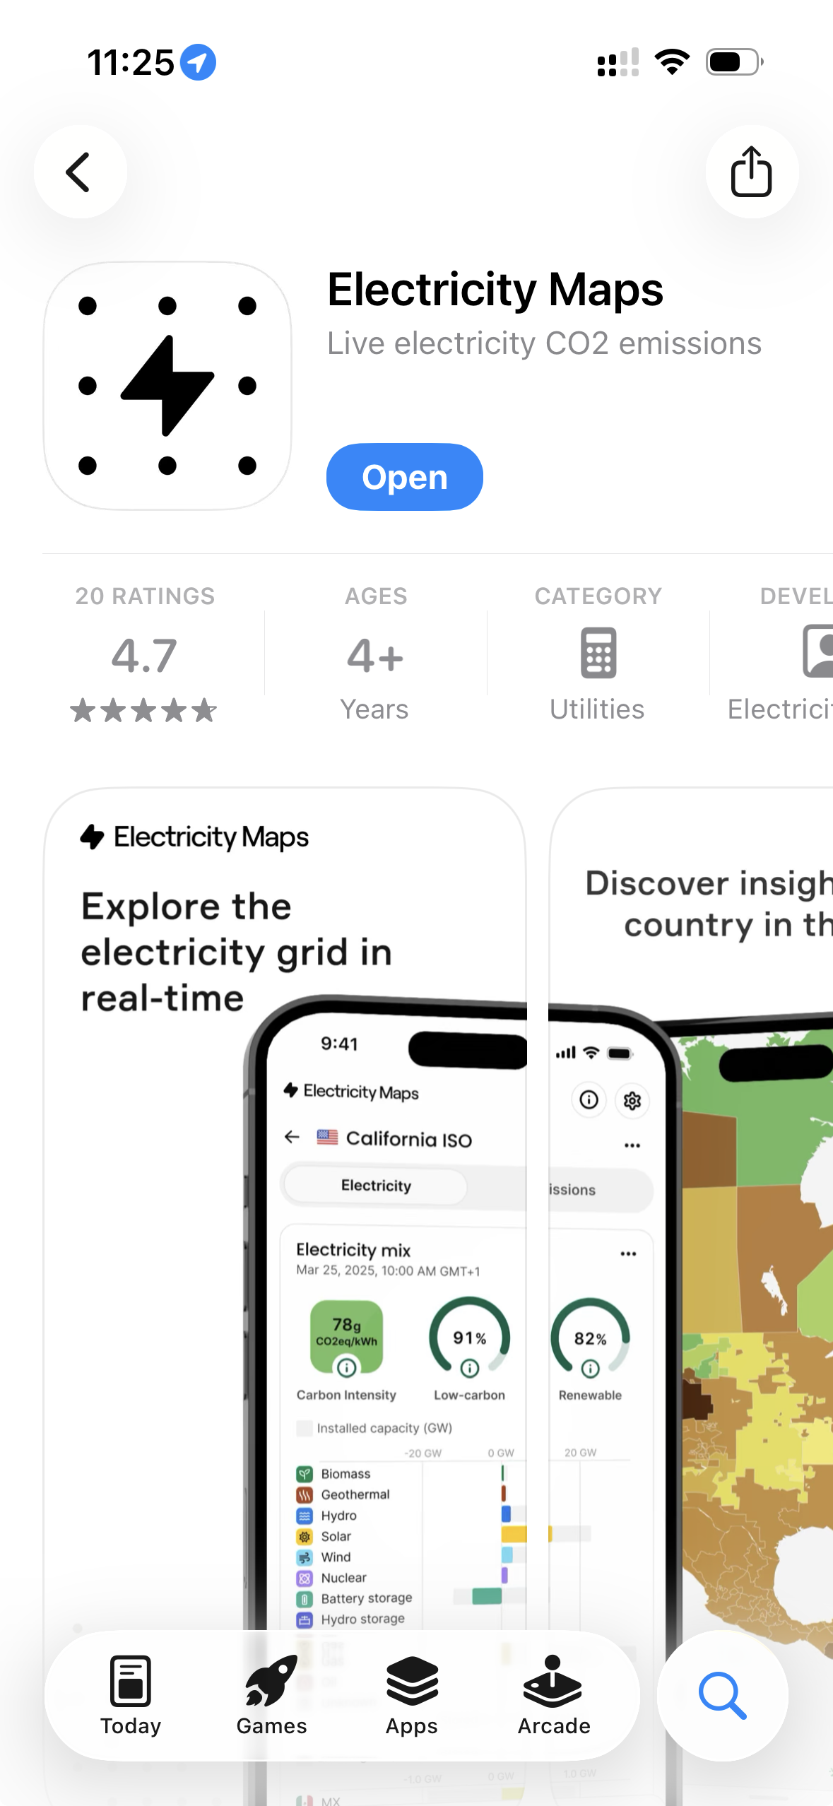
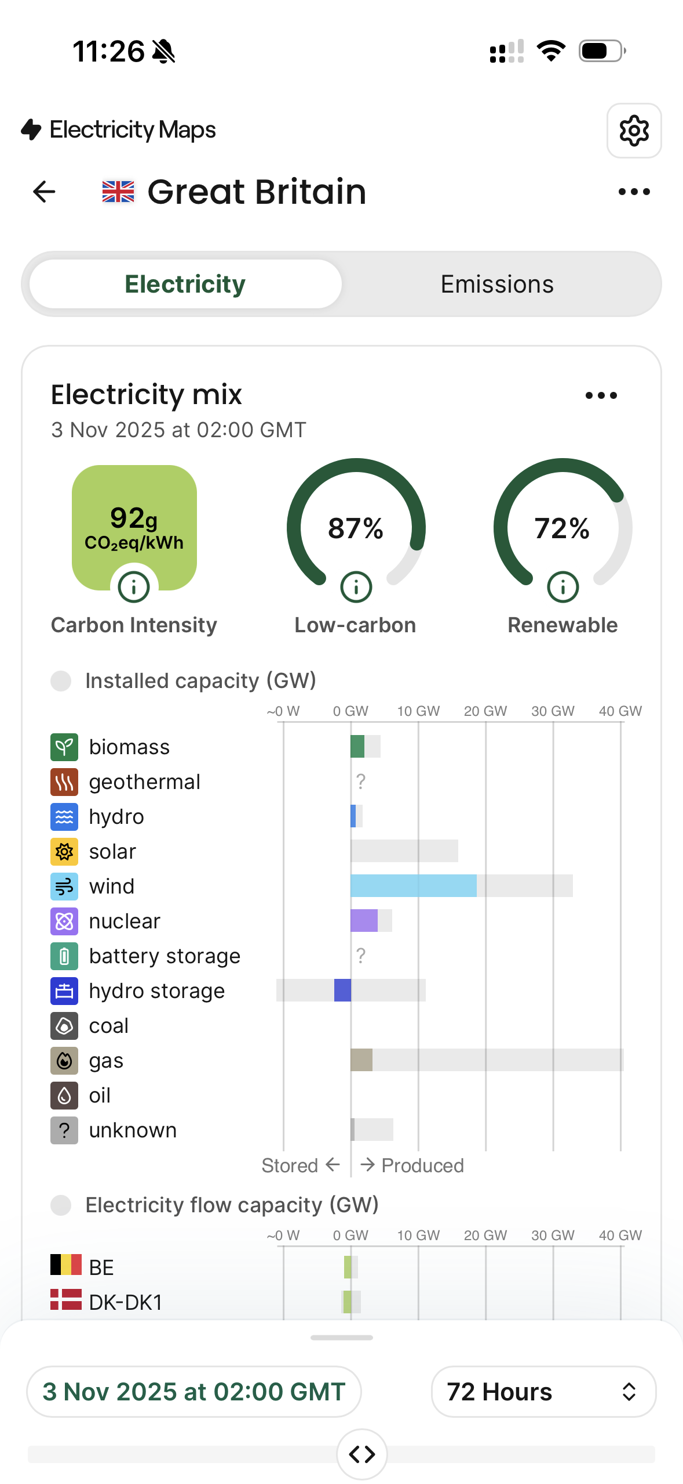
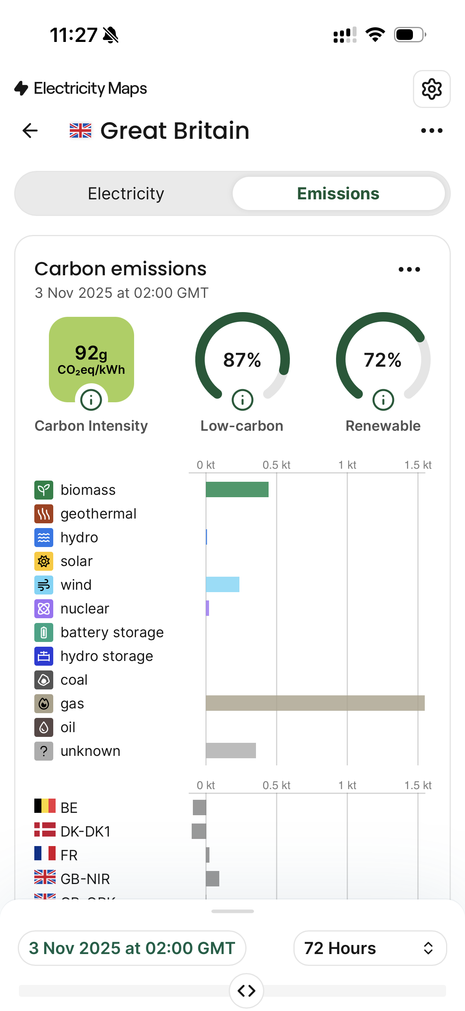
Competition
No postcode search and no individual energy use
State of the grid
Emissions of the grid

