Slide 1
Time-optimal Flying a VTOL Drone
Leonardo Igler and Larissa Rickler

Slide 2
Talk
The talk of each team is 8 min (about 4 - 6 slides) + 3 min questions. Each of the two members of each team has to do half of the talk.
Other than the report, the talk has to include an introduction so that your fellow students get the idea of your project..
The talk has to address the following points:
  topic and motivation
  methods used and what has been done so far
  first results
  next steps (at least two) until the end of the project
The report and presentation are done in workshop style, e.g., you present “the raw plots” of your work in progress and you are not investing too much time in perfect slides.

Slide 3
Topic and Motivation
* Add picture...
Minimum-time flight for VTOL-Drone
Push platform to its limits
Use Cases:
Rescue
Delivery
Transportation

Slide 4
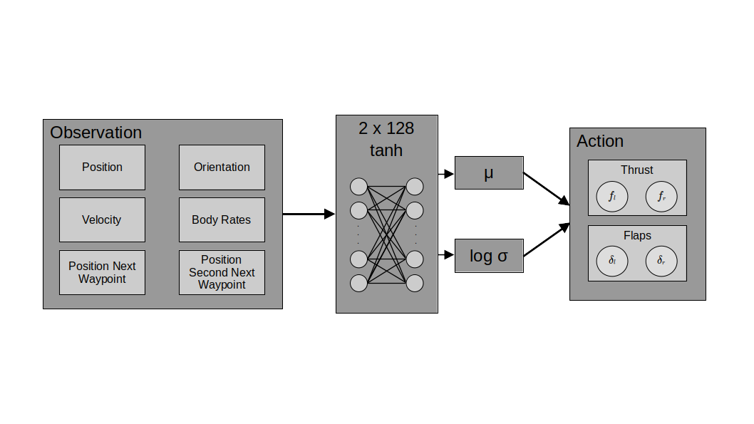
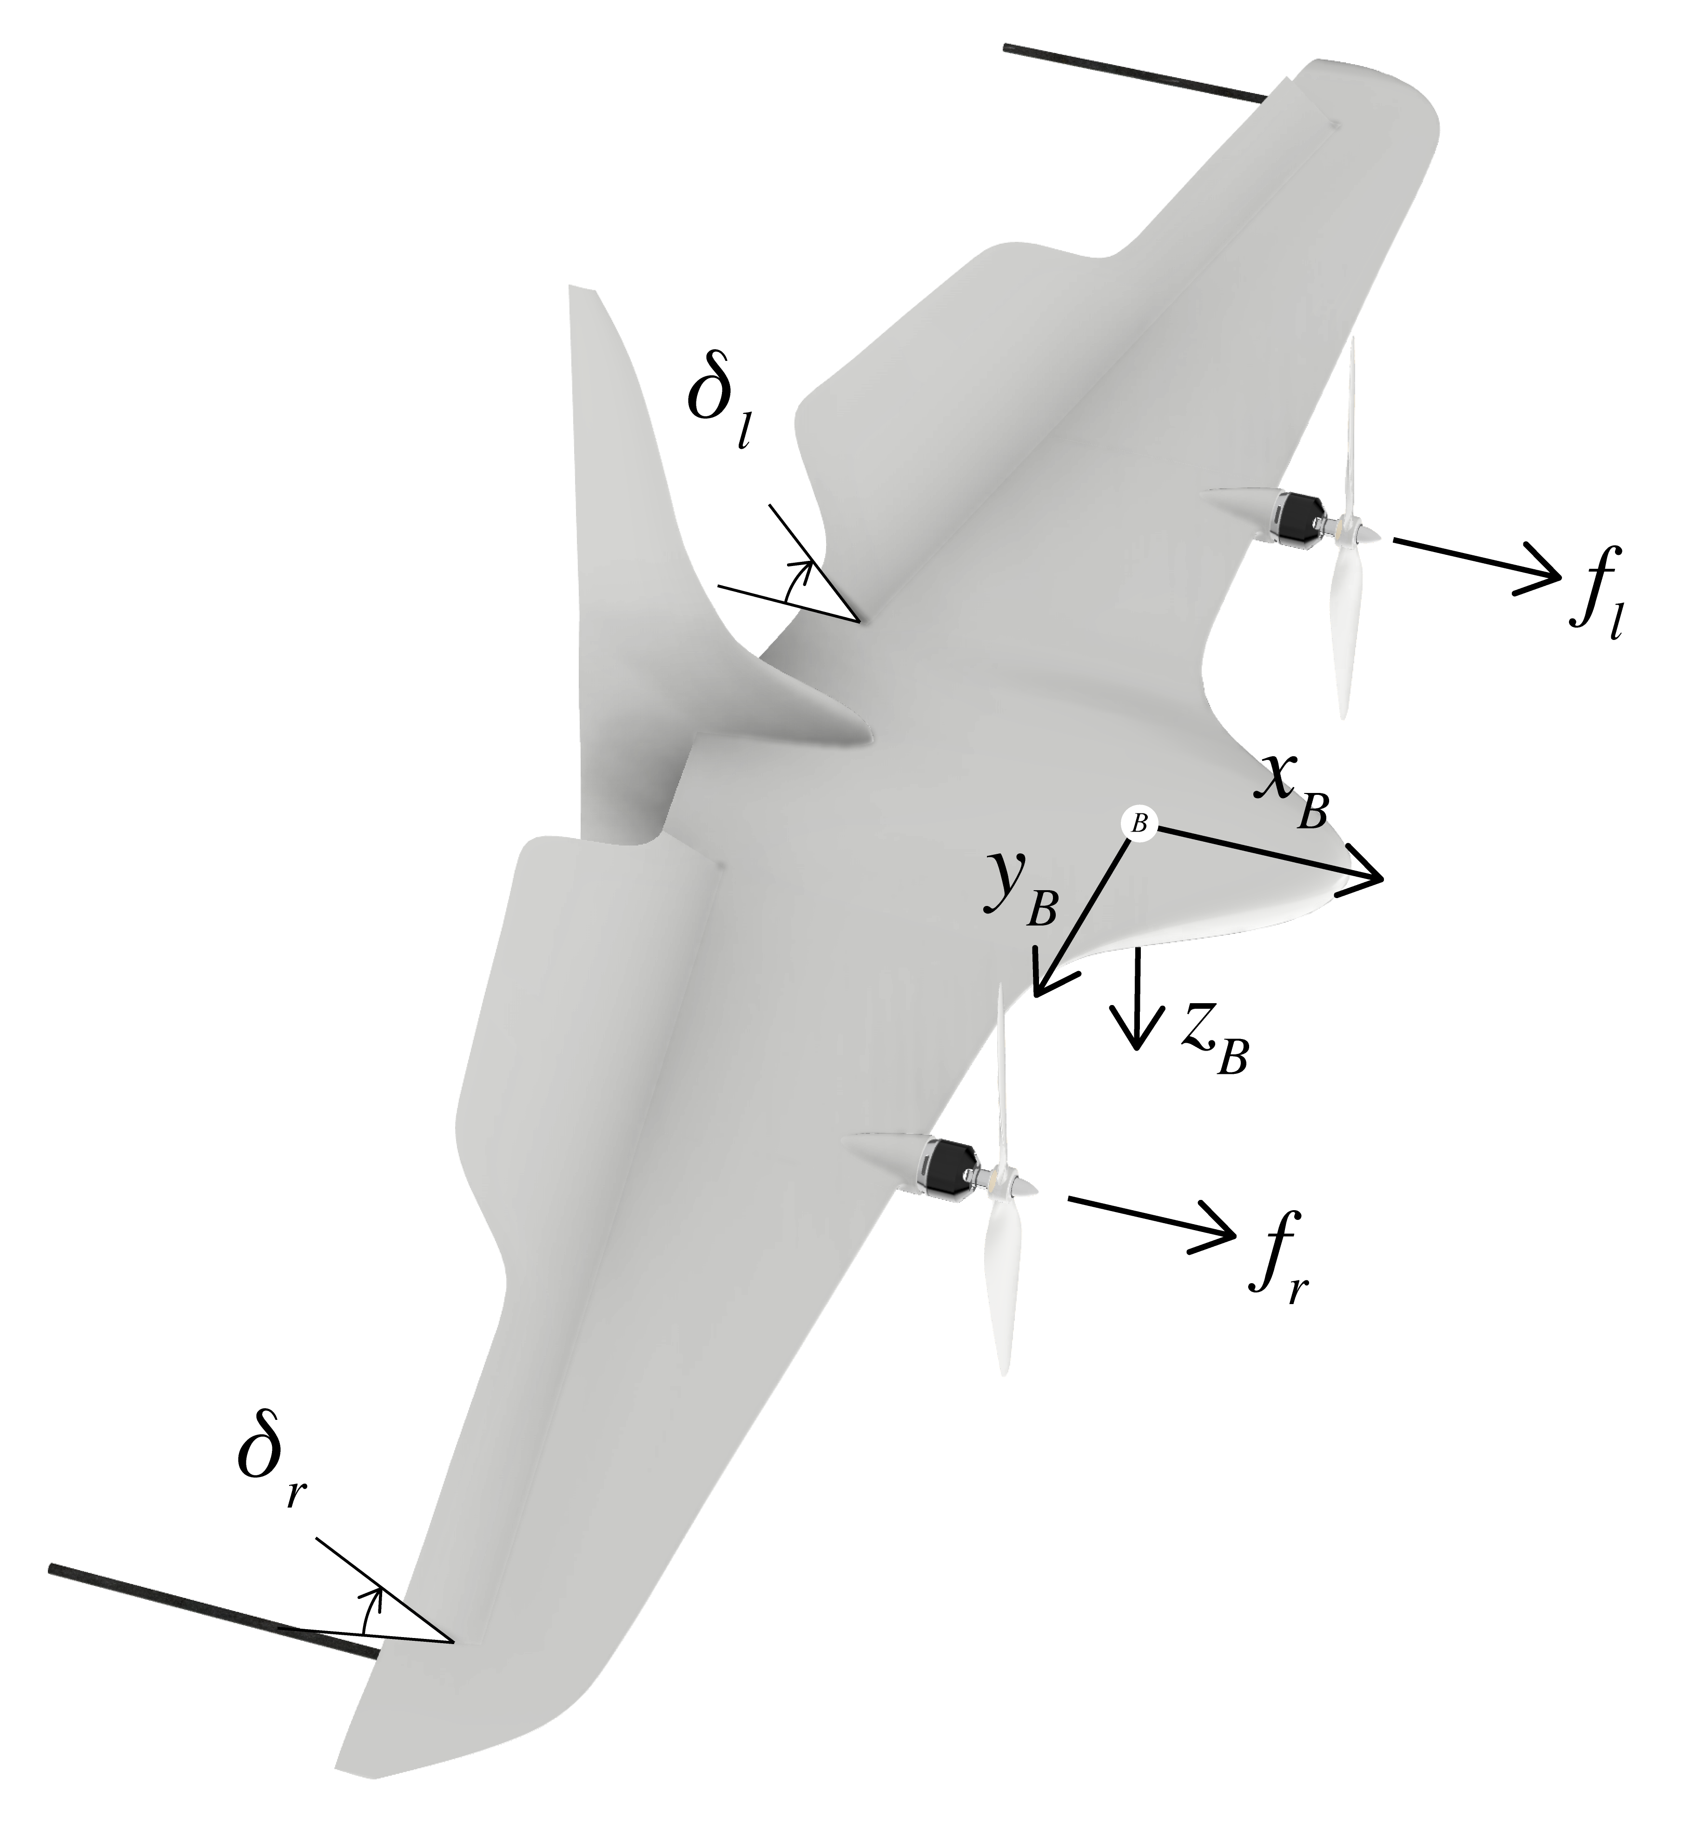
Our Approach
Actor Critic
Adam Optimizer

Slide 5
Our Approach
Actor Critic
Adam Optimizer

Slide 6
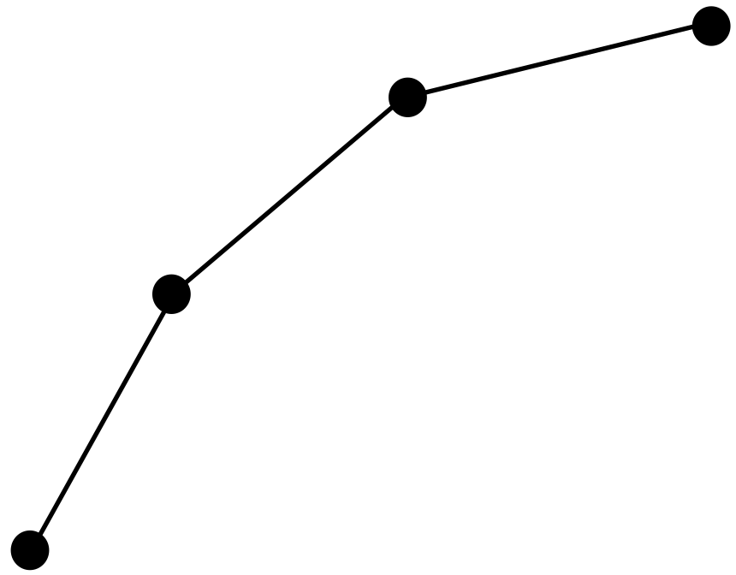
What has been done so far
Problem reduced to 2D
Steer towards single points
Fly along small random trajectories

Slide 7
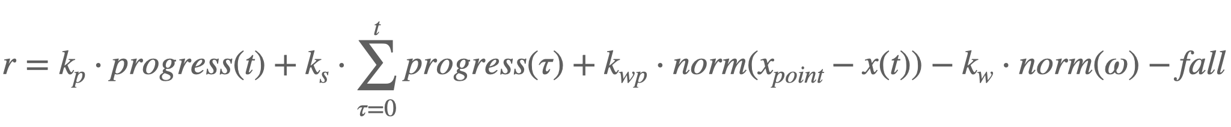
Reward Function
Encourage line progression
Encourage reaching points
Penalize spinning
Penalize inactivity

Slide 8
Training Strategy
Two Phases: Slow and Fast
Slow: Learn to follow path
Fast: Time optimality
* BILD?

Slide 9
SLOW VIDEO

Slide 10
SLOW PLOTS

Slide 11
FAST VIDEO

Slide 12
Next Steps
Adjust network architecture
Stabilize fast flight in 2D
Generalize achievements to 3D

Slide 13
Appendix

Slide 14
Our Approach
Actor Critic
Adam Optimizer
PPO

Slide 15
Next Steps
Adjust network architecture
Stabilize fast flight in 2D
Generalize achievements to 3D
  Adjust observation and action space
  Adjust network architecture for 3D
  (Optional: change drone model to quadrotor)

Slide 16
What has been done so far
2D
  Flight to one fix point
  Flight to random point
  Flight to random trajectory

Slide 17
Reward Function
r = k_p * r_p + k_s * r_s + k_wp * r_wp - k_ω * norm_ω - fall

Slide 18
Reward Function
r = k_wp * r_wp - k_ω * norm_ω + k_p * r_p + k_s * r_s - fall
Reward for reaching waypoint
k_wp = 10.0 * num_waypoints
if reached_waypoint
r_wp = exp(-norm(distance_center/r_tol)
else
r_wp = 0.0
end

Slide 19
Reward Function
r = k_wp * r_wp - k_ω * norm_ω + k_p * r_p + k_s * r_s - fall
Penalty for high body rates
k_ω = 0.01
norm_ω = norm(ω_B[3])

Slide 20
Reward Function
r = k_wp * r_wp - k_ω * norm_ω + k_p * r_p + k_s * r_s - fall
Reward for progress per step (negative if we fly in wrong direction)
k_p = 5.0 * s
r_p = (progress - progress_prev)

Slide 21
Reward Function
r = k_wp * r_wp - k_ω * norm_ω + k_p * r_p + k_s * r_s - fall
Reward for overall progress (since progress per step can have singularities)
k_s = s * (2 * v_max * Δt) / norm_way
r_s = progress

Slide 22
Reward Function: Slow Flight Phase
k_s = s * (2 * v_max * Δt) / norm_way
k_p = 5.0 * s
s = …....................................
Encourages velocity in certain range

Slide 23
Reward Function
r = k_wp * r_wp - k_ω * norm_ω + k_p * r_p + k_s * r_s - fall
Penalty for falling down

Slide 24
Termination Criteria
Im vortrag erwähnen?

