Slide 1
Decomposição
de Cholesky
OpenMP
Larissa Trindade

Slide 2
1. Contexto

Slide 3

Definição
Decomposição de Cholesky ou Fatoração de Cholesky é um método de álgebra linear para resoluções de sistemas lineares.
Para utilizar este método e necessário que a matriz do sistema linear seja quadrada (n x n), simétrica e definida positiva.
Para utilizar a decomposição de Cholesky é utilizado a equação (1) onde A é a matriz inicial e L é uma matriz triangular inferior com elementos da diagonal principal estritamente positivos.

Slide 4
Especificações da máquina
Intel® Core™ i5-7200
Core | 2
Threads | 4
Cache | 3 MB Intel® Smart Cache
Memória | 16 GB

Slide 5
2. Algoritmo

Slide 6
Algoritmo
novo
void cholesky(double** A, int n) {
double s = 0;
int diagonal = 0;
int i, j, k;
for (i = 0; i < n; i++) { //coluna
s = 0;
if (diagonal == 0) {
diagonal = 1;
for (k = 0; k < i; k++) s += A[i][k] * A[i][k];
A[i][i] = sqrt(A[i][i] - s);
}
for (j = i + 1; j < n; j++) { //linha
for (k = 0; k < i; k++) s += A[j][k] * A[i][k];
A[j][i] = (1.0 / A[i][i] * (A[j][i] - s));
A[i][j] = A[j][i];
}
diagonal = 0;
}
}
anterior
void cholesky(double** A, int n) {
for (int i = 0; i < n; i++) //linha
for (int j = 0; j < (i + 1); j++) { //coluna
double s = 0;
for (int k = 0; k < j; k++) s += A[i][k] * A[j][k];
A[i][j] = (i == j) ? sqrt(A[i][i] - s) : (1.0 / A[j][j] * (A[i][j] - s));
}
}

Slide 7

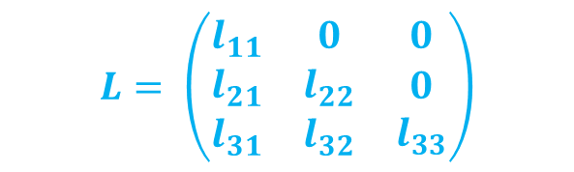


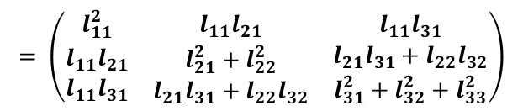
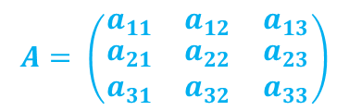
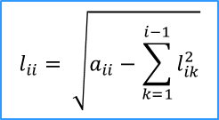
Algoritmo
$$A= \left(\begin{matrix}a_{11} & a_{12} & a_{13} \\ \begin{aligned}a_{21} \\ a_{31}\end{aligned} & \begin{aligned}a_{22} \\ a_{32}\end{aligned} & \begin{aligned}a_{23} \\ a_{33}\end{aligned}\end{matrix}\right)$$
$$= \left(\begin{matrix}l_{11}^{2} & l_{11}l_{21} & l_{11}l_{31} \\ \begin{aligned}l_{11}l_{21} \\ l_{11}l_{31}\end{aligned} & \begin{aligned}l_{21}^{2}+l_{22}^{2} \\ l_{21}l_{31}+l_{22}l_{32}\end{aligned} & \begin{aligned}l_{21}l_{31}+l_{22}l_{32} \\ l_{31}^{2}+l_{32}^{2}+l_{33}^{2}\end{aligned}\end{matrix}\right)$$
$$L= \left(\begin{matrix}l_{11} & 0 & 0 \\ \begin{aligned}l_{21} \\ l_{31}\end{aligned} & \begin{aligned}l_{22} \\ l_{32}\end{aligned} & \begin{aligned}0 \\ l_{33}\end{aligned}\end{matrix}\right)$$
Diagonal Principal
$$l_{22}= \sqrt{a_{22}−l_{21}^{2}}$$
$$l_{33}= \sqrt{a_{33}−l_{31}^{2}−l_{32}^{2}}$$
$$l_{11}= \sqrt{a_{11}}$$
$$l_{ii}= \sqrt{a_{ii}−\sum_{k=1}^{i−1}{l_{ik}^{2}}}$$

Slide 8



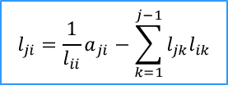
Algoritmo
$$A= \left(\begin{matrix}a_{11} & a_{12} & a_{13} \\ \begin{aligned}a_{21} \\ a_{31}\end{aligned} & \begin{aligned}a_{22} \\ a_{32}\end{aligned} & \begin{aligned}a_{23} \\ a_{33}\end{aligned}\end{matrix}\right)$$
$$= \left(\begin{matrix}l_{11}^{2} & l_{11}l_{21} & l_{11}l_{31} \\ \begin{aligned}l_{11}l_{21} \\ l_{11}l_{31}\end{aligned} & \begin{aligned}l_{21}^{2}+l_{22}^{2} \\ l_{21}l_{31}+l_{22}l_{32}\end{aligned} & \begin{aligned}l_{21}l_{31}+l_{22}l_{32} \\ l_{31}^{2}+l_{32}^{2}+l_{33}^{2}\end{aligned}\end{matrix}\right)$$
$$L= \left(\begin{matrix}l_{11} & 0 & 0 \\ \begin{aligned}l_{21} \\ l_{31}\end{aligned} & \begin{aligned}l_{22} \\ l_{32}\end{aligned} & \begin{aligned}0 \\ l_{33}\end{aligned}\end{matrix}\right)$$
Abaixo da Diagonal
$$l_{21}=\frac{1}{l_{11}}a_{21}$$
$$l_{31}=\frac{1}{l_{11}}a_{31}$$
$$l_{32}=\frac{1}{l_{22}}{(a}_{31}−l_{31}l_{21})$$
$$l_{ji}={\frac{1}{l_{ii}}a}_{ji}−\sum_{k=1}^{j−1}{l_{jk}l_{ik}}$$

Slide 9

Algoritmo
Diagonal Principal
void cholesky(double** A, int n) {
double s = 0;
int diagonal = 0;
int i, j, k;
for (i = 0; i < n; i++) { //coluna
s = 0;
if (diagonal == 0) {
diagonal = 1;
for (k = 0; k < i; k++) s += A[i][k] * A[i][k];
A[i][i] = sqrt(A[i][i] - s);
}
for (j = i + 1; j < n; j++) { //linha
for (k = 0; k < i; k++) s += A[j][k] * A[i][k];
A[j][i] = (1.0 / A[i][i] * (A[j][i] - s));
A[i][j] = A[j][i];
}
diagonal = 0;
}
}
$$l_{ii}= \sqrt{a_{ii}−\sum_{k=1}^{i−1}{l_{ik}^{2}}}$$

Slide 10
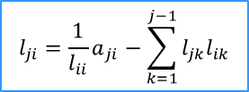
Algoritmo
Abaixo da Diagonal
void cholesky(double** A, int n) {
double s = 0;
int diagonal = 0;
int i, j, k;
for (i = 0; i < n; i++) { //coluna
s = 0;
if (diagonal == 0) {
diagonal = 1;
for (k = 0; k < i; k++) s += A[i][k] * A[i][k];
A[i][i] = sqrt(A[i][i] - s);
}
for (j = i + 1; j < n; j++) { //linha
for (k = 0; k < i; k++) s += A[j][k] * A[i][k];
A[j][i] = (1.0 / A[i][i] * (A[j][i] - s));
A[i][j] = A[j][i];
}
diagonal = 0;
}
}
$$l_{ji}={\frac{1}{l_{ii}}a}_{ji}−\sum_{k=1}^{j−1}{l_{jk}l_{ik}}$$

Slide 11
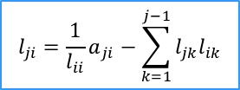
Algoritmo paralelizado
void cholesky(double** A, int n) {
double s = 0;
int diagonal = 0;
int i, j, k;
for (i = 0; i < n; i++) { //coluna
s = 0;
if (diagonal == 0) {
diagonal = 1;
for (k = 0; k < i; k++) s += A[i][k] * A[i][k];
A[i][i] = sqrt(A[i][i] - s);
}
#pragma omp parallel for shared(A, i, n) private(j, k, s)
for (j = i + 1; j < n; j++) { //linha
for (k = 0; k < i; k++) s += A[j][k] * A[i][k];
A[j][i] = (1.0 / A[i][i] * (A[j][i] - s));
A[i][j] = A[j][i];
}
diagonal = 0;
}
}
$$l_{ji}={\frac{1}{l_{ii}}a}_{ji}−\sum_{k=1}^{j−1}{l_{jk}l_{ik}}$$

Slide 12
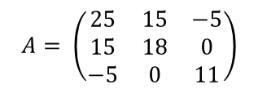
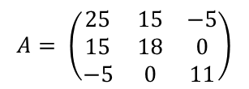

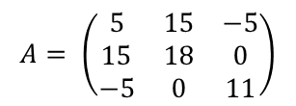
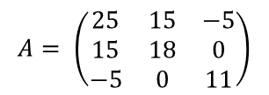
Exemplo com 2 Threads
void cholesky(double** A, int n) {
double s = 0;
int diagonal = 0;
int i, j, k;
for (i = 0; i < n; i++) { //coluna
s = 0;
if (diagonal == 0) {
diagonal = 1;
for (k = 0; k < i; k++) s += A[i][k] * A[i][k];
A[i][i] = sqrt(A[i][i] - s);
}
#pragma omp parallel for shared(A, i) private(j, k, s)
for (j = i + 1; j < n; j++) { //linha
for (k = 0; k < i; k++) s += A[j][k] * A[i][k];
A[j][i] = (1.0 / A[i][i] * (A[j][i] - s));
A[i][j] = A[j][i];
}
diagonal = 0;
}
}
$$A= \left(\begin{matrix}25 & 15 & −5 \\ 15 & 18 & 0 \\ −5 & 0 & 11\end{matrix}\right)$$
i=0
$$A= \left(\begin{matrix}25 & 15 & −5 \\ 15 & 18 & 0 \\ −5 & 0 & 11\end{matrix}\right)$$
diagonal = 0
$$A= \left(\begin{matrix}25 & 15 & −5 \\ 15 & 18 & 0 \\ −5 & 0 & 11\end{matrix}\right)$$
$$A= \left(\begin{matrix}5 & 15 & −5 \\ 15 & 18 & 0 \\ −5 & 0 & 11\end{matrix}\right)$$
$$l_{11}= \sqrt{a_{11}}=5$$

Slide 13
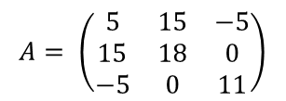


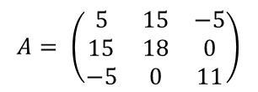
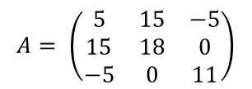
Exemplo com 2 Threads
void cholesky(double** A, int n) {
double s = 0;
int diagonal = 0;
int i, j, k;
for (i = 0; i < n; i++) { //coluna
s = 0;
if (diagonal == 0) {
diagonal = 1;
for (k = 0; k < i; k++) s += A[i][k] * A[i][k];
A[i][i] = sqrt(A[i][i] - s);
}
#pragma omp parallel for shared(A, i) private(j, k, s)
for (j = i + 1; j < n; j++) { //linha
for (k = 0; k < i; k++) s += A[j][k] * A[i][k];
A[j][i] = (1.0 / A[i][i] * (A[j][i] - s));
A[i][j] = A[j][i];
}
diagonal = 0;
}
}
i = 0
$$A= \left(\begin{matrix}5 & 15 & −5 \\ 15 & 18 & 0 \\ −5 & 0 & 11\end{matrix}\right)$$
diagonal = 1
Parallel for – 2 Threads
j = i + 1
Thread 0
Thread 1
i = 0 j = 1
i = 0 j = 2
$$A= \left(\begin{matrix}5 & 15 & −5 \\ 15 & 18 & 0 \\ −5 & 0 & 11\end{matrix}\right)$$
$$A= \left(\begin{matrix}5 & 15 & −5 \\ 15 & 18 & 0 \\ −5 & 0 & 11\end{matrix}\right)$$
$$l_{21}=\frac{1}{l_{11}}a_{21}=\frac{15}{5}=3$$
$$l_{31}=\frac{1}{l_{11}}a_{31}=\frac{−5}{5}=−1$$

Slide 14
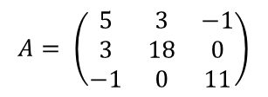

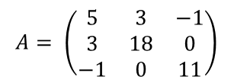
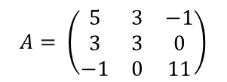
Exemplo com 2 Threads
void cholesky(double** A, int n) {
double s = 0;
int diagonal = 0;
int i, j, k;
for (i = 0; i < n; i++) { //coluna
s = 0;
if (diagonal == 0) {
diagonal = 1;
for (k = 0; k < i; k++) s += A[i][k] * A[i][k];
A[i][i] = sqrt(A[i][i] - s);
}
#pragma omp parallel for shared(A, i) private(j, k, s)
for (j = i + 1; j < n; j++) { //linha
for (k = 0; k < i; k++) s += A[j][k] * A[i][k];
A[j][i] = (1.0 / A[i][i] * (A[j][i] - s));
A[i][j] = A[j][i];
}
diagonal = 0;
}
}
i=1
$$A= \left(\begin{matrix}5 & 3 & −1 \\ 3 & 18 & 0 \\ −1 & 0 & 11\end{matrix}\right)$$
diagonal = 0
$$A= \left(\begin{matrix}5 & 3 & −1 \\ 3 & 18 & 0 \\ −1 & 0 & 11\end{matrix}\right)$$
$$l_{22}= \sqrt{a_{22}−l_{21}^{2}}=\sqrt{18−3^{2}}=\sqrt{9}=3$$
$$A= \left(\begin{matrix}5 & 3 & −1 \\ 3 & 3 & 0 \\ −1 & 0 & 11\end{matrix}\right)$$

Slide 15
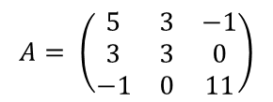

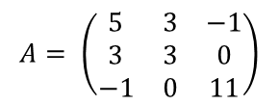
Exemplo com 2 Threads
void cholesky(double** A, int n) {
double s = 0;
int diagonal = 0;
int i, j, k;
for (i = 0; i < n; i++) { //coluna
s = 0;
if (diagonal == 0) {
diagonal = 1;
for (k = 0; k < i; k++) s += A[i][k] * A[i][k];
A[i][i] = sqrt(A[i][i] - s);
}
#pragma omp parallel for shared(A, i) private(j, k, s)
for (j = i + 1; j < n; j++) { //linha
for (k = 0; k < i; k++) s += A[j][k] * A[i][k];
A[j][i] = (1.0 / A[i][i] * (A[j][i] - s));
A[i][j] = A[j][i];
}
diagonal = 0;
}
}
i = 1
$$A= \left(\begin{matrix}5 & 3 & −1 \\ 3 & 3 & 0 \\ −1 & 0 & 11\end{matrix}\right)$$
diagonal = 1
Parallel for – 2 Threads
j = i + 1
Thread 1
não necessária
Thread 0
i = 1 j = 2
$$A= \left(\begin{matrix}5 & 3 & −1 \\ 3 & 3 & 0 \\ −1 & 0 & 11\end{matrix}\right)$$
$$l_{32}=\frac{1}{l_{22}}{(a}_{31}−l_{31}l_{21})=\frac{1}{3}(0−(−1∗3))=\frac{3}{3}=1$$

Slide 16
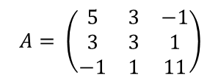

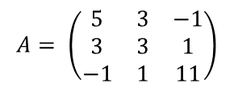
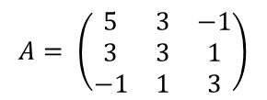
Exemplo com 2 Threads
void cholesky(double** A, int n) {
double s = 0;
int diagonal = 0;
int i, j, k;
for (i = 0; i < n; i++) { //coluna
s = 0;
if (diagonal == 0) {
diagonal = 1;
for (k = 0; k < i; k++) s += A[i][k] * A[i][k];
A[i][i] = sqrt(A[i][i] - s);
}
#pragma omp parallel for shared(A, i) private(j, k, s)
for (j = i + 1; j < n; j++) { //linha
for (k = 0; k < i; k++) s += A[j][k] * A[i][k];
A[j][i] = (1.0 / A[i][i] * (A[j][i] - s));
A[i][j] = A[j][i];
}
diagonal = 0;
}
}
i=2
$$A= \left(\begin{matrix}5 & 3 & −1 \\ 3 & 3 & 1 \\ −1 & 1 & 11\end{matrix}\right)$$
diagonal = 0
$$A= \left(\begin{matrix}5 & 3 & −1 \\ 3 & 3 & 1 \\ −1 & 1 & 11\end{matrix}\right)$$
$$l_{33}= \sqrt{a_{33}−l_{31}^{2}−l_{32}^{2}}=\sqrt{11−{(−1)}^{2}−1^{2}}= \sqrt{9}=3$$
$$A= \left(\begin{matrix}5 & 3 & −1 \\ 3 & 3 & 1 \\ −1 & 1 & 3\end{matrix}\right)$$

Slide 17
3. Resultados

Slide 18
Resultados
3 entradas analisadas e definidas pelo trabalho 1:
cholesky_5000.in
cholesky_7000.in
cholesky_10000.in
Verificação: Próprio programa da Decomposição de Cholesky (caso algo esteja errado e a matriz não esteja correta, o arquivo .out possui algumas linhas com #INDO)

Slide 19
Resultados – Tempo médio
Tamanho | Sequencial Antigo (min) | Sequencial Novo (min) | 2 Threads (s) | 3 Threads (s) | 4 Threads (s)
5000 | 71,4 | 68,12 | 39,98 | 44,42 | 35,83
7000 | 189 | 185,41 | 109,52 | 113,67 | 97,91
10000 | 547,8 | 539,32 | 332,08 | 337,29 | 282,64
Média realizada com a remoção dos outliers

Slide 20
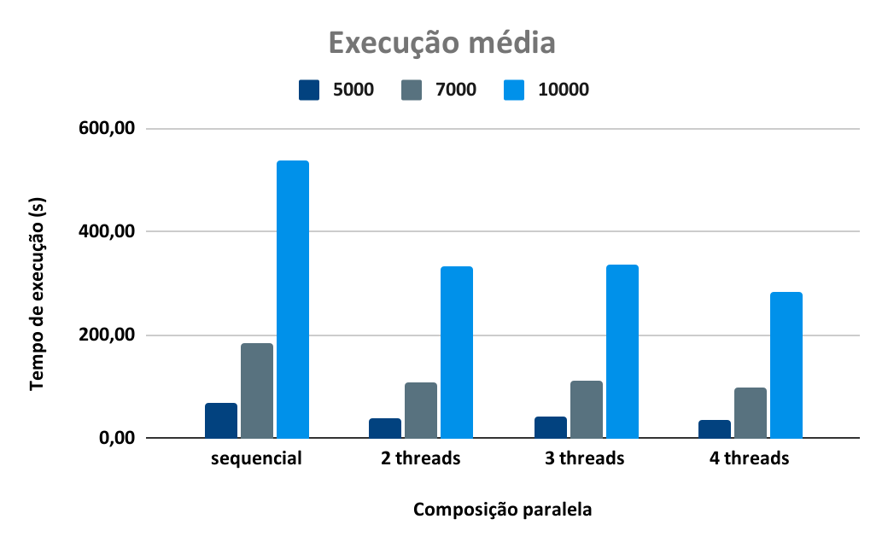

Slide 21
Speedup - Médio com omp
Tamanho | 2 Threads | 3 Threads | 4 Threads
5000 | 1,70 | 1,53 | 1,90
7000 | 1,69 | 1,63 | 1,89
10000 | 1,62 | 1,60 | 1,91

Slide 22
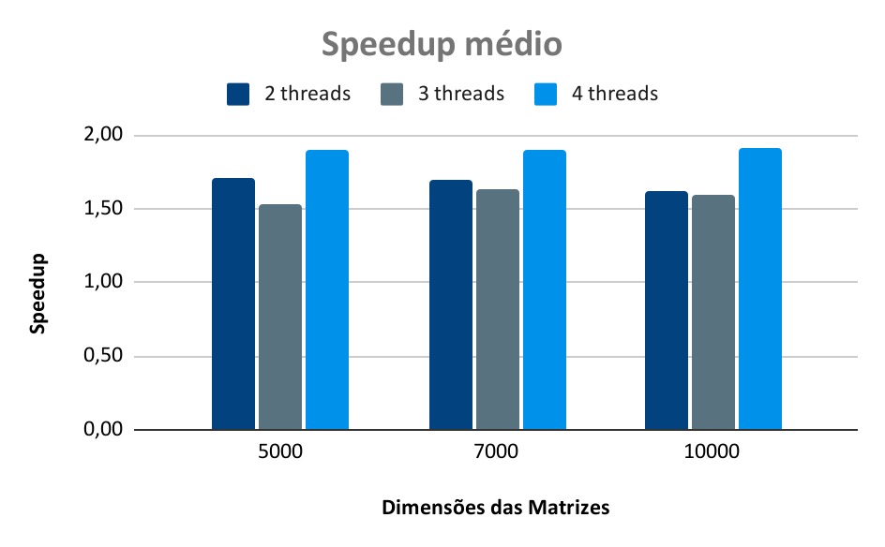

Slide 23


Obrigada!
lala.trindade.2008@gmail.com
https://github.com/LarissaTrin/CholeskyDecomposition

