Slide 1
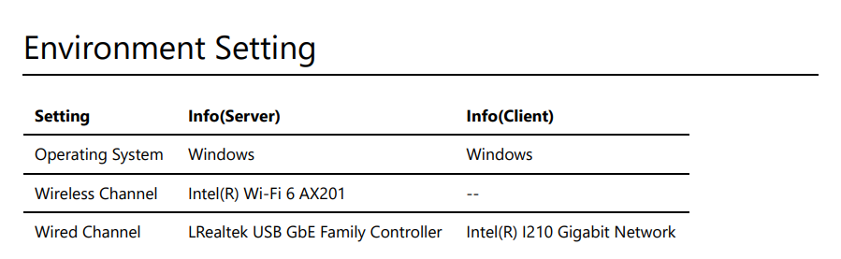

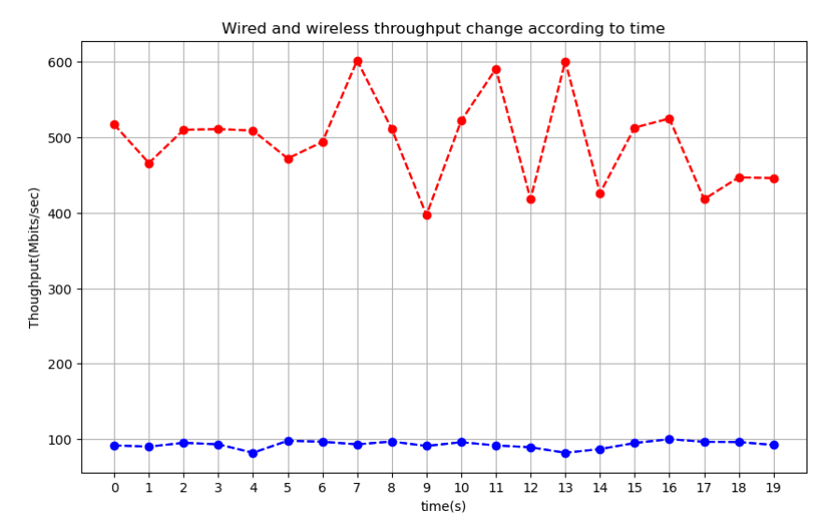
Different Interface
It's easy to understand that wired channel has better bandwidth due to the worse noisy for wireless signal as well as the multiple user for iCampus WIFI.
KAUST Network
WIFI
Ethernet
Server(Harbor)
10.240.136.29
Client(Campus)
10.68.75.53
KAUST Network
Ethernet
Ethernet
Server(Harbor)
10.185.179.41
Client(Campus)
10.68.75.53
Da LI

Slide 2
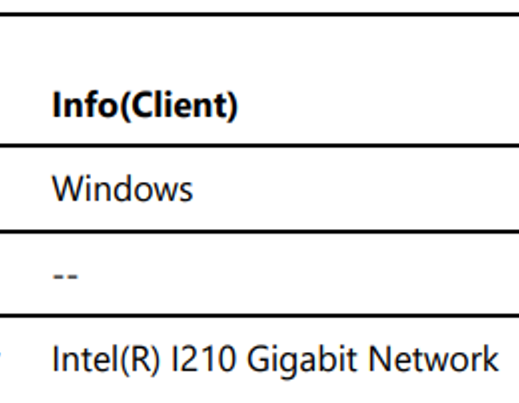
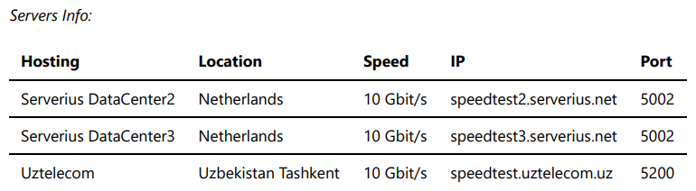
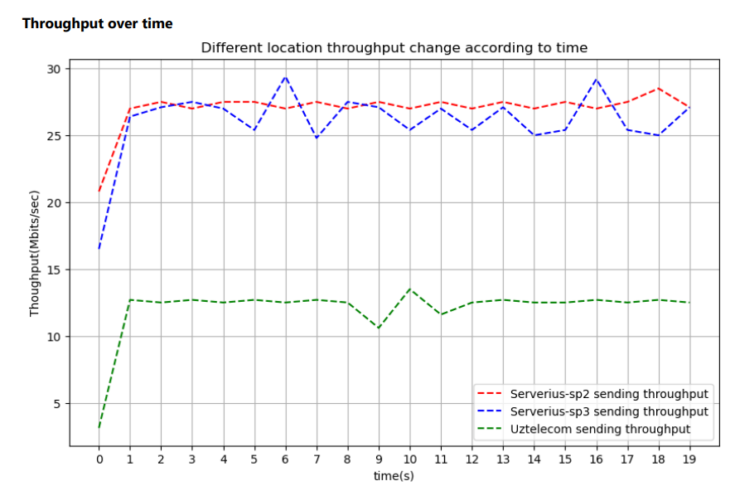
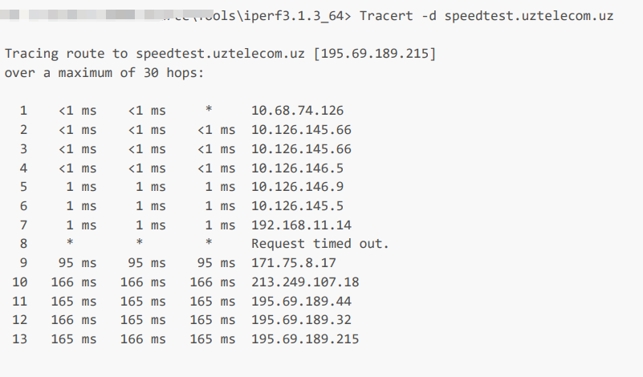
Different locations
Speedtest2 and Speedtest3
Features:
Have same claimed speed
Small difference
Close location
Difference:
Speedtest3 has heavier traffic
Uztelecom
Features:
Have same claimed speed
Difference:
Some bad router nodes(Tracert)
Da LI

Slide 3
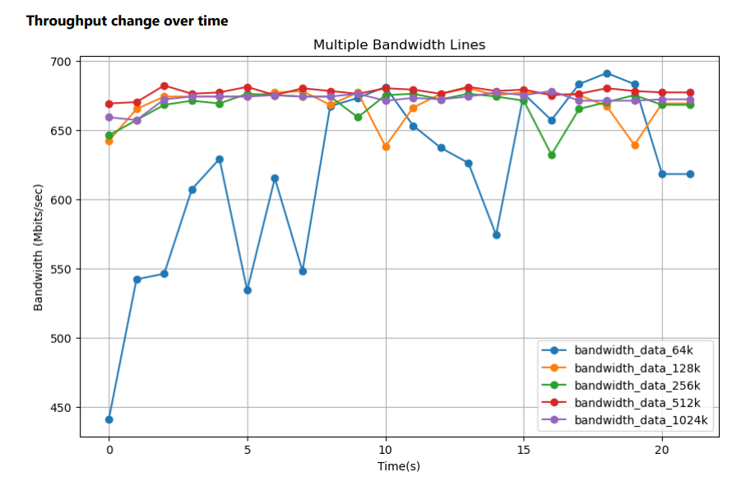
Different Bufferlen
The length of buffers to read or write. iPerf works by writing an array of len bytes a number of times. Default is 128 KB for TCP, 8 KB for UDP.
Smaller buffers:
increase system overhead
cause throughput fluctuations
Larger buffers:
reduce system calls
improving throughput stability and efficiency
especially in high-bandwidth networks.(Unless reach the limit of the network)
Da LI

Slide 4
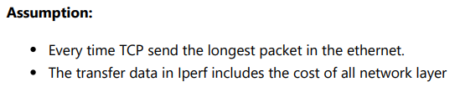
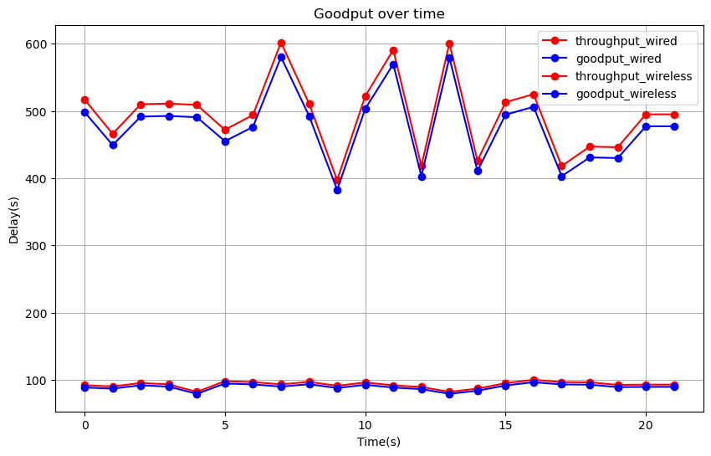
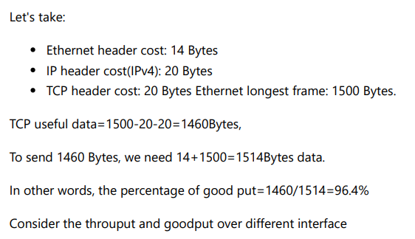
Goodput
Da LI

Slide 5

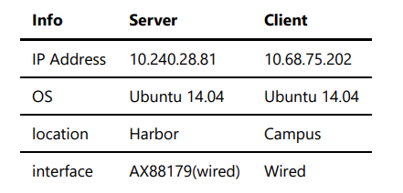
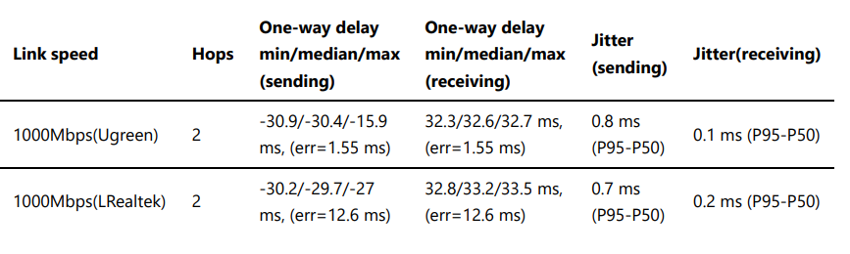
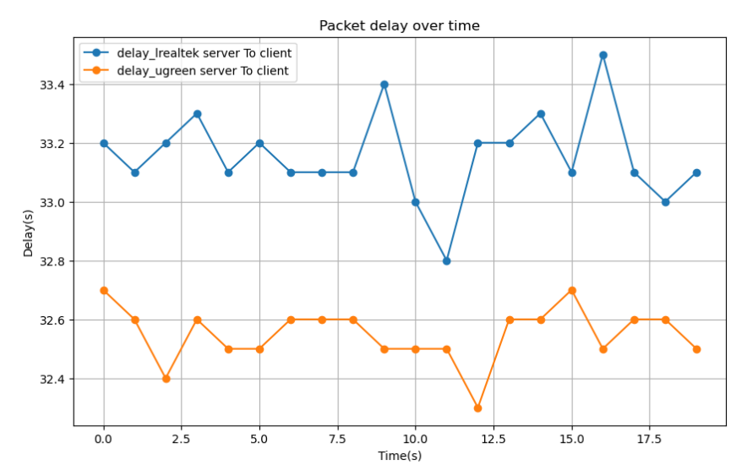
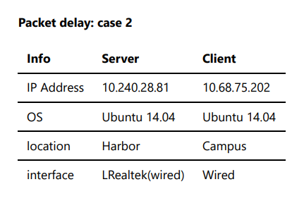
Owamp
Da LI

Slide 6
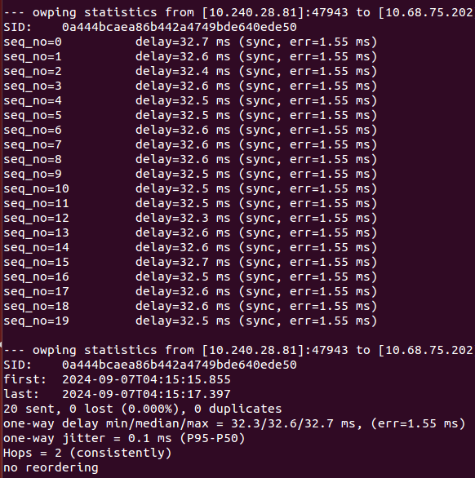
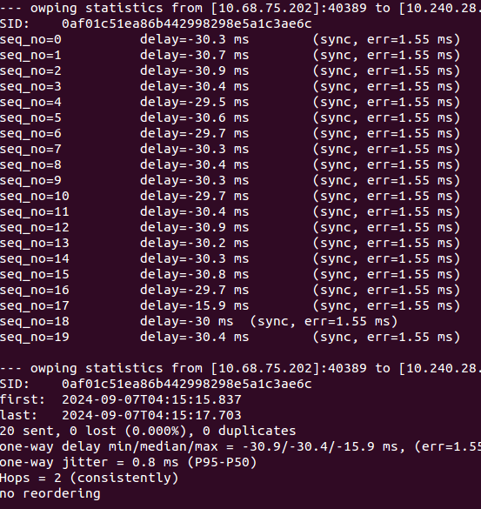
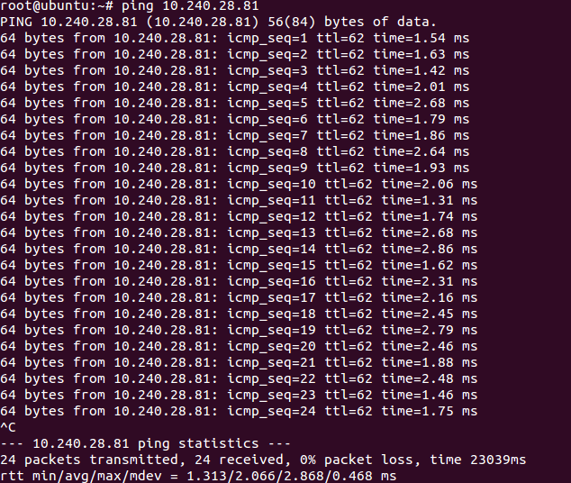
Question
Why we have negative delay value from owamp? What’s the err time? If the delay time plus or minus the err time equal to the real delay?
Why the one way delay is totally different the round trip time(RTT) from ping tool?
delay min/median/max = 32.3/32.6/32.7 ms, (err=1.55 ms)
delay min/median/max = -30.9/-30.4/-15.9 ms
rtt min/avg/max/mdev = 1.313/2.066/2.868/0.468 ms

