Slide 1
1. Experiment Setting
Experiment Design:
Queue length is tested with fine-to-coarse classification rule.[1,4,8,12,….100,200…1000]
Each queue configuration is tested five times for 50 seconds.
TCP: iPerf with JSON output; UDP: throughput only.
Use ip link to change the OS queue instead of ethtool

Slide 2
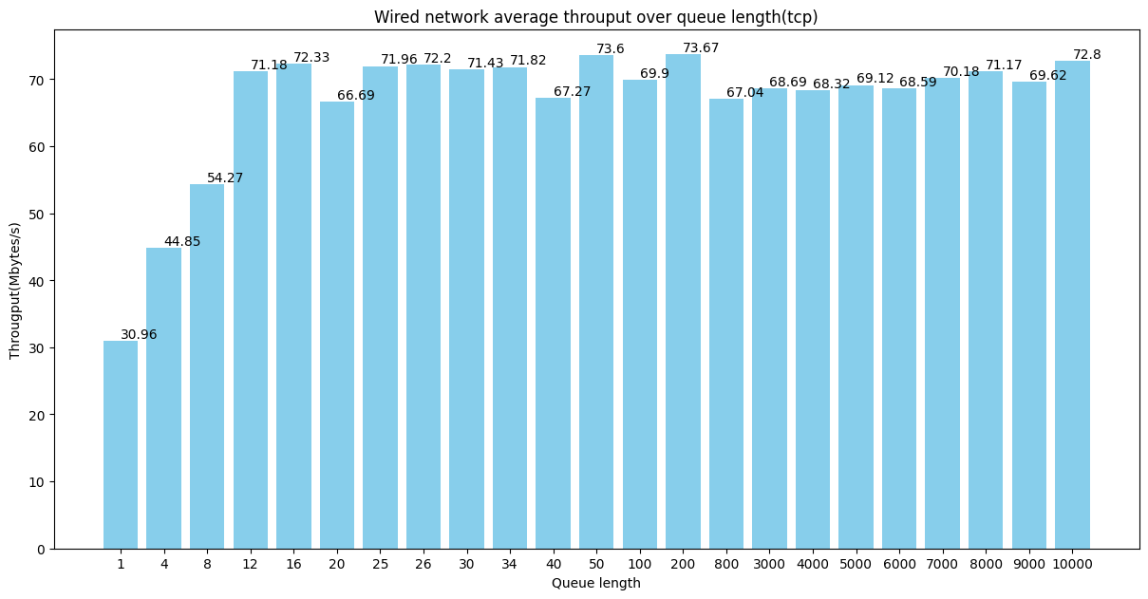
Throughput increases with the queue length grows
Throughput reaches the peak when the queue length at range (50,200)
Keep stable after 800

Slide 3
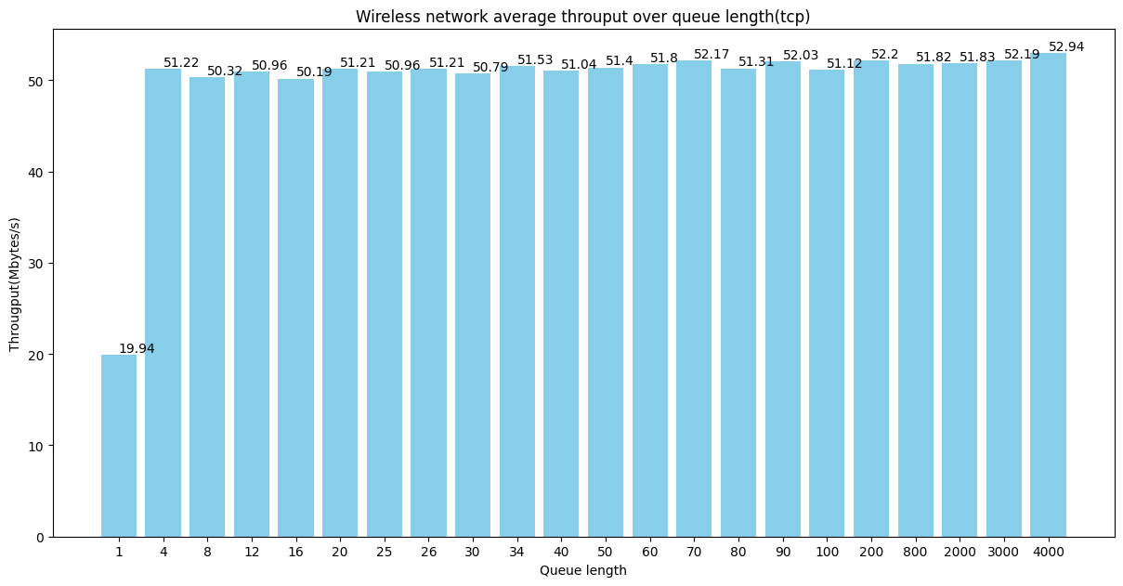
Throughput increases dramatically with the queue length grows to 4 and keep stable after that.
For wireless network, queue length is not the key factor for network performance.

Slide 4
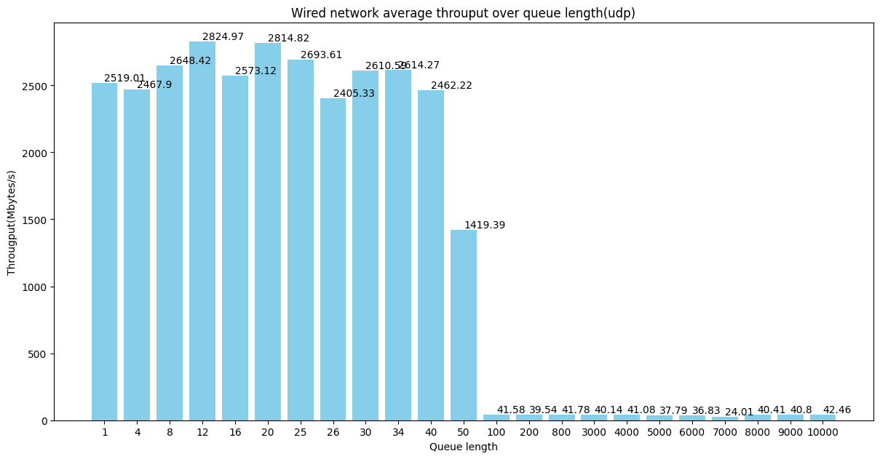
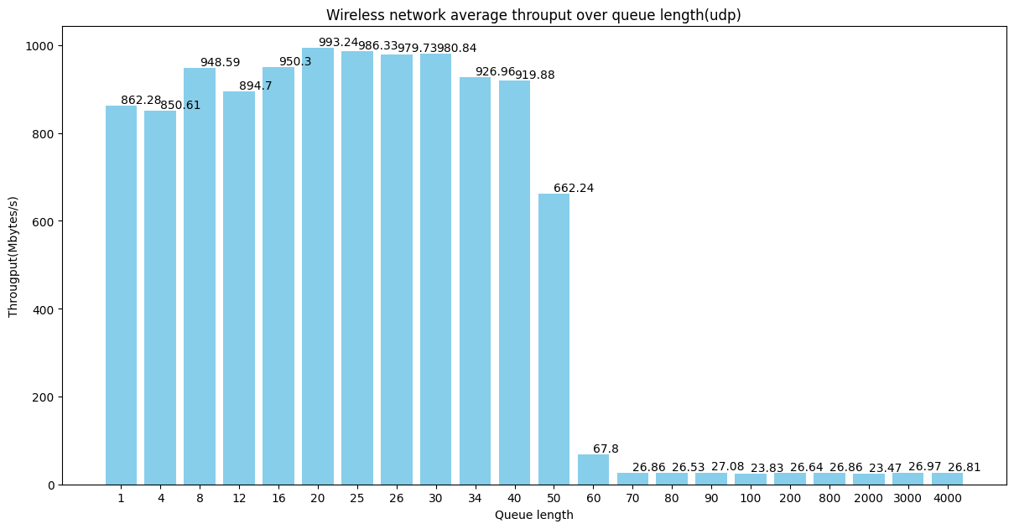
upward trend before 25
Dramatical drop after 50
Capability of the network interface
Host NAT forwarding limit

Slide 5
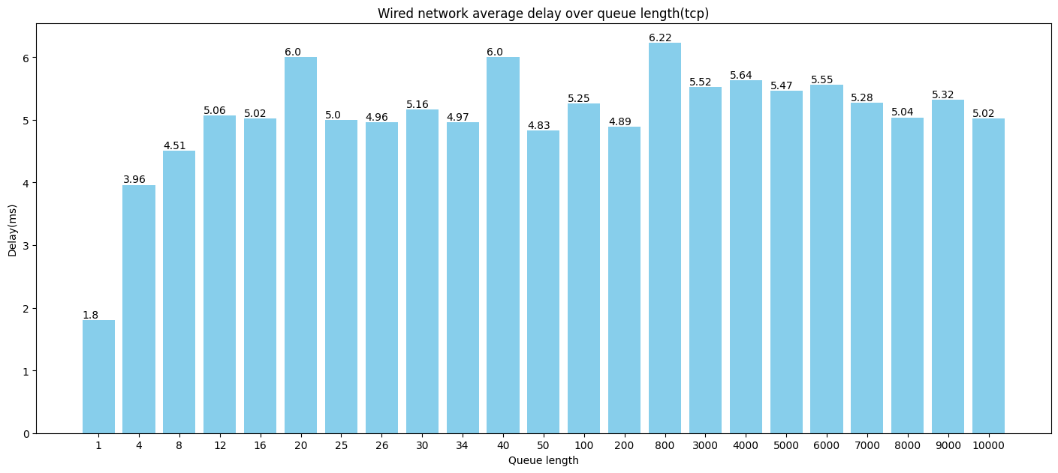
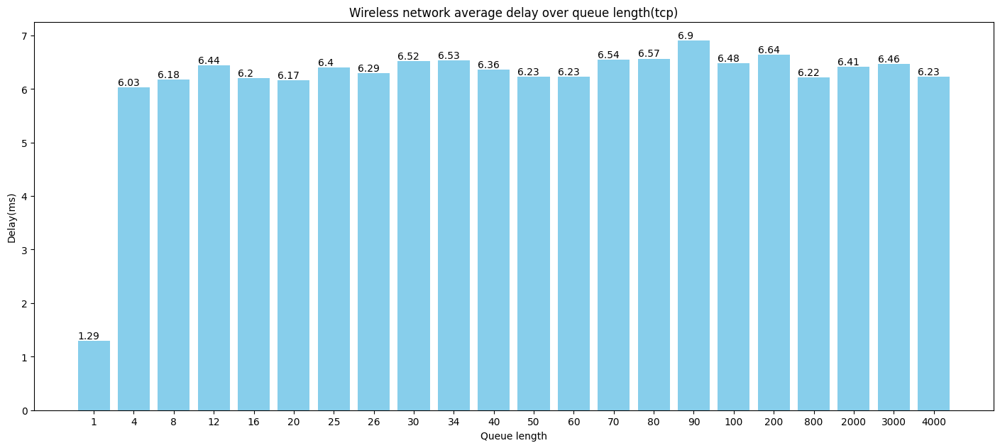
Smallest delay when queue length=1
Range in 50-100, we can have a relatively small delay.

Slide 6
4. Conclusion
Summary of Key Findings:
Optimal queue length is around 50 for best performance.
Wired: 73.67 MBytes/s; Wireless: 51.4 MBytes/s. Delay is also relatively small in this case.
Balances throughput and delay for optimal performance. Otherwise we can choose queue length=1 all the time.

