Slide 1
FOR INSTRUCTOR PURPOSES ONLY
instructor notes
Instructor Prep
Review & modify lesson plan & slide deck
Write learning objectives & relevant information on board
Review Student Roster and Instructor Checklist
Prepare handout to distribute to students.

Slide 2
FOR INSTRUCTOR PURPOSES ONLY
Materials

Slide 3
FOR INSTRUCTOR PURPOSES ONLY
PRE-WORK
Before this lesson, students will need to:
Bring a laptop with Anaconda installed. Scroll to your operating system version and click on the install button for Anaconda with Python 2.7. Note: we’ll be using Python version 2.7 in this workshop.
We will be using Jupyter Notebooks as the main IDE for the workshop. If you are using Anaconda (with Win, Mac or Linux) you are ready to go

Slide 4
Data Science 101
Adam Blomberg
DSI+ Instructor, General Assembly

Slide 5
Learning objectives
Data Science 101
Explain the field of data science, defining common roles & trends.
Explore popular tools & resources to visualize, analyze, & model data.
Recognize the types of problems that can be solved by data science.
Apply the data science workflow to provide real world recommendations.
Create a custom learning plan to continue building your data science skills after this workshop!
Notes:
Learning objectives will frame the class and give student reference points.

Slide 6
Data Science 101
PRE-WORK

Slide 7
Pre-WORK REVIEW
Bring a laptop with Anaconda installed. Scroll to your operating system version and click on the install button for Anaconda with Python 2.7.
We will be using Jupyter Notebooks as the main IDE for the workshop. If you have installed Anaconda, then you are ready to go!

Slide 8
Data Science 101
OPENING
Notes:
10m
Instructor Note:
I strongly recommend you time-box each step of the activities. Recommended timing is included on each slide.
More time won’t make the ideas better, it will just give them more time to feel stressed—have them work quickly and focus in on the most important things.

Slide 9
About Me
Welcome to Data Science 101!
Here's a bit about me:
Name: Adam Blomberg
Background: Nuclear Physics PhD, 15 years experience
Experience at GA: DSI student, teach 3rd DSI cohort next week
Last Movie Watched: Our Souls at Night (Netflix)
Notes:
Monte Carlo Methods for physics experiments in Fortran, C++, and Python
MIS and Business Admin., Database design - SQL and Web interfaces
Cloud computing
Automation

Slide 10
About You
Before we dive in, let’s talk a bit about you!
Name
What brings you to DS 101?
(Current Activities and Goals)
What is the last movie you watched?

Slide 11
OUR EXPECTATIONS
You're ready to take charge of your learning experience.
You're curious and excited about data science!
You've installed Anaconda with Python 2.7.

Slide 12
The Big Picture
What we’ll cover:
Why data science & what it can do for me?
Data science skills
Explore the Data Science Toolkit
Analyse data
Algorithms in action

Slide 13
The Big Picture
Why this topic matters:
Data science is a sought-after skill
Using Python due to its increased popularity and simplicity
Why this topic rocks:
Data science opens up a door to a variety of opportunities
Data science has been dubbed the “Sexiest job of the 21st century”!

Slide 14
Introduction
What is Data Science and What can it do for me?
Notes:
15m
Instructor Note:
I strongly recommend you time-box each step of the activities. Recommended timing is included on each slide.

Slide 15
The sexiest job of the 21st century
What is Data Science?
Data Science: A set of tools and techniques used to extract useful information from data.
An interdisciplinary, problem-solving oriented subject.
The application of scientific techniques to practical problems.
A rapidly growing field.

Slide 16
Your turn: Qualities of a data scientist and you
DIRECTIONS
Let's talk through the following questions as a group:
What do you think are the most important qualities for a data scientist?
Can you think of any other quality/skill we have not mentioned?
What is your field of expertise?
What tools have you used? (Excel, Stata, R, or Python)
Where are you in the intersection of these skills?
deliverable
Discussion and Questions in Group
Notes:
Instructor Note: The discussion for this part of the lesson can be used to prompt the students to self-assess those areas where they are stronger/weaker. This will help with creating their "Learning Plan".

Slide 17
Qualities of a data scientist
Programming skills
Math and Statistics knowledge
Business acumen (substantive expertise)
Plus: Communication skills

Slide 18
Self assessment
Take a moment to rate yourself in the areas we’ve discussed at:
https://goo.gl/forms/8EV0f6SL0e7Savss1

Slide 19
What can Data Science do for me?
Ask good questions:
What is required?
How are results evaluated? (measures of success)
What do we currently know? (existing data)
What has happened? (descriptive analytics)
What will happen (if)? (predictive analytics)
What to do to achieve what we require? (insight)
Define and test a hypothesis/run experiments.

Slide 20
What can Data Science do for me?
Scrape, munge, & sample business relevant data.
Manipulate, sanitize, and wrangle data.
Visualize data.
Understand data relationships.
Tell the machine how to learn from data.
Create data products that deliver actionable insight.
Tell relevant business stories from data.

Slide 21
Independent Practice: Self-assessment
DIRECTIONS
Create a table for the qualities of a data scientist and then rate yourself on each of these skills on a scale from 1-10.
We will then use the data to show how simple statistics in action are part of the data science workflow.
deliverable
Skill | Name
Programming
Math
Statistics
Business acumen
Communication
A table with your self-assessment:
Notes:
Instructor Note:
Check: With one minute left, have one student share their answer with the class.

Slide 22
DEMO
Visualizing the Data Science Workflow
Notes:
20m
Instructor Note:
Make sure to emphasize that the workflow is an iterative process and not necessarily a linear one.

Slide 23
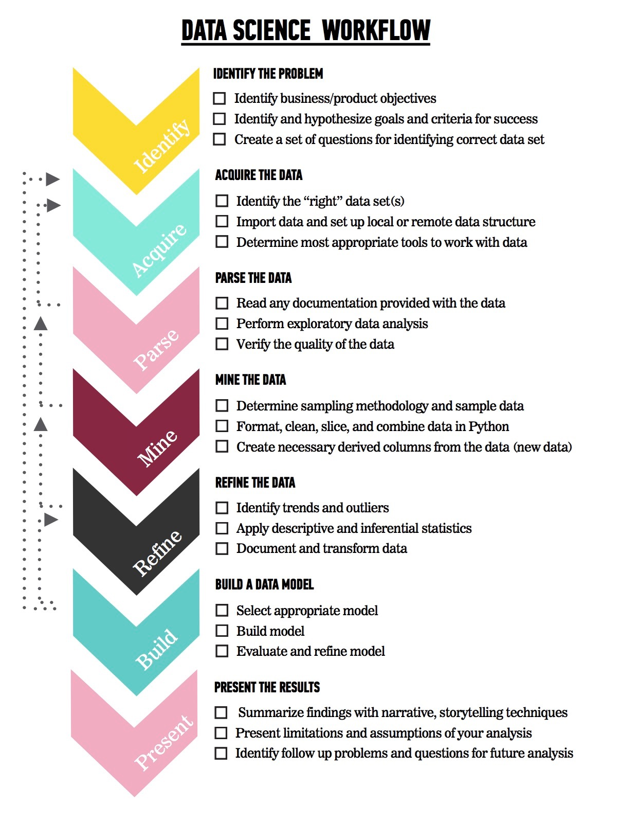
Main Phases
The data Science workflow
Identify the problem
Acquire the data
Parse the data
Mine the data
Refine the data
Build a data model
Present the results

Slide 24
Your turn: Visualizing the data Science workflow
DIRECTIONS
You are a junior data scientist at Amazon. Your boss asks you about the leading indicators that a user will make a new online purchase. How would you go about solving this question?
Acquire Data: What could we do first here? What are some considerations we should make?
Parse Data: What do you think this means? Why is it important?
Mine and Refine: Is the raw data enough? What calculations/transformation do you recommend doing? How do you determine the presence of outliers?
Data model: What attributes would you include in the modeling stage? How do you know if the model is performing well?
Results: Who is your audience? What is the best way to present your results?
deliverable
Take 10 minutes to work with the person next to you and talk through answers to these questions. Then, we'll take 5 minutes at the end of this period to come back and discuss.

Slide 25
leading indicators that a user will make a new online purchase
Collect data around user retention, user actions within the product, potentially find data outside of company
Extract aggregated values from raw data
How many times did a user share through Facebook within a week?
A month?
How often did they open up our emails?
Examine data to find common distributions and correlations
Extract new meaning to predict if user would purchase again
Share results via an interactive presentation with a Jupyter Notebook (and probably also go back to the drawing board)
Notes:
5m
**Check:** By this point, students should be able to understand out specific actions related to the steps in the data science workflow. To assess this you can then break the class into group and tackle a similar problem in their groups and share their results with the class

Slide 26
GUIDED PRACTICE
Exploring the Data Science Toolkit
Notes:
20m
Instructor Note:
I strongly recommend you time-box each step of the activities. Recommended timing is included on each slide.

Slide 27
Why Python?
Python is:
Great for rapid prototyping and full-stack commercial applications.
A modern, elegant, object-oriented language.
Highly expressive, i.e., you can be more productive.
Well documented and has an established and growing community.
Comes with "batteries included" - in other words, Python has libraries that will help you do a ton of different tasks!

Slide 28
Packages
Libraries of code written to solve particular set of problems
Can be installed with: conda install <package name>
Ever used Excel? How would you like working with data structured in a similar way, but without the irritation of formatting, long formula, and better graphics?
Try pandas!
Does your application require the use of advanced mathematical functions or numerical operations with arrays, vectors or matrices?
Try SciPy (scientific Python).
Try NumPy (numerical Python).

Slide 29
Packages
Are you interested in using Python in a data science workflow and exploit the use of machine learning in your applications
Look no further than Scikit-learn.
Are you tired of the boring-looking charts produced with Excel? Are you bored of looking for the right menu to move a label in your plot?
Take a look at the visuals offered by matplotlib.
Is your boss asking about significance testing and confidence intervals? Are you interested in descriptive statistics, statistical tests, plotting functions, and result statistics?
Well, statsmodels offers you that and more.
All the data you require is available freely on the web but there is no download button and you need to scrape the website?
You can extract data from HTML using Beautiful soup.

Slide 30
Instructions (GITHUB)
We recommend using a Jupyter notebook for this practice.
To get a hold of the starter code, you’ll need to download these materials.
Visit this page: https://github.com/blomadam/data-science-101-cwe-materials
Click on the “Clone or Download” button, and click “Download ZIP”
Unzip the file downloaded in a known location in your file system
Open Jupyter: Open a terminal
Mac: Using spotlight search for "Terminal"
Windows: Click the "Start" button and type "cmd"
In the terminal type: `jupyter notebook`
Navigate to the folder where you have saved the file in step 1
Open the file from the Jupyter interface
Voilà, you are ready to type the commands we will cover below
In this guided practice we are using a sample dataset, demonstrate how to carry out descriptive analytics using the pandas library we introduced above.

Slide 31
InDEPENDENT PRACTICE
Analyze some Data!
Notes:
20m
Instructor Note: I strongly recommend you time-box each step of the activities. Recommended timing is included on each slide.

Slide 32

Flowers and more
Now you try!
You are a business intelligence manager at a fast moving startup that deals with flowers.
You need to analyze some data for iris flowers of three different species.
The business has received a sample data set with typical measures for the following three species for iris flowers…
Notes:
Instructor Note:
Using a second dataset, ask the students to carry out similar analysis to the one demonstrated in during the "Guided Practice".
This can be a pair programming activity or done independently depending on the size of the class and on students abilities.
In either case, make sure that discussion of the results is done with the entire class.

Slide 33
Iris data set
Famous data set analyzed by Ronald Fisher
50 samples of 3 different flower types:
Setosa
Virginica
Varsicolor
4 features:
Sepal: length and width
Petal: length and width
Let us use Python to review some analytics that will help us differentiate these three species.

Slide 34
Instructions
We recommend using a Jupyter notebook for this practice.
From the materials downloaded:
Unzip the file downloaded in a known location in your file system
Locate the file called DataScience101_Part1_IndPractice.ipynb
Open Jupyter: Open a terminal
Mac: Using spotlight search for "Terminal"
Windows: Click the "Start" button and type "cmd"
In the terminal type: `jupyter notebook`
Navigate to the folder where you have saved the file in step 1
Open the file from the Jupyter interface
Voilà, you are ready to type the commands we will cover below
In this guided practice we are using a sample dataset, demonstrate how to carry out descriptive analytics using the pandas library we introduced above.
Notes:
**Solutions**
You can find a Jupyter notebook with solutions to the independent practice exercise in DataScience101_Part1_IndPractice_Solutions.ipynb
This can be a pair programming activity or done independently depending on the size of the class and on students abilities.
In either case, make sure that discussion of the results is done with the entire class.

Slide 35
TITLE
BREAK
Notes:
5 min

Slide 36
INTRODUCTION
What Are Algorithms, anyway?
Notes:
15m
Before re-starting the class, check for any questions the students may have about the first part of the workshop

Slide 37
activity: What comes to mind when you hear the word “Algorith”?
DIRECTIONS
What do you think when you hear the word “algorithm”?
Can you give an example?
Do you use any algorithms in your every-day-life?
deliverable
Discussion with the class
Notes:
Instructor Note:
Amass a list of different definitions of “algorithm” from students. Compare results and look for features & misconceptions.

Slide 38
A set of steps to accomplish a task
Algorithm
Algorithms need to have their steps in the right order.
When you write an algorithm, the order of the instructions is very important.

Slide 39
A set of steps to accomplish a task
Algorithm
Would you put on your shoes before you put on your socks?
What if you put on your jacket before you put on your coat?

Slide 40
Computer science
Algorithm
Algorithms are a formal way of describing precisely defined instructions.
Computers are very good at carrying out series of precisely defined instructions.

Slide 41
Criteria of a good algorithm
Algorithm
An algorithm is an unambiguous description that makes clear what has to be implemented.
In a recipe, a step such as “Bake until done” is ambiguous because it doesn’t explain what “done” means.
In a computational algorithm, a step such as “Choose a large number” is vague: what does “large” mean to a computer?

Slide 42
Criteria of a good algorithm
Algorithm
An algorithm expects a defined set of inputs.
For example, it might require two numbers where both numbers are greater than zero. Or it might require a word, or a list of zero or more numbers.
An algorithm produces a defined set of outputs.
It might output the larger of the two numbers, an all-uppercase version of a word, or a sorted version of the list of numbers.

Slide 43
Criteria of a good algorithm
Algorithm
An algorithm should be guaranteed to terminate and produce a result, always stopping after a finite time.
If an algorithm could potentially run forever, it wouldn’t be very useful because you might never get an answer!

Slide 44
Criteria of a good algorithm
Algorithm
We can condense some of this information as follows:

Slide 45
activity: What is the algorithm for…?
DIRECTIONS - Pick an Every-day Task (or think of your own)
Making breakfast.
Commuting to work.
Making a cup of coffee.
Brushing teeth.
deliverable
Break down the steps into the smallest discrete, sequential items and think of the logical order in which things have to be done to achieve the task.
Discuss in your group and we will compare with the entire class afterwards
Notes:
Instructor Note:
Divide the class in three groups and ask students to list the steps they follow to achieve an every-day task, e.g. making buttered toast, commuting to work, making a cup of coffee.
Student need to break down steps into the smallest, discrete, sequential items, etc.

Slide 46
Demo
Algorithms in action
Notes:
15m
Instructor Note:
I strongly recommend you time-box each step of the activities. Recommended timing is included on each slide.

Slide 47
Let us see how to write an algorithm
Thinking like an algorithm
We will use Python to write our algorithm
Example:
Problem: Given a list of positive numbers, return the largest number on the list.
Inputs: A list L of positive numbers.
The list must contain at least one number.
Notes:
(Asking for the largest number in a list of no numbers is not a meaningful question.)

Slide 48
what is the output
Thinking like an algorithm
Output: A number n, which will be the largest number of the list.

Slide 49
what is the output
Thinking like an algorithm
ALGORITHM
Set the variable `max` to 0.
For each number `x` in the list `L`, compare it to `max`.
If `x` is larger, set `max` to `x`.
`max` is now set to the largest number in the list.

Slide 50
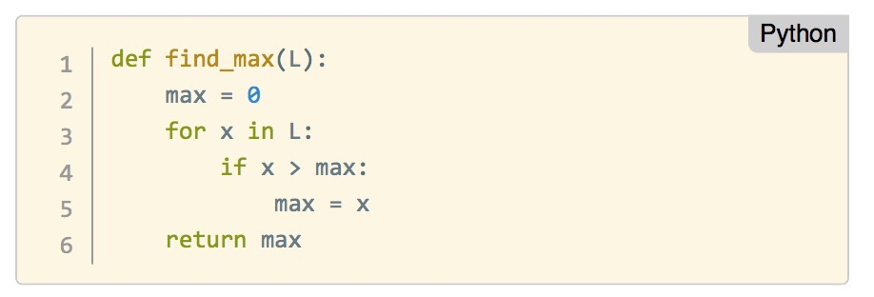
Here it is in python
Thinking like an algorithm

Slide 51
activity: Discussion…?
DIRECTIONS
Does the algorithm above meet the criteria for a good algorithm?
It is unambiguous?
Does it have defined inputs and outputs?
Is it guaranteed to terminate?
Does it produce the correct results?
deliverable
Discuss in your group and we will compare with the entire class afterwards.

Slide 52
Algorithms in the context of machine learning
Machine learning is a branch of artificial intelligence. It is concerned with the construction and study of systems that can learn from data.
The core of machine learning deals with representation and generalization.
Representation – extracting structure from data
Generalization – making predictions from data

Slide 53
machine learning problems
Supervised Machine Learning: Making predictions (generalization)
For example, suppose you want to predict whether someone will make make a purchase the week after they visit your site.
You have a set of data on previous customers, including age, interests, previous purchases, time of visit, etc.
You know whether previous customers made a purchase within a week of their last visit.
So, the problem is combining all the existing data into a model that can predict whether a new person will make a purchase within a week.

Slide 54
machine learning problems
Supervised Machine Learning:
You can then take action and send a reminder or offer a discount.
Amazon, Netflix, and others do this based on the history of their existing customers.
Some examples of supervised learning algorithms include:
linear regression
decision trees
neural networks

Slide 55
machine learning problems
Unsupervised Machine Learning: Extracting structure (representation)
For example, suppose you want to understand your customer base so that you can produce appropriate segments that you can target with your next marketing campaign.
You have a set of data about your customers, including age, location, previous purchases, time of visit, etc.
But what characteristics should you use?

Slide 56
machine learning problems
Unsupervised Machine Learning:
Based on these attributes you can find similarities and differences that provide groupings (segments) of customers.
You can then take action and make an offer or recommend a product specifically to these segments.
Some unsupervised learning algorithms include:
clustering
anomaly detection
principal component analysis

Slide 57
Guided PRACTICE
Thinking logically
Notes:
20m
Instructor Note:
Run through the example with the students and ask them to draw a decision tree based on the "business rules" below in plain English (you can also show pseudo-code).

Slide 58
Thinking logically
Data Science 101
We just reviewed types of machine learning models at a high level.
We mentioned decision trees in the context of supervised learning.
Do you remember what a supervised learning model is again?
Why are they called "trees"?

Slide 59
LET’s APPLY OUR KNOWLEDGE
During a doctor's examination some patients show the following characteristics:
X1: temperature
X2: coughing
X3: reddening throat
The doctor has the following outcomes for the patients:
Y = {W1, W2, W3, W4, W5}
W1: cold
W2: tonsilitis
W3: flu
W4: pneumonia
W5: healthy

Slide 60
Example
The doctor is required to find a diagnosis based on the symptoms presented by the patient.
In data science terms, the doctor requires a model where `Y` (the diagnosis) depends on `X` (the symptoms). The rules below illustrate such a model:
If `X1 < 98` , `Y`= is healthy.
If `X1` has values between [98, 102] and `X3`="there is no reddening of throat", then `Y`=cold;
If `X1` has values between [98, 102] and `X3=`"there is reddening of throat", then `Y`=tonsillitis;
If `X1 99` and `X2=`"there is no cough", then `Y`=flu;
If `X1 99` and `X2=`"there is cough", then `Y`=pneumonia;

Slide 61
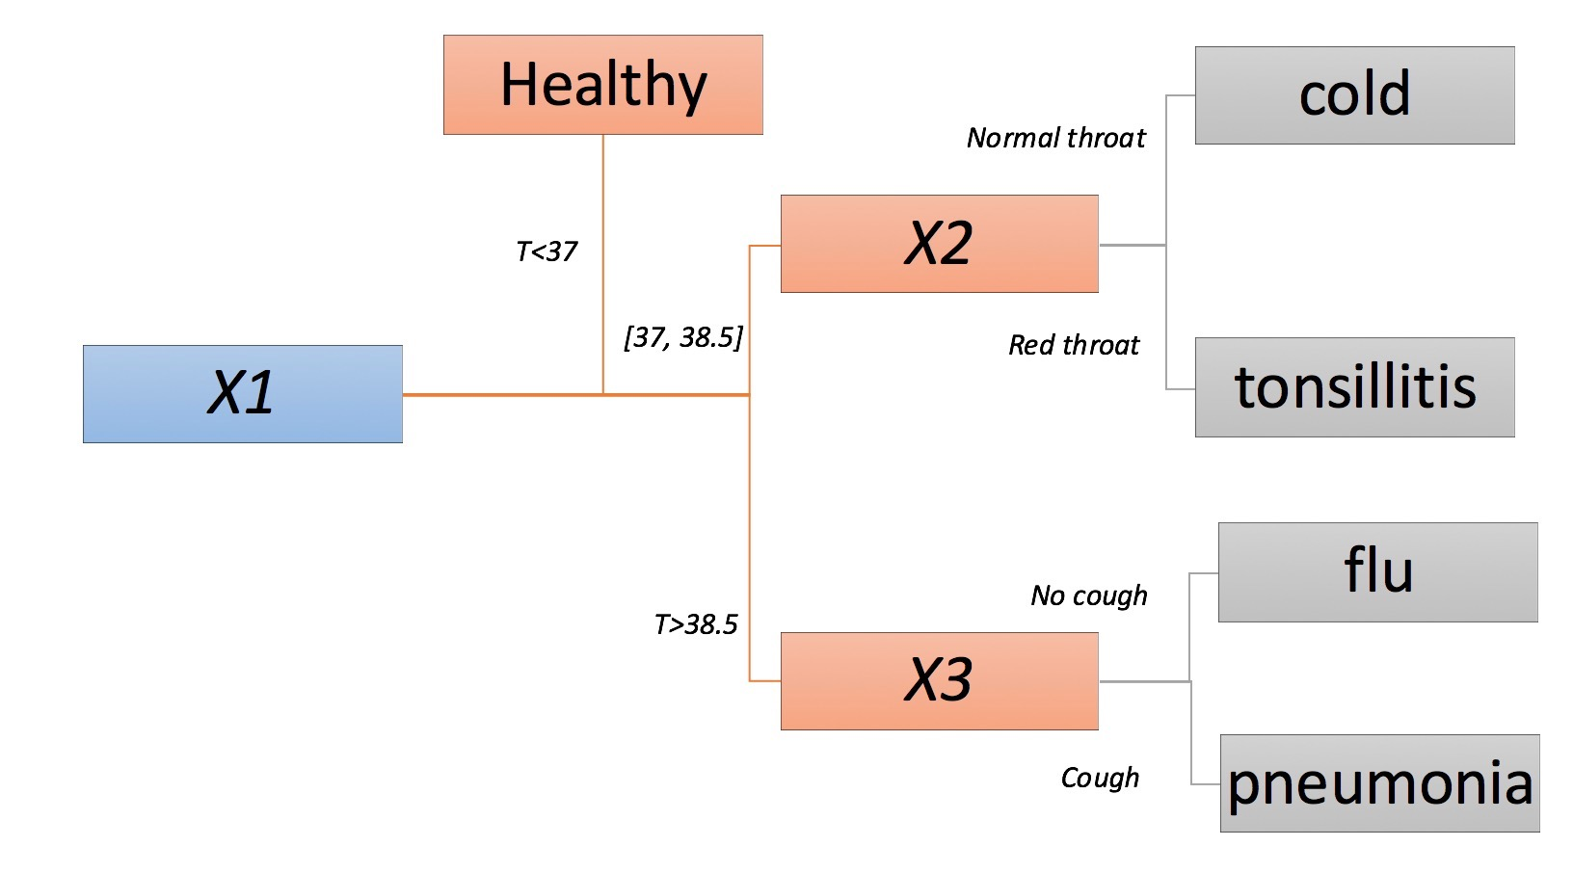
Example
Any new (unseen) patient can now be diagnosed using these rules.

Slide 62
Independent practice
Data Science: Case study
Notes:
20m
Instructor Note:

Slide 63
Instructions
We recommend using a Jupyter notebook for this practice.
From the materials:
Unzip the file downloaded to a known location in your file system
Locate the file called DataScience101_Part2_DecisionTree.ipynb and the Iris dataset.
Open Jupyter: Open a terminal
Mac: Using spotlight search for "Terminal"
Windows: Click the "Start" button and type "cmd"
In the terminal type: `jupyter notebook`
Navigate to the folder where you have saved the file in step 1
Open the file from the Jupyter interface
Voilà, you are ready to follow this practice
In this independent practice we are using the Iris data set to see how Python can help us construct a decision tree like the one we have discussed.
Notes:
Instructor Note:
Using the dataset(s) from Part 1 - Guided Practice or Part 1 - Independent Practice implement a decision tree algorithm using scikit-learn.
Remind the students of that scikit-learn is, from the discussion from Guided Practice
Provide a copy of the notebook DataScience101_Part2_DecisionTree.ipynb and the Iris dataset
The notebook makes use of the Scikit-learn library.
We have not had an opportunity to demo the library or the decision tree model. Therefore we suggest providing the complete notebook and let the students work in pairs to run and discuss the code.
Bring the class together to explain the code and allow for questions.

Slide 64
Data Science 101
CONCLUSION
Notes:
10m
Instructor Note:
I strongly recommend you time-box each step of the activities. Recommended timing is included on each slide.

Slide 65
Review & Recap
In this workshop, we've covered the following topics:
Why data science?
What can data science do for me?
What is the data science workflow?
How to analyze and visualize data using Python
Define the role of algorithms and their relationship with machine learning
Demonstrate how these concepts can be applied to make predictions

Slide 66
Learning Plan
Takeaways
Evaluate your data science skills! How confident are you with:
• Programming skills (Python or R)
• Knowledgable in algebra and statistics (analyzing and modeling data)
• Business acumen (how to work with stakeholders)
• Industry expertise (for the type of field you're working within)
• Communication skills (visualize data, tell stories)

Slide 67
What SHOULD YOU DO NEXT?
TAKEAWAYS
Refer back to your earlier self-assessment:
1 Which skills do you want to improve first? Which ones are you most interested in learning about?
2 Rank these and identify the top three focus areas.
3 For each focus area, identify at least one possible resource and a related goal.

Slide 68

What SHOULD YOU DO NEXT?
TAKEAWAYS
Want to be a better programmer?
Work on these:
Continue learning Python syntax on sites like Codecademy or Code School.
Already know R? Work on comparing the two.
Interested in other frameworks? Try Spark!

Slide 69
What SHOULD YOU DO NEXT?
TAKEAWAYS
Want to brush-up on your math and statistics skills? Have a look at these:
Data Analysis with Open Source Tools, P. K. Jannert
Pattern Recognition and Machine Learning, C. Bishop
Data Science and Analytics with Python, J Rogel-Salazar
An Introduction to Statistical Learning with Applications in R (free PDF)
Elements of Statistical Learning (free PDF)

Slide 70
What SHOULD YOU DO NEXT?
TAKEAWAYS
Concerned about business acumen & communication skills?
Have a look at these:
Data Science for Business, F. Provost and T. Fawcett
Storytelling with Data: A Data Visualization Guide for Business Professionals, C. Nussbaumer Knaflic

Slide 71
Want More?
TAKEAWAYS
General Assembly offers courses in data science! Check out our:
Part-time Data Science Course
Data Science Immersive Course

Slide 72
Data Science 101
ADDITIONAL RESOURCES

Slide 73
BOOKS
Data Science 101
Data Analysis with Open Source Tools, P. K. Jannert
Data Science for Business, F. Provost and T. Fawcett
Pattern Recognition and Machine Learning, C. Bishop
Data Science and Analytics with Python, J Rogel-Salazar
An Introduction to Statistical Learning with Applications in R (free PDF)
Elements of Statistical Learning (free PDF)
Think Stats (free PDF or HTML)
Mining of Massive Datasets (free PDF)

Slide 74
MOOCS
Data Science 101
Andrew Ng’s Machine Learning Class on Coursera link
MIT’s Artificial Intelligence course link
Johns Hopkins' Data Analysis Methods link
Cal Tech’s Learning from Data course link

Slide 75
AGGREGATORS
Data Science 101
DataTau: Like Hacker News, but for data
MachineLearning on reddit: Very active subreddit
Quora’s Machine Learning section: Lots of interesting Q&A
Quora’s Data Science topic FAQ
KDnuggets: Data mining news, jobs, classes and more

Slide 76
SOCIAL
Data Science 101
Hillary Mason (@hmason): Data Scientist in Residence at Accel and Scientist Emeritus at bitly.
Dj Patil (@dpatil): VP of Product at RelateIQ.
Jeff Hammerbacher (@hackingdata): Founder and Chief Scientist at Cloudera and Assistant Professor at the Icahn School of Medicine at Mount Sinai.
J Rogel-Salazar (@quantum_tunnel): Data scientist at IBM and GA instructor
Peter Skomoroch (@peteskomoroch): Equity Partner at Data Collective, former Principal Data Scientist at LinkedIn.
Drew Conway (@drewconway): Head of Data at Project Florida

Slide 77
Data Science 101
Notes:
Instructor Notes:
Encourage the students to share any thoughts or questions before closing the session.

Slide 78
Data Science 101
Don’t forget to fill out your exit ticket
https://goo.gl/forms/yiwioi3lrw9xh5uw2
Notes:
Exit tickets are quick surveys students complete at the end of each class. It should only take about 5 minutes. This allows you to receive real time feedback and make any necessary changes.
Post exit ticket link on Schoology so students always have easy access.
Don't include WWW in the link as it produces an error.

