Slide 1

Landon Armstrong
Daniel Rivera
Jaewook Lee
Nadine Legarreta

Slide 2
What is this Web Portal?
A streamlined platform for our military-affiliated Vets2Tech program participants to help them gain employment after certification.
Exclusive to partnered companies who are seeking candidates with a military background and their families.

Slide 3
Roles
Daniel: Build a database and design UML diagram
Jae: Web page for admin and connect to database
Nadine: Web API
Landon: Web pages for student & employer

Slide 4
Software Requirements
Must be able to store user information for Admin, Company, and Student users.
Profiles require extensive form fields for education, employment, and military background.
Front end application built with React with a web API using ASP.Net
Provide security to protect user data against web-based attacks such as Sql injection.

Slide 5
Agile Methodology
Pair Programming
Test Driven Development
Customer Team Member
Flexibility

Slide 6
Technical Restraints
Not able to synchronize with other applications
Restrictions on storing large amounts of information
Server overload
Page movement is slower than client side rendering since initial loading

Slide 7
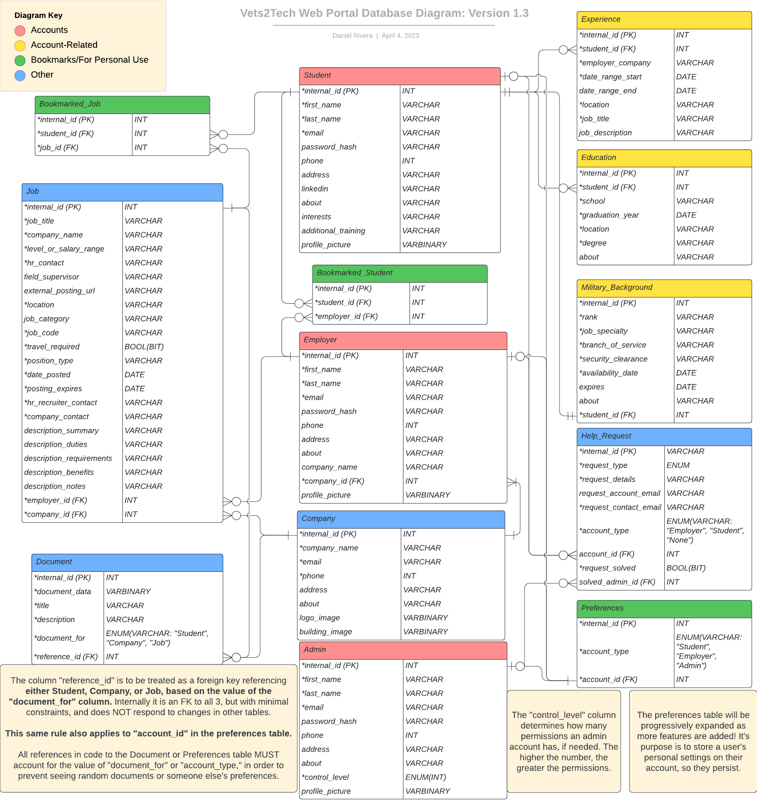
Database Design
This diagram outlines every table/data field currently coded into the database.
Some things are subject to change, but the overall structure should remain the same.
Also shows which tables are connected to each other, and by which fields.
This is pretty complicated, so let’s take a look at each of the individual tables one-by-one.

Slide 8
Database: Accounts
The tables marked in red are used to store the accounts of those who will be using the site.
The “Student” table contains the important information regarding student accounts.
Likewise, the “Employer” table contains the accounts of employers who use the web portal.
Finally, the “Admin” table is reserved for those managing the website. All 3 types of accounts share similar properties, but are still distinct.
Note: The “password_hash” field is to be used for our authentication method. It is NOT the password itself, but part of the encryption.

Slide 9
Database:
Account-Related
The tables marked in yellow are additional records that are related to a specific student account.
Unlike the fields in the “Student” table, there can be multiple records of these types corresponding to a single student, which is why they need their own tables.
The “Experience” table is for a student to fill out information about their previous employment.
The “Military_Background” table is for a student to explain the nature of their military service, past or present.
The “Education” table is for attended schools (colleges).

Slide 10
Database: Bookmarks/Personal
The tables marked in green are contain an account’s bookmarks and other saved data.
Students can bookmark a job listing they may want to revisit - this is tracked in “Bookmarked_Job”
Employers may bookmark a student that catches their eye; this is tracked under “Bookmarked_Student”
Finally, the “Preferences” will save any other data a user has saved (i.e. how they prefer the web portal to look), so this data can be loaded the next time they log in.
The “Preferences” table is basically empty for now, but it will be expanded as more features are implemented.

Slide 11
Database: Other
The tables marked in blue represent everything that doesn’t fall into the previous categories.
The “Job” table is the largest table in terms of how many fields there are, and contains many fields for the employer to fill out when creating a job listing.
The “Company” table will represent each company that is looking for students, and will tie together all employer accounts and job listings related to it.
The “Document” table is for hosting documents related to Students, Companies, or Jobs. This can include things like a Student’s resume, or a job application form.
“Help_Request” is meant for storing information on help inquiries/error reports. Information on each request, and its status, will be tracked here.

Slide 12
Design Problems/Solutions
The database structure is created/updated in SQL Server Management Studio, and exported to the rest of the team in whatever file formats are needed (typically .bak or .sql).
One challenge that came with designing the database was having a foreign key that can reference one of multiple different tables, depending on the context. The solution was to have enumerable fields that are assigned one of a few possible values, and then write code in a way that accounts for the value of this field.
Not including code/screenshots, as the database diagram already explains the database better than screenshots would.

Slide 13
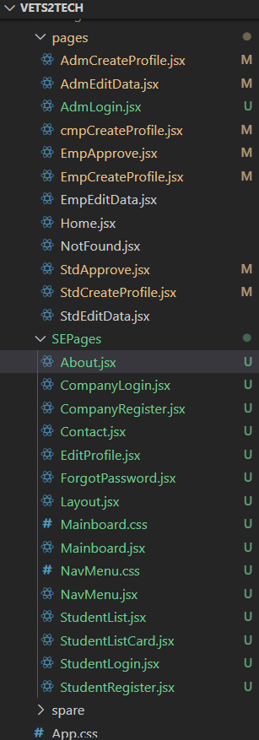
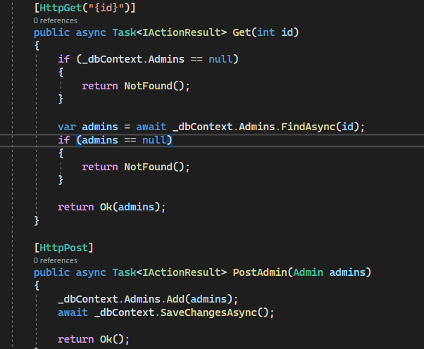
Codes

Slide 14
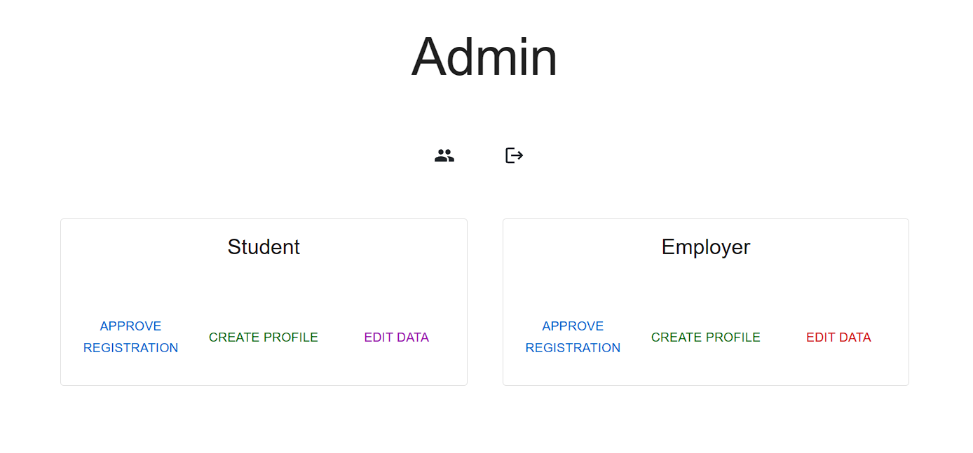
Pages
Admin dashboard
Approval registration
Create profile
Edit data
Search

Slide 15
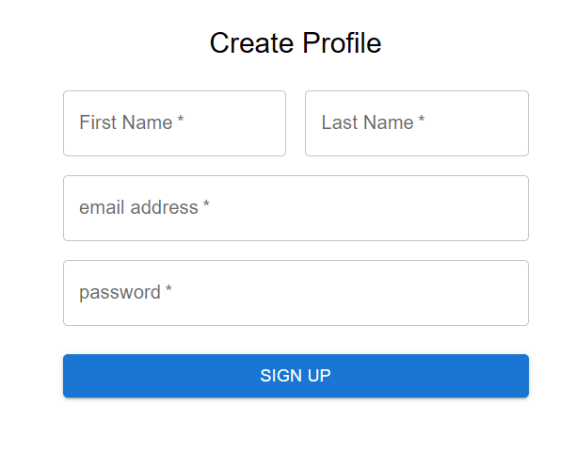
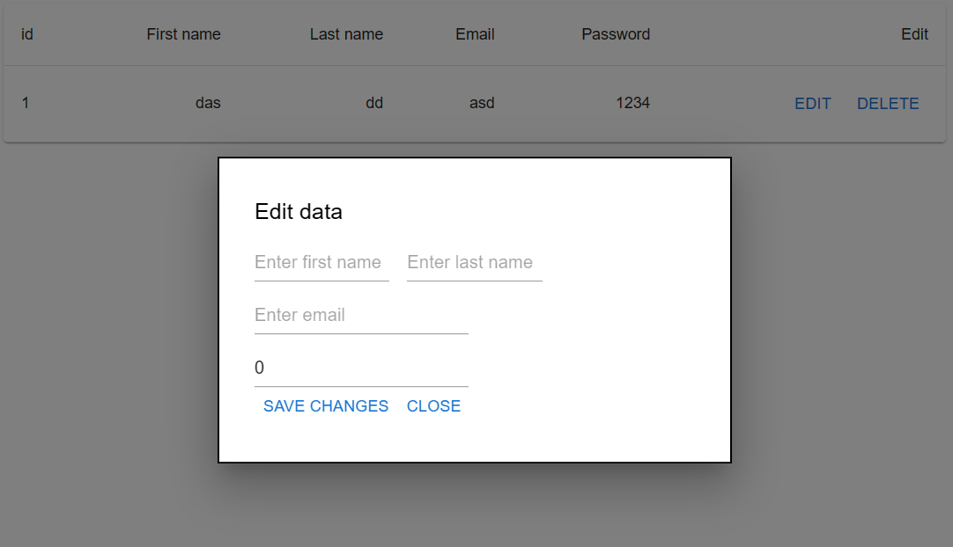
Pages

Slide 16
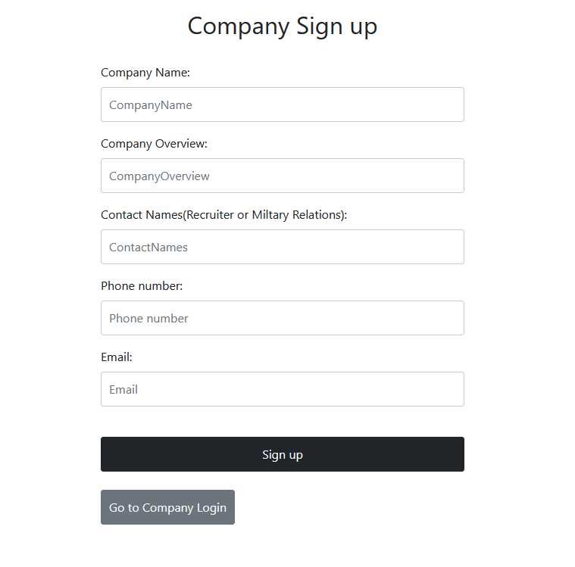
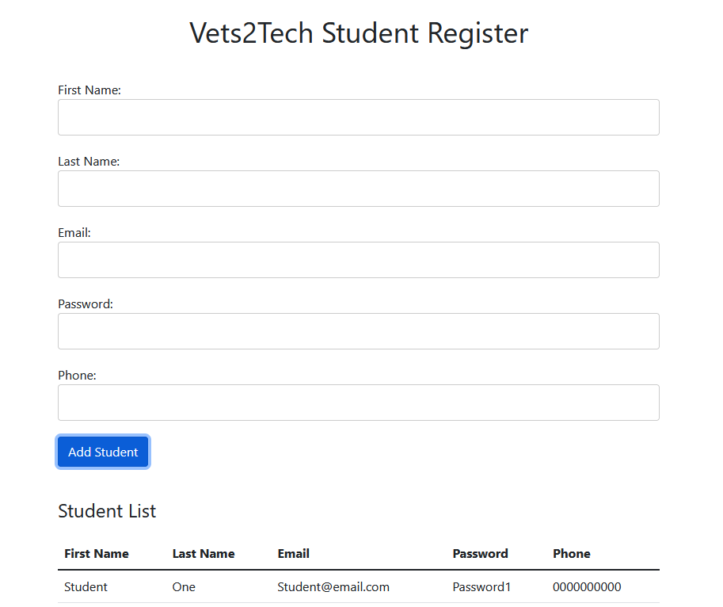
Pages

Slide 17
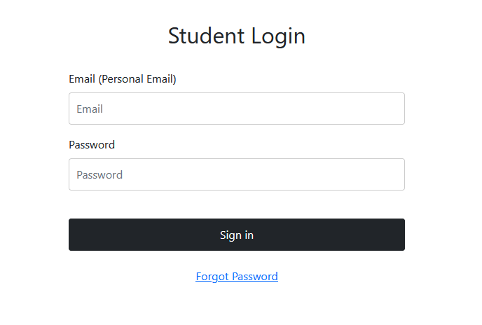
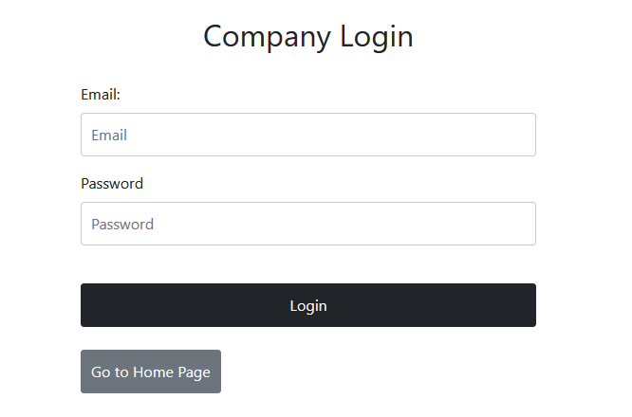
Pages

Slide 18
Current Problems
Knowledge of application being built with SPA authentication prior to development caused unpredictable issues with database structure compatibility.
To continue development with this method for authentication, refactoring is required for the database as well as the Api to build secure authorization. Custom middleware supporting this method is also needed with considerations for possible exposure to unsafe development practices that protect URL query parameters from being exposed within server logs and browser history.
Changes to database structure should be considered for including non-sql database integration for file storage, as Sql Server is not efficient for storing files.

Slide 19
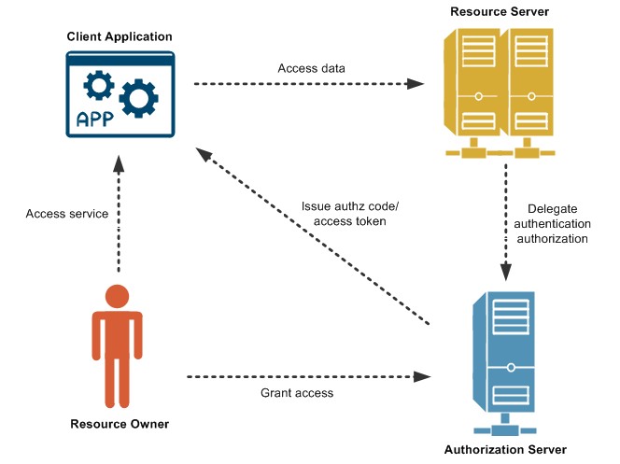
Possible Solutions
The application could continue to be refactored within the database and the current React.Net structure, requiring help from a more experienced programmer.
The application could be converted over to ASP.Net with Razor pages, reducing the steep learning curve with React integration.
Alternately, the application could be refactored within React and utilize the native node.js Api.
Recommended that application is converted to typescript rather than React.
Consider OAuth method for authentication to eliminate the need for complicated SPA authentication.

Slide 20
Issues within the Api
?
The application should have been built beginning with the structure of the Identity Server in ASP.Net.
Factors affecting authentication were unknown before development of the database and would require further refactoring of the database in order to utilize SPA authentication.
Lack of background in authorization for applications led to delays in development and frequent errors.
Little documentation on ASP.Net integration with React
?
?
?
?
?
?

Slide 21
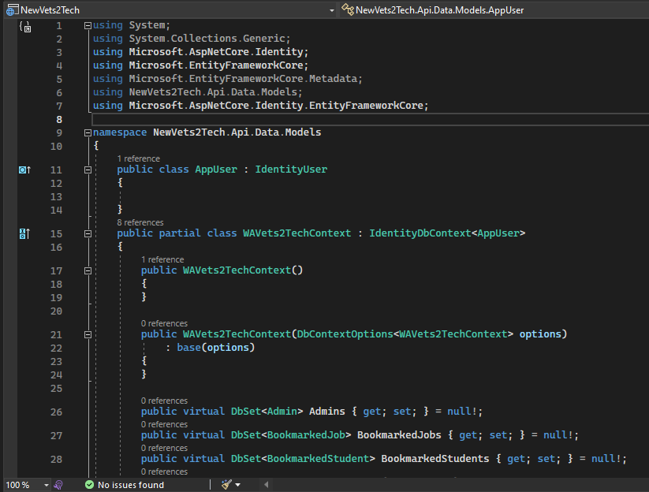
SPA Authentication
Our database was integrated into the application using Model Builder within Entity Framework.
The identity classes should have been mapped first to handle SPA authentication. The IdentityUser class requires separate context with consideration only for the user login data and requires Azure integration
User credentials such as password hashes need to be stored separate from current database.

Slide 22
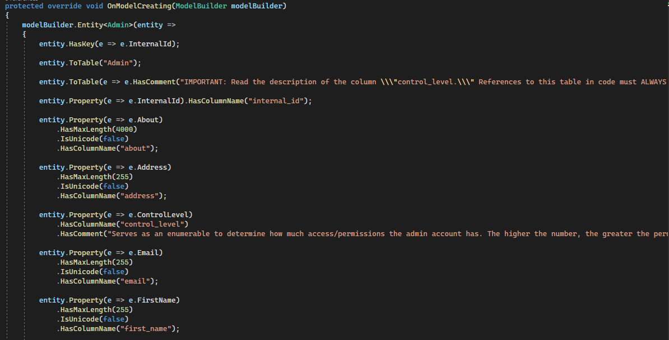
The data within is referenced by the WAVets2TechContext class, which holds the properties for each column within each table. Constraints for the data are set within this class such as length limits, input type and cross reference checks such as unique inputs.

Slide 23
Risks
The largest risk to the application is the current method of authentication. Ensuring that all endpoints are secure is a difficult task for less experienced students to develop.
Hosting requirements should be considered before further development, as some methods will be more efficient and less expensive upon deployment. SPA authentication is less expensive than HTTP authentication and user data is cached within a free repository.
Future students taking over this project should have more resources readily available and more input from developers with relevant experience to the languages chosen.

Slide 24
Budget
Software tools being utilized: MS Visual Studio, MS Sql Server, MS Teams
So far, resources required for building this project have not required monetary expenses as the programs needed for development are available at no cost.
Materials such as Marketing and Logos for the website are also being provided and do not need to be sourced by us.
Future development should consider whether on-premises hosting or cloud hosting will be utilized to consider costs.

Slide 25
Future Plan
Login authentication
Database handling

Slide 26
Demo

Slide 27

Questions

