Slide 1
Plan B
De-specializing SALMONN-SQA into a calibrated, multi-dimensional speech-quality rater
Turning a lenient noise specialist into a model that perceives, names, and scores
every common degradation — and emits a de-compressed, calibrated MOS.
Every training input is public — LibriTTS-R + MUSAN + OpenSLR SLR28 RIRs.
Clement Laroche · published model ckpt_stage2_open · VoiceBank-DEMAND held-out

Slide 2
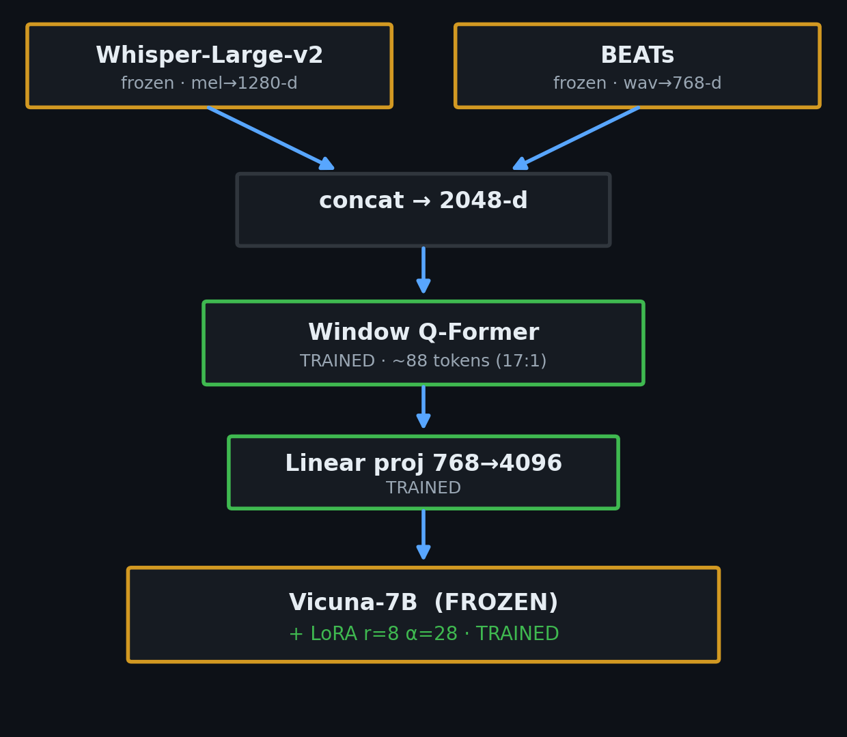
The model: SALMONN-7B, SQA-finetuned
Audio LLM: two frozen encoders → a trained audio bottleneck → frozen Vicuna-7B + small LoRA.
• Whisper-Large-v2 — mel→1280-d. ASR-trained, deliberately reverb-invariant.
• BEATs — raw waveform → 768-d acoustic-event features.
• Window Q-Former — ~0.33s windows → ~88 tokens. TRAINED. ~17:1 compression.
• Linear projection 768→4096, spliced at <SpeechHere>. TRAINED.
• Vicuna-7B-v1.5 + LoRA (r=8, α=28). Base FROZEN, LoRA TRAINED.
Plan B trains only the green blocks + LoRA. Encoders stay frozen.

Slide 3
The problem: a lenient noise specialist
Good additive-noise descriptions — but as a quality meter, weak and blind to whole classes.
① MOS isn't a usable scale
• Coarse 5 discrete values, floored at 2.5. Agrees with PESQ/NISQA/DNSMOS at only ρ 0.40–0.49
– — yet those metrics agree with each other at 0.72–0.82. It is the outlier.
② Blind to whole degradation types
• Reverb ρ(MOS,severity) = −0.11 (no response). Weak on bandwidth (−0.39), clipping (−0.33).
③ Blind to enhancement
• Denoise: every objective metric improves, MOS moves +0.03.
④ Brittle output
• OOD degradation → made-up JSON schema. Acquiescent: leading yes/no → always YES.
Goal: keep the descriptive ability; add perception + calibration across ALL degradations.

Slide 4
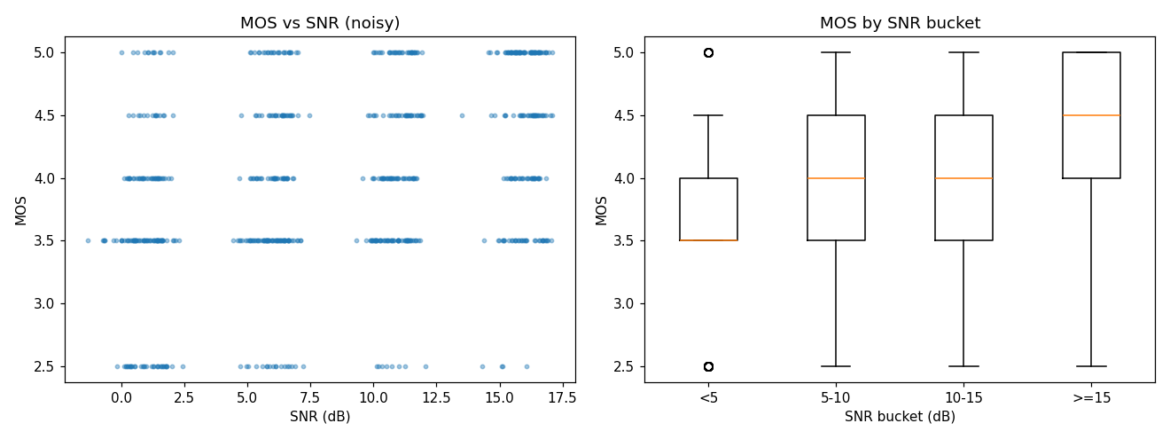
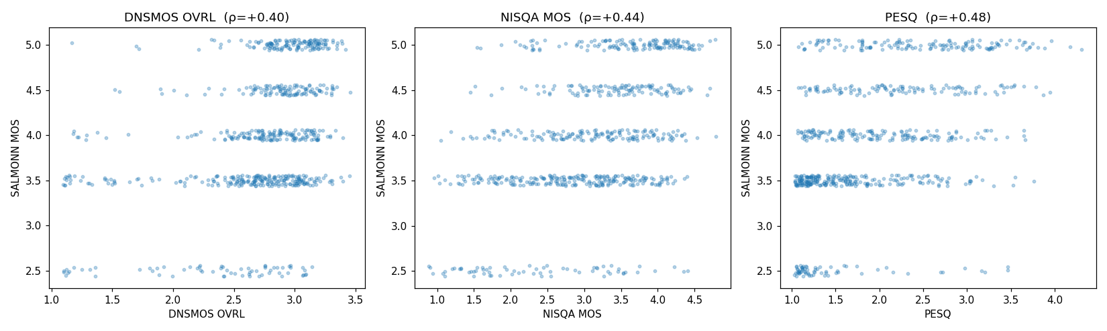
Evidence of the blindness (original model)
• Left: MOS barely tracks SNR, and sits in a narrow high band — the floored, compressed scale.
• Right: vs DNSMOS / NISQA / PESQ the MOS quantizes into a few horizontal stripes (ρ 0.40–0.49).

Slide 5
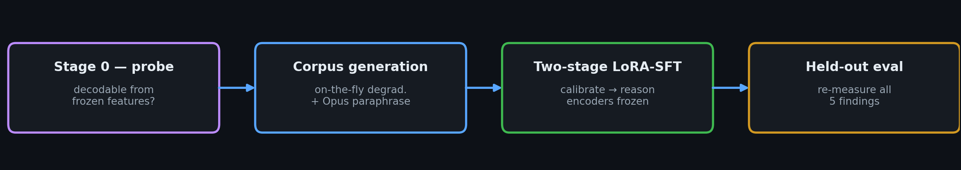
Experiment design: de-risk, then train
Ask the key question cheaply, first
• Whisper is reverb-invariant; Q-Former compresses 17:1. If reverb/bandwidth info is destroyed
– in the frozen front-end, no LoRA training recovers it → would need to unfreeze encoders (heavy).
The hypothesis
• Blindness lives in the LLM's learned read-out (only ever trained on noise), not the architecture.
If true, the fix is data + targets — not surgery on the encoders.

Slide 6
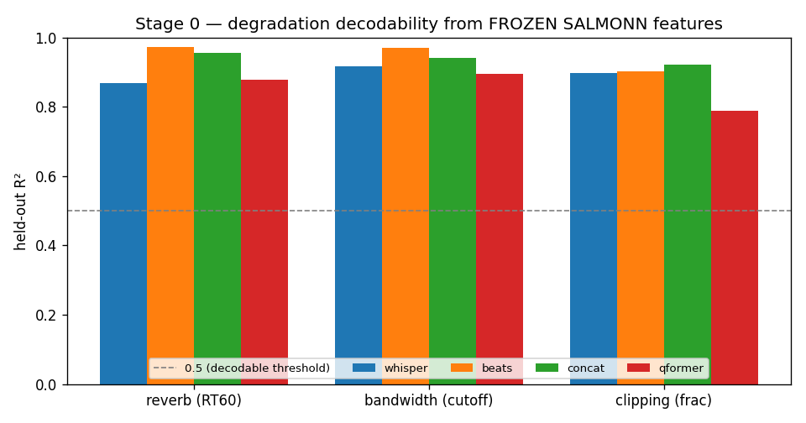
Stage 0 — is degradation decodable from frozen features?
Known-parameter degradations → features at 4 frozen taps → linear probe (PCA+ridge),
scored by R²+Spearman, held out by utterance.
A linear probe is the point: tests whether info is linearly decodable, not buried.
Taps: whisper · beats · concat · qformer (the bottleneck that reaches the LLM)
Result — PASSED. R² 0.82–0.95, Spearman 0.90–0.98 at every tap, incl. Q-Former output.
• Decision: keep encoders frozen; the fix is data + targets.

Slide 7
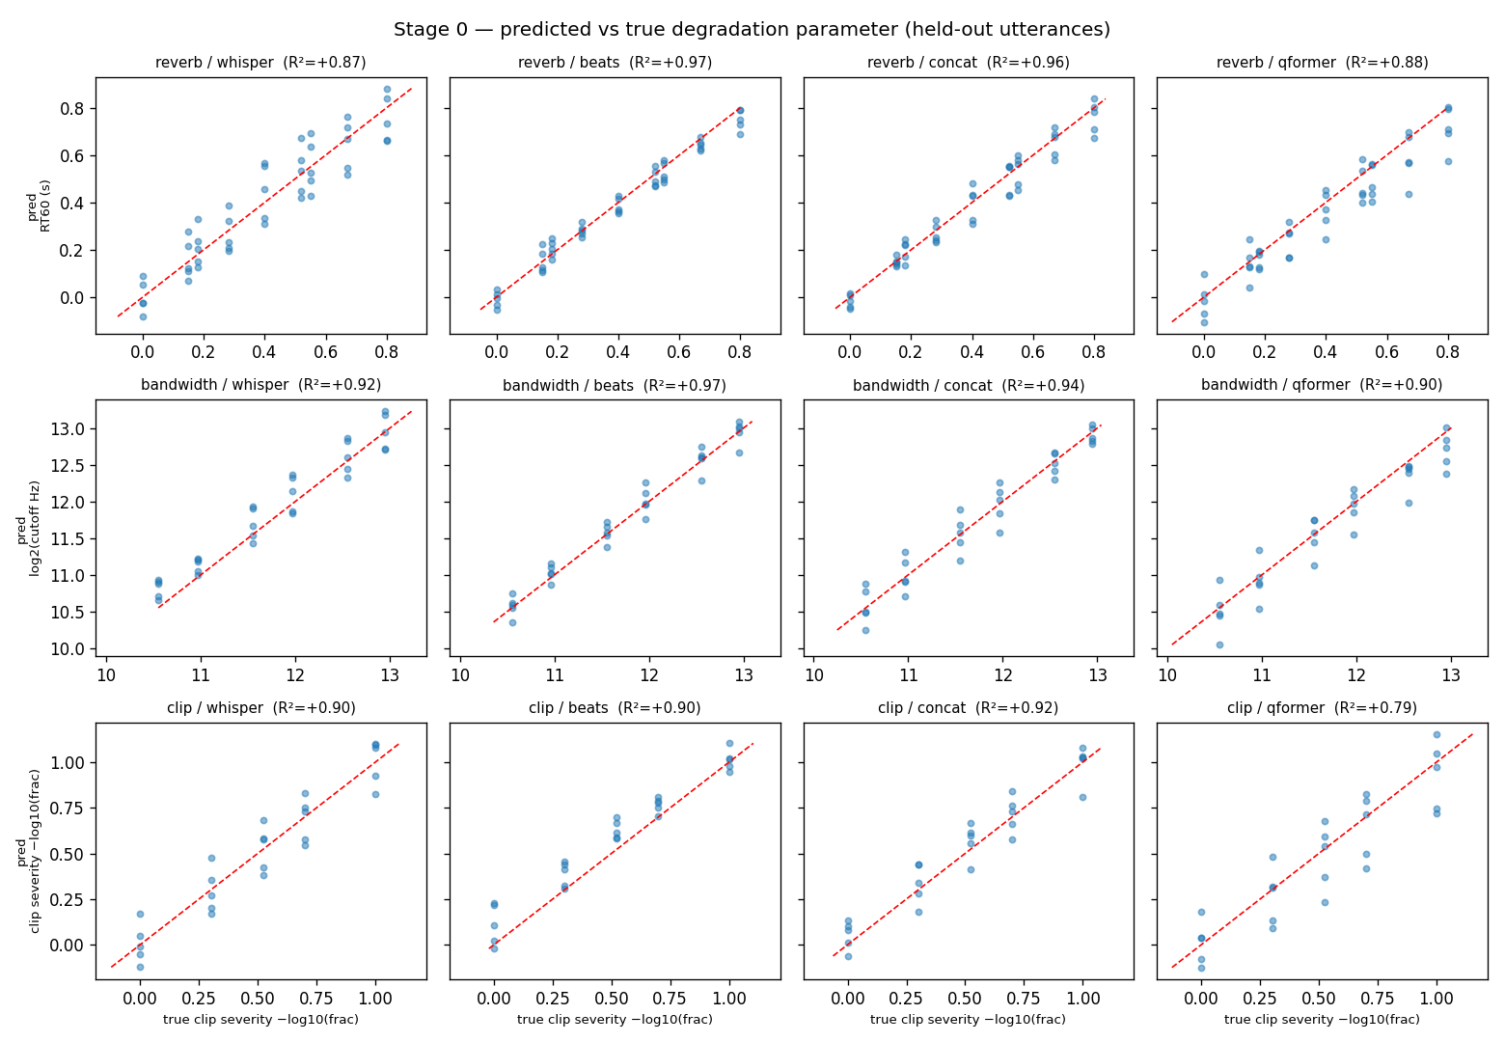
Stage 0 — the signal survives to the LLM's doorstep
Where the blindness actually is
• Predicted-vs-true RT60 / cutoff / clip-fraction sit on y=x at every tap, incl. qformer.
• The degradation reaches the LLM intact — the model was never taught to read it
– (its read-out head was trained only on additive noise).
Each axis is probed one-at-a-time → proves per-axis detectability, not type-discrimination.
Discriminating WHICH degradation is the residual that the synthetic-type data fixes.

Slide 8
Data generation: on-the-fly, known-parameter corpus
Clean speech — leakage-safe
• Train: LibriTTS-R train-clean-100 — 4,000 clips. Val: dev-clean — 300 clips.
• No VCTK speakers → disjoint from VoiceBank-DEMAND eval. No DEMAND noise in training.
Description text — Opus 4.8 paraphrase
• ~740 unique profiles → one Opus 4.8 call each → grounding-verified prose
• All 4,300 descriptions paraphrased, 0 template fallbacks.
axis | how | train
reverb | SLR28 simulated RIRs (Apache-2.0) + synthetic | 2,138
noise | real MUSAN + synth white/pink/brown | 512
codec | real Opus/MP3 → bandwidth | 509
bandwidth | Butterworth low-pass | DSP
clipping / disc. | hard-clip / frame-drop | DSP
loudness | re-gain | DSP
clean | untouched | 373
Every dataset is openly licensed (CC BY 4.0 / Apache-2.0), so the whole corpus regenerates from public data.

Slide 9
Choice of artefacts & the severity map
8 degradation classes, each scored 1–5 from its exact applied parameter (5=pristine,1=severe).
Three design choices
• Perceptual bands — thresholds follow speech-quality convention (telephone BW ≈ 3.4 kHz).
• Reverb floors at 4 for any applied RIR — measured RIRs measured at distance, never truly dry;
– very low DRR (<−15 dB) drops one more band. (Fixed an early RT60-0.15-scored-clean mislabel.)
• Use the measured effect, not the knob — clip/disc. on measured fraction; codec→measured rolloff.
axis | parameter → score bands
noise | SNR: ≥30→5, 20-30→4, 12-20→3, 6-12→2, <6→1
reverb | RT60: <.25→4, .45→3, .70→2, >.70→1; DRR<−15 → −1
bandwidth | cutoff: ≥7500→5, 6000→4, 4000→3, 2500→2, <2500→1
clipping | frac: 0→5, <1%→4, 5%→3, 15%→2, >15%→1
discontinuity | loss: 0→5, <2%→4, 5%→3, 10%→2, >10%→1
loudness | |Δgain|: ≤3→5, 6→4, 12→3, 20→2, >20→1

Slide 10
Targets: calibrate-then-describe
Per-dimension 1–5 scores
• From exact params — direct fix for 'quality prior overrides the named dimension'.
Overall MOS
• 0.55·min + 0.45·mean of dim scores (worst-axis-dominant), blended 70/30 with fused
– PESQ+NISQA+DNSMOS. Pure metric fusion rejected: PESQ floors on reverb, DNSMOS reverb-blind.
Expected I/O
• Input: waveform + sqa_full instruction.
• Stage 1 target: score block ONLY (learn calibrated numbers first).
• Stage 2 target: scores + paraphrased description + Overall MOS.
Cross-entropy on target tokens only; prompt + 88 audio embeds masked to −100.

Slide 11
Training: two-stage LoRA-SFT
What LoRA does here
• Learn tiny low-rank adapters (r=8, α=28) in Vicuna's projections — a few M params that
– re-shape the read-out without disturbing the 7B frozen base.
• Trainable: Q-Former + speech→LLaMA proj + Vicuna-LoRA. Frozen: Whisper, BEATs, Vicuna base.
single GPU · AMP · batch 2 × accum 8 · lr 1e-5 · warmup→cosine
Why two stages
• Learn calibrated numbers in isolation first (no description tokens competing for gradient),
– then describe + emit MOS on top of a representation that already rates correctly.
stage | target text | from | ep
1 — calibration (sqa_score) | per-dimension score block only | released SQA ckpt | 2
2 — reasoning (sqa_full) | scores + description + Overall MOS | Stage 1 best | 4

Slide 12
Results: all five findings re-measured
Held-out synthetic degradation sweep on VoiceBank-DEMAND clean (disjoint speakers).
# | Original finding | published (open)
1 | MOS↔SNR ρ 0.37, lenient | ρ 0.46; penalizes low SNR; names noise 98% (low SNR)
2 | ρ 0.40–0.49; 5 values floored | ρ 0.65–0.71; 63 distinct values (1.90–4.89)
3 | reverb −0.27, bw −0.37, clip −0.48 | reverb −0.80, bw −0.88, clip −0.81, noise −0.93
4 | Enhancement MOS +0.03, ρ≈0 | MOS gain +1.05 (91% of files), ρ +0.32
5 | Acquiescence → always YES | calibrated discriminative scores; N/A
5→63
distinct MOS values
+0.83
measured-reverb ρ vs PESQ
0 / 108
degenerate outputs
+1.05
enhancement MOS gain

Slide 13
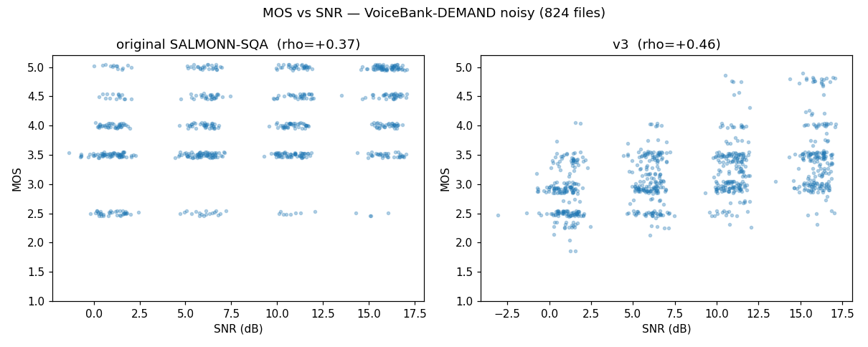
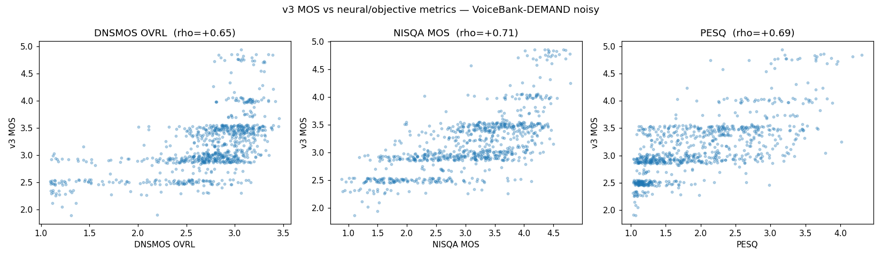
Results: the MOS scale is rebuilt
• Left: MOS vs SNR — the cloud spreads the full range and slopes with SNR (was a flat band).
• Right: MOS vs metrics — continuous, rank-aligned (ρ 0.65–0.71); the stripes are gone.

Slide 14
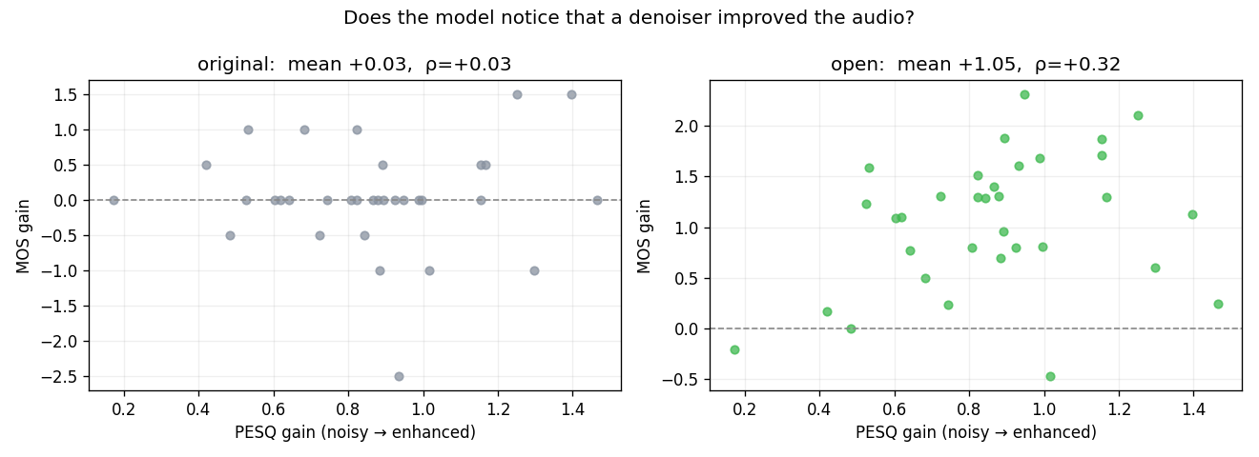
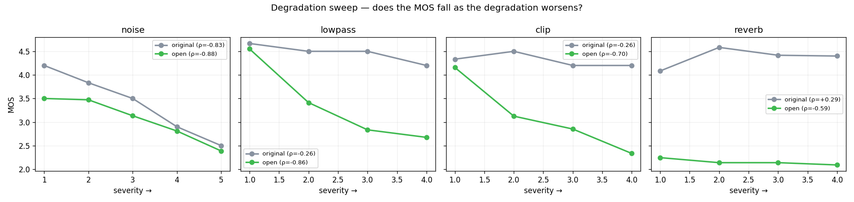
Results: every axis now responds
• Left: MOS vs severity — monotone downward everywhere, incl. the former reverb blind spot.
• Right: enhancement — MOS rises with denoiser gain (+1.05, 91% of files): a usable enhancer evaluator.

Slide 15
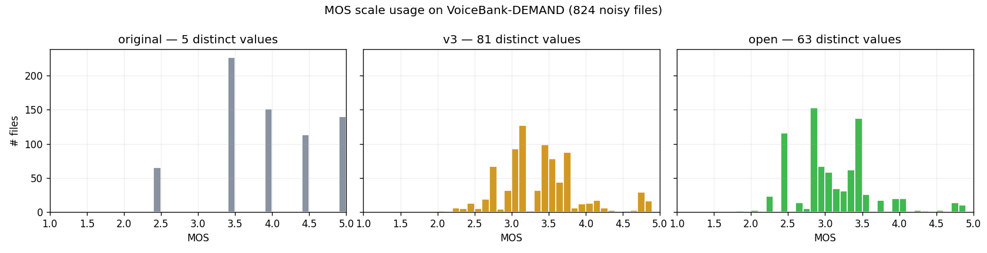
Results: from a 5-rung ladder to a continuous meter
• Original emitted a handful of MOS values, floored well above the bottom of the scale.
The published model uses 63 distinct values spanning 1.90–4.89 — it meters quality, not buckets.
This de-compression lets rank-correlations climb into the band where the metrics agree.

Slide 16
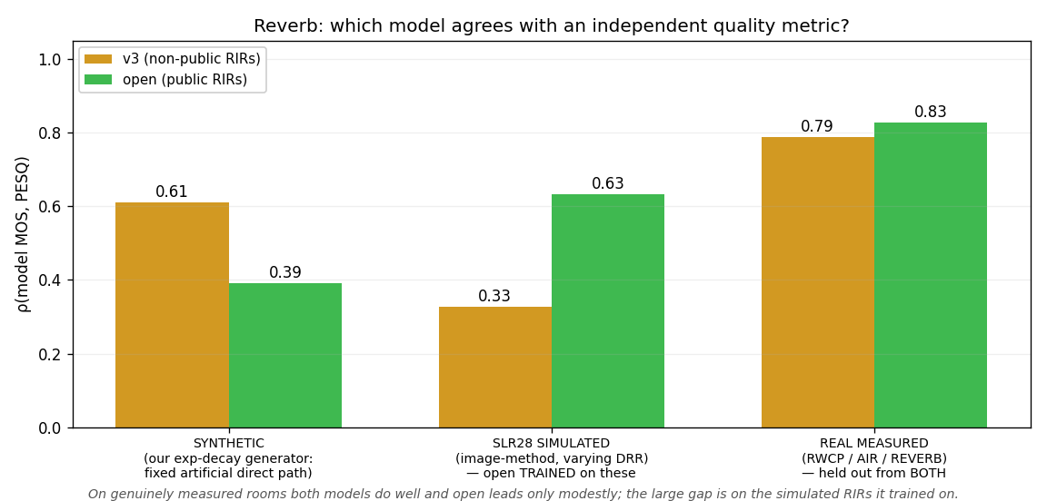
The reverb result: the benchmark was measuring an artefact
Scored against PESQ — which knows nothing about either severity map
• synth_reverb injects an explicit direct path → our synthetic reverb has an
– artificially HIGH DRR at every RT60. v3 keys on RT60 alone — exactly how that
– sweep grades severity. So the sweep flattered v3 and penalized open.
On REAL measured rooms both models do well; open leads modestly (0.83 vs 0.79).
The big gap is on SLR28 SIMULATED RIRs — which open trained on. That is an
– in-distribution advantage, not generalization. Reporting it as 'real rooms'
– would have been an overclaim (an earlier draft of this control made exactly that
– mistake: the pool is 60k simulated vs 320 measured, so uniform sampling drew none).
Lesson: name your test distribution precisely — eval_realreverb.py now asserts it.

Slide 17
Bottom line
The fine-tune turns a lenient noise specialist with a weak 5-value MOS into a calibrated rater:
• MOS de-compressed (5→63), rank-aligned with PESQ/NISQA/DNSMOS (ρ 0.65–0.71)
• Perceives and ranks every degradation type — incl. the former reverb blind spot
• Tracks enhancement gain (+1.05 MOS, 91% of files) → a usable automatic enhancer evaluator
• Names degradations in natural, grounded prose; 0 degenerate outputs
Per-dimension structured scores are the most reliable signal. The whole fix was data + targets —
encoders never unfrozen, validated up-front by the Stage 0 probe.
Optional further work
• Scale clean pool to train-clean-360 · more degradation types · scalar regression head if banding remains.

