Slide 1

USED CARS SALES ANALYSIS
PRESENTED BY:
AHMED LAWAL
CARS4U LIMITED

Slide 2

Introduction
As part of CARS4U Ltd’s plan to win a lion’s share of the automobile market, the goal of this project is to build a pricing model that can effectively predict the price of used cars.
Part 1: Explore, Pre-process and clean the data.
Part 2: Find and show the most important features that affect prices.
Part 3: Build a predictive model to predict the prices of cars at CARS4U and make recommendations.

Slide 3
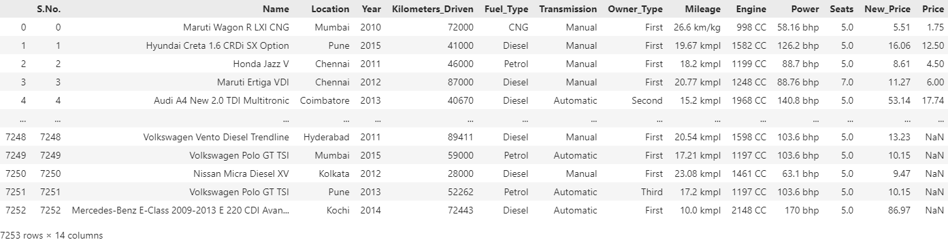
Data Description

Slide 4
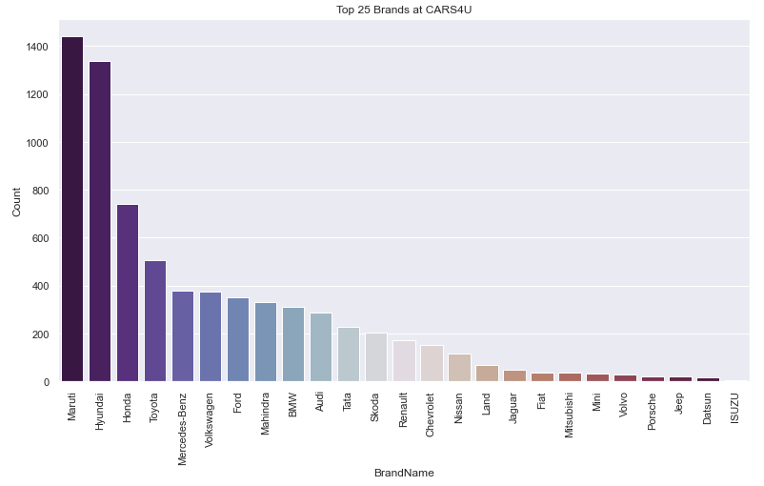
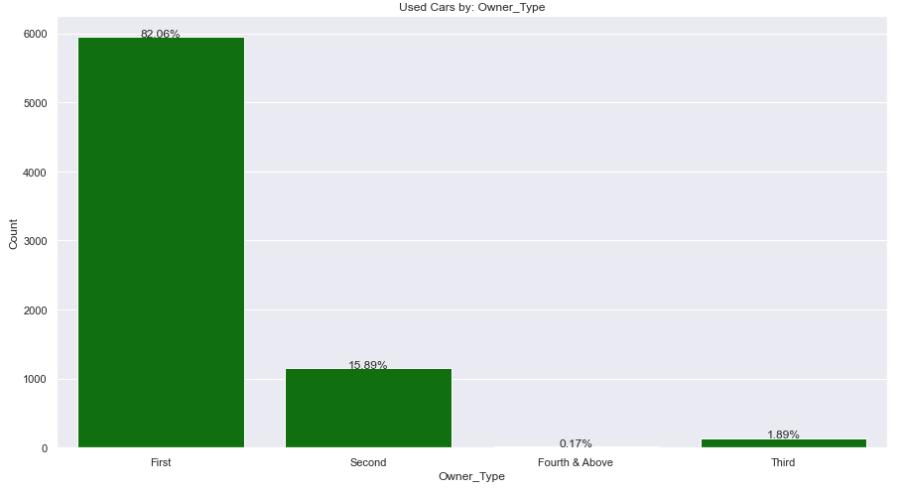
Business understanding
Car Brands and owner types

Slide 5
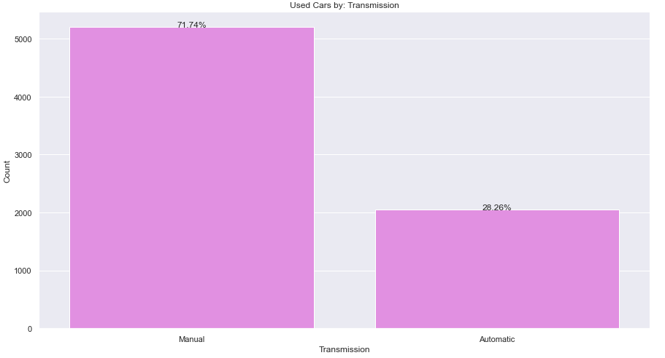
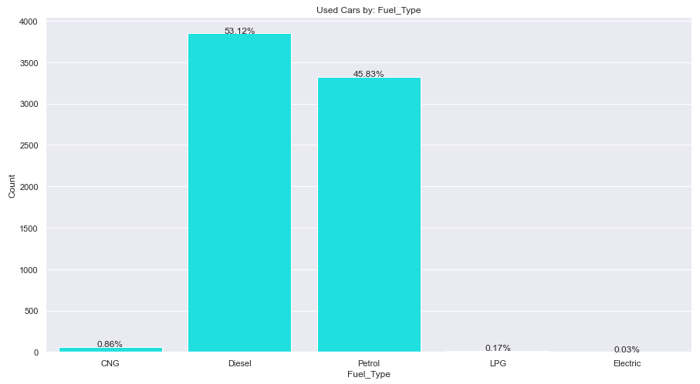
Business understanding(cont.)
Used cars by transmission and fuel type

Slide 6
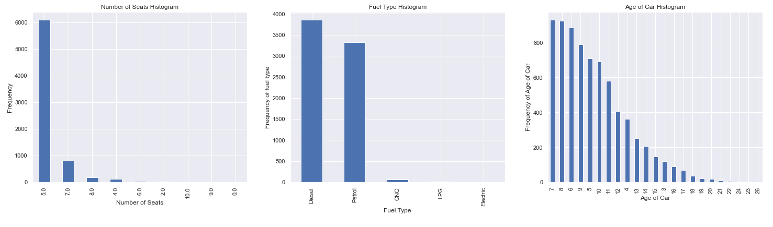
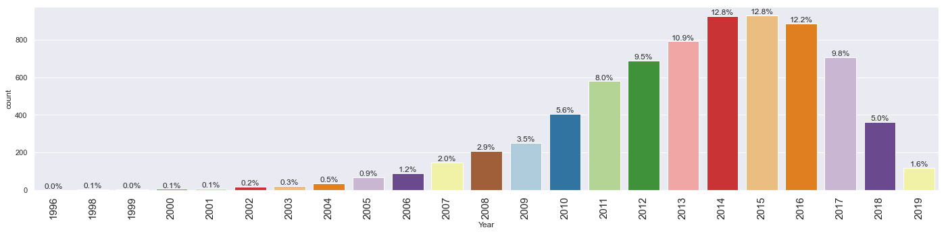
Business understanding: Age of cars/No. of seats

Slide 7
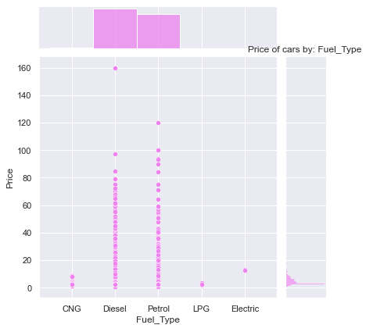
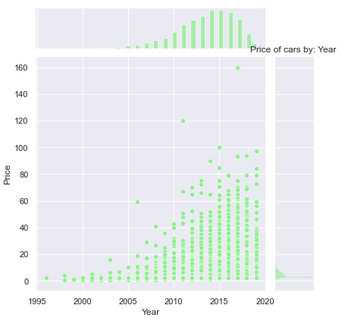
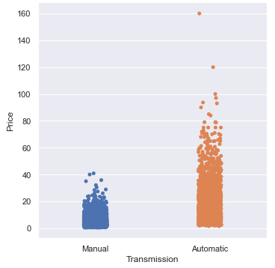
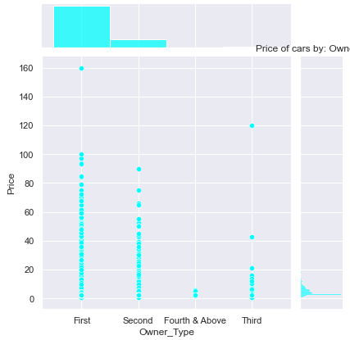
Bivariate Analysis

Slide 8
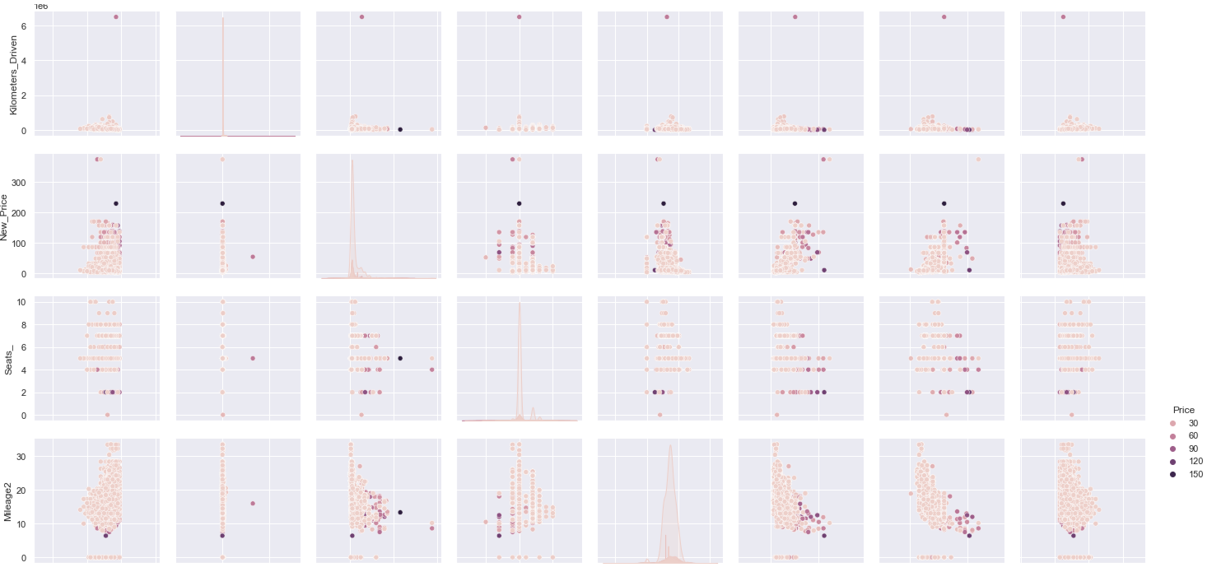
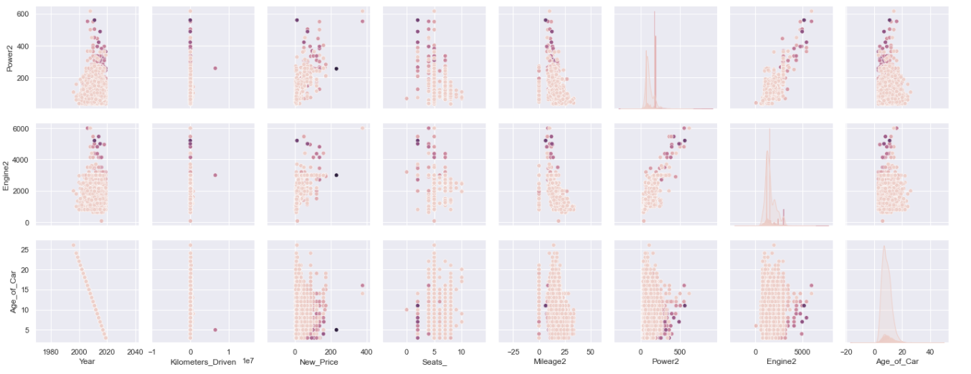
Multivariate Analysis
Cars4u

Slide 9

Thank you

