Slide 1
Data processing Data processing for tumor and t-cell detections
Yannis laaroussi
Bachelor thesis – initial presentation

Slide 2
motivation
Link between biology/medicine and computer science
Learn python
Manipulate data

Slide 3
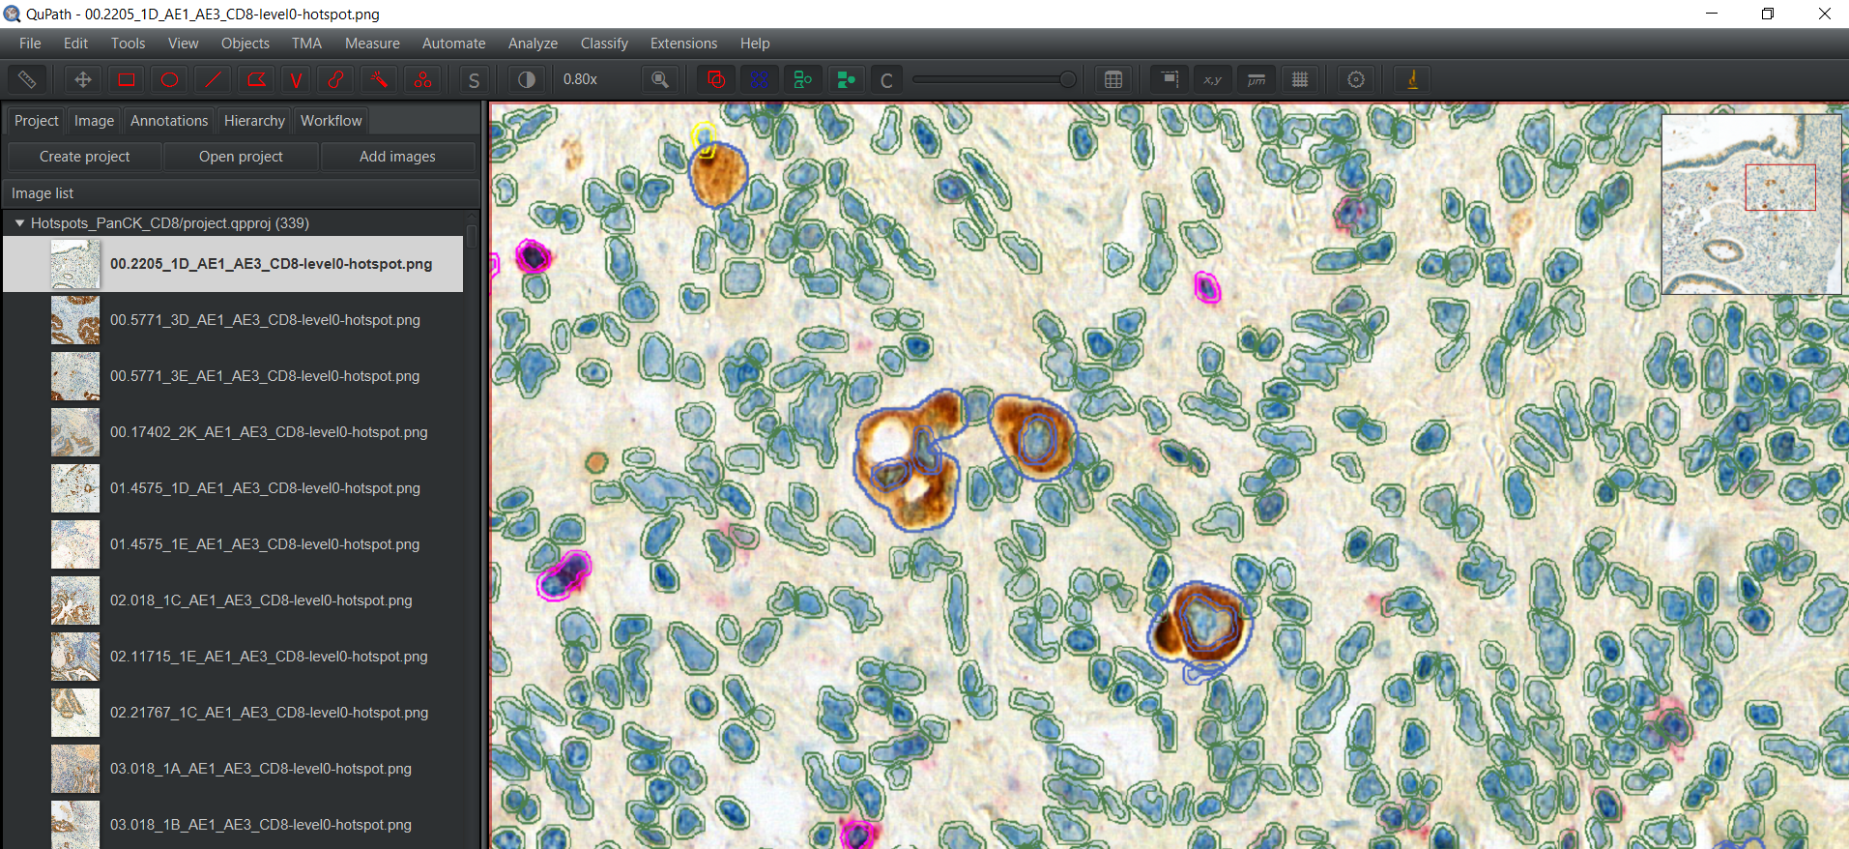
qupath
Tumor
Polygon

Slide 4
goal
JSON file (from QuPath)
XML file

Slide 5
Asap
Visualisation using xml file

Slide 6
excel
JSON file to .CSV

Slide 7
Timeline
Preparation/Introduction to the subject
Part 1 : JSON to XML
Part 2 : JSON to EXCEL
Part 3 : Writing

Slide 8
Questions ?

