Slide 1

Production-Ready Grant Allocation Pipeline
DATA ENGINEER FINAL ROUND
LARRY MULUNDA
This is fundamentally a matching-and-exhaustion problem: Finance needs every eligible transaction matched to a grant, deterministically and idempotently.
🎯 Accuracy
🔍 Auditability
Non-negotiable — this is a Finance ledger, no money can be created or destroyed
Matters as much as correctness — every dollar traceable to the exact run, rule, and grant
🔁 Idempotency
Reruns and retries must never double-count or silently diverge from a prior result

Slide 2



Architecture Overview
Medallion Layers
1
Bronze (raw), Silver (validated), Gold (certified ledger) — each with a distinct contract
Prefect Orchestration
2
Retries, scheduling, flow-state hooks for notifications, task-level checkpointing
Soda Core Data Contracts
3
Declarative quality gates between Bronze and Silver, editable without touching Python
GitHub Version Control
4
Feature branch, PR, CI with linting and pytest, then merge

Slide 3

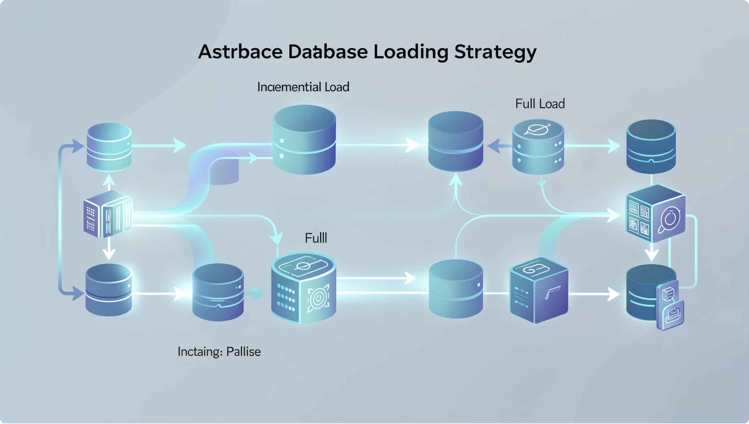
Loading Strategy
Grants (Dimension)
Full load — no reliable watermark, small table, safer than partial incremental logic
Transactions (Fact)
Rolling window incremental — watermark plus a lookback buffer to catch late-arriving data
Gold Allocations
Hybrid windowed — closed periods are immutable, only the open period recomputes each run

Slide 4





Reliability & Resilience
Exponential Backoff Retries
3 attempts at 30, 60, 120 seconds, verified against Prefect's real backoff utility
Idempotent Writes
MERGE / INSERT OR IGNORE everywhere so a retried load can never create a duplicate record
Watermark Advances on Success Only
A failed run leaves the cursor untouched so the next run retries correctly
Rolling Window Lookback
Re-scans a buffer behind the watermark so late-arriving older-dated transactions are never permanently missed

Slide 5




Data Quality — A Real Bug, Not a Hypothetical
Silver-Layer Contract Gate
Enforced before the allocator ever runs: required columns, no silent type drift, referential integrity
Silver Contract
Caught in Development
An Account code stored as "10002.0" on one side and "10002" on the other silently failed every match
Bug Caught
Silent Misclassification
Silent Misclassification
Real spend was misclassified as grant-exhausted with zero errors raised anywhere in the pipeline
Reconciliation Gate
Reconciliation as Final Gate
Every run asserts no money is created or destroyed, and no grant balance goes negative

Slide 6





Period Governance
Open Period
Full recompute each run via atomic swap — nothing is final yet, so a clean overwrite is safe and cheap
Closed Period
Immutable after sign-off — the write path refuses any swap against a closed period
Correction: Reopen & Cascade
Recomputes forward through every affected period, snapshotting before and after as audit evidence
Verified against real data: multiple periods correctly reclosed in sequence, cascade stopped cleanly at the right boundary

Slide 7
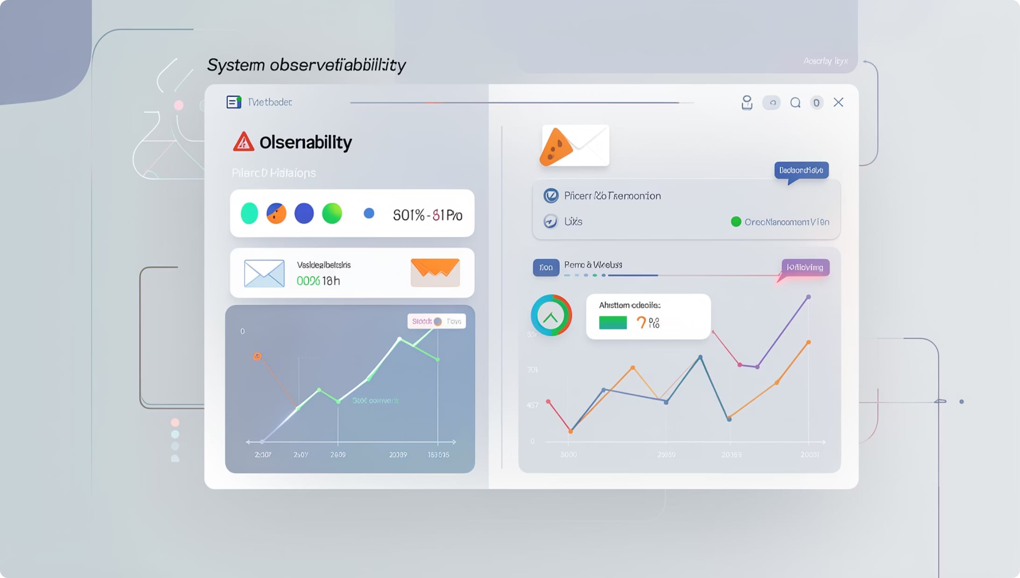
Monitoring & Alerting
Flow-State Hooks
Success and failure notifications wired via Prefect flow-state hooks — every run emails a result automatically
Full Traceback on Failure
Confirmed directly that Prefect exposes the real exception, not a placeholder
AI-Assisted Triage
The traceback is sent to an LLM for a first-hypothesis troubleshooting checklist, embedded in the failure alert
Fail-Soft by Design & Test
No API key, network error, or rate limit ever cascades into a second failure

Slide 8




AI Application in Data Engineering
AIOps Initial Triage
AI Insights in Reporting
Built & verified — a real failure-triage agent embedded in alert emails, fires only on failure, uses a low-cost model tier
Proposed — forecasting expected allocation rate and volume ahead of period-end
Governance
Human-in-the-loop always — AI drafts and never auto-decides, every AI section is explicitly labeled as AI-generated

Slide 9


Open Engineering Questions
1
2
3
Unallocated Amounts at Period-End
New Grant Onboarding
Reopen & Cascade Governance
What is the process for adding new grants, and can a grant be added today with a back-dated start date?
How should unallocated amounts be treated at the end of an accounting period — carried forward, written off, or flagged for Finance?
No access control yet on who can trigger a correction, and no protection against colliding with a scheduled run
These questions are intentionally surfaced — they represent real design decisions that require Finance and Engineering alignment before production go-live.

Slide 10

Thank You
Questions & Discussion
Larry Mulunda — Data Engineer Final Round
Accuracy
Auditability
Every dollar accounted for, no money created or destroyed
Full traceability to run, rule, and grant
Idempotency
Safe to retry, safe to rerun, always deterministic

