Slide 1
MiAtbot
ICT3214 Group 4
Members: Larrissa Yeo, Michelle Lim, Nathan Leow, Tan Zhi Qing, Carment Tham, Villarico Gabriel Babiera

Slide 2
Table of contents
01
02
03
04
05
06
07
Introduction
Datasets
Data Preprocessing
Model
Chatbot
Demo
Conclusion

Slide 3
01
Introduction

Slide 4
Introduction
Challenges of Incident Response plan:
Difficult for corporations to maintain
Cyber threats are more complex
Static playbooks are not flexible enough
Proposed Solution:
MiAtbot - AI-powered chatbot
Real-time, structured guidance
Based on industry standards
Most recent threat data from MITRE ATT&CK
Notes:
Intro about our project
—-------------------------------------
Maintaining efficient incident response plans becomes more difficult for corporations as cyber threats become more complex. In order to provide analysts with situational, actionable guidance, traditional methodologies sometimes rely on static playbooks that are not flexible enough to react to changing threat scenarios.
In order to fill these gaps, we have created an AI-powered chatbot named MiAtbot that provides users with real-time, structured guidance that is based on industry standards, enhanced with the most recent threat data from MITRE ATT&CK ™ Framework, and customized to meet their individual needs.

Slide 5
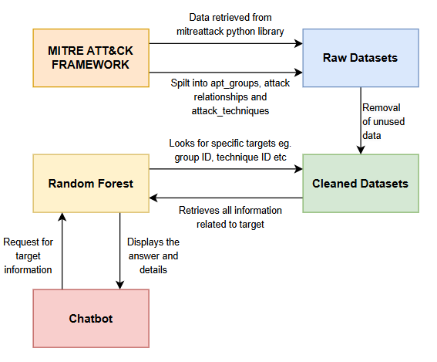
System Diagram

Slide 6
02
Dataset

Slide 7
Dataset
Dataset was retrieved using mitreattack-python library
The library is a Python-based tool created to communicate with the MITRE ATT&CK TM framework, a thorough knowledge base of adversary tactics, techniques, and procedures (TTPs) employed in cyberattacks.
This library offers an intuitive interface to automate the data processing, mapping, and querying processes of the ATT&CK framework
Researchers and cybersecurity experts can use it to incorporate ATT&CK data into unique tools and methods, including automated incident response, threat detection, and security monitoring
Notes:
Talk about mitreattack-python library

Slide 8



Dataset Used
Groups
Relationships
Techniques
Retrieve information of all APT groups listed in MITRE ATT&CK TM Framework
Retrieve information about the relationships between techniques, groups and other entities in MITRE ATT&CK TM Framework
Retrieve information of all techniques listed in MITRE ATT&CK TM Framework

Slide 9
03
Data Preprocessing

Slide 10
Data Preprocessing
In the dataset, we have:
Identify the Key columns
Remove any unnecessary columns
Handle missing values in each columns
Normalize text fields
Notes:
Talk about mitreattack-python library

Slide 11
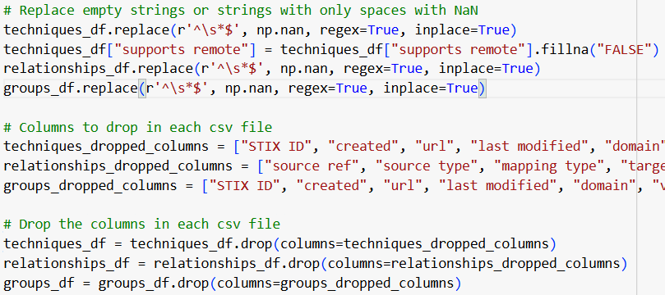
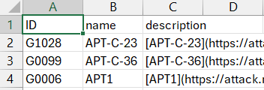
Data Cleaning
Before:
After:

Slide 12
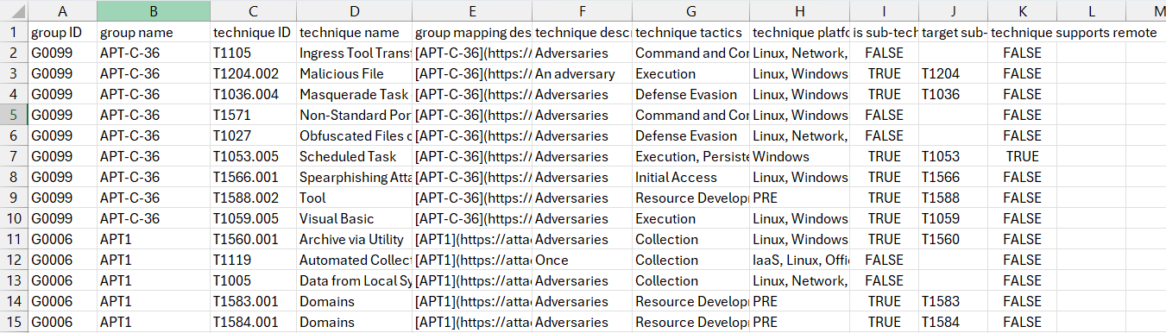
Final Dataset
Data shows which techniques that are used by each APT group

Slide 13
04
Model

Slide 14
Random Forest (RF)

Slide 15
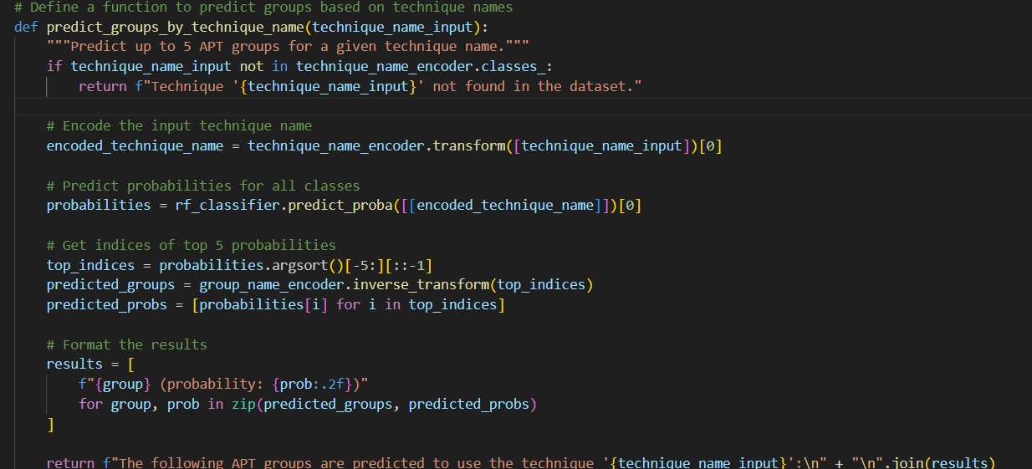
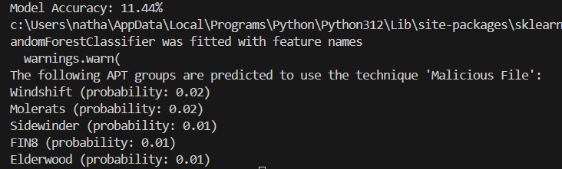
Predicting which group uses which technique

Slide 16
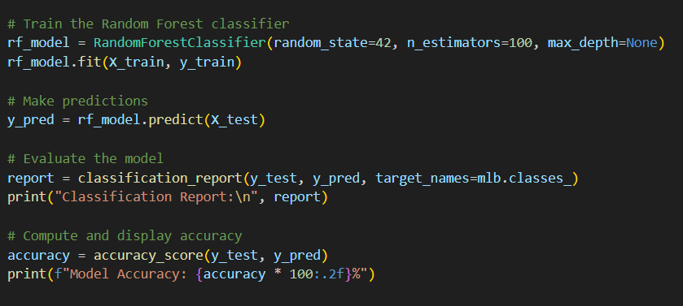
2. Predicting which platform is used by technique

Slide 17
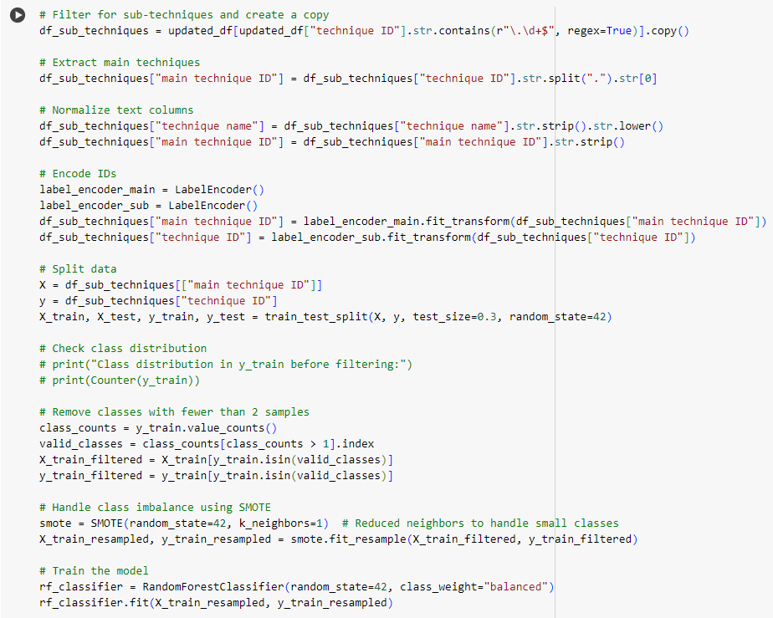
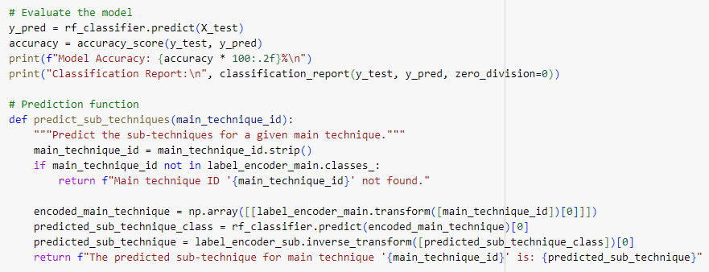

3. Predict the Sub-Technique is link to which Main Technique

Slide 18
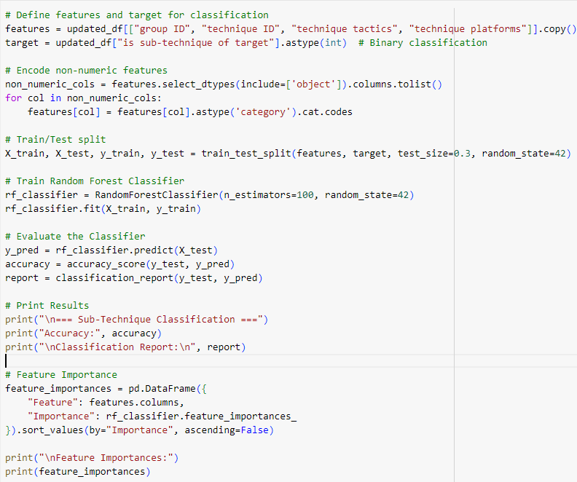
4. Predict whether the technique is a sub-technique

Slide 19
Reason
Falls under Supervised Learning
Models learn from labeled datasets.
Has a specific supervised machine learning algorithm for RF
Random Forest Classifier
Combines predictions of multiple decisions tree to give a more accurate and robust result.
Reduces overfitting.
Notes:
Talk about mitreattack-python library

Slide 20
05
Chatbot

Slide 21
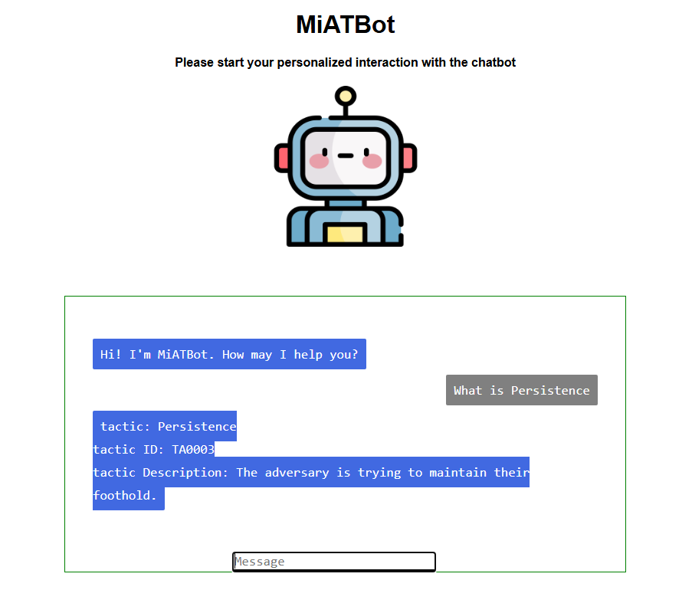
Chatbot Development
Language used:
Python Flask
HTML / CSS / Javascript
Libraries used:
Flask
Pandas
Environ
chatbotAI

Slide 22
Chatbot functions
queryFilter(query) | extract_query(user_message)
Determines which column of the csv to search | Determines the main query of a user’s question
generate_response(query, searchCata) | chat_with_bot()
Responsible for generating the responses to the user’s questions | Responsible for calling the needed functions for the chatbot to function

Slide 23
06
Demo

Slide 24

Demo
Notes:
Talk about mitreattack-python library

Slide 25
07
Conclusion

Slide 26
Conclusion
Successful development of Chatbot that can provide real-time guidance of the MITRE ATT&CK framework
Utilized machine learning models to reduce probability of overfitting, variances to provide accurate and reliable information
Notes:
Talk about mitreattack-python library
Successful development of Chatbot that can provide real-time guidance of the MITRE ATT&CK framework
Utilized machine learning models to reduce probability of overfitting, variances to provide accurate and reliable information

Slide 27
Thank you !

