Slide 1
Introduction to AI Fundamental
For Primary Education (Ages 9-12)
Runlin Wang

Slide 2


About Lecturer
About Lecturer
👤 Runlin Wang (Preferred Name: Larry) 🌍 China 🎓 University of California, Irvine 💻 Computer Science with specialization in algorithms 🛠Professional Experience: - Data Annotator Intern at DataAnnotation - Worked on Generative AI tools - AI code debugging, mathematical proofs 🔗 GitHub: https://github.com/Larry-DayDayUp

Slide 3
Teaching Motto

Slide 4
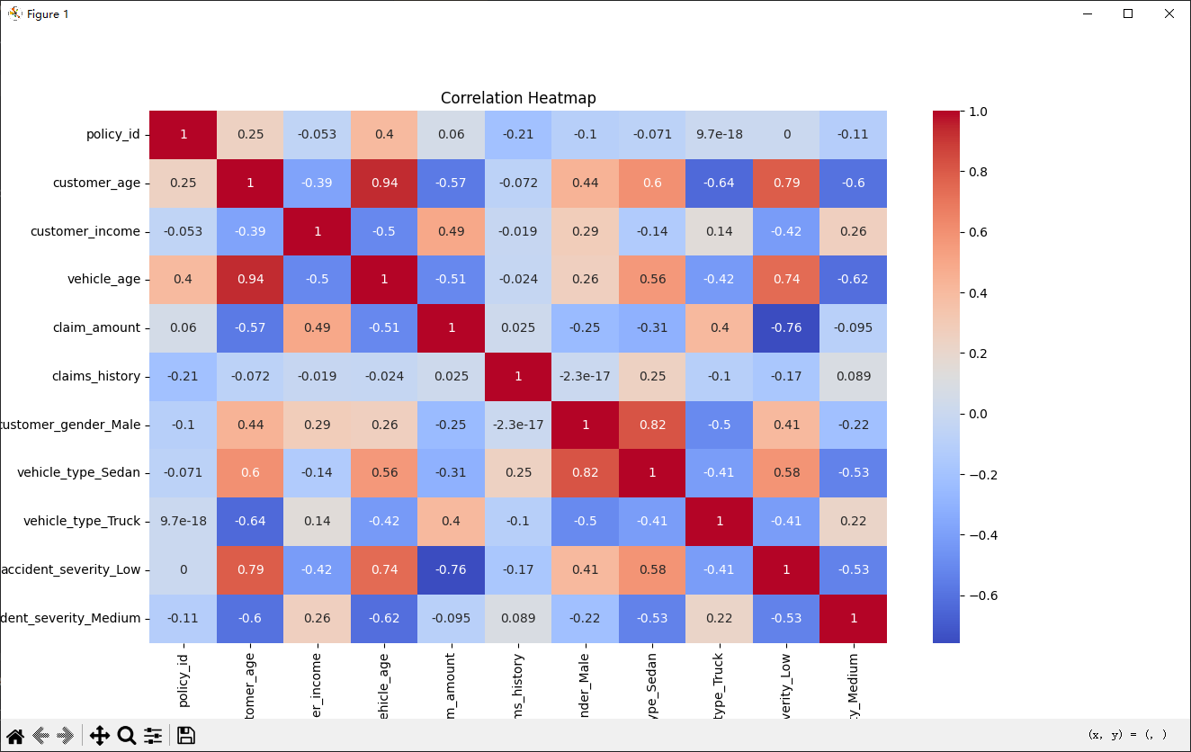
AI in Industry

Slide 5
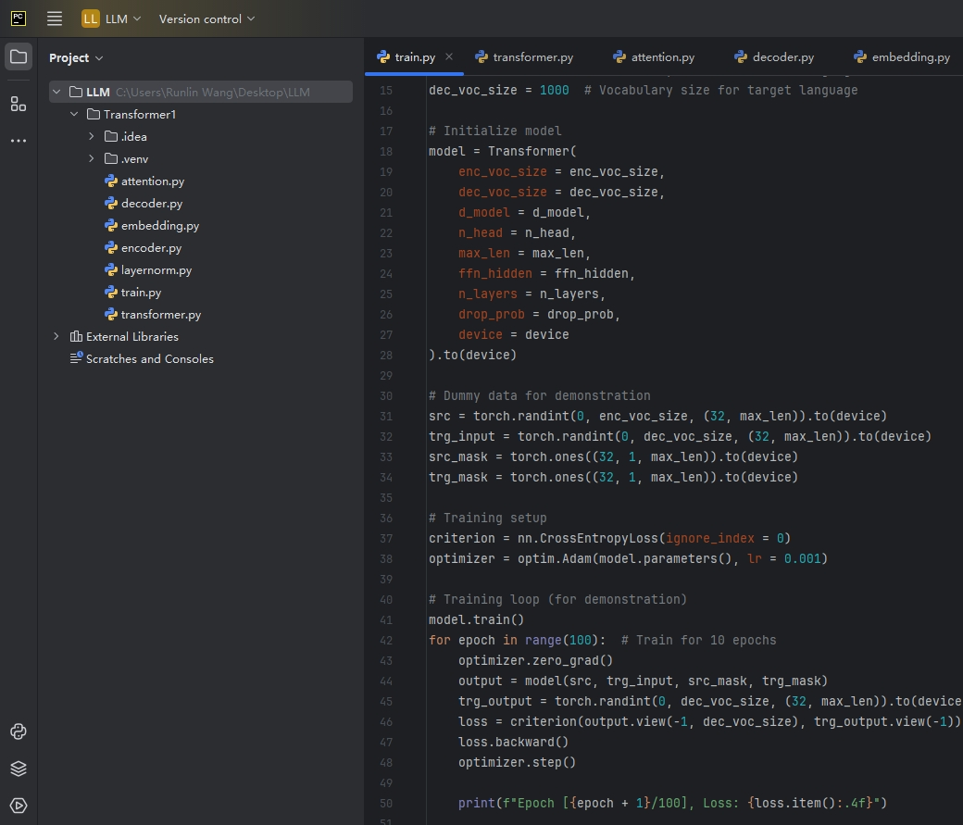

Slide 6


Slide 7
Our Job Is Much More Easy!

Slide 8
LEARNING OBJECTIVES

Slide 9
Learning objectives
After this presentation you:
- will be familiar with the definition of Artificial Intelligence;
will have an understanding of the difference between narrow and general AI;
will be familiar with the concept of Machine Learning;

Slide 10
INTRODUCTION TO ARTIFICIAL INTELLIGENCE

Slide 11
What is AI?
Definition
No universal definition
Sci-fi created unrealistic images/associations of AI
Field changes too fast
Interdisciplinary nature
What is intelligent?

Slide 12
What is AI?
Definition (1)
No universal definition
Sci-fi created unrealistic images/associations of AI
Field changes too fast
Interdisciplinary nature
What is intelligent?
General definition:
AI are computer systems that are autonomous and adaptive
Autonomous: the ability to perform tasks in complex environments without constant guidance by a use
Adaptive: the ability to improve performance by learning from experience

Slide 13

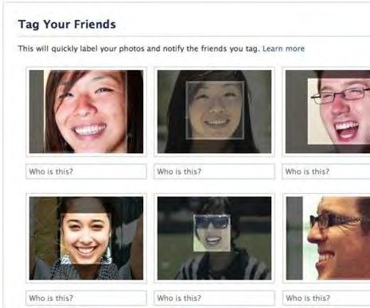
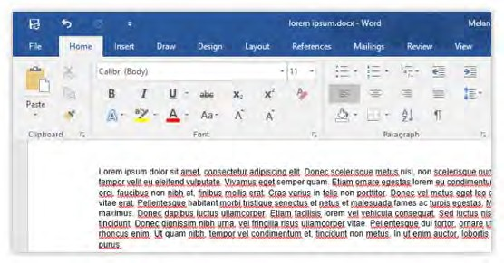
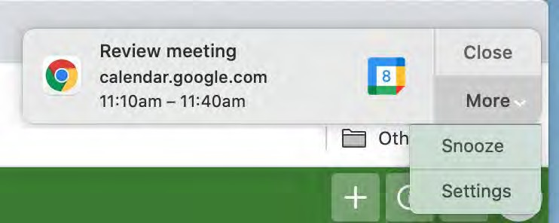
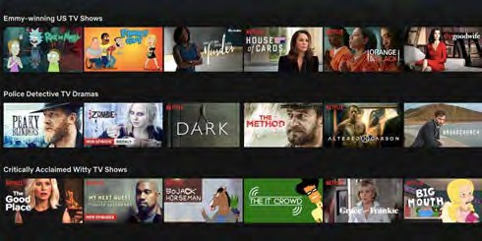
What is AI?
Examples of AI
AI AI are systems that are autonomous and adaptive Not AI

Slide 14
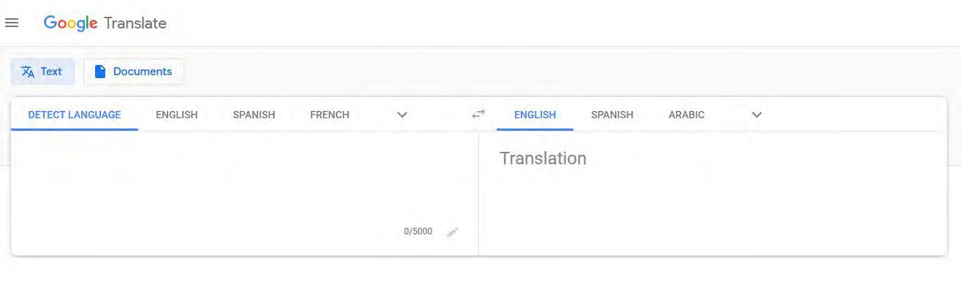
What is AI?
Exercise: Is it AI or not?
AI AI are systems that are autonomous and adaptive Not AI

Slide 15
What is AI?
Exercise: Is it AI or not?
AI AI are systems that are autonomous and adaptive Not AI

Slide 16
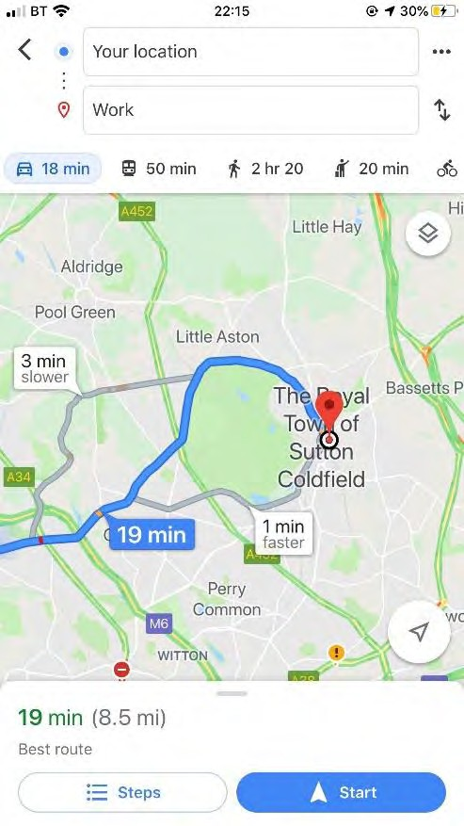
What is AI?
Exercise: Is it AI or not?
AI AI are systems that are autonomous and adaptive Not AI

Slide 17
What is AI?
Exercise: Is it AI or not?
AI AI are systems that are autonomous and adaptive Not AI

Slide 18
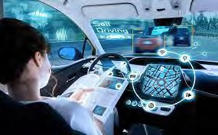
What is AI?
Exercise: Is it AI or not?
AI AI are systems that are autonomous and adaptive Not AI

Slide 19
What is AI?
Exercise: Is it AI or not?
AI AI are systems that are autonomous and adaptive Not AI

Slide 20
What is AI?
Narrow vs. General AI
Narrow AI
General AI
• AI focused on one specific or limited task: recommending a movie, make a reservation, clean
your house.

Slide 21
What is AI?
Narrow vs. General AI
Narrow AI
AI focused on one specific or limited task: recommending a movie, make a reservation, clean your house.
General AI

Slide 22
What is AI?
Narrow vs. General AI
Narrow AI
AI focused on one specific or limited task: recommending a movie, make a reservation, clean your house.
General AI
Similar to human intelligence
Can solve unfamiliar problems

Slide 23
What is AI?
Narrow vs. General AI
Narrow AI
AI focused on one specific or limited task: recommending a movie, make a reservation, clean your house.
General AI
Similar to human intelligence
Can solve unfamiliar problems
Weak vs. Strong AI

Slide 24
Subfields of AI
Definition
General definition:
AI are computer systems that are autonomous and adaptive

Slide 25
Subfields of AI
Definition
General definition:
AI are computer systems that are autonomous and adaptive
‘The theory and development of computer systems able to perform tasks normally requiring human intelligence, such as visual perception, speech recognition, decision-making, and translation between languages.’ – Oxford Dictionary (Lexico)

Slide 26
Subfields of AI
Tasks requiring human intelligence
What tasks do we do that require intelligence?
What tasks can we mimic with AI?

Slide 27
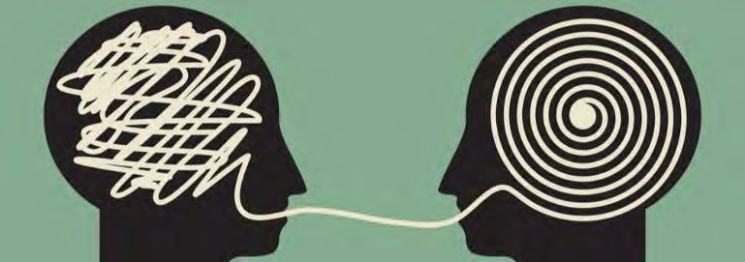
Subfields of AI
Tasks requiring human intelligence
What tasks do we do that require intelligence?
What tasks can we mimic with AI?
Speech recognition

Slide 28

Subfields of AI
Tasks requiring human intelligence
What tasks do we do that require intelligence?
What tasks can we mimic with AI?
Speech recognition
Natural Language Processing

Slide 29
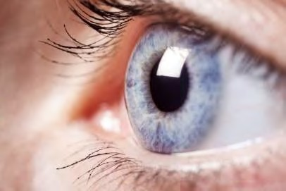
Subfields of AI
Tasks requiring human intelligence
What tasks do we do that require intelligence?
What tasks can we mimic with AI?
Speech recognition
Natural Language Processing
Image Processing and Computer Vision

Slide 30
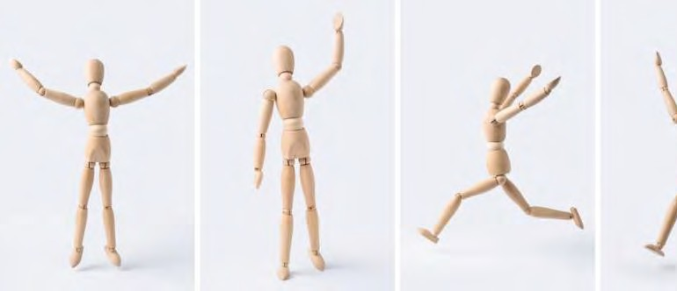
Subfields of AI
Tasks requiring human intelligence
What tasks do we do that require intelligence?
What tasks can we mimic with AI?
Speech recognition
Natural Language Processing
Image Processing and Computer Vision
Robotics

Slide 31
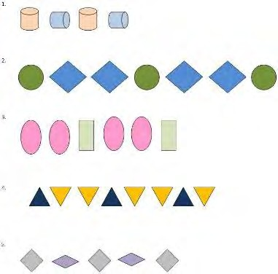
Subfields of AI
Tasks requiring human intelligence
What tasks do we do that require intelligence?
What tasks can we mimic with AI?
Speech recognition
Natural Language Processing
Image Processing and Computer Vision
Robotics
Machine Learning

Slide 32
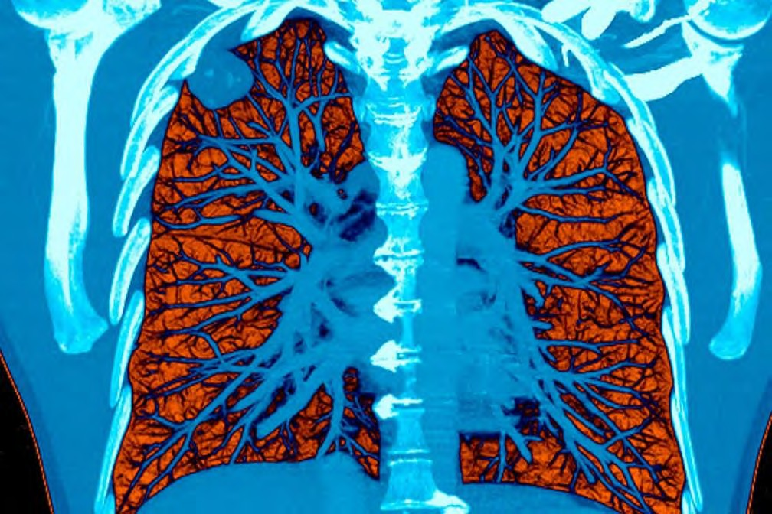
Subfields of AI
Examples
Tumor Detection
Image processing and Computer vision
Machine Learning
Voisin/Science Source via New York Times https://www.nytimes.com/2019/05/20/health/cancer-artificial-intellige nce-ct-scans.html

Slide 33
Subfields of AI
Examples
Tumor Detection
Image processing and Computer vision
Machine Learning
Customer Service (e.g. Chatbot)
Natural Language Processing
Machine Learning
Voisin/Science Source via New York Times https://www.nytimes.com/2019/05/20/health/cancer-artificial-intellige nce-ct-scans.html

Slide 34
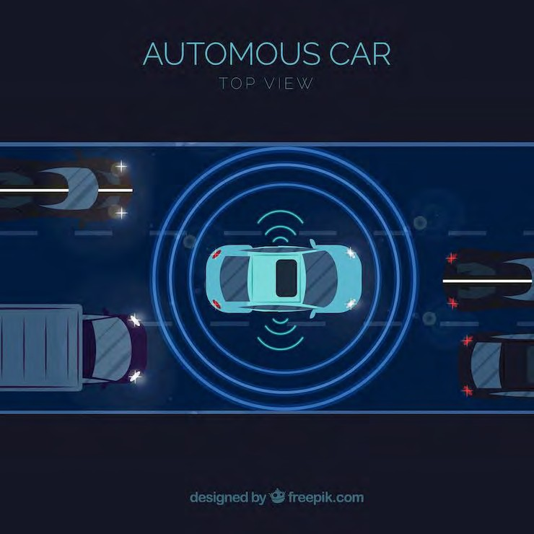
Subfields of AI
Examples
Self driving cars
Robotics
Image processing and Computer vision
Machine Learning
Speech Recognition

Slide 35
Subfields of AI
Subfields
Speech recognition
Natural Language Processing
Image Processing and Computer Vision
Robotics
Machine Learning

Slide 36
Subfields of AI
Subfields
Speech recognition
Natural Language Processing
Image Processing and Computer Vision
Robotics
Machine Learning

Slide 37
AI: Science and Engineering
AI tasks
Recap Definition AI :
Autonomous and adaptive
Systems that perform tasks that require human intelligence
- What things do we do that require intelligence?

Slide 38

How does AI work?
Solving Problems
- Can they cross? https://www.youtube.com/watch?v=fx6nq gld-Zs

Slide 39

Machine Learning
Ability to Learn
- Gives computers the ability to learn without explicitly being programmed

Slide 40
Machine Learning
Ability to Learn
Gives computers the ability to learn without explicitly being programmed
Solving Problems

Slide 41
Machine Learning
Ability to Learn
Gives computers the ability to learn without explicitly being programmed
Solving Problems
Tic Tac Toe

Slide 42
Machine Learning
Ability to Learn
- Gives computers the ability to learn without explicitly being programmed
Solving Problems
Tic Tac Toe
X

Slide 43
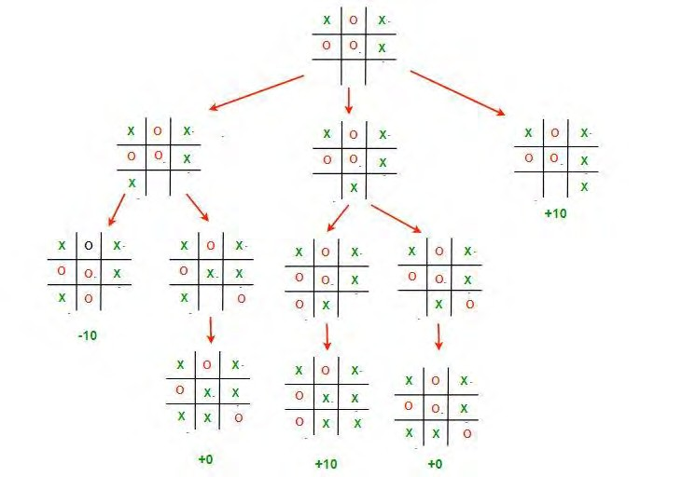
Machine Learning
Ability to Learn
Gives computers the ability to learn without explicitly being programmed
Solving Problems
Tic Tac Toe
X

Slide 44
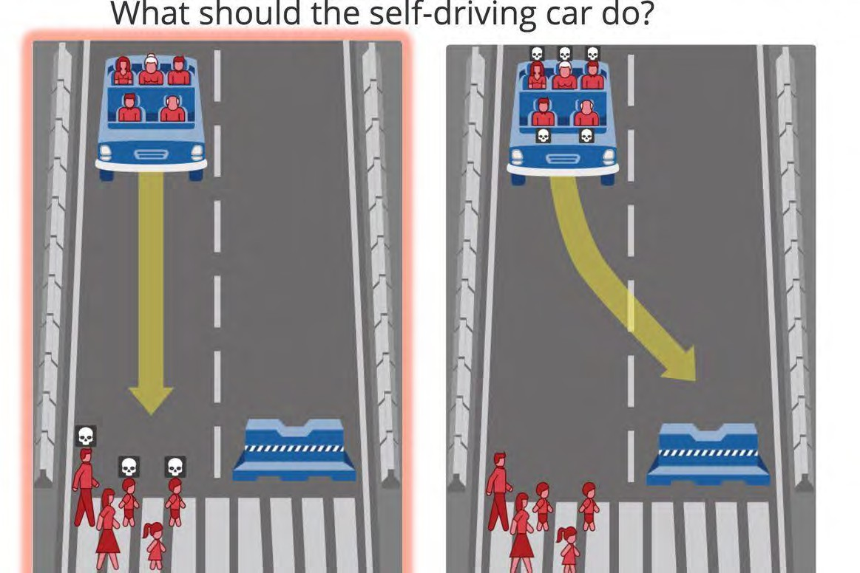
Machine Learning
Solving Problems in the Real World
This picture is one example of the many scenarios posed by the Moral Machine: https://www.moralmachine.net/

Slide 45
Machine Learning
What is Machine Learning?
Definition:
‘The use and development of computer systems that are able to learn and adapt without following explicit instructions, by using algorithms and statistical models to analyse and draw inferences from patterns in data.’ – Oxford Dictionary (Lexico)

Slide 46
Machine Learning
What is Machine Learning?
Definition:
‘The use and development of computer systems that are able to learn and adapt without following explicit instructions, by using algorithms and statistical models to analyse and draw inferences from patterns in data.’ – Oxford Dictionary (Lexico)

Slide 47
Machine Learning
What is Machine Learning?
Definition:
‘The use and development of computer systems that are able to learn and adapt without following explicit instructions, by using algorithms and statistical models to analyse and draw inferences from patterns in data.’ – Oxford Dictionary (Lexico)

Slide 48
Machine Learning
What is Machine Learning?
Definition:
‘The use and development of computer systems that are able to learn and adapt without following explicit instructions, by using algorithms and statistical models to analyse and draw inferences from patterns in data.’ – Oxford Dictionary (Lexico)
Goal:
To make predictions based on these patterns to solve problems, answer research questions or identify themes.

Slide 49
Machine Learning
What is Machine Learning?
Definition:
‘The use and development of computer systems that are able to learn and adapt without following explicit instructions, by using algorithms and statistical models to analyse and draw inferences from patterns in data.’ – Oxford Dictionary (Lexico)
Goal:
To solve problems by making predictions based on these patterns.
Examples
How can we optimize the learning process of students?
What treatment is most effective for a particular patient?

Slide 50
Machine Learning
Different types of Machine Learning
Supervised Unsupervised Reinforcement

Slide 51
Machine Learning
Different types of Machine Learning
Supervised
Labeled datasets
Train algorithms to classify or predict outcomes accurately

Slide 52
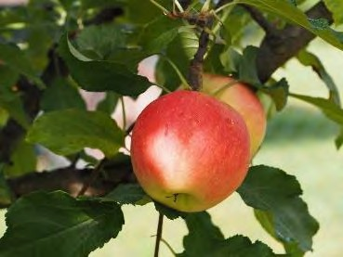
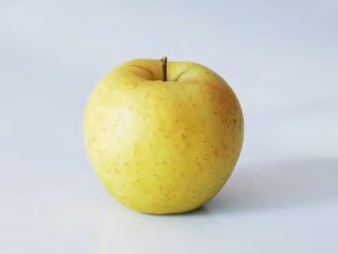
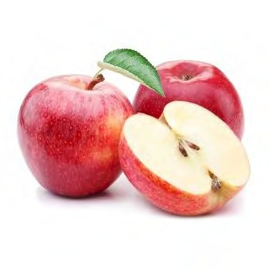
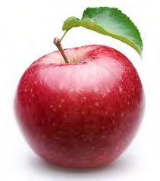
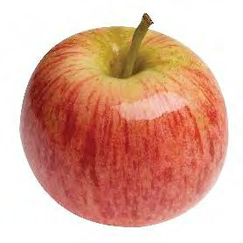
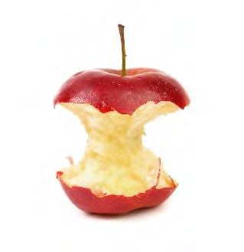
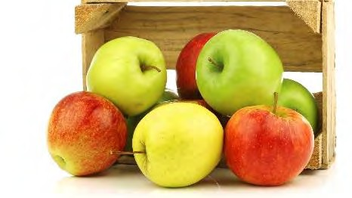
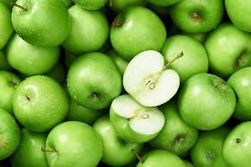
Machine Learning
Different types of Machine Learning
Supervised
Labeled datasets
Train algorithms to classify or predict outcomes accurately
Apple

Slide 53
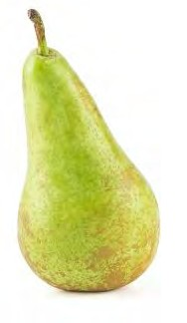
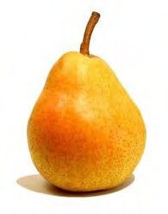
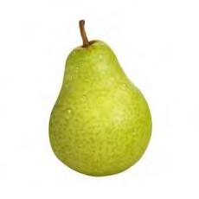
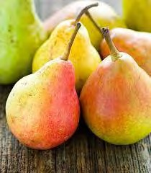
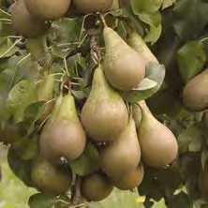
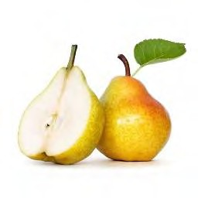
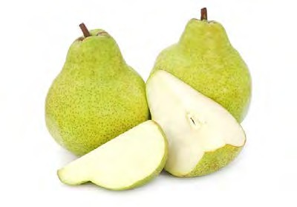
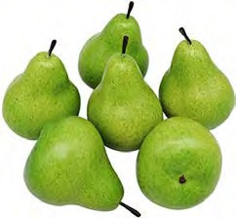
Machine Learning
Different types of Machine Learning
Supervised
Labeled datasets
Train algorithms to classify or predict outcomes accurately
Apple Pear

Slide 54

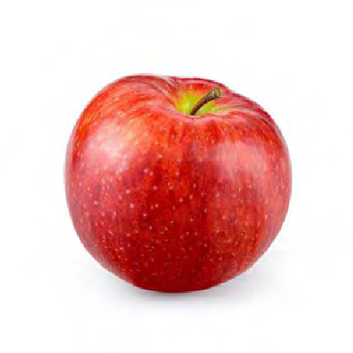
Machine Learning
Different types of Machine Learning
Supervised
Labeled datasets
Train algorithms to classify or predict outcomes accurately
Apple Pear
Input:

Slide 55
Machine Learning
Different types of Machine Learning
Supervised
Labeled datasets
Train algorithms to classify or predict outcomes accurately
Apple Pear
Input:
Output: Apple

Slide 56
Machine Learning
Different types of Machine Learning
Unsupervised
Unlabeled datasets
Discovers hidden patterns

Slide 57
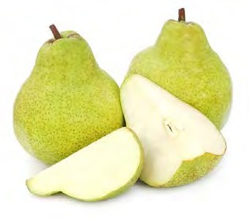
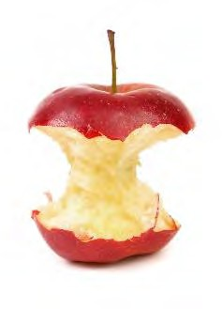
Machine Learning
Different types of Machine Learning
Unsupervised
Unlabeled datasets
Discovers hidden patterns

Slide 58
Machine Learning
Different types of Machine Learning
Unsupervised
Unlabeled datasets
Discovers hidden patterns

Slide 59

Machine Learning
Different types of Machine Learning
Unsupervised
Unlabeled datasets
Discovers hidden patterns
Apple Pear
Input:

Slide 60
Machine Learning
Different types of Machine Learning
Unsupervised
Unlabeled datasets
Discovers hidden patterns
Apple Pear
Input:
Output: Apple

Slide 61
Machine Learning
Different types of Machine Learning
Unsupervised
Unlabeled datasets
Discovers hidden patterns

Slide 62
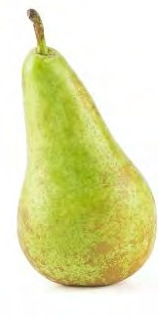
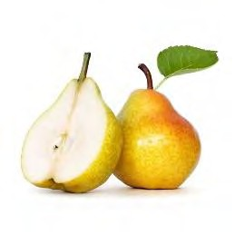
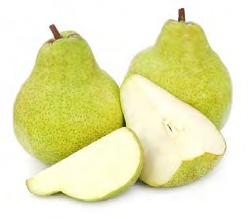
Machine Learning
Different types of Machine Learning
Unsupervised
Unlabeled datasets
Discovers hidden patterns

Slide 63
Machine Learning
Different types of Machine Learning
Unsupervised
Unlabeled datasets
Discovers hidden patterns
Red/yellow/orange Green
Input:

Slide 64
Machine Learning
Different types of Machine Learning
Unsupervised
Unlabeled datasets
Discovers hidden patterns
Red/yellow/orange Green
Input:
Output: Red/yellow/orange

Slide 65
Machine Learning
Different types of Machine Learning
Unsupervised
Unlabeled datasets
Discovers hidden patterns

Slide 66
Machine Learning
Different types of Machine Learning
Unsupervised
Unlabeled datasets
Discovers hidden patterns

Slide 67
Machine Learning
Different types of Machine Learning
Unsupervised
Unlabeled datasets
Discovers hidden patterns
Multiple Single
Input:

Slide 68
Machine Learning
Different types of Machine Learning
Unsupervised
Unlabeled datasets
Discovers hidden patterns
Multiple Single
Input:
Output: Single

Slide 69
Machine Learning
Different types of Machine Learning
Unsupervised
Unlabeled datasets
Discovers hidden patterns
Exercise: Can you think of other hidden patterns?

Slide 70
Machine Learning
Different types of Machine Learning
Unsupervised
Unlabeled datasets
Discovers hidden patterns
Exercise: Can you think of other hidden patterns?
Tree vs. no tree
Leaf vs. no leaf
Inside/white/pit vs. no inside/white/pit
Multiple colors vs. one color

Slide 71


Machine Learning
Different types of Machine Learning
Reinforcement
Unlabeled datasets
System receives feedback/rewards
Closest to how humans learn

Slide 72
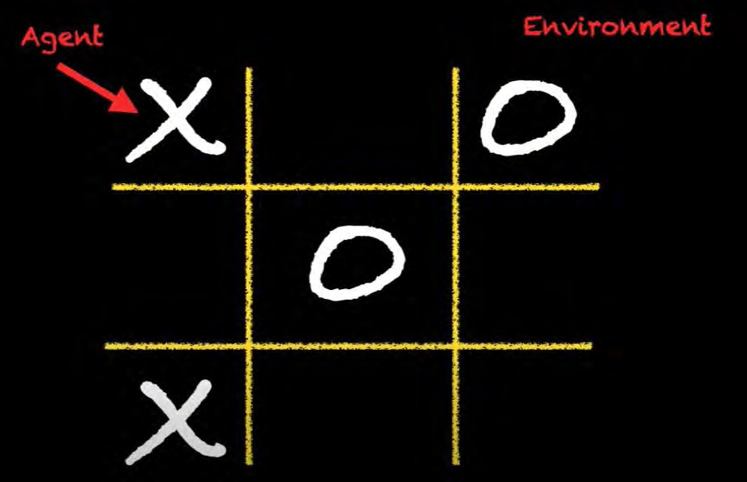
Machine Learning
Different types of Machine Learning
Reinforcement
Unlabeled datasets
System receives feedback/rewards
Closest to how humans learn
Example: Tic-Tac-Toe
Please watch:
https://www.youtube.com/watch?v=KEQhaBI Z9yk for full video and explanation

Slide 73
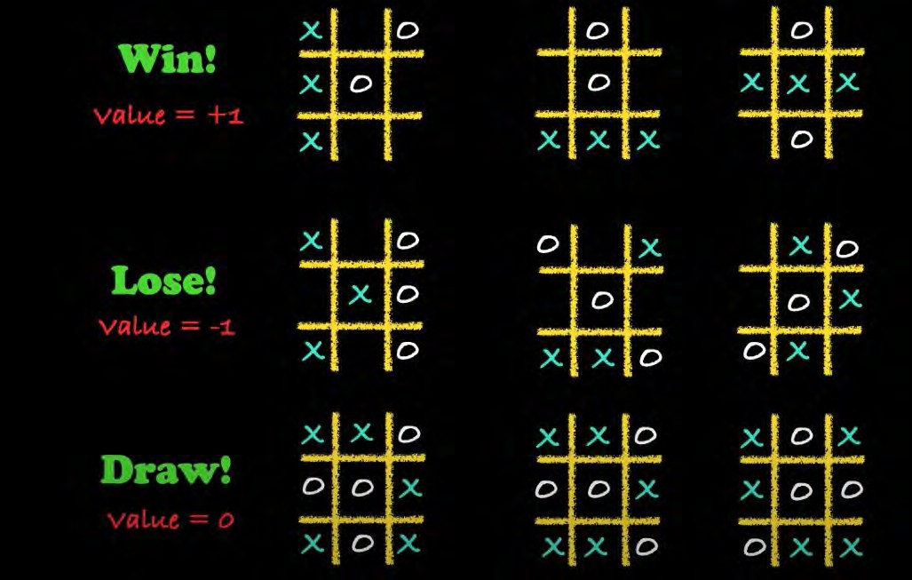
Machine Learning
Different types of Machine Learning
Reinforcement
Unlabeled datasets
System receives feedback/rewards
Closest to how humans learn
Example: Tic-Tac-Toe
AlphaZero beats World’s chess Champion
Please watch:
https://www.youtube.com/watch?v=KEQhaBI Z9yk for full video and explanation

Slide 74
Machine Learning
Different types of Machine Learning
Supervised Unsupervised Reinforcement
Labeled datasets
Train algorithms to classify or predict outcomes accurately
Unlabeled datasets
Discovers hidden patterns
Unlabeled datasets
System receives feedback/rewards
Closest to how humans learn

Slide 75
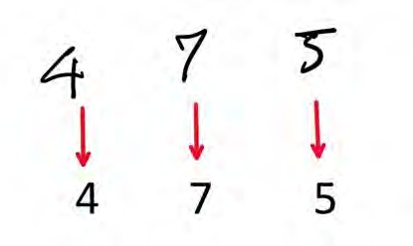
Machine Learning
Different types of Machine Learning
Supervised Unsupervised Reinforcement
Labeled datasets
Train algorithms to classify or predict outcomes accurately
Unlabeled datasets
Discovers hidden patterns
Unlabeled datasets
System receives feedback/rewards
Closest to how humans learn
Examples: hand writing recognition, face recognition
Examples: fraud detection, recommendations
Examples: recommendations

