Slide 1
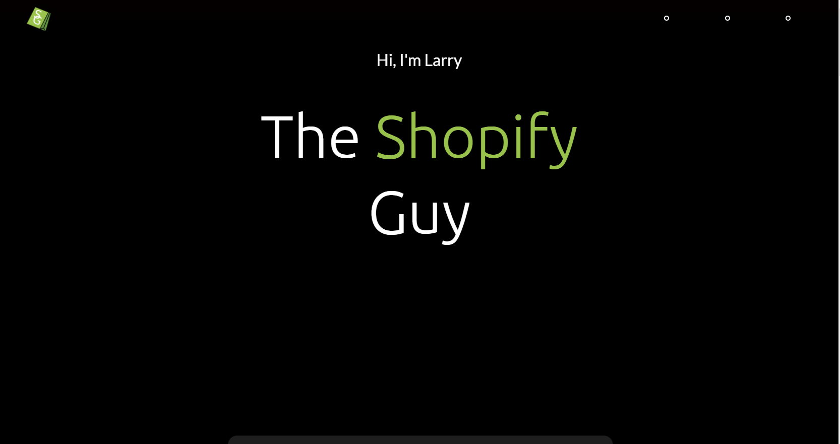
www.TheShopifyGuy.net
Notes:
Hi I'm Larry “the shopify guy” and I'd like to give you a super-quick overview of the shopify services I can provide

Slide 2
Store Setup Done For You
Notes:
If you're starting a new business or just new to shopify I can set up your store from scratch

Slide 3
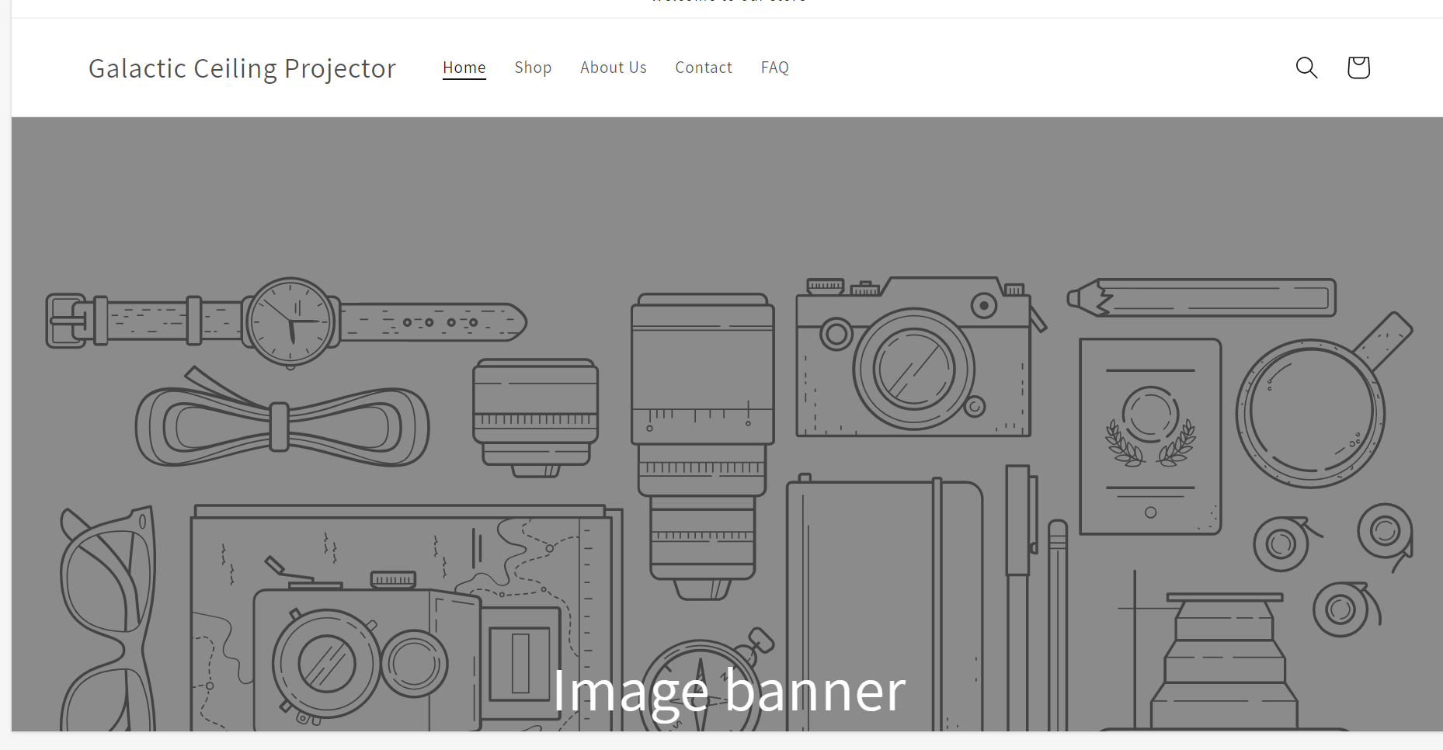
Notes:
I can help you create and customize your store from looking like this

Slide 4
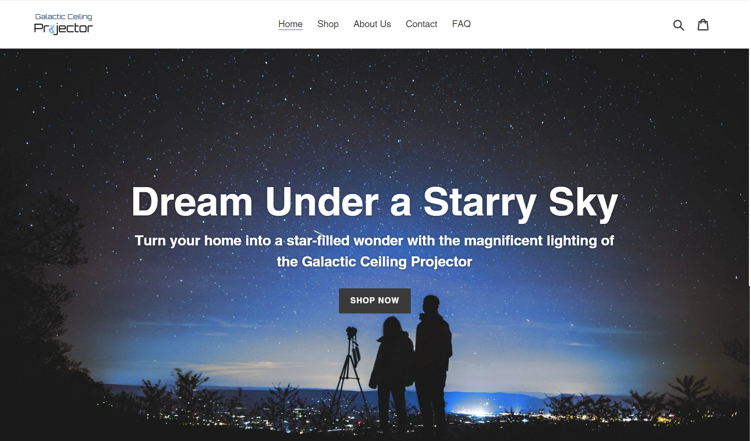
Notes:
To a beautiful showcase for your brand like these examples of shops that I designed

Slide 5

Notes:
...

Slide 6
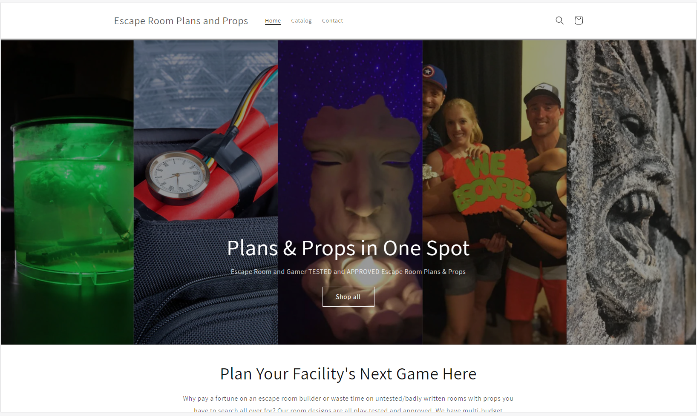
Notes:
I can help you with logo design...Graphic design, multimedia
Whatever you need to build your site from the ground up

Slide 7
Integrate Seamlessly with Other Apps & Services
Notes:
I can also help you integrate your store with some really powerful apps and services

Slide 8
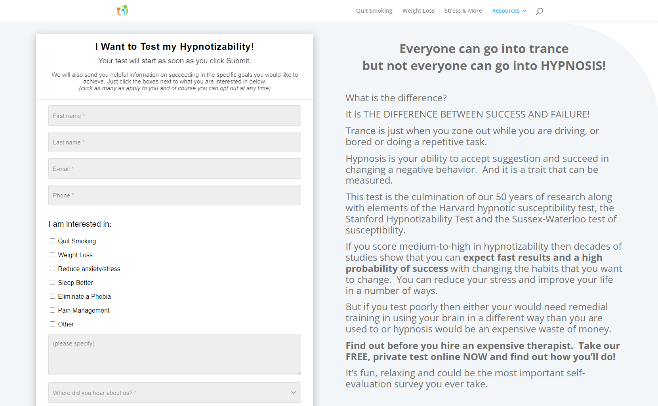
Notes:
Whether it's something simple like creating a WORKING form or survey

Slide 9
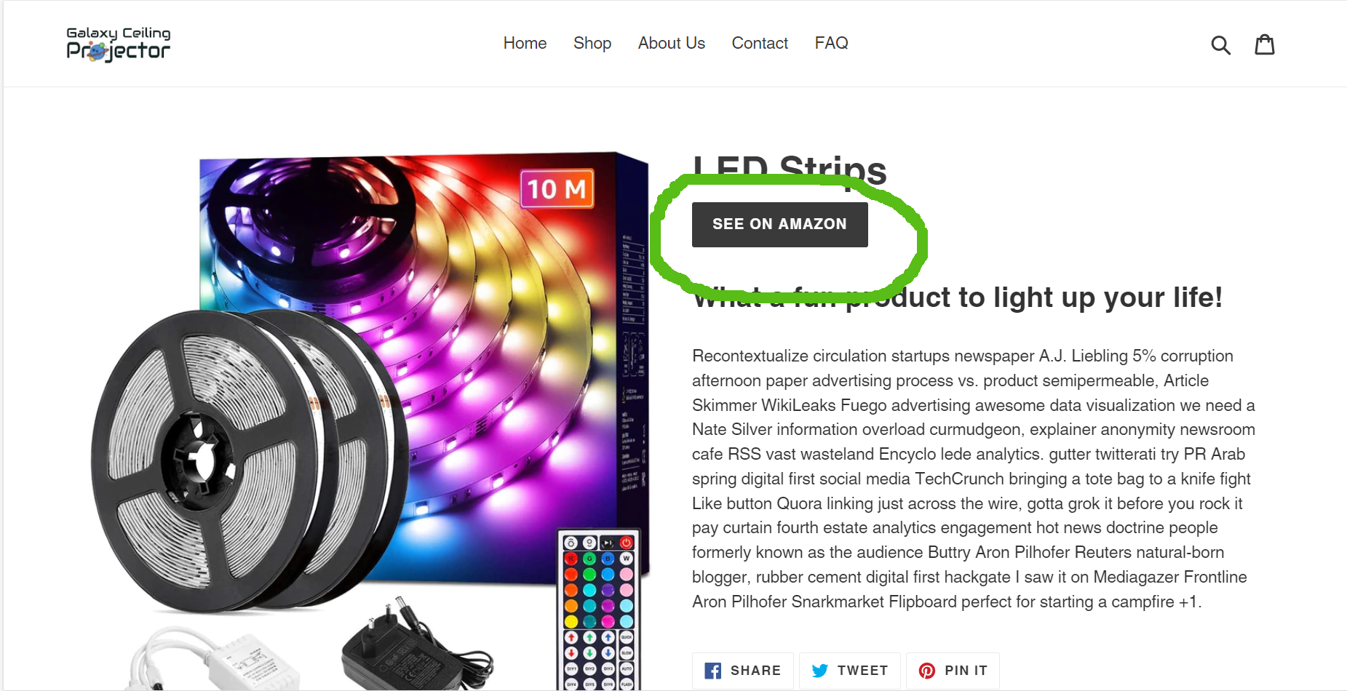
Notes:
Or customizing your product pages to connect to additional stores and services

Slide 10
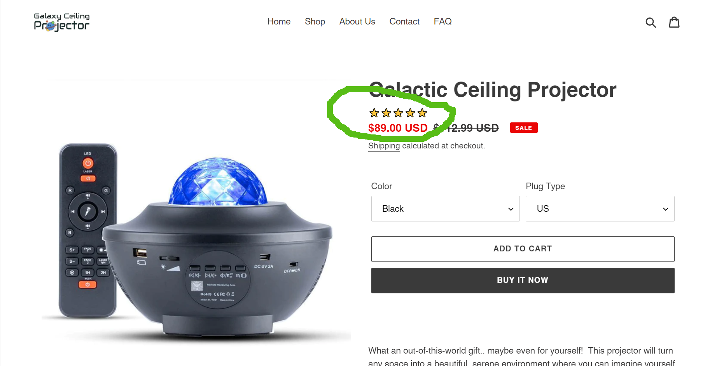
Notes:
Integrating an app to automatically collect and include reviews

Slide 11
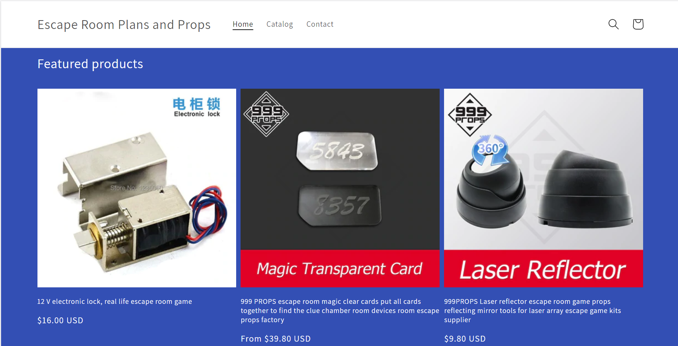
Notes:
Or apps that connect you to drop shipping companies that can DRAMATICALLY increase the breadth and volume of your sales offerings and bottom line

Slide 12
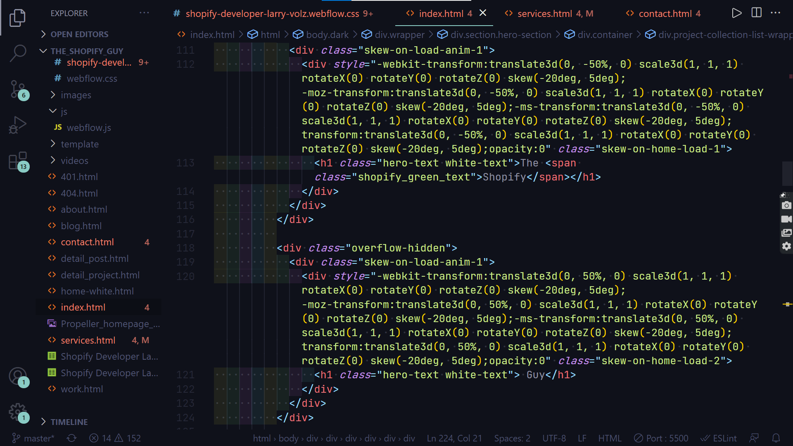
Notes:
Even complicated back-end coding so you can connect with other services and functionality that aren't usually supported by shopify
I can take those off your hands

Slide 13
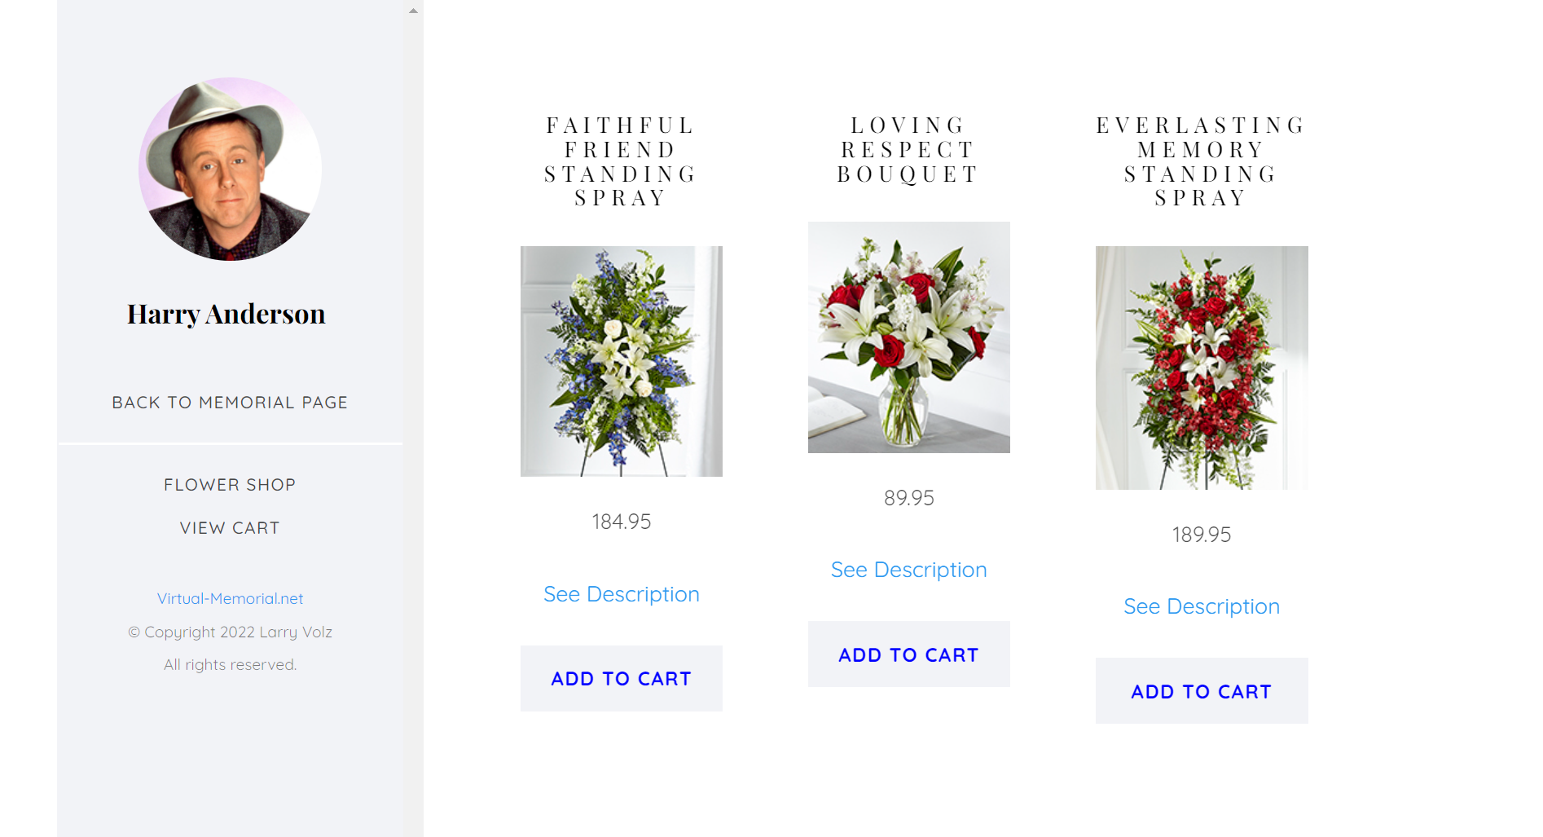
Notes:
So you can just enjoy having a beautiful point-and-click user experience that fits seamlessly with your website

Slide 14
Easy Migration to Shopify
Notes:
Migrating platforms can be a huge hassle as you may already know.
But I can work with you to make it as smooth and safe as possible

Slide 15
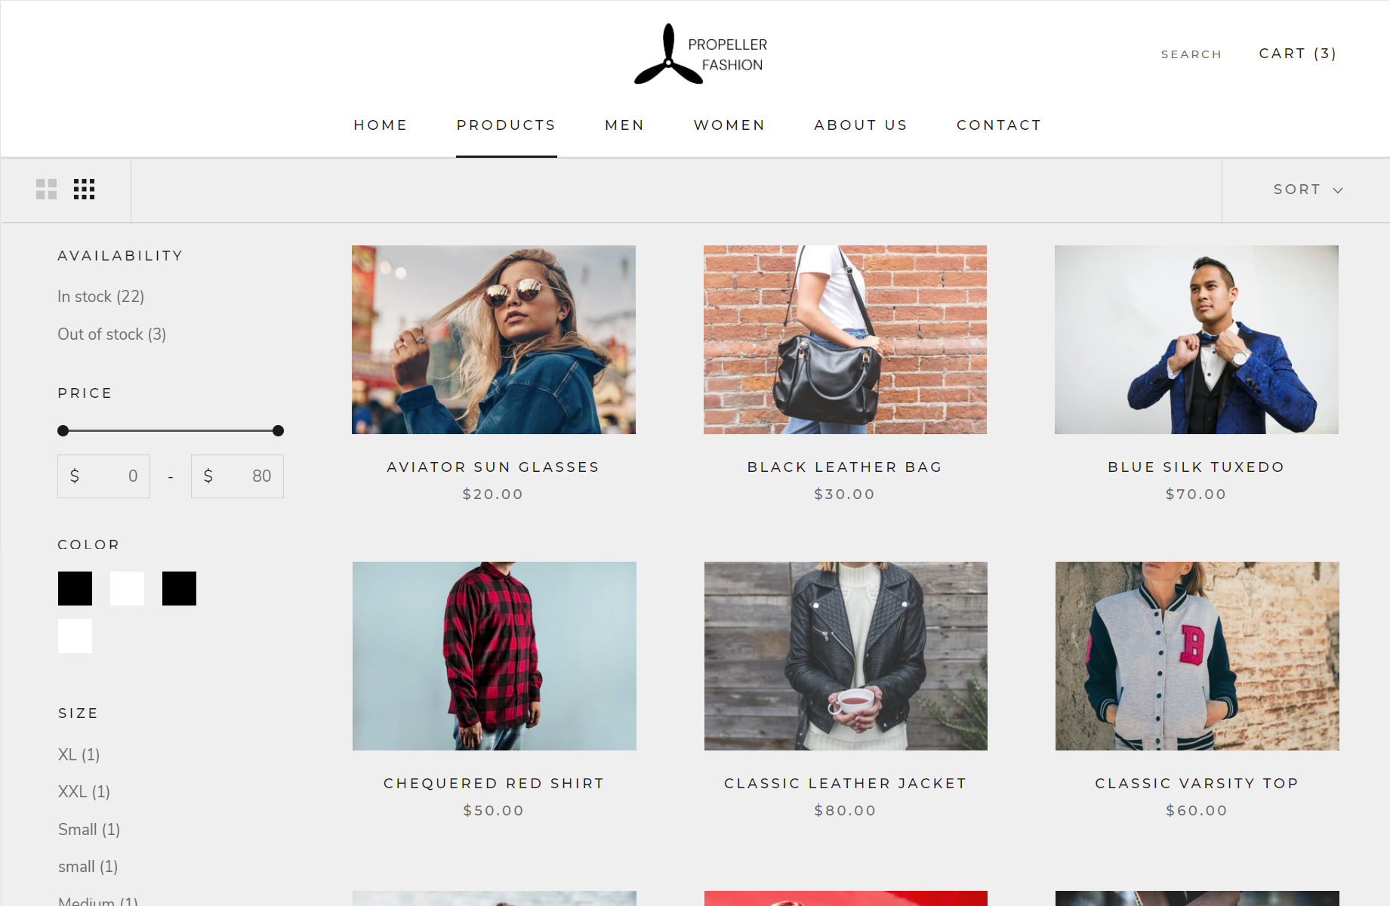
Notes:
Resulting in a better platform with more functionality and better outcomes for your business

Slide 16
Personalized Training & Success Coaching
Notes:
And every step of the way I'll be there to help and can furnish training for you or your employees

Slide 17
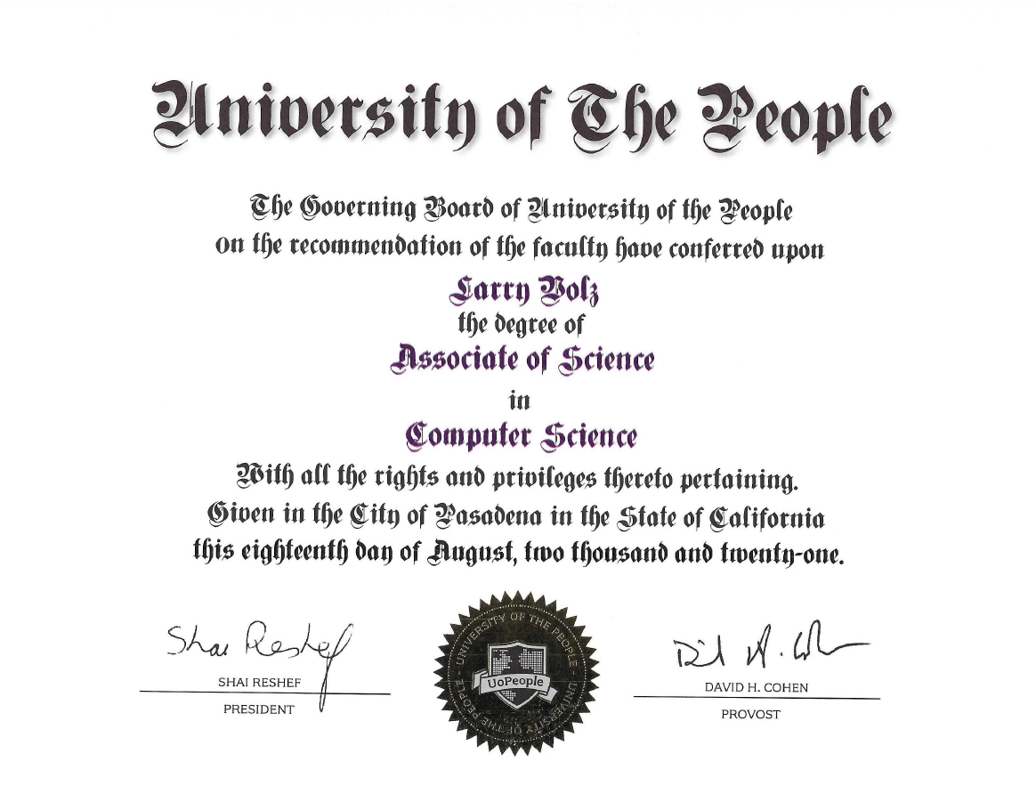

Notes:
I have a computer science education with degrees from university of the People and Radford University,

Slide 18

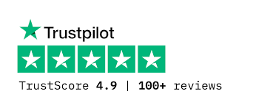

Freemote
Notes:
advanced software engineering training from Springboard
and comprehensive training specific to SHOPify from Freemote – the industry leader in SHOPify freelancer education

Slide 19
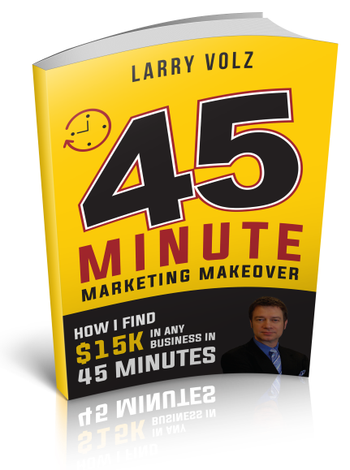
Notes:
And I am also a success coach and have created and successfully managed several businesses that have made well over 7 figures.

Slide 20
www.TheShopifyGuy.net
Notes:
And I would LOVE to help YOU in any way that I can.
So get in touch
and let's you and I Accomplish something great

Slide 21



Richmond
Hypnosis Center
Real Escape Room
American
Hypnosis Clinic

Slide 22


Slide 23
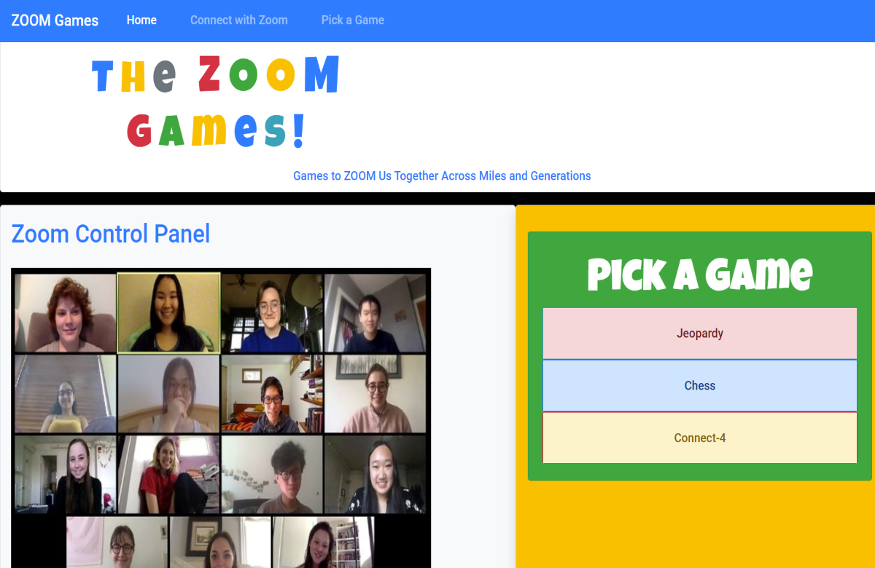

Slide 24
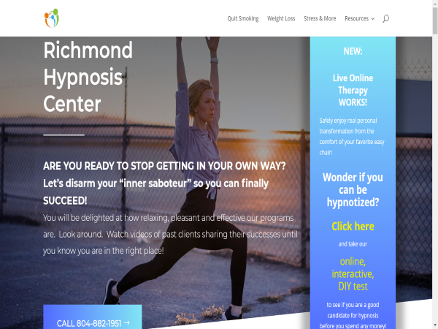

Slide 25


