Slide 1
Employing Word Embeddings and Machine Learning For Effective Fake News Detection
CHAN, Ka Chun (20952857) LIU, Kwun Ho (20959984)
Presentation video link

Slide 2
Dataset
validation set
News dataset (44919 rows)
title
text
subject
date
class
We will keep columns `text` and `class`.
Drop the duplicate rows: 38658 rows
Split dataset into training set (34793 rows) and testing set (3865 rows) with testing ratio = 0.1 before doing word embeddings.
In the training set (34793 rows), 25% of them (8699 rows) forms a validation set.
3865
26094
8699
testing set
training set

Slide 3
Machine Learning Tasks
Embeddings: convert the text in the news article into vectors which can be fitted into classifiers
Word embeddings
Doc2vec
Term Frequency Inverse Document Frequency
Pre-trained Large Language Models
Classification: take an embedded text (vector) in a news article as the input, classify it as either fake news (1) or not (0).
Logistic Regression
Decision Tree
MLP

Slide 4
Machine Learning Tasks
Workflow
embeddings
(+ pretrained transformers)
whole training set (34793 instances)
Train: training set excluding the validation set
(26094 instances)
Evaluate: validation set (8699 instances)
Logistic regression
Decision Tree
MLP
(1 hidden layer,
100 neurons, relu)
Evaluate: testing set
(3865 instances)

Slide 5
Word embeddings (Continuous Bag Of Words)
Continuous Bag Of Words (CBOW)
Learns the embeddings by training a neural network with a single hidden layer to predict a target word based on the context words within a fixed window.
For example: window size = 2,
“ I am studying machine learning”

Slide 6
Word embeddings (Continuous Bag Of Words)
For example: window size = 2,
“ I am studying machine learning”
Context words: {“I”, “am”, “machine”, “learning”}
“I” : (1, 0, 0, 0, 0) = e1
“am” : (0, 1, 0, 0, 0) = e2
“studying”: (0, 0, 1, 0, 0) = e3
“machine”: (0, 0, 0, 1, 0) = e4
“learning”: (0, 0, 0, 0, 1) = e5
Aggregate context vectors by sum/ mean:
e1 + e2 + e4 + e5 = (1, 1, 0, 1, 1)

Slide 7
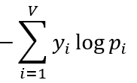
Word embeddings (Continuous Bag Of Words)
Loss function:
Cross-entropy loss
Aggregate context vectors by sum/ mean:
e1 + e2 + e4 + e5 = (1, 1, 0, 1, 1)
(One-hot)
“studying”
1
0
1
0
0
W1
W2
1
Softmax
1
0
1
0
2 dimensional embedding
Backward propagation

Slide 8
Word embeddings (Skip-gram)
Skip-gram
Learns the embeddings by training a neural network with a single hidden layer to predict context words based on the middle word within a fixed window.
“Reverse of continuous bag of words”
For example: window size = 2,
“ I am studying machine learning”
“I” : (1, 0, 0, 0, 0) = e1
“am” : (0, 1, 0, 0, 0) = e2
“studying”: (0, 0, 1, 0, 0) = e3
“machine”: (0, 0, 0, 1, 0) = e4
“learning”: (0, 0, 0, 0, 1) = e5

Slide 9




Word embeddings (Skip-gram)
Loss function:
Cross-entropy loss
Backward propagation
(One-hot)
“I”
“am”
“machine”
“learning”
W2
0
0
(One-hot)
“studying”
1
W1
softmax
0
0
2 dimensional embedding

Slide 10
Word embeddings
Embedding results on the news dataset: similar words
Setup: window size =10, embedding dimension =100
Top 5 most similar to “Trump”
Continuous Bag Of Words | Skip-gram
[('Trump’s', 0.6752964854240417), ('president-elect', 0.6383985877037048), ('Conway', 0.5692538022994995), ('himself', 0.559880793094635), ('bigotry-filled', 0.500789225101471)] | [('Donald', 0.8969791531562805), ('magnanimous', 0.8028818368911743), ('scold', 0.7866173982620239), ('backtracked', 0.784342885017395), ('regretful', 0.7759620547294617)]

Slide 11
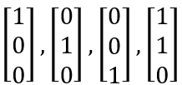
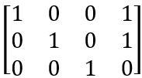
Word embeddings
Text embeddings by weighted aggregation
Instead of just simply concatenating the word embeddings in the text, we embed the text as follows:
Let’s say all the tokens in the text are
[“A”, “B”, “C”, “D”]
and their word embeddings are
respectively. Then we can form an embedding matrix

Slide 12
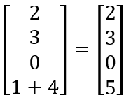
Word embeddings
Text embeddings by weighted aggregation
Embedding matrix
For example, we have a text (after tokenization) like this [“D”, “A”, “B”, “D”].
Then, we can form an encoding vector
“A” “B” “C” “D”
1, 2, 3, 4
“A” appears in 2nd position
“B” appears in 3rd position
“C” doesn’t appear
“D” appears in the 1st and 4th position

Slide 13
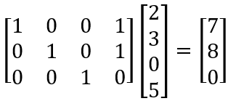
Word embeddings
Text embeddings by weighted aggregation
Embedding matrix Encoding vector
Then, we can multiply the embedding matrix and the encoding vector to get the embedding for the text.
“A” “B” “C” “D”

Slide 14
Word embeddings
Performance on the validation set and the testing set
Setup:
window size =10, embedding dimension = 100, weighted aggregation
3 classification models
Logistic regression
Decision tree
MLP classifier
One hidden layer,
Learning rate =0.001
100 neurons,
RELU activation function

Slide 15
Word embeddings
Performance on the validation set and the testing set
Logistic Regression
 | CBOW |  | Skip-gram
 | Validation set | Testing set | Validation set | Testing set
accuracy | 0.96 | 0.67 | 0.96 | 0.68
precision | 0.94 | 0.94 | 0.94 | 0.94
recall | 0.99 | 0.44 | 0.99 | 0.46
F1-score | 0.97 | 0.60 | 0.97 | 0.62

Slide 16
Word embeddings
Performance on the validation set and the testing set
Decision Tree
 | CBOW |  | Skip-gram
 | Validation set | Testing set | Validation set | Testing set
accuracy | 0.93 | 0.98 | 0.93 | 0.70
precision | 0.94 | 0.98 | 0.94 | 0.97
recall | 0.94 | 0.46 | 0.94 | 0.48
F1-score | 0.94 | 0.63 | 0.94 | 0.64

Slide 17
Word embeddings
Performance on the validation set and the testing set
MLP
 | CBOW |  | Skip-gram
 | Validation set | Testing set | Validation set | Testing set
accuracy | 0.98 | 0.68 | 0.97 | 0.66
precision | 0.98 | 1.00 | 0.98 | 1.00
recall | 0.98 | 0.43 | 0.97 | 0.40
F1-score | 0.98 | 0.60 | 0.98 | 0.58

Slide 18
Word embeddings
Performance on the validation set and the testing set
In our use case, recall is the metric that we care more about.
“Among these fake news, how many of them can we distinguish?”
However, the recall values on testing set in our model is not ideal (< 0.5).

Slide 19
Word embeddings
Experiment: Dimensions of embeddings
Setup:
window size =10
embedding dimension from 10 to 70
3 classification models
Logistic regression
Decision tree
MLP classifier
One hidden layer, 100 neurons, RELU activation functions

Slide 20
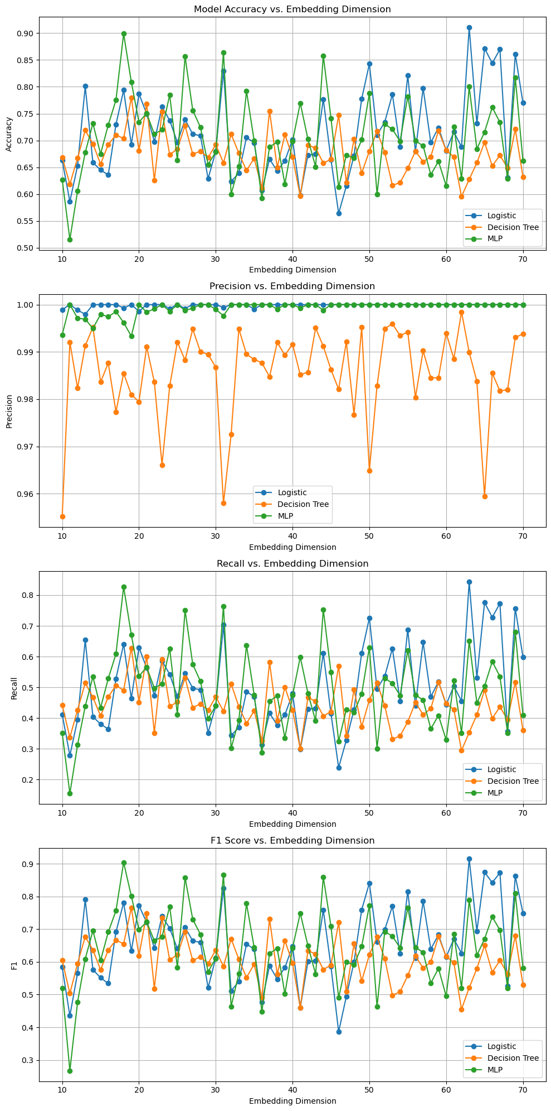
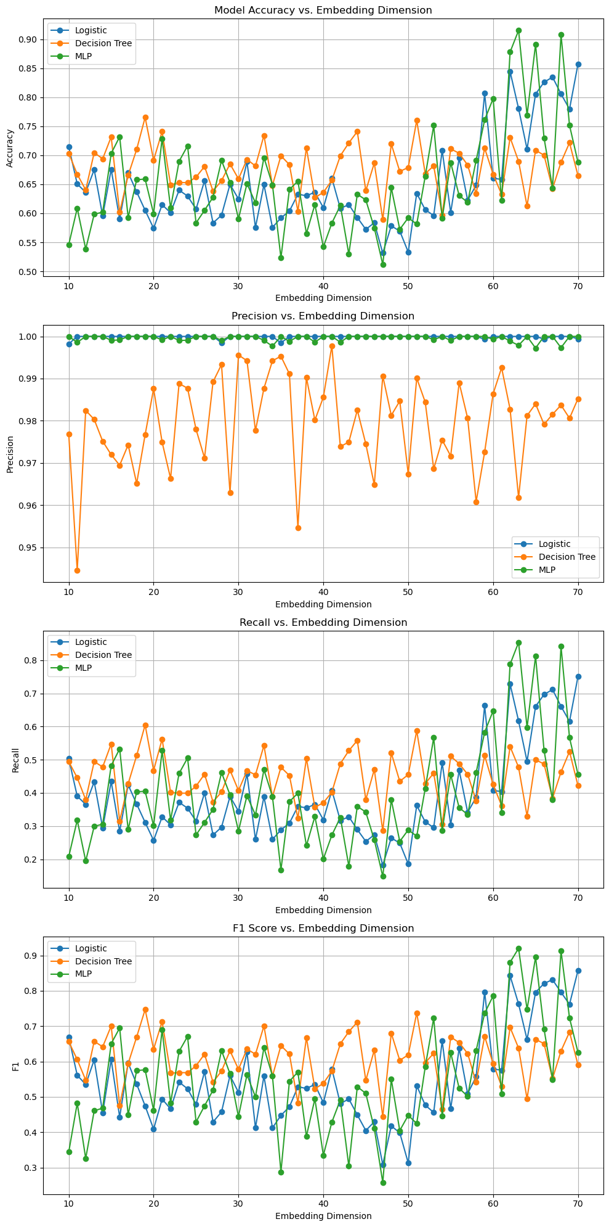
Word embeddings
Experiment: Dimensions of embeddings
CBOW
Skip-gram

Slide 21
Word embeddings (GloVe)
Pre-trained word embeddings: Global Vectors for Word Representation (GloVe)
We are using `glove.6B.50d`
6 billions tokens
Embedding dimension =50
Texts are embedded in the same method as before (weighted aggregation)

Slide 22
Word embeddings (GloVe)
Performance on the validation set and the testing set
Logistic Regression
 | Validation set | Testing set
accuracy | 0.88 | 0.56
precision | 0.85 | 0.56
recall | 0.95 | 1.00
F1-score | 0.90 | 0.72

Slide 23
Word embeddings (GloVe)
Performance on the validation set and the testing set
Decision Tree
 | Validation set | Testing set
accuracy | 0.85 | 0.57
precision | 0.86 | 0.59
recall | 0.87 | 0.81
F1-score | 0.87 | 0.68

Slide 24
Word embeddings (GloVe)
Performance on the validation set and the testing set
MLP
 | Validation set | Testing set
accuracy | 0.92 | 0.57
precision | 0.92 | 0.57
recall | 0.93 | 0.98
F1-score | 0.92 | 0.72

Slide 25
Doc2vec
An extension of CBOW/ Skip-gram
Instead of embedding each single word, Doc2Vec embeds the whole document (text) into vectors.
For each document, an unique document identifier (vector) is assigned to it. For each word embeddings and the document identifier, the vectors are randomly initialised before the model training.
Tokenized documents
Doc1: [“dogs”, “are”, “great”, “pet”]
Doc2: [“the”, “cat”, “sits”, “on”, “the”, “mat”]
Document identifiers
Doc1: D1 [0.1, 0.2]
Doc2: D2 [0.3, 0.4]
Initial word embeddings
“dogs”: [0.0, 0.1] “are” :[0.2, 0.3]
“great”: [0.4, 0.5] “pet” :[0.5, 0.5]
“the”: [0.7, 0.2] “sits” :[0.3, 0.5]
“on”: [0.8, 0.6] “mat” :[0.8, 0.2]

Slide 26
Doc2vec
Tokenized documents
Doc1: [“dogs”, “are”, “great”, “pet”]
Doc2: [“the”, “cat”, “sits”, “on”, “the”, “mat”]
Document identifiers
Doc1: D1 [0.1, 0.2]
Doc2: D2 [0.3, 0.4]
Initial word embeddings
“dogs”: [0.0, 0.1] “are” :[0.2, 0.3]
“great”: [0.4, 0.5] “pet” :[0.5, 0.5]
“the”: [0.7, 0.2] “sits” :[0.3, 0.5]
“on”: [0.8, 0.6] “mat” :[0.8, 0.2]
Distributed Memory (DM)
Similar to CBOW, use context words to predict the target word.
In addition to the context words, the document identifiers are also used.
[...]
(one hot) “are”
W
Backward propagation with respect to W and inputs
[...]
concatenate
Aggregation
(by sum/ average)
[0.1, 0.2]
D1
[0.0, 0.1]
“dogs”
[0.4, 0.5]
“great”
[0.5, 0.5]
“pet”

Slide 27
Doc2vec
Tokenized documents
Doc1: [“dogs”, “are”, “great”, “pet”]
Doc2: [“the”, “cat”, “sits”, “on”, “the”, “mat”]
Document identifiers
Doc1: D1 [0.1, 0.2]
Doc2: D2 [0.3, 0.4]
Initial word embeddings
“dogs”: [0.0, 0.1] “are” :[0.2, 0.3]
“great”: [0.4, 0.5] “pet” :[0.5, 0.5]
“the”: [0.7, 0.2] “sits” :[0.3, 0.5]
“on”: [0.8, 0.6] “mat” :[0.8, 0.2]
Distributed Bag Of Words (DBOW)
Similar to skip-gram, but it uses the document identifier to predict the context words.
(one-hot)
“are”
(one-hot)
“great”
[...]
[...]
[...]
(one-hot)
“pet”
[...]
(one-hot)
“dogs”
Backward propagation with respect to W1, W2 and D1
W2
[...]
W1
[0.1, 0.2]
D1

Slide 28
Doc2Vec
Performance on the validation set and the testing set
Logistic Regression
 | DM |  | DBOW
 | Validation set | Testing set | Validation set | Testing set
accuracy | 0.94 | 0.94 | 0.99 | 1.00
precision | 0.93 | 0.93 | 0.99 | 1.00
recall | 0.96 | 0.96 | 1.00 | 1.00
F1-score | 0.94 | 0.95 | 1.00 | 1.00

Slide 29
Doc2Vec
Performance on the validation set and the testing set
Decision Tree
 | DM |  | DBOW
 | Validation set | Testing set | Validation set | Testing set
accuracy | 0.85 | 0.86 | 0.93 | 0.94
precision | 0.86 | 0.88 | 0.93 | 0.95
recall | 0.87 | 0.87 | 0.94 | 0.95
F1-score | 0.87 | 0.87 | 0.94 | 0.95

Slide 30
Doc2Vec
Performance on the validation set and the testing set
MLP
 | DM |  | DBOW
 | Validation set | Testing set | Validation set | Testing set
accuracy | 0.95 | 0.95 | 0.99 | 0.99
precision | 0.95 | 0.97 | 1.00 | 1.00
recall | 0.95 | 0.95 | 0.99 | 0.99
F1-score | 0.95 | 0.96 | 1.00 | 1.00

Slide 31
Term Frequency-Inverse Document Frequency (TF-IDF)
Similar to BOW, TF-IDF is a word embedding method
It calculates the importance of words to documents in a collection of corpus.
The higher frequency the word appear in a text, the higher meaning assigned to that word
But is compensated by total word frequency in the corpus (whole dataset).
Solved the major drawback for Bag Of Words

Slide 32
Term Frequency-Inverse Document Frequency (TF-IDF)
Product of two terms
Normalised Term Frequency
Inverse Document Frequency
The words with higher scores of weight are deemed to be more significant.
Term Frequency (TF) | Inverse Document Frequency (IDF)
In a document d, the frequency represents the number of instances of a given word t. Normalization will also be performed to ensure fairness in results. | Number of documents containing word t divided by # of documents is the document frequency (DF) of t, and we want to take the inverse and log of it to test the relevance of t.
TF(d,t) = count of t in d / number of words in d | IDF(d,t) = log(# of d / DF(t))

Slide 33
Term Frequency-Inverse Document Frequency (TF-IDF)
Example texts
Today is a sunny day!
He is handsome.
She is going to play today.
Word | TF (Before normalization) | IDF
is | ⅕ | 0 (useless)
today | ⅓ | 0.2385
sunny | ⅙ | 0.4771

Slide 34
Term Frequency-Inverse Document Frequency (TF-IDF)
Raw dataset (news)
Logistic Regression
TF-IDF Vectorizer
Weighting vectors
Decision Tree
Text vectors from TF-IDF Vectorizer could be fed into the input of classifiers
MLP

Slide 35
Term Frequency-Inverse Document Frequency (TF-IDF)
Performance on the validation set and the testing set
Logistic Regression
 | Validation set | Testing set
accuracy | 0.9836 | 0.9816
precision | 0.98 | 0.98
recall | 0.98 | 0.98
F1-score | 0.98 | 0.98
True Positive | 2087
True Negative | 1707
False Positive | 49
False Negative | 22

Slide 36
Term Frequency-Inverse Document Frequency (TF-IDF)
Performance on the validation set and the testing set
Decision Tree
 | Validation set | Testing set
accuracy | 0.9939 | 0.9943
precision | 0.99 | 0.99
recall | 0.99 | 0.99
F1-score | 0.99 | 0.99
True Positive | 2100
True Negative | 1743
False Positive | 13
False Negative | 9

Slide 37
Term Frequency-Inverse Document Frequency (TF-IDF)
Performance on the validation set and the testing set
MLP
 | Validation set | Testing set
accuracy | 0.9832 | 0.9816
precision | 0.98 | 0.98
recall | 0.98 | 0.98
F1-score | 0.98 | 0.98
True Positive | 2088
True Negative | 1706
False Positive | 50
False Negative | 21

Slide 38
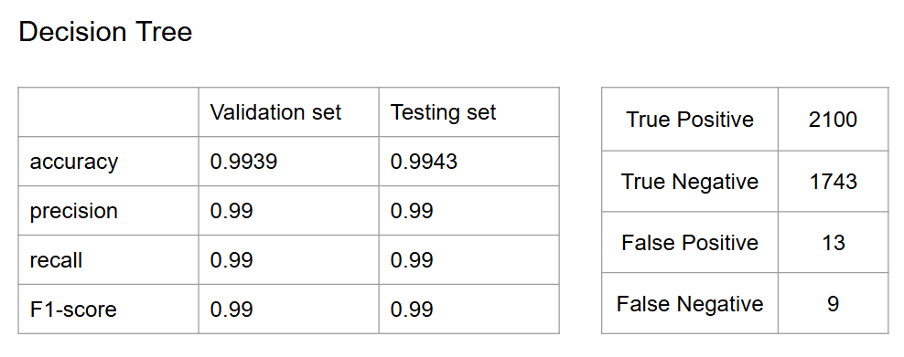
Term Frequency-Inverse Document Frequency (TF-IDF)
Among three classifiers, decision tree has a slightly better edge
TF-IDF creates a sparse representation of the text inputs
Simpler feature space
More interpretable and less complex
Effective splits for decision tree
Overall better than previous traditional methods
GloVe
Doc2Vec
CBOW/Skip-Gram

Slide 39
Pre-trained Transformers (BERT)
A type of transformer that only consists of encoders
Only requires unlabelled data to train on
Self-supervised training
We will use the base BERT model for our project
Input
Encoder
Encoder
Encoder
(12 in total) … (110 Mil Parameters)
Encoder
Output

Slide 40
Pre-trained Transformers (GPT)
Contrast to BERT, GPT only consists of decoders
Only requires unlabelled data to train on
Self-supervised training
Powerful at predicting the next token in a sequence
We will import and use the GPT2* model for our project
(* OpenAI GPT-2 English model)
Input
Encoder
Decoder
Decoder
(12 in total) … (117 Mil Parameters)
Decoder
Output

Slide 41
Pre-trained Transformers (BERT / GPT)
Raw dataset (news)
Logistic Regression
BERT tokenizer
/ GPT2 Tokenizer
Text Embeddings
Decision Tree
Obtain the text embedding from the pre-trained model’s tokenizer
Add a classification layer on top of the pre-trained model
MLP

Slide 42
Pre-trained Transformers (BERT)
Performance on the validation set and the testing set
Logistic Regression
 | Validation set | Testing set
accuracy | 0.9925 | 0.9920
precision | 0.99 | 0.99
recall | 0.99 | 0.99
F1-score | 0.99 | 0.99
True Positive | 2087
True Negative | 1747
False Positive | 15
False Negative | 16

Slide 43
Pre-trained Transformers (BERT)
Performance on the validation set and the testing set
Decision Tree
 | Validation set | Testing set
accuracy | 0.9178 | 0.9200
precision | 0.92 | 0.92
recall | 0.92 | 0.92
F1-score | 0.92 | 0.92
True Positive | 1942
True Negative | 1614
False Positive | 148
False Negative | 161

Slide 44
Pre-trained Transformers (BERT)
Performance on the validation set and the testing set
MLP
 | Validation set | Testing set
accuracy | 0.9943 | 0.9959
precision | 0.99 | 0.99
recall | 0.99 | 0.99
F1-score | 0.99 | 0.99
True Positive | 2090
True Negative | 1759
False Positive | 3
False Negative | 13

Slide 45
Pre-trained Transformers (GPT)
Performance on the validation set and the testing set
Logistic Regression
 | Validation set | Testing set
accuracy | 0.9995 | 0.9995
precision | 1.00 | 1.00
recall | 1.00 | 1.00
F1-score | 1.00 | 1.00
True Positive | 2101
True Negative | 1762
False Positive | 0
False Negative | 2

Slide 46
Pre-trained Transformers (GPT)
Performance on the validation set and the testing set
Decision Tree
 | Validation set | Testing set
accuracy | 0.9687 | 0.9588
precision | 0.97 | 0.96
recall | 0.97 | 0.96
F1-score | 0.97 | 0.96
True Positive | 2016
True Negative | 1690
False Positive | 72
False Negative | 87

Slide 47
Pre-trained Transformers (GPT)
Performance on the validation set and the testing set
MLP
 | Validation set | Testing set
accuracy | 0.9995 | 0.9997
precision | 1.00 | 1.00
recall | 1.00 | 1.00
F1-score | 1.00 | 1.00
True Positive | 2102
True Negative | 1762
False Positive | 0
False Negative | 1

Slide 48
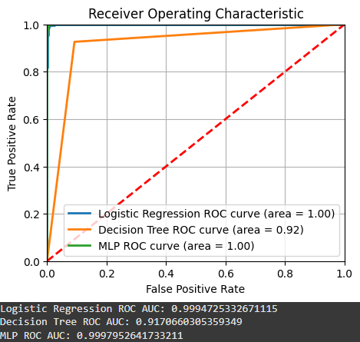
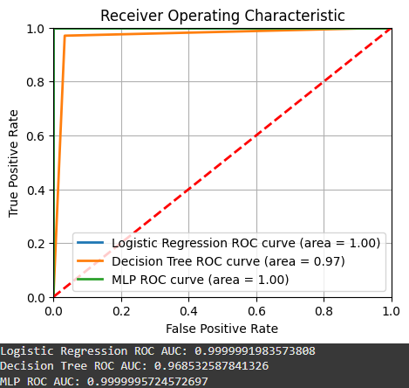
Pre-trained Transformers (BERT / GPT)
Unlike TF-IDF -> BERT/GPT both have significantly lower accuracy on decision tree compared to other classifiers
Reasons possibly due to:
Tokenized text embeddings are high-dimensional
Contextually rich
High complexity -> overfitting (captured noise rather than generalization)

Slide 49
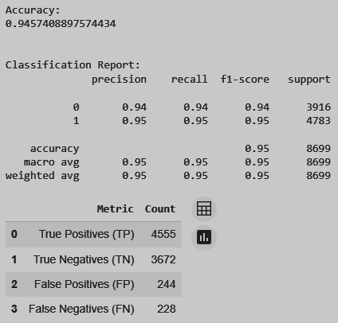
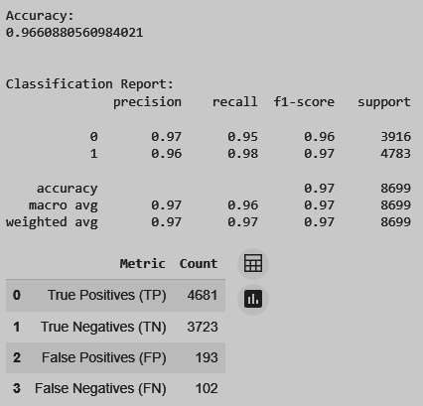
Pre-trained Transformers (BERT / GPT)
Reduce dimensionality and complexity of the embeddings
Principal Components Analysis (PCA)
Use random forest instead of decision tree
Prevent overfitting
Better suited for high dimensionality
Original BERT + decision tree accuracy/recall: 0.92
PCA with n_componets = 30
(BERT)
Random Forest using PCA data
(BERT)

Slide 50
Further possible exploration with our results
Domain-specific contexts : Not limited to political news -> medical news?
Multilingual Text Classification : Different languages?
Discover the potentials of ensemble methods -> combining the use of pre-trained model with our word-embedding methods for higher accuracy

