Slide 1
Mini Market Project
By Larry De La Muala

Slide 2


Call to action button inviting the user to browse the site

Slide 3
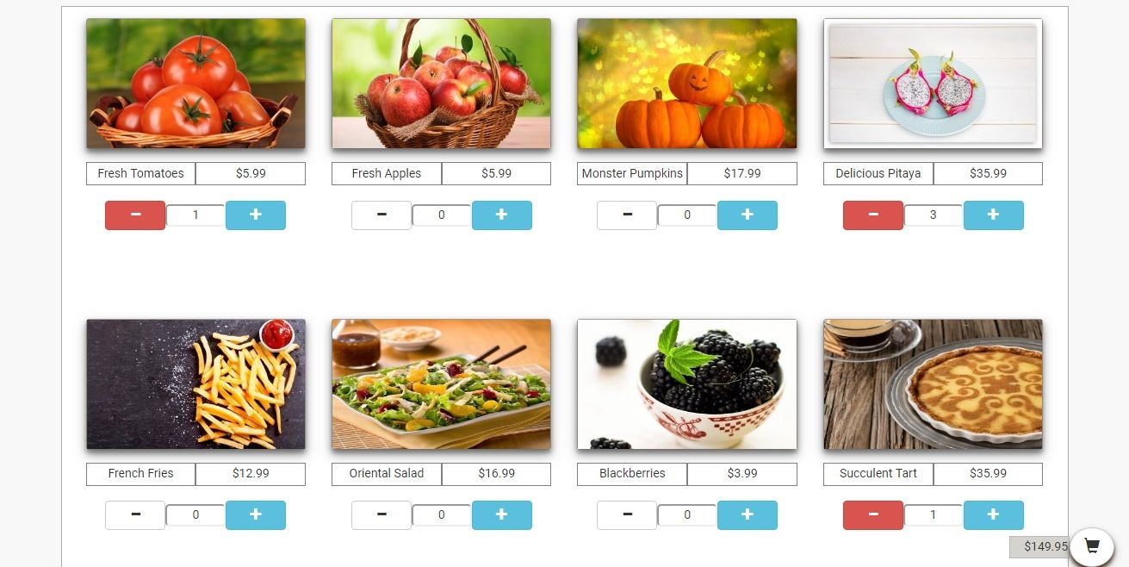
Real time addition and subtraction of items into cart

Slide 4

4 Items added to cart
Cart value automatically updated every time an item is added or subtracted

Slide 5
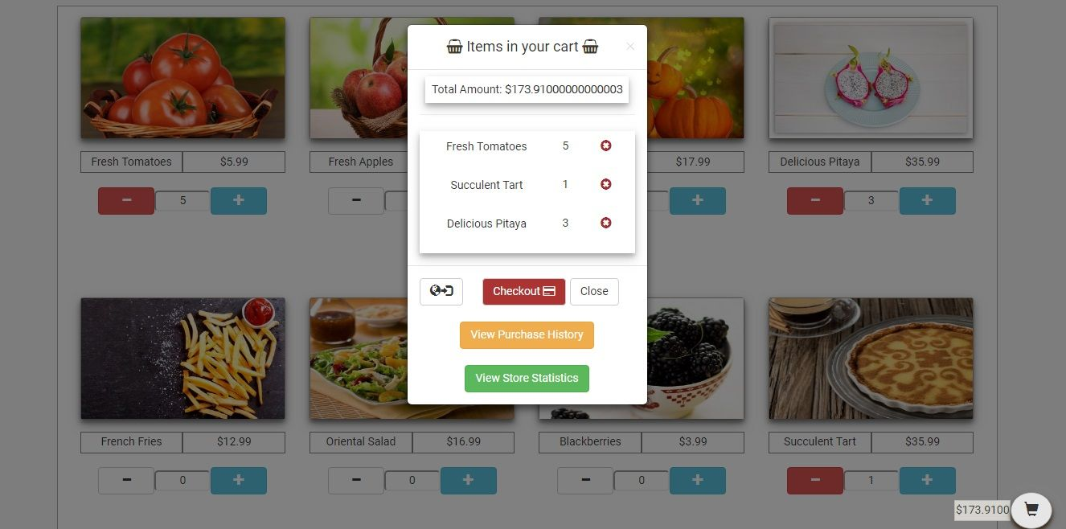
Option to see history of items previously purchased by the user
Option to see users’ statistics and items performance in the store
Clicking on the cart icon displays the items currently in the user’s cart

Slide 6
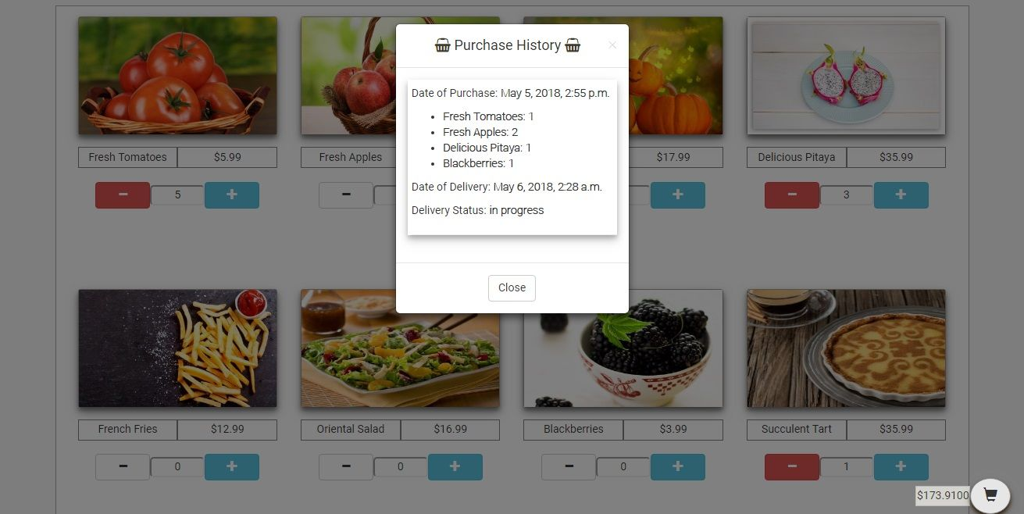
History of items previously purchased by the user and delivery status

Slide 7
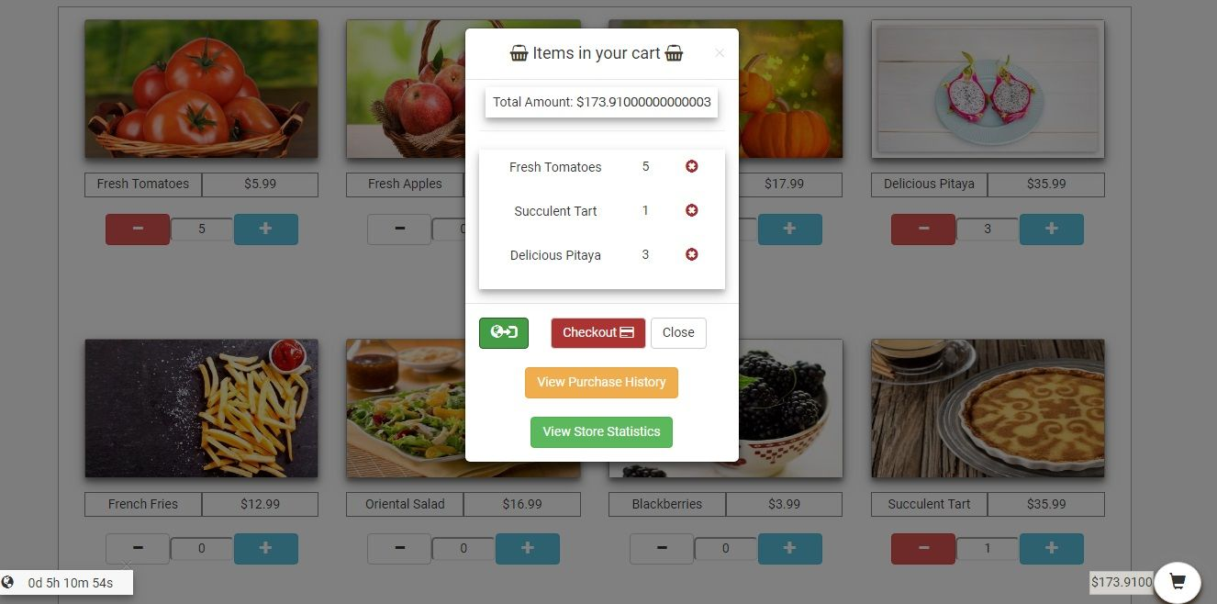
Items delivery tracker option
Timing of items delivery according to user’s location

Slide 8
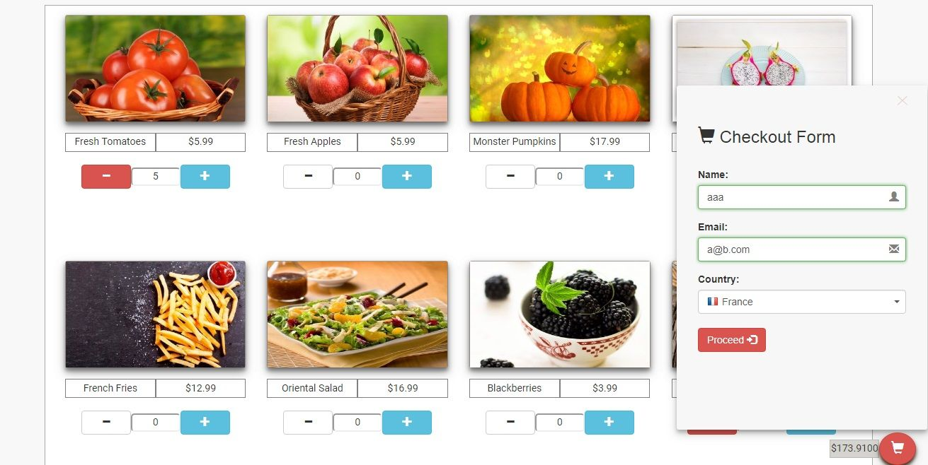
Checkout form to finalize purchase

Slide 9
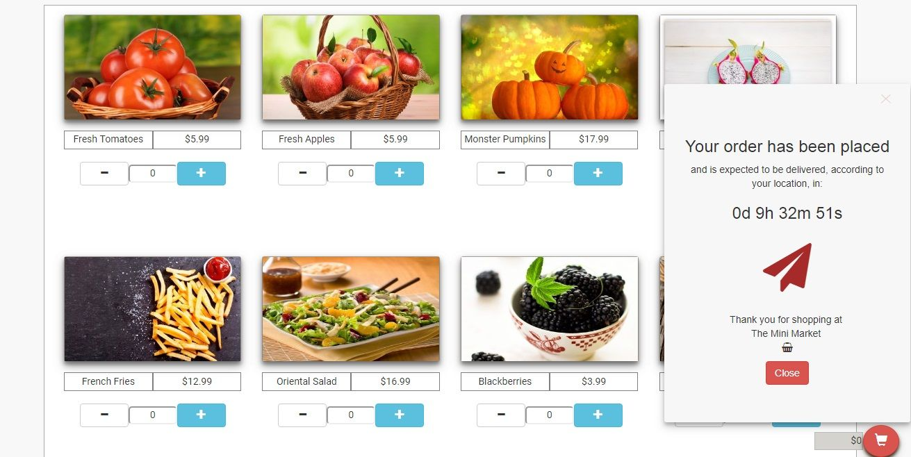
Confirmation of purchase and user profile creation for delivery tracking

Slide 10
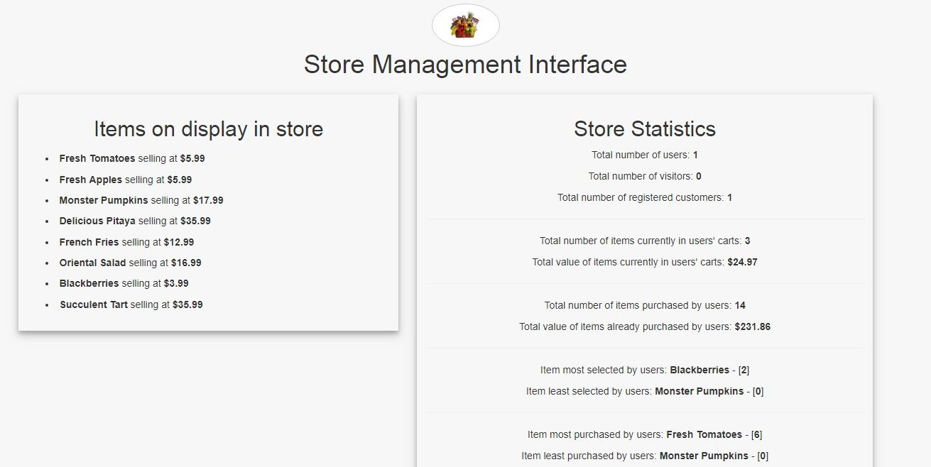
Visits and registrations records on site
Items currently displayed on site by vendor, with price points
Items performance on site

Slide 11
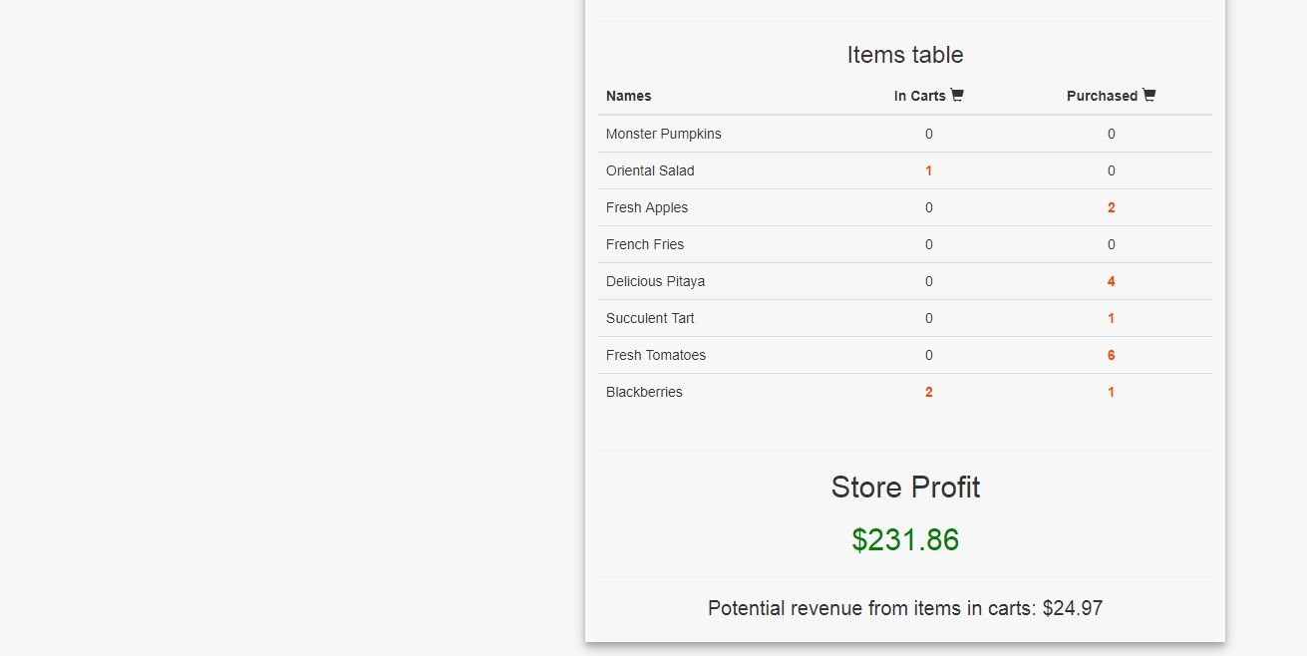
Report of items selected vs items purchased
Total profit from all purchases
Potential revenue from items currently in users’ carts

Slide 12



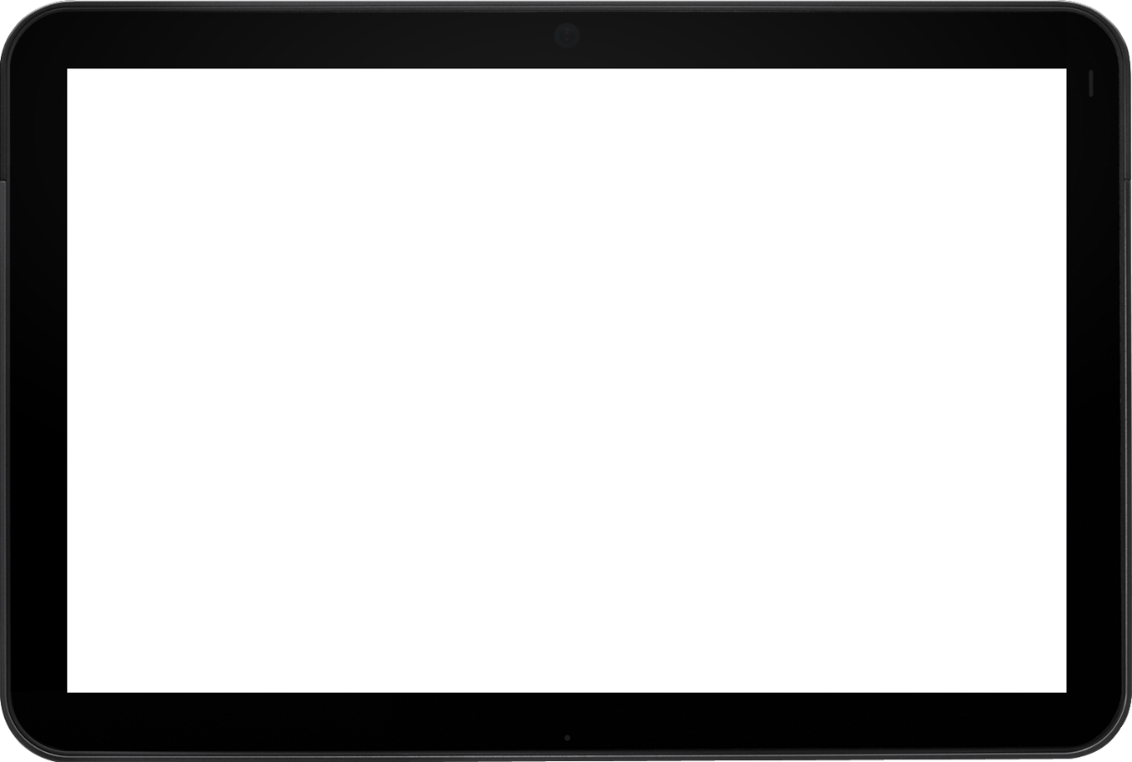

Slide 13
THANK YOU

