Slide 1
AI and AWS
Larry Huynh
CITS5503, S2 2026

Slide 2
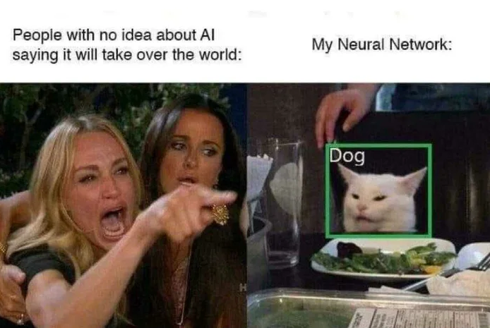
Is AI taking over human jobs? Is it true that AI is becoming the dominant form of intelligence on Earth? Will it take control of the planet?

Slide 3
What is AI?
Artificial Intelligence
AI: is about making machines act like humans.
Machine Learning: extract knowledge from data and learn from it autonomously.
Deep Learning: uses neural network models that mimic biological brain structures and enhance the automation of training AI models.
Machine Learning
Deep Learning

Slide 4
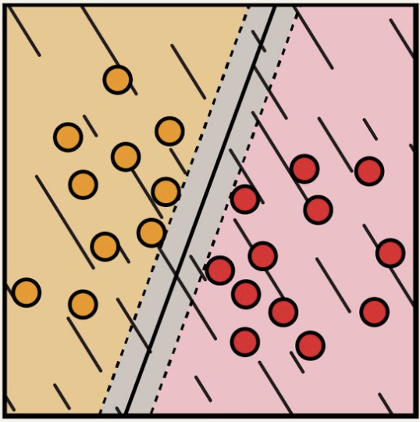
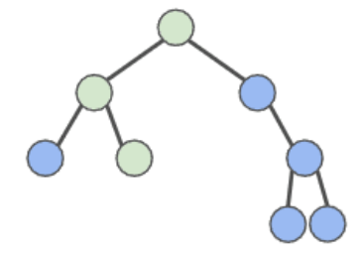
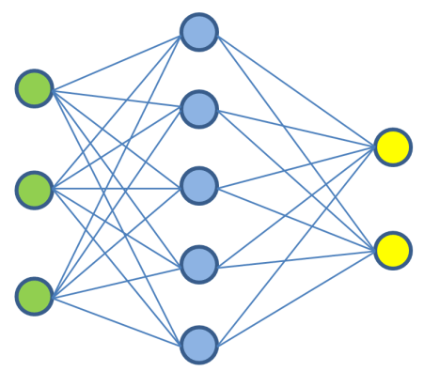
Question Answering
Text
Sentiment Analysis
Images
Information Extraction
Training
Model
Adaptation
Speech
Image Caption
Tabular Data
Object Recognition
…
3D signals
Instruction Following
Support Vector
Machine
Random
Forest
Neural
Network

Slide 5
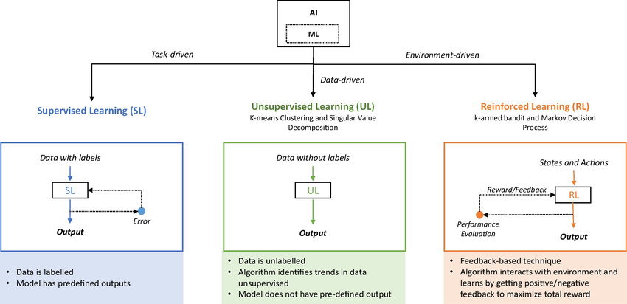
Types of Machine Learning

Slide 6
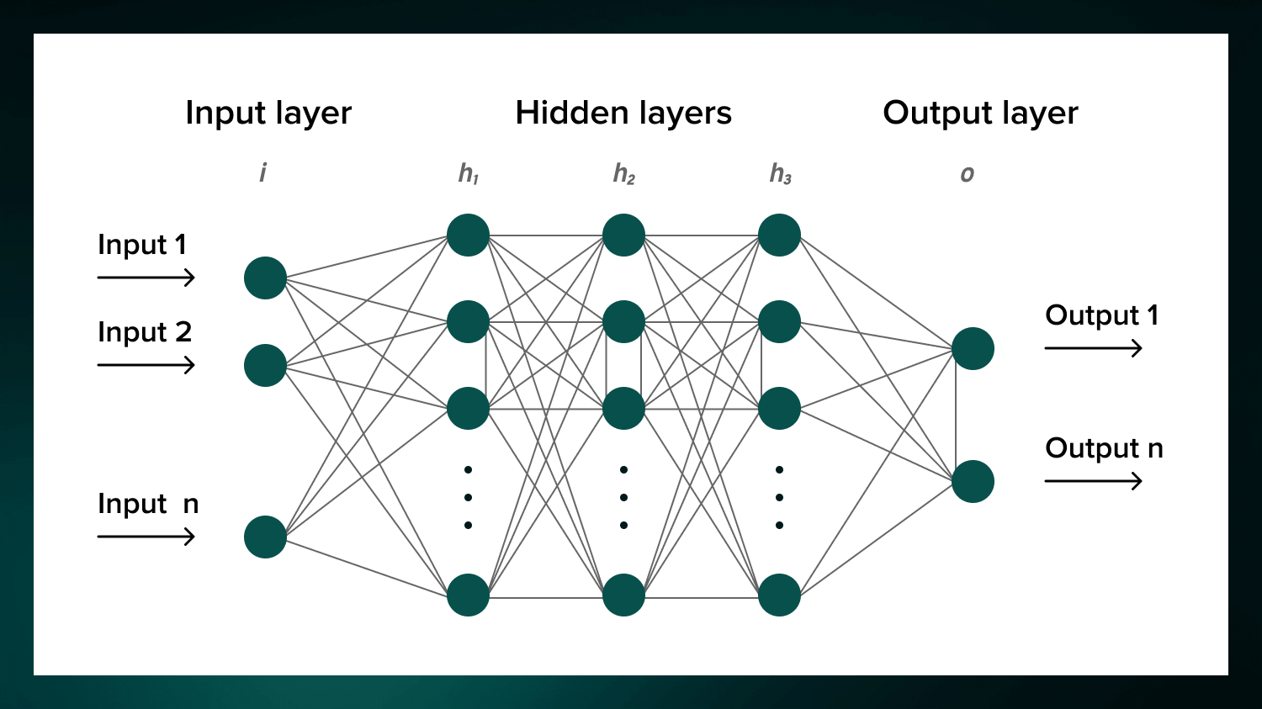
Neural Network Infrastructure

Slide 7

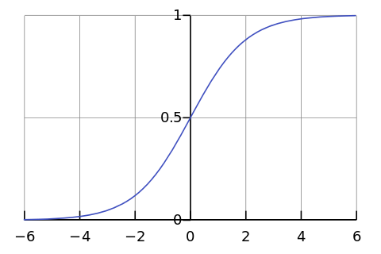




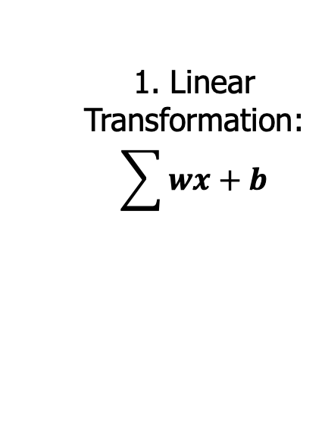

Perceptron (Single node neural network)
1. Linear
Transformation:
$$\sum{wx+b}$$
2. Non-linear
Transformation
(Activation Function)
x₁
$$w_{1}$$
x₂
$$w_{2}$$
$$\sum{wx+b}$$
$$\hat{y}$$
Prediction
$$w_{3}$$
x₃

Slide 8
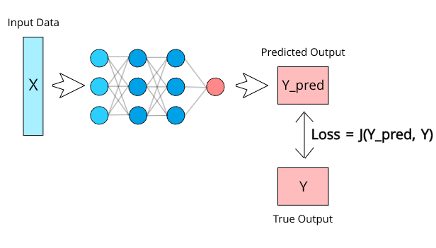

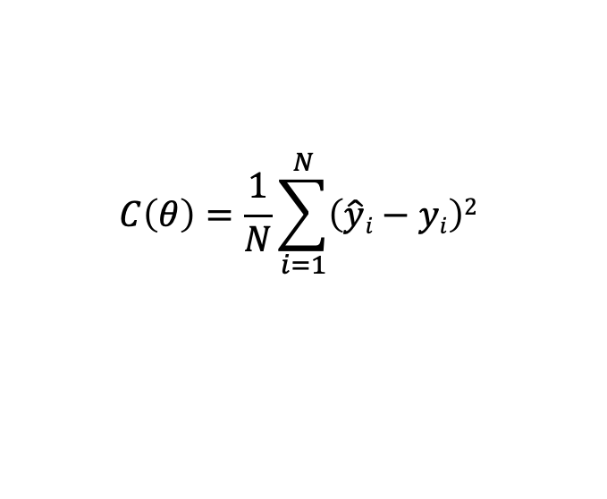


Calculating the Loss
Loss: the difference between the prediction and the actual value for the individual data instance.
Example Loss Function:
Cost: The aggregate of the losses of all data instances
Example Cost Function:
θ are all the model parameters: w’s and b’s
Goal in training the model:
$$l\left(\hat{y}, y\right)= \left(\hat{y}−y\right)2$$
$$C\left(θ\right)=\frac{1}{N}\sum_{i=1}^{N}{\left(\hat{y}i−yi\right)2}$$
$$Loss= l\left(\hat{y}, y\right)$$
$$min⁡(Cost)$$

Slide 9
Classification metrics
Accuracy:
  Measure the percentage of correctly classified instances.
Precision:
  Proportion of true positive predictions among all positive predictions.
  “Out of all positive predictions, how many were correct?”
Recall:
  Proportion of true positive predictions among all actual positive instances.
  “Out of all actual positives, how many were correctly identified?”
F1 Score:
  Harmonic mean of precision and recall, balancing both metrics.

Slide 10
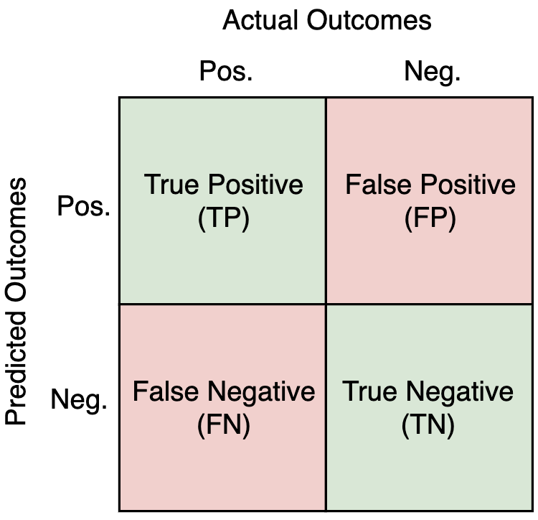
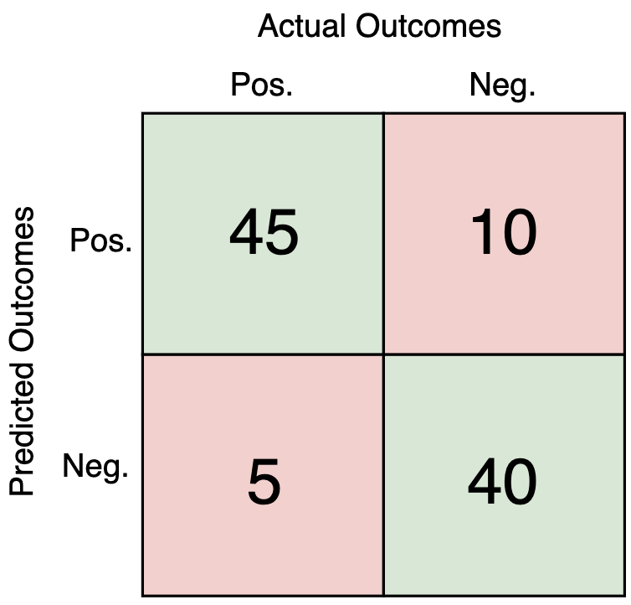
Metrics for Monitoring Model Performance
A confusion matrix is useful for calculating these metrics.
Example with 100 instances:
Accuracy = TP + TN / (TP + FP + FN + TN)
= 85 / 100 = 85%
Precision = TP / (TP + FP)
= 45 / 55 = 81.82%
Recall = TP / (TP + FN)
= 45 / 50 = 90%
F1 Score = 2 * Precision * Recall / (Precision + Recall)
= 2 * 0.8182 * 0.90 / (0.90 + 0.8182)
= 85.71%

Slide 11
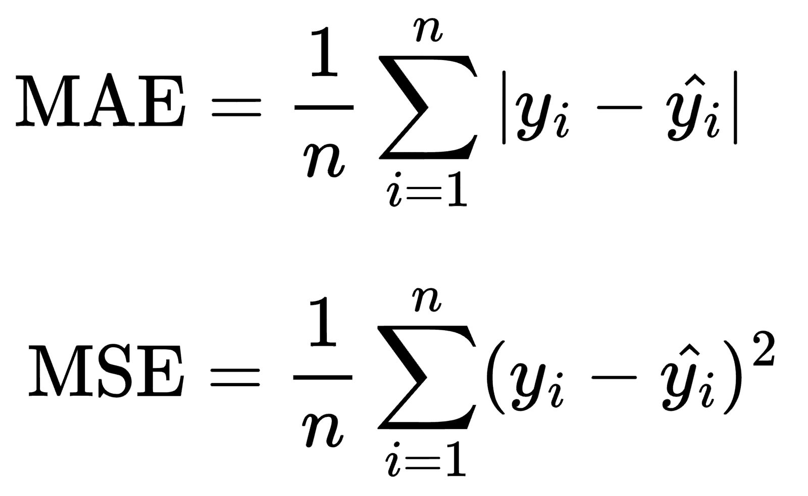
Regression and validation metrics
Mean Absolute Error (MAE):
  Commonly used for regression tasks, it measures the average absolute difference between predicted and actual values.
Mean Squared Error (MSE):
  Another regression metric, measures the average squared difference between predicted and actual values, giving higher weight to larger errors.
Cross-Validation Scores:
  Assess model performance on multiple subsets of the data to check for overfitting and assess generalization.

Slide 12
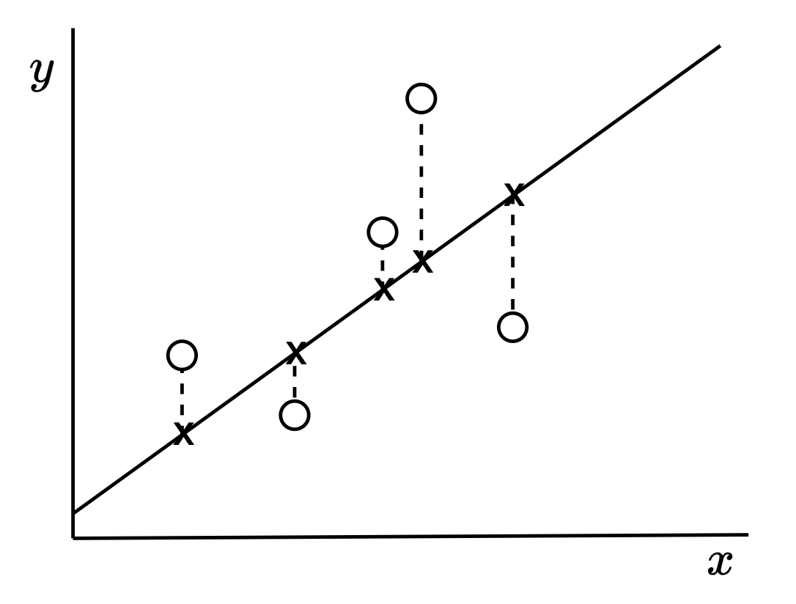
Metrics for Monitoring Model Performance
Example regression problem:
Dots are actual data points.
Line is the learned function (“line of best fit”).
X are the intercepts.

Slide 13
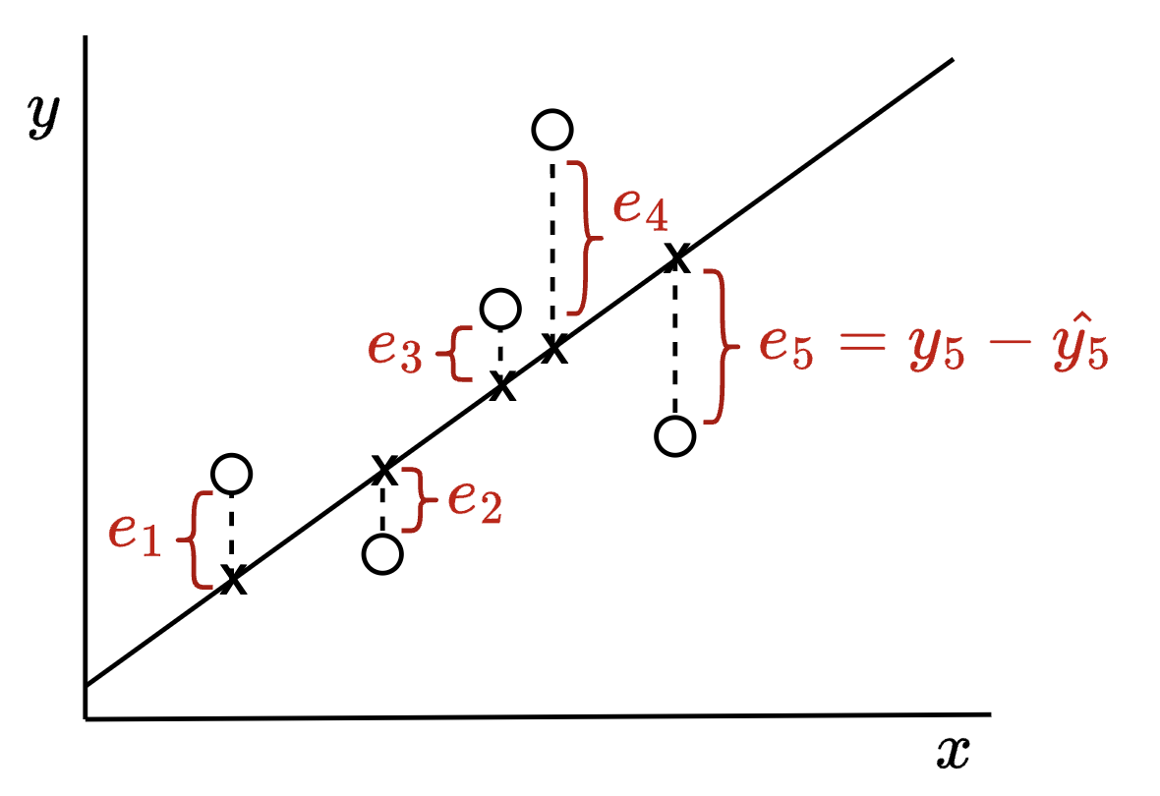
Metrics for Monitoring Model Performance
Errors e are the differences between the actual y and the predicted ŷ
You can see how the MSE penalises larger errors.

Slide 14
The machine learning lifecycle
Prepare the environment
Define the task and prepare the data
Select the model
Preprocess the data
Train and configure hyperparameters
Evaluate the model
Deploy the model and run inference

Slide 15
Ownership of the ML lifecycle
Demo 1: consume a trained capability
  Rekognition: AWS owns the model lifecycle; we supply the input and use the result.
Demo 2: configure a general-purpose model
  Bedrock: we select a model, design prompts, and evaluate its responses.
Demo 3: build and operate a custom model
  SageMaker AI: we take responsibility for data, training, evaluation, and deployment.
Across the demos, more of the ML lifecycle becomes our responsibility.

Slide 16
Demo 1: Consume a managed AI service
Architecture: S3, Lambda, Rekognition, DynamoDB, CloudWatch.
Demo action: upload an image to S3 and inspect the labels stored by the triggered workflow.
We own: the event flow, application logic, data storage, and interpretation of the result.
AWS manages: model development, training, tuning, hosting, and scaling.
Lifecycle view: we begin near deployment and inference; most earlier stages are hidden.
Key idea: We are consuming a trained capability, not building a model.

Slide 17
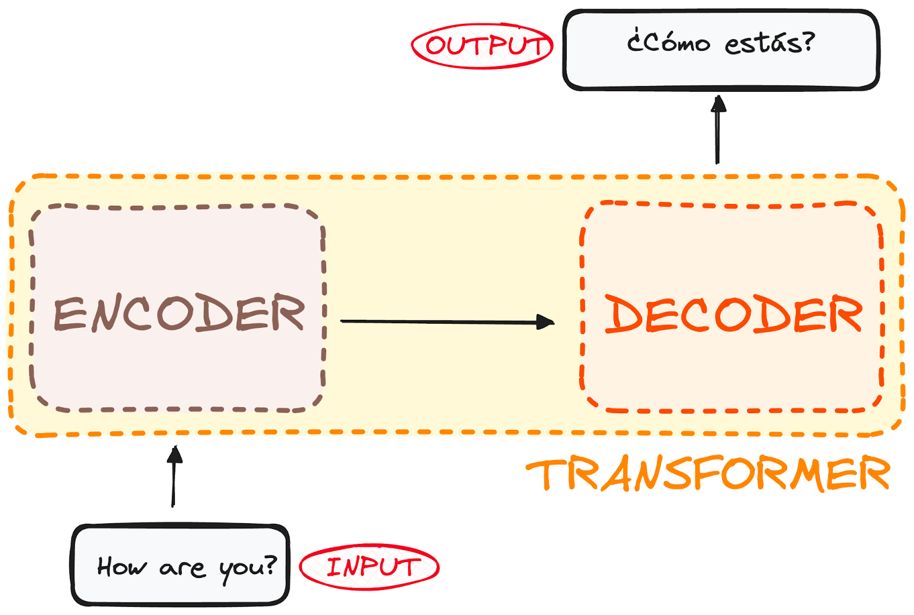
Foundation models and prompting
Transformers use attention to model relationships across a sequence.
Foundation models train on broad datasets and can support many downstream tasks.
Applications usually begin by selecting a model and designing prompts.
Prompting changes the model's instructions and context; it does not change the model weights.

Slide 18
Demo 2: Configure a foundation model
Application path: client request, API Gateway, Lambda, Amazon Bedrock.
We own: model choice, prompt design, application logic, and response evaluation.
AWS manages: pre-training, model hosting, infrastructure, and scaling.
Lifecycle view: model selection and evaluation become more visible, but we still do not train the model.
Key idea: A foundation model is flexible, but it remains a managed component in this demo.

Slide 19
Demo 3: Build and operate a custom model
Workflow: S3, SageMaker hyperparameter tuning, model artifact, endpoint.
Store prepared training and validation data in S3.
Launch several training jobs across a hyperparameter search space.
Compare jobs using one objective metric and select the best model artifact.
Deploy the selected model to an endpoint and invoke it with new data.
Lifecycle view: We now own the decisions across the complete ML lifecycle.

Slide 20
1. Preparing your Environment
Hardware and Software Requirements: Ensure you have access to a suitable environment for training.
  AWS EC2 Instances, S3 buckets, EBS, etc., and associated policies.
  Amazon Elastic Inference: Elastic Inference allows you to attach low-cost GPU-powered inference acceleration to your EC2 instances.
  Amazon CloudWatch: CloudWatch provides monitoring and logging
Install Required Libraries: Use Pip to install the necessary Python libraries. Common libraries:
  NumPy and Pandas (data manipulation)
  Matplotlib and Seaborn (visualisation)
  Scikit-learn (for ML) TensorFlow or PyTorch (for deep learning).

Slide 21
2. Task Definition and Data Preparation
Task Definition:
  What is the problem to solve, and what business logic do we need to do so?
  Data Domain: image, text, audio, tabular?
  Task: classification, regression, generative outcomes?
Data Collection:
  Identify and gather relevant data sources (e.g., databases, APIs, web scraping).
  Ensure the data is clean, accurate, and representative of the problem domain.
  (Try to) collect sufficient data to train robust models, considering the complexity of the task.

Slide 22
3. Model Selection
What model are we going to use?
Certain ML/AI models work best in specific contexts (below is a generalisation):
  Convolution Neural Networks (CNNs) are ideal for images.
  Sequence models (LSTM, RNN, Transformers) are ideal for text.
  Tree-based models (Random Forests, Boosting models) are suitable for tabular, non-structured data.
Evaluate Costs Involved
  Select the size of the model that is appropriate for the scale of your data, and your budget.
  More data = larger models = higher costs.

Slide 23
4. Data Preprocessing
Steps needed to prepare data for ML
  Handling missing values via imputation (replace missing values with substitutes), removing the datapoint itself, etc.
  Ensure features are on a comparable scale, crucial for many machine learning algorithms.
    Standardization: Centres data by removing the mean and scales it by dividing it by the standard deviation.
    Normalization: Rescales data to a fixed range, typically [0, 1], which is helpful for algorithms like neural networks that are sensitive to the scale of input data.
Some preprocessing steps are data format-specific:
  Text: tokenisation, stop-word removal, stemming/lemmatization, etc.
  Tabular Data: encoding categorical values, etc.

Slide 24
5. Training and Hyperparameterisation
Model ingests your data and extracts patterns/knowledge from it, and updates these beliefs iteratively as more data is feed through.
Important considerations:
  Loss Function: Define a loss function that calculates the error between model predictions and ground truth.
  Optimizer: Choose an optimizer such as Adam or RMSprop to update the model's weights during training.
  Training Loop: Implement a training loop that iterates through your dataset.
  Validation: Periodically evaluate your model on a validation dataset to check its performance during training.

Slide 25
5. Training and Hyperparameterisation
Training: model ingests your data and extracts patterns/knowledge from it, and updates these beliefs iteratively as more data is feed through.
Hyperparameters: settings that control the learning process.
  The hyperparameters and their values depend on your specific task and dataset.

Slide 26
6. Evaluation
Test Data: evaluate your fine-tuned model on a separate test dataset.
  Metrics: Calculate and report relevant evaluation metrics for your specific task: Accuracy, Precision, Recall, F1, AUC, etc.
Monitoring: Continuously monitor your training and evaluating process.
Debugging: If your model isn't performing as expected, check your data, preprocessing, and model architecture for issues.

Slide 27
7. Deployment and Inference
Model Deployment
  Make a trained model available for use in a production environment.
  Deploy models to endpoints for real-time or batch predictions. Users can then access the model via the endpoint(s).
Inference
  Applying a trained machine learning model to new, unseen data to generate predictions or decisions.

Slide 28
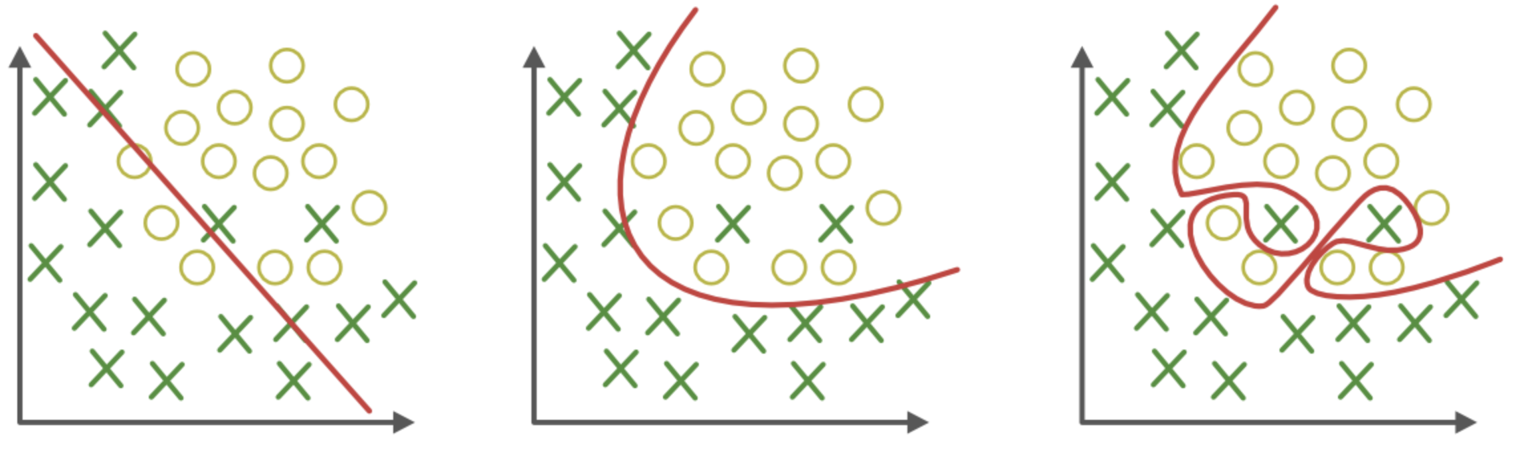
Training risk: overfitting
Overfitting
  The model cannot generalize and fits too closely to the training dataset, and cannot predict new data well; it performs well on training data but poorly on unseen data.
  Often due to noisy data, using too small of a training dataset, or using too complex of a model relative to the data.
Underfitting
Just Right
Overfitting

Slide 29
Training risk: underfitting
Underfitting
  Model fails to capture patterns and does not learn the underlying trend in the data, leading to poor performance on both training and test data.
  Often due to using too few parameters, or overly simplistic assumptions, or not training a sufficiently complex model for long enough.
Underfitting
Just Right
Overfitting

Slide 30
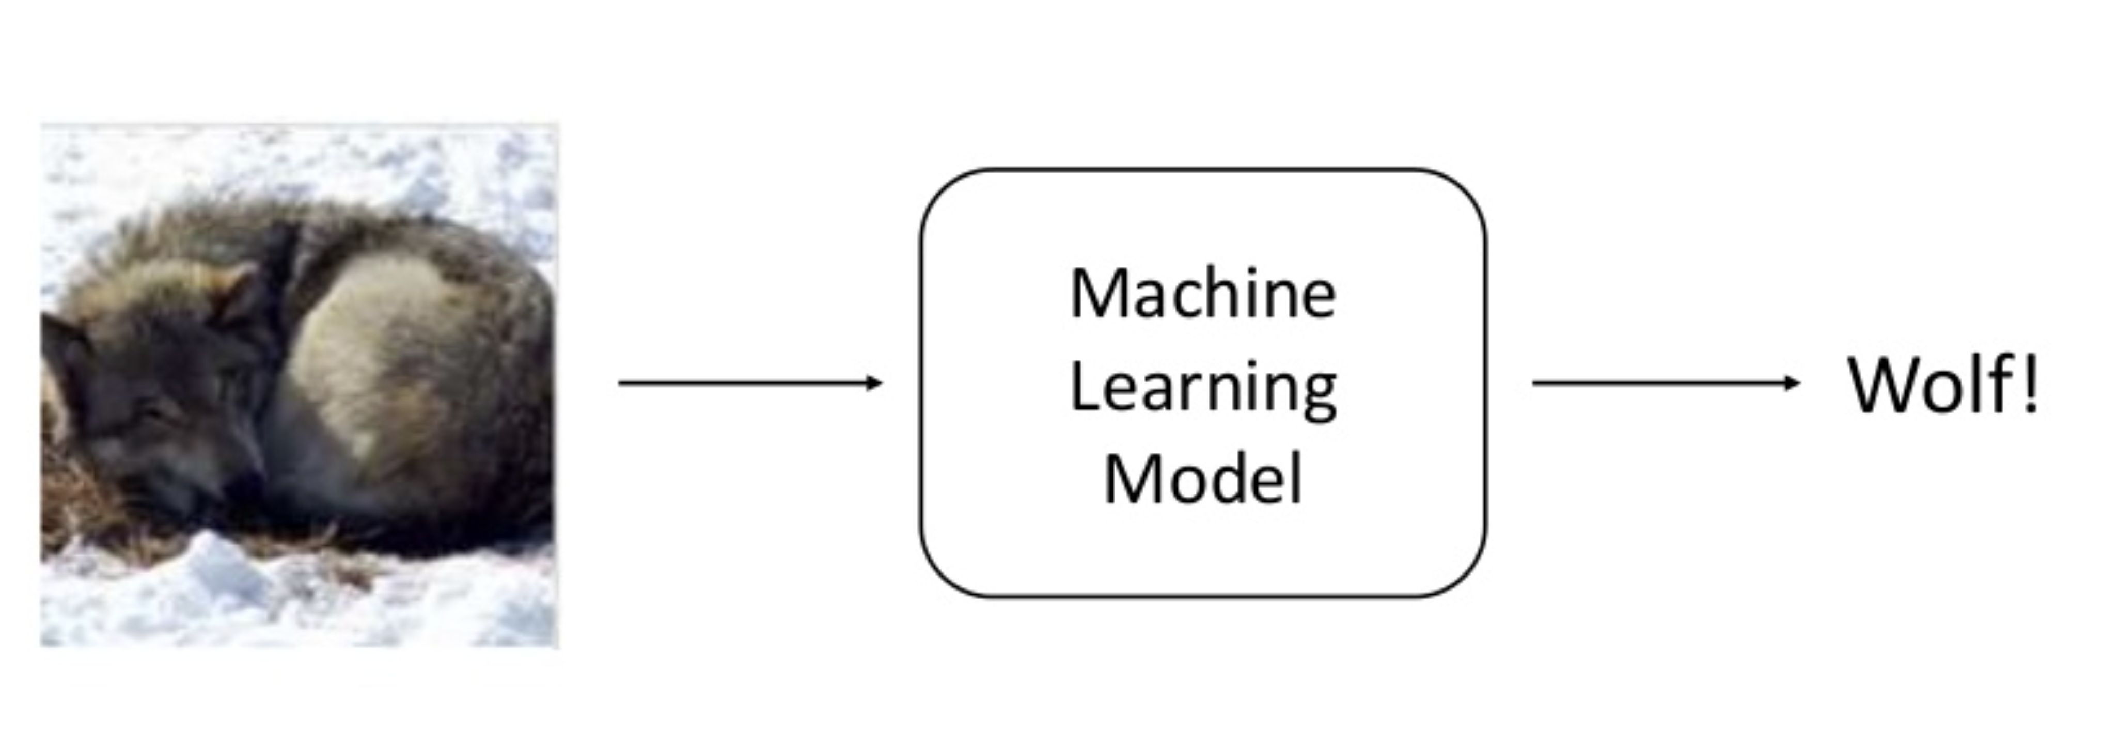
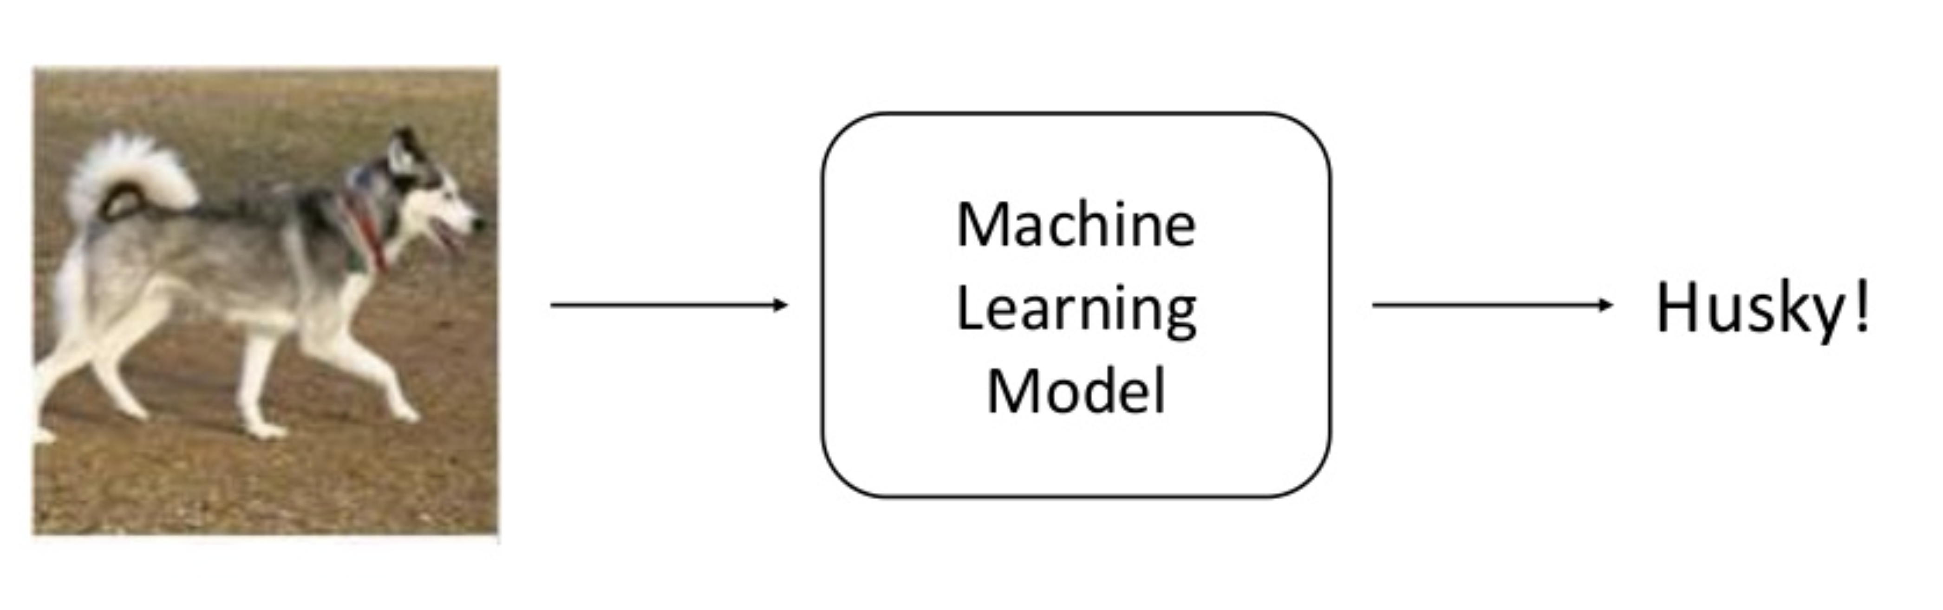
Evaluation risk: misleading validation
Having Too Much Confidence in Model Outcomes
  Example: Classifier to recognize images as either Wolf or Husky
Sameer Singh UC Irvine https://www.slideshare.net/0xdata/explaining-blackbox-machine-learning-predictions

Slide 31
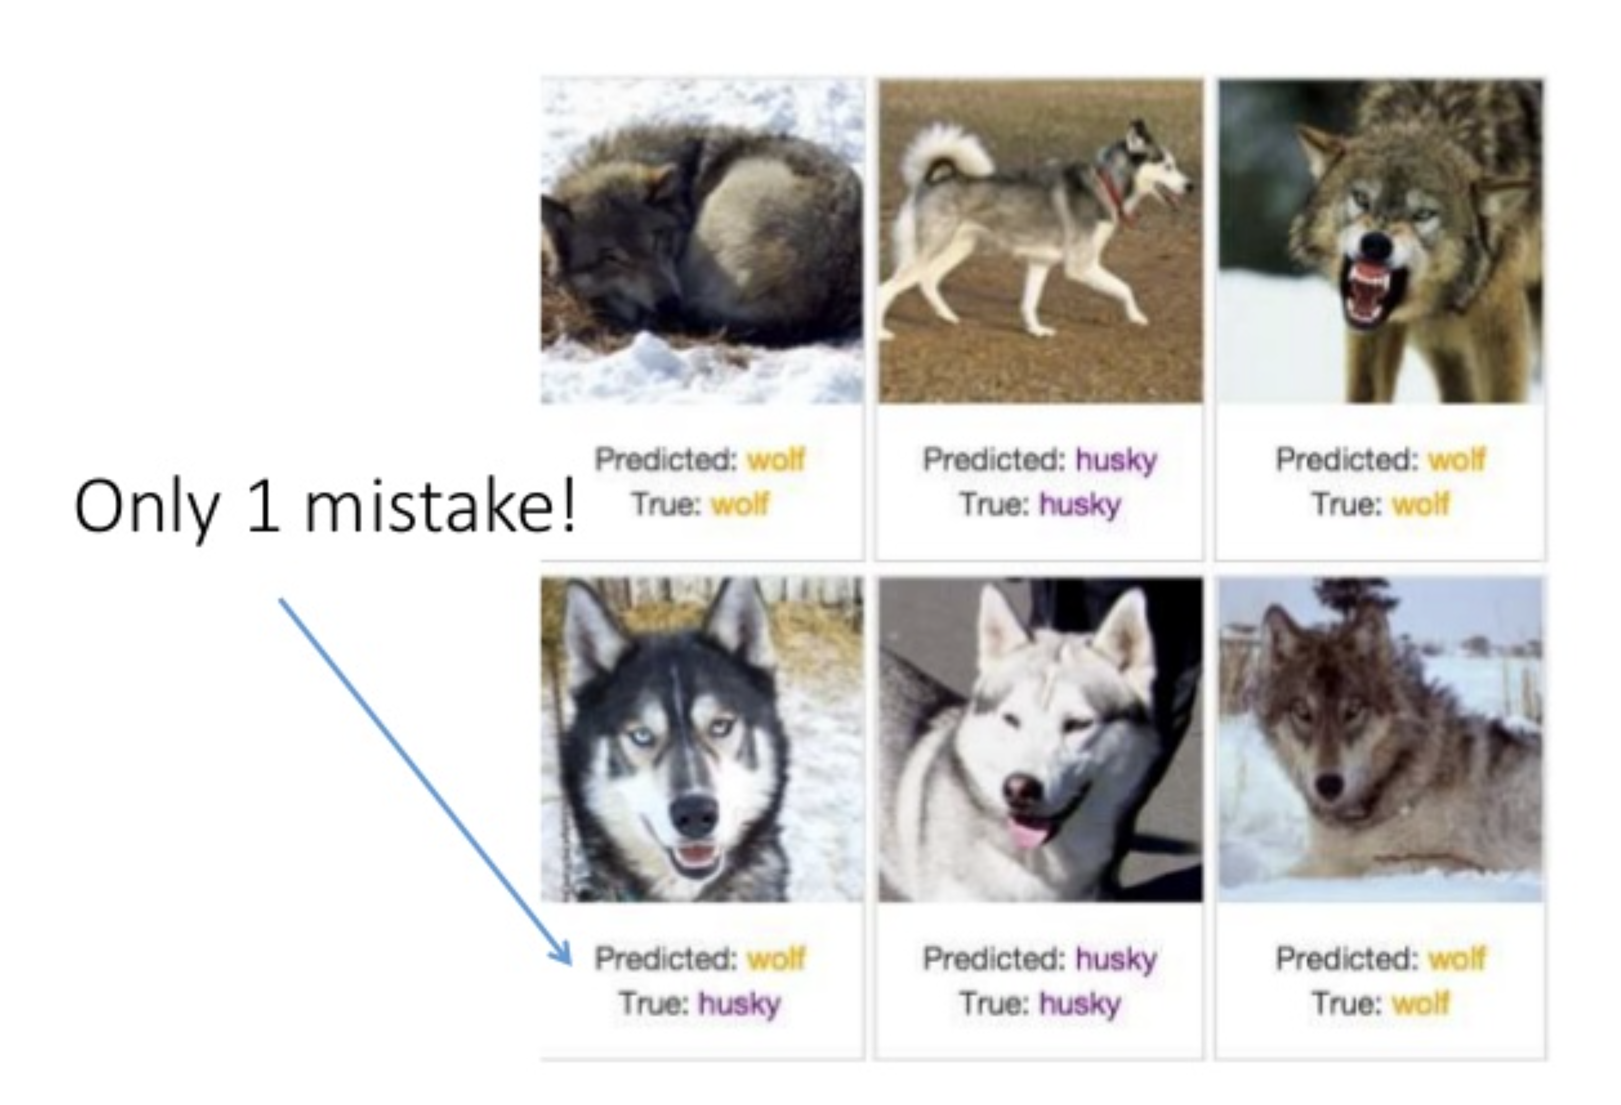
Evaluation risk: misleading validation
Having Too Much Confidence in Model Outcomes
  Predictions indicate strong
  performance!
  Does this mean we
  have a good model?
Sameer Singh UC Irvine https://www.slideshare.net/0xdata/explaining-blackbox-machine-learning-predictions

Slide 32
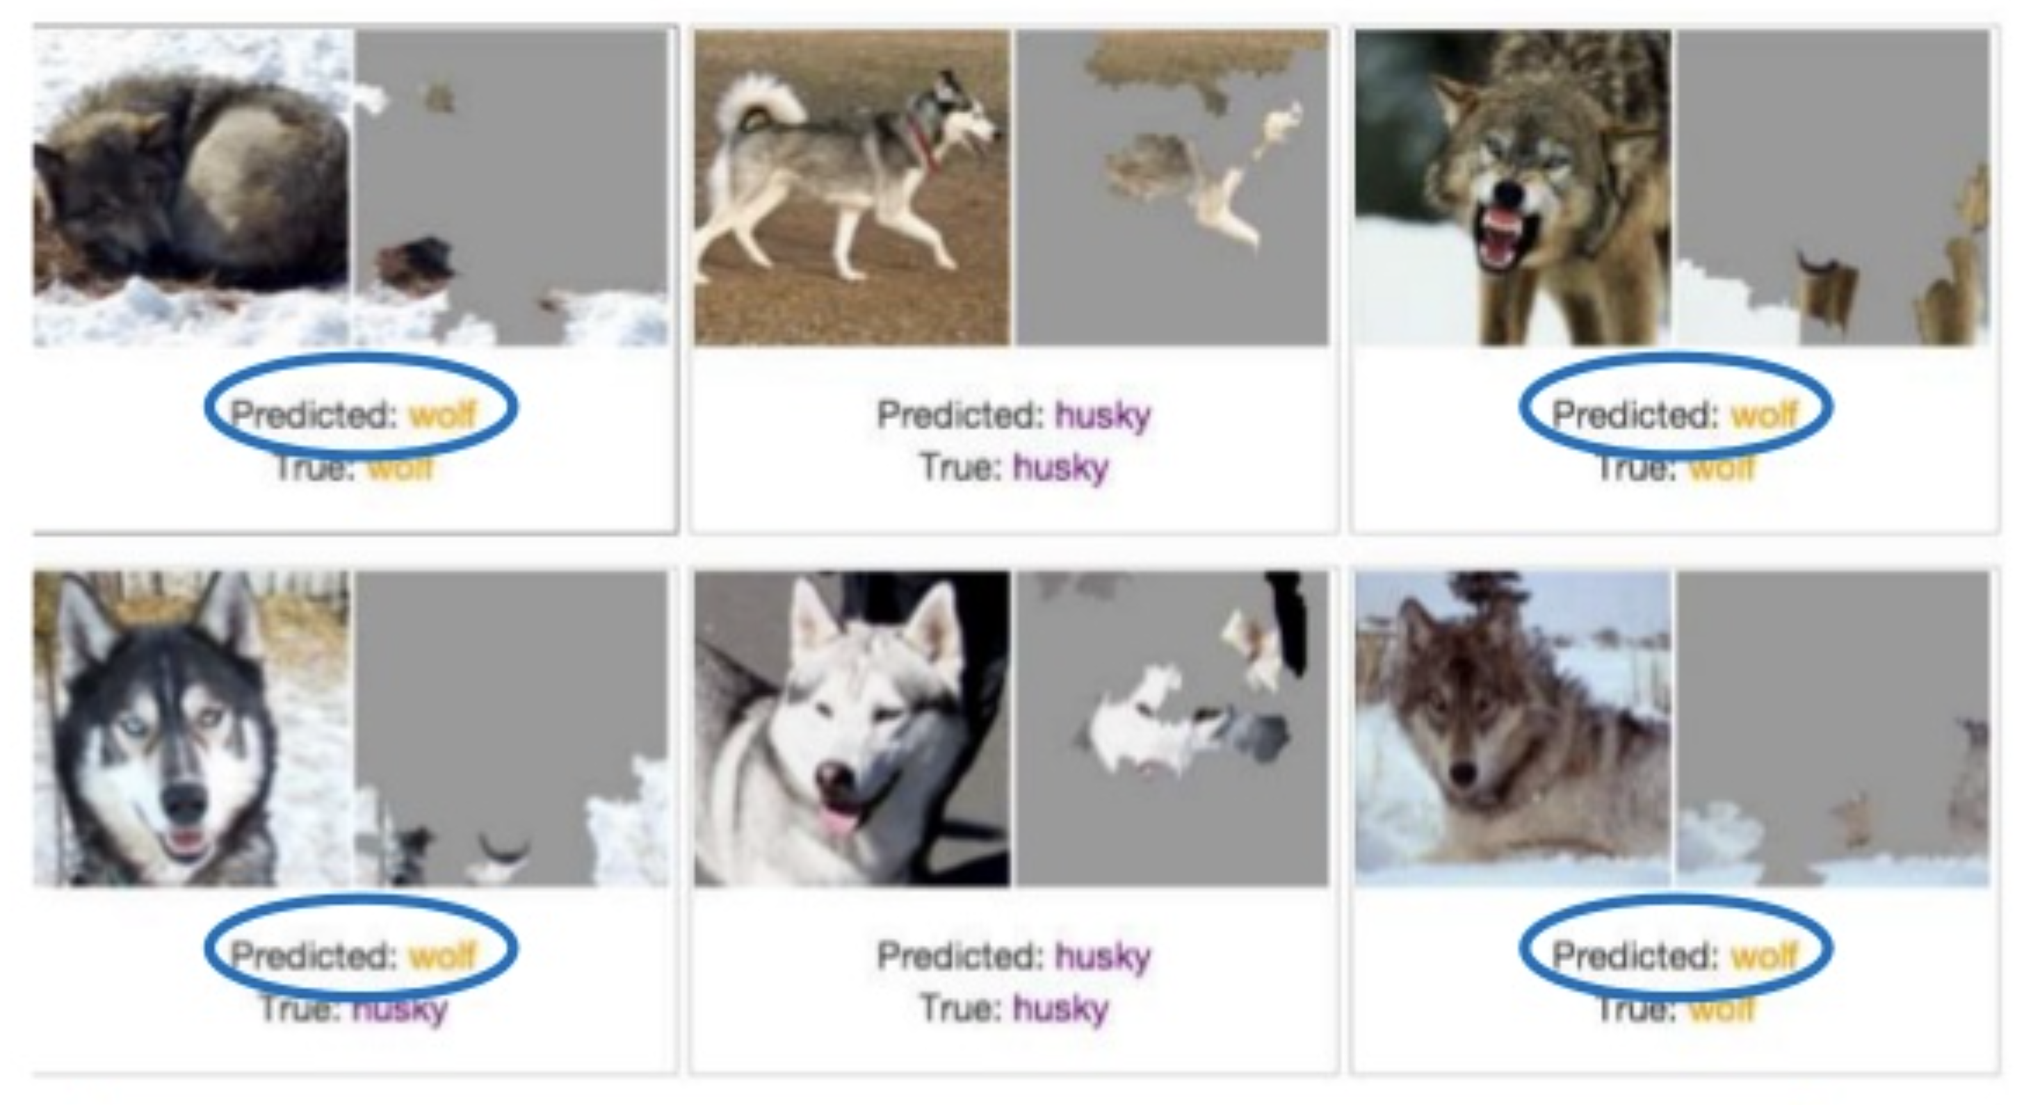
Evaluation risk: misleading validation
Having Too Much Confidence in Model Outcomes
  Turns out, the model was recognising snow as the distinguishing feature for wolf!
Sameer Singh UC Irvine https://www.slideshare.net/0xdata/explaining-blackbox-machine-learning-predictions

Slide 33
Further Interest Topics
Model Interpretability
  AI models are “black boxes”, but large research efforts are put into model explainability and interpretability.
Model Hosting and Scalability
  Cost effective hosting strategies as models scale and use-cases grow.
  Multi-model deployment, AWS AutoScaling, AWS DeepSpeed Inference.
Beyond AWS
  AI/ML services on other cloud platforms like Google Cloud AI, Microsoft Azure AI, and even GitHub.

Slide 34
Thanks!
Questions and conversations: larry.huynh@uwa.edu.au

