Slide 1
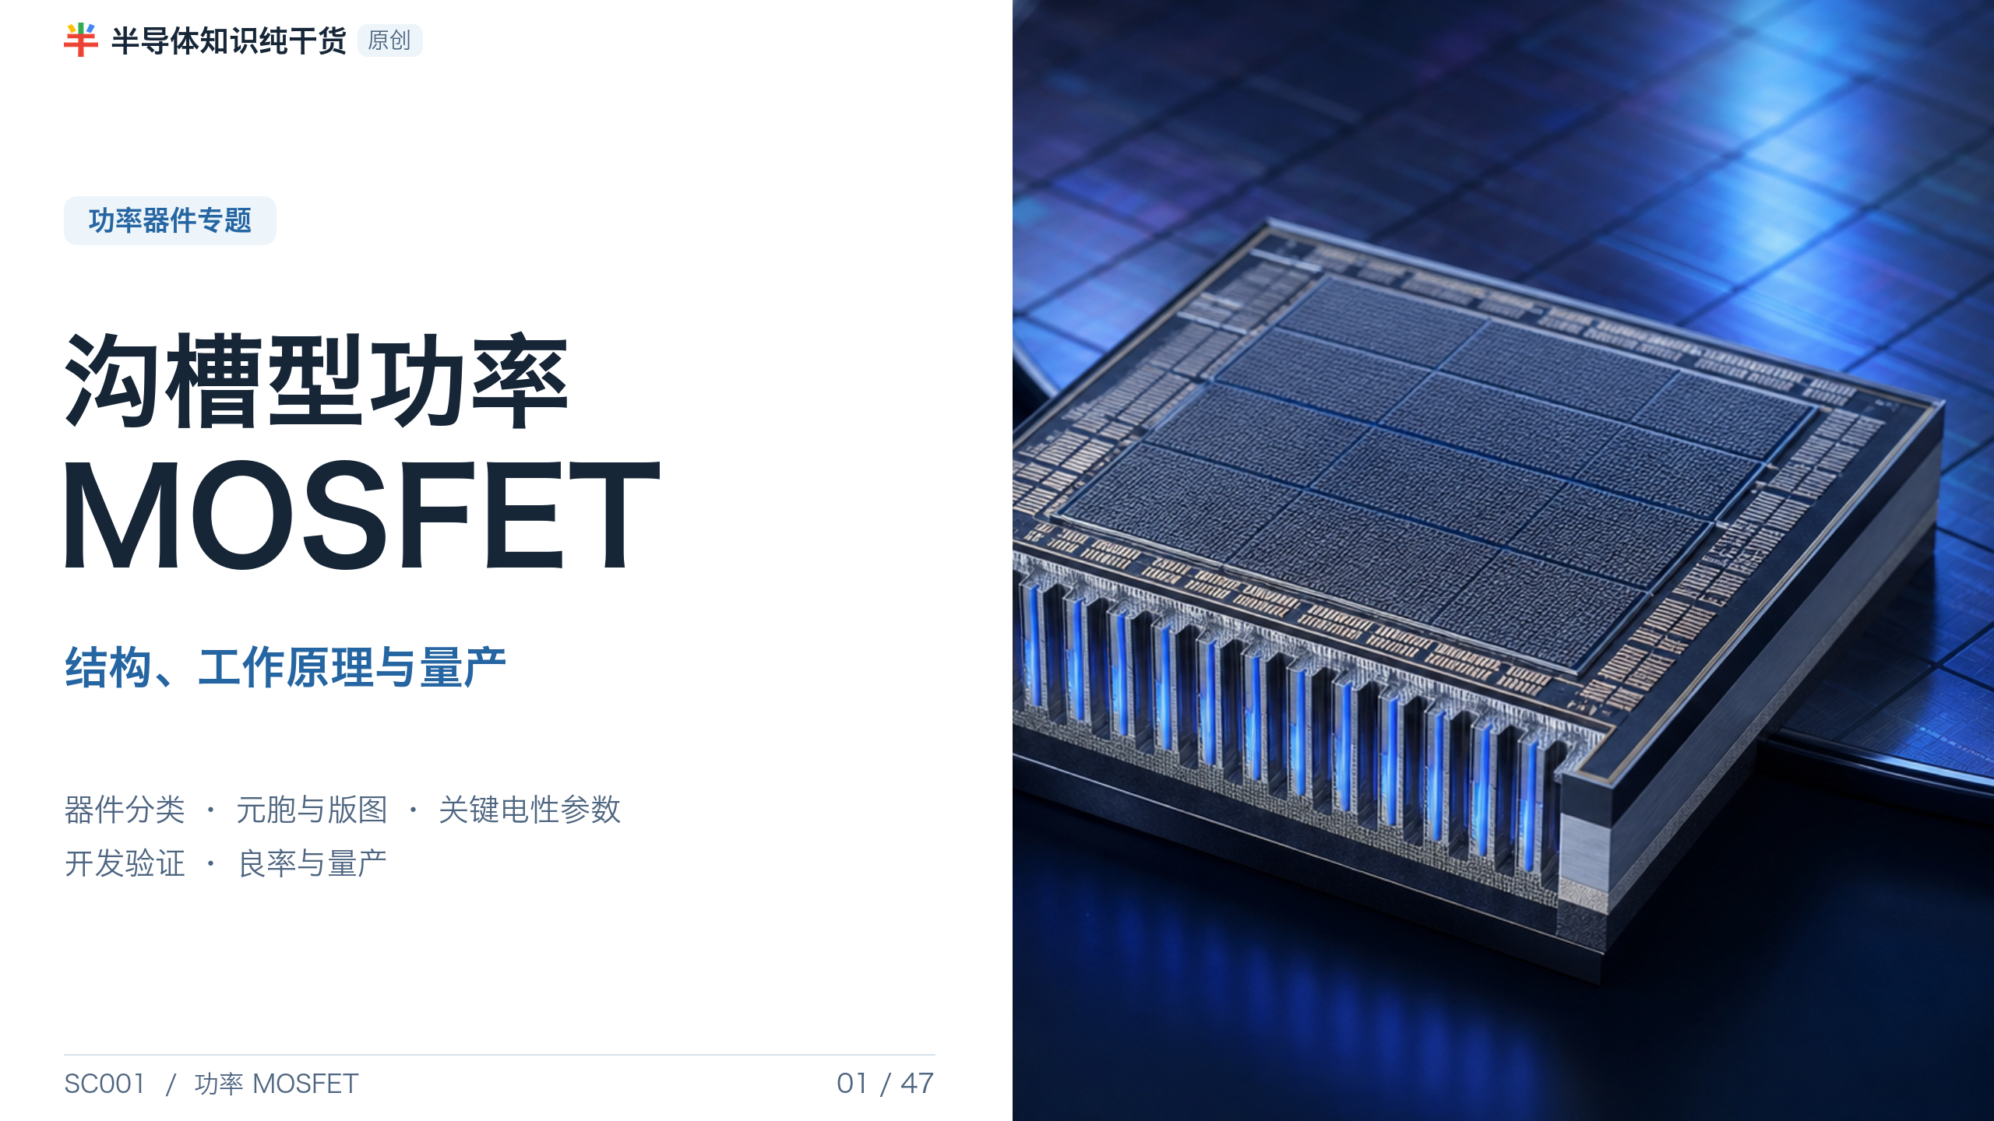
Notes:
[Presenter Notes]
- 本课程聚焦硅基垂直 N-channel trench 与 shielded-gate trench Power MOSFET。
- 目标不是只会读 datasheet，而是把器件目标、版图、工艺 CTQ、电性和可靠性连成闭环。
- SiC/GaN 仅用于器件定位和市场比较；其界面、栅氧与可靠性需要独立专题。
[Sources]
- Infineon, MOSFET portfolio: https://www.infineon.com/products/power/mosfet
- Generated asset: OpenAI image generation, fab-pie-cover.png; no external stock image.

Slide 2
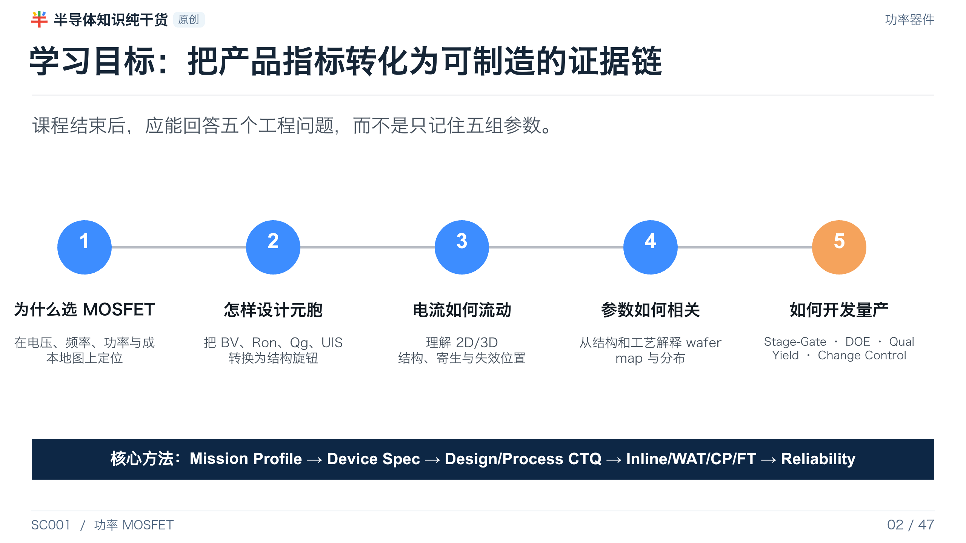
Notes:
[Presenter Notes]
- 强调 工艺整合 的输出是可制造窗口与证据链，不只是工艺流程表。
- 本课程用同一组结构旋钮贯穿设计、电性、可靠性和量产控制。
[Sources]
- AEC-Q101 Rev.E: https://www.aecouncil.com/Documents/AEC_Q101_Rev_E_Base_Document.pdf
- Synopsys, TCAD Process Simulation: https://www.synopsys.com/manufacturing/tcad/process-simulation.html

Slide 3
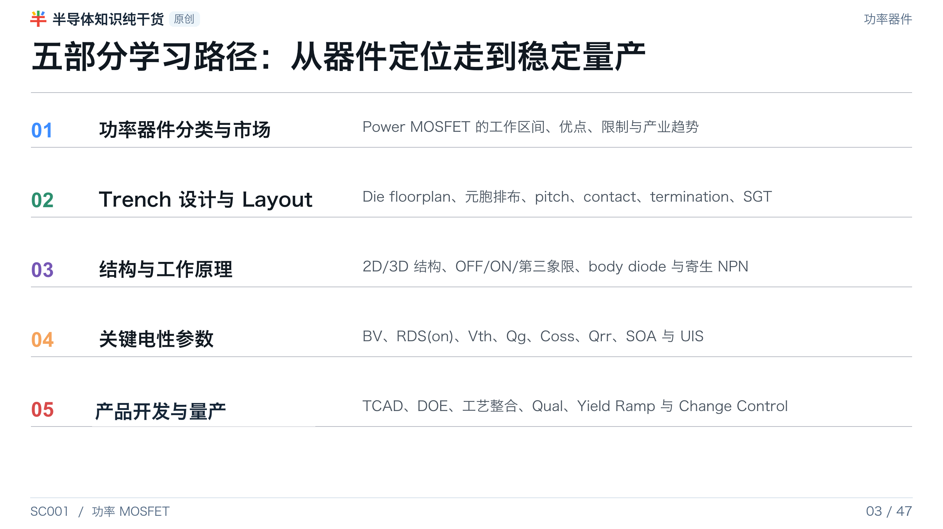
Notes:
[Presenter Notes]
- 叙事顺序是刻意安排的：器件定位决定 target spec，target spec 决定设计旋钮，结构决定电性，最终由 工艺整合 把这些旋钮转化为稳定工艺。
[Sources]
- No external source; section divider or original synthesis.

Slide 4
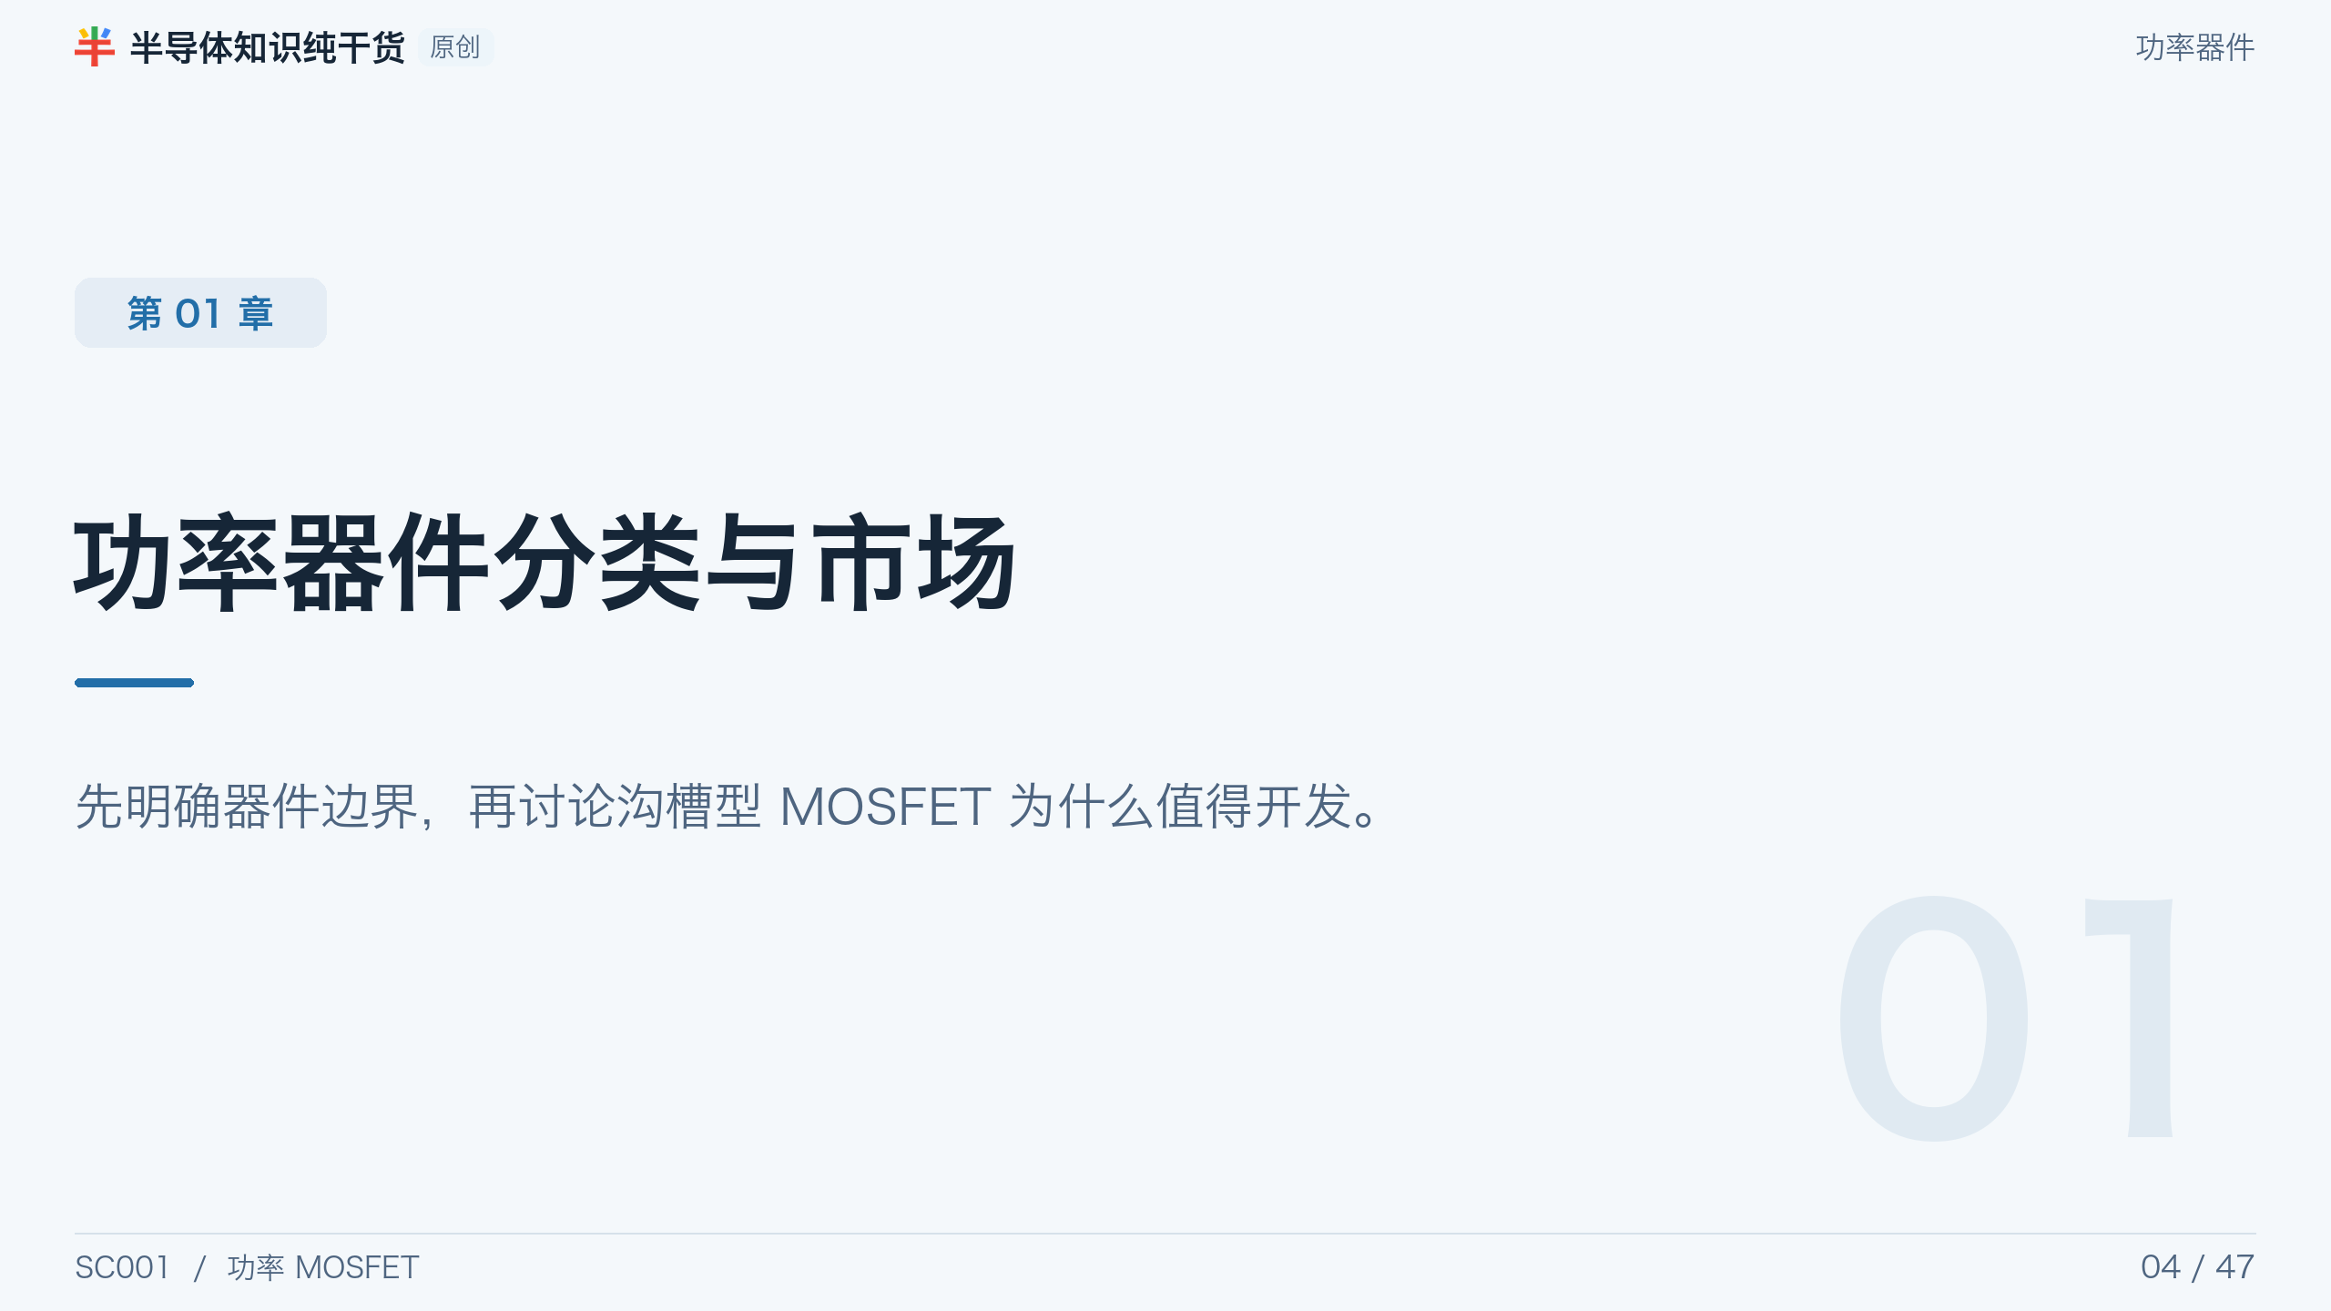
Notes:
[Presenter Notes]
- 先明确器件边界，再讨论 Trench MOSFET 为什么值得开发。
[Sources]
- No external source; section divider or original synthesis.

Slide 5
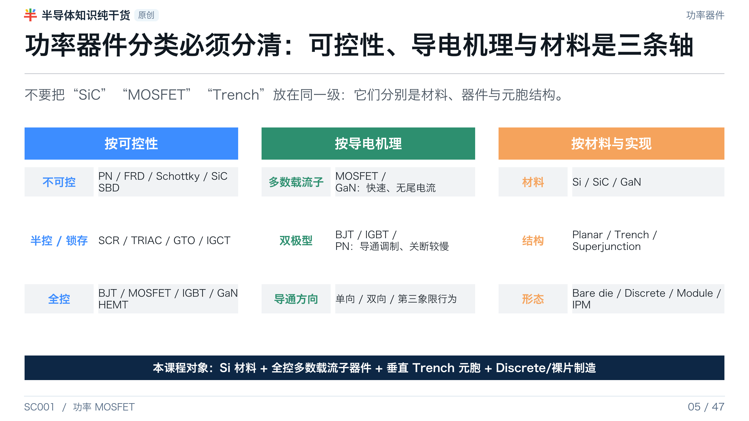
Notes:
[Presenter Notes]
- 用三条轴避免分类混乱；同一种 MOSFET 可以采用 Si、SiC，不同元胞结构和不同封装形态。
- 工艺整合 需要明确产品边界：这里不是 SiC trench MOSFET 可靠性课程，也不是高压 superjunction 流程课程。
[Sources]
- Infineon, BJT/MOSFET/IGBT comparison: https://www.infineon.com/knowledge-centre/difference-between-bjts-mosfets-and-igbts
- Infineon, MOSFET portfolio: https://www.infineon.com/products/power/mosfet

Slide 6
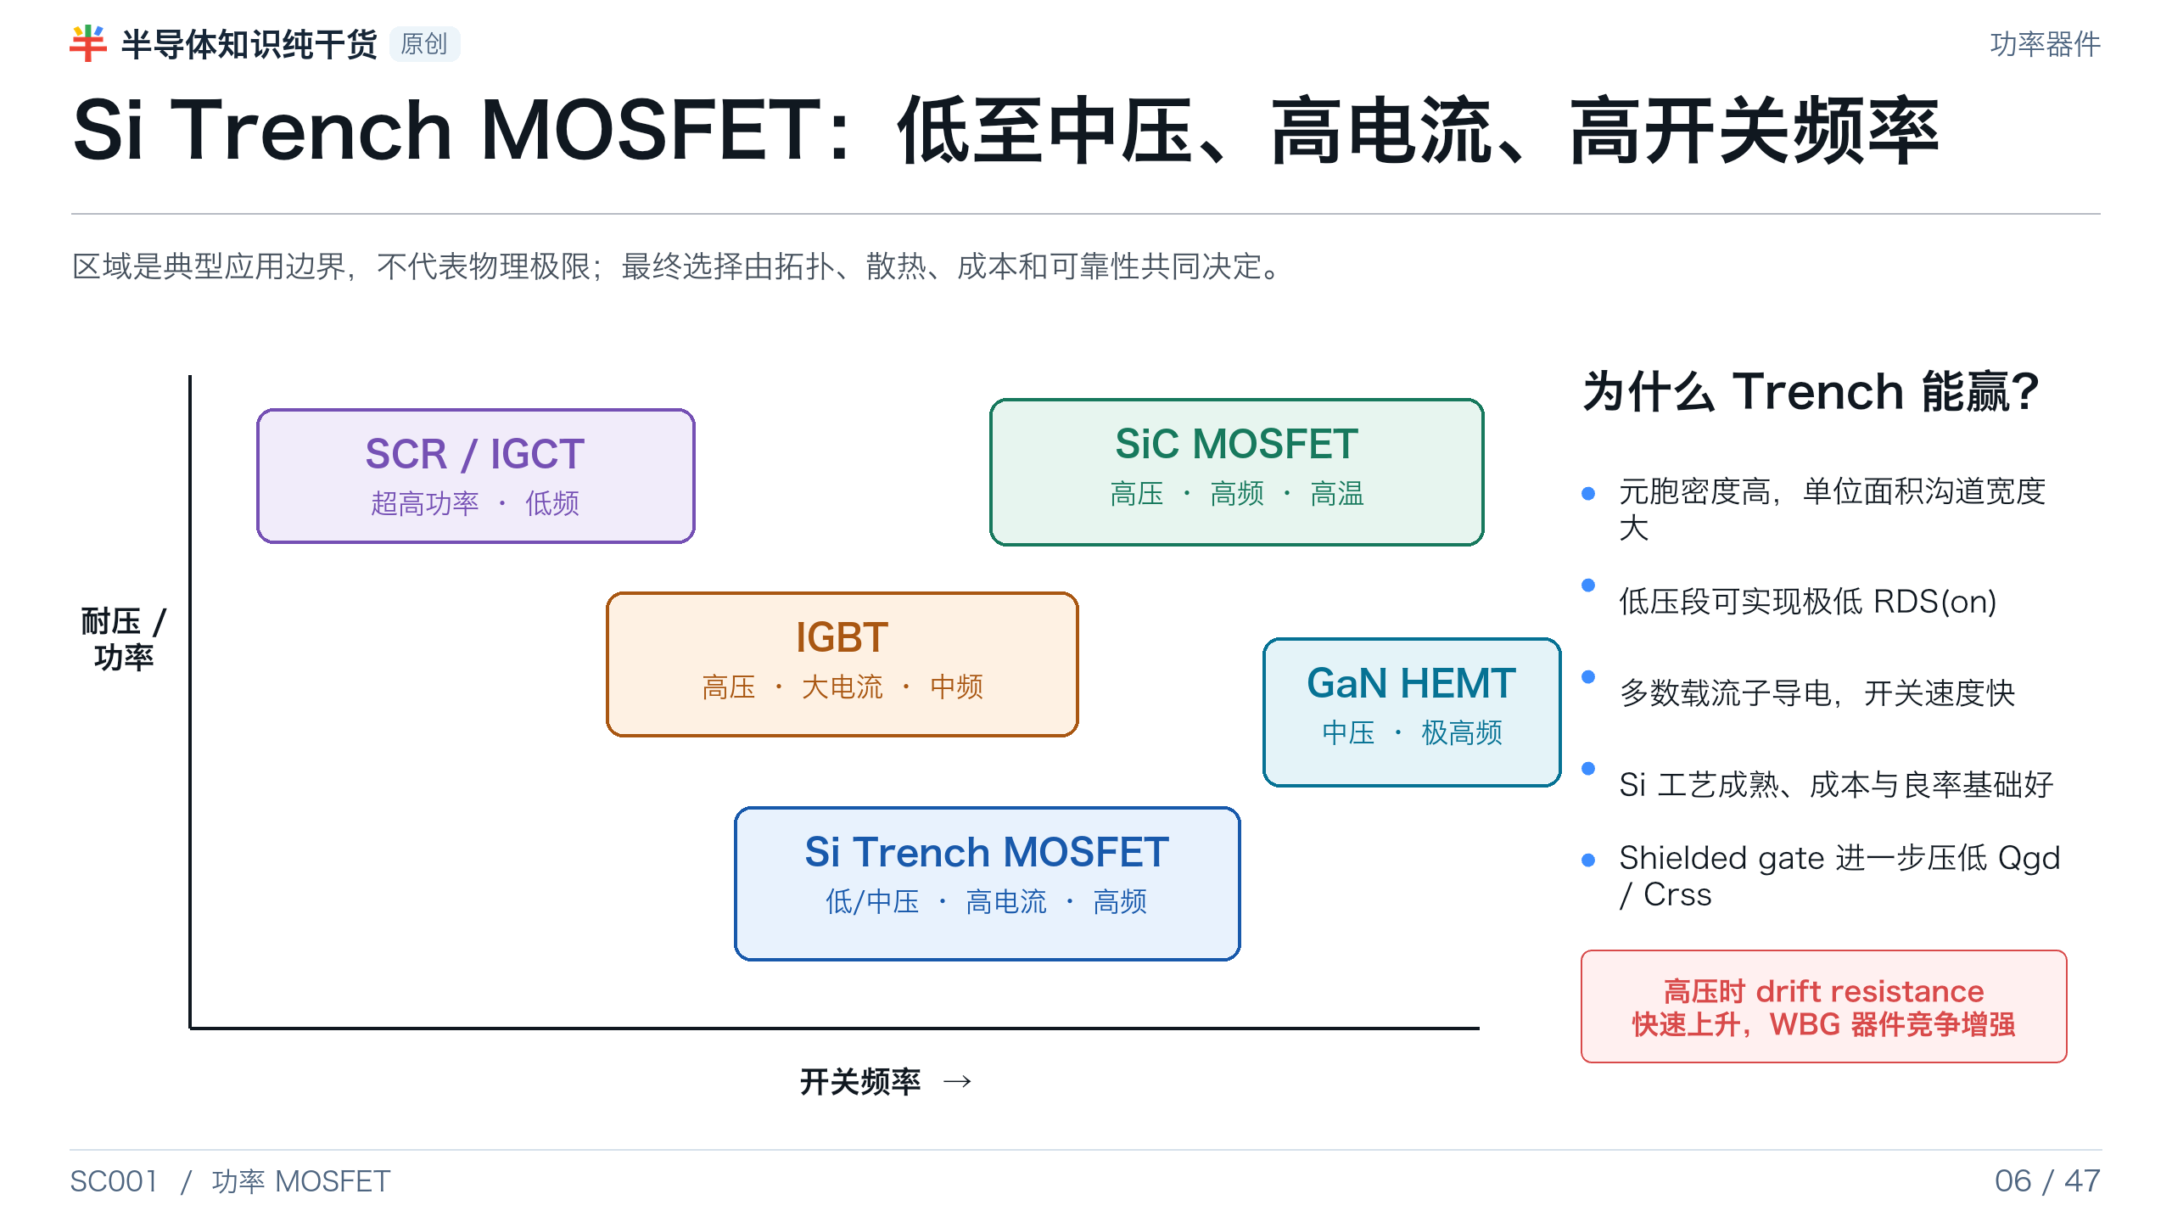
Notes:
[Presenter Notes]
- 选择地图用来解释器件定位，不应拿图中的边界作为规格承诺。
- 低压 trench MOSFET 的优势来自高单元密度和小 drift contribution；额定电压升高后，drift layer 成为主导。
[Sources]
- Infineon, MOSFET portfolio: https://www.infineon.com/products/power/mosfet
- Infineon, BJT/MOSFET/IGBT comparison: https://www.infineon.com/knowledge-centre/difference-between-bjts-mosfets-and-igbts
- onsemi AN-4158, Shielded Gate PowerTrench technology: https://www.onsemi.com/download/application-notes/pdf/an-4158.pdf

Slide 7
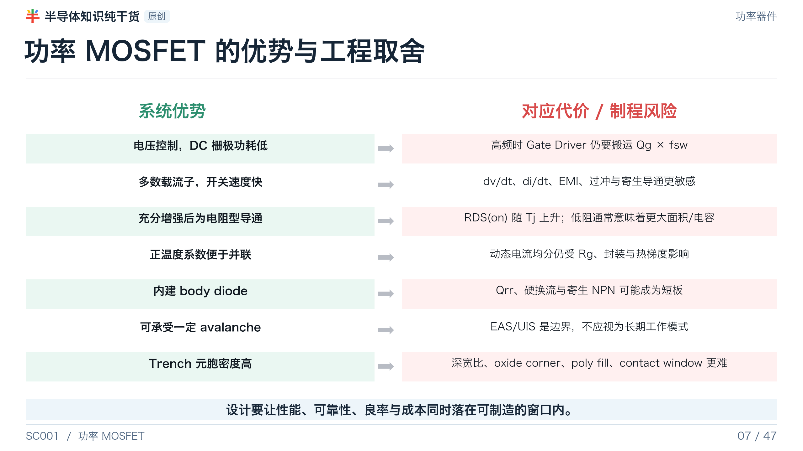
Notes:
[Presenter Notes]
- 把技术宣传中的“低阻、高速、鲁棒”拆成对应的代价，避免单目标优化。
- 正温度系数有利于稳态并联，但不等于动态开通过程自动均流。
[Sources]
- Infineon, Power MOSFET Basics: https://www.infineon.com/assets/row/public/documents/24/54/infineon-power-mosfet-basics-article-en.pdf
- onsemi AN-4158, Shielded Gate PowerTrench technology: https://www.onsemi.com/download/application-notes/pdf/an-4158.pdf
- Nexperia AN11158, Understanding power MOSFET data sheet parameters: https://assets.nexperia.com/documents/application-note/AN11158.pdf
- Nexperia TN00008, Power MOSFET FAQ: https://assets.nexperia.com/documents/technical-note/TN00008.pdf

Slide 8
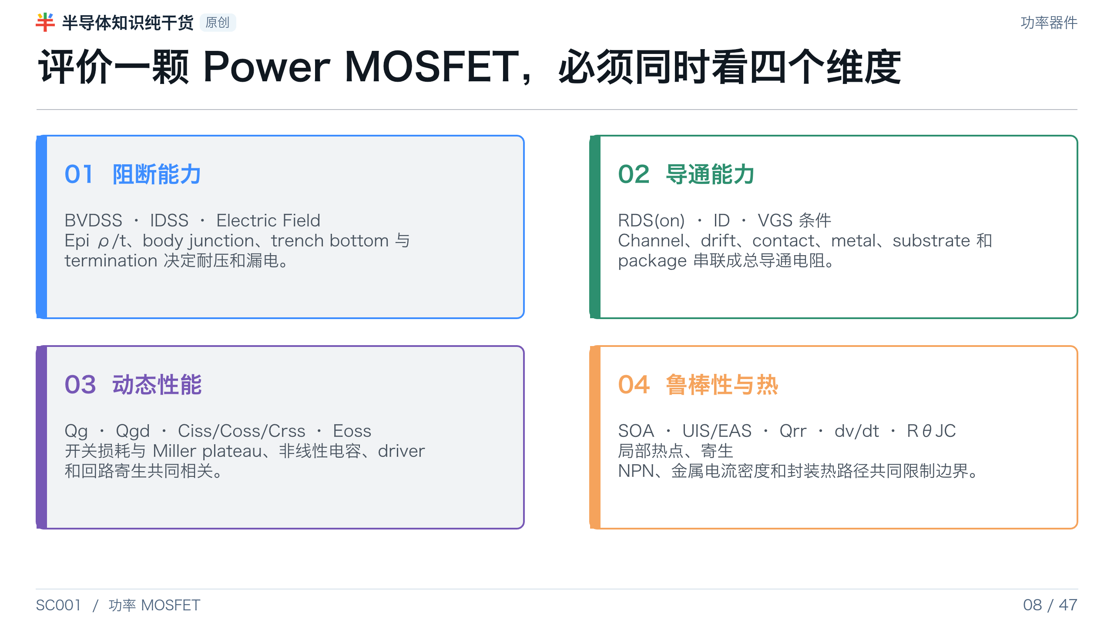
Notes:
[Presenter Notes]
- 四维框架用于后续所有 design review 和 DOE response 的组织。
- 只用 RDS(on)×Qg 一个 FOM 不能覆盖 body diode、SOA、thermal 与 application mission profile。
[Sources]
- onsemi AN-4163, Shielded Gate PowerTrench datasheet explanation: https://www.onsemi.com/download/application-notes/pdf/an-4163.pdf
- Nexperia AN11158, Understanding power MOSFET data sheet parameters: https://assets.nexperia.com/documents/application-note/AN11158.pdf
- onsemi AN-9034, Power MOSFET avalanche/UIS: https://www.onsemi.com/download/application-notes/pdf/an-9034.pdf

Slide 9
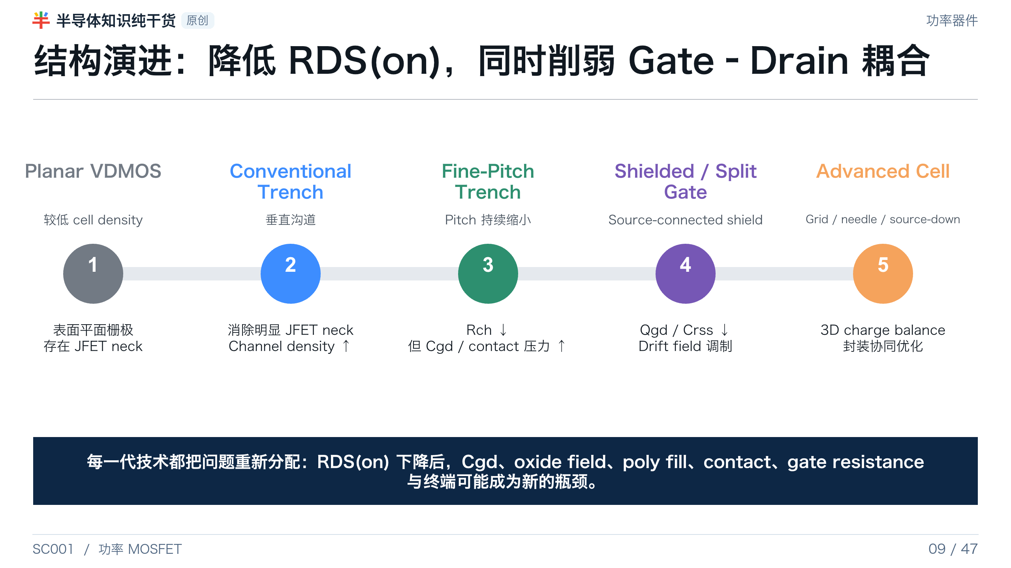
Notes:
[Presenter Notes]
- 结构演进不等于所有参数单调改善；新结构往往增加 mask、oxide stack、poly fill 与 contact 复杂度。
- Shielded-gate 的核心不是单纯缩小 pitch，而是用 source shield 降低 gate-drain coupling 并调制 drift field。
[Sources]
- onsemi AN-4158, Shielded Gate PowerTrench technology: https://www.onsemi.com/download/application-notes/pdf/an-4158.pdf
- Infineon, Needle Trench Cell: https://www.infineon.com/technology/needle-trench-cell
- ST AN4150, planar versus trench structure and trench-depth discussion: https://www.st.com/resource/en/application_note/dm00061867-power-mosfet-technology-gate-current-needs-in-a-synchronous-buck-converter-stmicroelectronics.pdf

Slide 10
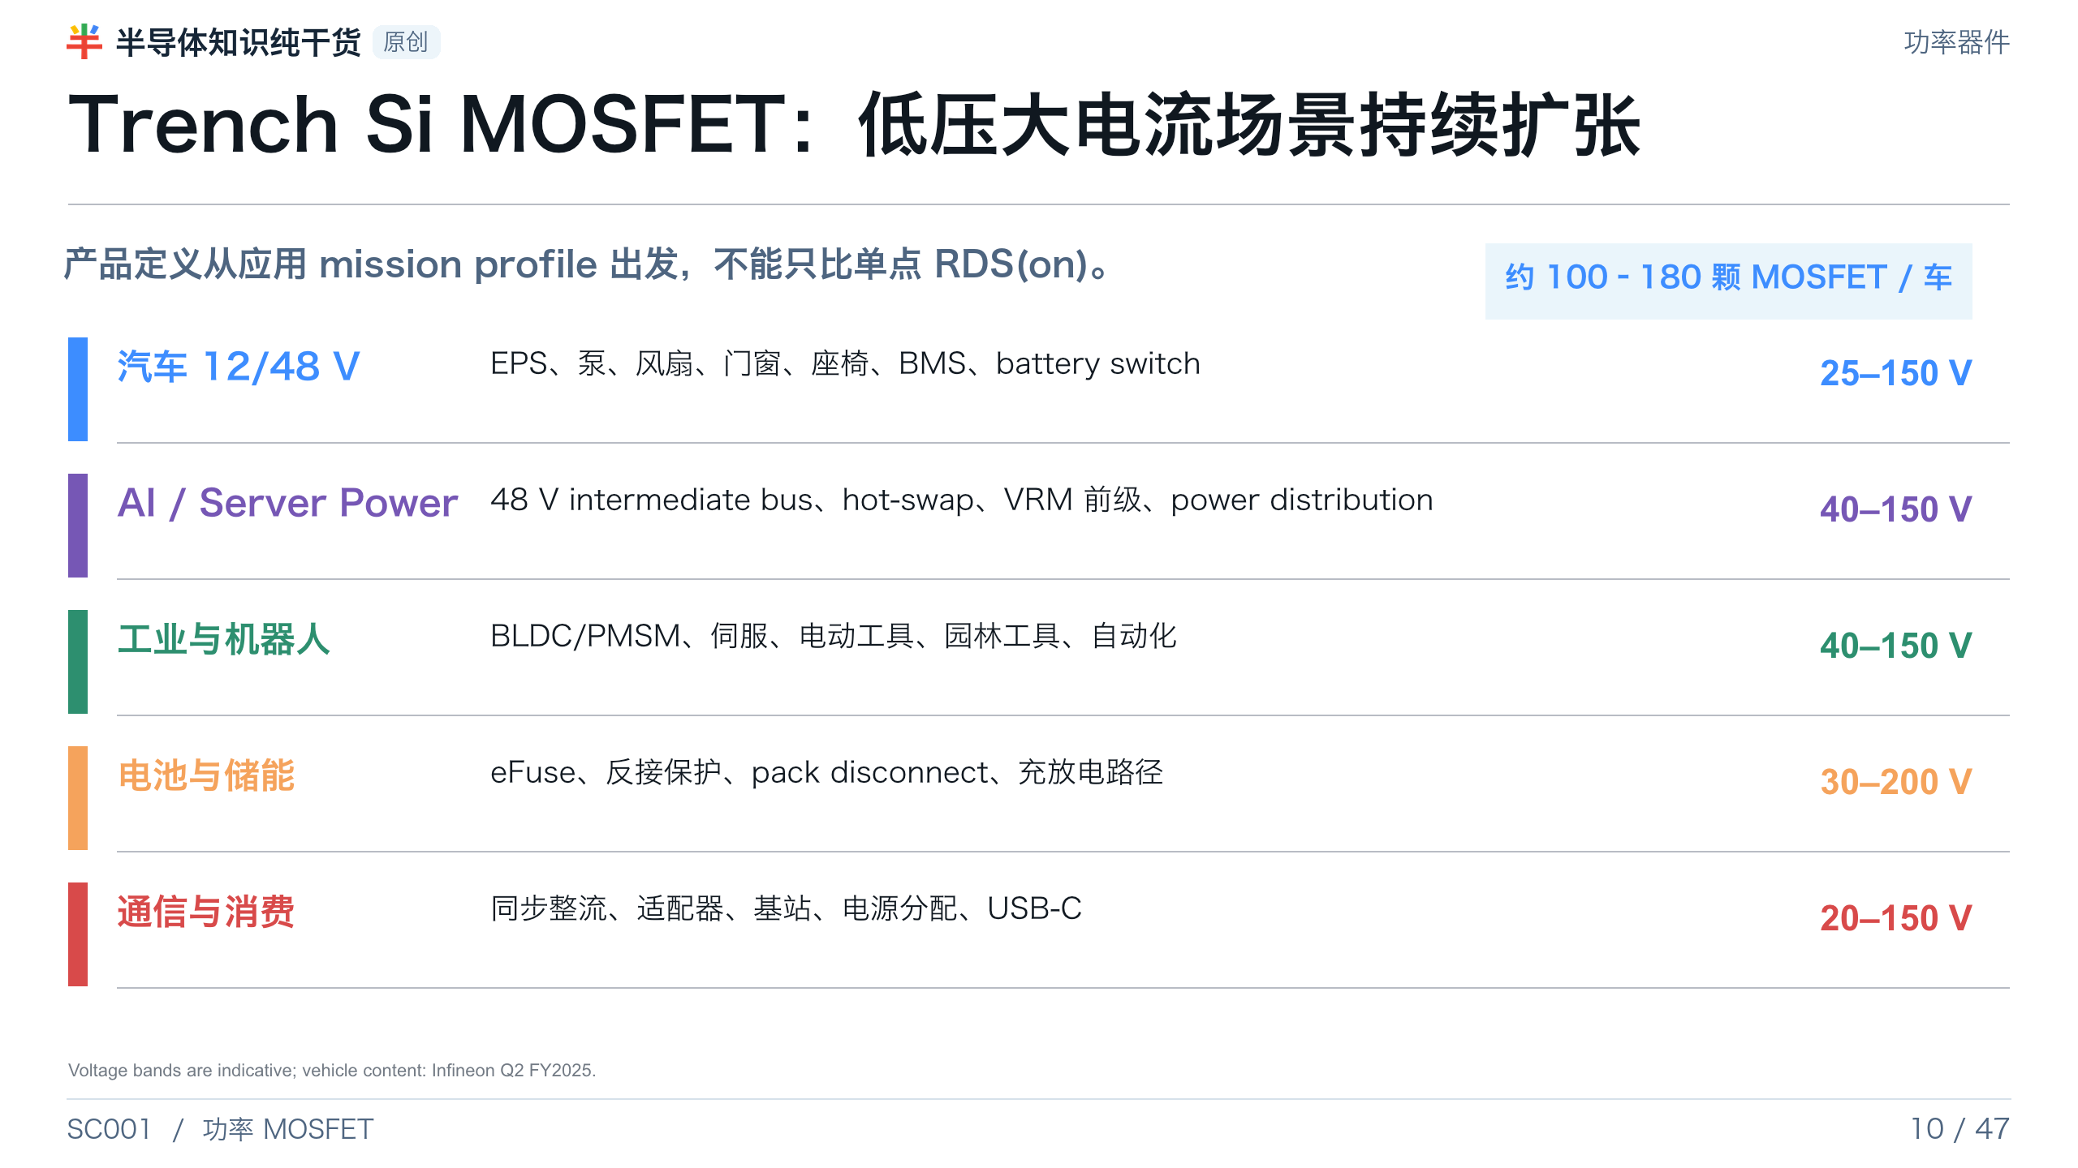
Notes:
[Presenter Notes]
- 每辆车 MOSFET 数量来自 Infineon 公开投资者材料，应用约覆盖 90 类功能；数字是组合性参考，不是所有车型的固定值。
- 面向 Fab 的产品定义要包含温度、感性负载、avalanche、湿度、寿命与负载循环，而不是只列额定电压。
[Sources]
- Infineon Q2 FY2025 Investor Presentation, vehicle MOSFET applications: https://www.infineon.com/row/public/documents/corporate/investors/presentations/2025/2025-05-08-q2-fy25-investor-presentation-v01-00-en.pdf
- Infineon, MOSFET portfolio: https://www.infineon.com/products/power/mosfet

Slide 11
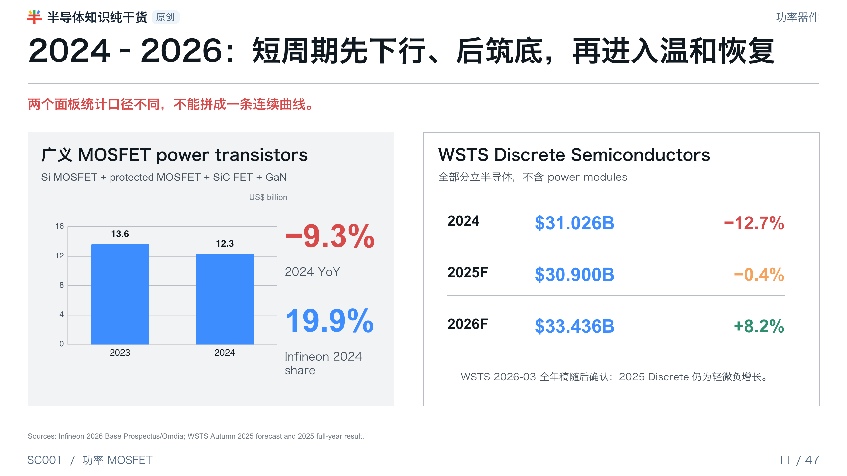
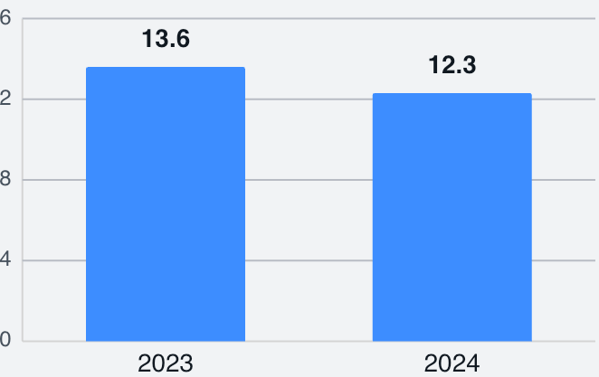
Notes:
[Presenter Notes]
- 广义 MOSFET 市场 2024 为 123 亿美元，同比下降 9.3%；该口径包含 SiC 与 GaN FET。
- WSTS 的 Discrete 口径更宽但不含模块，2024 下行更深，2025 接近筑底，2026 预测恢复。
- 市场分析页必须保留统计口径，避免把不同报告数字误解为冲突。
[Sources]
- Infineon Base Prospectus 2026, pp.52–53, Omdia 2H25 data: https://www.infineon.com/assets/row/public/documents/corporate/investors/fixed-income/infineon-dip-update-2026-base-prospectus-final-4-february-2026-v01-00-en.pdf
- WSTS Autumn 2025 Forecast: https://www.wsts.org/esraCMS/extension/media/f/WST/7310/WSTS_FC-Release-2025_11.pdf
- WSTS 2025 full-year results: https://www.wsts.org/76/103/Global-Semiconductor-Market-grows-26-in-2025-to-796B

Slide 12
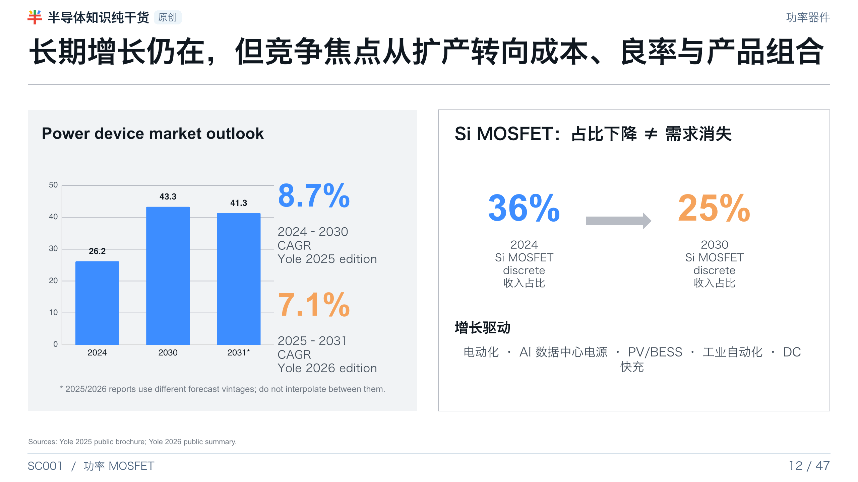
Notes:
[Presenter Notes]
- 2025 和 2026 版 Yole 使用不同预测区间和基准，不应把 2030 与 2031 端点拼成同一序列。
- Si MOSFET 占总功率器件收入的相对份额下降，原因是 SiC、GaN 和模块增长更快；低压大电流市场仍需要 Si trench MOSFET。
- 行业从容量扩张转向运营效率，直接提高了对 Fab yield、cycle time、cost-down 与产品组合管理的要求。
[Sources]
- Yole, Status of the Power Electronics Industry 2025 public brochure: https://d36oxfnefkrtho.cloudfront.net/static/flyer/yintr25514-status_of_the_power_electronics_industry_2025-product_brochure.pdf
- Yole 2026 report summary, Power Electronics News: https://powerelectronicsmagazine.net/article/124641/Power_electronics_at_a_turning_point%2C_says_Yole

Slide 13
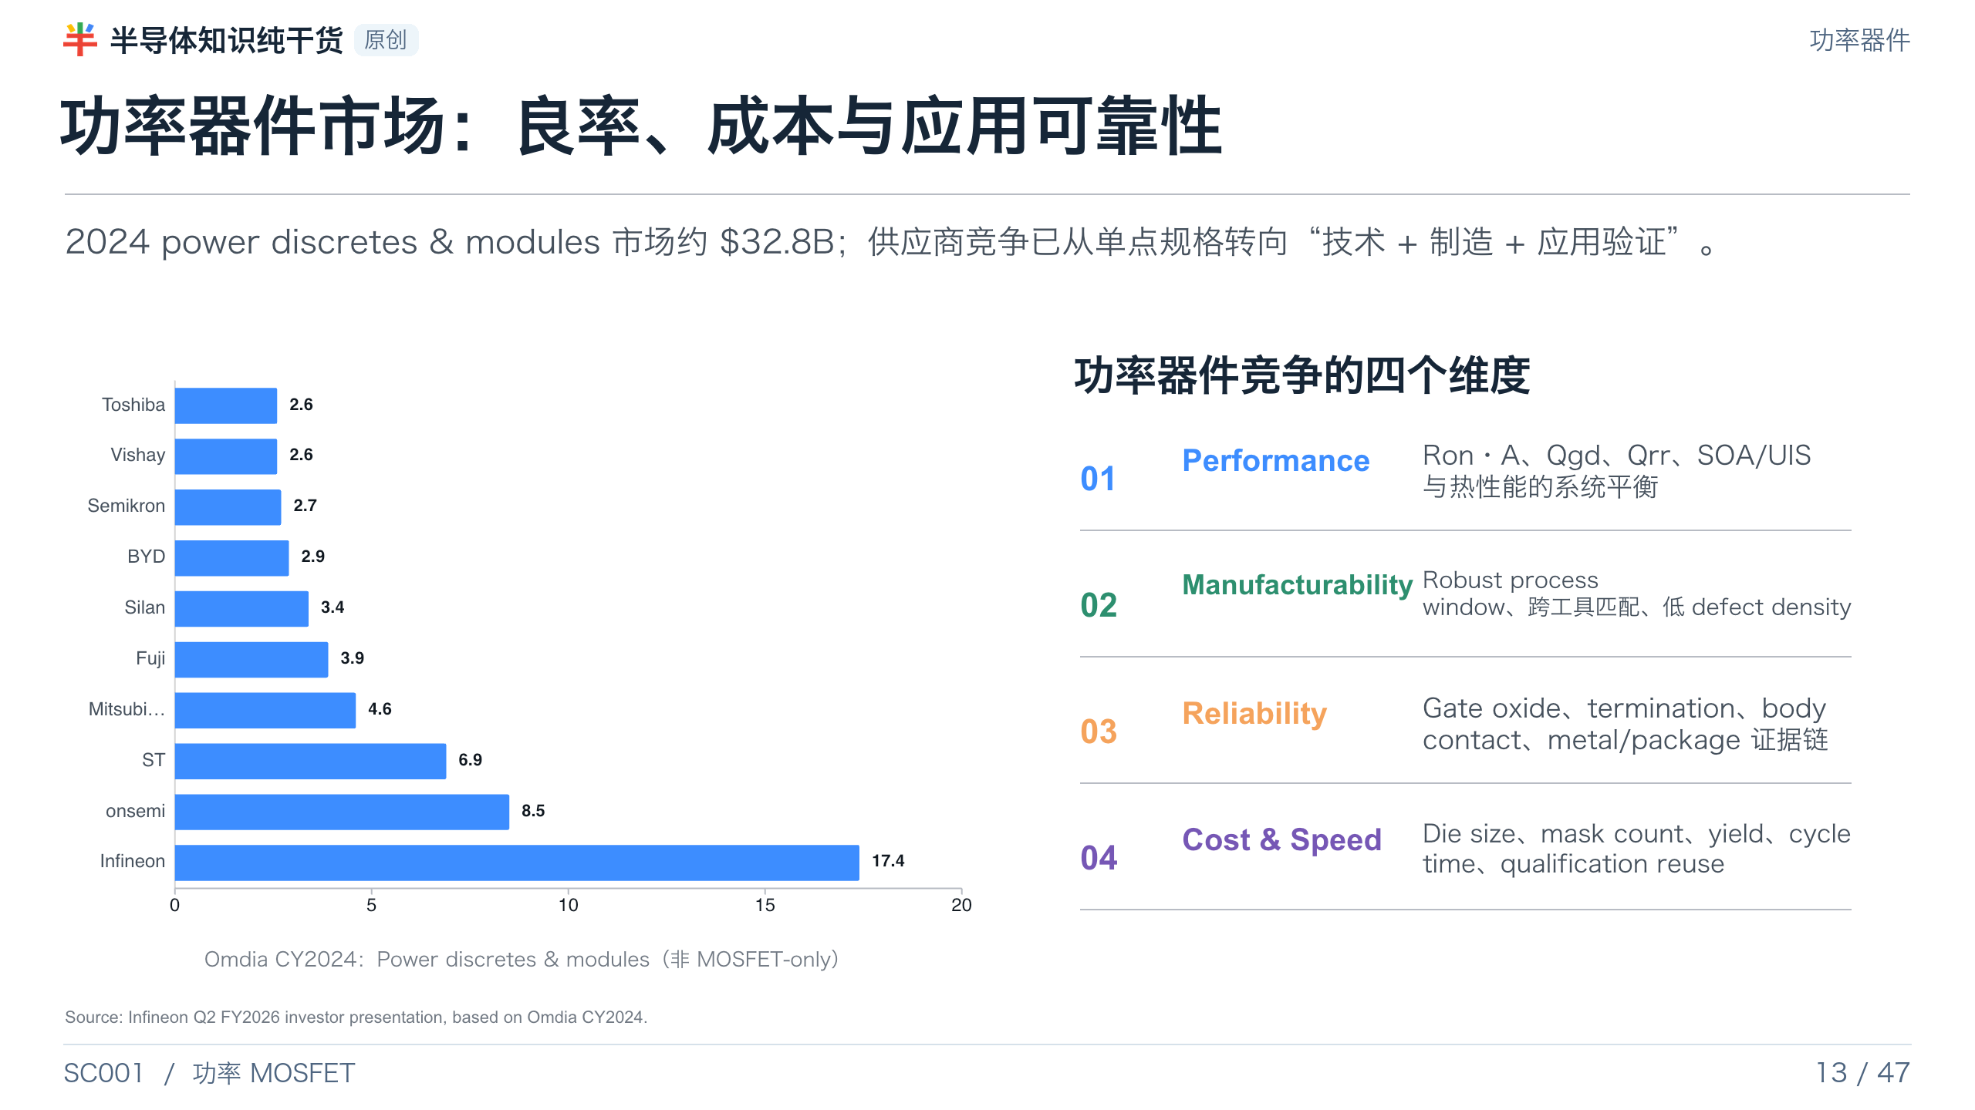
Notes:
[Presenter Notes]
- 竞争图使用 Power discretes & modules 口径，并非 MOSFET-only；必须在可见注释和讲者备注中说明。
- Fab 能形成的壁垒是性能、可制造性、可靠性与成本/速度的组合，而不是单一最小 RDS(on)。
[Sources]
- Infineon Q2 FY2026 Investor Presentation, Omdia CY2024 power discretes/modules: https://www.infineon.com/row/public/documents/corporate/investors/presentations/2026/2026-05-06-q2-fy26-investor-presentation-v01-00-en.pdf
- Yole 2026 report summary, Power Electronics News: https://powerelectronicsmagazine.net/article/124641/Power_electronics_at_a_turning_point%2C_says_Yole

Slide 14
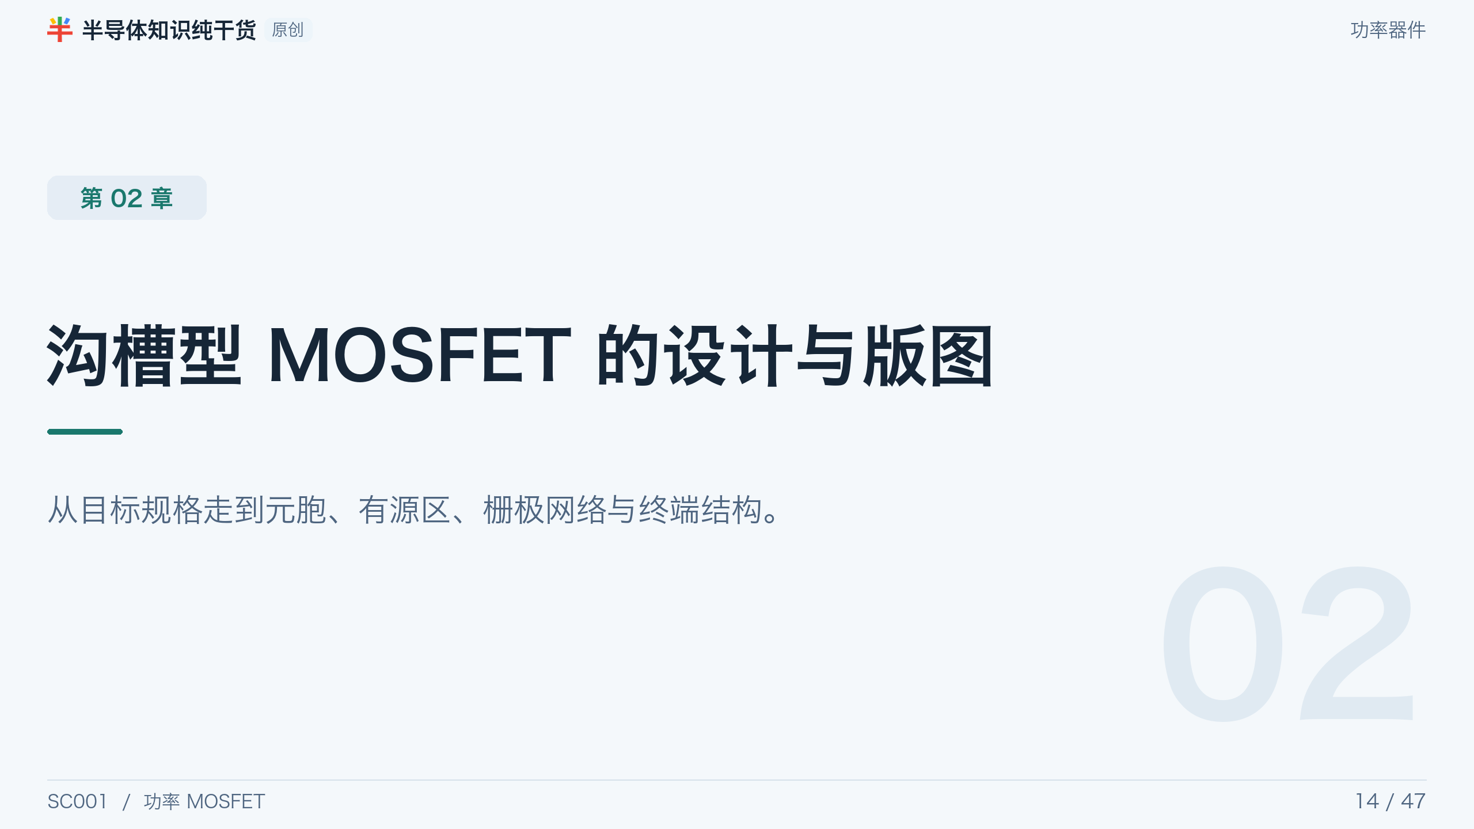
Notes:
[Presenter Notes]
- 从 target spec 走到 unit cell、active array、gate network 与 termination。
[Sources]
- No external source; section divider or original synthesis.

Slide 15
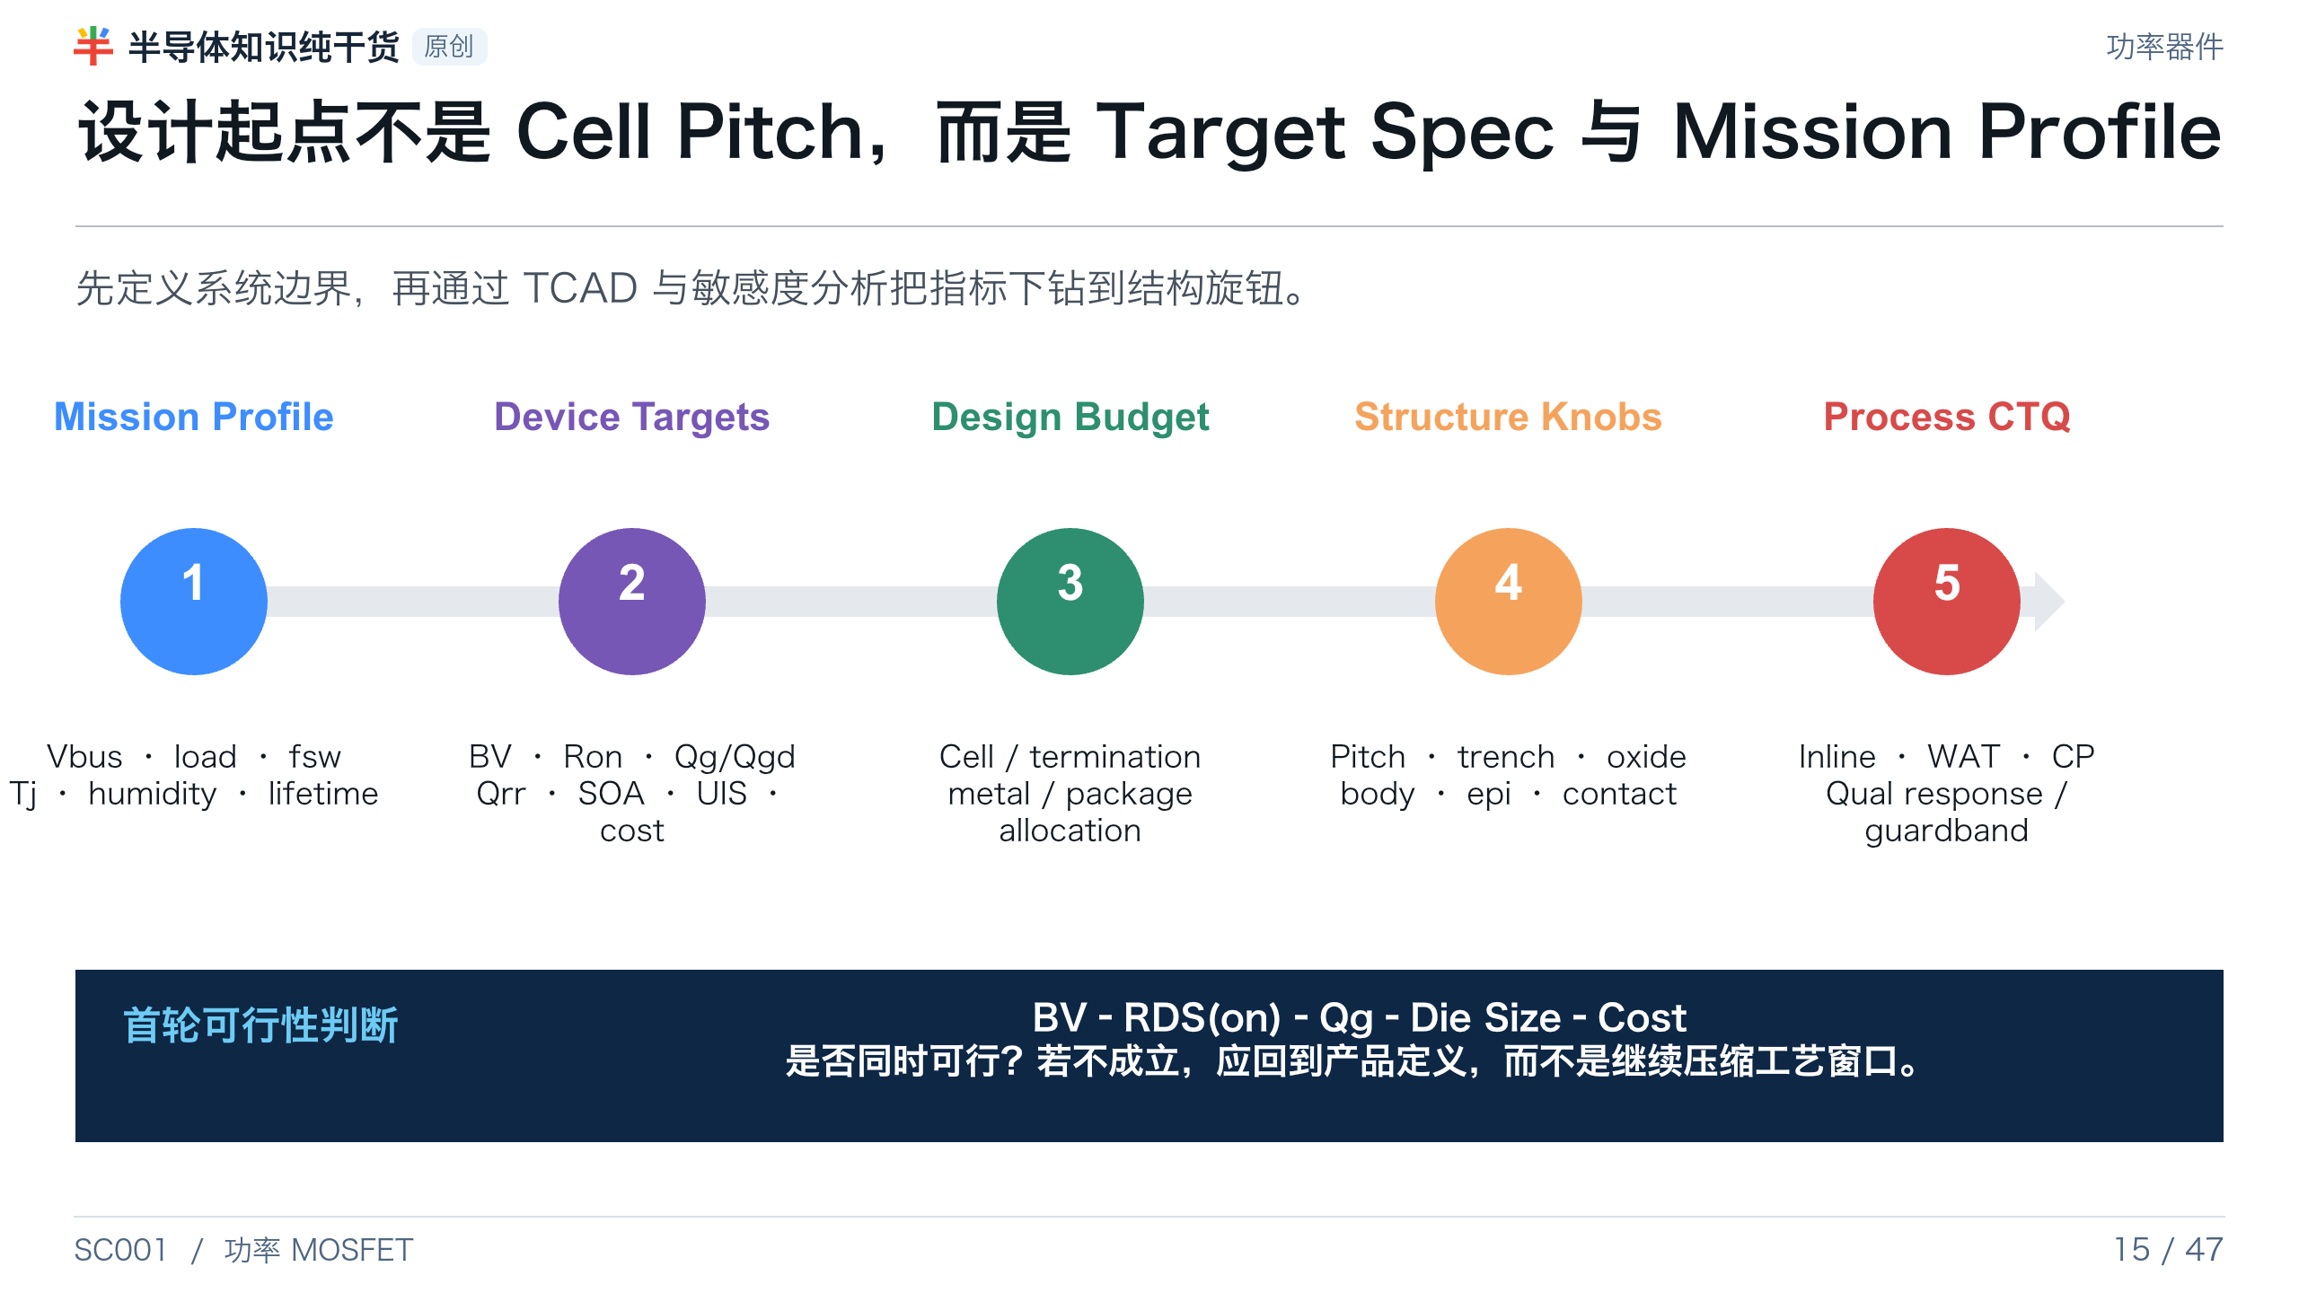
Notes:
[Presenter Notes]
- Mission profile 必须包含静态额定值、测试条件、温度、开关频率、感性瞬态、湿度和寿命。
- 设计预算应明确哪些损耗/裕量由 cell、termination、top metal、backside 和 package 承担。
[Sources]
- AEC-Q101 Rev.E: https://www.aecouncil.com/Documents/AEC_Q101_Rev_E_Base_Document.pdf
- Synopsys, TCAD Process Simulation: https://www.synopsys.com/manufacturing/tcad/process-simulation.html
- Nexperia AN11158, Understanding power MOSFET data sheet parameters: https://assets.nexperia.com/documents/application-note/AN11158.pdf

Slide 16
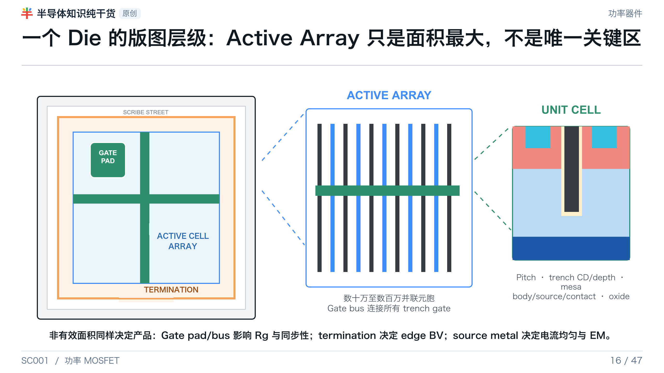
Notes:
[Presenter Notes]
- Die 顶层包含 active array、source metal、gate pad/bus、termination、channel stop 和 scribe street。
- Gate bus 降低分布式栅极电阻与远端延迟，但占用 active area 并增加寄生。
- 背面金属通常为共用 drain。
[Sources]
- US20040173844A1, die layout/gate bus/network: https://patents.google.com/patent/US20040173844A1/en
- US6204533B1, square/hexagonal/stripe trench cell geometry: https://patents.google.com/patent/US6204533B1/en

Slide 17
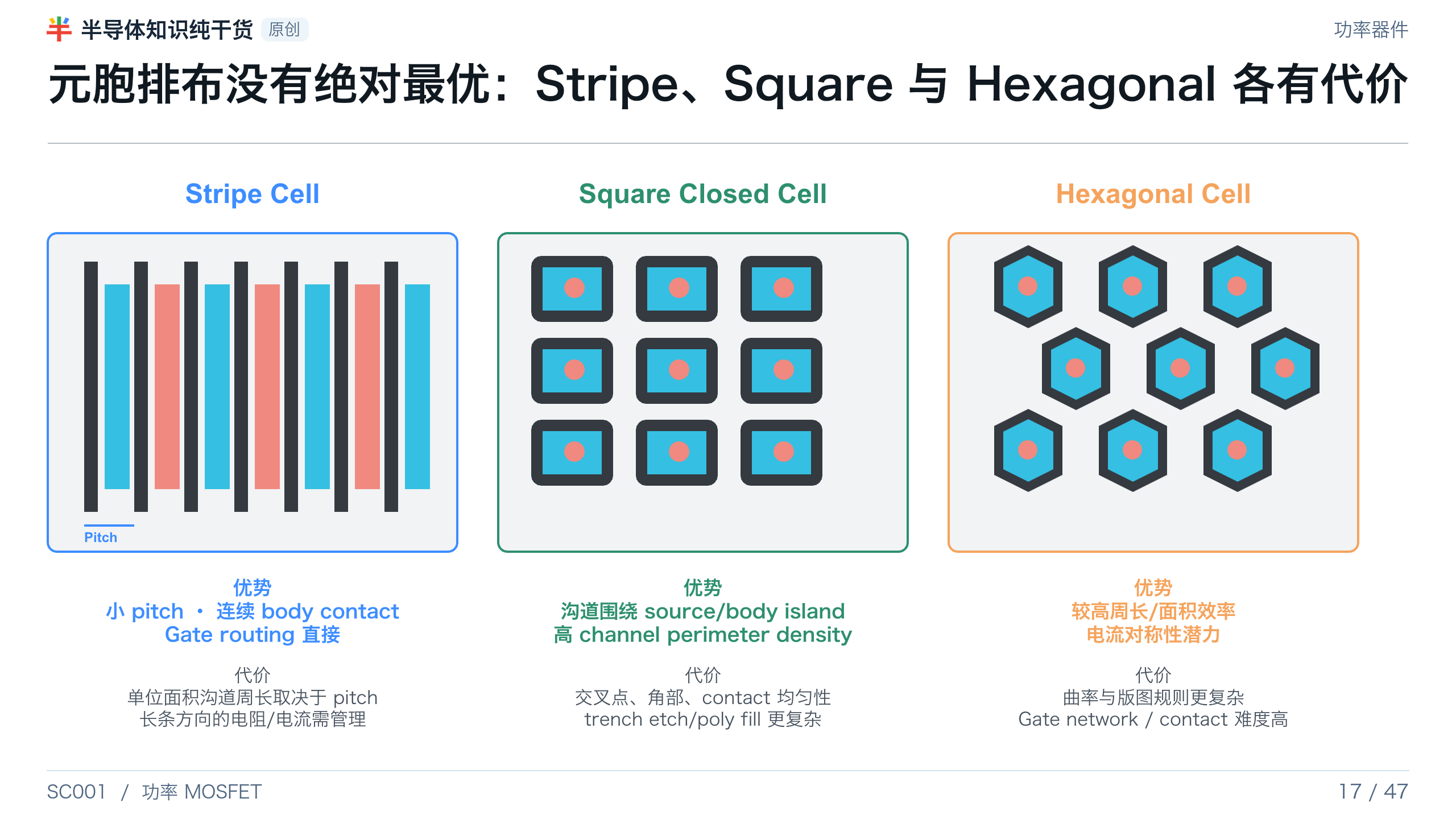
Notes:
[Presenter Notes]
- 评价 cell density 应看单位 active area 的总 channel width，而不只看 cells/mm²。
- Closed-cell 几何可提高 channel perimeter，但角部电场、contact、etch loading 和 poly fill 复杂度也会上升。
- 最终选择取决于 design rule、contact CD、trench corner、gate network 与目标 FOM。
[Sources]
- US6204533B1, square/hexagonal/stripe trench cell geometry: https://patents.google.com/patent/US6204533B1/en
- US8569134B2, closed-cell trench MOSFET: https://patents.google.com/patent/US8569134B2/en

Slide 18
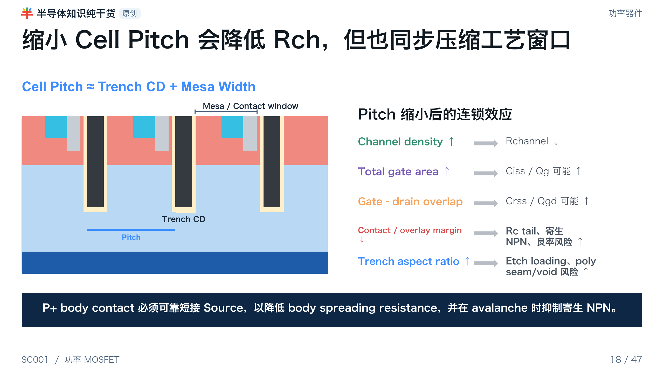
Notes:
[Presenter Notes]
- 缩小 pitch 不应只看 RDS(on)，还要同步评估 capacitance、contact、overlay、gate resistance 和 poly fill。
- P+ body contact 对 UIS、SOA 与 parasitic NPN 抑制非常关键。
[Sources]
- US6204533B1, square/hexagonal/stripe trench cell geometry: https://patents.google.com/patent/US6204533B1/en
- onsemi AN-4158, Shielded Gate PowerTrench technology: https://www.onsemi.com/download/application-notes/pdf/an-4158.pdf
- Nexperia TN00008, Power MOSFET FAQ: https://assets.nexperia.com/documents/technical-note/TN00008.pdf

Slide 19
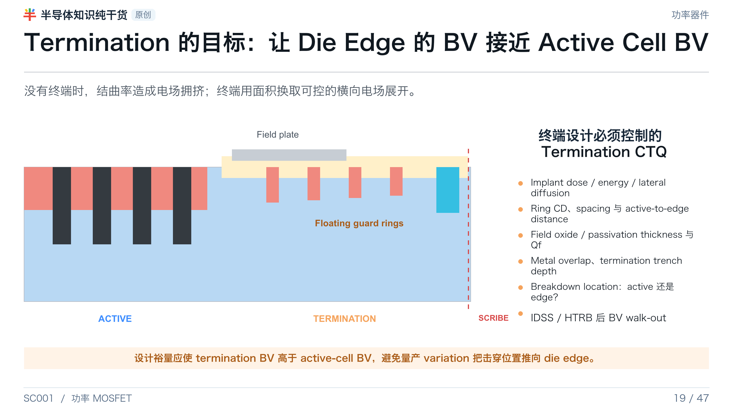
Notes:
[Presenter Notes]
- 终端通过 guard ring、field plate、termination trench、channel stop 等方式把电场横向展开。
- 高压器件还常用 JTE；本页结构用于说明原理，不宣称某一方案适用于所有电压等级。
- 量产时必须追踪 breakdown location，而不只是 lot average BV。
[Sources]
- US5614751A, trench termination/field plate/channel stop: https://patents.google.com/patent/US5614751A/en
- AEC-Q101 Rev.E: https://www.aecouncil.com/Documents/AEC_Q101_Rev_E_Base_Document.pdf

Slide 20
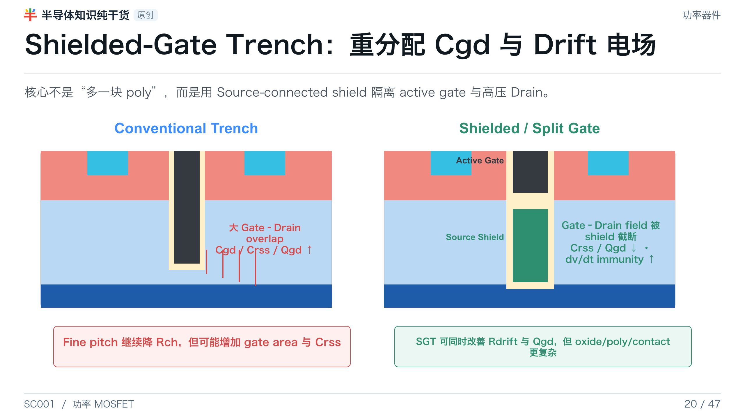
Notes:
[Presenter Notes]
- Conventional trench 的 gate electrode 延伸到 trench bottom，形成较大的 gate-drain capacitance。
- Shielded/split-gate 在 active gate 下加入 source-connected shield，降低 Qgd/Crss，并可通过 field plate 作用提高 drift doping、降低 Rdrift。
- 代价是 oxide stack、poly fill、shield contact、mask 与 process integration 更复杂；Cgs 也可能增加。
[Sources]
- onsemi AN-4158, Shielded Gate PowerTrench technology: https://www.onsemi.com/download/application-notes/pdf/an-4158.pdf
- Infineon, Needle Trench Cell: https://www.infineon.com/technology/needle-trench-cell

Slide 21
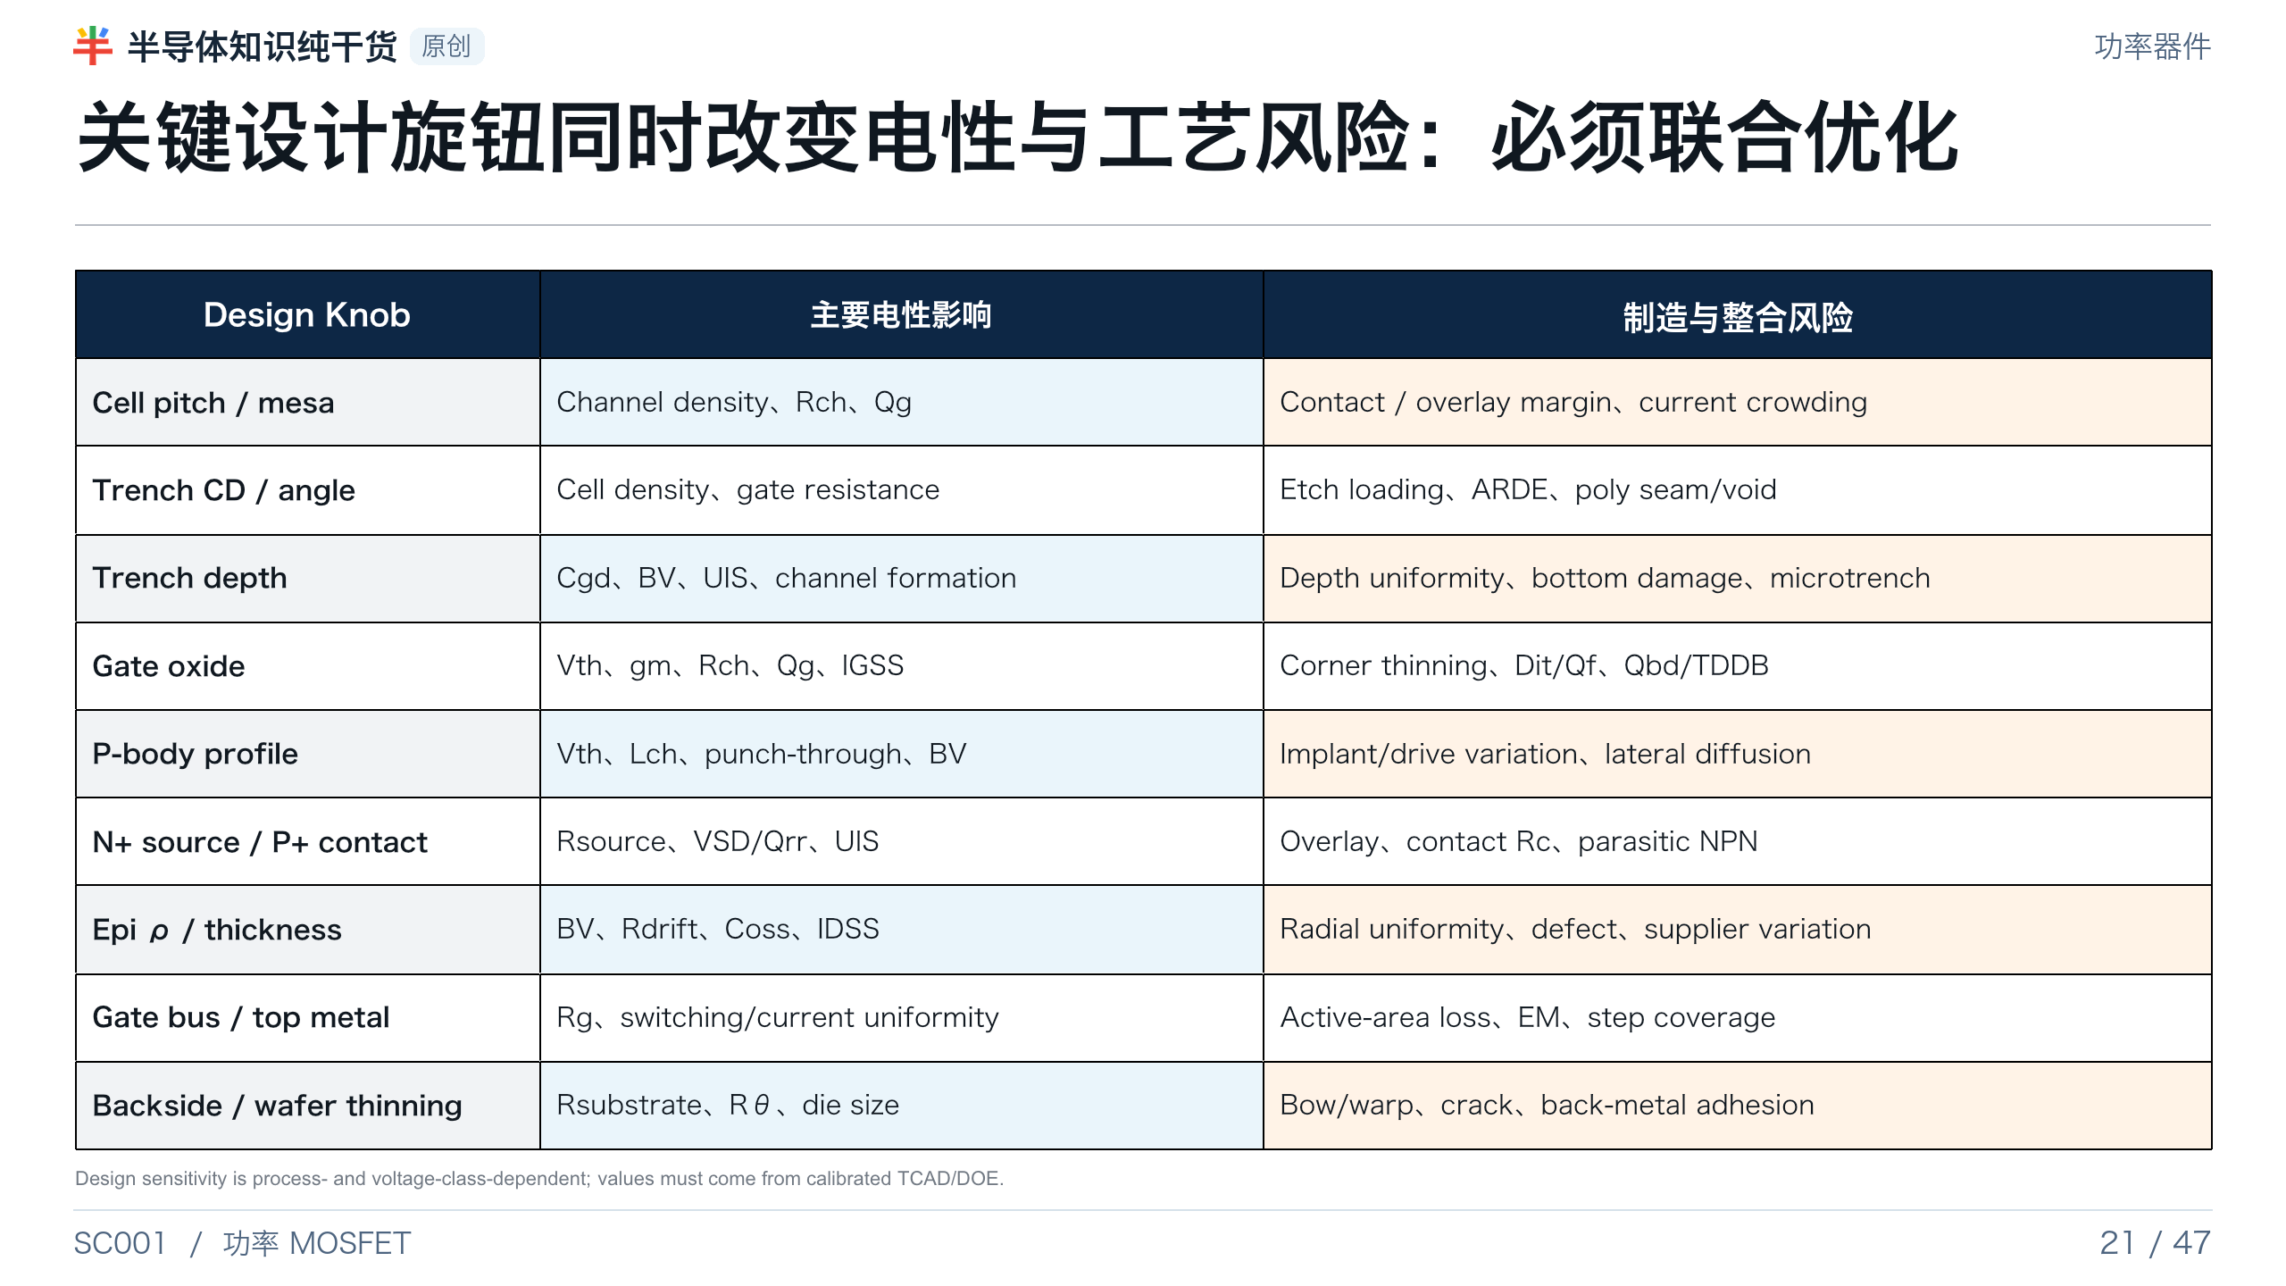
Notes:
[Presenter Notes]
- 尺寸敏感度没有行业通用常数；必须基于本厂工艺、目标电压和校准 TCAD/DOE。
- 表格的价值是建立结构旋钮—电性—工艺风险的共同语言，而不是给出固定 recipe。
[Sources]
- onsemi AN-4158, Shielded Gate PowerTrench technology: https://www.onsemi.com/download/application-notes/pdf/an-4158.pdf
- ST AN4150, planar versus trench structure and trench-depth discussion: https://www.st.com/resource/en/application_note/dm00061867-power-mosfet-technology-gate-current-needs-in-a-synchronous-buck-converter-stmicroelectronics.pdf
- Synopsys, TCAD Process Simulation: https://www.synopsys.com/manufacturing/tcad/process-simulation.html
- Trench Power MOSFET TDDB methodology: https://doi.org/10.1016/j.microrel.2015.11.021

Slide 22
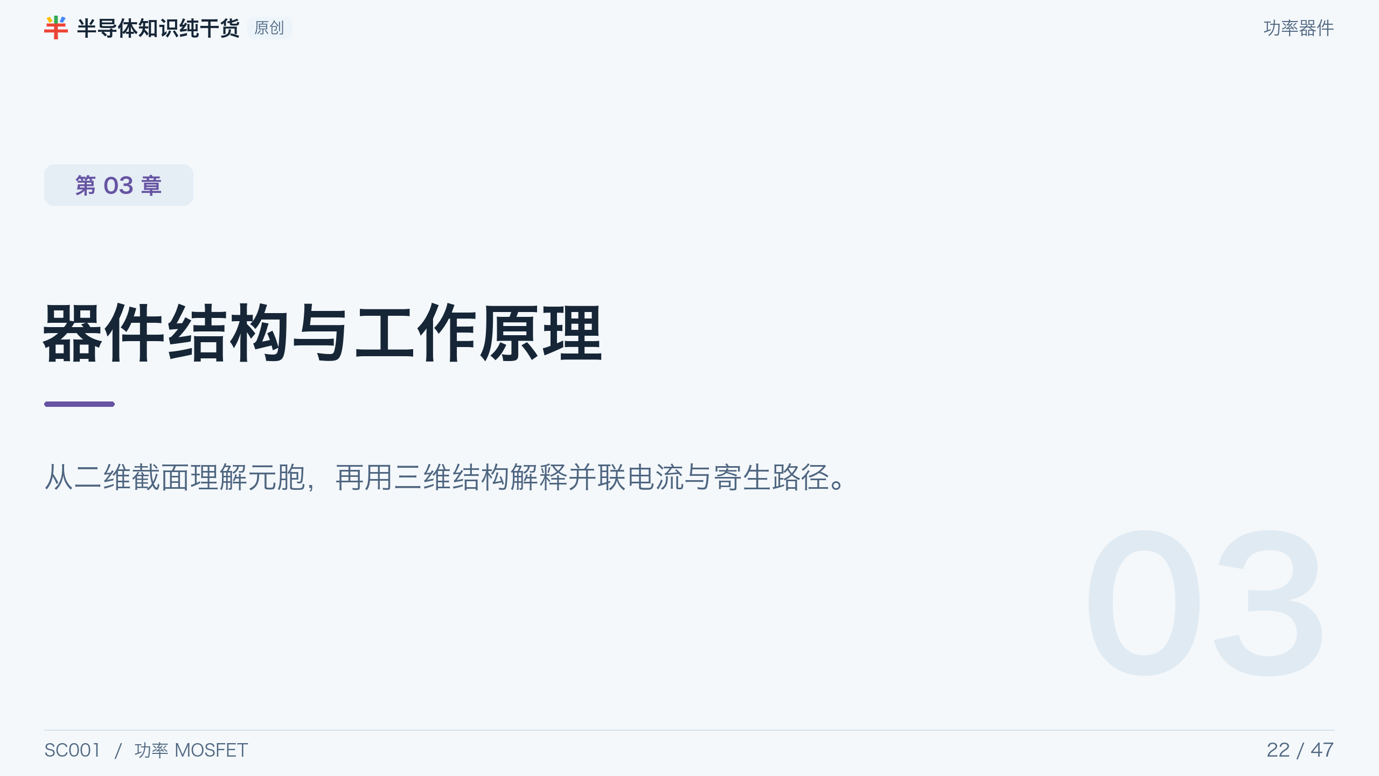
Notes:
[Presenter Notes]
- 从二维截面理解单元，再用三维结构解释并联电流与寄生路径。
[Sources]
- No external source; section divider or original synthesis.

Slide 23
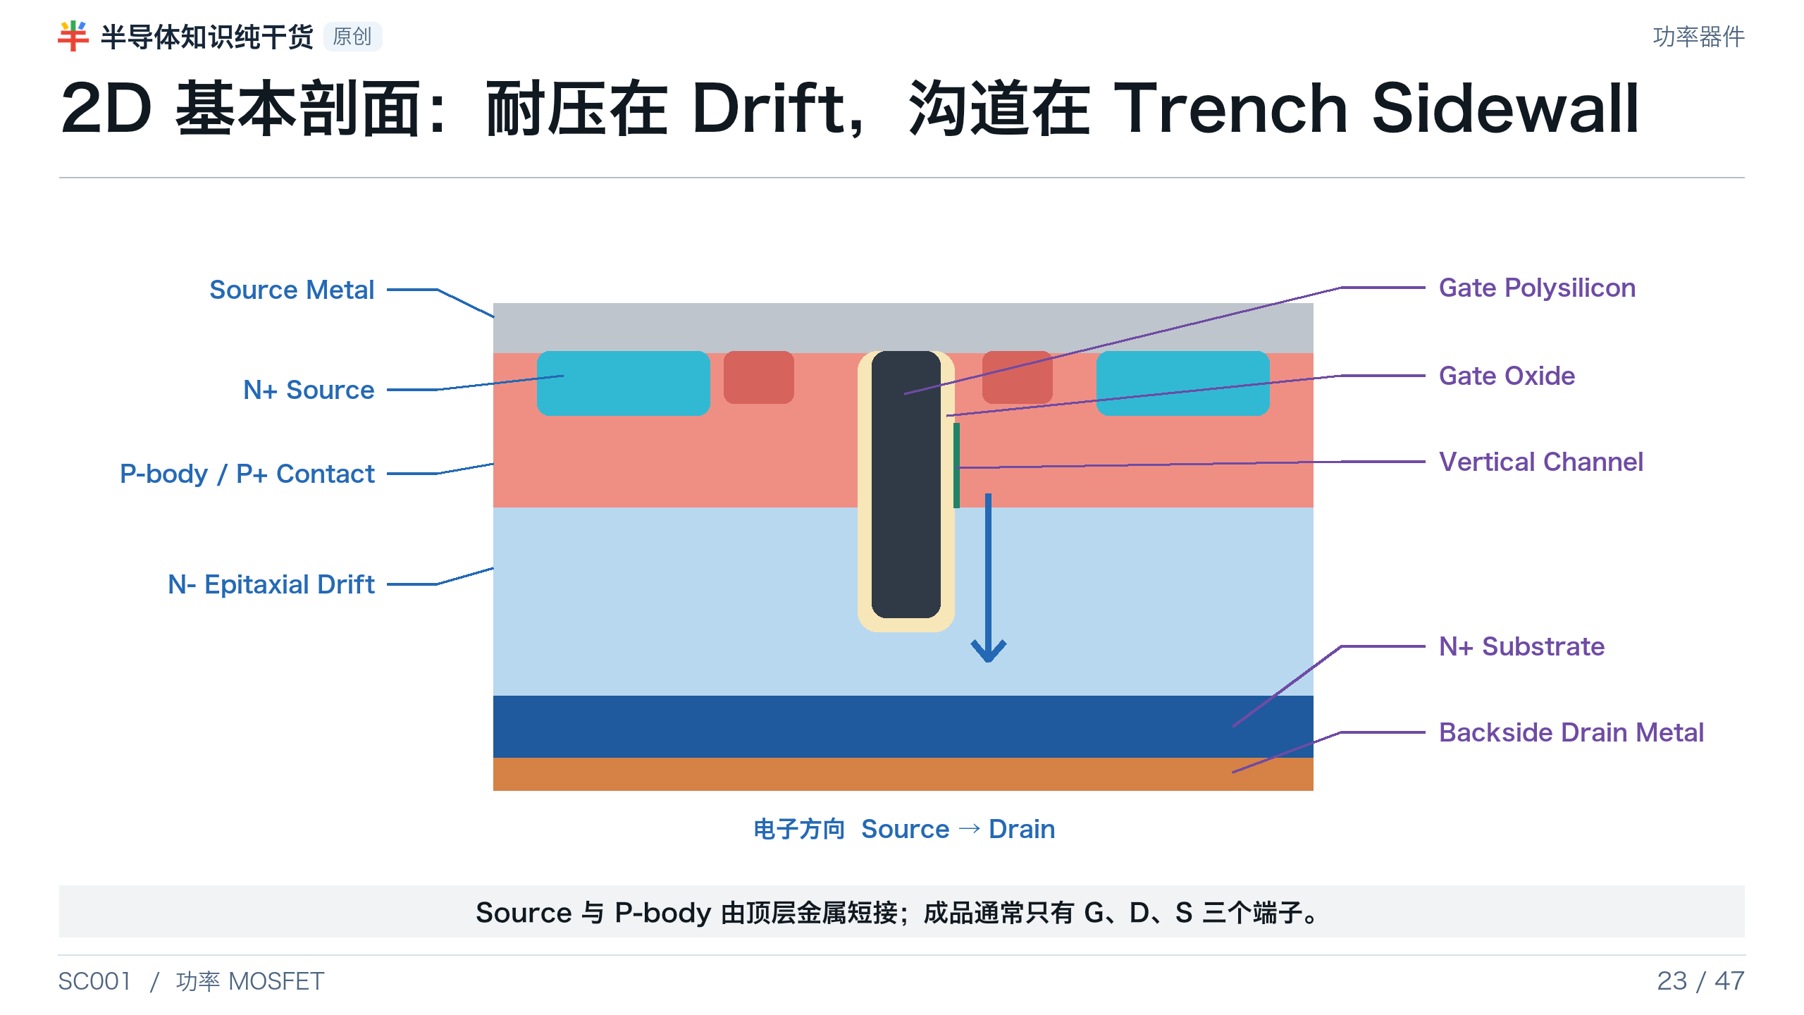
Notes:
[Presenter Notes]
- Trench gate 把沟道从水平改为垂直，提高单位面积沟道宽度，并消除 planar DMOS 的明显 JFET neck。
- 耐压主要由 N− drift layer 和 termination 决定；源极与 body 短接用于抑制寄生 NPN。
- 2D 图是概念示意；实际产品的 oxide、contact、recess 和 dopant profile 取决于工艺平台。
[Sources]
- Toshiba, MOSFET Structure and Operation: https://toshiba.semicon-storage.com/us/semiconductor/knowledge/e-learning/discrete/chap3/chap3-7.html
- ST AN4150, planar versus trench structure and trench-depth discussion: https://www.st.com/resource/en/application_note/dm00061867-power-mosfet-technology-gate-current-needs-in-a-synchronous-buck-converter-stmicroelectronics.pdf
- Generated asset: OpenAI image generation, trench-mosfet-2d.png; final labels added as editable PowerPoint text.

Slide 24
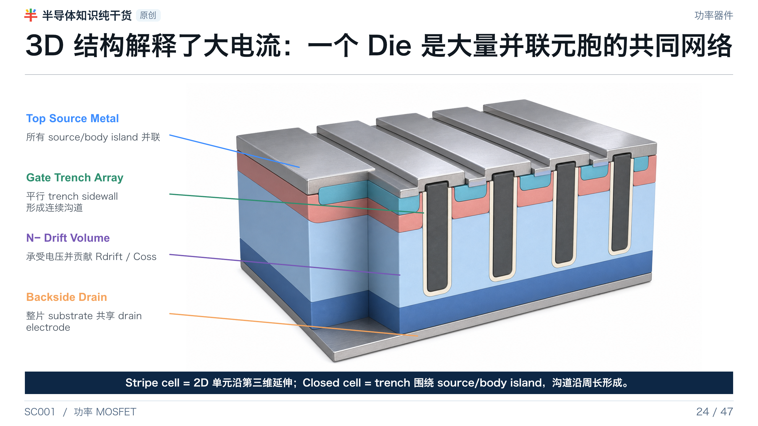
Notes:
[Presenter Notes]
- 2D 截面只是一小段；实际 die 由大量并联元胞组成。
- 所有 trench gate 通过 gate network/bus 相连，所有 source/body 由顶部金属相连，drain 为整个背面。
- 3D 生成图用于理解层次和重复性，并非产品尺寸或 mask 版图。
[Sources]
- US20040173844A1, die layout/gate bus/network: https://patents.google.com/patent/US20040173844A1/en
- US6204533B1, square/hexagonal/stripe trench cell geometry: https://patents.google.com/patent/US6204533B1/en
- Generated asset: OpenAI image generation, trench-mosfet-3d.png; final labels added as editable PowerPoint text.

Slide 25
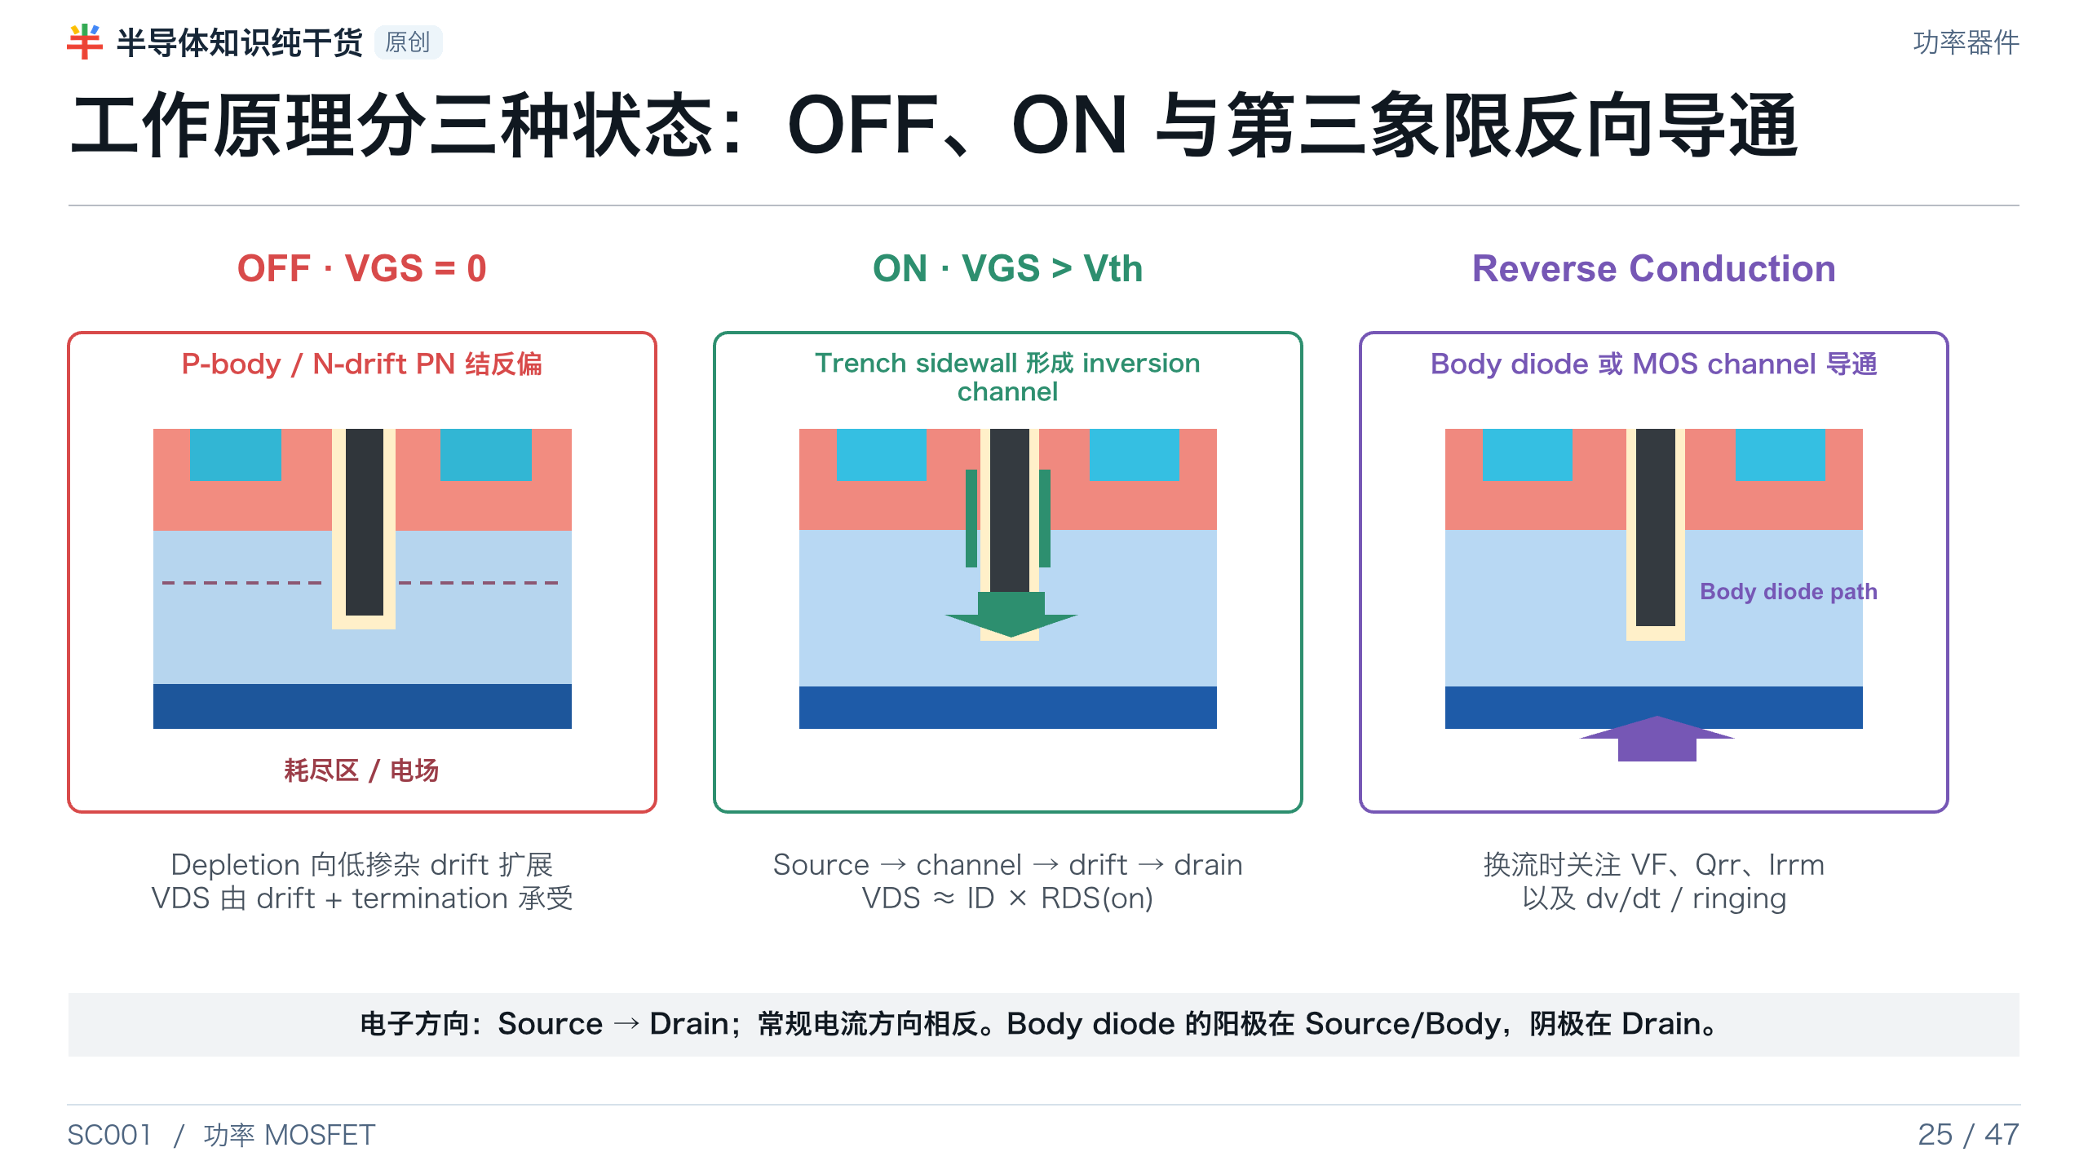
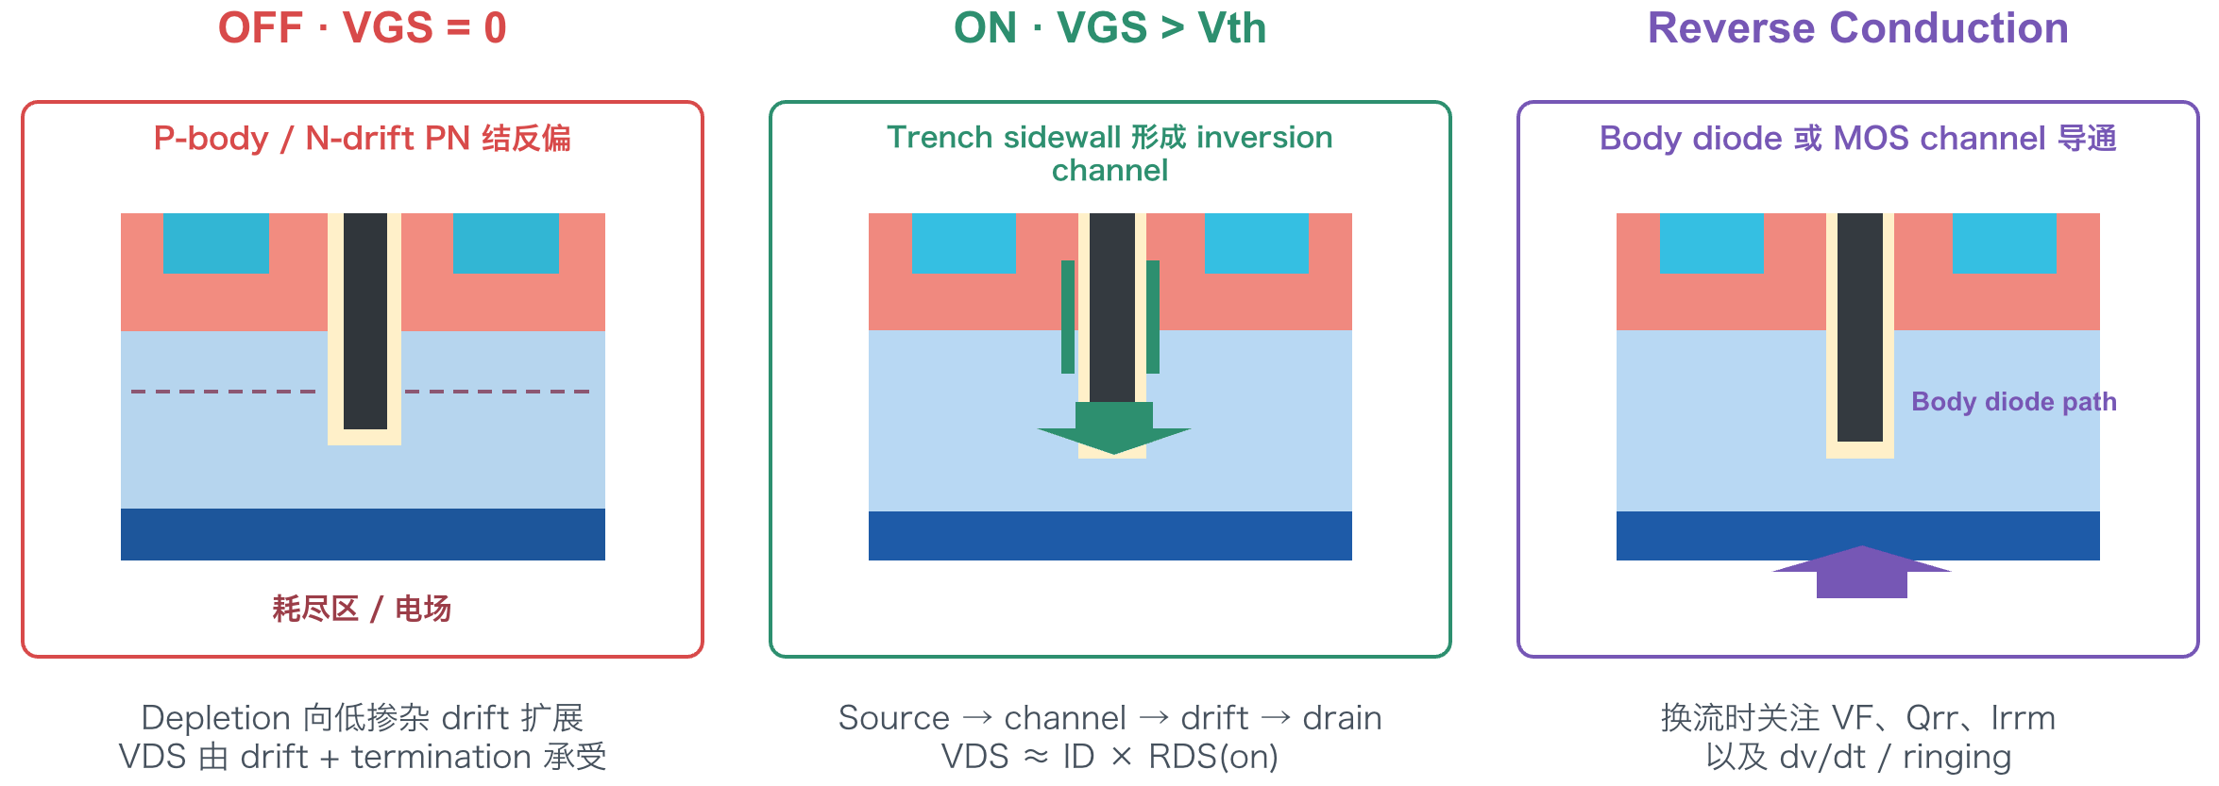
Notes:
[Presenter Notes]
- OFF：P-body 表面无 inversion channel，depletion region 在 drift 中展开。
- ON：正 VGS 在 trench sidewall 形成 N 型反型沟道，器件近似电阻。
- 第三象限：反向电流可先经 body diode；gate 打开后 MOS channel 也可双向导通。
[Sources]
- Toshiba, MOSFET Structure and Operation: https://toshiba.semicon-storage.com/us/semiconductor/knowledge/e-learning/discrete/chap3/chap3-7.html
- Nexperia AN11158, Understanding power MOSFET data sheet parameters: https://assets.nexperia.com/documents/application-note/AN11158.pdf

Slide 26
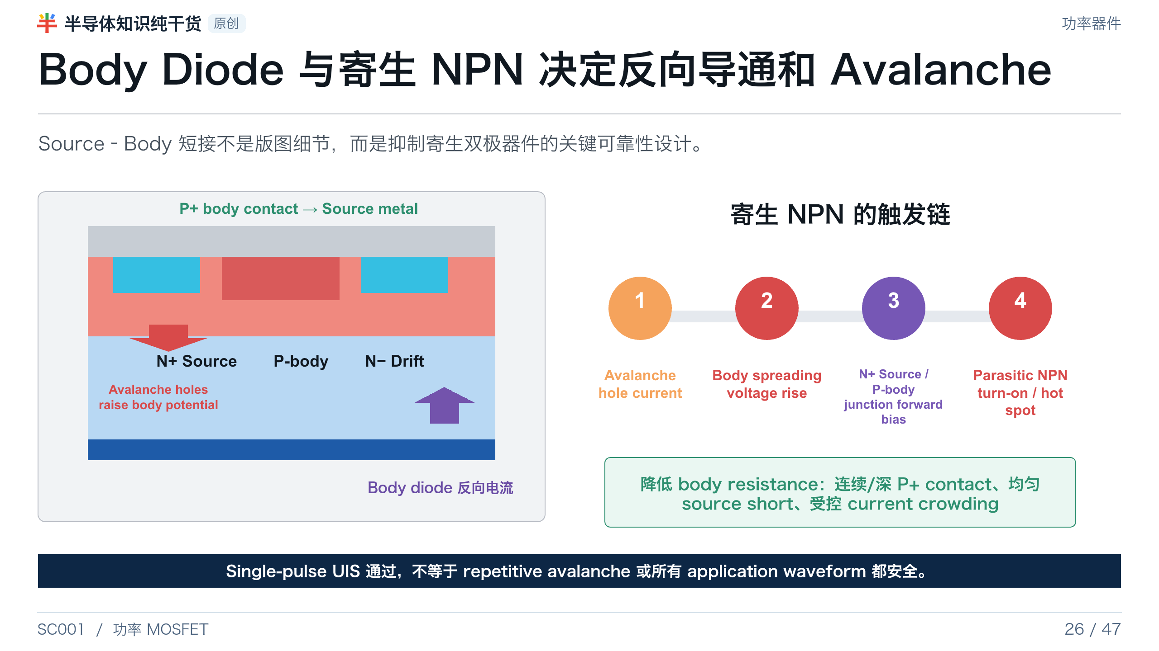
Notes:
[Presenter Notes]
- Body diode 的阳极在 source/body，阴极在 drain；反向恢复 Qrr 会影响半桥换流。
- Avalanche hole current 通过 P-body spreading resistance 产生压降，可能正向偏置 source/body junction 并触发寄生 NPN。
- P+ body contact、source short 与 current uniformity 是 UIS/SOA 设计和工艺的关键。
[Sources]
- Nexperia TN00008, Power MOSFET FAQ: https://assets.nexperia.com/documents/technical-note/TN00008.pdf
- onsemi AN-9034, Power MOSFET avalanche/UIS: https://www.onsemi.com/download/application-notes/pdf/an-9034.pdf
- Nexperia AN11158, Understanding power MOSFET data sheet parameters: https://assets.nexperia.com/documents/application-note/AN11158.pdf

Slide 27
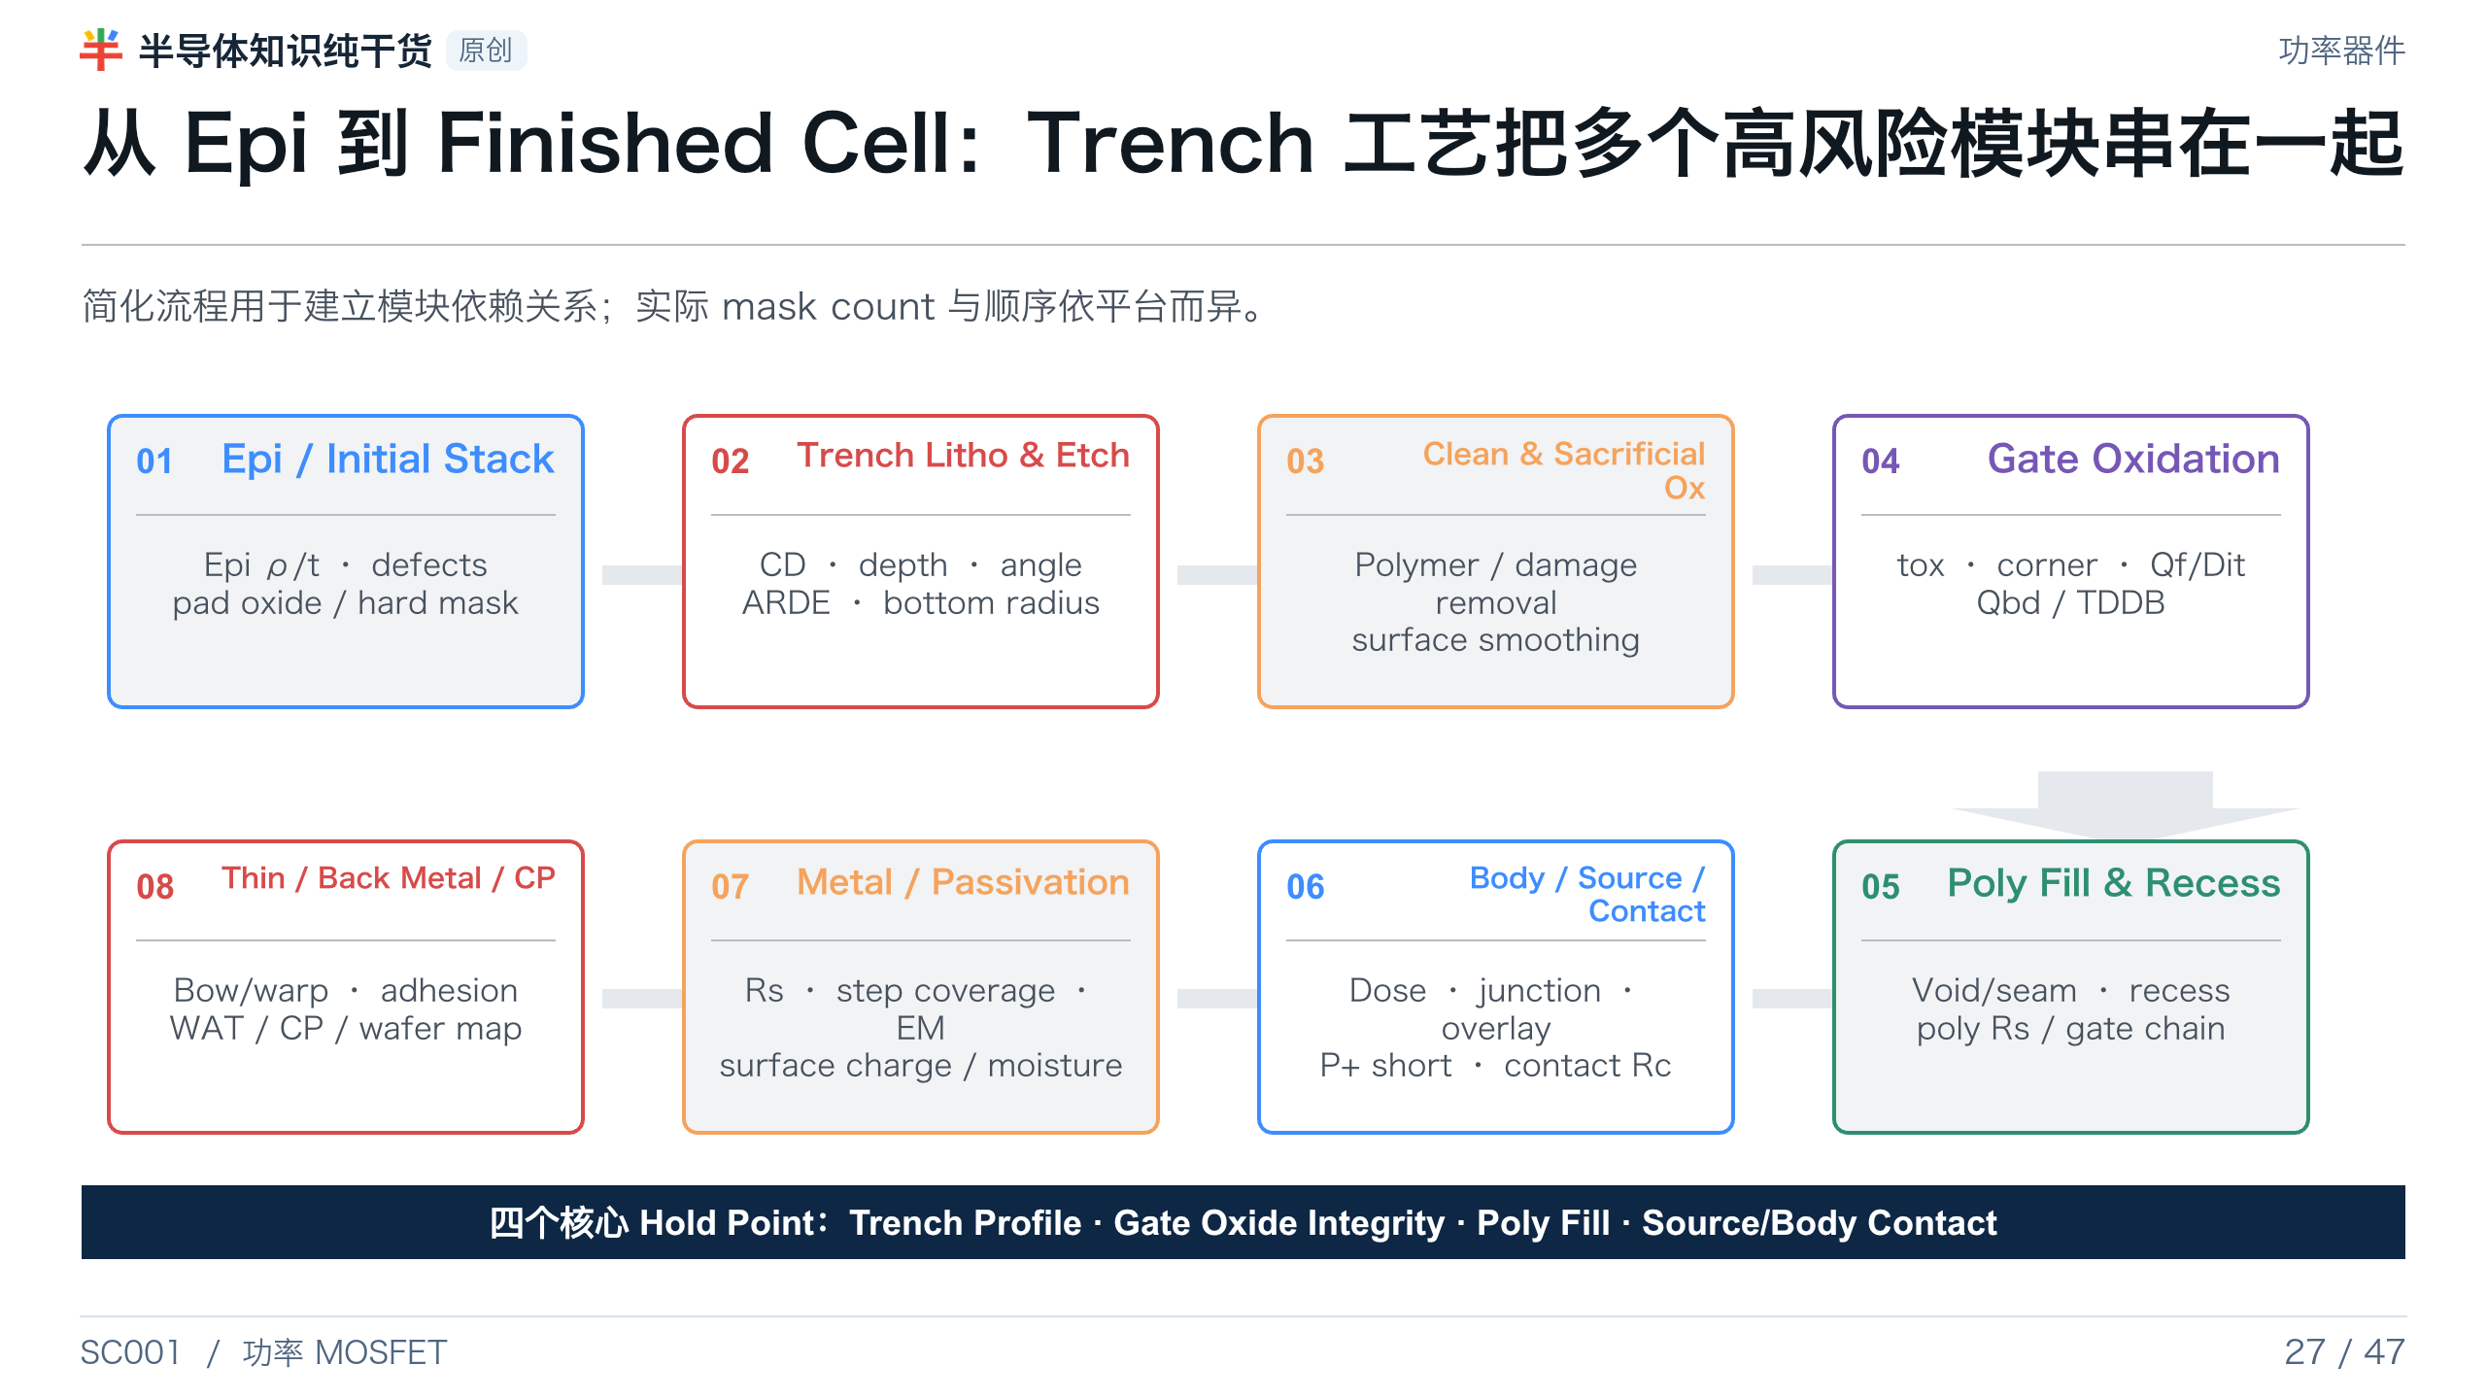
Notes:
[Presenter Notes]
- 流程是培训级简化，不代表任何特定 Fab 的专有 flow。
- 模块间强耦合：trench etch 与 clean 决定 oxide interface；trench taper 决定 poly fill；body/source 与 contact 决定 Vth、RDS(on) 与 UIS。
- 工艺整合 应在四个核心 Hold Point 建立 inline 与电性关联。
[Sources]
- Sidewall Modification Process for Trench Silicon Power Devices: https://www.mdpi.com/2079-9292/12/11/2385
- Trench Power MOSFET TDDB methodology: https://doi.org/10.1016/j.microrel.2015.11.021
- Toshiba, trench field-plate process optimization/poly fill/warpage: https://toshiba.semicon-storage.com/content/dam/toshiba-ss-v3/master/en/company/technical-review/pdf/issm2020_2.pdf

Slide 28
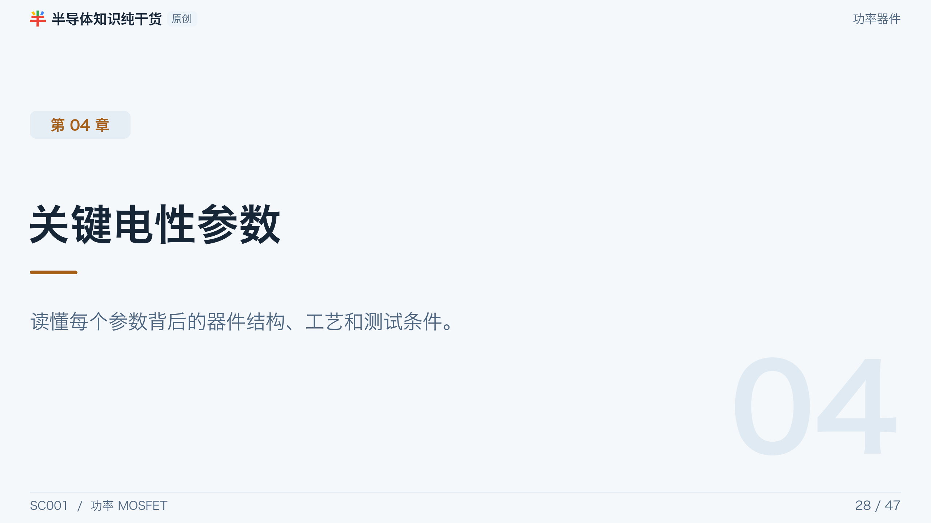
Notes:
[Presenter Notes]
- 参数不是 datasheet 名词表；每个分布背后都有结构、工艺和测试条件。
[Sources]
- No external source; section divider or original synthesis.

Slide 29
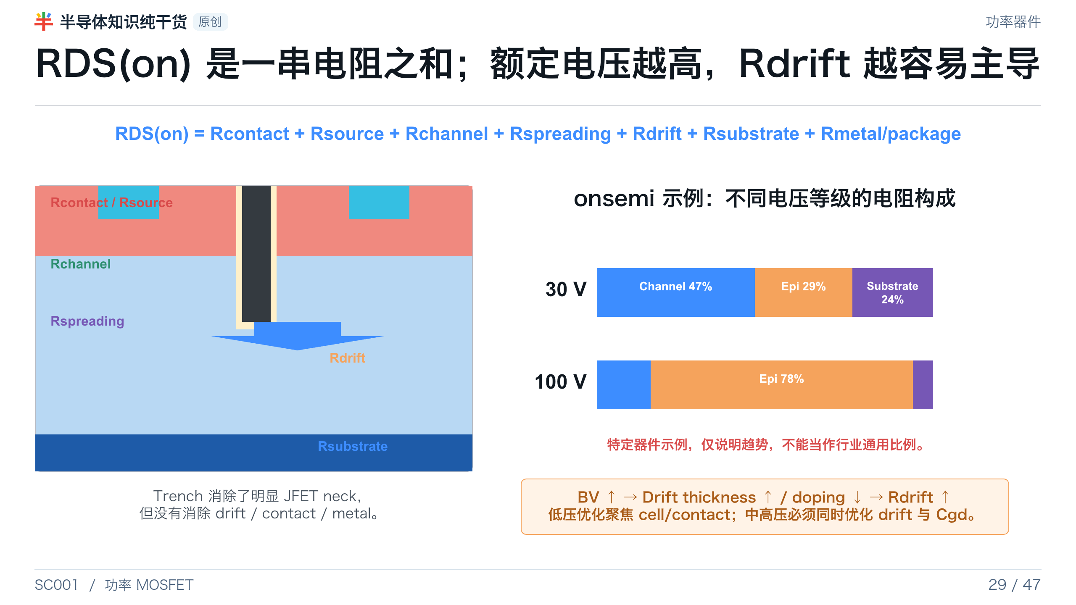
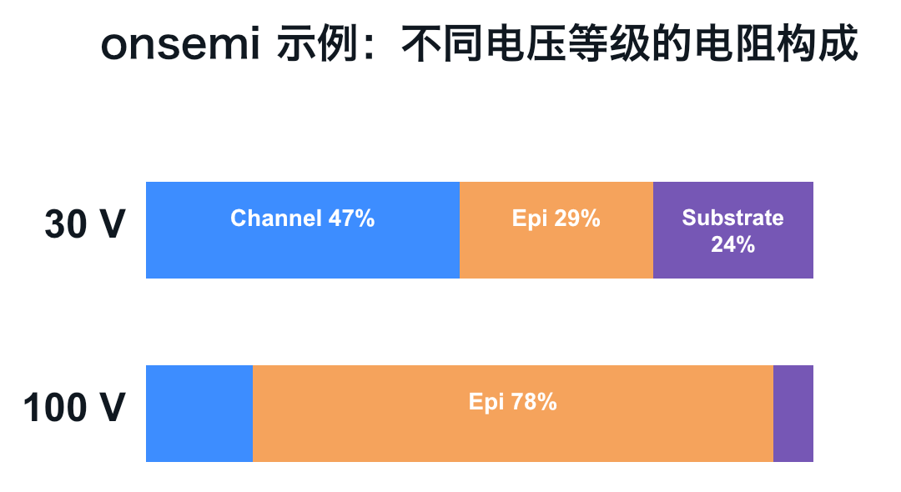
Notes:
[Presenter Notes]
- RDS(on) 必须在指定 VGS、ID、Tj 条件下比较。
- onsemi 30 V/100 V 的电阻占比是特定示例，主要用来说明额定电压升高后 epi/drift contribution 上升。
- 低阻 cell 不能弥补过高 contact、substrate、metal 或 package resistance。
[Sources]
- onsemi AN-4158, Shielded Gate PowerTrench technology: https://www.onsemi.com/download/application-notes/pdf/an-4158.pdf
- Toshiba, factors determining RDS(on): https://toshiba.semicon-storage.com/us/semiconductor/knowledge/e-learning/discrete/chap3/chap3-8.html

Slide 30
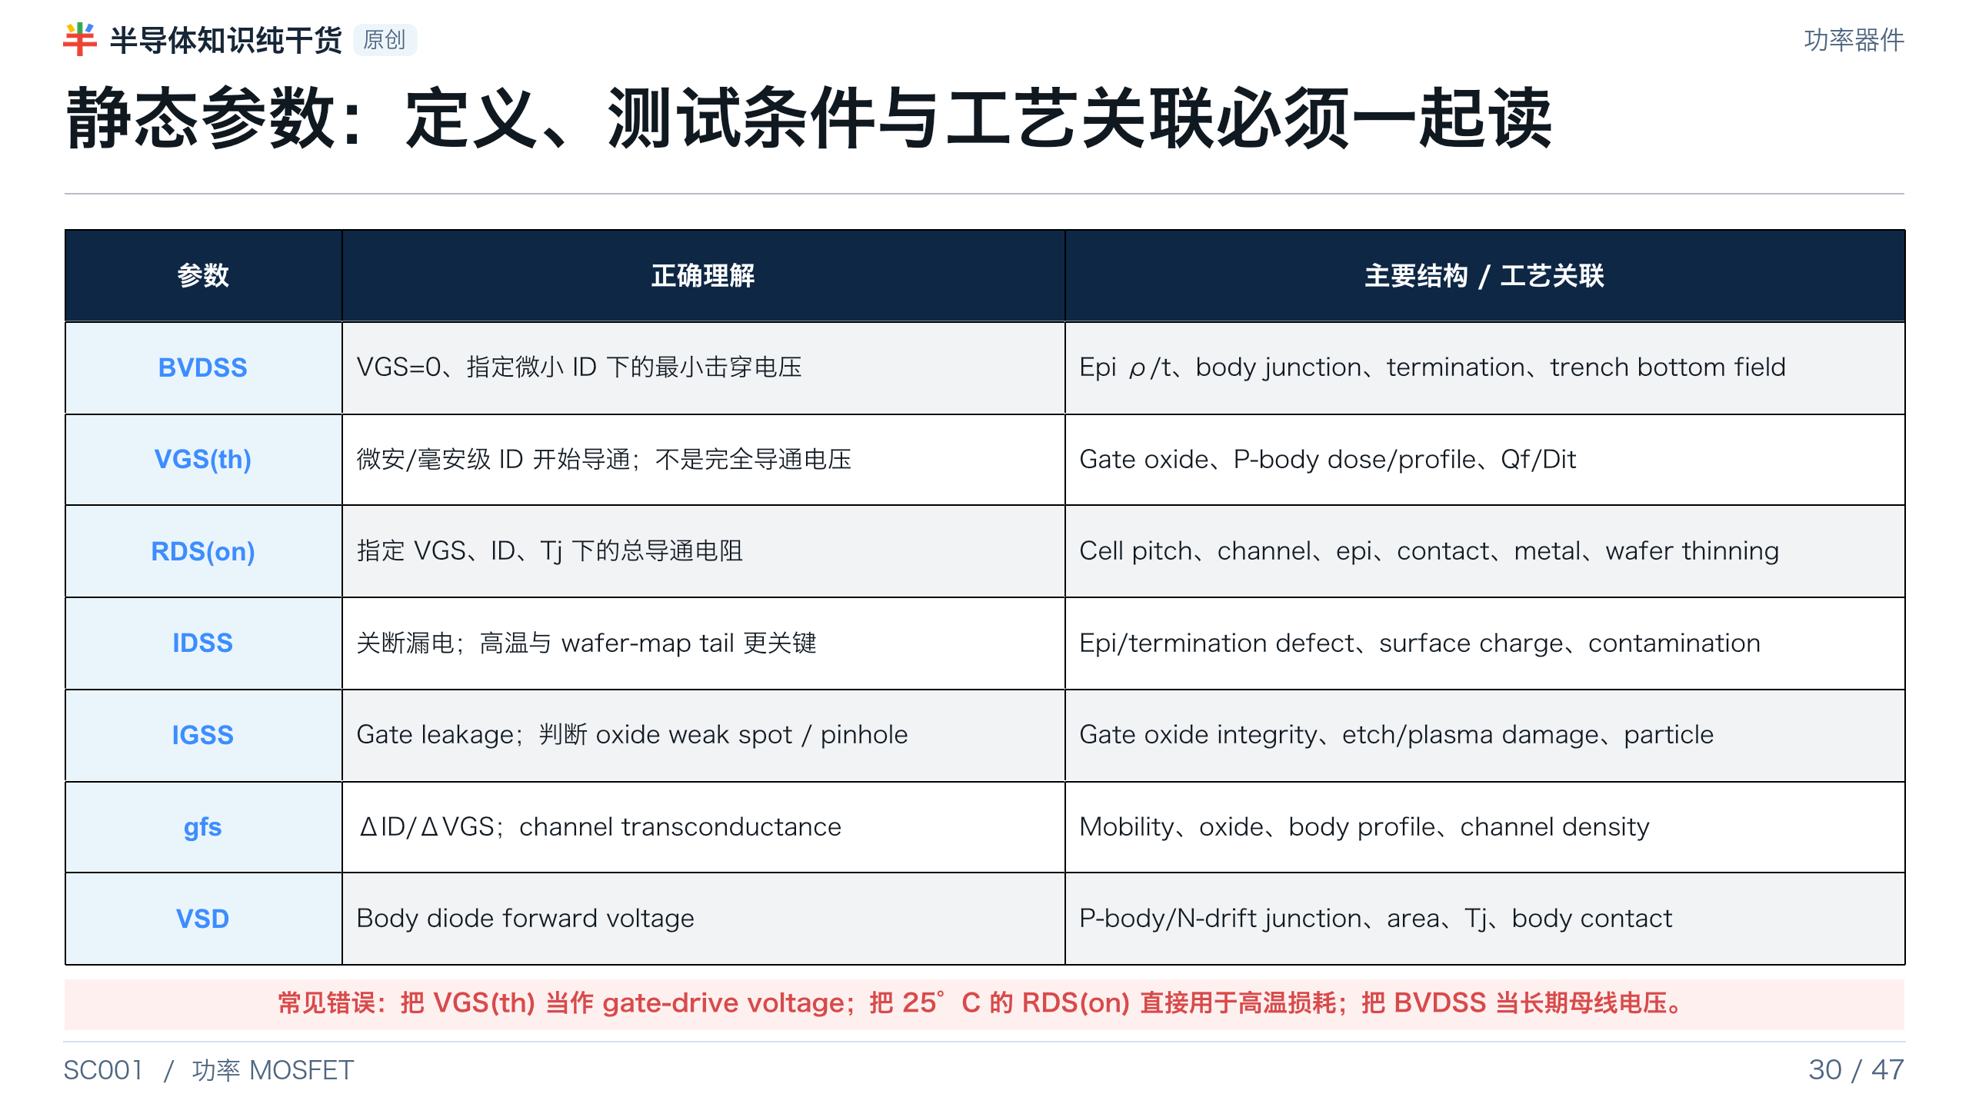
Notes:
[Presenter Notes]
- 所有静态参数都必须带测试条件；尤其是 VGS(th)、RDS(on)、IDSS 和 BVDSS。
- 高温 leakage 与 wafer map tail 往往比 room-temperature lot average 更能暴露制程风险。
[Sources]
- Nexperia AN11158, Understanding power MOSFET data sheet parameters: https://assets.nexperia.com/documents/application-note/AN11158.pdf
- onsemi AN-4163, Shielded Gate PowerTrench datasheet explanation: https://www.onsemi.com/download/application-notes/pdf/an-4163.pdf

Slide 31
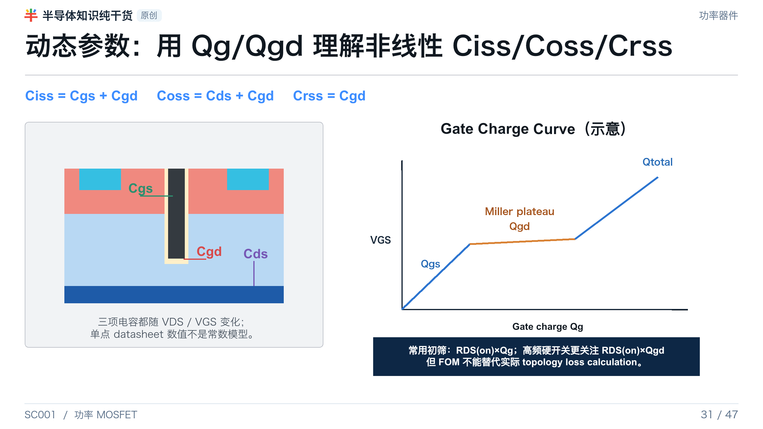
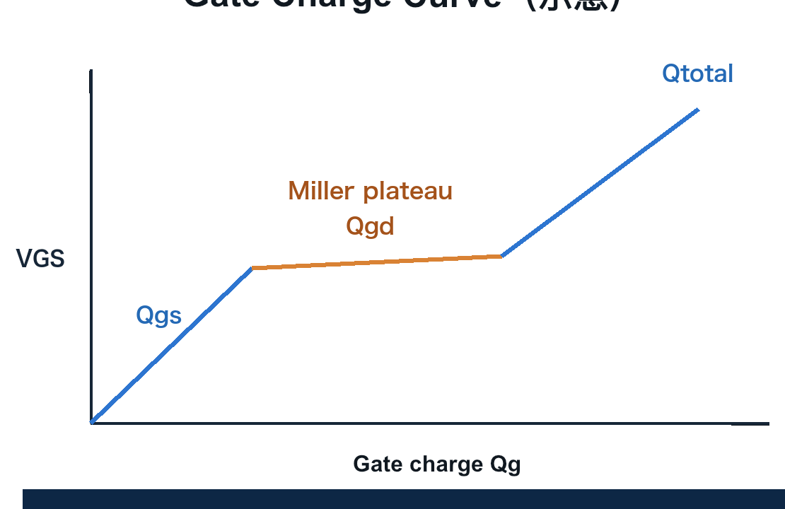
Notes:
[Presenter Notes]
- Qg/Qgd 往往比单点 Ciss/Crss 更直接反映 driver 需要和 Miller period。
- 更大 die 或更高 cell density 通常降低 RDS(on)，同时提高 intrinsic capacitance 与 total Qg。
- Shielded gate 主要降低 Cgd/Crss/Qgd，并不自动降低所有电容。
[Sources]
- Nexperia AN11158, Understanding power MOSFET data sheet parameters: https://assets.nexperia.com/documents/application-note/AN11158.pdf
- onsemi AN-4163, Shielded Gate PowerTrench datasheet explanation: https://www.onsemi.com/download/application-notes/pdf/an-4163.pdf
- onsemi AN-4158, Shielded Gate PowerTrench technology: https://www.onsemi.com/download/application-notes/pdf/an-4158.pdf

Slide 32
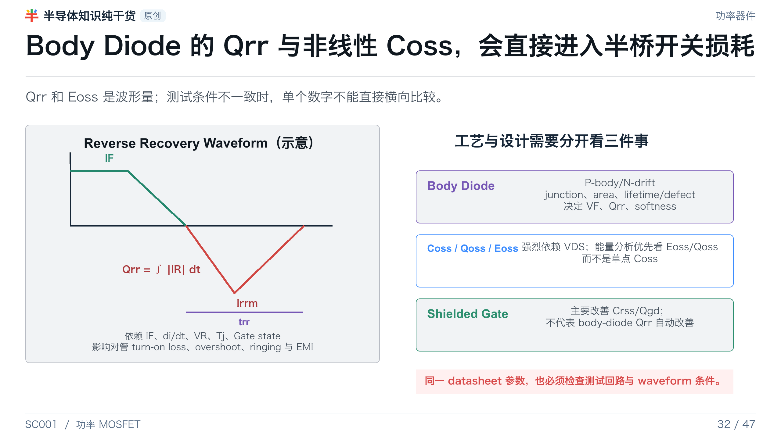
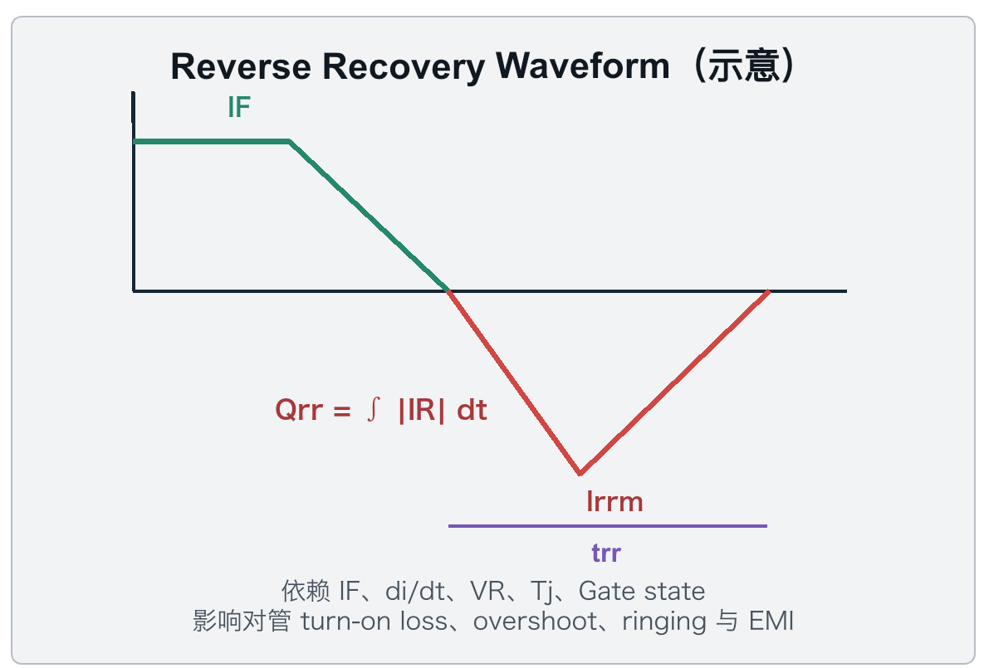
Notes:
[Presenter Notes]
- Qrr 是 reverse current 的积分，强烈依赖前向电流、di/dt、反压、温度与 gate state。
- Coss 是非线性电容；用于损耗时优先采用 Eoss/Qoss 曲线或实际 switching test。
- Fab 关联包括 body/epi defect、junction profile、cell area 与 body contact；shielded gate 不是 Qrr 的直接解决方案。
[Sources]
- Nexperia AN11158, Understanding power MOSFET data sheet parameters: https://assets.nexperia.com/documents/application-note/AN11158.pdf
- onsemi AN-4163, Shielded Gate PowerTrench datasheet explanation: https://www.onsemi.com/download/application-notes/pdf/an-4163.pdf

Slide 33
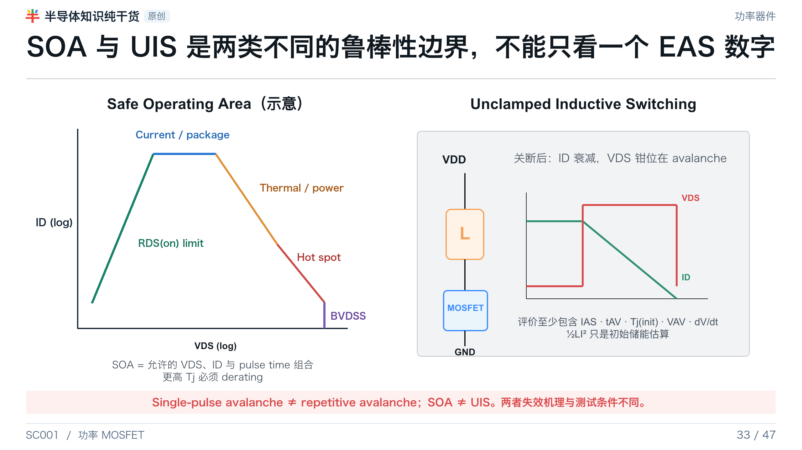
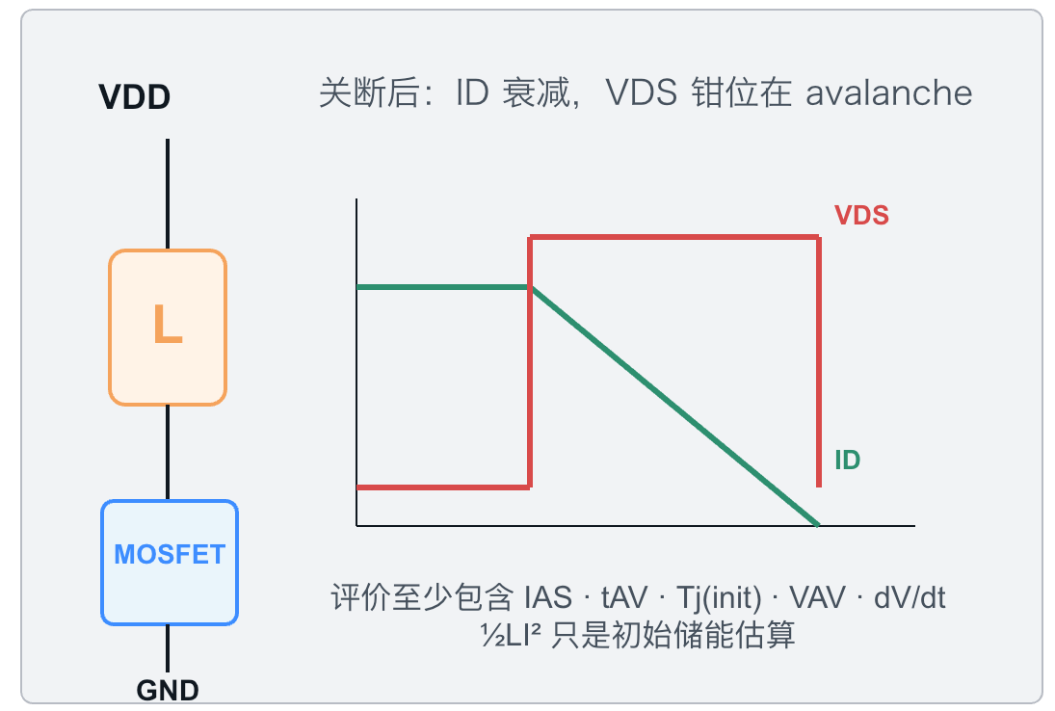
Notes:
[Presenter Notes]
- SOA 是 VDS、ID、pulse time、初始温度与安装条件的组合边界；包含 thermal instability / hot-spot 限制。
- UIS 评价感性负载关断后的 avalanche，不能只用 EAS 一个数字判断。
- 结构/工艺关联包括 body contact、epi/termination、trench-bottom field、metal/current uniformity 与热分布。
[Sources]
- Nexperia AN11158, Understanding power MOSFET data sheet parameters: https://assets.nexperia.com/documents/application-note/AN11158.pdf
- onsemi AN-9034, Power MOSFET avalanche/UIS: https://www.onsemi.com/download/application-notes/pdf/an-9034.pdf
- onsemi AN-4161, trench MOSFET linear-mode stability: https://www.onsemi.com/download/application-notes/pdf/an-4161.pdf

Slide 34
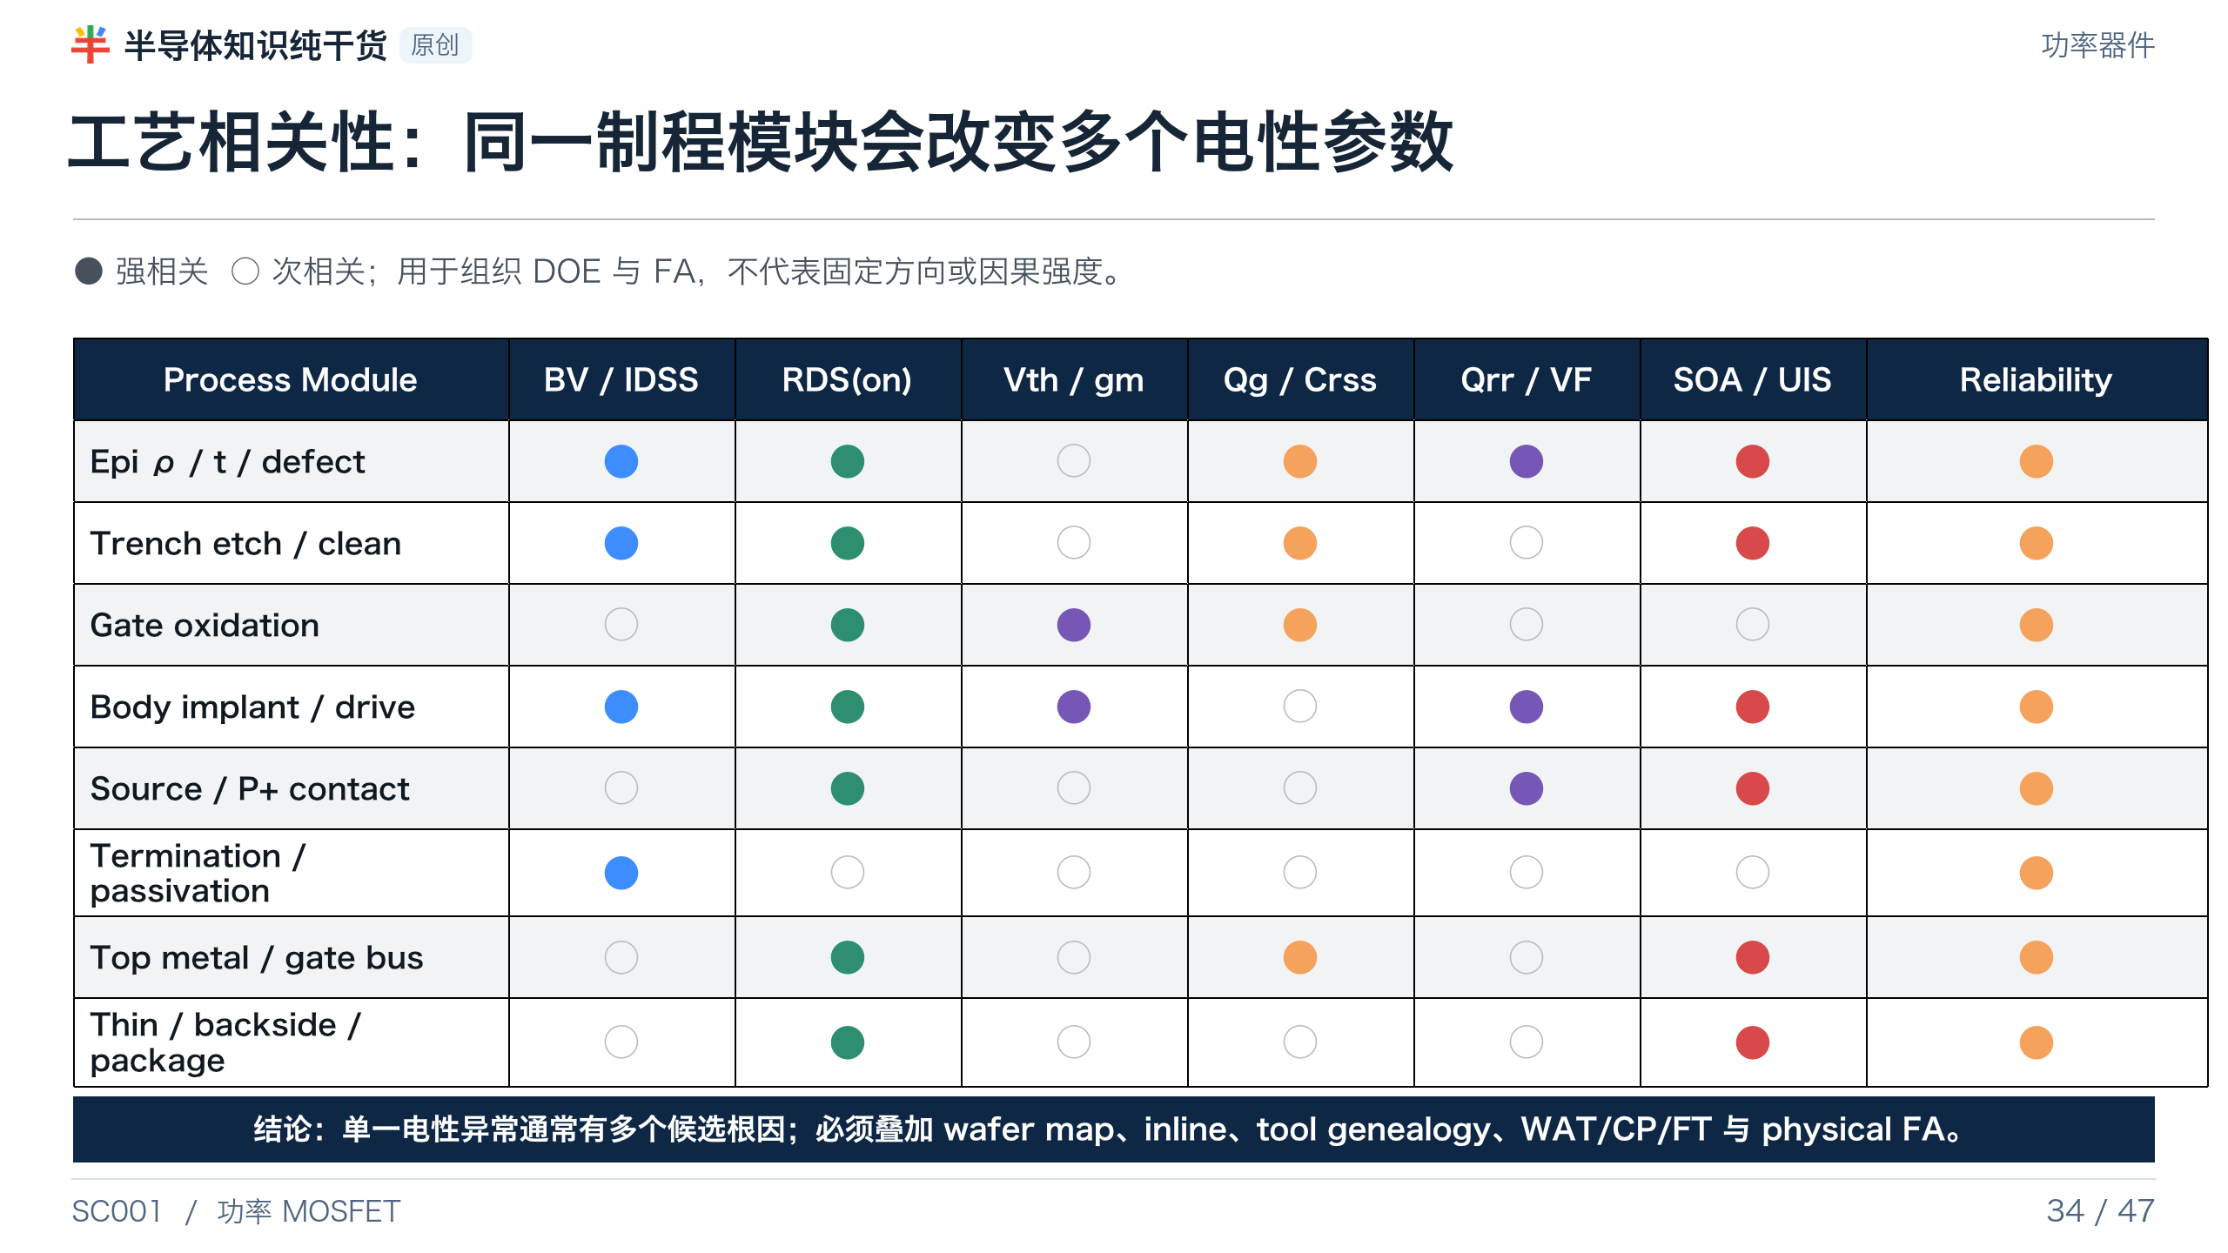
Notes:
[Presenter Notes]
- 矩阵用于建立 multi-response DOE 与 failure analysis 路径。
- 不要用单一参数反推出唯一工艺根因；例如 High RDS(on) 可能来自 channel、epi、contact、metal、backside 或测量。
[Sources]
- onsemi AN-4158, Shielded Gate PowerTrench technology: https://www.onsemi.com/download/application-notes/pdf/an-4158.pdf
- Nexperia AN11158, Understanding power MOSFET data sheet parameters: https://assets.nexperia.com/documents/application-note/AN11158.pdf
- Sidewall Modification Process for Trench Silicon Power Devices: https://www.mdpi.com/2079-9292/12/11/2385
- Trench Power MOSFET TDDB methodology: https://doi.org/10.1016/j.microrel.2015.11.021

Slide 35
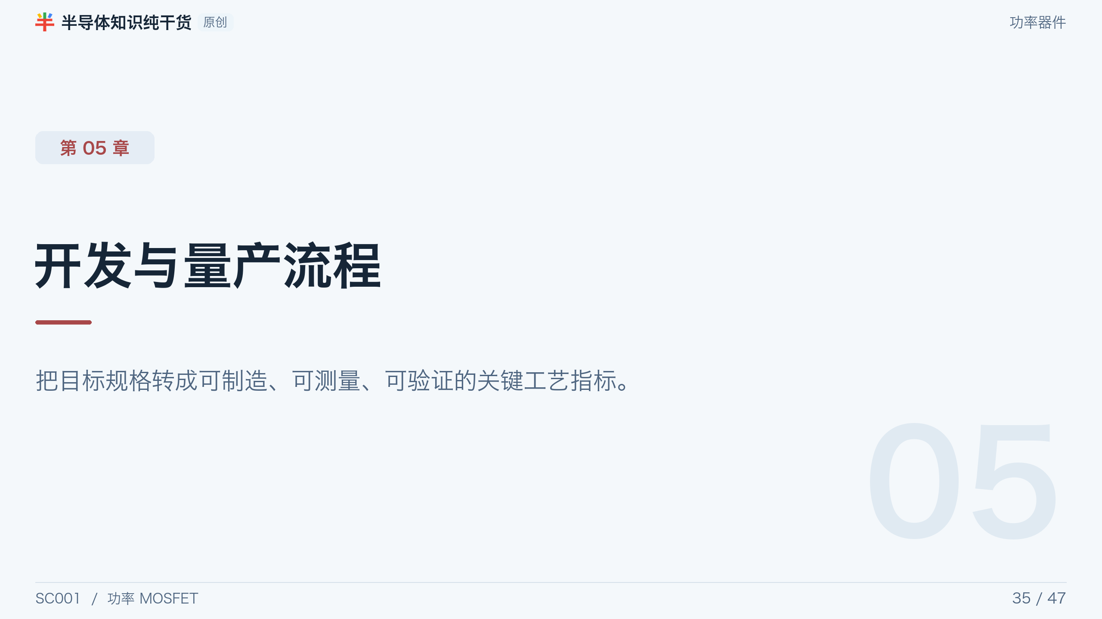
Notes:
[Presenter Notes]
- 把 Target Spec 转成可制造、可测量、可验证、可稳定量产的 Process CTQ。
[Sources]
- No external source; section divider or original synthesis.

Slide 36
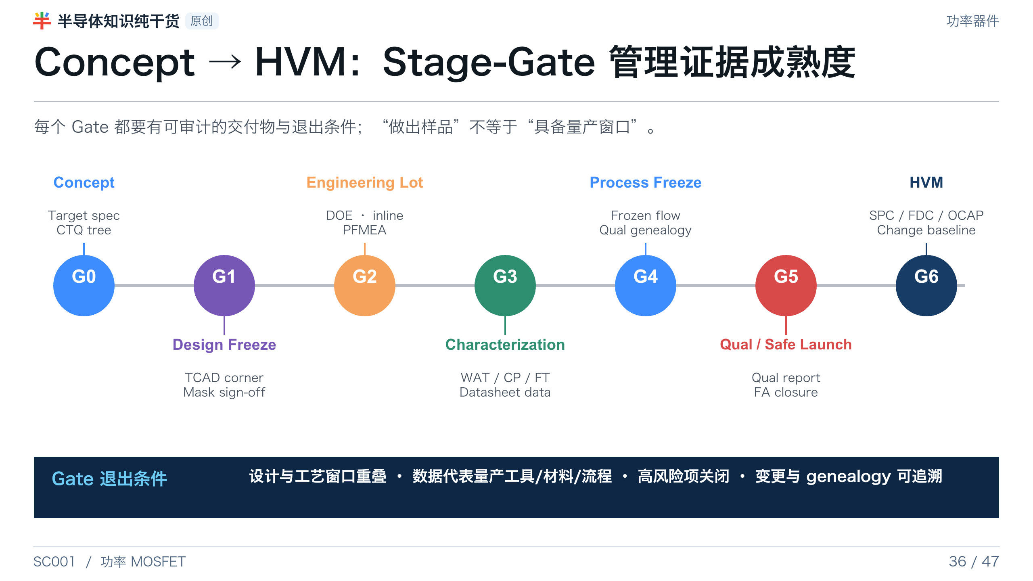
Notes:
[Presenter Notes]
- Stage-Gate 的本质是随着项目推进提高证据成熟度：从模拟可行到模块可重复、全流程相关、qual representative、HVM stable。
- Gate 条件必须定义在项目启动时，并在设计/流程重大变化后重新评估。
[Sources]
- AEC-Q101 Rev.E: https://www.aecouncil.com/Documents/AEC_Q101_Rev_E_Base_Document.pdf
- Synopsys, TCAD Process Simulation: https://www.synopsys.com/manufacturing/tcad/process-simulation.html

Slide 37
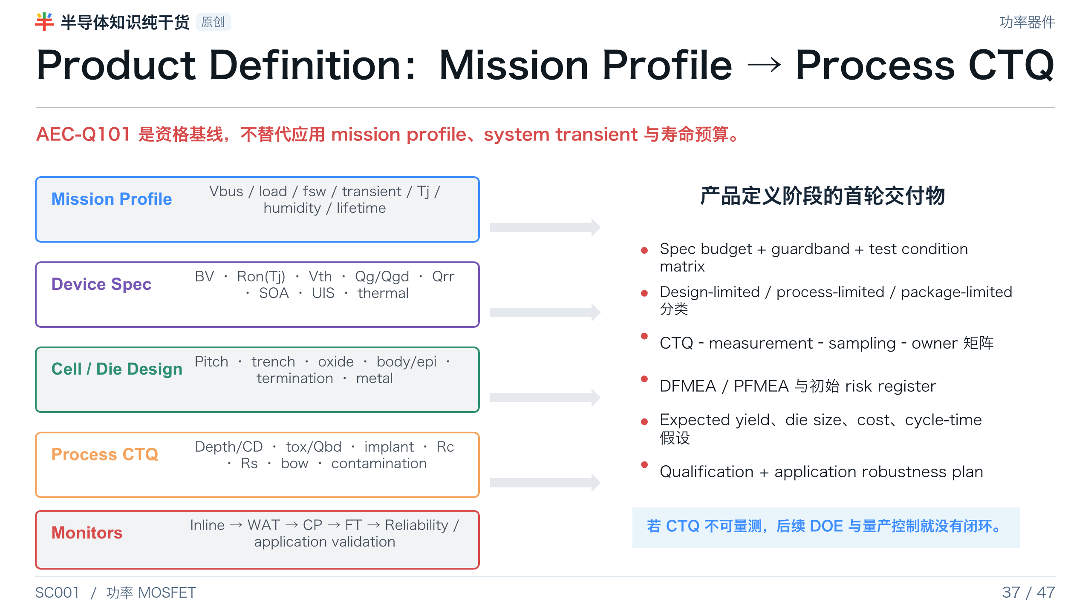
Notes:
[Presenter Notes]
- Target spec 必须包含测试条件、温度和 mission profile，而不仅是 datasheet maximum ratings。
- 工艺整合 要把每个 device target 分解到可测量 CTQ，并明确 monitor、sampling、owner 和 reaction plan。
- AEC-Q101 qualification 不替代具体客户和应用的 mission-profile assessment。
[Sources]
- AEC-Q101 Rev.E: https://www.aecouncil.com/Documents/AEC_Q101_Rev_E_Base_Document.pdf
- Automotive Electronics Council documents index: https://www.aecouncil.com/AECDocuments.html

Slide 38
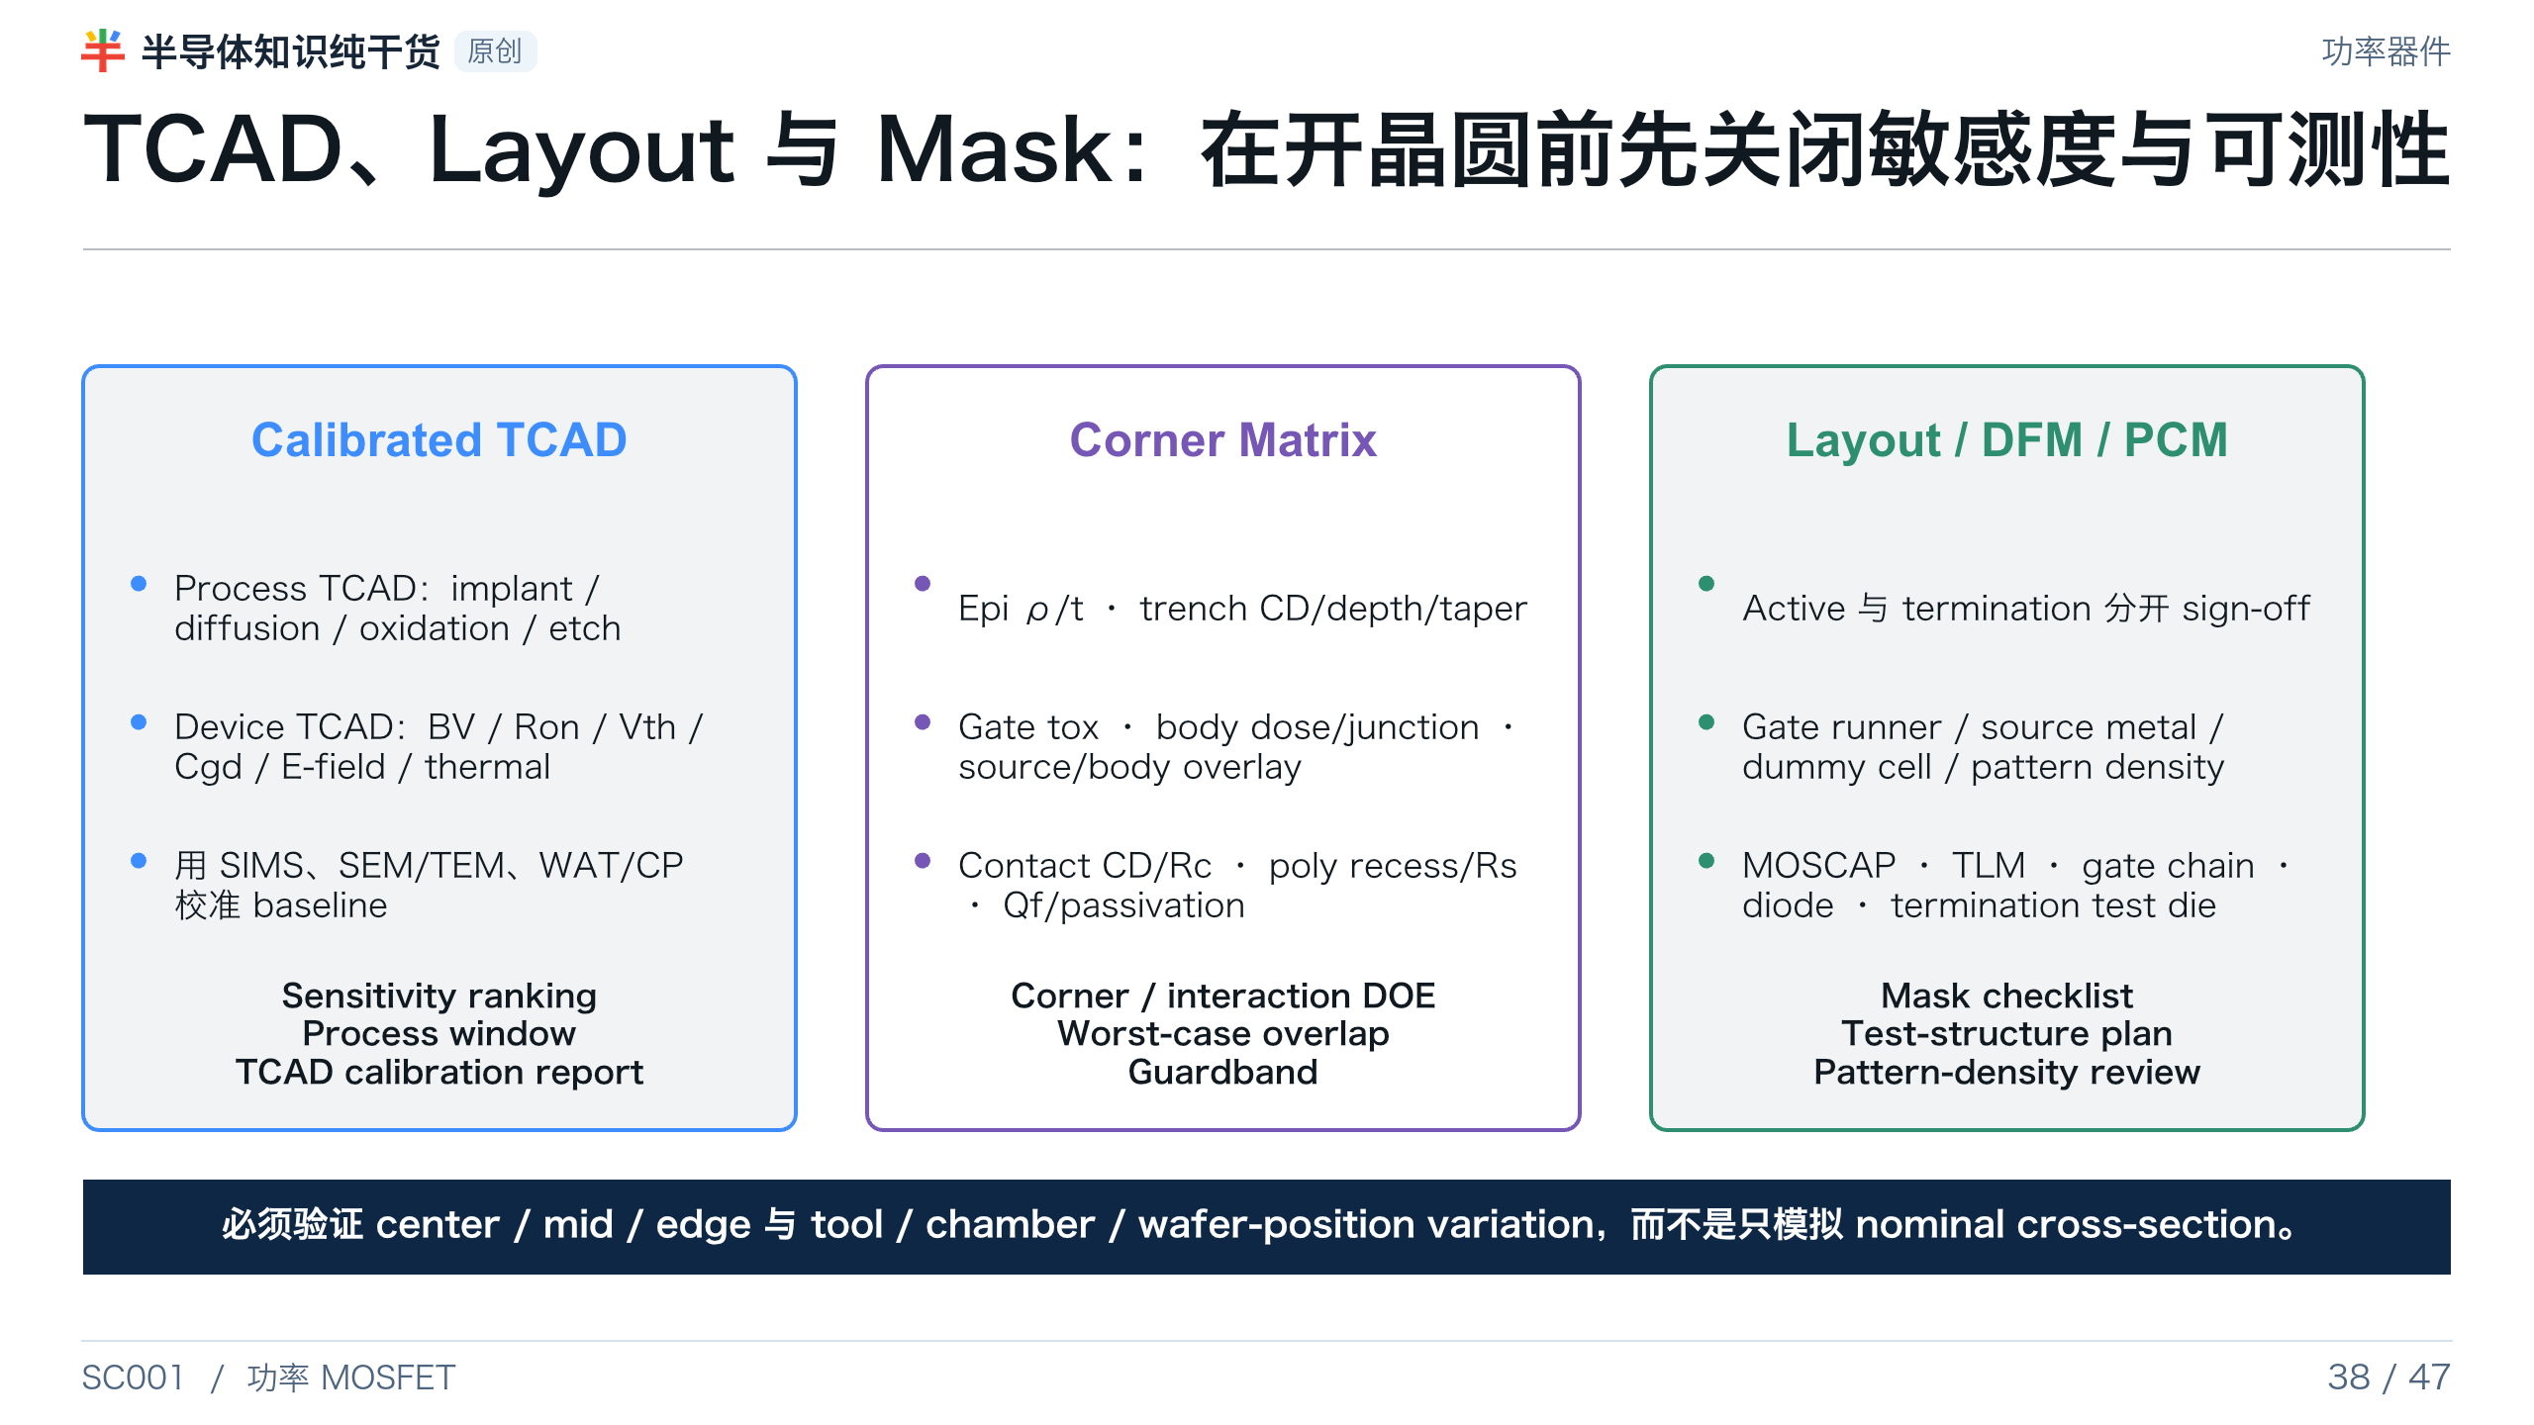
Notes:
[Presenter Notes]
- TCAD 只有经过 baseline wafer 数据校准才适合做 process-corner prediction。
- Layout sign-off 除了 active cell，还要检查 termination、gate network、metal current density、dummy cell、scribe lane 与 test structures。
- Process monitor 要在设计时嵌入，而不是电性异常后再补。
[Sources]
- Synopsys, TCAD Process Simulation: https://www.synopsys.com/manufacturing/tcad/process-simulation.html
- US20040173844A1, die layout/gate bus/network: https://patents.google.com/patent/US20040173844A1/en
- US5614751A, trench termination/field plate/channel stop: https://patents.google.com/patent/US5614751A/en

Slide 39
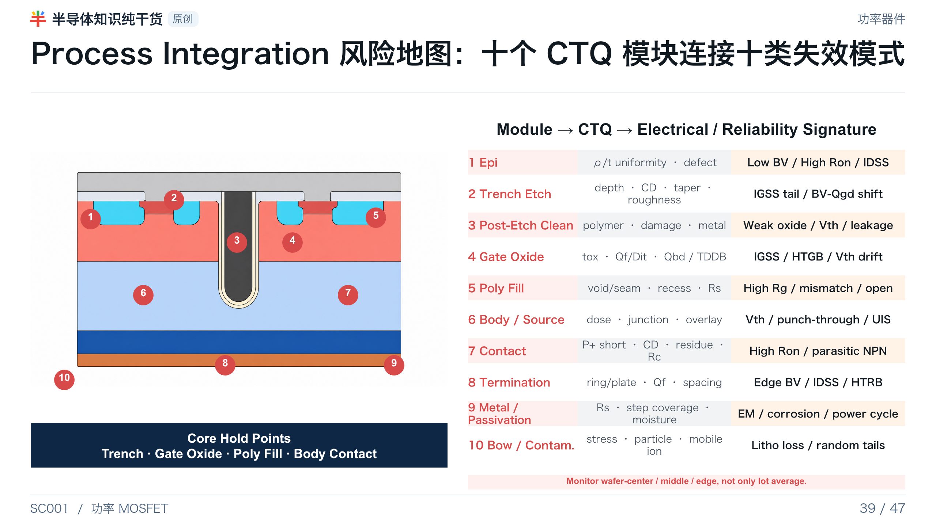
Notes:
[Presenter Notes]
- 风险地图用于 review 与 control-plan completeness，不代表所有问题都能靠单一 inline monitor 捕获。
- Trench etch sidewall damage、post-etch polymer 和 oxide corner nonuniformity 会形成 extrinsic GOI population。
- Poly fill/taper 与 wafer stress/bow 应在 process integration 中联合考虑。
[Sources]
- Sidewall Modification Process for Trench Silicon Power Devices: https://www.mdpi.com/2079-9292/12/11/2385
- Trench Power MOSFET TDDB methodology: https://doi.org/10.1016/j.microrel.2015.11.021
- Toshiba, trench field-plate process optimization/poly fill/warpage: https://toshiba.semicon-storage.com/content/dam/toshiba-ss-v3/master/en/company/technical-review/pdf/issm2020_2.pdf
- SEMI, particle and contamination control: https://www.semi.org/en/standards-watch-2023-jun/setting-the-standard-advancing-test-methods-for-particle-and-contamination-analysis
- Generated asset: OpenAI image generation, trench-mosfet-2d.png; numbered risk markers added in PowerPoint.

Slide 40
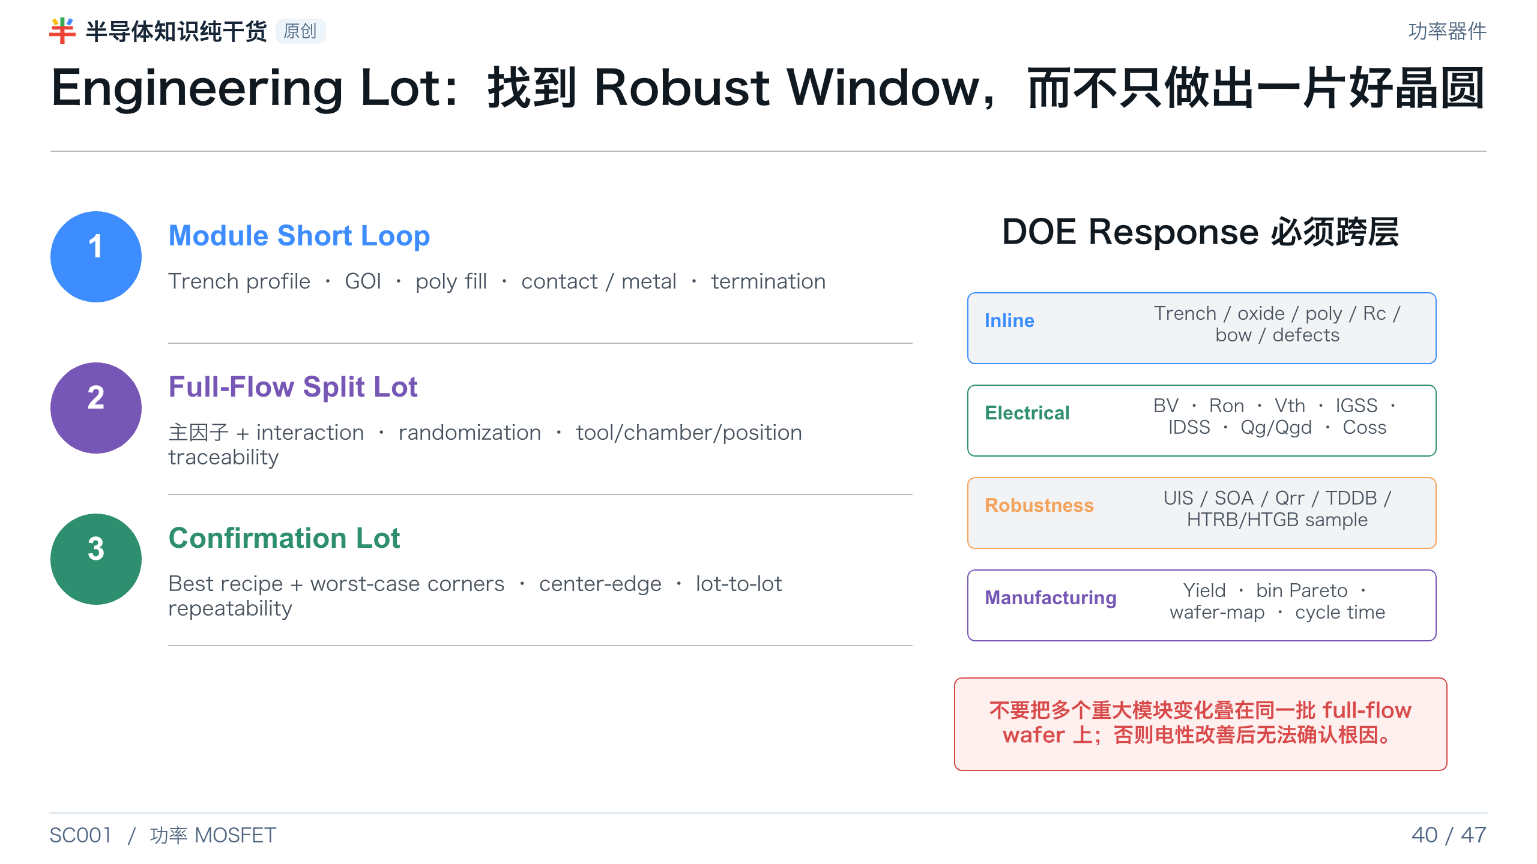
Notes:
[Presenter Notes]
- DOE 要覆盖 interaction、wafer position、tool/chamber 与 lot-to-lot，而不是只做 nominal one-factor-at-a-time。
- Module short loop 用于快速建立局部窗口；full-flow 验证跨模块耦合；confirmation lot 验证 worst case 和 repeatability。
- 响应必须包含 inline、electrical、robustness 和 manufacturing 四层。
[Sources]
- Synopsys, TCAD Process Simulation: https://www.synopsys.com/manufacturing/tcad/process-simulation.html
- Sidewall Modification Process for Trench Silicon Power Devices: https://www.mdpi.com/2079-9292/12/11/2385
- Trench Power MOSFET TDDB methodology: https://doi.org/10.1016/j.microrel.2015.11.021
- Toshiba, trench field-plate process optimization/poly fill/warpage: https://toshiba.semicon-storage.com/content/dam/toshiba-ss-v3/master/en/company/technical-review/pdf/issm2020_2.pdf

Slide 41
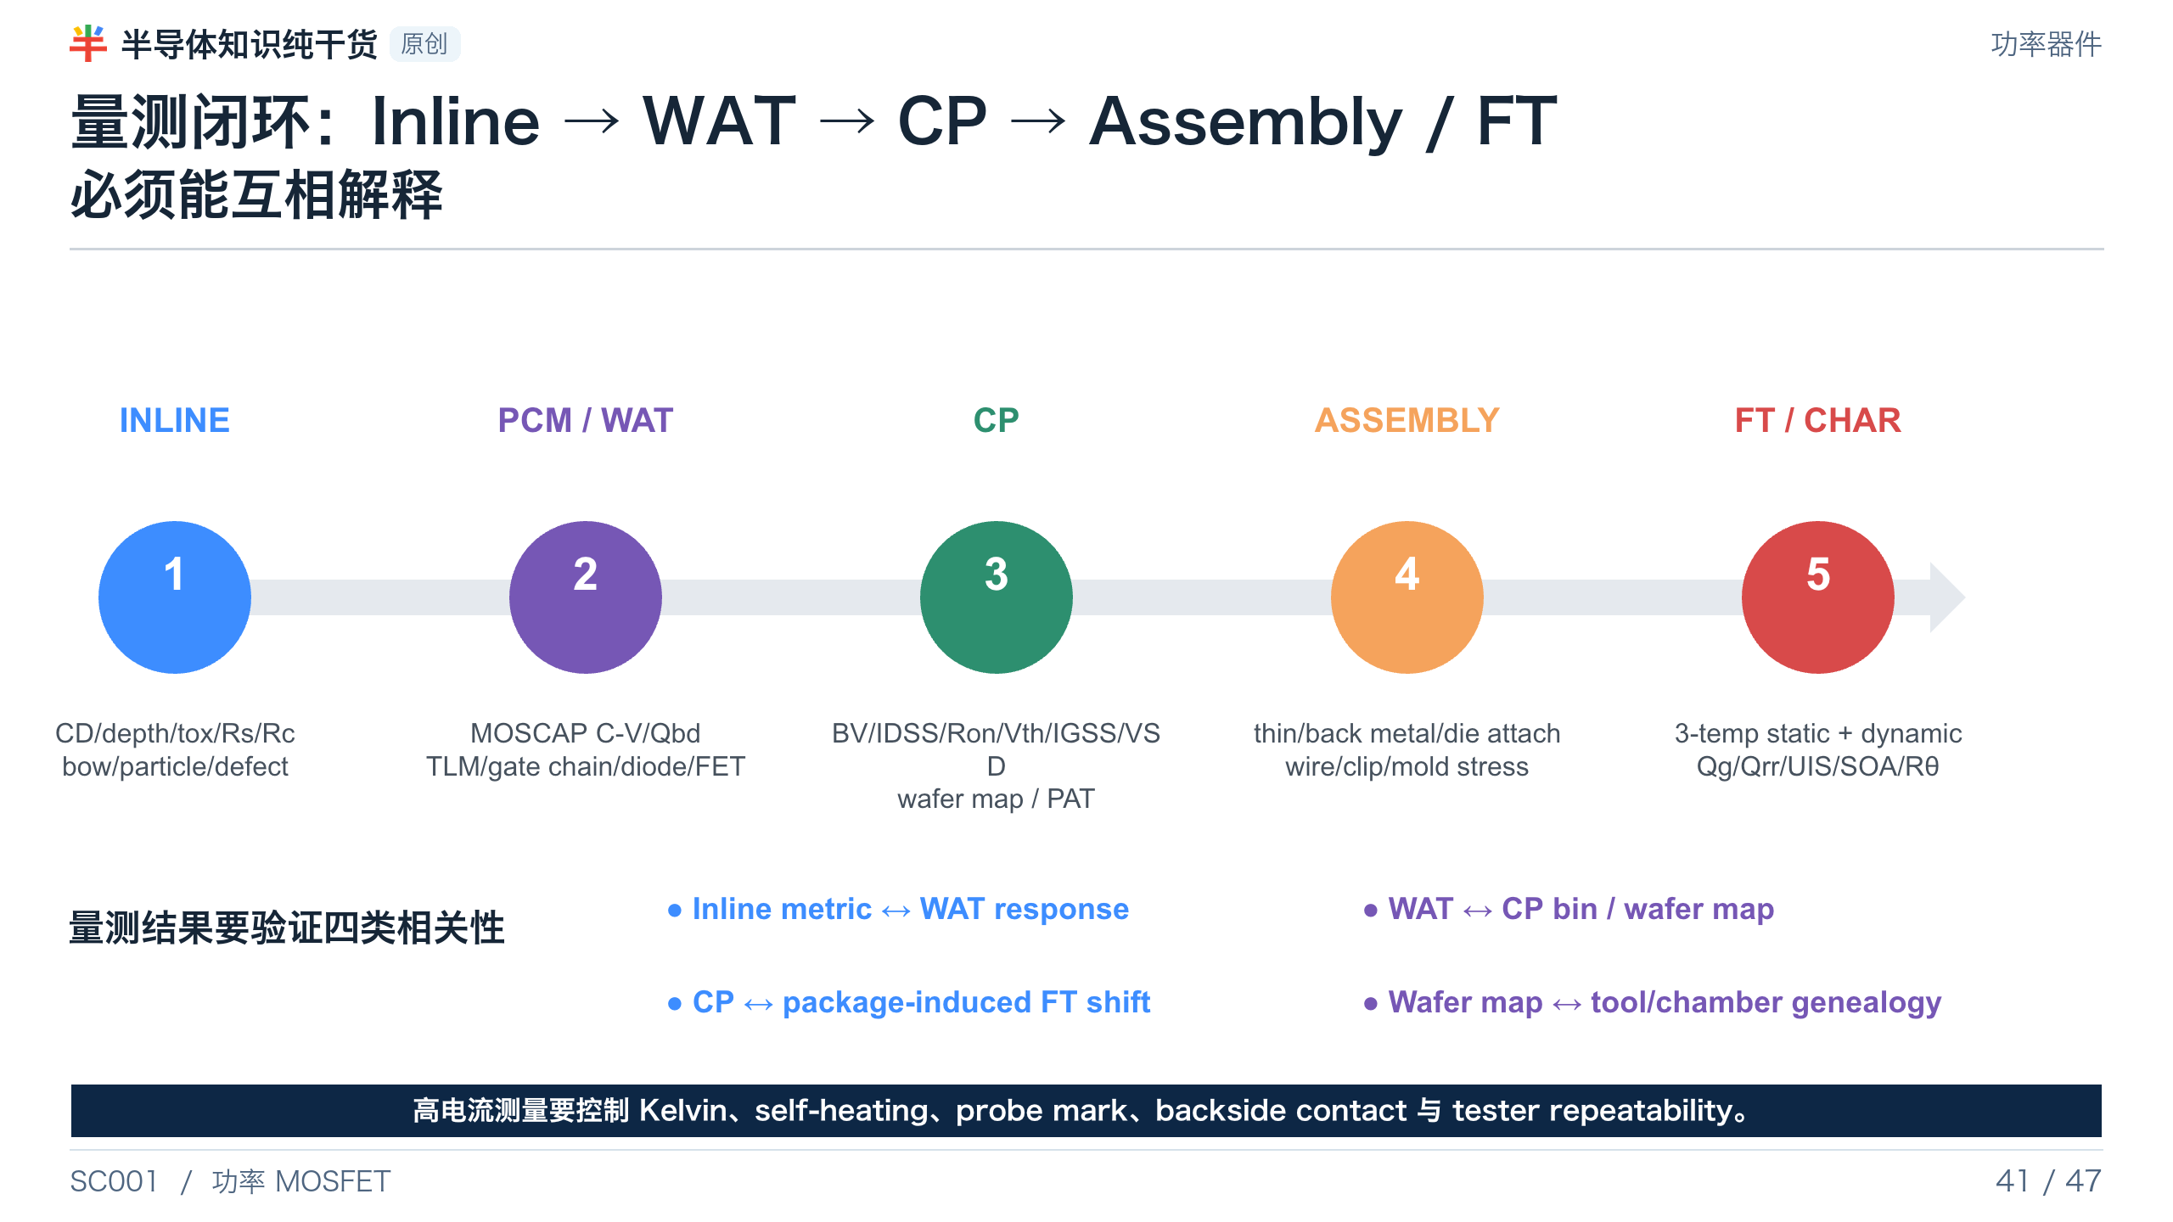
Notes:
[Presenter Notes]
- Inline、WAT、CP、FT 是不同粒度和不同物理层次的数据，必须建立可解释的 correlation，而不只是分别过 spec。
- 动态参数通常做 sample characterization；高电流 Ron 测试要特别控制 self-heating 与接触。
- Package stress 可能引起 Vth、BV、Ron、IGSS shift，需要 CP–FT correlation。
[Sources]
- AEC-Q101 Rev.E: https://www.aecouncil.com/Documents/AEC_Q101_Rev_E_Base_Document.pdf
- Nexperia AN11158, Understanding power MOSFET data sheet parameters: https://assets.nexperia.com/documents/application-note/AN11158.pdf
- Infineon MOSFET Product Qualification Report example: https://www.infineon.com/assets/row/public/documents/24/316/infineon-ipp016n06nf2s-productqualificationreport-en.pdf

Slide 42
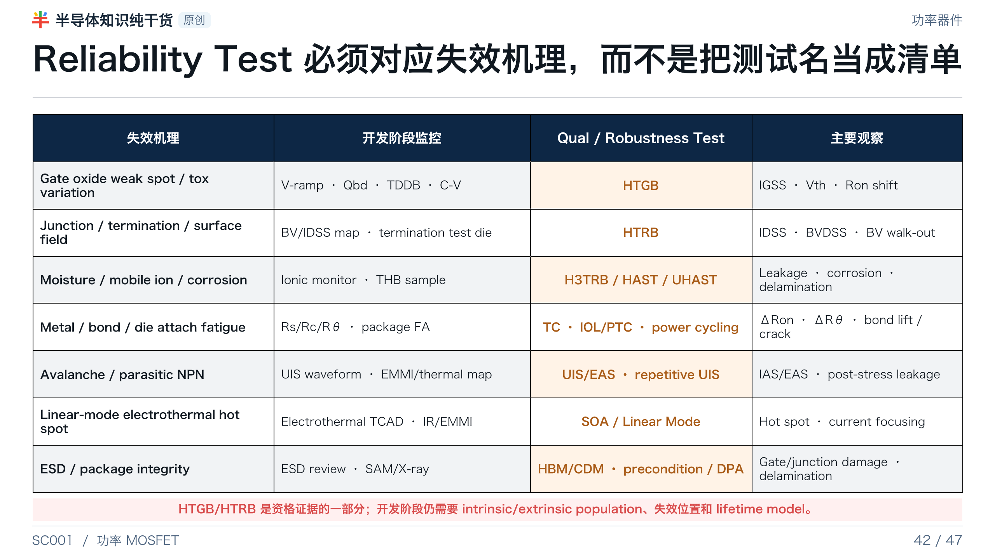
Notes:
[Presenter Notes]
- HTRB 主要暴露 junction、termination、surface/passivation 与高场 leakage；不是只测一次 BV。
- HTGB 不能替代 V-ramp/Qbd/TDDB 对 intrinsic 与 extrinsic oxide population 的开发确认。
- UIS 与 SOA 失效机理不同；power cycling 主要考验 bond、chip metal 和 die attach。
[Sources]
- AEC-Q101 Rev.E: https://www.aecouncil.com/Documents/AEC_Q101_Rev_E_Base_Document.pdf
- Trench Power MOSFET TDDB methodology: https://doi.org/10.1016/j.microrel.2015.11.021
- onsemi AN-9034, Power MOSFET avalanche/UIS: https://www.onsemi.com/download/application-notes/pdf/an-9034.pdf
- onsemi AN-4161, trench MOSFET linear-mode stability: https://www.onsemi.com/download/application-notes/pdf/an-4161.pdf
- Infineon, Power/Temperature Cycling: https://www.infineon.com/assets/row/public/documents/60/42/infineon-an2019-05-pc-and-tc-diagrams-applicationnotes-en.pdf

Slide 43
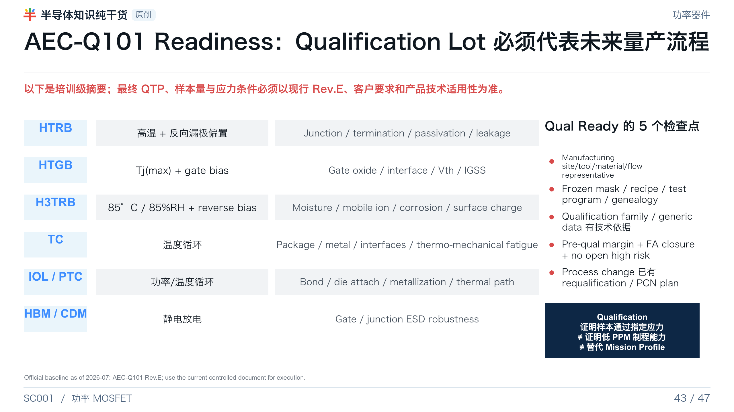
Notes:
[Presenter Notes]
- AEC 官网截至 2026-07 列出的汽车分立器件基线是 AEC-Q101 Rev.E。
- Qualification sample 主要识别设计、材料和结构问题，不证明低 PPM；低 PPM 依赖 SPC、PAT/SYA、OCAP 和零缺陷框架。
- 实际执行必须用受控版本标准和客户 QTP；本页不替代正式标准。
[Sources]
- AEC-Q101 Rev.E: https://www.aecouncil.com/Documents/AEC_Q101_Rev_E_Base_Document.pdf
- Automotive Electronics Council documents index: https://www.aecouncil.com/AECDocuments.html
- Infineon MOSFET Product Qualification Report example: https://www.infineon.com/assets/row/public/documents/24/316/infineon-ipp016n06nf2s-productqualificationreport-en.pdf

Slide 44
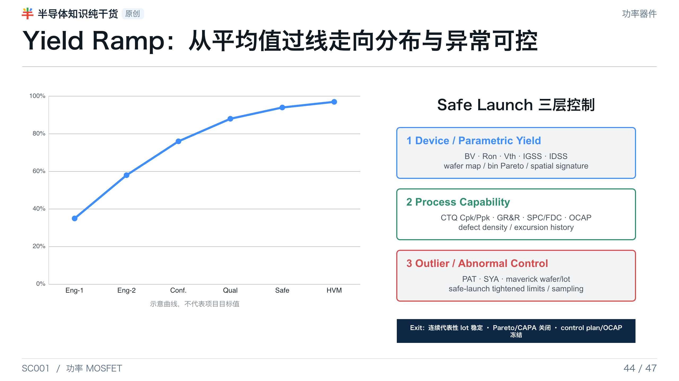
Notes:
[Presenter Notes]
- 示意 yield S-curve 只表达阶段成熟度，不是项目承诺值。
- 工艺整合 要同时管理 parametric yield、process capability 和 abnormal-lot/outlier controls。
- Safe-launch exit 需要稳定代表性批次、FA/CAPA 关闭、control plan/OCAP/test limits 冻结，以及客户批准（如适用）。
[Sources]
- Automotive Electronics Council documents index: https://www.aecouncil.com/AECDocuments.html
- AEC-Q101 Rev.E: https://www.aecouncil.com/Documents/AEC_Q101_Rev_E_Base_Document.pdf

Slide 45

Notes:
[Presenter Notes]
- 任何可能影响 form/fit/function/quality/reliability 的变化都要进行风险评估、bridge data 与必要 requalification。
- Change control 的重点是 affected-product mapping、before/after distributions、genealogy 和 controlled release，而不仅是完成 PCN 文件。
[Sources]
- AEC-Q101 Rev.E: https://www.aecouncil.com/Documents/AEC_Q101_Rev_E_Base_Document.pdf
- Infineon, Product Change Notification: https://www.infineon.com/quality/quality-management/product-change-notification

Slide 46

Notes:
[Presenter Notes]
- Low BV 与 High Ron 可能共享 epi 根因，也可能来自完全不同模块；空间共址与 genealogy 是第一轮证据。
- 不要在没有可证伪假设和 FA 证据前直接调整 recipe。
- 最终要区分 design、process、measurement 与 package 四类问题。
[Sources]
- Synopsys, TCAD Process Simulation: https://www.synopsys.com/manufacturing/tcad/process-simulation.html
- Sidewall Modification Process for Trench Silicon Power Devices: https://www.mdpi.com/2079-9292/12/11/2385
- Trench Power MOSFET TDDB methodology: https://doi.org/10.1016/j.microrel.2015.11.021
- Nexperia AN11158, Understanding power MOSFET data sheet parameters: https://assets.nexperia.com/documents/application-note/AN11158.pdf

Slide 47

Notes:
[Presenter Notes]
- 用十点检查表收束课程，建议在项目 review、DOE plan、process freeze 和 safe launch 阶段重复使用。
- 课程最重要的结论：BV、Ron、Qg、Qrr、SOA、UIS 与可靠性来自同一组结构/工艺变量的耦合，必须用跨层数据闭环。
[Sources]
- AEC-Q101 Rev.E: https://www.aecouncil.com/Documents/AEC_Q101_Rev_E_Base_Document.pdf
- Synopsys, TCAD Process Simulation: https://www.synopsys.com/manufacturing/tcad/process-simulation.html
- onsemi AN-4158, Shielded Gate PowerTrench technology: https://www.onsemi.com/download/application-notes/pdf/an-4158.pdf
- Nexperia AN11158, Understanding power MOSFET data sheet parameters: https://assets.nexperia.com/documents/application-note/AN11158.pdf

