Slide 1
A Hardware Implementation of Evolvable Embedded System for Combinational Logic Circuits Using Virtex 6 FPGA
Laurence Burton
Notes:
The paper I got was called A Hardware Implementation Of Evolvable Embedded System For Combinational Logic Circuits Using Virtex 6 FPGA. It was written by C. Ranjith and S.P. Joy Vasantha Rani

Slide 2
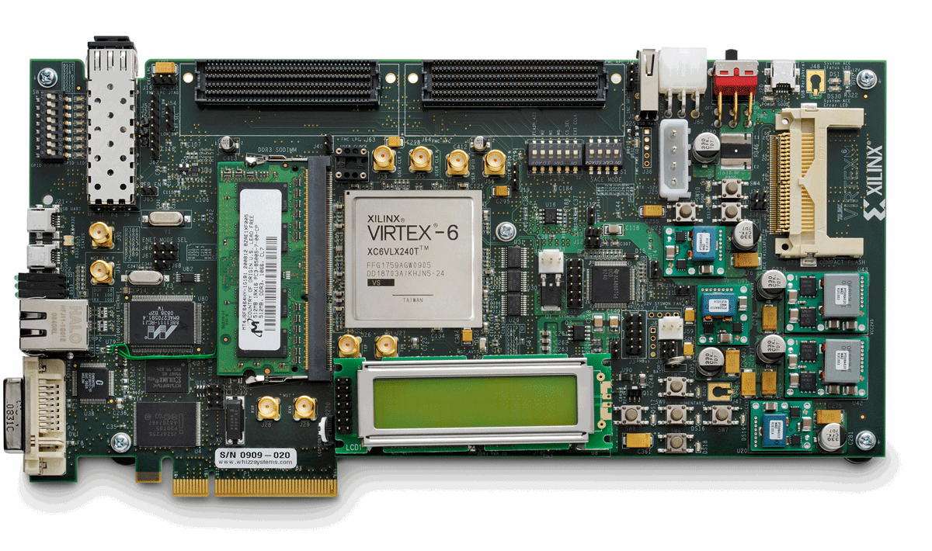
What Is my paper about
This paper is about Evolvable Embedded Hardware and how they can use optimisation algorithms within a FPGA to create the most efficient combinational logic circuits.
The evolvable embedded architecture was implemented on a ML605 Evaluation board with Virtex 6 FPGA.
ML605 Evaluation board with Virtex 6 FPGA

Slide 3
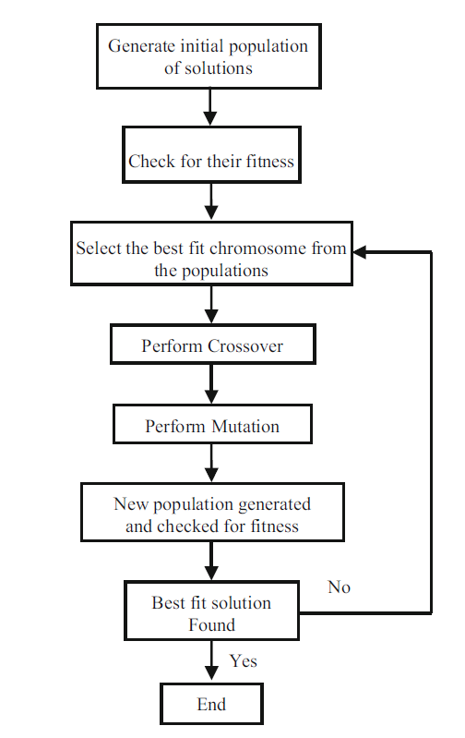
optimisation algorithm
A Genetic Algorithm is an example of optimisation algorithm.
It has the following stages:
Initial Population: This is where you get all the initial chromosomes.
Fitness function: This function tests how good each of the chromosomes are.
Selection: Here, the fittest chromosomes are selected. These will be used to create new chromosomes.
Crossover: In this stage, a random point is selected within two chromosomes. Then, from until they reach the crossover point the genes switch.
Mutation: During mutation, 2 or more genes(bits) are swapped. This is not done to every chromosome.
The new chromosomes are generated and tested to see how fit they are. If the best solution has been generated the process will end. If not the process will repeat from the Selection step.
Fig. 2.4 Flow graph of simple GA structure
Notes:
Explain what a chromosome is?
An optimisation algorithm is a procedure when multiple solutions are generated then compared until the best fit solution is generated.
The optimisation algorithm that they used was called Genetic Algorithm.
A GA has multiple stages.
Initial Population: This is where you get all the initial chromosomes.
Fitness function: This function tests how good each of the chromosomes are.
Selection: Here the fittest chromosomes are selected. These will be used to create new chromosomes.
Crossover: in this stage a random point is select within two chromosomes. Then from the start until they reach the crossover point the genes switch.
Mutation: During mutation 2 or more genes(bits) are swapped. This is not done to every chromosome.
The new chromosomes are generated and tested to see how fit they are. If the best solution has been generated the process will end. If not, the process will repeat from the Selection step.
Each of these chromosomes is passed on their fitness probability and the best fit chromosomes are selected.
The best chromosome strings from the pool of populations undergoes genetic operations.
New populations are generated at each iteration and checked for their fitness to produce new solutions. The cycle repeats till an optimized and best solution is found.

Slide 4
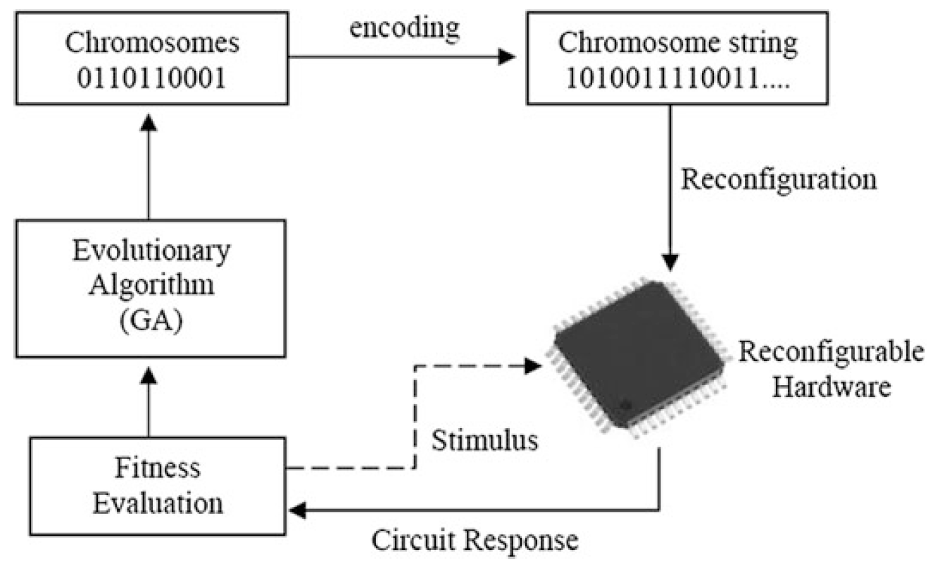
Evolvable hardware (EHW)
The term Evolvable Hardware was created in 1992 by Hugo De Garis
An EHW is a circuit which is able to reconfigure its own hardware and structure depending on changes in the environment and design parameters.
This was made possible by using efficient search algorithms such as genetic algorithm (GA) or Memetic algorithm(MA).
These are usually designed on a Field Programable Gate Array (FPGA).
Fig. 2.1 Basic structure of EHW
Notes:
Evolvable hardware (EHW) was a term coined by Hugo De Garis in the year 1992 for circuits which could configure its own hardware structure dynamically depending on the changes in the environment or on design parameters [1]. This capability of configuring the hardware was achieved by employing efficient search algorithms, like genetic algorithms (GA) [2, 3]. Evolvable systems for digital domain are mainly designed using field programmable gate array (FPGA) chips.
A Field Programable Gate Array (FPGA) is chip which can be reprogramed to create different circuits.
Memetic algorithm (MA) is another optimization algorithm which could be employed in the evolutionary process to obtain faster and better convergence.

Slide 5
virtual reconfigurable architecture (VRA)
The VRA architecture of combinational circuits is modelled and coded by a hardware description language.
The VRA is called the configuration cell.
It contains three 16:1 multiplexers and an 8 × 1 bit RAM
The multiplexers are used to select the inputs to the lookup table , which are driven from one of the set of sixteen inputs.
The configuration cell is driven by 20 configuration bits (3 * 4 select lines of MUX + 8 selectable lines to RAM).
Fig. 2.5 Architecture of the cell

Slide 6
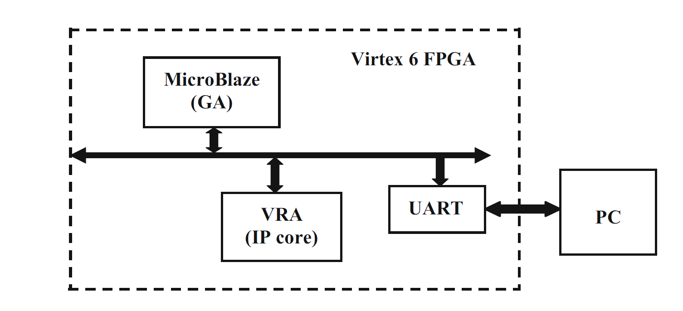
Complete structure of the FPGA
A description of the hardware architecture was programmed onto the reconfigurable chip. This allowed them to implement the evolution structure.
The GA was fused with the MicroBlaze soft processor. This is where the fitness is measured and computed. It’s then sent to the PC via the UART peripheral.
Fig. 2.2 Structure of evolvable embedded system
Notes:
The architecture of the EHW uses the concept of the virtual reconfigurable architecture (VRA) [6].
A hardware description of the architecture was layered over the reconfigurable chip, to implement the evolutionary structure.
The GA program was fused in the MicroBlaze soft processor where the computed fitness measure was displayed on the PC through a configured UART peripheral. The complete structure is as shown in Fig. 2.2.

Slide 7
MicroBlaze
A MicroBlaze processer is a soft processer used for Xilinx FPGAs
This schematic shows the MicroBlaze that was used for the GA with it’s peripherals.
Fig. 2.8 MicroBlaze processor with peripheral interconnections (viewed through XPS tool)
Notes:
An inbuilt Micro Blaze soft processor having 32 bit, Reduced Instruction Set Computer (RISC) architecture is utilized for modelling the system [9]. The MicroBlaze processor with its peripherals for the design include UART (for communication with PC), 4 seven-segment LEDs, push buttons for inputs and reset options, realized from XPS 14.6 EDK platform tool. The peripherals are linked to the processor via the processor local bus (PLB).

Slide 8
Parallelisation
By using the FPGA for the GA it allows the evaluation and the evolution to run in parallel.
This image shows the block which is used to evaluate the 2-bit address.
Fig. 2.6 Single cell array with fitness check connections (showing the outputs for a 2-bit adder circuit)
Notes:
The advantage of performing the GA in parallel is that it speeds up the process
The FPGA is able to run the GA in parallel. FPGA’s are great for Parallelism because unlike a microcontroller there is no CPU controlling each part. When you program an FPGA you program the actual hardware. This allows the hardware to work in paroral with itself.
fitness evaluations in hardware was that multiple evaluations can be done in parallel could be achieved easily.
This processor computes the GA, therefore faster evaluation time can be achieved. The main advantage is that the complete EHW process can be implemented on a single chip, thereby making area efficient and flexible

Slide 9
Results
The program will stop once the GA believes it has found the fittest chromosomes (combination of configuration bits).
The results are then displayed on a PC using the UART connection.
From the results you can see that the 2bit adder had 88 combinations and the 2-bit multiplier had 135.
Fig. 2.9 GA fitness evaluation results a 2-bit adder b 2-bit multiplier
Notes:
The program is terminated once the fitness is evaluated and displays the number of generations and configurations for each cell array as shown in Fig. 2.9a, b for 2-bit adder and multiplier, respectively. From the results, it can be analysed that a 2-bit adder was evolved over 88 generations, and 135 generations were required to evolve a 2-bit multiplier. The number of generations differs with the number of inputs and outputs of the system.
Optimized results were obtained for crossover rate = 55%, mutation rate = 0.1%, and tournament selection of 5 individuals at a time.
The complete floor plan of the evolvable embedded system for the combinational circuit using the VRA concept is shown in Fig. 2.10 using the PlanAhead tool. From the figure, it can be seen that around 40% of the implemented chip area were occupied by the MicroBlaze processor and its peripherals and the rest, by the VRA IP core. From the total chip area, around 6% of LUTs, 4% IOBs and 3% of registers were used from the available resources as tabulated in Table 2.1. The timing criteria weremet with an implementation time of 17.063 ns (maximum frequency of 58.606 MHz)

Slide 10

Conclusion
To conclude this paper, it was about programming an FPGA with a GA to create a EHW. A MicroBlaze soft processor was used for the computation of the GA and as a link to the PC.
Using this method speed up the process as the FPGA allowed for the GA to run in parallel but it could have been faster if when programming the FPGA they had a compact flash card instead of a JTAG.

Slide 11

Any Question?

