Slide 1
Larry S. Liebovitch
https://sites.google.com/view/Larry-phd
BS Physics City College, City University NY | PhD Astronomy Harvard University | Asst. Professor Columbia University College of Physicians & Surgeons
Professor Psychology Interim Director Center for Complex Systems & Brain Sciences Florida Atlantic University | Professor of Physics & Psychology Dean of the Division of Mathematics & Natural Sciences Queens College, City University NY | Adjunct Senior Research Scholar AC4, Climate School, Columbia University

Slide 2
Larry S. Liebovitch, Previous Work
Physical | Biological | Social
Nonlinear Oscillators (autoresonance) | Gene Regulatory Networks | Models of Sustainable Peace
Dynamics of Coupled Maps | Predicting Drug Interactions | Emotions in Psychotherapy
Kinetics of Protein Ion Channels | Timing of Heart Arrhythmias | Dynamics on Small World Networks
Motions in Proteins | Flow of Ions and Water through Cells & Tissues | Analysis of Difficult Conversations
Motions of Stars & Gas in Galaxies | Why Eyes are Round | Models of Conflicts
Fractals | Error Correcting Codes in DNA | Commodity Prices in Ancient Babylon
Chaos Theory | Anoxia in the Turtle Brain | Distribution of Artifacts at Archeological Sites

Slide 3
Melissa Mannis
B.A. Arabic & Sociology Georgetown University Washington, DC | M.A. Peace & Conflict Management University of Haifa Haifa, Israel | PhD (2nd year student) Applied Anthropology Teachers College, Columbia University
Co-Founder, Peace Innovation Initiative University for Peace San José, Costa Rica | Special Advisor University for Peace Mission to the United Nations New York, NY | Area of Research Digital anthropology & peacebuilding, ethnographic data analysis & discourse analysis

Slide 4
Columbia University: Climate School
Advanced Consortium on Cooperation, Conflict, & Complexity
Sustaining Peace Project
Peter T. Coleman Columbia University social psychology | Larry S. Liebovitch Columbia University physics | Melissa Mannis Columbia University anthropology
Allegra Chen-Carrel San Francisco University social psychology | Douglas P. Fry Univ. of NC, Greensboro anthropology | Geneviève Souillac Univ. of NC, Greensboro philosophy
Philippe Vandenbroeck ShiftN mathematics | Zach Stone Columbia University data science | Natalie Zadrozna Columbia University data science
William Powers Queens College, CUNY computer science | Lin Shi Queens College, CUNY computer science | Columbia Data Science Institute MS Student Capstone 2020 data science
Columbia Data Science Institute MS Student Capstone 2021 data science | Columbia Data Science Institute MS Student Capstone 2022 data science | Joshua Fisher Columbia University environmental science

Slide 5

Sustaining Peace Project
Goals
Goals of the Sustaining Peace Project
Positive Peace
identify the social process that support peace
Peace Speech
use machine learning to find the words that represent peace
Create New Measures of Peace
from machine learning / AI models of media and social media
Real Time Dashboard
assessment tools for policy makers, academics, journalists

Slide 6
Sustaining Peace Project
Positive Peace
Positive Peace
Most previous research studies have analyzed peace only in a negative way, as the absence of conflict, violence, or war.
A growing effort is to understand "positive peace’’, the political, economic, and social systems that generate and sustain peaceful societies.
Example of Positive Peace
Iroquois Great League of Peace (1450-1750)
Myths: war hatchets buried and washed away by an underground river
Mores: reinforced at an annual peace ceremony
Conflict Management: at the village, tribal, and confederacy levels
Women: authority to remove chiefs

Slide 7
Last 200 years of Science
Hypothesis
Collect Data
Statistical Analysis
Results -> Interpretation
Machine Learning
Data
Machine learning “model” that makes correct predictions
Results -> Hypothesis
Conjecture what words are different in conflicts and peace, and then search for the frequency of those words in the data.
Use natural language processing and machine learning to find the words that best predict if a country is lower-peace or higher-peace.

Slide 8
Sustaining Peace Project
Machine Learning
Data Sources
NOW
News On the Web: https://www.english-corpora.org/now/
18 countries, 723,574 media articles, January 2010 – September 2020
from newspapers, magazines, technical journals, and media broadcast stations
e.g. AlterNet, Austin American-Statesman, Business Insider, Business Wire (press release), Chicago Tribune, FOX43.com, Jerusalem Post, Israel News, KCCI Des Moines, Kentwired.
Lexis-Nexis
through Elsevier-Columbia University partnership
20 countries, 2,000,000 media articles, 2010-2020
e.g. 24 Hours Toronto, AARP The Magazine, ABC News Transcripts, Accounting Today, AutoWeek, BBC Monitoring: International Reports, Bollywood Country, Business of Fashion, FDA Week, Hair, Internet World, Journal of European Studies, Marie Claire, News Bites, Pittsburgh Tribune Review, Pizza Marketplace, Gas Week, St. Louis Post-Dispatch (Missouri), Tech News, The Nation, World Oil.
Twitter, Local Newspapers
media: 16 countries, 600,000 articles
e.g. The Star (Canada), The Independent (UK), News in English (Norway), Sunday World (Ireland), Daily Finland, The Straits Times (Singapore), 9news (Australia), France24, Times of India, The Independent (Uganda), Tehran Times, The Nigerian Voice, Bulawayo24 (Zimbabwe), The Point (Gambia), The Libya Observer.
twitter: 16 countries, 800,000 tweets

Slide 9
Sustaining Peace Project
Machine Learning
Summary of Results
Liebovitch, Powers, Shi, Chen-Carrel, Loustaunau, Coleman
NOW Dataset
Effective predictions of lower-peace and higher-peace countries from their language
Lower-peace: government /control
Higher-peace: daily activities/diversity of words
CAPSTONE 2021
LexisNexis Dataset
Effective predictions of lower-peace and higher-peace countries from their language
Weak similarities of language within lower-peace and higher-peace countries
Guzman, Liebovitch
NOW Dataset
Less diversity in words in lower- peace than in higher- peace countries
2020
2021
Fall 2022
2023
Capstone 2020
NOW Dataset
Effective predictions of lower-peace and higher-peace countries from their language
Unable to identify word differences between lower-peace and higher-peace countries
Capstone 2022
Scraped Twitter & Local Newspapers
Lower-peace: government /control
Higher-peace: daily activities/diversity of words
Less diversity in words in lower peace than in higher peace countries
Liebovitch, Mannis, Stone, Zadrozna
LexisNexis Dataset

Slide 10
Core Engine
Connection Strengths - Quantitative
Low (0.3)
+ Historical
Memory
+ Future
Expectations
Med (1.5)
Med (1.5)
Med-Hi
(3.0)
Med-Hi
(3.0)
+ Intergroup
Reciprocity
Hi
(-5.0)
Low
(-0.3)
Hi
(5.0)
– Intergroup
Reciprocity
Med-Hi (3.0)
Hi
(5.0)
Low
(0.3)
– Historical
Memory
– Future
Expectations
Hi (5.0)

Slide 11
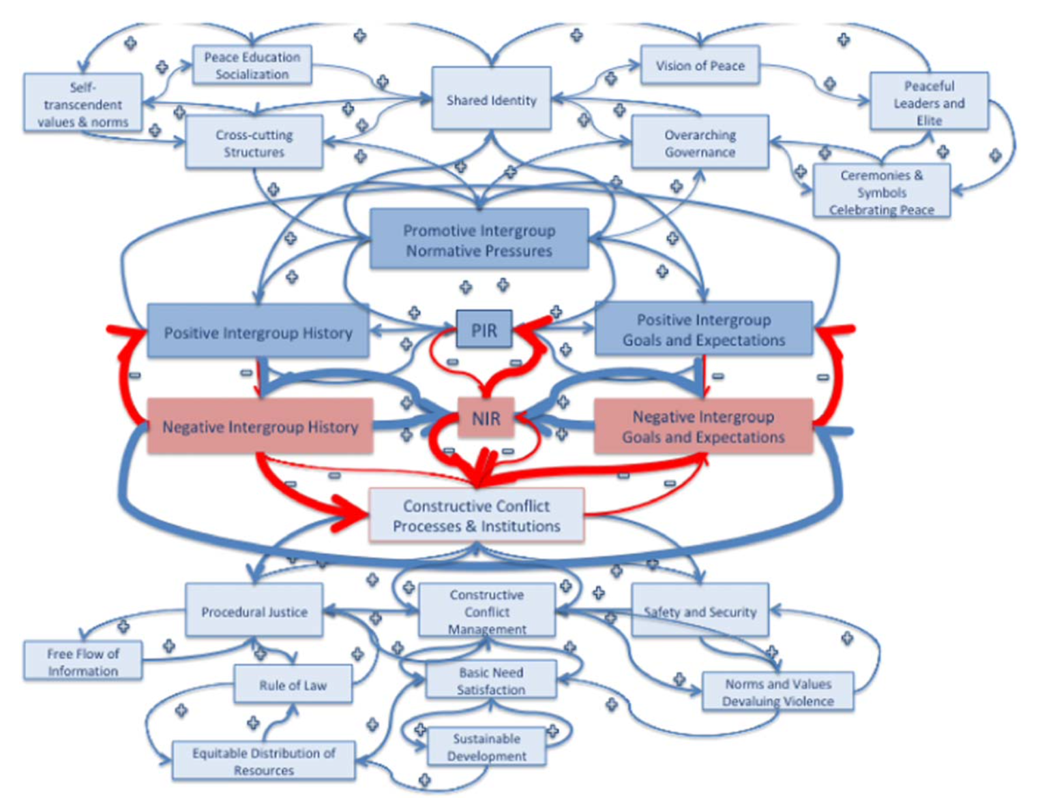
More Features

Slide 12
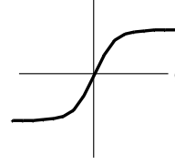
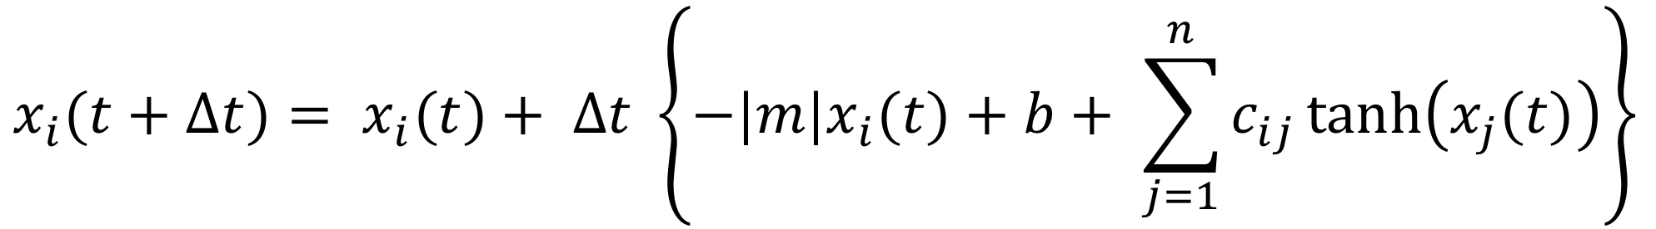
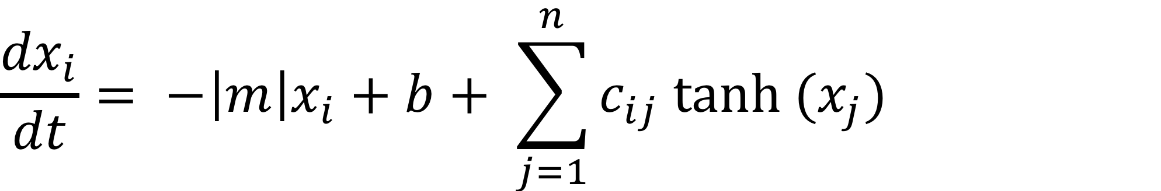
Formulation into Equations
How the variable x_{i} changes in time
x_{i} getting too big? – reduce it (proportionately); m is also the time scale for changes
Each variable stimulates its own growth (auto-catalytic) (actually b = 0)
x_{i}
Effects of other variables:
c_{ij} = strength of the effect of x_{j} on x_{i}
c_{ij} > 0, positive
c_{ij} < 0, negative
low value of x_{j}: the effect of x_{j} on x_{i} is proportional, = to x_{j}
high value of x_{j}: the effect of x_{j} on x_{i} reaches a threshold, = ±c_{ij}
c_{ij}
x_{j}
-c_{ij}
Numerical Integration to evolve the variables in time.

Slide 13
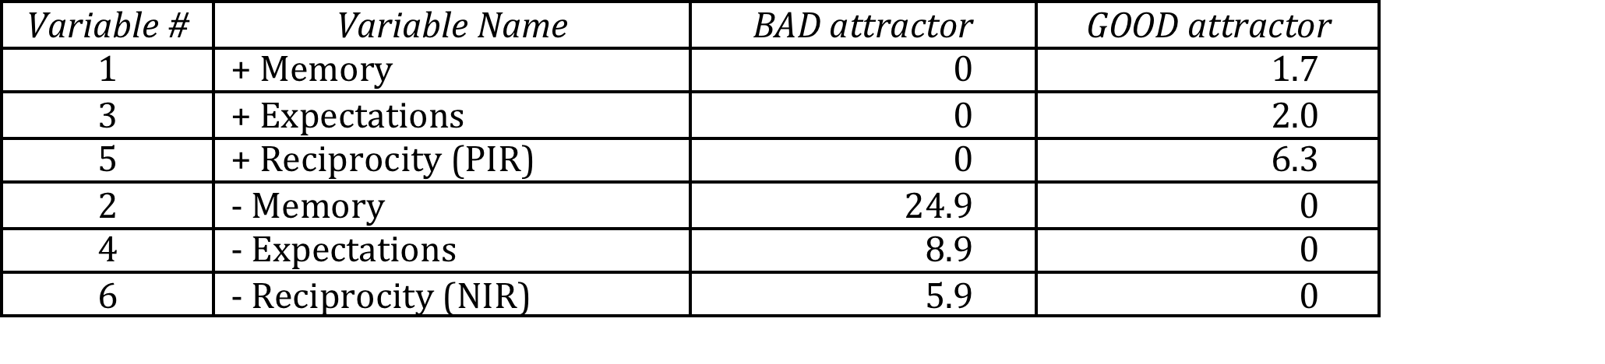
What did we learn from the mathematical model
Only 2 Attractors:
Over long times, depending on their initial values, the values of these variables evolve to only one of two possible sets of values.
BAD Attractor
negative variables are large
positive variables are zero
GOOD Attractor
negative variables are zero
positive variables are large

Slide 14
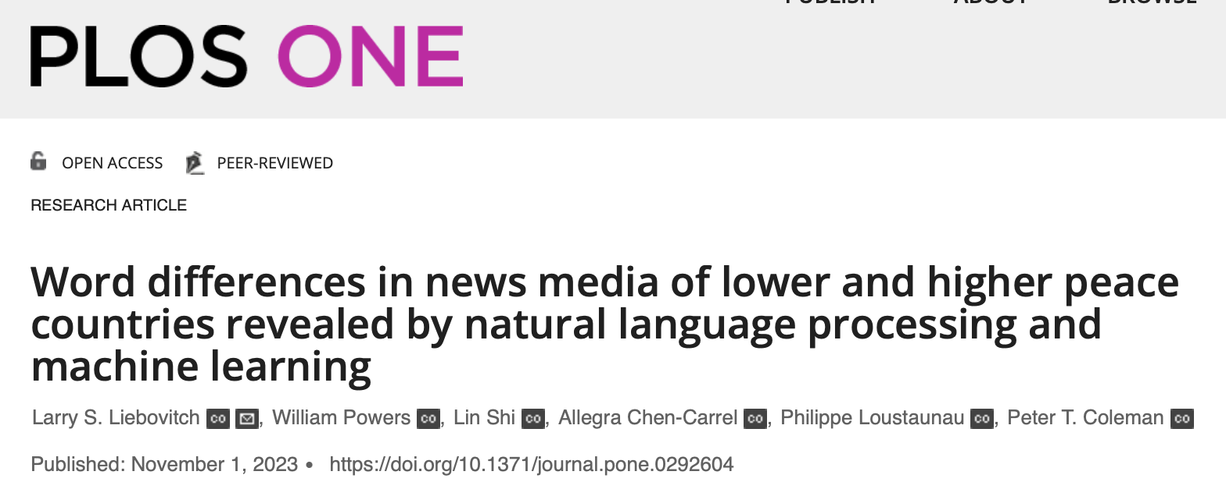
Sustaining Peace Project
Liebovitch et al.
L. Liebovitch, W. Powers, L. Shi, A. Chen-Carrel,
P. Loustaunau, P. Coleman
https://journals.plos.org/plosone/article?id=10.1371/journal.pone.0292604
NOW data set

Slide 15
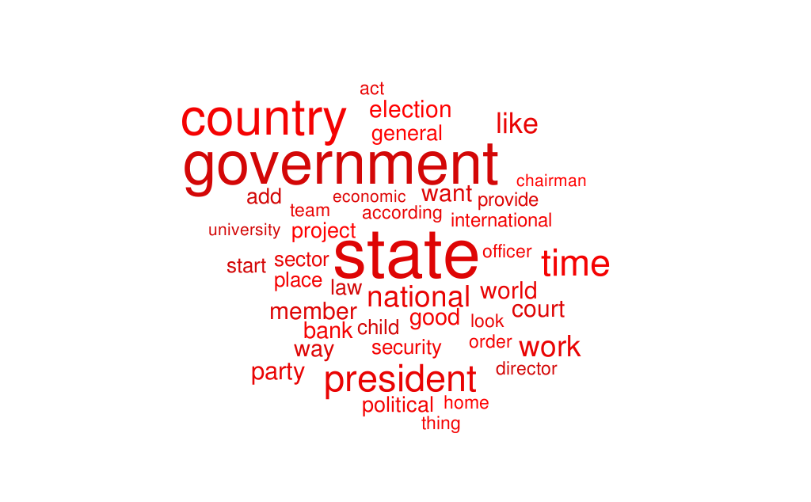
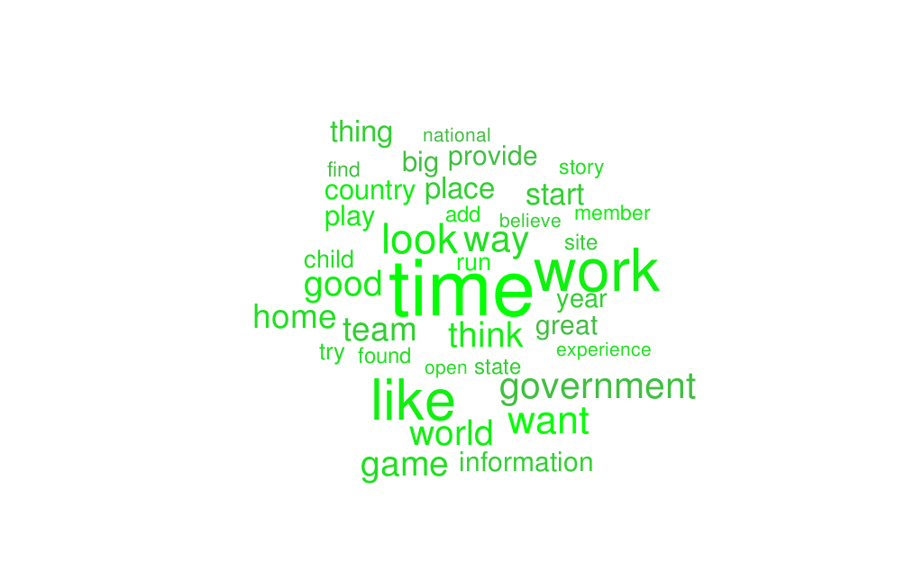
Sustaining Peace Project
Liebovitch et al.
L. Liebovitch, W. Powers, L. Shi, A. Chen-Carrel,
P. Loustaunau, P. Coleman
Lower-peace
Higher-peace
words: government, social control
words: future, daily activities

Slide 16
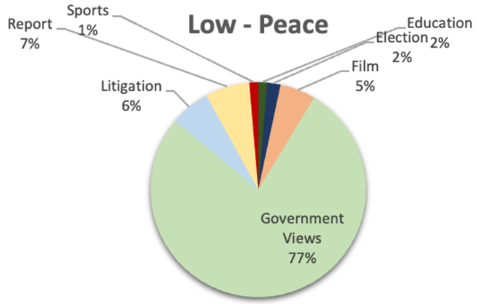
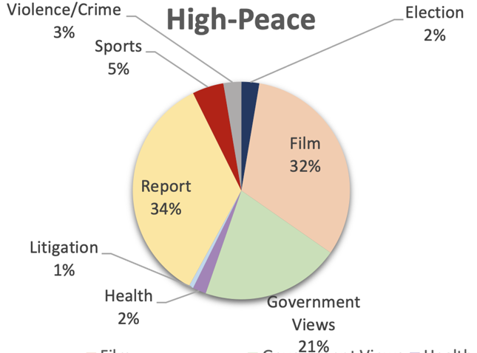
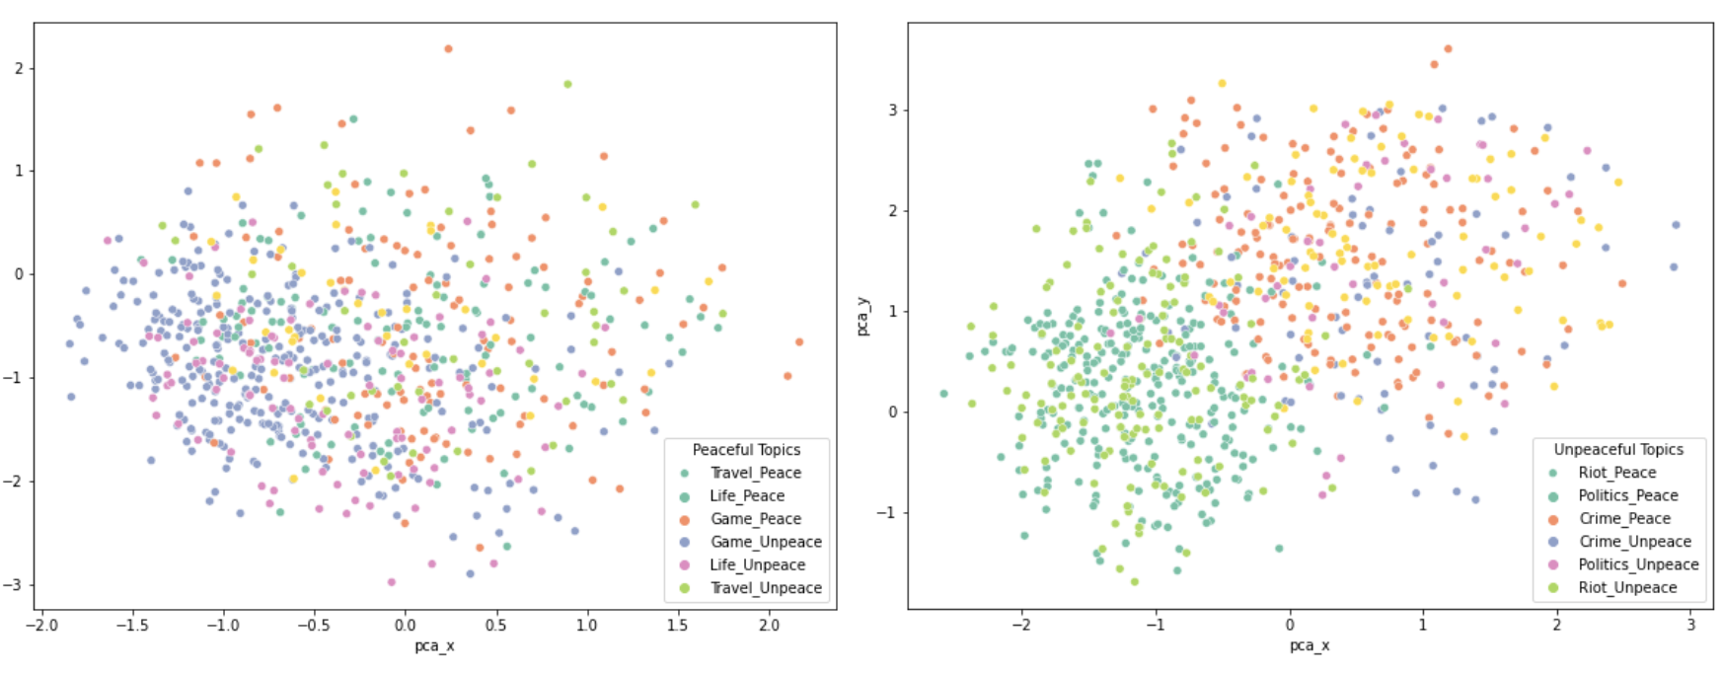
Sustaining Peace Project
Capstone 2022
Capstone 2022 Columbia MS Data Science Students
Yibo Chen, Hongou Liu, Ziheng Ru, Xinfu Su, Pinyi Yang, Yuwen Zhang
Results
Identified clusters of word meanings in lower and higher peace countries.
Fewer different words in lower than higher peace countries.
Low-Peace
High-Peace

Slide 17
Sustaining Peace Project
Machine Learning
Peace Speech
Research Problem:
What are the characteristics of “peace speech” that reflect and support peace?
Goals of Your Project:
From the LexisNexis data of the number of times each word occurs in LOW and HIGH peace countries.
peace_10K.txt word count of top 10K words in HIGH peace countries
nopeace_10K.txt word count of top 10K words in LOW peace countries
Use machine learning
logistic regression, random forest, SVM, XGBoost
To find the words and clusters of words of similar meaning
that best classify countries as peace vs. nopeace

