Slide 1
How to properly create a pptx for simple matrix construction

Slide 2
Objects to use
Rectangles
Lines and connectors
Access these by going to “Insert” > “Shape”
For rectangles, use the first option (it looks like a square)
For lines/connectors, use the straight connector, curved connector, or elbow connector

Slide 3
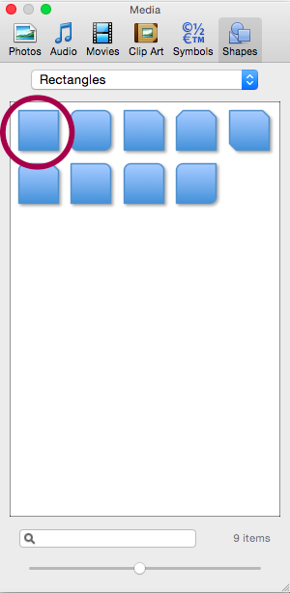
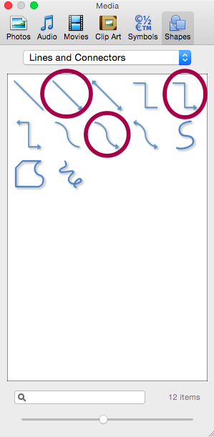
Objects to use

Slide 4
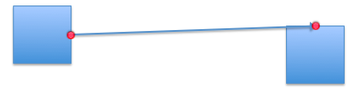
How to properly connect the objects
To ensure proper data access, make sure the connectors are connected to the boxes properly.
When dragging the head of an arrow towards a box, the box will highlight several positions (usually in red or green) on itself where you may connect the connector properly. This is crucial for matrix construction.
Below is an example of how to connect the connector between boxes.

Slide 5

How NOT to connect the objects
Clicking on the connector will reveal whether or not a connector was connected properly. It should have its endpoint(s) highlighted but NOT in grey. Grey implies it was connected improperly.
Below is an example of a connector improperly connected between boxes

Slide 6
Adjusting the weight
You can adjust the weight of a connector by right clicking (or ctrl + clicking) on the arrow, going to “format shape”, and “weights and arrows” on the top of the window. You edit the weight directly in the “weight” section. It is 2 by default.

Slide 7
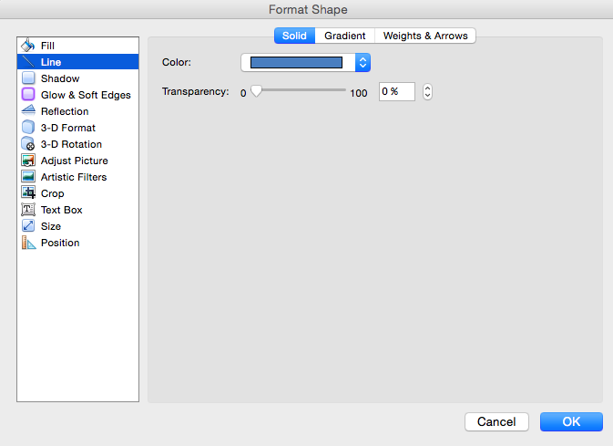
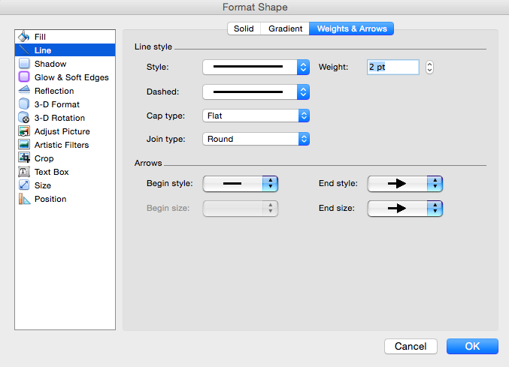
Adjusting the weight

Slide 8
Negative and positive weights
Please do NOT add pluses and minuses next to the arrows.
To mark a weight as positive, use the default blue color for connectors
To mark a weight as negative, use the standard red color
You can edit the color by right (or ctrl + clicking) on the connector, and selecting “format shape”
The correct red (and default blue) will be shown in the following slide

Slide 9
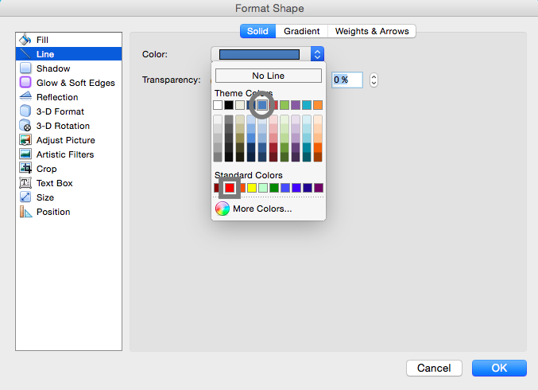

Slide 10
Box colors
Boxes will be colored based on whether they are positive or negative
Positive boxes can take on any of the “accent 1” colors in the color pallet
Negative boxes can take on any of the “accent 2” colors in the color pallet
Examples of accent 1 and accent 2 colors are on the next slide

Slide 11
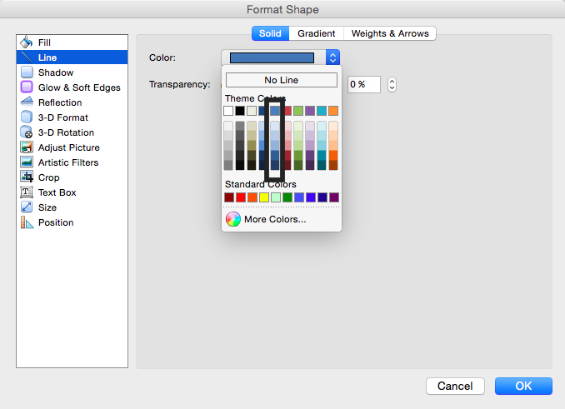
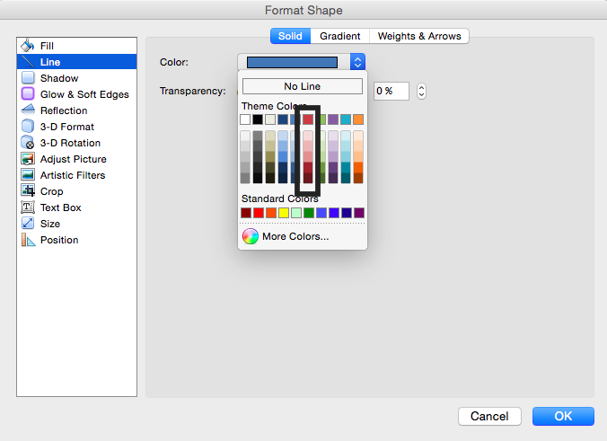
Accent 1 and Accent 2
Accent 1/positive
Accent 2/negative

