Slide 1
Common Families of Probability Distributions

Slide 2
Bernoulli Distribution
An experiment consists of one trial. It can result in one of 2 outcomes: Success or Failure (or a characteristic being Present or Absent).
Probability of Success is π (0 < π < 1)
Y = 1 if Success (Characteristic Present), 0 if not

Slide 3

Example – Shaquille O’Neal – NBA Free Throw Shooting
Shaquille O’Neal played in 1207 Career NBA games over 19 seasons
Famous for being a very poor Free Throw Shooter
Of 11252 Career Free Throw Attempts, he made 5935 ⇒ π = .5275
Failure
Success

Slide 4
Binomial Distribution

Slide 5
Binomial Experiment
Experiment consists of a series of n identical trials
Each trial can end in one of 2 outcomes: Success or Failure
Trials are independent (outcome of one has no bearing on outcomes of others)
Probability of Success, π, is constant for all trials
Random Variable Y, is the number of Successes in the n trials is said to follow Binomial Distribution with parameters n and π
Y can take on the values y=0,1,…,n Notation: Y~Bin(n,π)

Slide 6
Example – Shaquille O’Neal Free Throws
Suppose we observe Shaq take n = 15 Free Throws (or sample 15 from his population of attempts)
Let Y be the number of Successful attempts in the 15 shots
Compute: E{Y}, V{Y}, σ, P(Y ≤ 7), P(Y ≥ 10), and the Probability Distribution

Slide 7
Estimating π From Sample Data

Slide 8
Estimating π From Sample Data – R Program
shaq.n <- 11252; shaq.y <- 5935
shaq.ft <- cbind(shaq.y, shaq.n - shaq.y)
shaq.mod1 <- glm(shaq.ft ~ 1, binomial("logit"))
summary(shaq.mod1)
predict(shaq.mod1) # logit scale (a)
predict(shaq.mod1, type="response") # response scale (p)
shaq.data <- c(rep(1,shaq.y), rep(0,shaq.n-shaq.y))
shaq.mod2 <- glm(shaq.data ~ 1, binomial("logit"))
summary(shaq.mod2)
predict(shaq.mod1)
predict(shaq.mod1, type="response")
> summary(shaq.mod1)
Coefficients:
Estimate Std. Error z value Pr(>|z|)
(Intercept) 0.10996 0.01888 5.823 5.78e-09
> predict(shaq.mod1)
1
0.1099578
> predict(shaq.mod1, type="response")
1
0.5274618

Slide 9
Poisson Distribution
Distribution often used to model the number of incidences of some characteristic in time or space:
Arrivals of customers in a queue
Numbers of flaws in a roll of fabric
Number of typos per page of text.
Distribution obtained as follows:
Break down the “area” into many small “pieces” (n pieces)
Each “piece” can have only 0 or 1 occurrences (π=P(1))
Let λ=nπ ≡ Average number of occurrences over “area”
Y ≡ # occurrences in “area” is sum of 0^{s} & 1^{s} over “pieces”
Y ~ Bin(n, π) with π = λ/n
Take limit of Binomial Distribution as n →∞ with π = λ/n
In R: ppois(y,λ) gives F(y)=P(Y <= y) dpois(y,λ) gives p(y) = P(Y=y)

Slide 10
Example – German Football League - 2013
Total Goals Per Game (Both Teams)
Mean=3.16 Variance=2.94
Comparison with Poisson(λ = 3)
Compute P(Y=0), P(Y<=2), P(Y>3), and Probability Distribution (Observed and Theoretical)
Observed:
P(Y > 3) = 1-P(Y ≤ 2) = 1-0.3889 = 0.6111
Theoretical:
P(Y > 3) = 1-P(Y ≤ 2) = 1-0.4232 = 0.5768

Slide 11
Total Goals per Game – German Premier League 2013
0
1
2
3
4
5
6
7
8+

Slide 12
Estimating λ from Sample Data
> summary(gg.mod)
Coefficients:
Estimate Std. Error z value Pr(>|z|)
(Intercept) 1.15061 0.03216 35.78 <2e-16
> predict(gg.mod)[1]
1
1.150613
> predict(gg.mod, type="response")[1]
1
3.160131
gg.freq <- c(13,34,72,68,55,35,18,6,5)
gg.goals <- rep(0:8, gg.freq)
gg.mod <- glm(gg.goals ~ 1, poisson("log"))
summary(gg.mod)
predict(gg.mod)[1] # Print out just first case
predict(gg.mod, type="response")[1]

Slide 13
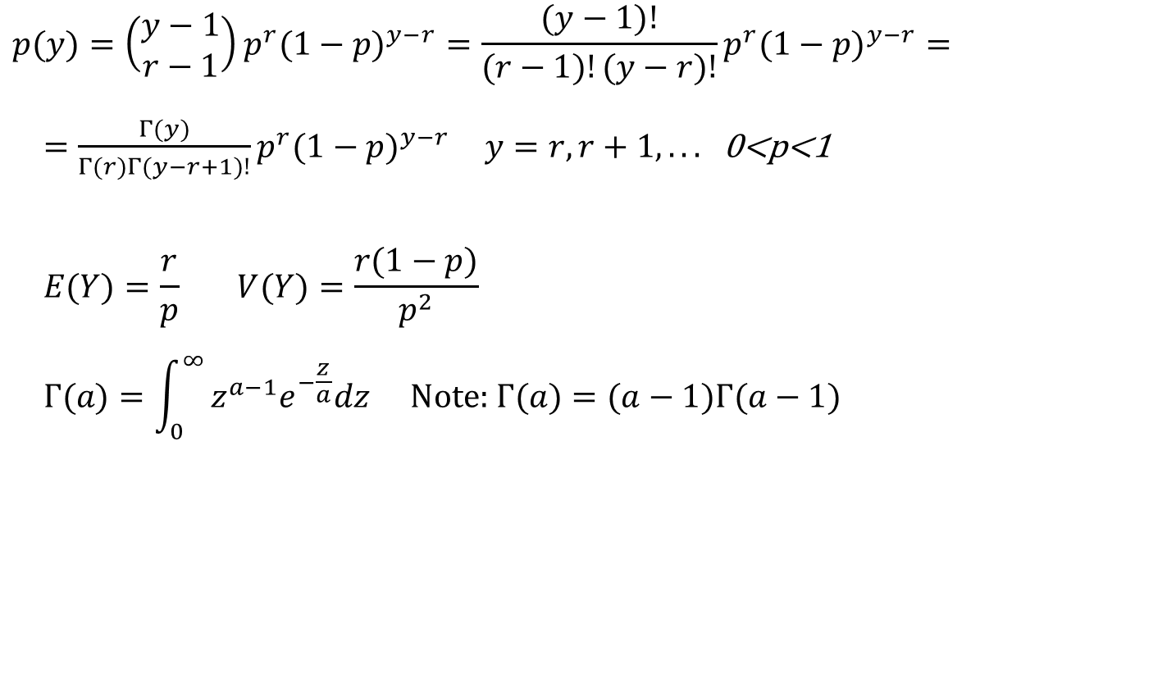
Negative Binomial Distribution
Used to model the number of trials needed until the r^{th} Success (extension of Geometric distribution)
Based on there being r-1 Successes in first y-1 trials, followed by a Success
$$p(y)=\left(\begin{matrix}y−1 \\ r−1\end{matrix}\right)p^{r}(1−p)^{y−r}=\frac{(y−1)!}{(r−1)!(y−r)!}p^{r}(1−p)^{y−r}=$$
$=\frac{Γ(y)}{Γ(r)Γ(y−r+1)!}p^{r}(1−p)^{y−r} y=r,r+1,...$ 0<p<1
$$E(Y)=\frac{r}{p} V(Y)=\frac{r(1−p)}{p^{2}}$$
$$Γ(a)=\int_{0}^{∞}{z^{a−1}e^{−\frac{z}{a}}dz} \text{Note}\text{: }Γ(a)=(a−1)Γ(a−1)$$
Obtaining Probabilities in R: p(y) = dnbinom(y,r,p) F(y) = P(Y ≤ y) = dnbinom(y,r,p)

Slide 14
Negative Binomial Distribution (II)
This model is widely used to model count data when the Poisson model does not fit well due to over-dispersion: V(Y) > E(Y).
In this model, k is not assumed to be integer-valued and must be estimated via maximum likelihood (or method of moments)

Slide 15
Negative Binomial Distribution – Estimating Parameters
> summary(gg.mod.nb)
Coefficients:
Estimate Std. Error z value Pr(>|z|)
(Intercept) 1.15061 0.03216 35.78 <2e-16
(Dispersion parameter for Negative Binomial(34400.78) family taken to be 1)
Theta: 34401
Std. Err.: 409434
library(MASS)
gg.mod.nb <- glm.nb(gg.goals ~ 1)
summary(gg.mod.nb)

Slide 16
Normal (Gaussian) Distribution
Bell-shaped distribution with tendency for individuals to clump around the group median/mean
Used to model many biological phenomena
Many estimators have approximate normal sampling distributions (see Central Limit Theorem)
Obtaining Density and Probabilities in R: f(Y) = dnorm(y,μ,σ) F(y) = P(Y ≤ y) = pnorm(y,μ,σ)

Slide 17
Normal Distribution – Density Functions (pdf)

Slide 18
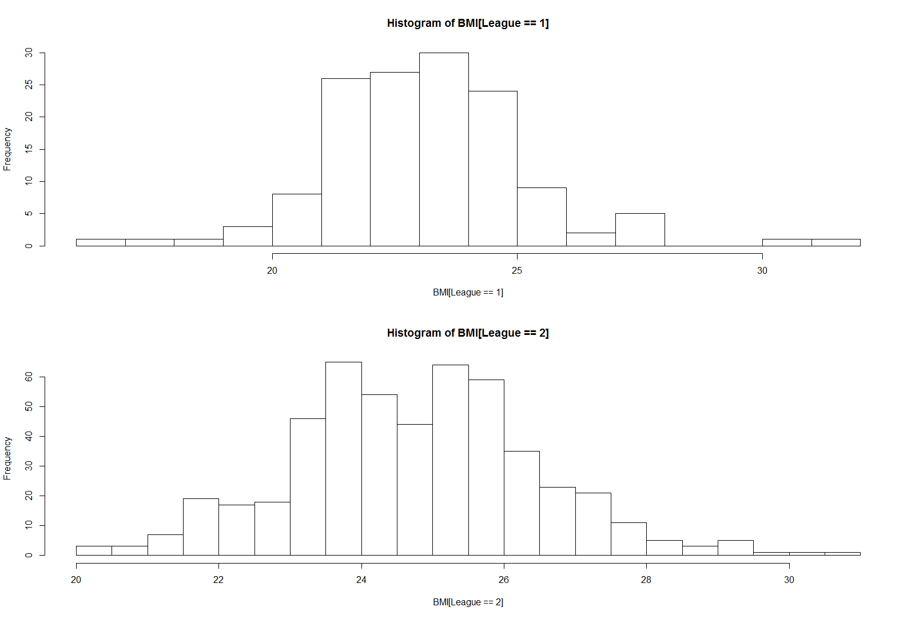
Data Description - I
Body Mass Index: BMI = 703*Weight(lbs)/(Height(in))²
WNBA (Females): 139 w/ Mean=23.135, SD=2.105
NBA (Males): 505 w/ Mean=24.741, SD=1.720
Distributions are approximately normal

Slide 19
Normal Densities for Male (NBA) and Female (WNBA) BMI

Slide 20
Probability and Quantile Calculations
Note: If we used >24 vs <24 as a classifier between Males and Females, about 2/3 of Males and 2/3 of Females would be classified correctly

Slide 21
Other Choices of Cut-Off Values
If we make the cut-off very low (say BMI=20), we get very accurate test for Males (.9971 Correct), but very inaccurate test for Females (.0682) correct.
Similarly, if we make the cut-off very high (say BMI=28), we get very accurate test for Females (.9896 correct), but very inaccurate for Males (.0291 correct)
This situation is very similar to diagnostic tests for patients for a disease

Slide 22
Prior/Posterior Probabilities, Odds, Likelihood Ratios

Slide 23
Computations

Slide 24
Receiver Operating Characteristic Curve for Classifying Gender by BMI

Slide 25
Performance of BMI as Test for M/F
An excellent test would have a high arc to the Northwest corner of the graph, allowing for a high sensitivity, P(T⁺|M) along with a low 1-specificity, P(T⁺|F)
Clearly, this test does not perform particularly well (due to large overlap in the Male/Female BMI densities
Commonly reported measure is the Area Under the ROC Curve (AUC) 0.5 ≤ AUC ≤ 1
Rule of Thumb:
0.9-1 = Excellent, 0.8-0.9 = Good, 0.7-0.8 = Fair, 0.6-0.7 = Poor, 0.5-0.6 = Fail
For this Test, AUC = 0.6621 (applying trapezoidal rule)

Slide 26
Gamma Distribution
Family of Right-Skewed Distributions
Random Variable can take on positive values only
Used to model many biological and economic characteristics
Can take on many different shapes to match empirical data
Obtaining Density and Probabilities in R: f(Y) = dgamma(y,α,β) F(y) = P(Y ≤ y) = pgamma(y,α,β)

Slide 27
Gamma Distribution – Mean and Variance

Slide 28
Gamma/Exponential Densities (pdf)

Slide 29
Lognormal Distribution
Obtaining Density and Probabilities in R: f(Y) = dlnorm(y,μ,σ) F(y) = P(Y ≤ y) = plnorm(y,μ,σ)

Slide 30
Lognormal pdf’s

Slide 31
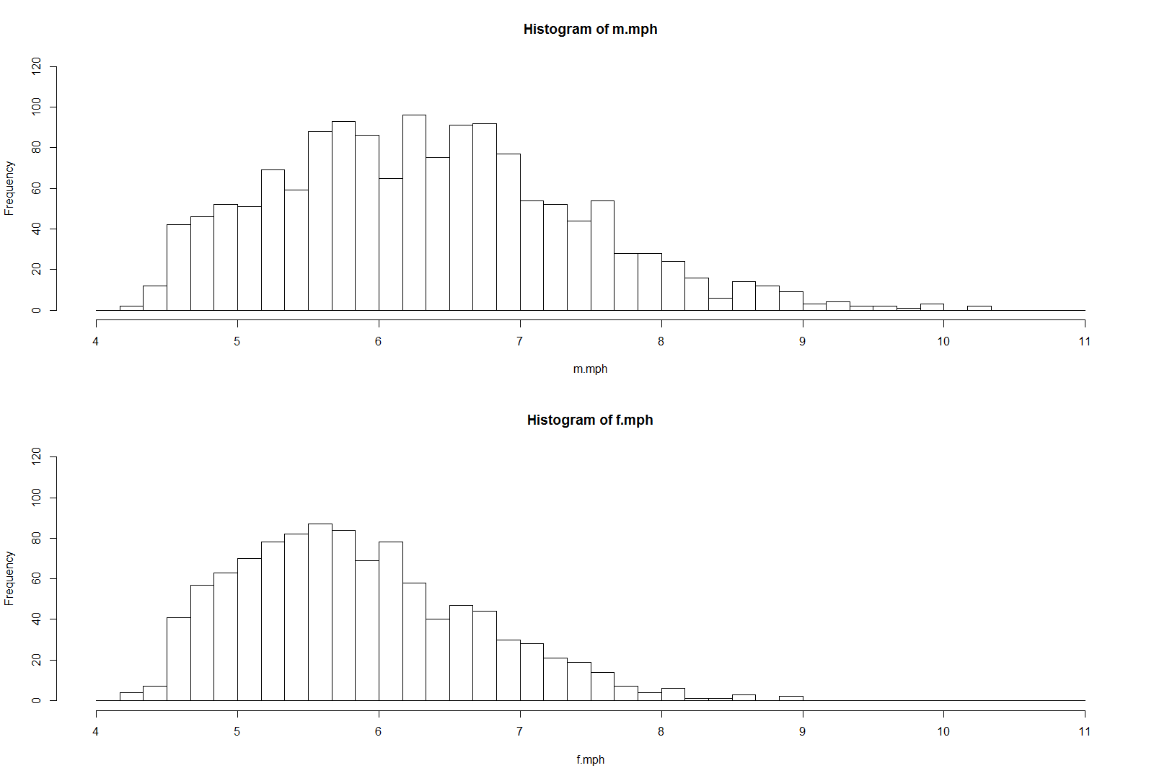
Data Description - II
Miles per Hour for 2499 people completing the marathon (1454 Males, 1045 Females)
Males: Mean=6.337, SD=1.058, Min=4.288, Max=10.289, P(Y_{M} ≤ 7) = .7538
Females: Mean=5.840, SD=0.831, Min=4.278, Max=8.963, P(Y_{F} ≤ 7) = .8986

Slide 32
Method of Moments Estimators - Gamma
Obtain the Sample Mean and Variance and Use them to obtain estimates of parameters and P(Y ≤ 7)

Slide 33
Method of Moments Estimators - Lognormal

Slide 34
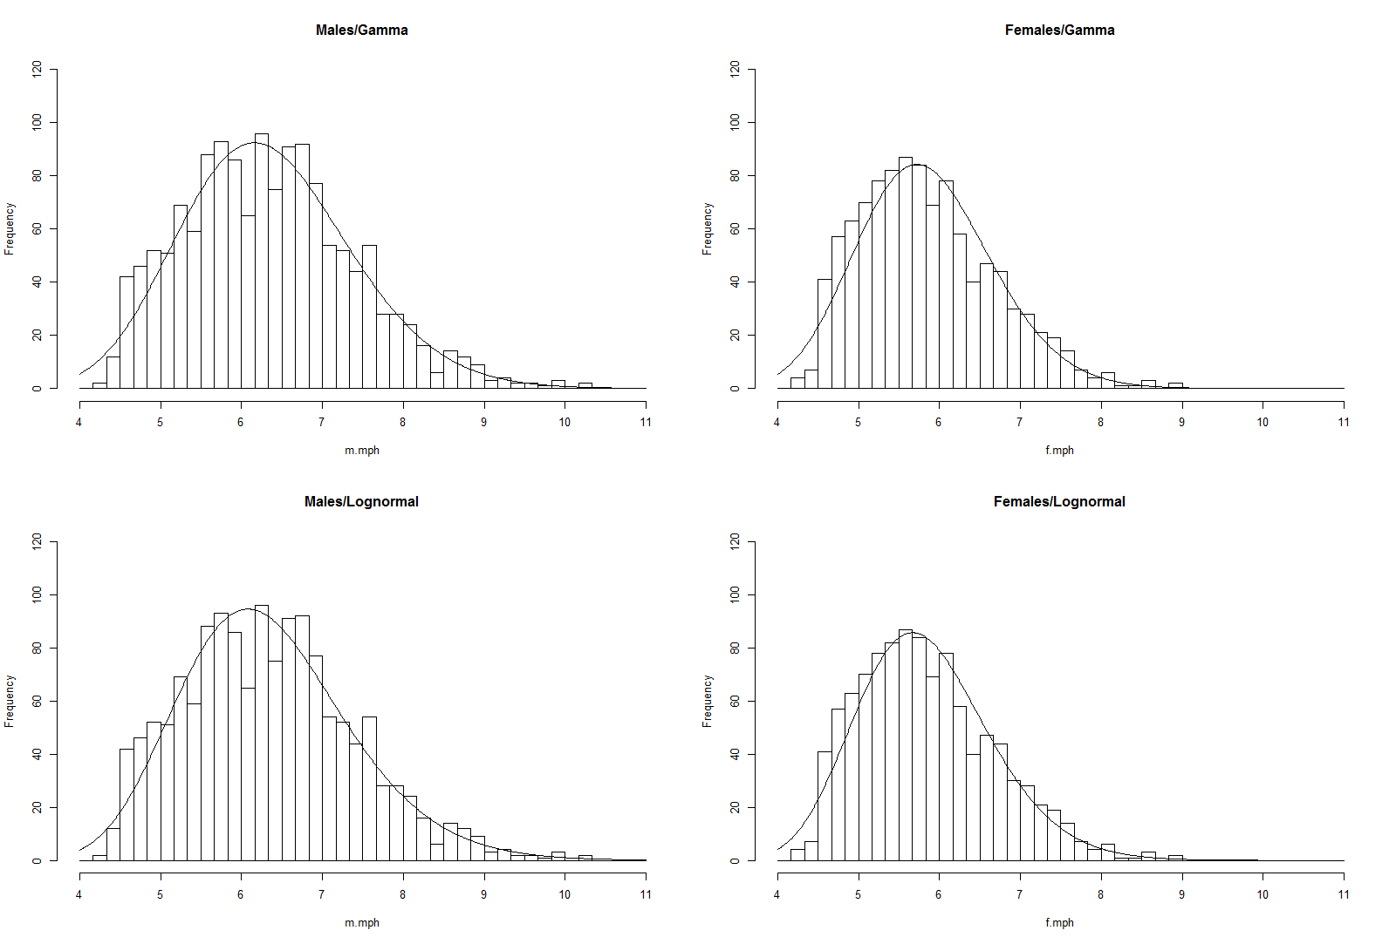
Method of Moments Estimates / Graphs

Slide 35
Beta Distribution
Used to model probabilities (can be generalized to any finite, positive range)
Parameters allow a wide range of shapes to model empirical data
Obtaining Density and Probabilities in R: f(Y) = dbeta(y,α,β) F(y) = P(Y ≤ y) = pbeta(y,α,β)

Slide 36
Beta Density Functions (pdf)

Slide 37
Data Description - III
All NBA 2016-2017 Regular Season Team/Games
Proportion of 3-Point Shots Made (Attempts range from 7-61 per team/game)
Mean = .3566 SD = .0946 Var=.008958

Slide 38
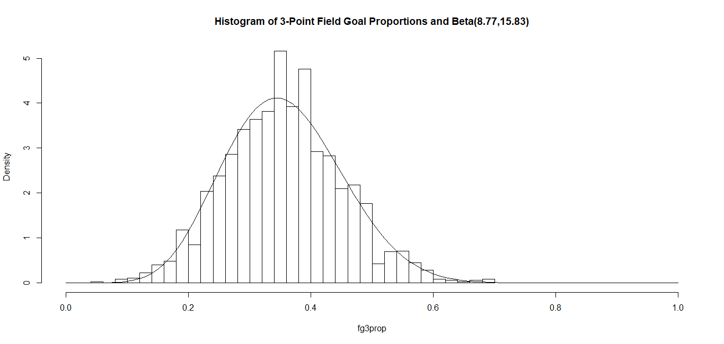
Method of Moments Estimates / Graph

