Slide 1
Normal Distribution, Likelihood Ratios, and ROC Curves
Body Mass Indices for WNBA and NBA Players 2013-2014 Seasons

Slide 2
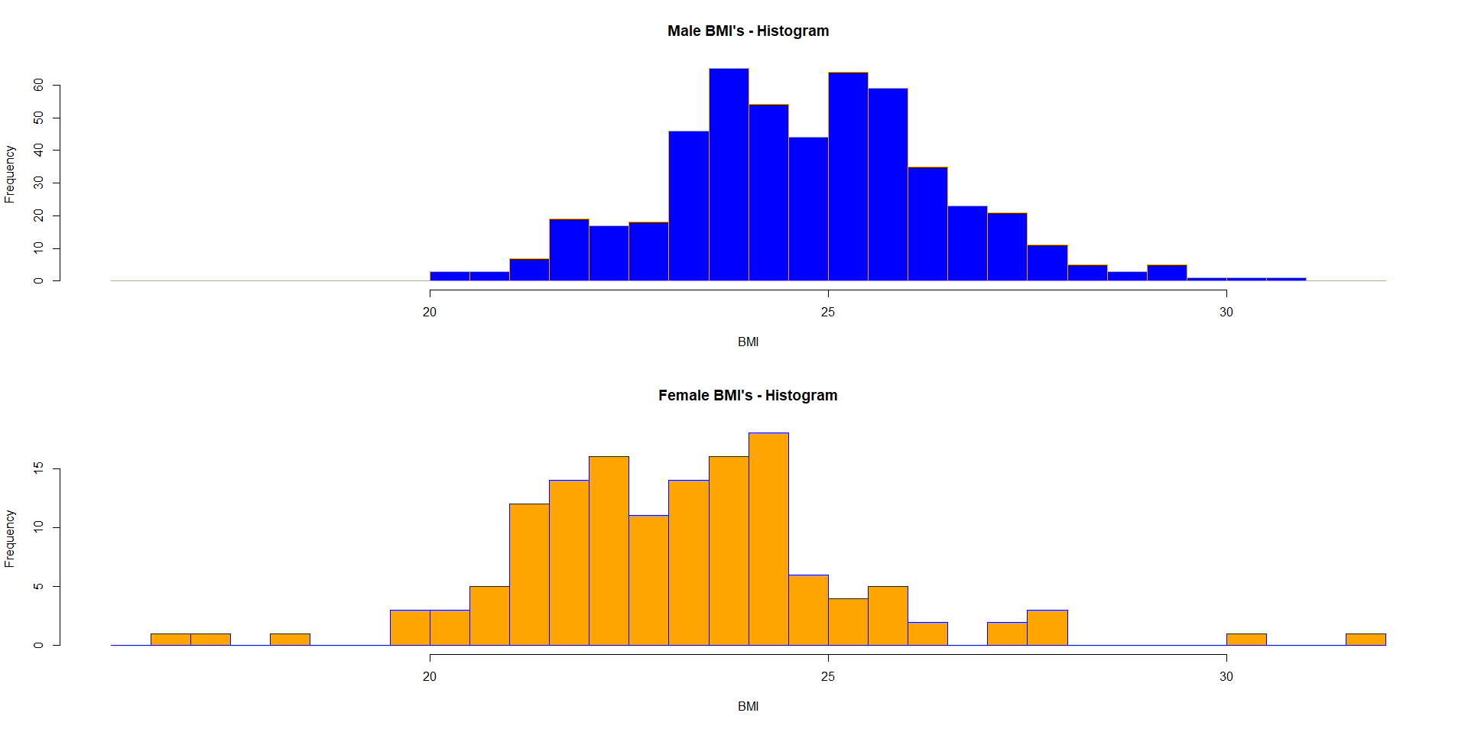
Data Description
Body Mass Index: BMI = 703*Weight(lbs)/(Height(in))²
WNBA (Females): 139 w/ Mean=23.135, SD=2.105
NBA (Males): 505 w/ Mean=24.741, SD=1.720
Distributions are “approximately” normal

Slide 3
Normal Densities for Males and Females

Slide 4
Probability and Quantile Calculations
Note: If we used >24 vs <24 as a classifier between Males and Females, about 2/3 of Males and 2/3 of Females would be classified correctly

Slide 5
Other Choices of Cut-Off Values
If we make the cut-off very low (say BMI=20), we get very accurate test for Males (.9971 Correct), but very inaccurate test for Females (.0682) correct.
Similarly, if we make the cut-off very high (say BMI=28), we get very accurate test for Females (.9896 correct), but very inaccurate for Males (.0291 correct)
This situation is very similar to diagnostic tests for patients for a disease

Slide 6
Prior/Posterior Probabilities, Odds, Likelihood Ratios

Slide 7
Computations

Slide 8
Receiver Operating Characteristic (ROC) Curve

Slide 9
Performance of BMI as Test for M/F
An excellent test would have a high arc to the Northwest corner of the graph, allowing for a high sensitivity, P(T⁺|M) along with a low 1-specificity, P(T⁺|F)
Clearly, this test does not perform particularly well (due to large overlap in the Male/Female BMI densities)
Commonly reported measure is the Area Under the ROC Curve (AUC) 0.5 ≤ AUC ≤ 1
Rule of Thumb: 0.9-1 = Excellent, 0.8-0.9 = Good, 0.7-0.8 = Fair, 0.6-0.7 = Poor, 0.5-0.6 = Fail
For this Test, AUC = 0.6621 (applying trapezoidal rule)

