Slide 1
Ridge Regression
Population Characteristics and Carbon Emissions in China (1978-2008)
Q. Zhu and X. Peng (2012). “The Impacts of Population Change on Carbon Emissions in China During 1978-2008,” Environmental Impact Assessment Review, Vol. 36, pp. 1-8

Slide 2
Data Description/Model
Data Years: 1978-2008 (n = 31 Years)
Dependent Variable – Carbon Emissions (million-tons)
Independent Variables
Population (10,000s)
Urbanization Rate (%)
Percentage of Population of Working Age (%)
Average Household Size (persons/hhold)
Per Capita Expenditures (Adjusted to Year=2000)

Slide 3
Correlation Transformation

Slide 4
Data
Note that the X-variables are very highly correlated, causing problems when it is inverted and used to obtain the least squares estimate of β and is variance-covariance matrix.
Eigenvalues of X*’X* : (X’X)⁻¹:
VIF₁ = 50.62 VIF₂ = 147.72 VIF₃ = 31.40 VIF₄ = 122.38 VIF₅ = 213.60

Slide 5
Ridge Regression - I
Method of producing a biased estimator of β that has a smaller Mean Square Error than OLS
Mean Square Error of Estimator = Variance + Bias²
Ridge estimator trades of bias for large reduction of variance when the predictor variables are highly correlated
Problem: Choosing the shrinkage parameter c
We will work with the standardized regression model based on the correlation transformed variables, then “back transform” the regression coefficients to original scale

Slide 6
Ridge Estimator (Standardized X, Y)
Note the unconventional notation of γ as the standardized regression coefficient vector

Slide 7
China Carbon Emissions Data (c = 0.20)
The estimated regression coefficients have changed large amounts and in signs for Population and Urbanization rate

Slide 8
Back-Transforming Coefficients to Original Scale

Slide 9
Choosing the Shrinkage Parameter, c
Ridge Trace – Plot of the standardized ridge regression coefficients versus c and observe where they flatten out
C_{c} Statistic – Similar to C_{p} used in regression model selection
PRESS Statistic extended to Ridge Regression – Cross-Validation Sum of Squares for “left-out” residuals
Generalized Cross-Validation – Similar to PRESS, based on prediction
Plot of VIF^{s} versus c and observe where they all fall below 10

Slide 10
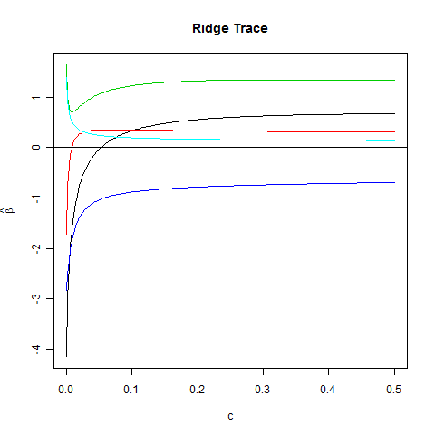
Plot of the Ridge Trace

Slide 11
C_{c} - Statistic
Goal: Choose c to minimize C_{c}

Slide 12
“PRESS” Statistic
Goal: Choose c to minimize PR_{Ridge}

Slide 13
Generalized Cross Validation
Goal: Choose c to minimize GCV

Slide 14
C_{c} , PRESS, GCV for China Carbon Data
All of these methods select very low values for c. The graphical methods tend to choose larger values for the stabilization of the regression coefficients and VIF^{s}.

Slide 15
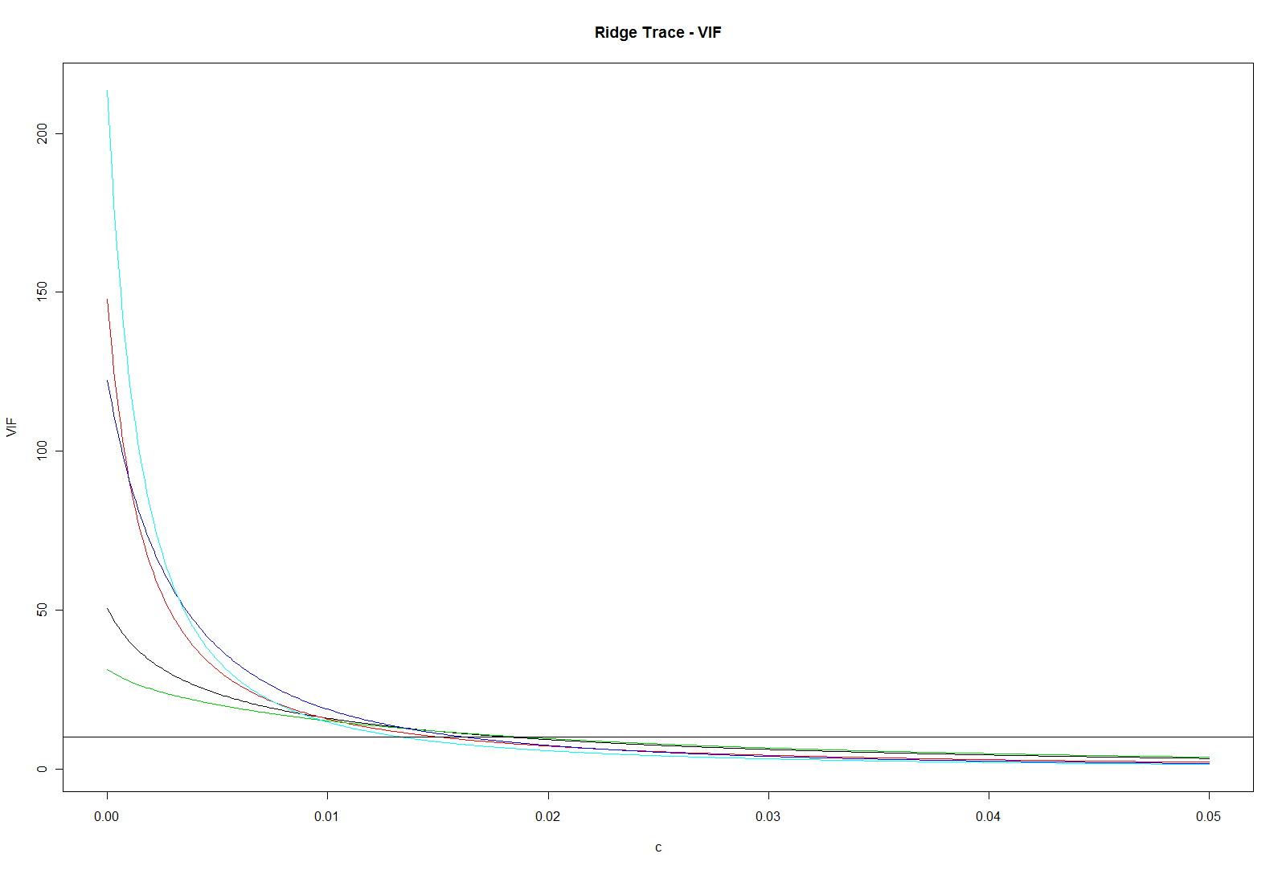
Variance Inflation Factors

Slide 16
Final Model – Estimated Regression Coefficients
The Residual based measures C_{c}, PRESS, and GCV suggest very small values of c
The Ridge Trace suggests larger value, with coefficients stabilizing above c = 0.15 or so
The VIF plot suggests values above c = 0.03 having all VIF values less than 10
The authors used c = 0.20, based on the ridge trace

