Slide 1
Regression Transformations for Normality and to Simplify Relationships
U.S. Coal Mine Production – 2011
Source: www.eia.gov

Slide 2
Data Description
Coal Mine Production and Labor Effort for all Mines Producing Over 100,000 short tons of Coal in 2011
Units: Mine (n = 691)
Response: Coal Production (100,000s of tons)
Predictor Variables:
Labor Effort (100,000s of Hours)
Surface Mine Dummy (1 if Surface Mine, 0 if Underground)
Appalachia Region Dummy (1 if Yes, 0 if Interior or Western)
Interior Region Dummy (1 if Yes, 0 if Appalachia or Western)
MinePrep Dummy (1 if Mine & Preparation Plant, 0 if Mine Only)

Slide 3
Model 1 – Non-Transformed with Interactions
Coefficients:
Estimate Std. Error t value Pr(>|t|)
(Intercept) -63.0381 5.7418 -10.979 < 2e-16 ***
labor 21.5790 1.1099 19.443 < 2e-16 ***
surface -8.9941 2.3124 -3.890 0.000110 ***
appalachia 65.9606 5.3749 12.272 < 2e-16 ***
interior 70.2902 6.1094 11.505 < 2e-16 ***
mineprep -15.1459 3.7579 -4.030 6.2e-05 ***
I(labor * surface) 8.9305 0.7371 12.116 < 2e-16 ***
I(labor * appalachia) -21.2830 0.9139 -23.288 < 2e-16 ***
I(labor * interior) -21.0385 1.0601 -19.846 < 2e-16 ***
I(labor * mineprep) 3.8508 0.6131 6.281 6.0e-10 ***
---
Residual standard error: 21.76 on 681 degrees of freedom
Multiple R-squared: 0.8915, Adjusted R-squared: 0.8901
F-statistic: 621.8 on 9 and 681 DF, p-value: < 2.2e-16

Slide 4
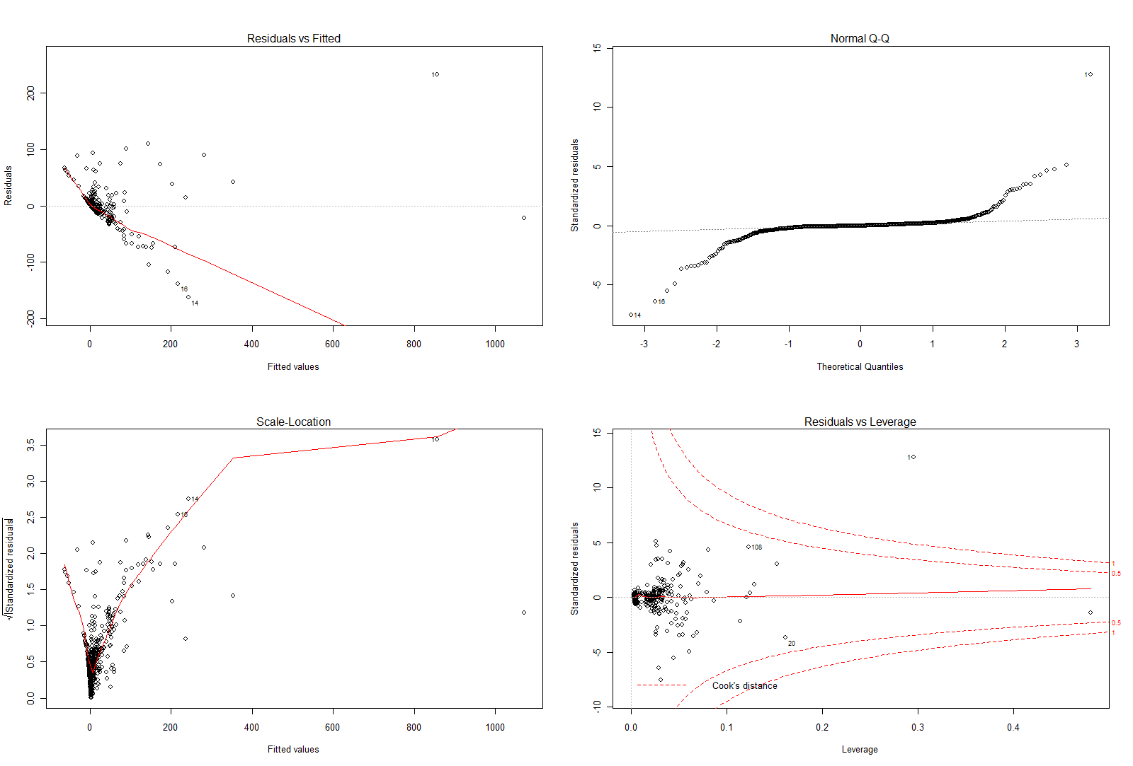
Residual Plots – Not Pretty!

Slide 5
Box-Cox Transformation of Y
Goal: Transform Y to Normality – Box-Cox Transformation (Power Transformation)
Goal: Choose power λ that minimizes Error Sum of Squares (maximizes normal likelihood), typically evaluated over (-2,+2)

Slide 6
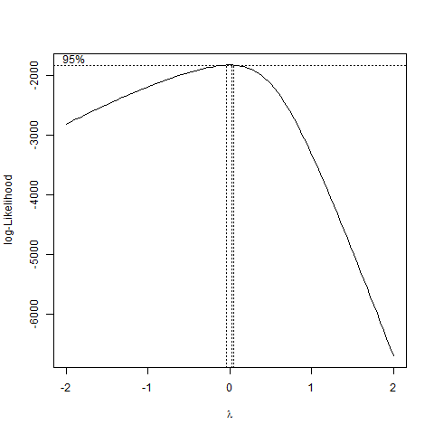
Plot of log-Likelihood vs λ
Choose λ=0 – Logarithmic transformation: Y’ = ln(Y)

Slide 7
Model with Y’ = ln(Y)
Coefficients:
Estimate Std. Error t value Pr(>|t|)
(Intercept) 2.55942 0.14293 17.906 < 2e-16 ***
labor 0.13648 0.02763 4.940 9.86e-07 ***
surface -0.07384 0.05756 -1.283 0.2
appalachia -2.03450 0.13380 -15.205 < 2e-16 ***
interior -1.52129 0.15209 -10.003 < 2e-16 ***
mineprep 0.50231 0.09355 5.370 1.08e-07 ***
I(labor * surface) 0.15908 0.01835 8.670 < 2e-16 ***
I(labor * appalachia) 0.16475 0.02275 7.242 1.20e-12 ***
I(labor * interior) 0.16721 0.02639 6.336 4.28e-10 ***
I(labor * mineprep) -0.12685 0.01526 -8.311 5.13e-16 ***
---
Signif. codes: 0 ‘***’ 0.001 ‘**’ 0.01 ‘*’ 0.05 ‘.’ 0.1 ‘ ’ 1
Residual standard error: 0.5417 on 681 degrees of freedom
Multiple R-squared: 0.8079, Adjusted R-squared: 0.8054
F-statistic: 318.2 on 9 and 681 DF, p-value: < 2.2e-16

Slide 8
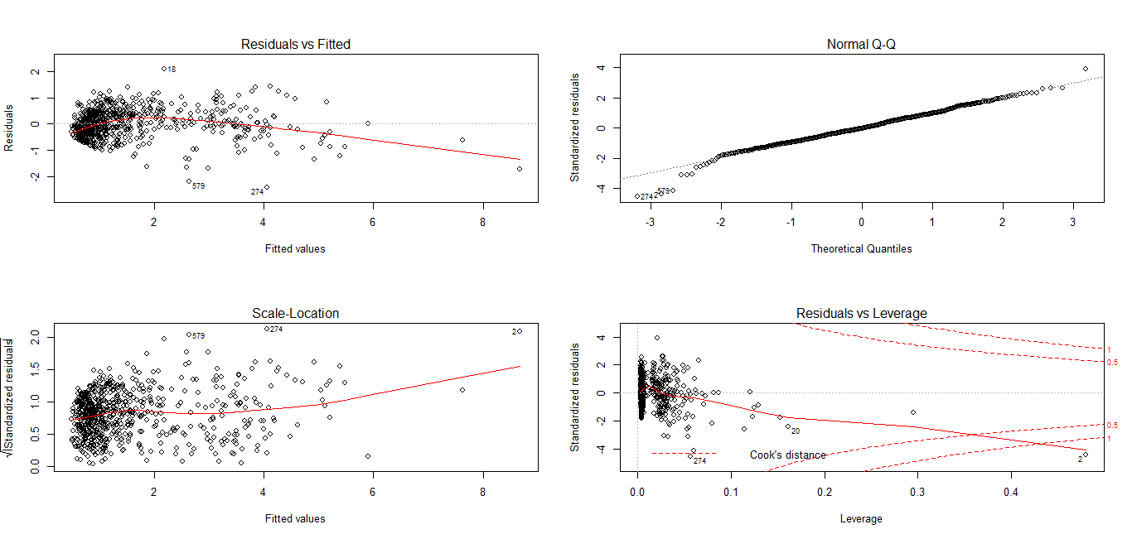
Residual Plots with Y’ = ln(Y)

Slide 9
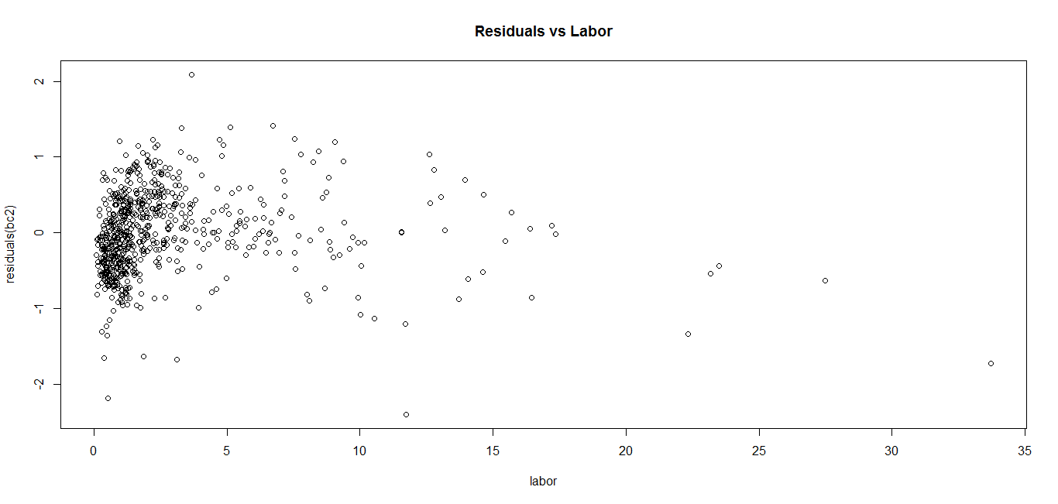
Plot of Residuals versus Labor
Evidence of possibly nonlinear relation between ln(Y) and X
Consider power transformation of X

Slide 10
Box-Tidwell Transformation of X
Goal: Power Transformation of X to make relation with (transformed, in this case) Y linear
Classify variables as to be transformed (Labor), and variables not to be transformed (regional and mine type dummies)
Can be computed in R with car package, along with a test of whether power = 1 (no transformation)
> boxTidwell(logprod ~ labor, other.x=~surface + appalachia + interior + mineprep)
Score Statistic p-value MLE of lambda
-21.75547 0 0.2768753
Choose to make X’ = X^{0.25} for labor (and labor interactions with regions and mine types

Slide 11
Full Model with Y’=ln(Y) and L’=L^{0.25}
Coefficients:
Estimate Std. Error t value Pr(>|t|)
(Intercept) -1.28897 0.35303 -3.651 0.000281 ***
labor25 3.12581 0.25251 12.379 < 2e-16 ***
surface -0.15534 0.15391 -1.009 0.313191
appalachia -0.93595 0.32755 -2.857 0.004402 **
interior -0.49939 0.36439 -1.370 0.170987
mineprep -0.43924 0.20918 -2.100 0.036110 *
I(labor25 * surface) 0.53234 0.13157 4.046 5.8e-05 ***
I(labor25 * appalachia) -0.18624 0.22728 -0.819 0.412831
I(labor25 * interior) -0.09431 0.25320 -0.372 0.709658
I(labor25 * mineprep) 0.28679 0.14875 1.928 0.054266 .
---
Signif. codes: 0 ‘***’ 0.001 ‘**’ 0.01 ‘*’ 0.05 ‘.’ 0.1 ‘ ’ 1
Residual standard error: 0.4508 on 681 degrees of freedom
Multiple R-squared: 0.8669, Adjusted R-squared: 0.8652
F-statistic: 493 on 9 and 681 DF, p-value: < 2.2e-16
Note that neither interaction of transformed labor and regional dummies (appalachia and interior) appear important – refit simpler model.

Slide 12
Reduced Model with Y’=ln(Y) and L’=L^{0.25}
Coefficients:
Estimate Std. Error t value Pr(>|t|)
(Intercept) -1.04247 0.14758 -7.064 4.00e-12 ***
labor25 2.94855 0.10597 27.824 < 2e-16 ***
surface -0.19196 0.14803 -1.297 0.1951
appalachia -1.19221 0.07681 -15.522 < 2e-16 ***
interior -0.64264 0.08357 -7.690 5.14e-14 ***
mineprep -0.48673 0.20247 -2.404 0.0165 *
I(labor25 * surface) 0.56751 0.12508 4.537 6.74e-06 ***
I(labor25 * mineprep) 0.32409 0.14287 2.268 0.0236 *
---
Signif. codes: 0 ‘***’ 0.001 ‘**’ 0.01 ‘*’ 0.05 ‘.’ 0.1 ‘ ’ 1
Residual standard error: 0.4504 on 683 degrees of freedom
Multiple R-squared: 0.8668, Adjusted R-squared: 0.8654
F-statistic: 634.9 on 7 and 683 DF, p-value: < 2.2e-16
Res.Df RSS Df Sum of Sq F Pr(>F)
1 683 138.56
2 681 138.39 2 0.17023 0.4189 0.658
Drop the 2 interactions from the model

Slide 13
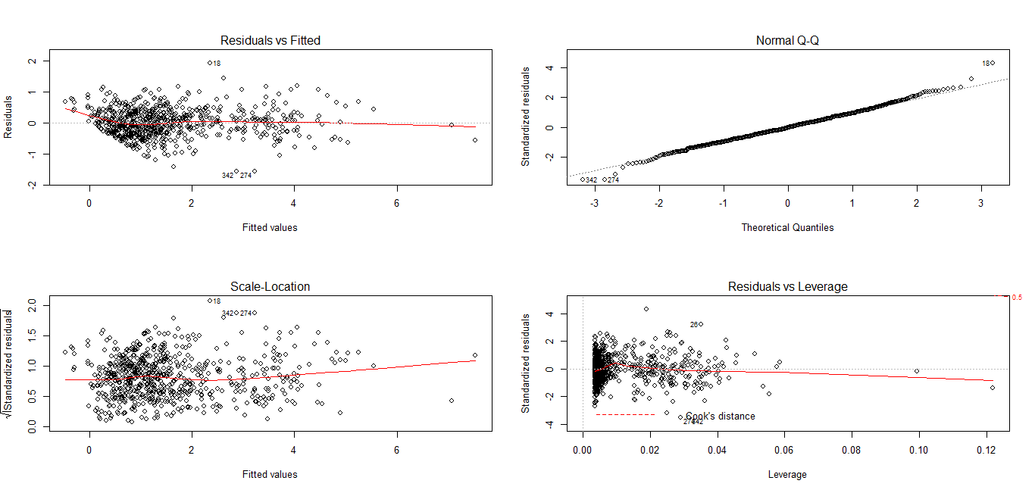
Residual Plots for Final Model

