Slide 1
Application of Empirical Joint Probability Distributions
NBA Regular Season Over/Under Betting Lines and Actual Total Points – 2006/07-2018/19 Regular Seasons
Data Source: covers.com

Slide 2
Data Description
Population: N = 15749 National Basketball Association Games from 2006/07-2018/19 Seasons
Variables observed for each game:
X = Over/Under Betting Line set pre-game for Total Points Scored in Game
Y = Total Points Actually Scored in Game
Z = Over/Under Betting Range (Representing a Partition of Sample Space of Over/Under), Used in Demonstrating Expectations, Variances, and Covariances
Note: all computations for Standard Deviations, Variances, and Covariances are adjusted to use N, not N-1 as divisor

Slide 3
Univariate Summaries

Slide 4
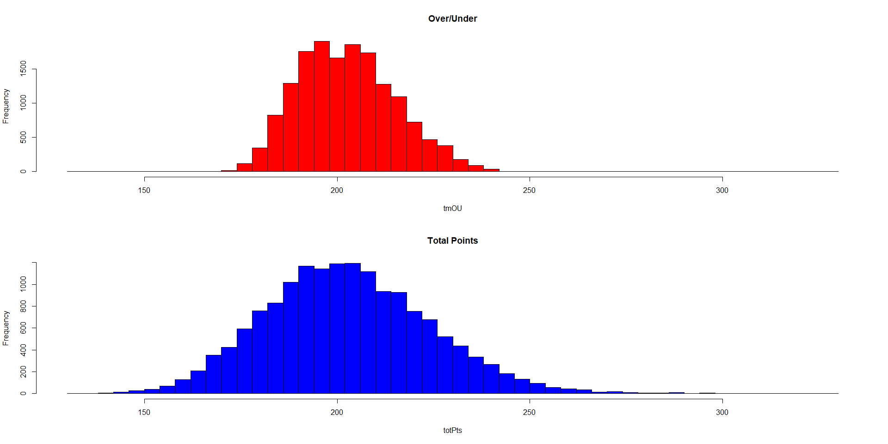
Histograms

Slide 5
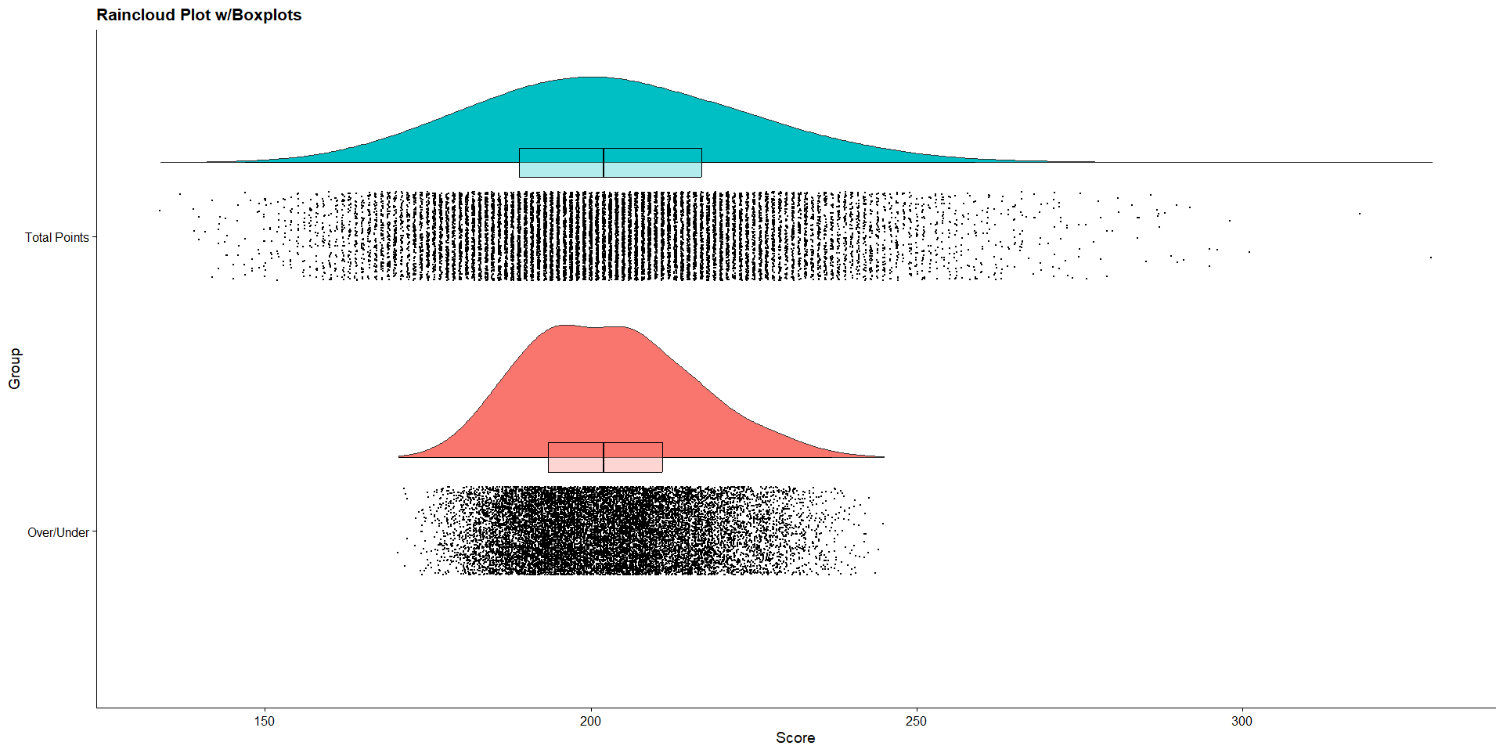
Raincloud Plot with Boxplots

Slide 6
Bivariate Association Between Over/Under (X) and Total Points (Y) - I

Slide 7
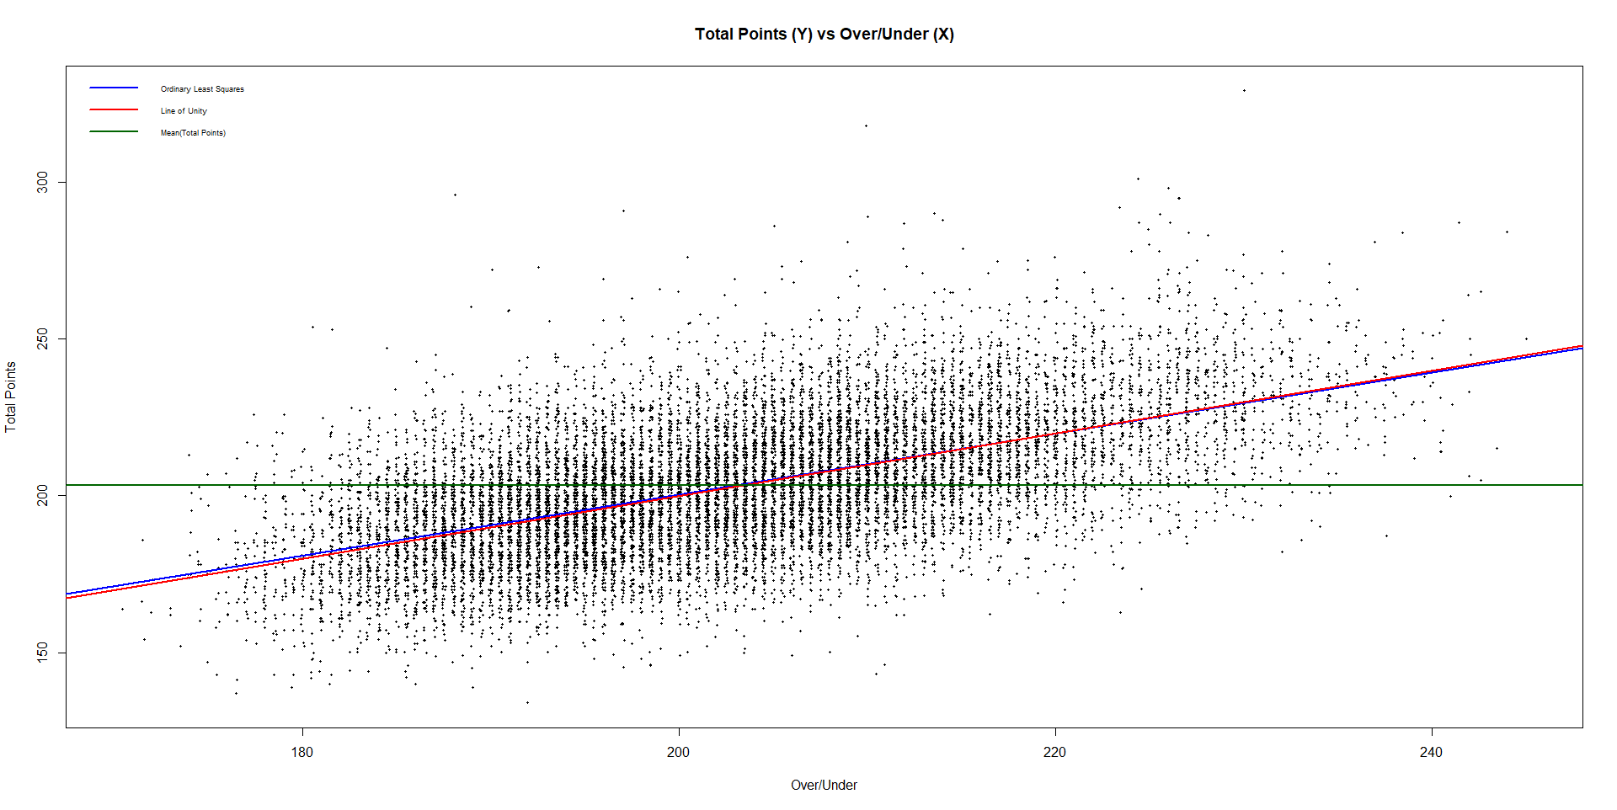
Bivariate Association Between Over/Under (X) and Total Points (Y) - II

Slide 8
Conditional Distributions of X and Y Given Z - I
Note:
1) The conditional means of X (Over/Under) and Y (Total Points) are very similar with each level of z (corr = .999)
2) The conditional means of X and Y are increasing in z (which is a partition of the Over/Under range) – not surprising
3) The conditional correlations between X and Y are much smaller within z levels than overall (ρ_{XY} = 0.568)
4) The highest conditional correlations are in the two extreme z levels (low score and high score games)

Slide 9
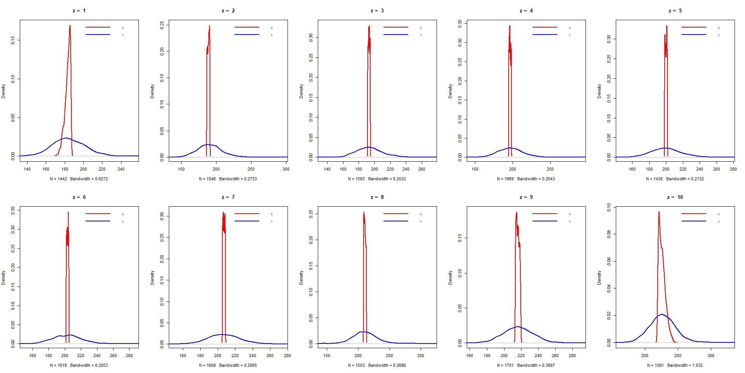
Conditional Distributions of X and Y Given Z - II

Slide 10
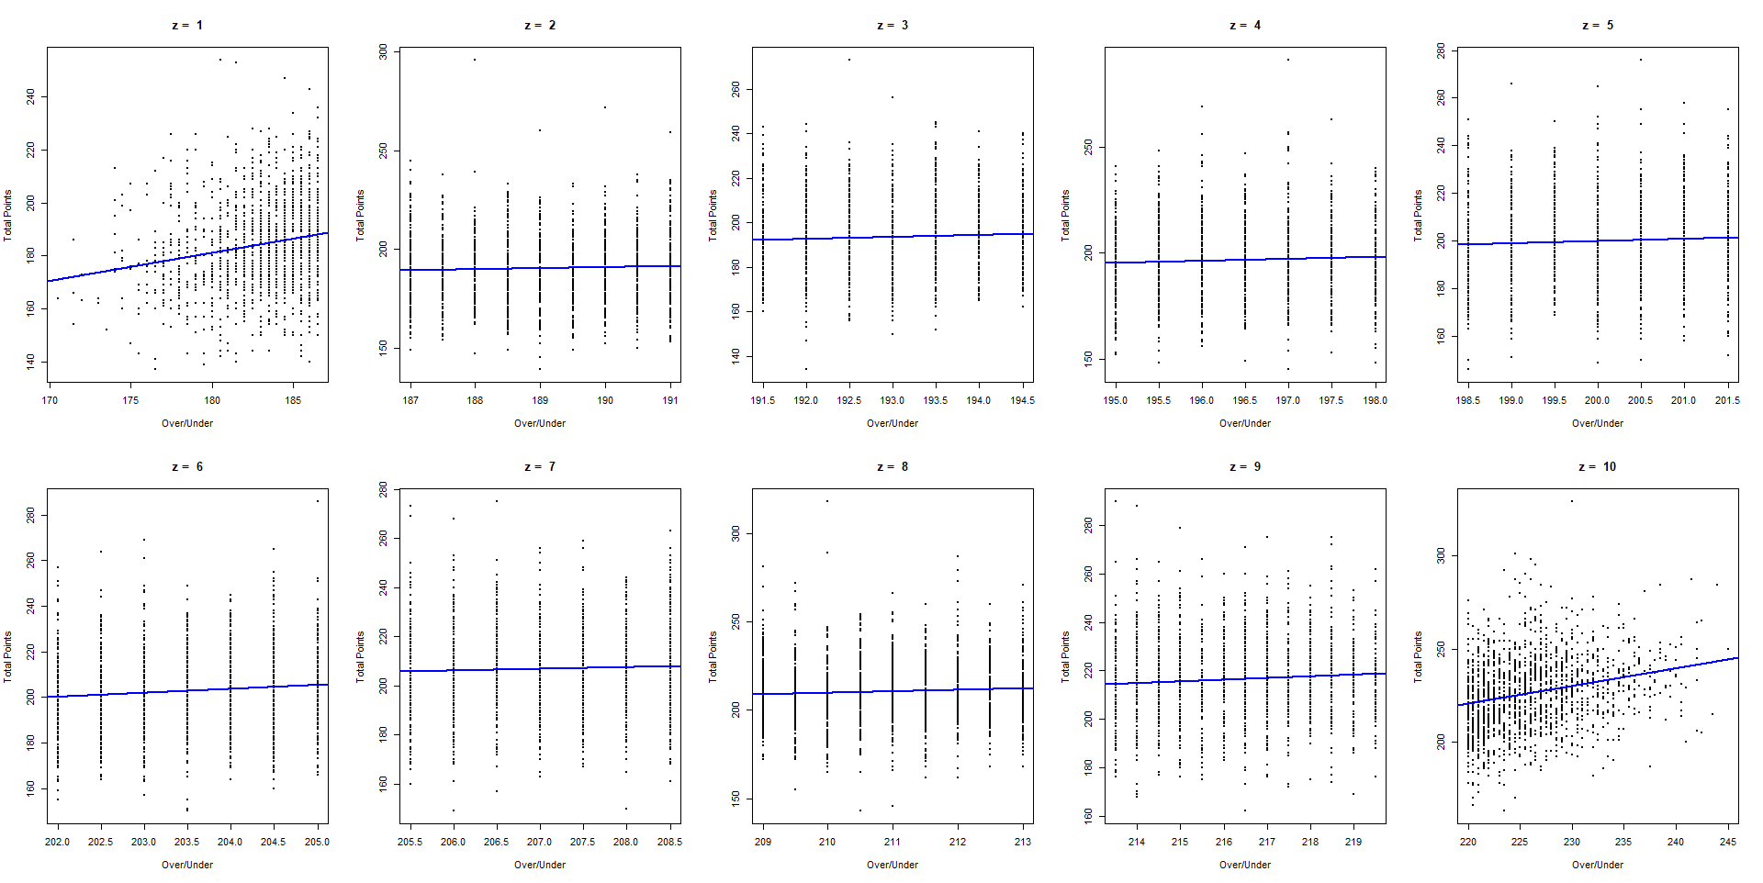
Associations Between X and Y Given Z

Slide 11
Conditional Expectations, Variances, and Covariances - I

Slide 12
Conditional Expectations, Variances, and Covariances - II
Marginal Mean = Probability weighted average of conditional means
Marginal Variance = Mean(Conditional Variances) + Variance(Conditional Means)
Marginal Covariance = Mean(Conditional Covariances) + Covariance(Conditional Means)

Slide 13
Application: NBA Over/Under (X), Total Points (Y), OU Group (Z)

