Slide 1
Checking Regression Model Assumptions
NBA 2013/14 Player Heights and Weights

Slide 2
Data Description / Model
Heights (X) and Weights (Y) for 505 NBA Players in 2013/14 Season.
Other Variables included in the Dataset: Age, Position
Simple Linear Regression Model: Y = β₀ + β₁X + ε
Model Assumptions:
ε ∼ N(0,σ²)
Errors are independent
Error variance (σ²) is constant
Relationship between Y and X is linear
No important (available) predictors have been ommitted

Slide 3
Plot of Weight versus Height with Fitted Line

Slide 4
Regression Model

Slide 5
Checking Normality of Errors
Graphically
Histogram – Should be mound shaped around 0
Normal Probability Plot – Residuals versus expected values under normality should follow a straight line.
Rank residuals from smallest (large negative) to highest (k = 1,…,n)
Compute the quantile for the ranked residual: p=(k-0.375)/(n+0.25)
Obtain the Z-score corresponding to the quantiles: z(p)
Expected Residual = √MSE*z(p)
Plot Ordered residuals versus Expected Residuals
Numerical Tests:
Correlation Test: Obtain correlation between ordered residuals and z(p). Critical Values for n up to 100 are provided by Looney and Gulledge (1985)).
Shapiro-Wilk Test: Similar to Correlation Test, with more complex calculations. Printed directly by statistical software packages

Slide 6
Normal Probability Plot / Correlation Test
Extreme and Middle Residuals
The correlation between the Residuals and their expected values under normality is 0.9972.
Based on the Shapiro-Wilk test in R, the P-value for H₀: Errors are normal is P = .0859 (Do not reject Normality)

Slide 7
Checking the Constant Variance Assumption
Plot Residuals versus X or Predicted Values
Random Cloud around 0 ⇒ Linear Relation
Funnel Shape ⇒ Non-constant Variance
Outliers fall far above (positive) or below (negative) the general cloud pattern
Plot absolute Residuals, squared residuals, or square root of absolute residuals
Positive Association ⇒ Non-constant Variance
Numerical Tests
Brown-Forsyth Test – 2 Sample t-test of absolute deviations from group medians
Breusch-Pagan Test – Regresses squared residuals on model predictors (X variables)

Slide 8
Plot of Residuals versus Fitted Values

Slide 9
Plot of Absolute Residuals versus Fitted Values

Slide 10
Equal (Homogeneous) Variance - I

Slide 11
Equal (Homogeneous) Variance - II

Slide 12
Brown-Forsyth and Breusch-Pagan Tests
Brown-Forsyth Test:
Group 1: Heights ≤ 79”, Group 2: Heights ≥ 80”
H₀: Equal Variances Among Errors (Reject H₀)
Breusch-Pagan Test:
H₀: Equal Variances Among Errors (Reject H₀)

Slide 13
Linearity of Regression - I

Slide 14
Linearity of Regression - II

Slide 15
Linearity of Regression - III

Slide 16
Height and Weight Data – n=505, c=18 Groups
Do not reject
H₀: μ_{j} = β₀ + β₁X_{j}

Slide 17
Box-Cox Transformations
Automatically selects a transformation from power family with goal of obtaining: normality, linearity, and constant variance (not always successful, but widely used)
Goal: Fit model: Y’ = β₀ + β₁X + ε for various power transformations on Y, and selecting transformation producing minimum SSE (maximum likelihood)
Procedure: over a range of λ from, say -2 to +2, obtain W_{i} and regress W_{i} on X (assuming all Y_{i} > 0, although adding constant won’t affect shape or spread of Y distribution)

Slide 18
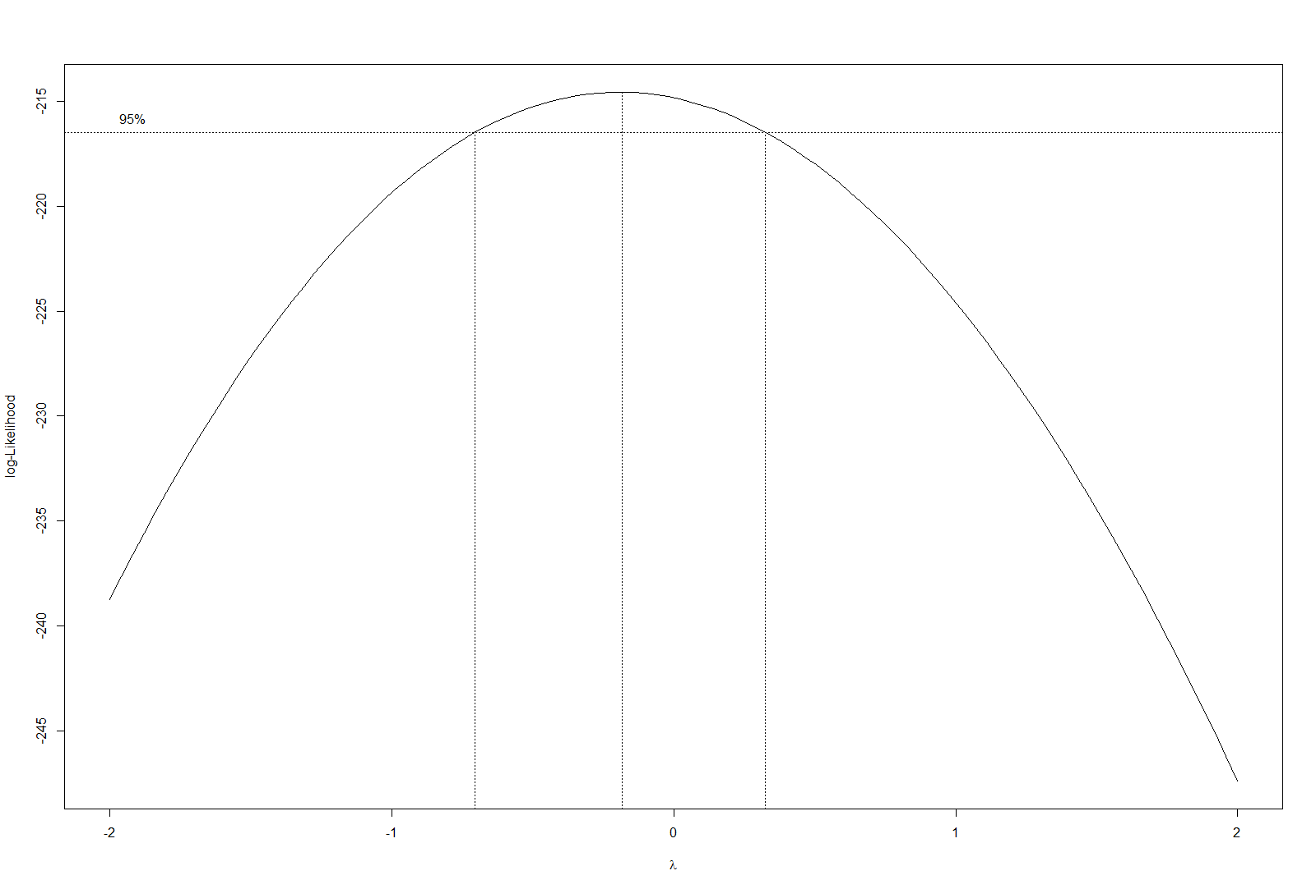
Box-Cox Transformation – Obtained in R
Maximum occurs near λ = 0 (Interval Contains 0) – Try taking logs of Weight

Slide 19
Results of Tests (Using R Functions) on ln(WT)
Normality of Errors (Shapiro-Wilk Test)
> shapiro.test(e2)
Shapiro-Wilk normality test
data: e2
W = 0.9976, p-value = 0.679
> nba.mod2 <- lm(log(Weight) ~ Height)
> summary(nba.mod2)
Call:
lm(formula = log(Weight) ~ Height)
Coefficients:
Est Std. Error t value Pr(>|t|)
(Intercept) 3.0781 0.0696 44.20 <2e-16 Height 0.0292 0.0009 33.22 <2e-16
Residual standard error: 0.06823 on 503 degrees of freedom
Multiple R-squared: 0.6869, Adjusted R-squared: 0.6863
F-statistic: 1104 on 1 and 503 DF, p-value: < 2.2e-16
Constant Error Variance (Breusch-Pagan Test)
> bptest(log(Weight) ~ Height,studentize=FALSE)
Breusch-Pagan test
data: log(Weight) ~ Height
BP = 0.4711, df = 1, p-value = 0.4925
Linearity of Regression (Lack of Fit Test)
nba.mod3 <- lm(log(Weight) ~ factor(Height))
> anova(nba.mod2,nba.mod3)
Analysis of Variance Table
Model 1: log(Weight) ~ Height
Model 2: log(Weight) ~ factor(Height)
Res.Df RSS Df Sum of Sq F Pr(>F)
1 503 2.3414
2 487 2.2478 16 0.093642 1.268 0.2131
Model fits well on all assumptions

