Slide 1
Violations of Assumptions In Least Squares Regression

Slide 2
Standard Assumptions in Regression
Errors are Normally Distributed with mean 0
Errors have constant variance
Errors are independent
X is Measured without error

Slide 3
Example X^{s} and OLS Estimators
“t” is used to imply time ordering

Slide 4
Non-Normal Errors (Shifted Gamma)

Slide 5
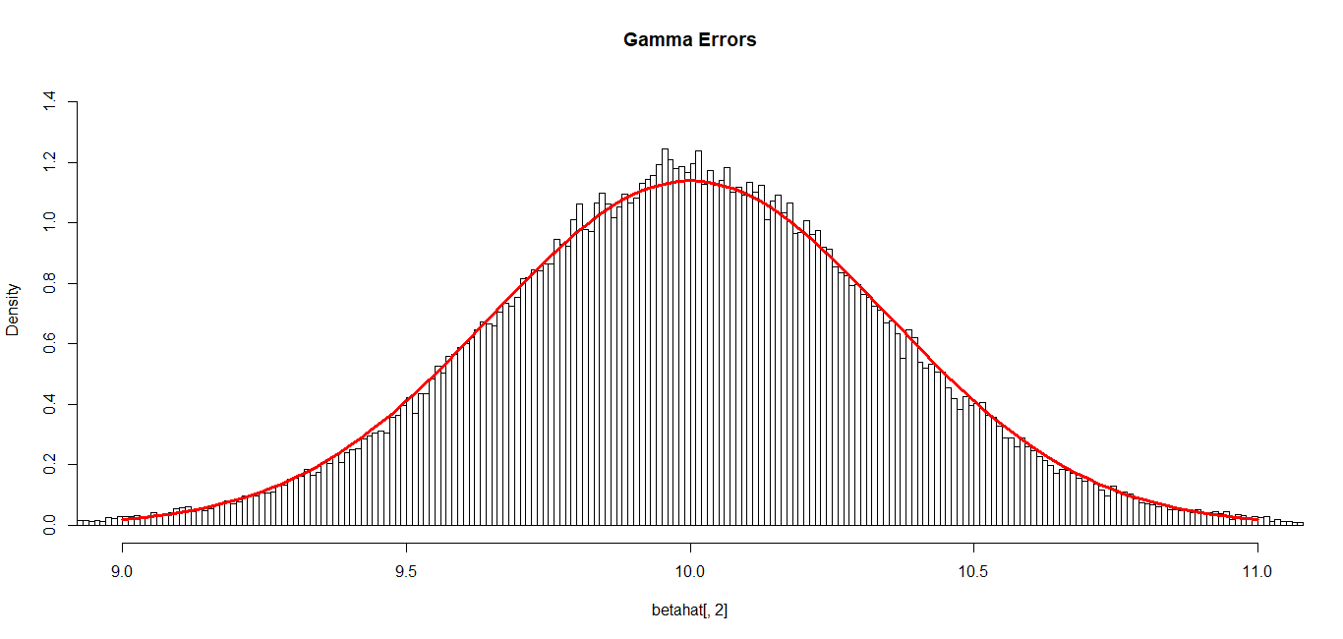
Errors = (Gamma(2,3.6742)-7.3485)
Y_{t} = 50 + 10X_{t} + (ε_{t}-7.35) = β₀*+β₁X_{t}+ε_{t}*
E(ε_{t}*) = 0 V(ε_{t}*) = 27
Based on 100,000 simulations, the 95% CI for β₁ contained 10 in 95.05% of the samples.
Average=9.99887, SD=0.3502
Average s²{b1} = 0.1224804

Slide 6
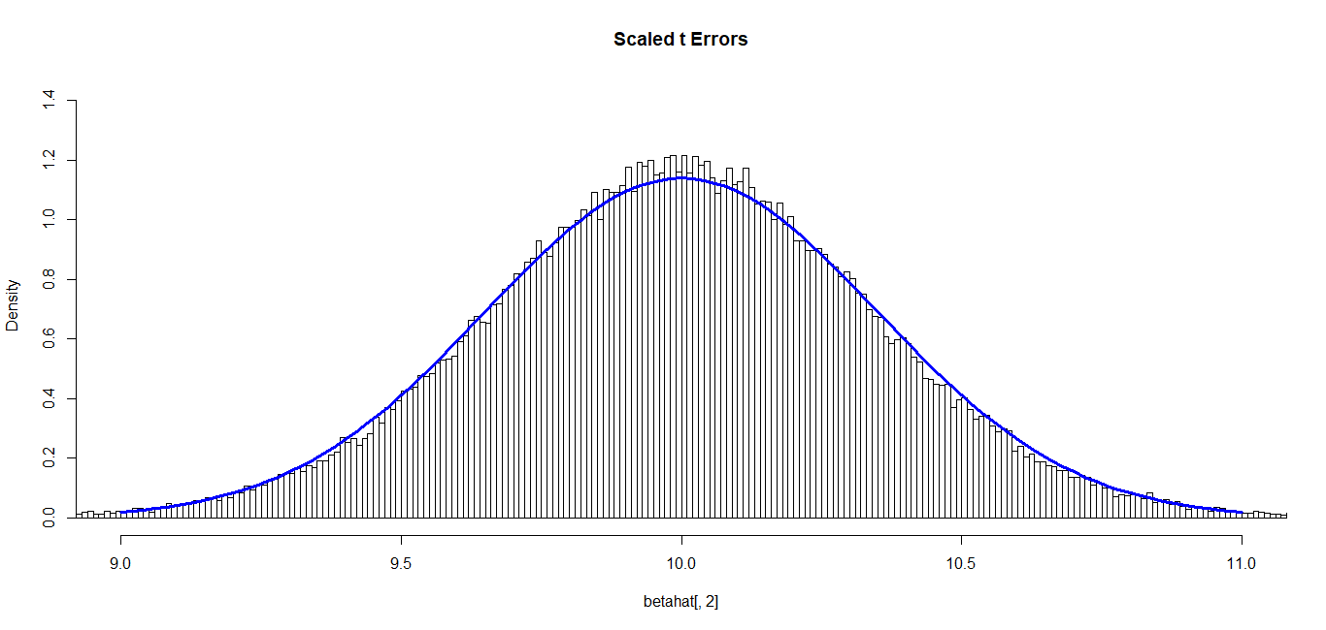
Errors = Scaled t(ν=5,μ=0,σ=√45)
Y_{t} = 50 + 10X_{t} + ε_{t} E(ε_{t}*) = 0 V(ε_{t}*) = 27
Based on 100,000 simulations, the 95% CI for β₁ contained 10 in 95.16% of the samples.
Average=9.99822, SD=0.34924
Average s²{b1} = 0.1223469

Slide 7
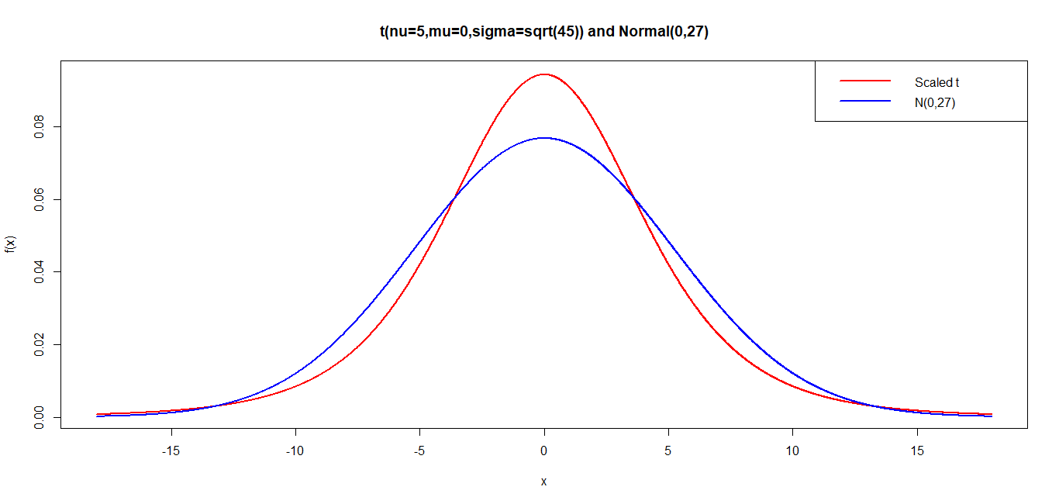
Scaled t-Distribution

Slide 8
Non-Constant Error Variance (Heteroscedasticity)- I
Mean: E(Y|X) = β₀ + β₁ X = 50 + 10X
Standard Deviation: σ_{Y|X} = X + 0.5
Distribution: Normal

Slide 9
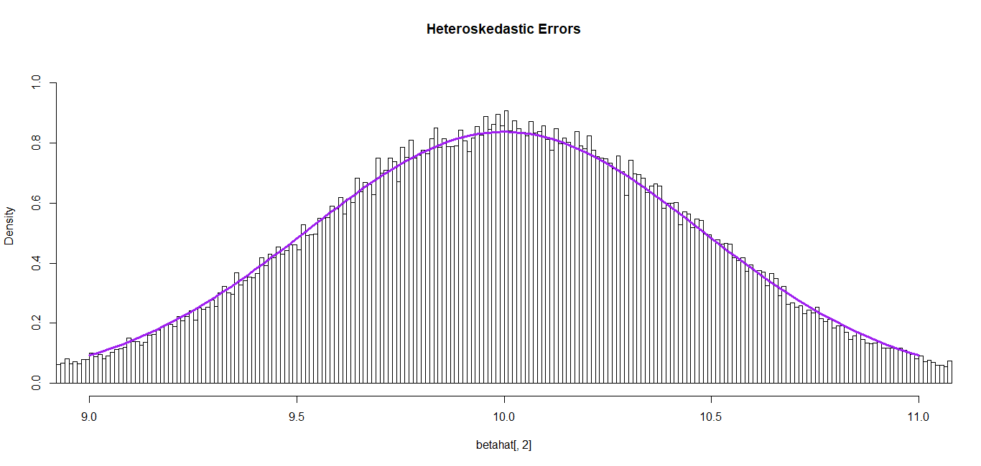
Non-Constant Error Variance (Heteroscedasticity) - II
Based on 100,000 simulations, the 95% CI for β₁ contained 10 in 92.62% of the samples.
Average=10.0023, SD = 0.46645
Average s²{b1} = 0.18111 < 0.2184

Slide 10
Correlated Errors - I
Example: σ²= 9, ρ=0.5, n=22

Slide 11
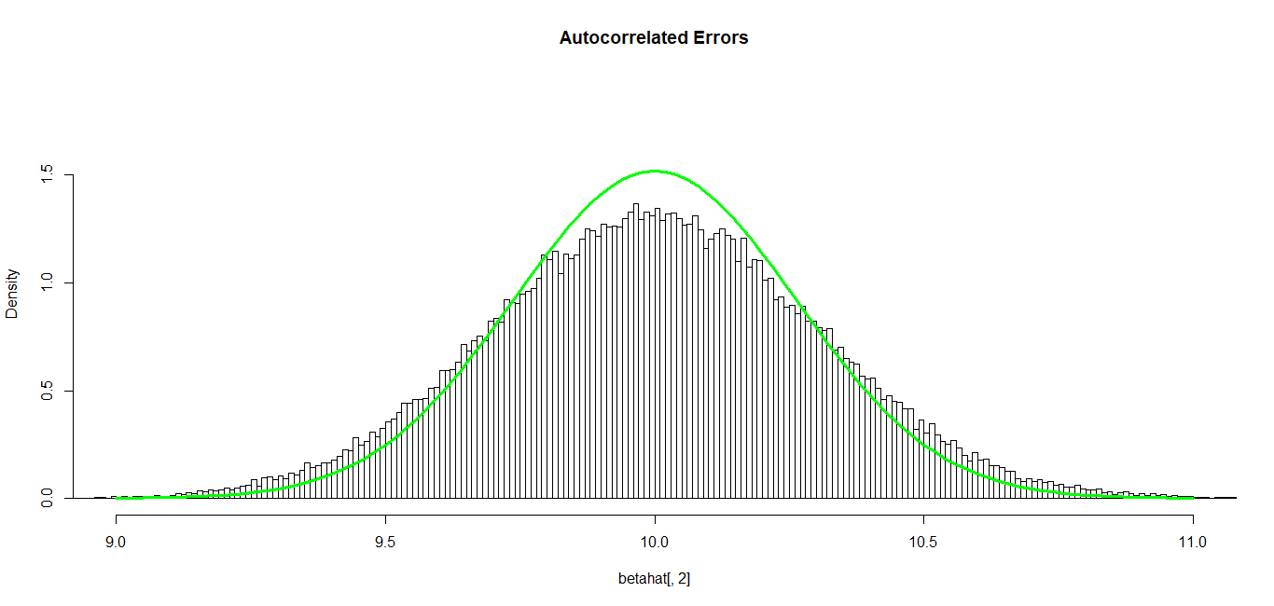
Correlated Errors - II
Based on 100,000 simulations, the 95% CI for β₁ contained 10 in 84.56% of the samples.
Average=10.00216, SD=0.3039251
Average s²(b1) = 0.0476444 < 0.092157

Slide 12
Measurement Error in X - I
Z=True Value of Independent Variable (Unobserved)
X=Observed Value of Independent Variable
X=Z+U (Z can be fixed or random)
Z, U independent (assumed) when Z is random
V(U) is independent of Z when Z is fixed

Slide 13
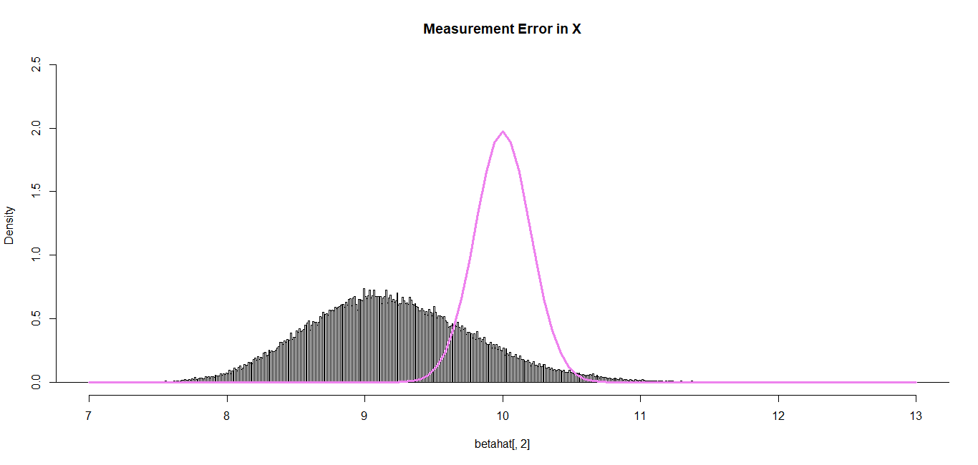
Measurement Error in X - II
Based on 100,000 simulations, the 95% CI for β₁ contained 10 in 76.81% of the samples.
Average=9.198791, SD=0.6087779
Average s²(b1) = 0.4294276 >> (0.20226)²

