Slide 1
Regression with Random Predictor(s)
NBA Total Points and Over/Under 2014-2015 Regular Season
Sources:
Covers.com (Data)
A.C. Cameron and P.K. Trivedi (2005). Microeconometrics: Methods and Applications, Cambridge (Section 4.4)

Slide 2
Data Description
2014-2015 NBA Regular Season (1230 Total Games, 1154 Non-OT Games)
Y = Total Points in Game (Home Team + Away Team, in 100s of Points)
X = Oddsmakers’ Over-Under for the game (Treated as Random, in 100s).
X* = Centered X (used because X’X matrix is nearly singular for uncentered X)
Data restricted to Population of non-Overtime games (N = 1154)
Population Model Given Below

Slide 3
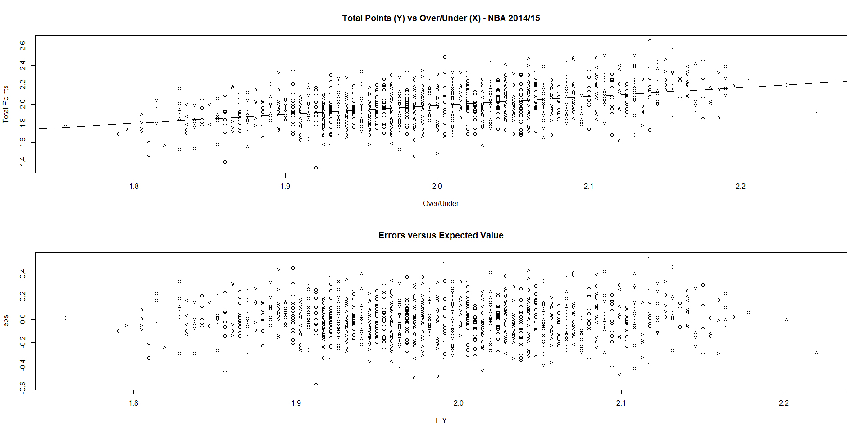
Plots of Total Points vs O/U and Errors vs Expected Value

Slide 4
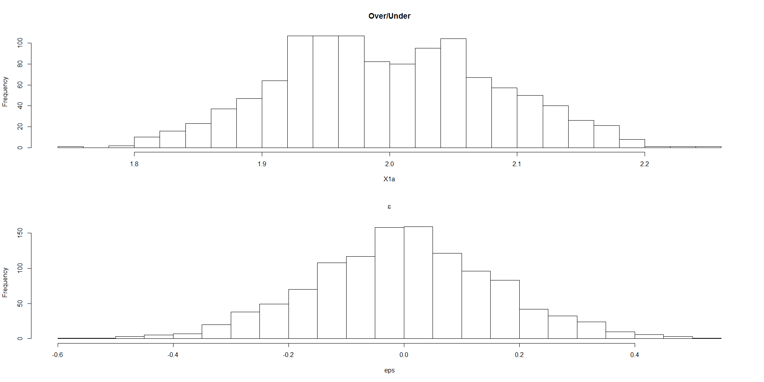
Plots of Over/Under (X) and Errors (ε)

Slide 5
Model With Random X (X , ε Independent)

Slide 6
Application to Population of N=1154 Games and Samples

Slide 7
Applying the Model to NBA Data
Select Sample Size (n = 25 in this Example)
Take a random sample of n = 25 games, obtain Y_{j} and X_{j}
Compute the estimated regression vector (X_{j}’X_{j})⁻¹X_{j}’Y_{j}
Compute s_{j}² = (Error Sum of Squares) / (n-p’)
Save the regression vector, (X_{j}’X_{j}) and s_{j}²
Repeat for many samples (m = 100000 in This Example)
Obtain the means, variances, and covariances of the estimated regression vector
Obtain the mean of the estimated variances: s_{j}²
Obtain the mean of (X_{j}’X_{j}) and the inverse of the mean

Slide 8
Theoretical Results and R Output (n=25 games per sample)
> mean(s2)
[1] 0.02632862
> mean(beta.hat[,1]); mean(beta.hat[,2])
[1] 1.986694
[1] 0.9275195
> var(beta.hat[,1]); var(beta.hat[,2]); cov(beta.hat[,1],beta.hat[,2])
[1] 0.0010876
[1] 0.1699506
[1] 0.001613797
> cor(beta.hat[,1],beta.hat[,2])
[1] 0.1187006

Slide 9
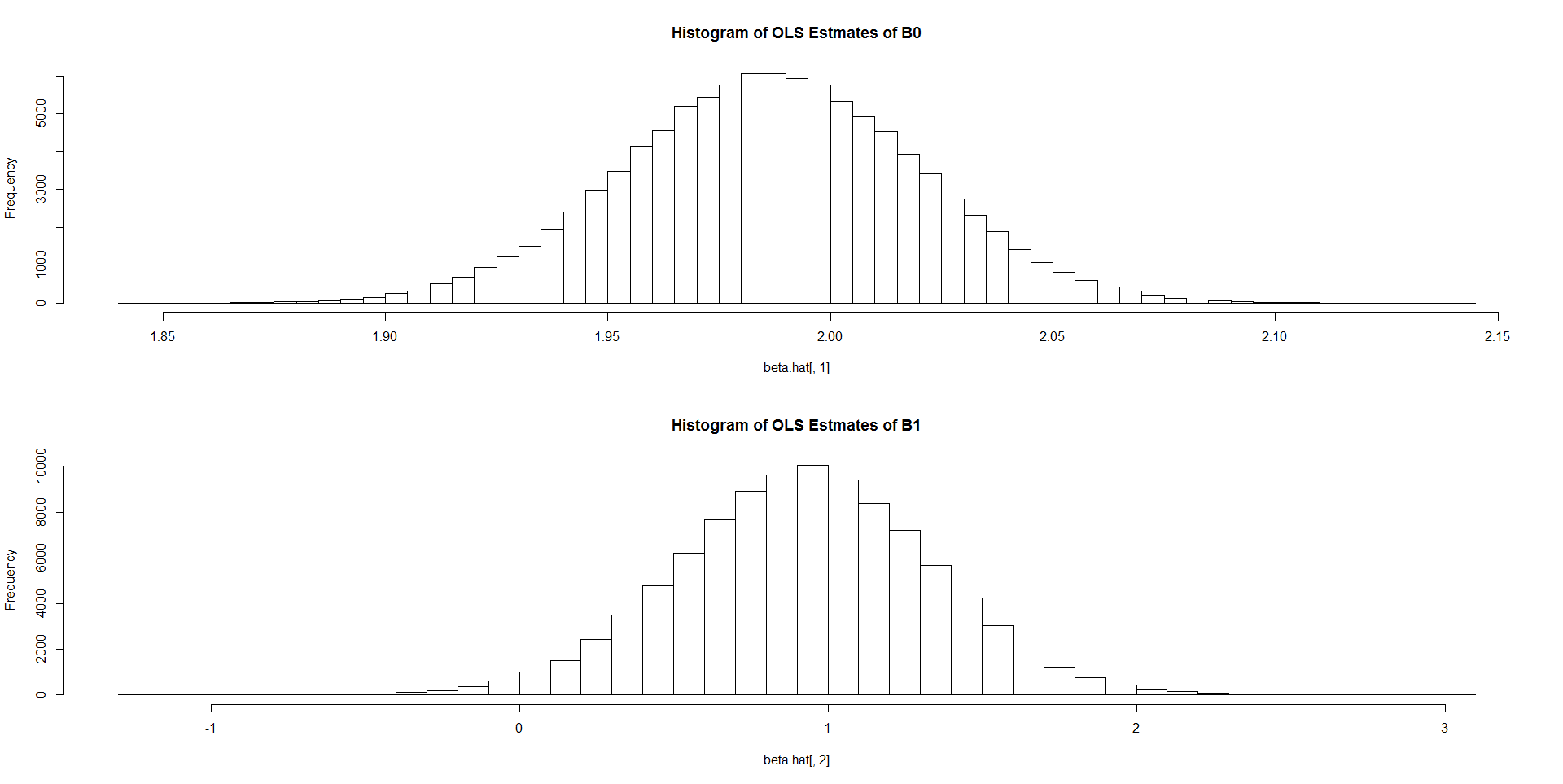
Histograms of Estimated Intercepts and Slopes From Samples

Slide 10
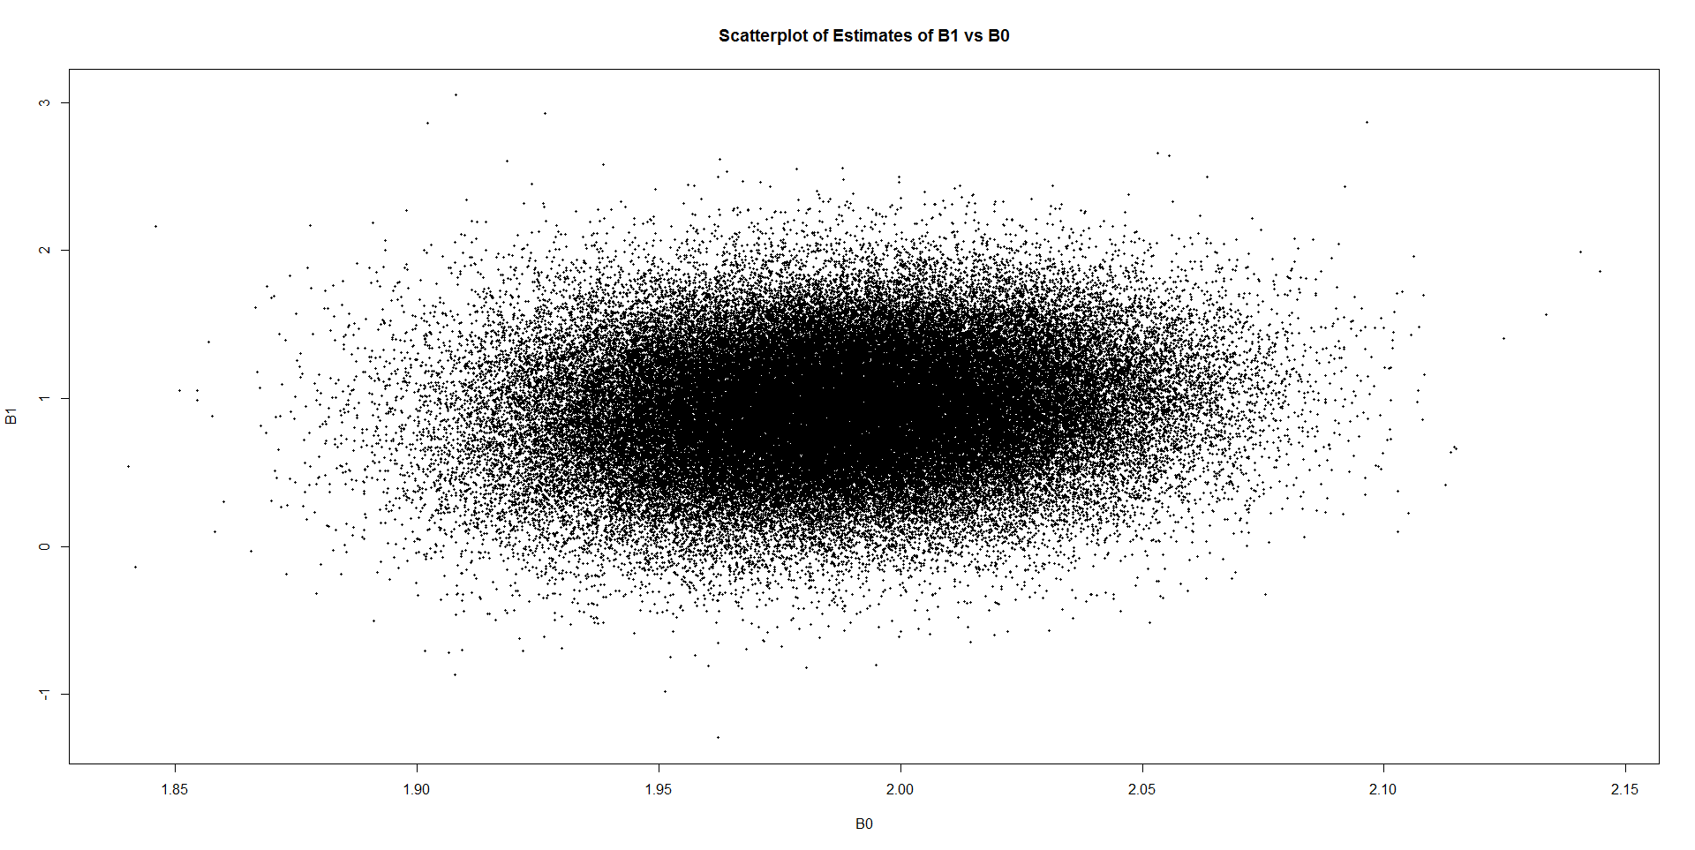
Scatterplot of Estimated Intercepts and Slopes from Samples

