Slide 1
Seemingly Unrelated Regressions
WNBA Point Spread & Over/Under 2010-2019

Slide 2
Data Description
WNBA Predicted and Actual Scores Based on Point Spreads and Over/Under Lines (2010-2019 Regular Seasons, n=2039 games)
Favored Team has Negative Point Spread (“laying points”)
Data are Based on the perspective of the Home Team
Y₁ = Actual Home Team Differential
Y₂ = Actual Home Team Points
X₁ = Predicted Home Team Differential = -Spread (Positive when Home Team is Favored) Centered
X₂ = Predicted Home Team Points ([Over/Under – Spread]/2) Centered

Slide 3
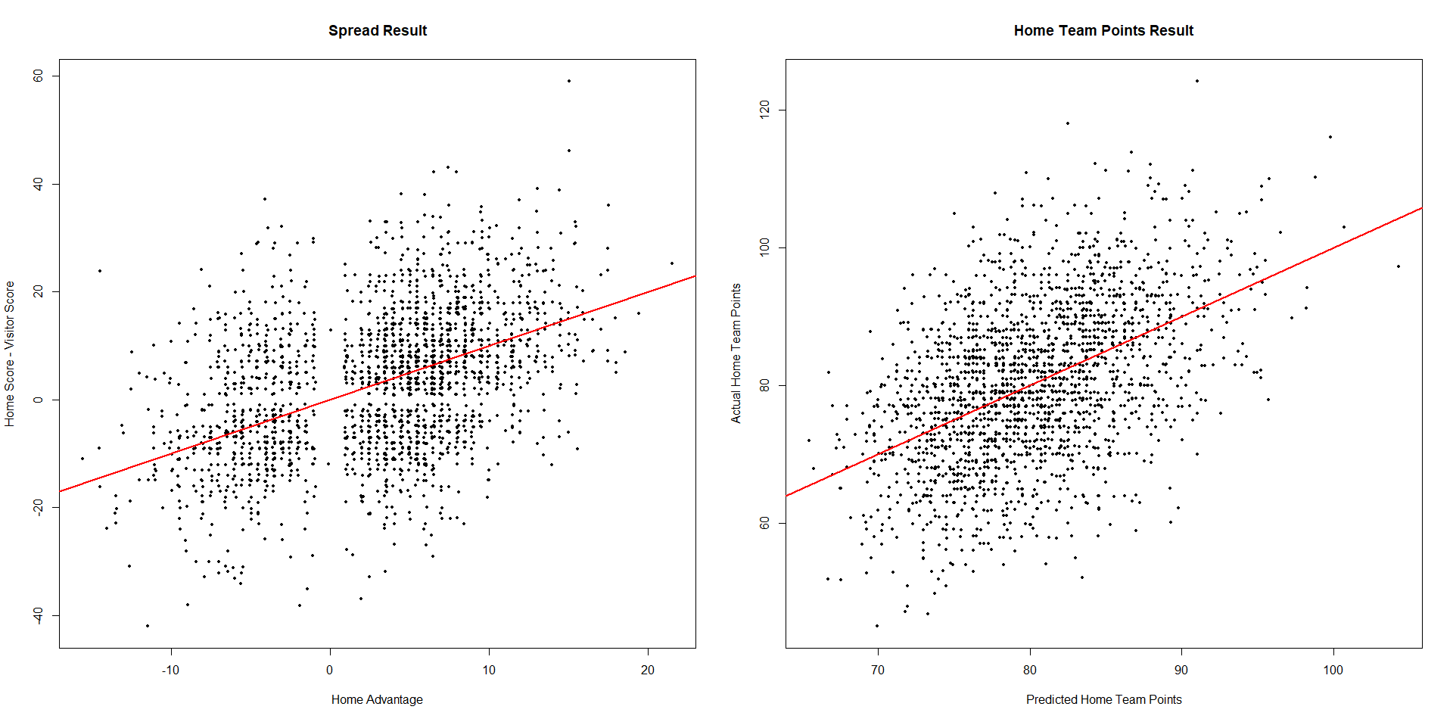
Plots Home Diff vs Spread and Home Points vs Spread Prediction
The Red Lines are the “Lines of Equality” Y = X

Slide 4
Seemingly Unrelated Regression Model - I
# of Experimental Units ≡ n
# of Regression Equations ≡ g
# of Predictor Variables in i^{th} Equation ≡ p_{i}

Slide 5
Seemingly Unrelated Regression Model - II

Slide 6
Seemingly Unrelated Regression Model - III

Slide 7
Example - WNBA

Slide 8
Example – WNBA – OLS and GLS Estimates, Std Errors and t-tests
Ordinary Least Squares
> round(bols.out, 4)
Estimate Std Err t 2P(T>|t|) LB UB
Beta0_Sprd 3.0152 0.2663 11.3239 0 2.4930 3.5374
Beta1_Sprd 0.8766 0.0411 21.3532 0 0.7961 0.9571
Beta0_OU 80.2952 0.2237 358.9031 0 79.8565 80.7340
Beta1_OU 0.9393 0.0395 23.7895 0 0.8619 1.0168
Generalized Least Squares after 5 iterations
> round(bgls.out, 4)
Estimate Std Err t 2P(T>|t|) LB UB
Beta0_Sprd 3.0152 0.2664 11.3194 0 2.4930 3.5374
Beta1_Sprd 0.9289 0.0351 26.4433 0 0.8600 0.9978
Beta0_OU 80.2952 0.2237 358.8887 0 79.8566 80.7339
Beta1_OU 0.9553 0.0338 28.2823 0 0.8891 1.0215

Slide 9
Variation Explained – R²
Home Diff Home Points System
R-Square 0.1822 0.2174 0.2155

Slide 10
Testing Linear Restrictions (General Linear Tests)
Often, we wish to test hypotheses regarding regression coefficients
In this example we may want to test whether (on average):
The actual home team point differential is equal to the prediction based on the point spread
The actual home team points scored is equal to the prediction based on the point spread and Over/Under lines

Slide 11
Test Statistics – I with g = 2 Regressions

Slide 12
Test Statistics - II

Slide 13
Example – WNBA – Theil and Wald F-tests

Slide 14
Example – WNBA – Wald and Likelihood Ratio Chi-Square Tests

