Slide 1
Bivariate Normal Distribution and Regression
Women’s NBA Team Predicted and Actual Points 2010-2024 Regular Seasons
Source: www.covers.com

Slide 2
Data – Predicted and Actual Points
Actual Team Score – WNBA Team Games 2010-2024 Regular Season Games (Y)
Predicted Team Score based on Over/Under and Point Spread Betting Lines where Favored team has negative spread (X)
N = 6118 team games

Slide 3
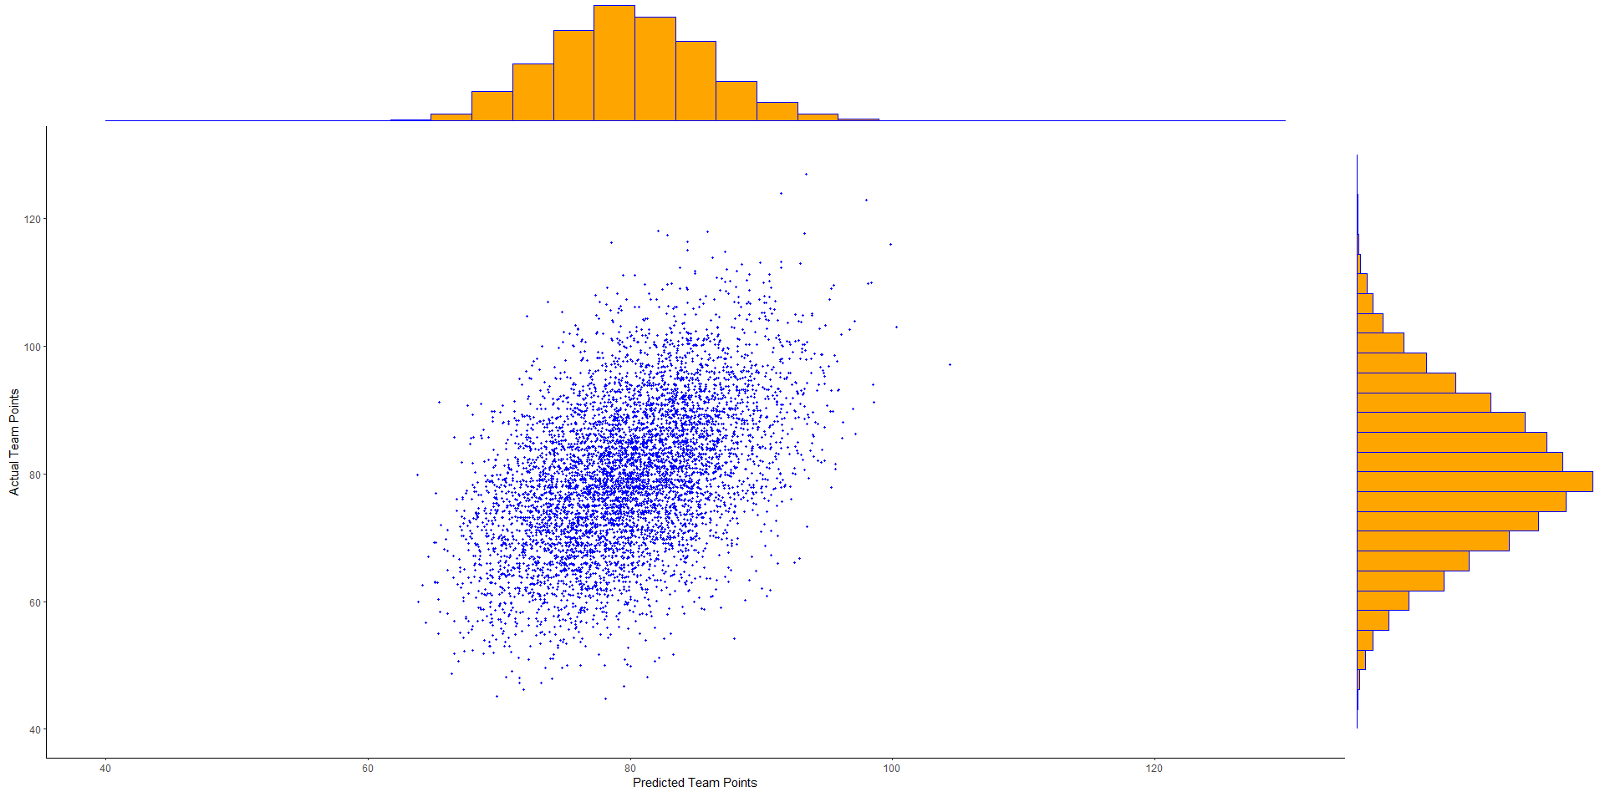
Bivariate Plot with Marginal Histograms

Slide 4
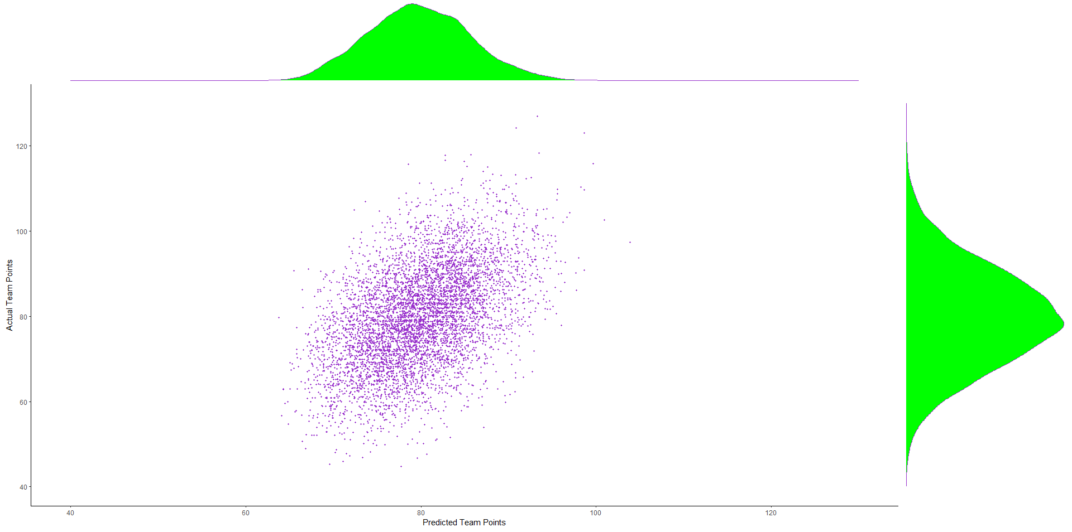
Bivariate Plot with Marginal Densities

Slide 5
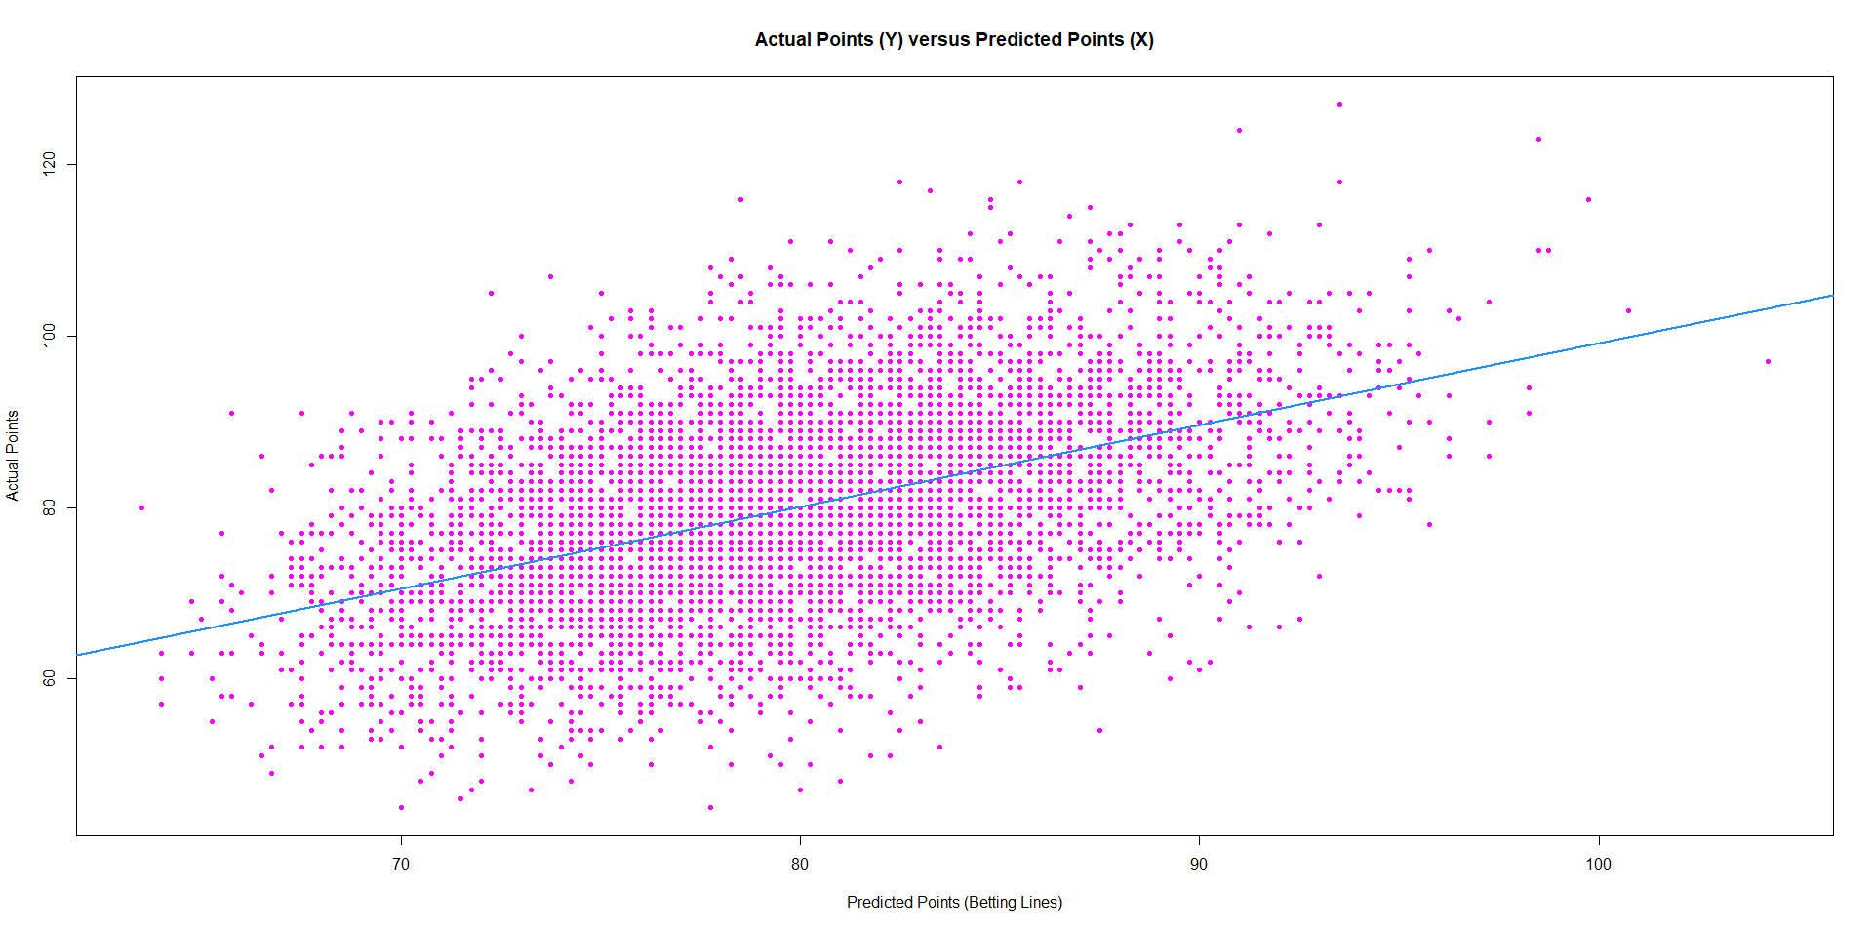
Scatterplot with Regression Line

Slide 6
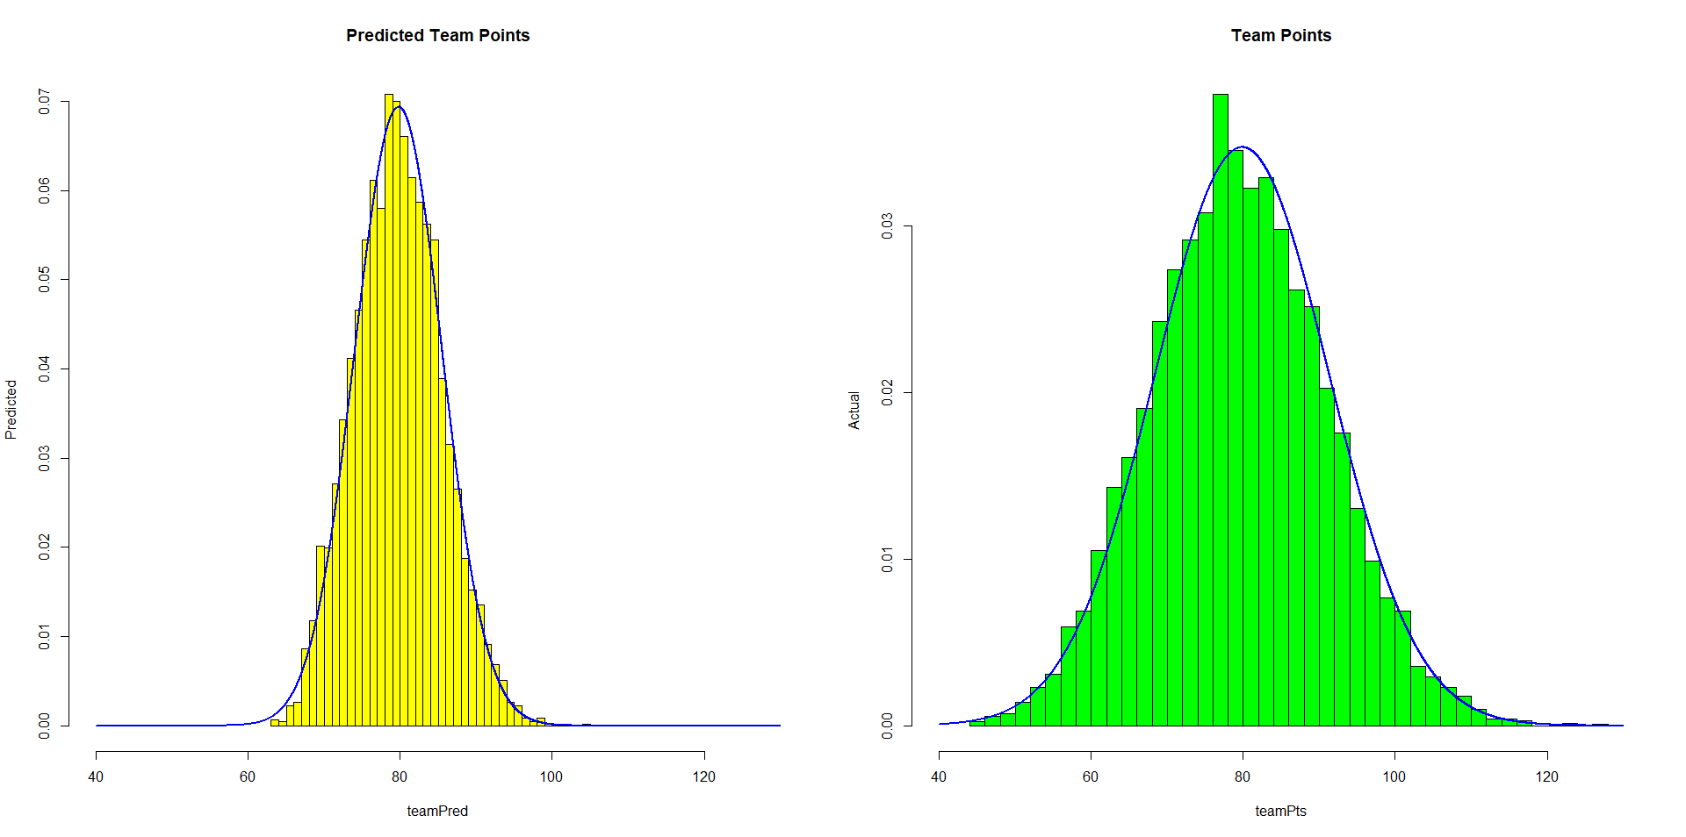
Histograms with Normal Densities

Slide 7
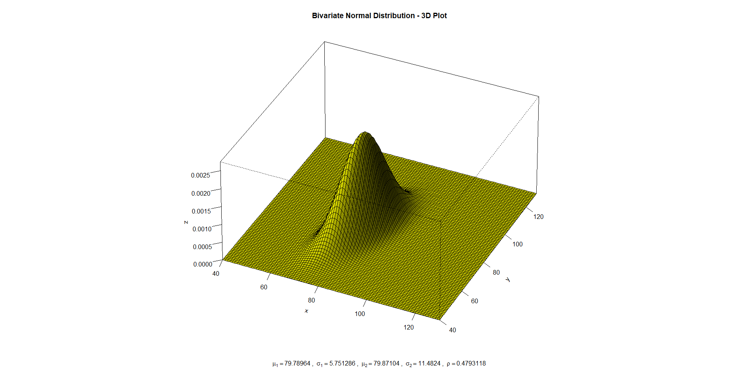
Joint Density Function

Slide 8
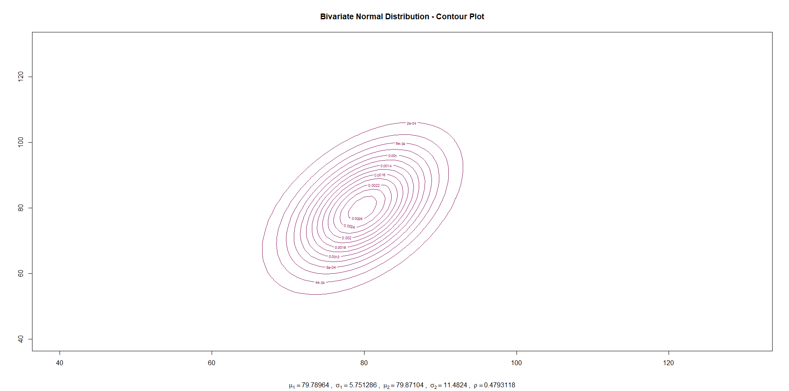
Bivariate Distribution of Actual/Predicted Points

Slide 9
Marginal Distribution of X (p. 1)

Slide 10
Marginal Distribution of X (p. 2)

Slide 11
Conditional Distribution of Y Given X=x (P. 1)

Slide 12
Conditional Distribution of Y Given X=x (P. 2)
This is referred to as the REGRESSION of Y on X

Slide 13
Summary of Results

Slide 14
Actual and Predicted Team Game Scores
Empirical Data Based on 6118 team games
Y = Actual Score
Y ~ N(79.8710,131.8455) σ_{Y} = 11.4824
X = Vegas Prediction
X ~ N(79.7896,33.0755) σ_{X} = 5.7513
COV(X,Y) = 31.6524 ⇒ ρ = 0.4793, ρ² = 0.2297
Y|X=x is Normal with conditional mean and variance:
x | Unconditional | 60 | 75 | 90 | 105
E[Y|x] | 79.8710 | 60.93 | 75.29 | 89.64 | 103.99
σ_{Y|x} | 11.4824 | 10.08 | 10.08 | 10.08 | 10.08

Slide 15
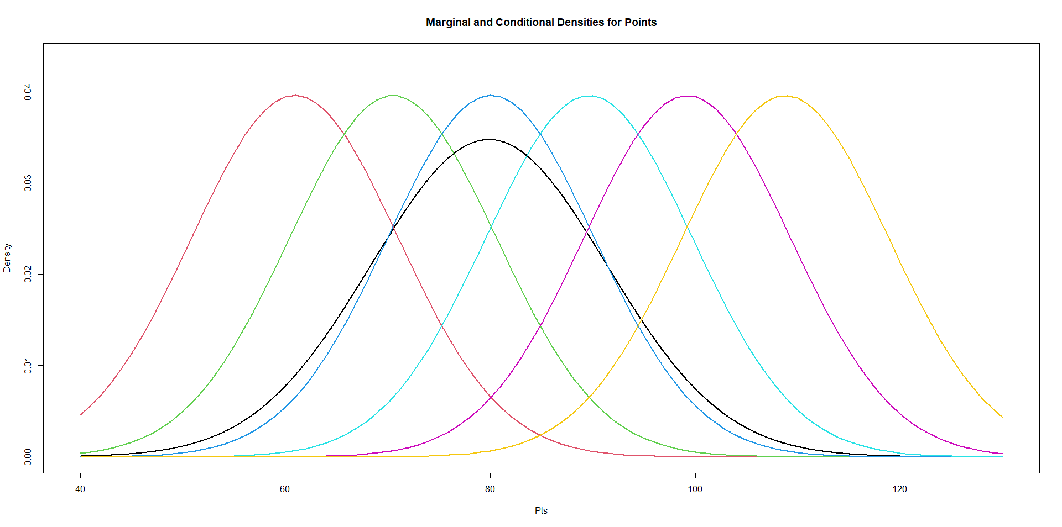
Marginal and Conditional Distributions for Points
Marginal Distribution (Black) and Conditional Distributions for X=60,70,…,100,110

Slide 16
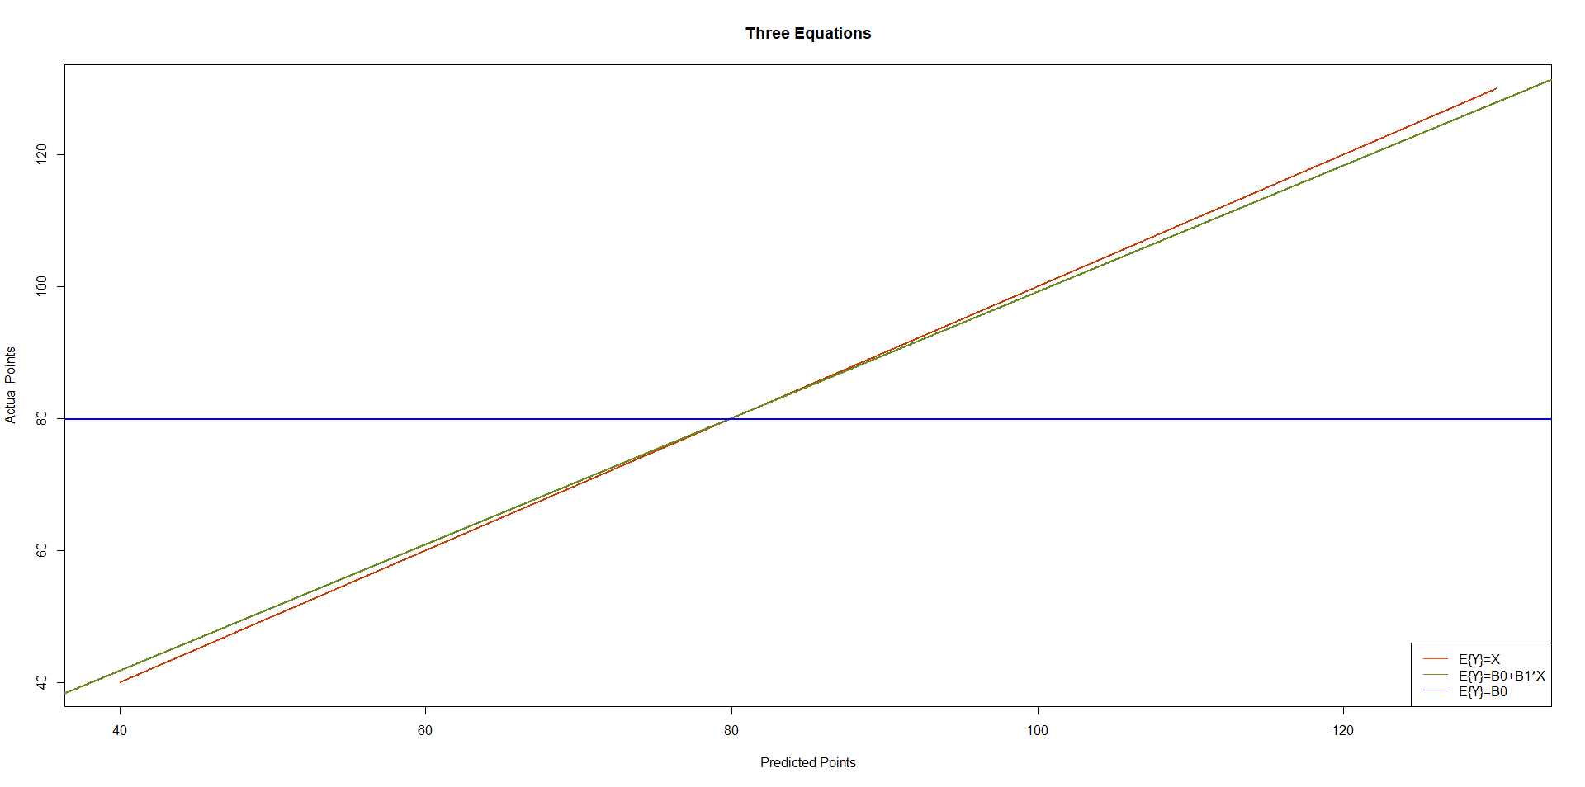
Plot of 3 Equations to Predict Points
Regression line is (slightly) above line of equality for predicted scores below mean and (slightly) below for predicted scores above mean. Regression to the mean

Slide 17
Expectations and Variances
E{X} = 79.7896 V {X} = 33.0755
E{Y} = 79.8710 V {Y} = 131.8455
E{Y|X=x} = 3.5190+0.9569x
E_{X}{E{Y|X=x}} = E_{X}{3.5190+0.9569X} =
3.5190+0.9569(79.7896) = 79.8697 = E{Y} (rounding)
V{Y|X=x} = 10.0777² ⇒ E_{X}{V{Y|X=x}} = 101.5606
V_{X}{E{Y|X=x}} = V_{X}{3.5190+0.9569X} =
(0.9569)² V(X) = (0.9157)33.0755 = 30.2858
E_{X}{V{Y|X=x}}+V_{X}{E{Y|X=x}} =
101.5606+30.2858=131.8464 = V{Y} (rounding)

Slide 18
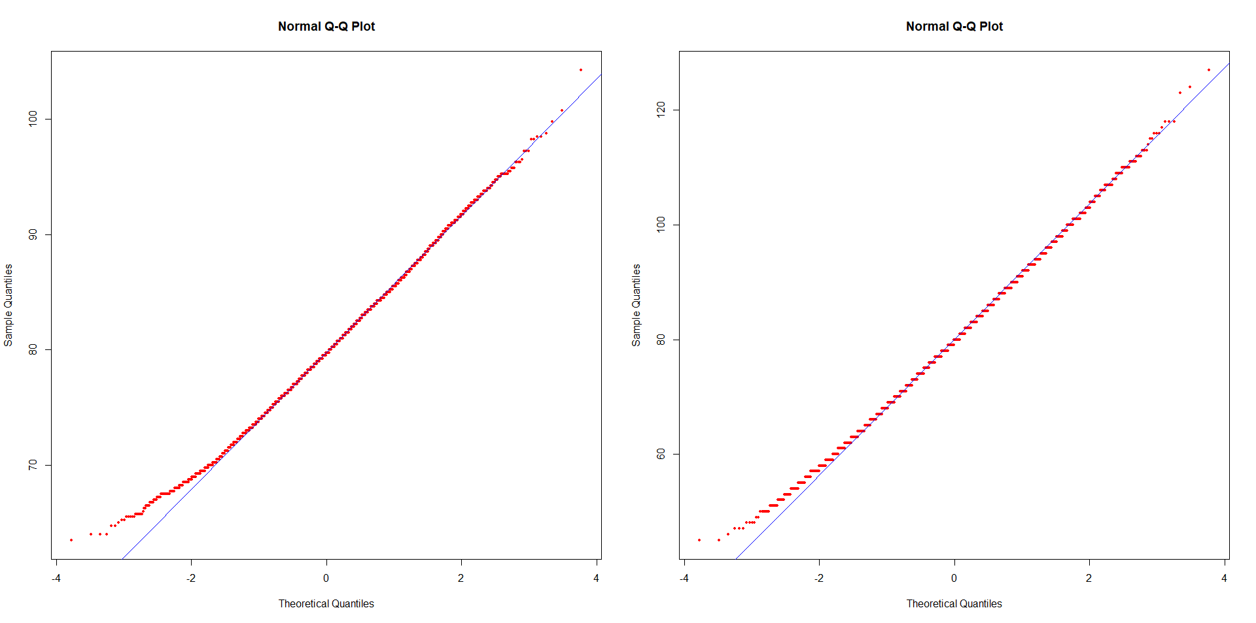
Normal Probability Plots for Points

Slide 19
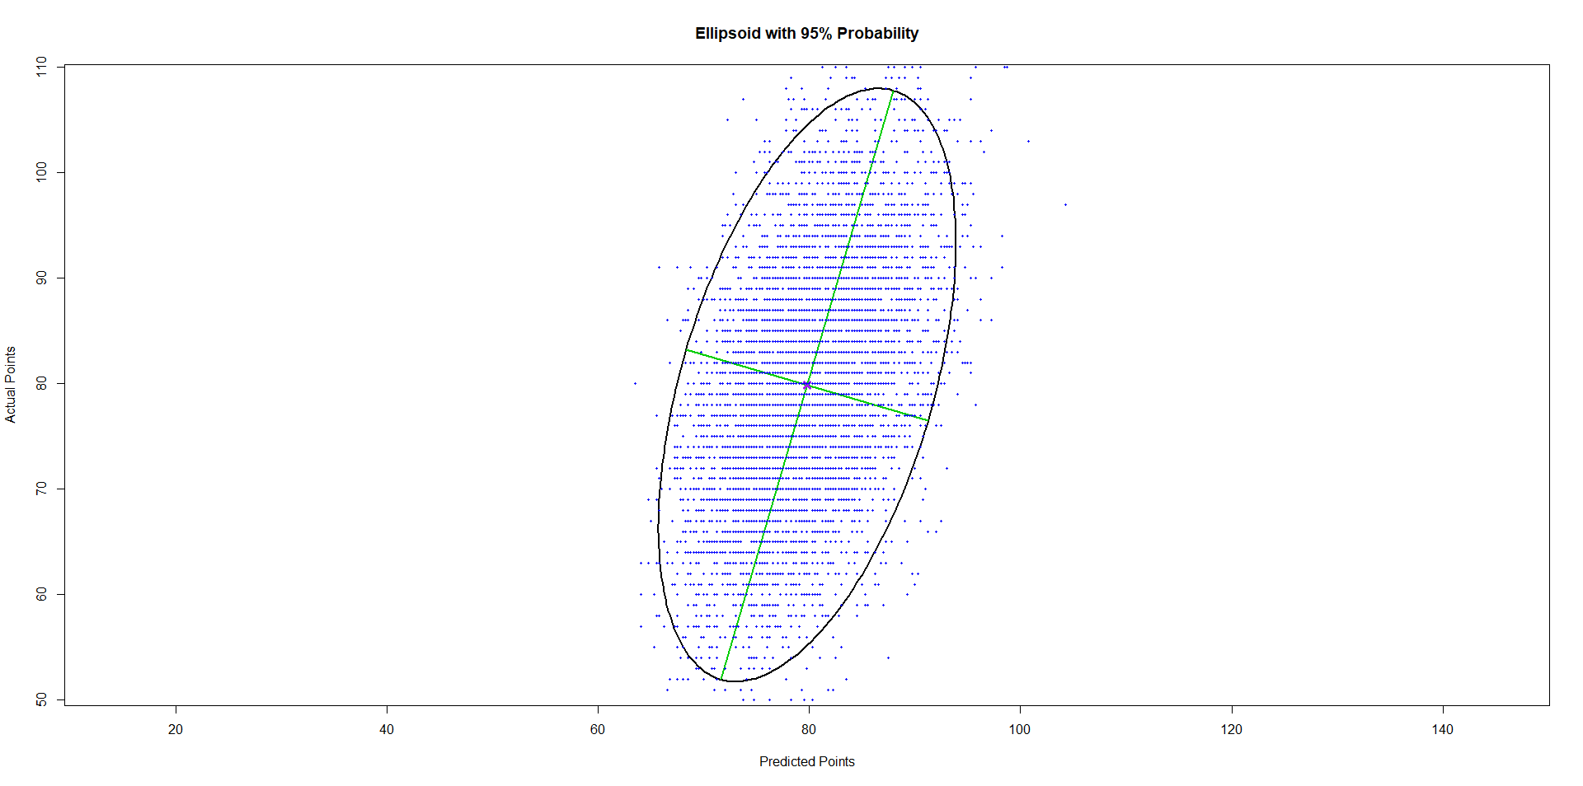
Ellipsoid Containing 95% of Games

