Slide 1
Intern Progress Command Center
Deployed on Amazon ECS (Fargate) · Larryking Akere Mokom (mokoml) · AMER CSE I Capstone
Notes:
OPENING (say this BEFORE advancing off this slide):
"Hi everyone, thanks for making the time — [Manager] and [Mentor]. I'm Larry, and today I'm walking you through my capstone: the Intern Progress Command Center, a web app I built and deployed on AWS.
Here's how I'll run it: I'll start with WHY I built this and who it's for, then show you the APP and walk through my ARCHITECTURE and how a request flows. Then some of the ECS and AWS DECISIONS I made and why. Then two LIVE DEMOS — I'll break something and show it heal, then put it under load and watch it scale. I'll close with something I got wrong and fixed, and where I'd take it next — then open it up for questions.
I'll mostly drive from slides and jump into the console and terminal for the demos. Feel free to stop me anytime, or hold questions for the end — whatever you prefer. Let me get started."
(Pause, then advance. Keep this to ~20 seconds. Say their names.)

Slide 2
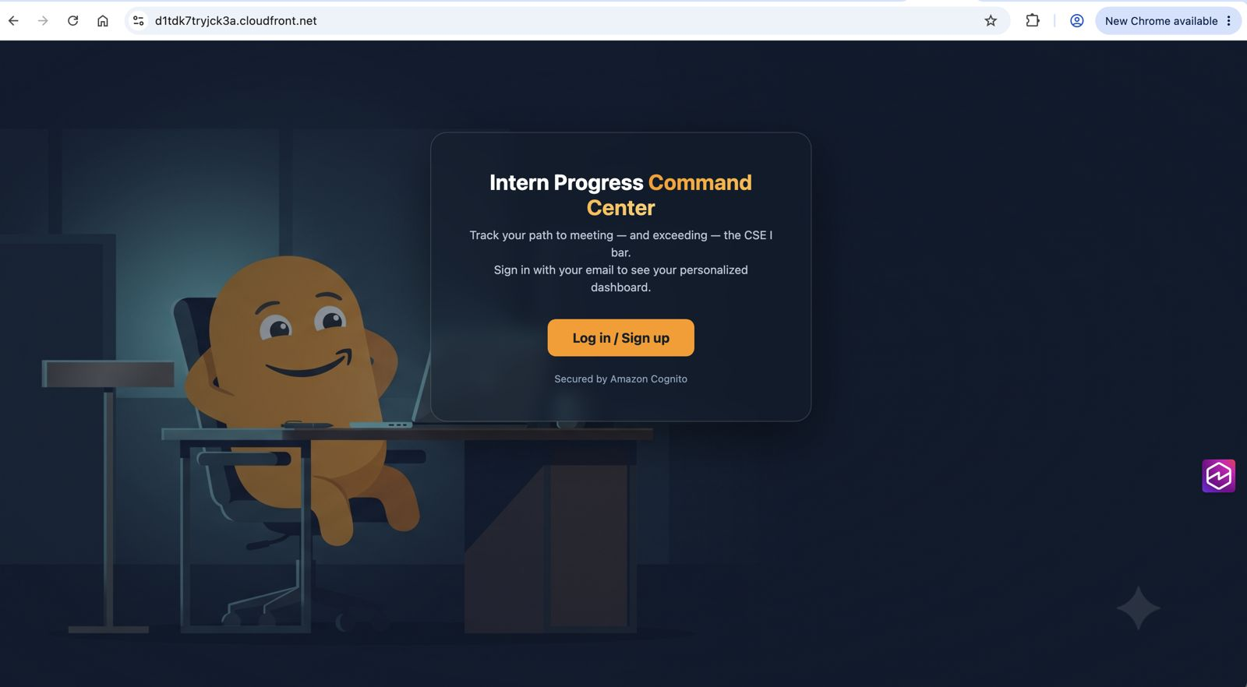
Why I built it
• I'm the customer here — an intern going through this capstone myself.
• So before writing code, I asked other interns what would actually help.
• Their progress was scattered — no single place to see where they stood.
• They wanted reminders so a task never slips by unnoticed.
• And real suggestions on how to raise the bar, not just log work.
Notes:
I want to start with the customer, and here that's me — I'm an intern doing this exact capstone. Before I touched any code I asked a few other interns what would genuinely make this easier. Everyone said their progress lived all over the place, with no single spot to see where they stood. They wanted reminders so nothing slipped by. And the one that stuck with me: they didn't just want to track work, they wanted suggestions on how to push it above the bar. So I worked backwards from those three things.

Slide 3
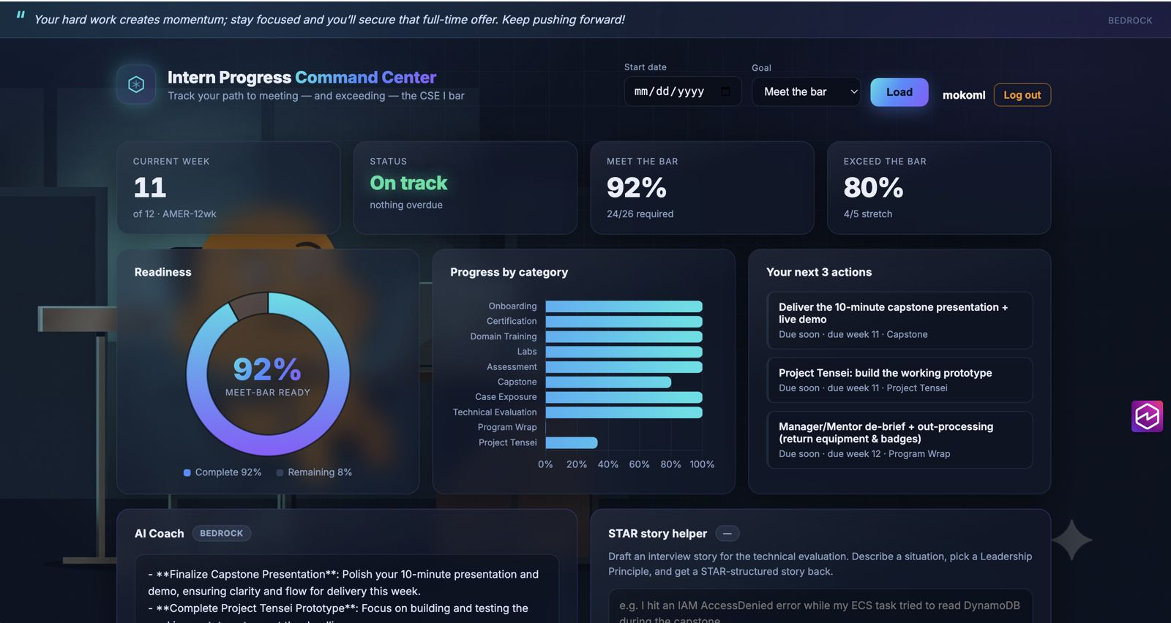
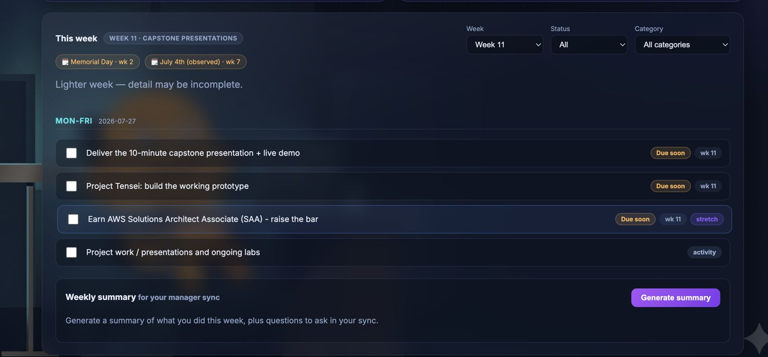
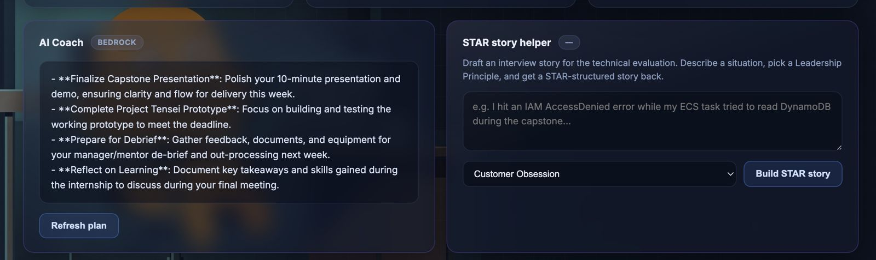
What it does
One dashboard — where you stand
Your week — nothing slips
AI Coach — raise the bar
Notes:
This is the app, and it does three things that map straight to what interns asked for. One dashboard shows all your progress against the bar, so you always know where you stand. The weekly view keeps your tasks front and center so nothing slips. And the AI Coach, running on Amazon Bedrock, gives concrete suggestions on how to push your work above the bar — it even drafts STAR stories for the technical eval.

Slide 4
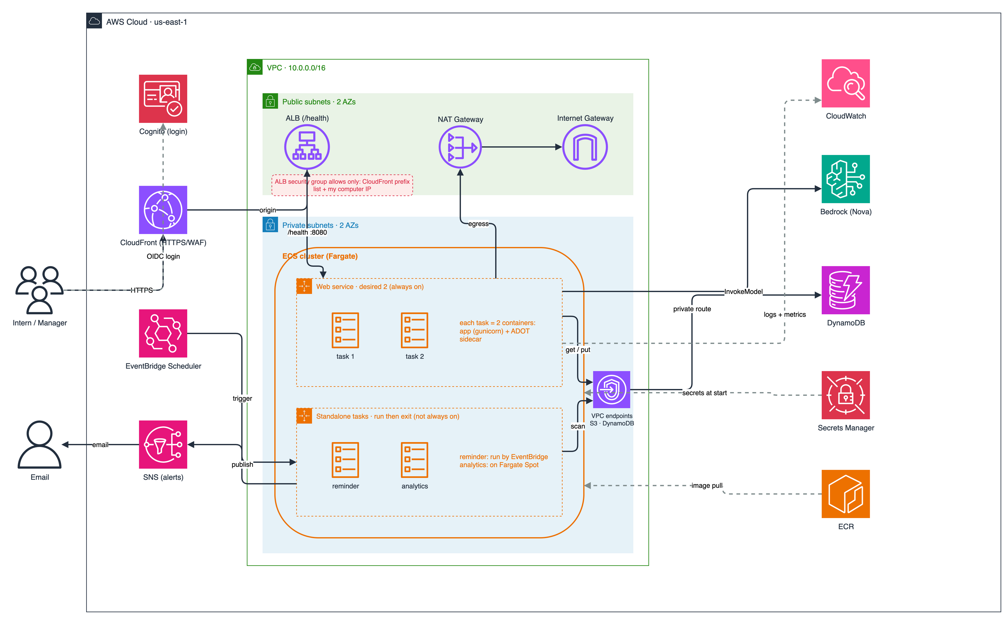
Architecture
Notes:
Here's the whole thing on one picture. Interns come in through CloudFront — my HTTPS and WAF at the edge — to an ALB that only accepts CloudFront traffic, into my app on Fargate: two tasks across two Availability Zones in private subnets. Data's in DynamoDB, login is Cognito, the AI Coach calls Bedrock, and the bottom lane is the scheduled reminders and analytics.

Slide 5
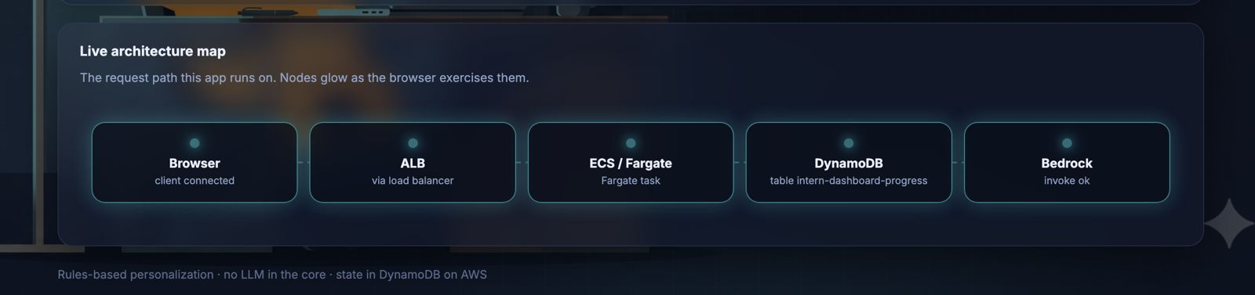
How a request flows
• It hits CloudFront first — HTTPS and WAF happen at the edge.
• Static files like CSS and images come from the edge cache.
• Dynamic requests go to the ALB, which only accepts CloudFront.
• The ALB hands it to a healthy Fargate task in one of two AZs.
• The app reads/writes DynamoDB over a private VPC endpoint.
• And reaches Bedrock for coaching through the NAT gateway.
Notes:
Let me trace one request. It lands on the nearest CloudFront edge — that's where TLS ends and WAF screens it, which is why my ALB can just speak plain HTTP inside. Static files come straight from the edge cache and never touch my app. Dynamic requests go to the ALB, which only accepts CloudFront, then to a healthy task. The app talks to DynamoDB through a VPC endpoint so that stays on Amazon's network, and calls Bedrock out through the NAT. Neat detail — the app actually draws its own live request path, which is what you're seeing here.

Slide 6
A closer look at ECS
▶ LIVE · open ECS console → Tasks
• My web service keeps two tasks running at all times.
• Each task is two containers — my app plus a telemetry sidecar.
• The sidecar is non-essential, so if it dies the app keeps serving.
• Reminders and analytics are separate jobs that run and then exit.
• ECS treats 'desired count' as a promise it constantly keeps.
Notes:
Going a bit deeper on ECS, because it's the heart of this. My web service has a desired count of two, so two tasks always run. Each task is actually two containers — my Flask app and an ADOT sidecar that ships metrics; the sidecar's non-essential, so if telemetry dies my app keeps serving. The reminders and analytics aren't part of this service — they're separate tasks that launch, do one job, and exit. The mental model: desired count is a promise, and ECS keeps restarting tasks until reality matches it. I'll pull up the console so you can see the two tasks live, one in each AZ.

Slide 7
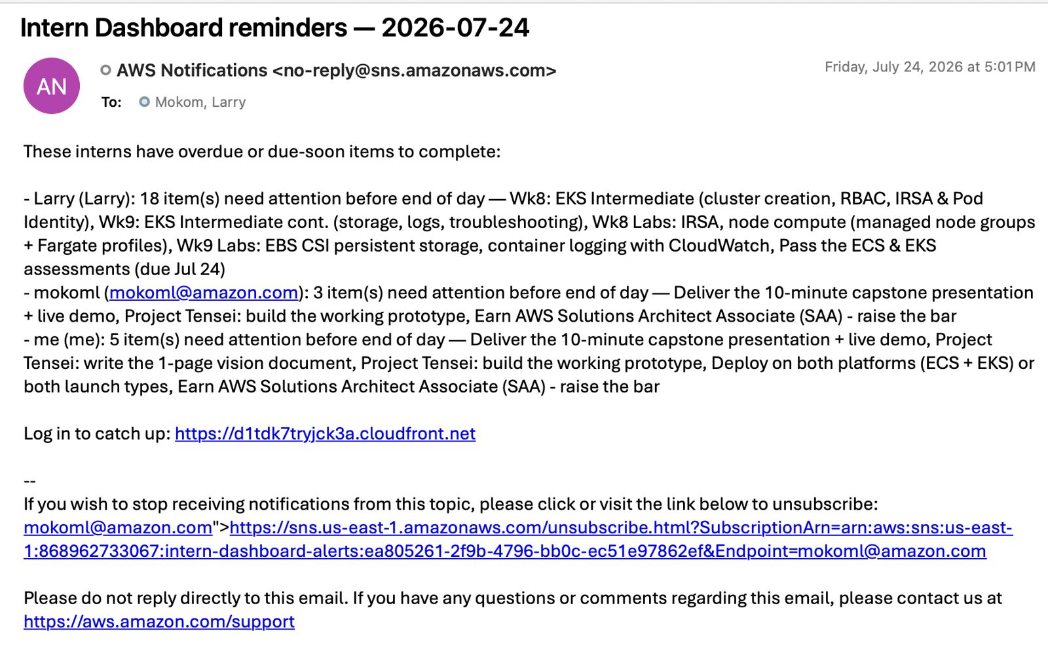
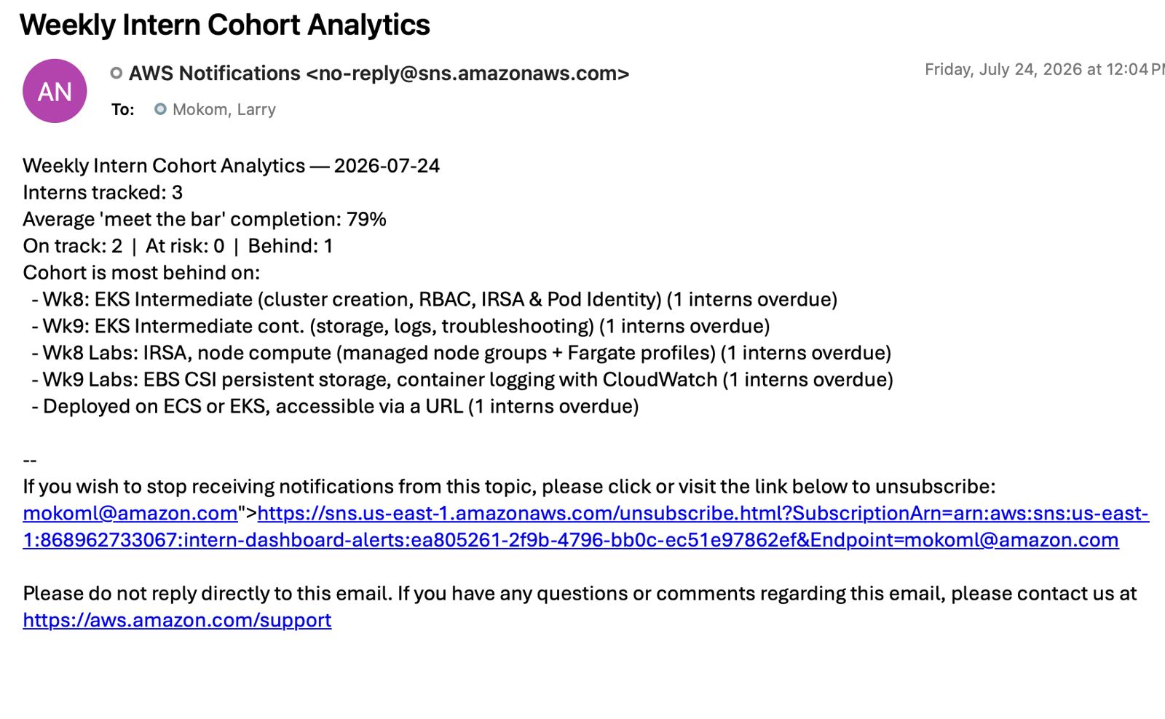
Scheduled jobs & alerts
• EventBridge triggers a reminder task on a schedule.
• It emails each intern their due-soon items via SNS.
• A separate analytics task emails a weekly cohort summary.
• Both run, do one job, and exit — no always-on cost.
Notes:
These are the scheduled jobs behind the scenes. EventBridge Scheduler fires on a cadence and launches a reminder task, which reads the data and emails each intern their due-soon items through SNS — that top email is a real one it sent. A second analytics task emails a weekly cohort summary to managers, like average completion and who's behind. The key point: neither of these is always-on — they launch, do their one job, exit, and stop billing. That's the run-to-completion model, versus my web service that's always up.

Slide 8
Why these choices
• ECS over EKS — no Kubernetes control plane to manage at my scale.
• CloudFront gives me HTTPS, WAF, and caching — and lets me hide the ALB.
• DynamoDB fits a simple lookup by intern — fast, nothing to patch.
• Fargate means there's no server for me to size or maintain.
Notes:
A few 'why' questions I expect. Why ECS not EKS — for a single-team app, EKS means running a Kubernetes control plane, which is overhead I don't need; EKS earns its keep when you're multi-tenant or need the K8s ecosystem. Why CloudFront — HTTPS, WAF, caching, and it lets me lock the ALB so only CloudFront reaches it. Why DynamoDB — my access is basically a key lookup by intern ID, no joins, so I get millisecond reads with nothing to patch; relational would be over-engineering. And Fargate means I never touch a server.

Slide 9
Staying available
▶ LIVE · ECS console → Tasks (show 2 AZs)
• Two tasks, one in each Availability Zone.
• If an AZ fails, the ALB routes to the survivor and ECS rebuilds.
• DynamoDB copies every write across three AZs automatically.
• Being honest: it's single-region today — that's my blast radius.
• Next step would be multi-region with Global Tables and Route 53.
Notes:
On availability — my two tasks sit one per AZ and the ALB spans both, so if a whole AZ went down the ALB routes to the healthy one and ECS rebuilds the lost task; NAT is regional so egress still works. DynamoDB is even better — it automatically replicates every write across three AZs, so an AZ loss is invisible to my data. I'll be honest about the limit though: this is single-region, so a full region outage is my blast radius. To survive that I'd go multi-region with Global Tables and Route 53 failover.

Slide 10
Demo: killing a task
▶ LIVE · run in terminal (CLI)
• I'll show two tasks running, then kill one on purpose.
• The app keeps working — the ALB routes around the dead one.
• Then ECS notices and rebuilds back to two.
• That's 'desired count is a promise' in action.
Notes:
First demo — I'm breaking something on purpose. Two tasks are running; I'll kill one like a real failure, and the app never goes down while ECS quietly puts it back.
DEMO CARD (terminal):
STOP: aws ecs stop-task --cluster intern-dashboard-cluster --region us-east-1 --task $(aws ecs list-tasks --cluster intern-dashboard-cluster --service-name intern-dashboard-service --region us-east-1 --query 'taskArns[0]' --output text)
SHOW: aws ecs describe-tasks --cluster intern-dashboard-cluster --region us-east-1 --tasks $(aws ecs list-tasks --cluster intern-dashboard-cluster --service-name intern-dashboard-service --region us-east-1 --query 'taskArns' --output text) --query 'tasks[].{Status:lastStatus,AZ:availabilityZone}' --output table
If it's slow, narrate: 'it's provisioning now — pulling the image and injecting secrets.'

Slide 11
Demo: scaling under load
▶ LIVE · run in terminal (CLI)
• I'll throw traffic at the ALB from my terminal.
• Requests-per-target crosses the scaling threshold.
• The service grows from two tasks toward six.
• Scale-in is slow on purpose so it doesn't flap.
Notes:
Second demo — autoscaling. I'll send a burst of traffic at the load balancer; I scale on requests per target, so once that crosses the threshold ECS adds tasks, two up toward six. Scaling in is deliberately slow, about ten minutes, so it doesn't flap.
DEMO CARD (start this during the availability slide — takes 2-4 min):
ALB DNS: aws elbv2 describe-load-balancers --names intern-dashboard-alb --region us-east-1 --query 'LoadBalancers[0].DNSName' --output text
LOAD: hey -z 240s -c 80 http://PASTE_ALB_DNS/health (once: brew install hey)
WATCH: aws ecs describe-services --cluster intern-dashboard-cluster --services intern-dashboard-service --region us-east-1 --query 'services[0].{desired:desiredCount,running:runningCount}' --output table
Stop the load with Ctrl+C.

Slide 12
A problem I ran into
• At first my ALB was public — open to the whole internet.
• A security scan caught it and pulled the listener down on me.
• I fixed it forward: CloudFront in front for HTTPS and WAF.
• And I locked the ALB to only accept CloudFront and my own IP.
Notes:
I want to be open about something I got wrong, because it's what I learned most from. Early on my ALB was public — sitting there open to the whole internet. A security scan actually caught it and pulled the listener down, which was a wake-up call that a public load balancer is a real exposure, not theoretical. I fixed it forward instead of just reverting: CloudFront in front for HTTPS and WAF, and I locked the ALB's security group to only accept CloudFront and my own IP. That incident is honestly why the architecture looks the way it does today.

Slide 13
What I'd do next
• At scale, my analytics table Scan would slow down first.
• I'd switch it to a targeted Query on an index instead.
• Add retries with backoff for when Bedrock gets busy.
• And go multi-region to survive a full region outage.
Notes:
If I kept building — the first thing that hurts at scale is my analytics job, which does a DynamoDB Scan across the whole table, so it gets slower and pricier as data grows; I'd switch it to a targeted Query on an index. I'd add retries with backoff around Bedrock in case it's throttled under load. And longer term I'd take the whole stack multi-region to survive a region outage. Knowing where my own design bends first is the part I care most about.

Slide 14
Thank you — questions?
Customer-obsessed · ECS Fargate · auto-scaling + secrets + self-healing
Notes:
CLOSING REMARKS (say this):
"So to wrap up: I started from a real problem other interns and I actually have — no single place to see if you're on track — and worked backwards to build something that solves it: a dashboard, reminders, and an AI Coach, running on ECS Fargate with auto-scaling, secrets management, and the self-healing you just saw live.
The biggest thing I take away isn't any single service — it's that I now understand how these pieces fit together and how to reason about them when something breaks, which is exactly the muscle I'll use as a CSE on customer cases.
Thank you for the time and the feedback throughout the program — I'd love to take any questions."
Q&A ready: AZ down / Bedrock fails / 10x traffic / where to look / why DynamoDB / service vs RunTask / how the two containers talk (localhost OTLP). Answer with the mechanism, stay calm.

